Slide 1
Intermediate 1 — Producer Internals
Copyright © 2026 by Elephant Scale, All Rights Reserved

Slide 2
Agenda
Serialization; the partitioner (key-based vs. round-robin)
Batching, linger.ms , batch.size , compression
Acknowledgements: acks=0/1/all and durability trade-offs
Idempotent producers — exactly-once at the producer
Copyright © 2026 by Elephant Scale, All Rights Reserved

Slide 3
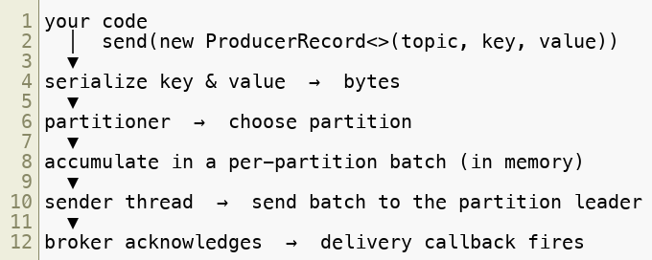
What a Producer Actually Does
producer.send(...) looks instant, but a lot happens between your call and a durable record on a broker.
The call is asynchronous — it returns before the broker has the record
Understanding these stages is how you tune for throughput, latency, and durability
Copyright © 2026 by Elephant Scale, All Rights Reserved
Notes:
The whole module is a walk down this pipeline. Anchor every config we discuss to a stage on this diagram.

Slide 4
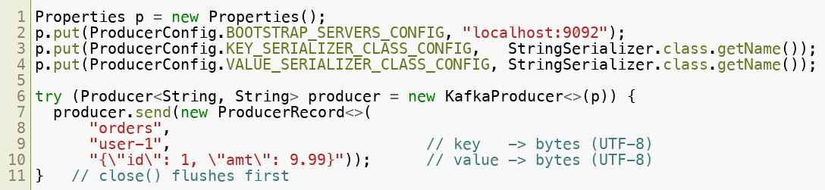
Stage 1: Serialization
Kafka stores bytes . Your keys and values must be turned into bytes on the way in.
The producer needs a serializer for the key and one for the value
Common choices: strings, JSON, and — with the Schema Registry — Avro / Protobuf (Module 8)
Consumers must use a matching deserializer , or they read garbage
Copyright © 2026 by Elephant Scale, All Rights Reserved
Notes:
In the Java client the serializer is configuration , not something you call — StringSerializer turns each String into UTF-8 bytes on the way out. The JSON here is a hand-built string; Module 8 replaces it with schema-backed Avro serdes. Note the type parameters <String, String> must match the configured serializers.

Slide 5

Stage 2: The Partitioner
The producer must pick which partition each record goes to. That's the partitioner .
Key present → hash(key) % partitions → same key always → same partition ( ordering )
No key → spread across partitions for even load (sticky batching, round-robin-ish)
You can supply a custom partitioner for special routing, but rarely need to
Design rule: choose a key when you need per-entity ordering; go keyless for maximum spread. This is the single most important producer decision.
Copyright © 2026 by Elephant Scale, All Rights Reserved

Slide 6

Ordering: The Guarantee and Its Limits
Kafka guarantees order within a partition , never across partitions.
All records with the same key share a partition → ordered relative to each other
Records with different keys may be in different partitions → no cross-partition order
Pick your key to match your ordering requirement (per user, per order, per device)
Copyright © 2026 by Elephant Scale, All Rights Reserved
Notes:
A frequent production bug: needing per-customer order but producing keyless "for balance," then being surprised events interleave. The key is the ordering contract.

Slide 7
Stage 3: Batching
The producer does not send one record per request. It batches records per partition, which is where its throughput comes from.
Two knobs decide when a batch is sent:
batch.size
— max bytes per batch (per partition). Full batch → send now.
linger.ms
— how long to wait for more records before sending a partial batch.
The trade-off: a little linger.ms dramatically improves throughput under load, at the cost of a few ms of latency. Default linger.ms is small; raise it to batch harder.
Copyright © 2026 by Elephant Scale, All Rights Reserved

Slide 8

Stage 3b: Compression
Batches can be compressed before they hit the network and disk — a big win because Kafka compresses the whole batch, not record-by-record.
compression.type : none , gzip , snappy , lz4 , zstd
zstd
and
lz4 are the usual picks — strong ratio, low CPU
Compression pairs with batching: bigger batches compress better
The broker stores it compressed; the consumer decompresses — end to end
Copyright © 2026 by Elephant Scale, All Rights Reserved
Notes:
Compression reduces network, disk, and replication traffic. On JSON especially the ratio is large. It costs producer CPU, but zstd/lz4 make that cheap.

Slide 9
Stage 4: Acknowledgements (
When is a write "done"? That's
acks — the durability dial.
Default and recommendation for real data:
 | Waits for | Durability | Risk
0 | nothing (fire-and-forget) | lowest | lose records silently
1 | leader only | medium | lose records if leader dies before replication
all | leader + all in-sync replicas | highest | none once acknowledged
Copyright © 2026 by Elephant Scale, All Rights Reserved

Slide 10
Why
acks=all means "all in-sync replicas" — but if the ISR has shrunk to just the leader, "all" is one. The topic/broker setting
min.insync.replicas sets the floor.
min.insync.replicas=2 with RF 3 → a write needs 2 in-sync replicas to succeed
If too few replicas are in sync, the producer gets an error instead of a false "durable"
Together: acks=all + min.insync.replicas=2 = "acknowledged means safely on ≥2 brokers"
Copyright © 2026 by Elephant Scale, All Rights Reserved
Notes:
This is the durability contract. We only introduce it here; Module 11 (Reliability) makes it hands-on. The point for producers: acks=all alone isn't enough without the ISR floor.

Slide 11
Retries and Ordering
If a send fails (leader moved, transient network), the producer retries — which is usually what you want, but it interacts with ordering.
Retries are on by default; a retried batch could, in theory, arrive after a later batch
max.in.flight.requests.per.connection
controls how many unacked batches are in flight
Historically you capped this to preserve order — but idempotence (next slides) solves it cleanly
Takeaway: don't disable retries to "keep order." Turn on idempotence instead.
Copyright © 2026 by Elephant Scale, All Rights Reserved

Slide 12

The Duplicate Problem
A subtle failure: the broker writes the record, then the ack is lost on the way back. The producer thinks it failed and retries → the record is written twice .
With plain acks=all + retries, you get at-least-once : no loss, but possible duplicates
For many pipelines duplicates are unacceptable (double charges, double counts)
This is exactly what the idempotent producer fixes.
Copyright © 2026 by Elephant Scale, All Rights Reserved

Slide 13
Idempotent Producer
Turn on idempotence and the broker will de-duplicate the producer's retries automatically.
How it works, briefly:
The producer gets a Producer ID (PID) and attaches a sequence number per partition
The broker tracks the last sequence it accepted per (PID, partition)
A retried record has the same sequence → the broker discards the duplicate
Result: exactly-once delivery from producer to broker , even across retries. Cheap enough to be a default — and since Kafka 3.0 it is the default ( enable.idempotence=true ), so on Kafka 4 you get it unless you turn it off.
Copyright © 2026 by Elephant Scale, All Rights Reserved
Notes:
Worth stating plainly — most students assume they must opt in. On Kafka 4 the trap is the reverse: setting acks=1 or max.in.flight > 5 silently conflicts with idempotence and the client will refuse to start (or, in older versions, quietly disable it).

Slide 14
What Idempotence Does and Doesn't Cover
Be precise about the guarantee — it's a common interview and production trap.
✅ De-dupes this producer's retries to a partition → no duplicates from resend
✅ Preserves ordering even with retries and multiple in-flight batches
❌ Does not de-dupe if your application calls send() twice for the same event
❌ Does not span multiple partitions or a consume-process-produce loop — that needs transactions (Module 7 / Delivery Semantics)
Idempotence = exactly-once
Copyright © 2026 by Elephant Scale, All Rights Reserved
Notes:
Draw the boundary clearly. Idempotence is a producer-local guarantee. End-to-end exactly-once (read-process-write) is the transactions story, which is the next big module.

Slide 15
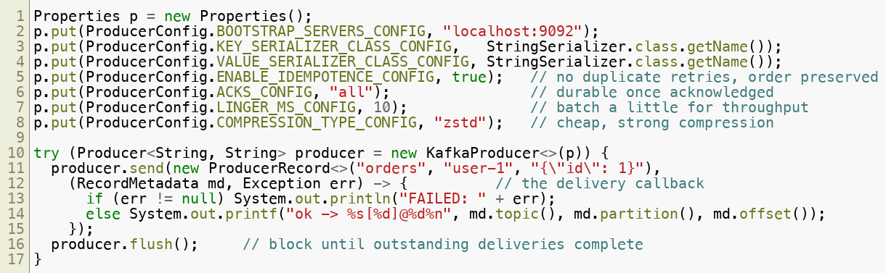
A Tuned Producer, End to End
Putting the pipeline together — a sensible production baseline:
Copyright © 2026 by Elephant Scale, All Rights Reserved
Notes:
The callback is how you learn the final partition/offset — or the error. send() also returns a Future<RecordMetadata> ; calling .get() on it makes the send synchronous, which is simple but kills throughput. Prefer the callback. flush() blocks until everything in flight is delivered; try-with-resources close() flushes too, so the explicit flush() here is belt-and-braces (and the place to check for errors before exiting).

Slide 16
Summary
The producer pipeline: serialize → partition → batch → send → ack → callback
Keys drive partitioning and per-partition ordering — the key is the ordering contract
linger.ms
trade a little latency for large throughput gains
acks=all
(with min.insync.replicas ) is the durability baseline for real data
Plain retries give at-least-once (possible duplicates);
enable.idempotence upgrades that to exactly-once to the broker and preserves order
End-to-end exactly-once across a processing step needs transactions — coming up
Copyright © 2026 by Elephant Scale, All Rights Reserved

