Slide 1
Agentic on AWS Bedrock
Copyright © 2026 by Elephant Scale, All Rights Reserved

Slide 2
Part IV G–H — What We'll Cover
Bedrock — one API in front of many foundation models
The model menu: Nova , Titan , Claude on Bedrock
Calling models with boto3 — the Converse API + tool use
Bedrock Agents — action groups, knowledge bases, orchestration
Connecting a CRM / database to an agent
Latency & scale — streaming, model choice, prompt caching
Guardrails , transactions, and enterprise compliance
Lab 12: a CRM assistant on Bedrock (with a local fallback)
Same agent loop you already know — now behind an enterprise-grade, IAM-governed API.
Copyright © 2026 by Elephant Scale, All Rights Reserved

Slide 3
Why Bedrock
Managed, serverless access to foundation models — no GPUs to run
One SDK, many models — swap providers without rewriting your app
Runs inside your AWS account — IAM, VPC, CloudTrail, KMS come for free
Data is not used to train the base models
Enterprises pick it for governance , not because the models are unique
Bedrock's product is not a model. It's models plus AWS's security and billing perimeter.
Copyright © 2026 by Elephant Scale, All Rights Reserved

Slide 4
The Model Menu
Pick per task: Nova/Haiku for routing, Claude Sonnet for reasoning.
Model IDs are region-specific — list them with bedrock list-foundation-models .
Family | Who | Good for
Amazon Nova | Amazon | Fast, cheap text + multimodal; tool use
Amazon Titan | Amazon | Text, embeddings, image; low cost
Claude on Bedrock | Anthropic | Strongest reasoning + tool use
Llama, Mistral, Cohere | Others | Open-weight / specialty options
Choose the cheapest model that passes your eval — not the biggest one you can afford.
Copyright © 2026 by Elephant Scale, All Rights Reserved

Slide 5

Two Ways to Build on Bedrock
A) Bedrock Runtime + your own loop (what Lab 12 does)
  You call converse / converse_stream , you own the tool loop
  Maximum control; the same ReAct pattern from Day 1
B) Bedrock Agents (managed orchestration)
  AWS runs the loop; you declare action groups + knowledge bases
  Less code, less control; good for standard enterprise wiring
Learn the loop by hand (A). Reach for managed Agents (B) when the wiring is standard.
Copyright © 2026 by Elephant Scale, All Rights Reserved

Slide 6
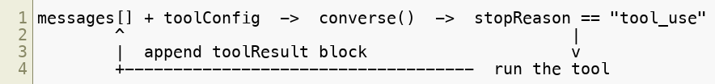
The Converse API
One uniform request/response shape across every model — no per-model JSON
Handles multi-turn messages , system , inferenceConfig , and
toolConfig
converse for a single response; converse_stream for token streaming
Tool use is built in — the model returns a toolUse block, you reply with toolResult
Converse is the portable door. Write the loop once; switch Nova <-> Claude by changing one ID.
Copyright © 2026 by Elephant Scale, All Rights Reserved

Slide 7
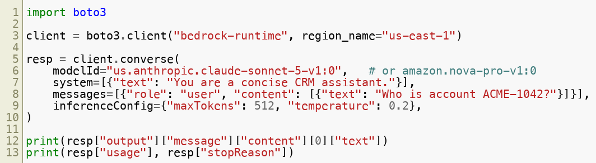
Calling a Model with boto3
Auth is IAM — no API key in the code; creds come from the environment / role.
usage gives token counts for cost logging; stopReason drives your loop.
If you can call one model this way, you can call all of them — that's the whole point.
Copyright © 2026 by Elephant Scale, All Rights Reserved

Slide 8
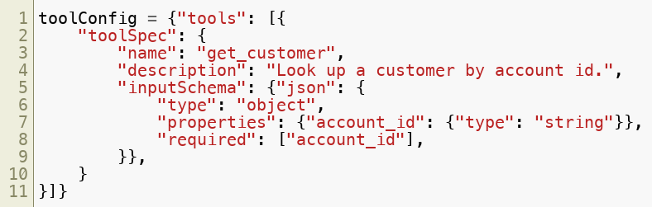
Tool Use with Converse
Declare tools in toolConfig — a JSON Schema per tool (like the Tool Spec Template)
Model replies with stopReason="tool_use" and a toolUse block (name + input)
You run the tool, then append a toolResult block and call converse again
Same tool-spec discipline as Day 2 — name, description, typed schema, safety class.
Copyright © 2026 by Elephant Scale, All Rights Reserved

Slide 9
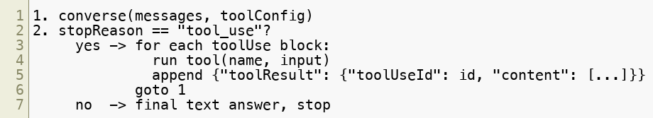
The Bedrock Tool Loop
Cap the loop ( max steps ) — a runaway loop is an AWS bill.
dangerous tools (update, delete) get a human gate before you run them.
Log every toolUse / toolResult to your JSONL audit log.
The provider changed; the safety rules did not. Cap, gate, log — every time.
Copyright © 2026 by Elephant Scale, All Rights Reserved

Slide 10
Bedrock Agents — Managed Orchestration
You declare , AWS orchestrates the reason-act loop:
  Action groups — your tools, backed by a Lambda or an OpenAPI schema
  Knowledge bases — managed RAG over your docs (S3 -> vector store)
  Orchestration — the agent plans, calls action groups, reads the KB, answers
Guardrails and memory attach to the agent as configuration
Action group = a tool. Knowledge base = retrieval. The concepts are the same; AWS runs the loop.
Copyright © 2026 by Elephant Scale, All Rights Reserved

Slide 11
Knowledge Bases (Managed RAG)
Point a knowledge base at S3 ; Bedrock chunks, embeds, and indexes
Backed by a vector store ( OpenSearch Serverless , Aurora pgvector, Pinecone)
Query returns grounded passages with citations — the agent cites its sources
Embeddings via Titan Embeddings or Cohere on Bedrock
Use it when the answer must come from your documents, not the model's memory.
Retrieved text is untrusted data, not instructions — even when AWS retrieved it for you.
Copyright © 2026 by Elephant Scale, All Rights Reserved

Slide 12

Connecting a CRM / Database
An agent reaches your data through a tool (action group), never raw SQL from the model
Pattern: model proposes account_id -> your code runs the parameterized query
Reads are safe ; writes (update balance, delete record) are dangerous
Least privilege: the agent's DB role is read-only until a write is truly needed.
Never let the model write SQL. It names the intent; your code owns the query and the schema.
Copyright © 2026 by Elephant Scale, All Rights Reserved

Slide 13
Latency & Scalability Patterns
Right-size the model — Nova/Haiku for routing & extraction, Sonnet for reasoning
Stream with converse_stream — first token fast, better perceived latency
Prompt caching — cache the long, stable system prompt / tool specs; pay once
Parallelize independent tool calls; don't serialize what can run at once
Provisioned Throughput for steady high volume; on-demand for spiky loads
Cache tool results that rarely change (pricing tables, product catalog)
Most latency and cost is model choice and prompt size — fix those before anything clever.
Copyright © 2026 by Elephant Scale, All Rights Reserved

Slide 14
Bedrock Guardrails
A policy layer applied to input and output, independent of the model:
  Denied topics — refuse whole subject areas
  Content filters — hate, violence, sexual, prompt-attack strengths
  Sensitive info (PII) — block or redact SSNs, cards, emails
  Word filters + contextual grounding (catch ungrounded / off-topic answers)
Attach to a converse call via guardrailConfig , or to a managed Agent
Guardrails are defense in depth — a backstop, not a replacement for your own gates and evals.
Copyright © 2026 by Elephant Scale, All Rights Reserved

Slide 15
Transactions & Compliance in the Enterprise
IAM least privilege — a per-agent role, scoped to exactly the actions it needs
CloudTrail logs every Bedrock API call; CloudWatch for metrics + alarms
KMS encryption at rest; VPC endpoints keep traffic off the public internet
Model invocation logging to S3/CloudWatch — full request/response audit
Certifications: HIPAA-eligible, SOC, ISO — check per model & region
Idempotency + human gate for money-moving or record-changing actions
In the enterprise, the model is the easy part. The audit trail is the deliverable.
Copyright © 2026 by Elephant Scale, All Rights Reserved

Slide 16
Bedrock vs. Direct APIs — Choosing
Lab 12 runs both — Bedrock as the primary path, direct API as the local fallback.
 | Direct (OpenAI / Anthropic) | Bedrock
Setup | API key | AWS account + IAM
Governance | provider's | your AWS perimeter
Model choice | one vendor | many, one SDK
Newest models | first | slight lag
Best when | fast start, one vendor | AWS shop, compliance, multi-model
Pick Bedrock for the perimeter and the model menu. Pick direct for speed and the latest model.
Copyright © 2026 by Elephant Scale, All Rights Reserved

Slide 17
Putting It Together
Converse is one portable API over every Bedrock model — tool use included
You can own the loop (Runtime) or let AWS run it (Bedrock Agents)
Data reaches the agent through tools / action groups , never raw model SQL
Guardrails + IAM + CloudTrail are why enterprises choose Bedrock
Tune latency & cost with model choice, streaming, and prompt caching
Every Day-1 rule still holds: cap, gate, log, treat output as untrusted
You now have the enterprise door. Next, build a CRM assistant through it.
Copyright © 2026 by Elephant Scale, All Rights Reserved

Slide 18
Lab 12 — CRM Assistant on AWS Bedrock
Stop here and run Lab 12.
You will:
Build a CRM assistant using the Converse API with tool use .
Wire read tools ( get_customer , search_customers ) and a write tool ( update_customer ).
Gate the dangerous write behind an explicit human approval step.
Run the loop with a max-steps cap and a JSONL audit log.
Flip one env var to the local fallback — same agent against a direct LLM + SQLite CRM.
Deliverable: a runnable bedrock_crm.py that answers a lookup and performs a gated update, plus the audit log from one run.
Time: 60 minutes
Copyright © 2026 by Elephant Scale, All Rights Reserved

