Slide 1
Low-Code Agentic Design
Copyright © 2026 by Elephant Scale, All Rights Reserved

Slide 2
Why This Module
Not every agent needs a repo
Business teams want wins this week
Low-code = ChatGPT + Zapier + Custom GPTs
Same patterns, less plumbing
The pattern outlives the tool. Low-code just moves the plumbing behind a UI.
Copyright © 2026 by Elephant Scale, All Rights Reserved

Slide 3

When Low-Code Fits
Fits when:
  the owner is not a developer
  the task is business automation (triage, drafting, routing)
  you want a fast win to prove value
  the systems already have connectors
Reach for code when:
  logic is complex or heavily branching
  you need tests, version control, custom tools
  latency, cost, or scale are tight
Pick the lightest tool that does the job — then graduate when it hurts.
Copyright © 2026 by Elephant Scale, All Rights Reserved

Slide 4
The Low-Code Stack
ChatGPT — the reasoning step
Custom GPT — a configured assistant + Actions
Zapier — triggers, connectors, the workflow spine
Actions (OpenAPI) — how a GPT calls real APIs
Zapier moves data. The GPT makes decisions. You keep the approval.
Copyright © 2026 by Elephant Scale, All Rights Reserved

Slide 5
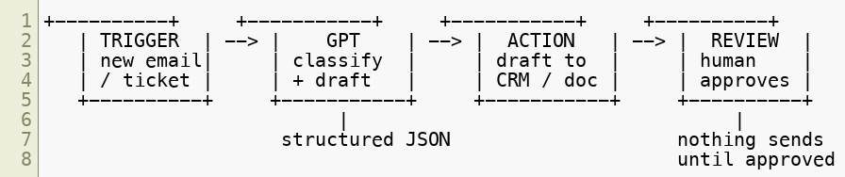
The Core Flow
Trigger -> reason -> act -> review. Four boxes. Every low-code agent is these.
Copyright © 2026 by Elephant Scale, All Rights Reserved

Slide 6

ChatGPT + Zapier
Zapier catches an event (email, form, row, ticket)
A ChatGPT step runs your prompt on that data
Insist on structured output so later steps can branch
Prose is for people. JSON is for the next Zap step.
Copyright © 2026 by Elephant Scale, All Rights Reserved

Slide 7
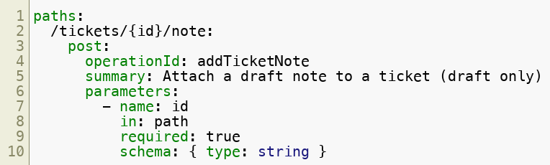
Custom GPTs With Actions
A Custom GPT = instructions + knowledge + Actions
An Action lets the GPT call an API you describe
You describe it with an OpenAPI schema
The OpenAPI schema is the tool spec — the same contract we wrote in Lab 4.
Copyright © 2026 by Elephant Scale, All Rights Reserved

Slide 8
Memory In A Low-Code Workflow
Chat memory is short and per-conversation
Durable memory lives outside the GPT:
  a Zapier Table / Google Sheet
  the CRM record itself
  a knowledge file in the Custom GPT
If you want the agent to remember, give it a place to write. Chat is not storage.
Copyright © 2026 by Elephant Scale, All Rights Reserved

Slide 9
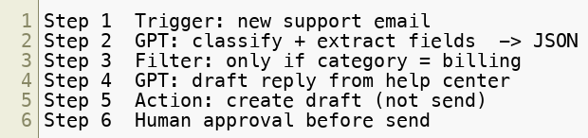
Chaining Steps
One Zap = a chain of steps, each feeding the next
Keep each step small and single-purpose
Small steps are testable steps. One giant prompt is a black box.
Copyright © 2026 by Elephant Scale, All Rights Reserved

Slide 10

Reflection In Low-Code
Add a second GPT step that critiques the first
Route the draft back for one revision if weak
Cap the loop — Zapier has no infinite loops by design
Reflection is just a second opinion wired in. Same pattern as LangGraph, fewer lines.
Copyright © 2026 by Elephant Scale, All Rights Reserved

Slide 11

A No-Code CRM Agent
Inbound lead or ticket arrives
GPT classifies, scores, and drafts a CRM note
Nothing writes to the record until a human approves
The agent proposes the CRM update. A person commits it. That line never moves.
Copyright © 2026 by Elephant Scale, All Rights Reserved

Slide 12

Governance In Low-Code
Low-code hides the code, not the risk
Same guardrails as everywhere:
  Human approval on send / write / delete
  Least privilege — scope the connector to one object
  Logging — every run to a table / sheet
  Treat inbound text as untrusted data
A Zap that auto-sends is not a pilot. It is an incident waiting for a trigger.
Copyright © 2026 by Elephant Scale, All Rights Reserved

Slide 13
Least Privilege With Connectors
A Zapier connection carries real credentials
Scope it down:
  a dedicated service account, not a person's admin login
  the narrowest permission that works (draft, not send)
  read-only first; write-back only after review works
The connector's scope is the agent's blast radius. Keep it small.
Copyright © 2026 by Elephant Scale, All Rights Reserved

Slide 14

Logging Every Run
Append one row per run — the review queue is the log
Status stays NEEDS_REVIEW until a human acts
Mirrors course-materials/audit-log-schema.md
If you can't see what the agent did, you can't govern it. Log first.
Copyright © 2026 by Elephant Scale, All Rights Reserved

Slide 15
Low-Code vs. Code: Honest Table
Concern | Low-Code | Code (LangGraph)
Time to first win | Hours | Days
Owner | Business user | Developer
Branching / cycles | Limited | Full
Testing / versioning | Weak | Strong
Custom tools | Prebuilt only | Anything
Governance | Manual, in-UI | In code
Start low-code to prove value. Move to code when the limits start to bite.
Copyright © 2026 by Elephant Scale, All Rights Reserved

Slide 16
Cloud-Free In The Classroom
No Zapier or ChatGPT account? You are not blocked
Lab 10 ships zap_sim.py — the same trigger -> GPT -> action -> review pipeline in Python
Lab 11 ships crm_agent.py — the CRM agent against a local SQLite DB
We simulate the SaaS locally so everyone builds the pattern, account or not.
Copyright © 2026 by Elephant Scale, All Rights Reserved

Slide 17
Lab 10 — Business Automation With ChatGPT + Zapier
Stop here and run Lab 10.
You will:
Design a Custom GPT with an Action (OpenAPI) for ticket triage.
Build a Zapier flow: trigger -> GPT step -> action -> review.
Add memory, a reflection step, and a human-approval gate.
Or run the local zap_sim.py over support_tickets.csv for the same result.
Deliverable: a documented Custom GPT + Zap (or a simulator run) with a review queue.
Time: 60 minutes
Copyright © 2026 by Elephant Scale, All Rights Reserved

Slide 18
Lab 11 — No-Code AI CRM Agent
Stop here and run Lab 11.
You will:
Build a no-code CRM assistant that classifies leads/tickets and drafts CRM notes.
Put every write behind a human-approval step.
Or run crm_agent.py against a local SQLite CRM with a review queue.
Confirm no dangerous write is ever auto-committed.
Deliverable: proposed CRM updates in a review queue, approved by a human before commit.
Time: 60 minutes
Copyright © 2026 by Elephant Scale, All Rights Reserved

