Slide 1
Agentic with Claude
Copyright © 2026 by Elephant Scale, All Rights Reserved

Slide 2
Part IV K–L — What We'll Cover
Anthropic's Messages API and how tool use works
The Claude model family — Opus vs. Sonnet vs. Haiku, and when to pick each
Building a multi-tool coding assistant
Memory & context management — the window, summarization, external files
Prompt caching — pay once for the stable prefix
Safety habits for an agent that reads and writes files and runs code
Lab 14: a Claude coding assistant with persistent memory
The API is small. The discipline — tools, memory, gates — is the whole job.
Copyright © 2026 by Elephant Scale, All Rights Reserved

Slide 3
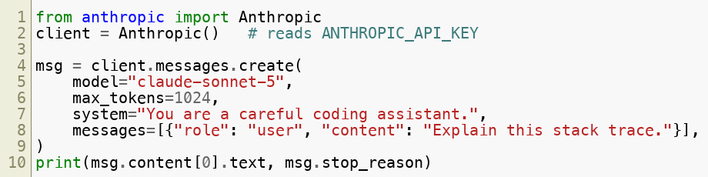
The Messages API
One endpoint: a list of messages ( user / assistant ) + a top-level system prompt
You always send the full conversation back — the API is stateless
Response carries
content (text and/or tool_use ) and a
stop_reason
Stateless means you own the memory. That's a burden and a superpower — you control context.
Copyright © 2026 by Elephant Scale, All Rights Reserved

Slide 4

The Claude Model Family
Model | ID | Pick it for
Opus | claude-opus-5 | Hardest reasoning, big refactors, deep planning
Sonnet | claude-sonnet-5 | The workhorse — coding, tool use, most agents
Haiku | claude-haiku-4-5-20251001 | Fast, cheap: routing, classify, extract, high volume
Same API and tool-use shape across all three — swap the model string.
Common pattern: Haiku routes / triages , Sonnet does the work , Opus for the hard 5% .
Default to Sonnet. Drop to Haiku for volume, reach for Opus only when Sonnet stalls.
Copyright © 2026 by Elephant Scale, All Rights Reserved

Slide 5
How Tool Use Works
You describe tools with a name, description, and (JSON Schema)
Claude replies with a tool_use block and stop_reason="tool_use"
You run the tool and send a tool_result block back as a new user message
Loop until stop_reason="end_turn" — same ReAct loop, native shape
Tool use is a conversation, not a callback. You and Claude take turns until it's done.
Copyright © 2026 by Elephant Scale, All Rights Reserved

Slide 6
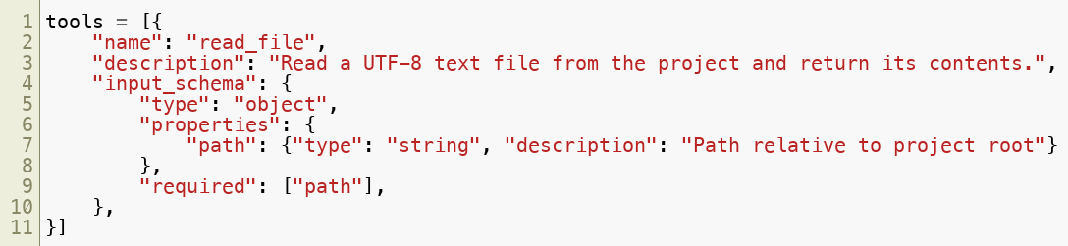
Defining a Tool
The description is the API — Claude only knows what you tell it here.
Give each tool a safety class : read_file is safe ; write_file is dangerous .
Write the description for the model, not for yourself. Vague tools get misused.
Copyright © 2026 by Elephant Scale, All Rights Reserved

Slide 7
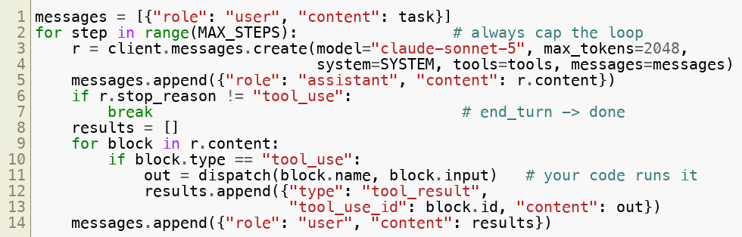
The Tool-Use Loop
One create call is one turn. The for loop with a cap is the agent.
Copyright © 2026 by Elephant Scale, All Rights Reserved

Slide 8

A Multi-Tool Coding Assistant
Give the agent a small, sharp toolset — that's Lab 14:
  read_file — safe , read source
  write_file — dangerous , gated behind human approval
  run_python — dangerous , sandboxed + time/output limited
  remember — update a persistent memory.json across sessions
Loop: read code -> propose change -> ask -> write -> run tests -> report
A coding agent is dangerous by definition — it edits files and runs code. Gate accordingly.
Copyright © 2026 by Elephant Scale, All Rights Reserved

Slide 9
Memory & Context Management
The context window is large but finite — and you pay for every token, every turn
Because the API is stateless, context = memory , and it has a budget
Three tiers of memory:
  Short-term — the message list this session (the scratchpad)
  Compressed — summarize old turns once they stop earning their tokens
  Long-term — an external store ( memory.json , files, a vector DB) read at start
Context is working memory, not a filing cabinet. Summarize the old; store facts outside.
Copyright © 2026 by Elephant Scale, All Rights Reserved

Slide 10
Summarizing Old Turns
When the transcript grows, replace old turns with a summary turn — keep tokens bounded
Keep the system prompt , the last few turns , and a running summary
Persist durable facts (decisions, file paths, preferences) to external memory
Trigger on a token budget , not turn count — measure, don't guess.
Don't let the window fill with stale scrollback. Compress the past; keep the present sharp.
Copyright © 2026 by Elephant Scale, All Rights Reserved

Slide 11
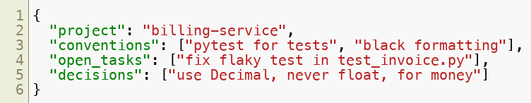
External Memory —
A tiny file the agent reads at startup and updates as it learns
Survives across sessions — the assistant "remembers" you tomorrow
Keep it small, structured, and reviewable — it's injected into context each run
External memory is a file you can read and edit. That's a feature — audit it, don't trust it blindly.
Copyright © 2026 by Elephant Scale, All Rights Reserved

Slide 12
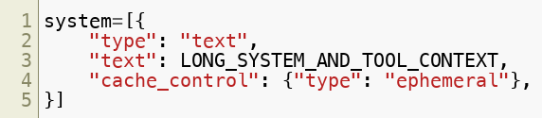

Prompt Caching
Mark a stable prefix (system prompt, tool specs, big context) as cached
Subsequent turns re-read the prefix from cache — cheaper and faster
Ideal for agents: the tools and system prompt are identical every turn
Order matters: put the stable stuff first, the changing stuff last.
Your tool specs don't change every turn — stop paying to re-read them. Cache the prefix.
Copyright © 2026 by Elephant Scale, All Rights Reserved

Slide 13
Safety Habits for Claude Agents
Max-steps cap and a token budget — enforced in code, not hoped for
Human gate on every dangerous tool: write_file , run_python , sends, deletes
Sandbox code execution — temp dir, timeout, bounded output, no network
Treat file contents and tool output as untrusted data , not instructions
Log every tool call (name, args, safety class, result) to JSONL
Least privilege — the smallest toolset that gets the job done
Same five habits from Lab 1. A more capable model raises the stakes, not the rules.
Copyright © 2026 by Elephant Scale, All Rights Reserved

Slide 14
Putting It Together
The Messages API is stateless — you own the memory and the loop
Tool use is a turn-taking conversation ending in end_turn
Pick the model by job: Haiku volume, Sonnet default, Opus hard problems
Manage context in tiers: scratchpad, summary, external file
Prompt caching cuts cost/latency on the stable prefix
Cap, gate, sandbox, log — safety scales with capability
You have the pattern and the API. Next, build a coding assistant that remembers.
Copyright © 2026 by Elephant Scale, All Rights Reserved

Slide 15
Lab 14 — Claude Coding Assistant with Persistent Memory
Stop here and run Lab 14.
You will:
Build a tool-use loop on the Messages API with claude-sonnet-5 .
Wire four tools: read_file , write_file (gated), run_python (sandboxed), remember .
Load a
memory.json at start and update it across sessions.
Enforce a max-steps cap and a human gate on write_file and run_python .
Summarize old turns to keep context bounded, and log every tool call.
Deliverable: a runnable coding_assistant.py that fixes a bug across two sessions, using persistent memory and gated writes.
Time: 60 minutes
Copyright © 2026 by Elephant Scale, All Rights Reserved

