Slide 1
Governance with Databricks
Copyright © 2026 by Elephant Scale, All Rights Reserved

Slide 2
Part IV O–P — What We'll Cover
Why agent governance — autonomy creates accountability
Tracking every agent action; data lineage
Audit logs as the backbone (ref audit-log-schema.md )
Access control and least privilege
Databricks tools, conceptually: Unity Catalog, MLflow tracing, Delta, dashboards
A worked HR-analytics governance example
Mapping controls to policy — who reviews, how long we keep it
Then you build the auditor — Lab 16
A chatbot answers; an agent acts. The moment it acts, someone must be able to answer for it.
Copyright © 2026 by Elephant Scale, All Rights Reserved

Slide 3
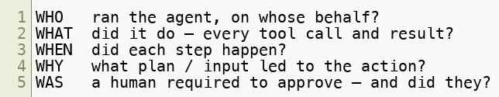
Why Governance — Autonomy ⇒ Accountability
An agent that can send / pay / delete / change records can cause real harm
"It's just the AI" is not an answer to an auditor, a regulator, or a customer
Governance answers five questions after the fact :
Governance is not paperwork. It's the ability to reconstruct exactly what happened, and prove it.
Copyright © 2026 by Elephant Scale, All Rights Reserved

Slide 4
Tracking Agent Actions
Every run emits a structured, append-only trace
One event per line (JSONL), one object per event (see audit-log-schema.md )
Log: run_start , plan , tool_call , tool_result , human_gate , reflection , run_end
Bound payloads , redact secrets/PII , put totals on .
If it isn't in the log, it didn't happen — and you can't prove it did.
Copyright © 2026 by Elephant Scale, All Rights Reserved

Slide 5
Data Lineage — Where Did This Come From?
Lineage = the path from source data → agent → output/action
Answers: which tables did the agent read to make that decision?
Needed for: audits, incident response, GDPR/CCPA requests, debugging plan drift
Lineage links the audit log to the actual data assets touched.
Lineage turns "the agent said so" into "here is every table that produced this number".
Copyright © 2026 by Elephant Scale, All Rights Reserved

Slide 6
Access Control and Least Privilege
The agent gets its own identity , not a human's admin token
Grant the fewest tables/tools with the narrowest scope that works
Read-only first — observe and draft before it can change anything
Column/row-level controls: the agent sees aggregates, not raw PII
Least privilege is the cheapest incident-limiter you have. Scope the agent before you trust it.
Copyright © 2026 by Elephant Scale, All Rights Reserved

Slide 7
Databricks, Conceptually
You don't need Databricks to learn this — the shapes are portable.
Local fallback (Lab 16): JSONL log → Parquet "Delta" table → pandas queries.
Databricks piece | Governance job
Unity Catalog | Central permissions + data lineage across tables/models
MLflow Tracing | Capture each agent run: prompts, tool calls, latency, cost
Delta tables | Store the audit log — ACID, append-only, time-travel
Dashboards / SQL | Query the log: violations, cost, volume, who-did-what
Unity Catalog = who + lineage. MLflow = the trace. Delta = the ledger. Dashboards = the answers.
Copyright © 2026 by Elephant Scale, All Rights Reserved

Slide 8
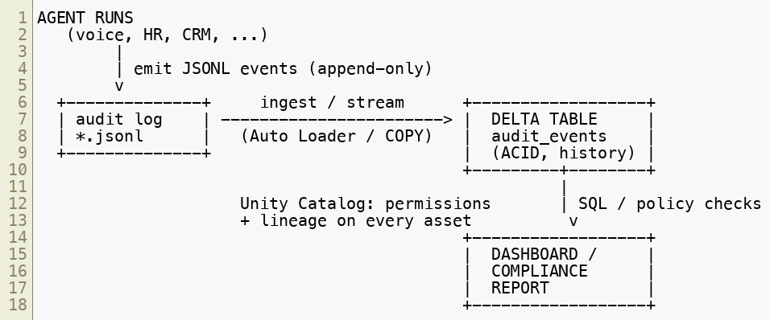
The Log → Delta → Dashboard Flow
Same pipeline locally: jsonl → pandas → parquet → query + markdown report .
Logs are the raw ledger. Delta makes them queryable. The dashboard is where governance becomes visible.
Copyright © 2026 by Elephant Scale, All Rights Reserved

Slide 9
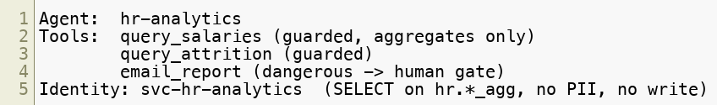
Worked Example — HR Analytics Agent
Goal: an agent answers HR questions ("pay gap by level?", "attrition in sales?")
It reads sensitive tables, so governance is not optional
Every question = one logged run. Every emailed report = a human_gate event.
High-value questions over sensitive data are exactly where an ungoverned agent gets you fired.
Copyright © 2026 by Elephant Scale, All Rights Reserved

Slide 10
What the Auditor Looks For
Ungated dangerous actions — a send/pay/delete with no approved human_gate
Missing human approval — action proceeded after a denied gate (or no gate at all)
PII in the logs — raw emails, SSNs, salaries in detail / result
Runaway loops — step counts or repeated identical calls past a threshold
Cost spikes — a run's cost_usd far above the norm
The auditor doesn't read the final answer. It reads the process — the log — and flags the exceptions.
Copyright © 2026 by Elephant Scale, All Rights Reserved

Slide 11
Mapping Controls to Policy
A control with no owner is a control that won't hold. Write it down:
Question | Policy answer (example)
Who reviews failures? | Named owner per agent; HRBP for HR-analytics
Who approves dangerous actions? | Role-based approver in the human gate
How long do we retain logs? | Audit log retained 13 months, then archived
Who can read the logs? | Compliance + agent owner; Unity Catalog grant
What triggers escalation? | Any ungated dangerous action → incident review
Every checkbox in the safety checklist should map to a person and a retention rule — or it's theater.
Copyright © 2026 by Elephant Scale, All Rights Reserved

Slide 12
Putting It Together
Autonomy ⇒ accountability — governance lets you reconstruct and prove what happened
Log everything (append-only JSONL), redact PII , totals on run_end
Lineage ties decisions back to the data that produced them
Least privilege + own identity limits the blast radius
Databricks shape: Unity Catalog + MLflow + Delta + dashboards — portable locally
Map every control to an owner, an approver, and a retention rule
You built agents that act. Governance is how you stay allowed to run them.
Copyright © 2026 by Elephant Scale, All Rights Reserved

Slide 13
Lab 16 — HR Governance Agent (Audit Agent Activity)
Stop here and run Lab 16.
You will:
Ingest an agent activity log (JSONL, per audit-log-schema.md ).
Run deterministic policy checks : ungated dangerous actions, missing approval, PII in logs, runaway loops, cost spikes.
Produce a compliance report (Markdown) with one row per finding.
Write findings to a Delta-style table — Parquet via pandas/pyarrow (note the Unity Catalog equivalent).
(Optional) Add an LLM narrative summarizing the audit for a non-technical reviewer.
Deliverable: a runnable hr_governance_agent.py that turns sample_activity_log.jsonl into findings.parquet + a Markdown compliance report.
Time: 60 minutes
Copyright © 2026 by Elephant Scale, All Rights Reserved

