Slide 1
Capstone: Enterprise AI Agent Challenge
Copyright © 2026 by Elephant Scale, All Rights Reserved

Slide 2
The Challenge
In teams, design and build a multi-agent system in one domain:
  Finance · HR · Real Estate · Customer Support
You have one day: design → build → evaluate → demo
It must be a system , not a single prompt — agents that cooperate
Everything you learned this week shows up here at least once
This is the whole course in one project. Small scope, done well, beats big scope, half-built.
Copyright © 2026 by Elephant Scale, All Rights Reserved

Slide 3
Required Capabilities (all six)
A passing project shows every capability at least once (ref capstone-rubric.md ):
Capability | Minimum bar
Reasoning | An explicit plan / ReAct loop, not one prompt
Tool use | ≥ 2 real tools with validated schemas
Reflection | The system self-checks or revises ≥ 1 output
Multi-agent | ≥ 2 cooperating roles/agents
Evaluation | A small frozen eval set + before/after scores
Governance | Audit log + human gate on dangerous actions
Six checkboxes. Wire all six early with one thin thread, then make each one good.
Copyright © 2026 by Elephant Scale, All Rights Reserved

Slide 4
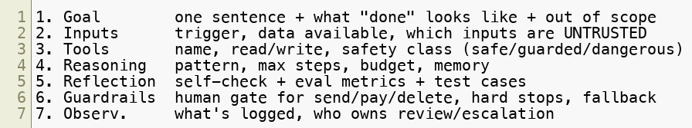
Scope It With the Agent Design Canvas
Fill agent-design-canvas.md before you write code — one page, seven boxes:
The "out of scope" line is the most valuable thing you'll write today.
A finished canvas is a scoped project. A blank canvas is a demo that dies at 4 p.m.
Copyright © 2026 by Elephant Scale, All Rights Reserved

Slide 5
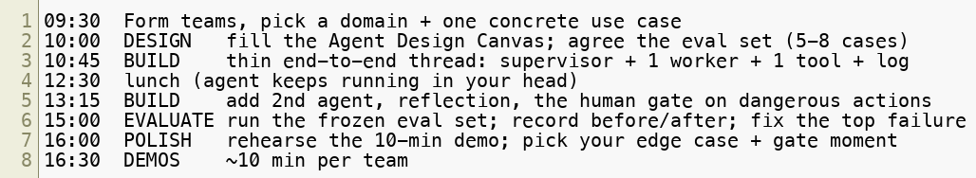
Timeline for the Day
Use the starter/ scaffold in labs/17-Capstone so hour one isn't plumbing.
Hit "end-to-end but ugly" by lunch. Everything after lunch is making it good, not making it work.
Copyright © 2026 by Elephant Scale, All Rights Reserved

Slide 6
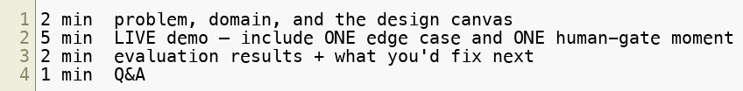
The Demo Format (10 min / team)
From capstone-rubric.md :
Show the audit log live — reviewers grade the process , not just the answer.
A handled edge case earns more than a flawless happy path.
Don't narrate what it would do. Run it, break it on purpose, and show the gate catching it.
Copyright © 2026 by Elephant Scale, All Rights Reserved

Slide 7
How You're Graded (100 pts)
Dimension | Wt | Full marks
Problem & design | 15 | Clear goal, sane scope, completed canvas
Reasoning & planning | 15 | Robust loop; recovers from surprises
Tools & integration | 15 | Well-specified tools; clean error handling
Reflection & quality | 10 | Measurable lift from self-evaluation
Multi-agent coordination | 15 | Distinct roles that actually cooperate
Evaluation | 15 | Frozen set, honest metrics, before/after
Governance & safety | 10 | Least privilege, human gate, full audit log
Demo & communication | 5 | Clear demo; team explains tradeoffs
Notice the weights: reasoning, tools, multi-agent, and eval are 60 of 100. Depth beats features.
Copyright © 2026 by Elephant Scale, All Rights Reserved

Slide 8
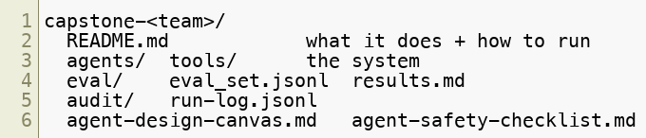
Deliverables
Repo with runnable code (or a documented low-code flow) + requirements.txt
Completed agent-design-canvas.md and agent-safety-checklist.md
Eval set + a results table (before/after one change)
A sample audit log (JSONL) from a real run
If the audit log and the eval results are missing, two of the six capabilities are unproven.
Copyright © 2026 by Elephant Scale, All Rights Reserved

Slide 9
Tips
Thin thread first — one supervisor, one worker, one tool, one logged run
Freeze the eval set early and never edit it — that's how "before/after" means anything
Fake slow/expensive tools with local stubs; spend your time on the loop , not integrations
Cap the loop (max steps + cost) on line one
One dangerous action, well-gated beats five ungated ones
Reuse the course assets: help_center.md , support_tickets.csv , the audit schema
Every hour ask: "what's the one thing that, if it breaks in the demo, sinks us?" Fix that.
Copyright © 2026 by Elephant Scale, All Rights Reserved

Slide 10
Common Pitfalls
Scope creep — five domains, zero finished. Pick one use case.
Prompt-in-a-trenchcoat — one giant prompt pretending to be multi-agent
No eval set — "it worked when I tried it" is not evaluation
Governance bolted on at 4 p.m. — the log and the gate are design, not garnish
Demo-by-slides — reviewers want it live , including the failure case
Real integrations eating the day — a flaky API will cost you the eval
The failure mode is always the same: too much scope, safety last, and nothing that runs end to end.
Copyright © 2026 by Elephant Scale, All Rights Reserved

Slide 11
Gallery — Finance
Invoice triage & approval — extract → validate against PO → flag anomalies → human gate to approve payment
Expense-policy auditor — read expense rows, cite the policy clause, escalate the gray areas
Earnings-call briefer — retrieve transcript → summarize → reflect for factuality → cite sources
Finance = high stakes, clear rules to cite, obvious dangerous action (pay). A natural governance story.
Copyright © 2026 by Elephant Scale, All Rights Reserved

Slide 12
Gallery — HR & Real Estate
HR
  Onboarding coordinator — schedule, draft welcome emails, checklist (draft-only, human sends)
  Pay-equity analyst — query aggregates (no raw PII), reflect on the finding, gated report
  Policy Q&A — answer only from the handbook; escalate anything legal
Real Estate
  Listing assistant — draft listings from specs + comps; reflect for compliance wording
  Lead qualifier — score inbound leads, route hot ones, book viewings (gated)
  Comps analyst — pull comparables, compute a range, cite each comp
HR and Real Estate both live near regulated data — perfect for showing least privilege and gates.
Copyright © 2026 by Elephant Scale, All Rights Reserved

Slide 13
Gallery — Customer Support
Tier-1 resolver — answer from help_center.md , escalate what it can't ground
Refund handler — verify eligibility from the KB, then a human gate before issuing
Voice support line — reuse your Lab 15 agent; add a second agent for account changes
Ticket triage swarm — classifier agent + drafting agent + a QA/reflection agent
Support has ready-made assets (help_center.md, support_tickets.csv) — you can be building by 10:15.
Copyright © 2026 by Elephant Scale, All Rights Reserved

Slide 14
Build It — Good Luck
Go to
labs/17-Capstone — run-of-show, the starter/ scaffold, and the rubric
Design on paper first. Get one thread running. Then make it good.
Log everything. Gate the dangerous thing. Prove it with the eval set.
Demo it live — edge case and all.
You started the week hand-building a ReAct loop. Today you ship a governed multi-agent system. Go build.
Copyright © 2026 by Elephant Scale, All Rights Reserved

