Slide 1
Building Agentic AI
Copyright © 2026 by Elephant Scale, All Rights Reserved

Slide 2
Agenda
Module | Topic
1 | Foundations of Agentic AI
2 | Reflection & Self-Evaluation
3 | Tools, Structured Output & MCP
4 | RAG & Vector Databases
5 | Evaluation, Error Analysis & Debugging
6 | Multi-Agent Systems & Planning
7 | LangGraph & Tavily
8 | Low-Code Agentic Design
9 | Agentic on AWS Bedrock
10 | DSPy & Databricks
11 | Agentic with Claude
12 | Voice Agents with Google ADK
13 | Governance with Databricks
14 | Capstone: Enterprise AI Agent Challenge
Copyright © 2026 by Elephant Scale, All Rights Reserved

Slide 3
Pre-requisites and Expectations
Comfortable with Python (functions, packages, virtual environments)
Comfortable with API calls and JSON
Basic machine-learning / LLM familiarity is helpful, not required
Curiosity!
  Ask a lot of questions
  Agents are new — we are all still learning the patterns
Class will move at the pace of the majority
Copyright © 2026 by Elephant Scale, All Rights Reserved

Slide 4
Our Teaching Philosophy
Emphasis on concepts & fundamentals — patterns outlive frameworks
API — no need to learn anything by heart
Highly interactive (questions and discussions are welcome)
Hands-on (learn by doing)
You will build an agent on every major framework in production use today
Copyright © 2026 by Elephant Scale, All Rights Reserved

Slide 5
Lots of Labs: Learn By Doing
15 labs + a team capstone
Every lab has copy-ready code and a "what a correct run looks like"
Cloud labs have a local fallback — nobody is ever blocked
We build the pattern by hand first, then let the framework carry it.
Copyright © 2026 by Elephant Scale, All Rights Reserved

Slide 6

Analogy: Learning To Fly...
Copyright © 2026 by Elephant Scale, All Rights Reserved

Slide 7

Introductions
Copyright © 2026 by Elephant Scale, All Rights Reserved

Slide 8

+ Flight Time
Copyright © 2026 by Elephant Scale, All Rights Reserved

Slide 9
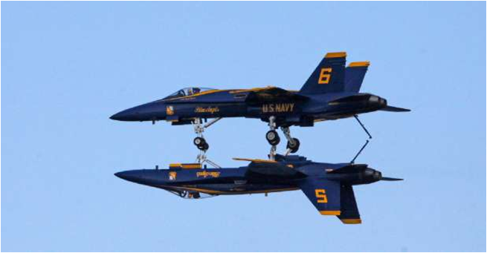
This Will Take A Lot Of Practice
Copyright © 2026 by Elephant Scale, All Rights Reserved

Slide 10



About You And Me
About the instructor
About you
  Your name
  Your role (developer, data scientist, lead, PM, ...)
  Languages / stacks you use every day
  Agent experience so far (1 - new ... 4 - I ship them)
  Something non-technical about you!
Copyright © 2026 by Elephant Scale, All Rights Reserved

Slide 11
What Is An Agent? (One-Line Version)
An LLM in a loop that can use tools to pursue a goal
A chatbot answers. An agent acts — so it needs limits, evaluation, and governance.
Copyright © 2026 by Elephant Scale, All Rights Reserved

Slide 12
The Five-Day Map
In every module you build a real artifact you can take back to work.
Day | You go from...
1 | mental model → a hand-built agent loop (ReAct) + a research assistant
2 | reflection → tools, structured output, MCP, an email assistant
3 | evaluation & debugging → multi-agent + planning-driven agents
4 | frameworks: LangGraph, low-code, Bedrock, DSPy, Claude
5 | voice agents, governance, and the team capstone
Copyright © 2026 by Elephant Scale, All Rights Reserved

Slide 13
Ground Rules for Building Agents
Least privilege — an agent gets the fewest tools and permissions that work.
Human-in-the-loop for anything that sends, publishes, deletes, buys, or changes records.
Log everything — every plan, tool call, and result is auditable.
Evaluate before you trust — a demo that works once is not a pilot.
Treat tool output and retrieved text as untrusted data , not instructions.
These five habits separate a useful agent from an expensive incident. We build them in from Lab 1.
Copyright © 2026 by Elephant Scale, All Rights Reserved

