Slide 1
Foundations of Agentic AI
Copyright © 2026 by Elephant Scale, All Rights Reserved

Slide 2
Part I — What We'll Cover
What Agentic AI is — and what it is not
From prompt-based AI to agents that act
OpenAI's guidance: when to use an agent vs. a plain workflow
Design principles: autonomy, reasoning, reflection, planning, safety
The canonical agent loop and the ReAct pattern
Tools and memory — how an agent reaches the world
Two labs: hand-build a ReAct loop, then a logged research assistant
Today's goal: a correct mental model first, then a working agent you built by hand.
Copyright © 2026 by Elephant Scale, All Rights Reserved

Slide 3
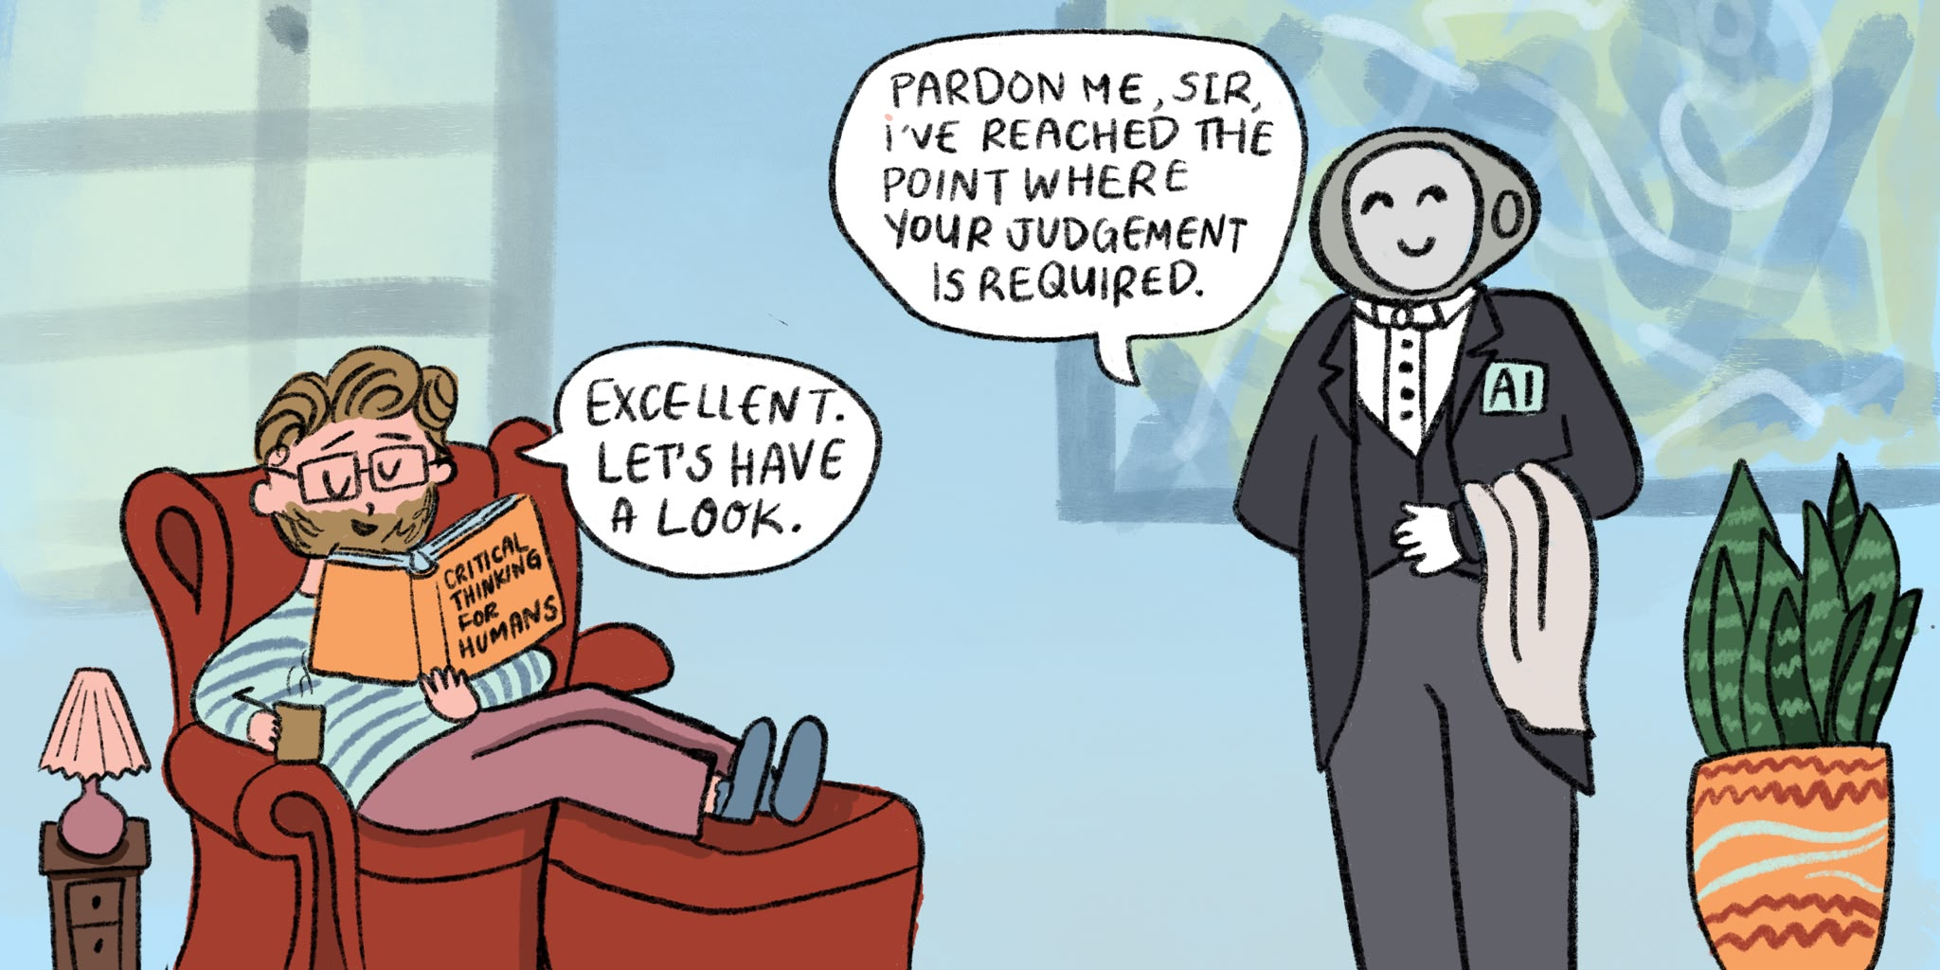
What Is Agentic AI?
An LLM in a loop that pursues a goal by using tools
  not one prompt, one answer — many steps
  the model decides what to do next each turn
Three ingredients:
  a goal (what "done" means)
  tools (search, code, APIs, databases)
  a loop (act, observe, decide, repeat)
Agentic ≠ a bigger model. It's a control loop wrapped around a model.
Copyright © 2026 by Elephant Scale, All Rights Reserved

Slide 4
Agent vs. Chatbot vs. Workflow
 | Chatbot | Fixed workflow | Agent
Steps | one turn | pre-wired, fixed | model chooses at runtime
Tools | none / one | called in fixed order | called as needed
Adapts to input | no | little | yes
Predictable | very | very | less — needs guardrails
A chatbot answers . A workflow executes a script . An agent decides .
More autonomy buys flexibility and costs predictability. You pay for it with evaluation and governance.
Copyright © 2026 by Elephant Scale, All Rights Reserved

Slide 5
From Prompt-Based AI to Autonomous Agents
Prompt — one instruction in, one completion out
Prompt chain — you wire step 2 to step 1 (you are the loop)
Tool-use / function calling — the model can request an action
Agent — the model runs its own loop: plan, call tools, observe, revise
Multi-agent — several agents specialize and collaborate (Day 3)
The shift is who holds the loop. In an agent, the model does — that is the whole idea.
Copyright © 2026 by Elephant Scale, All Rights Reserved

Slide 6
OpenAI's Agentic Guidance — When to Build an Agent
Reach for an agent when a task has all three :
  Complex, branching decisions — many "it depends" paths
  Rules too messy to hard-code — brittle or ever-changing logic
  Heavy reliance on unstructured input — language, documents, tickets
Good fits: triage, research, multi-step support, document workflows
If a flowchart would capture it cleanly, write the flowchart — not an agent.
Copyright © 2026 by Elephant Scale, All Rights Reserved

Slide 7
When NOT to Use an Agent
The task is deterministic — same input, same steps every time
You need hard guarantees on cost, latency, or output shape
A single prompt or a short script already does the job
Errors are expensive and hard to catch with no human in the loop
Prefer the simplest thing that works:
  one prompt < prompt chain < fixed workflow < agent
Start at the lowest rung of autonomy. Climb only when the task forces you to.
Copyright © 2026 by Elephant Scale, All Rights Reserved

Slide 8
Design Principles
Autonomy — the agent decides next steps, within limits you set
Reasoning — it thinks before it acts (make the thinking explicit)
Reflection — it checks its own work and revises (Day 2)
Planning — it breaks a goal into ordered sub-steps
Safety — least privilege, human gates, everything logged, a step cap
These five are not features you add later. They are the shape of the agent from Lab 1.
Copyright © 2026 by Elephant Scale, All Rights Reserved

Slide 9
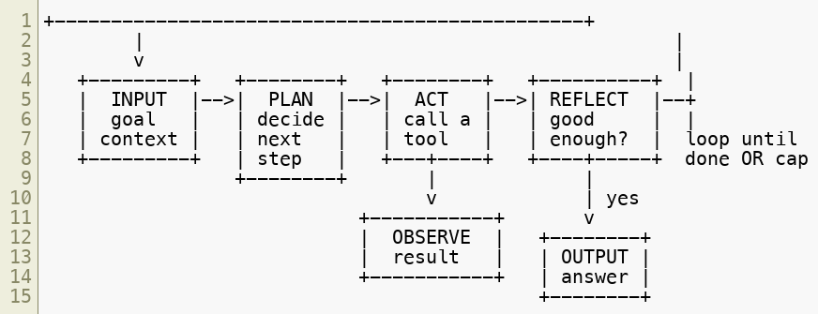
The Canonical Agent Loop
Every loop ends one of two ways: done , or max steps hit .
Input -> Plan -> Act -> Reflect -> Output. Memorize this — every framework this week is a variation of it.
Copyright © 2026 by Elephant Scale, All Rights Reserved

Slide 10
Anatomy of the Loop
Input — the goal plus available context and inputs
Plan — pick the next action (or decide you're done)
Act — call exactly one tool with concrete arguments
Observe — read the tool result (treat it as untrusted data )
Reflect — is the answer good enough, or loop again?
Output — the final answer, ideally with sources
The step cap is not optional — it's what stops a loop that never converges.
No cap, no ship. A runaway loop is a bill and an incident waiting to happen.
Copyright © 2026 by Elephant Scale, All Rights Reserved

Slide 11
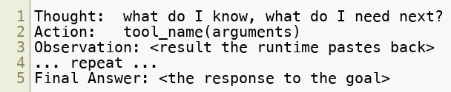
The ReAct Pattern
ReAct = Reasoning + Acting , interleaved in one trace
The model emits a fixed cycle until it can answer:
Your code parses each turn, dispatches the Action, pastes back the Observation
Simple, transparent, framework-free — you'll build it by hand in Lab 1
ReAct makes the reasoning visible and auditable. That's why we teach it first.
Copyright © 2026 by Elephant Scale, All Rights Reserved

Slide 12
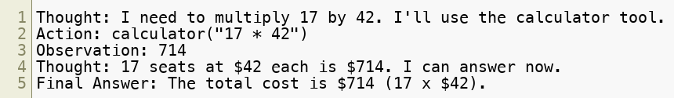

ReAct — A Worked Trace
Goal: "What is the total cost if we buy 17 seats at $42/seat?"
Notice: one action per step , and the model stops once it has enough.
The runtime — not the model — produces each Observation .
The loop is dumb and reliable; the intelligence lives in Thought and in the tools.
Copyright © 2026 by Elephant Scale, All Rights Reserved

Slide 13
Single- vs. Multi-Step Reasoning
Single-step — one tool call answers the goal
  "Convert 90F to Celsius" -> one calculator call -> done
Multi-step — the answer depends on earlier results
  "Compare the two most-cited ReAct follow-up papers" ->
    search -> read -> search again -> synthesize
Multi-step needs a scratchpad (what have I learned so far?) and a cap .
Most real tasks are multi-step. Lab 2 is where that becomes real.
Copyright © 2026 by Elephant Scale, All Rights Reserved

Slide 14


Tools — Giving the Agent Hands
A tool is a function the model may call : a name, a description, typed args
The model picks the tool and the arguments; your code runs it
Examples across this course: calculator , web_search , email, CRM query, code exec
Least privilege : give the fewest tools, narrowest scopes, that still work.
Untrusted output : a tool result is data , never new instructions.
The model proposes; your code disposes. That boundary is where safety lives.
Copyright © 2026 by Elephant Scale, All Rights Reserved

Slide 15
Memory — What the Agent Remembers
No memory — each run starts blank (simplest, safest default)
Scratchpad (this run) — the running Thought/Observation trace in context
Persistent (across runs) — stored notes, vectors, a DB (Day 4+)
Memory is context, and context has a budget — summarize, don't hoard
More memory = more capability and more attack surface
Start with a scratchpad. Add persistent memory only when the task can't succeed without it.
Copyright © 2026 by Elephant Scale, All Rights Reserved

Slide 16
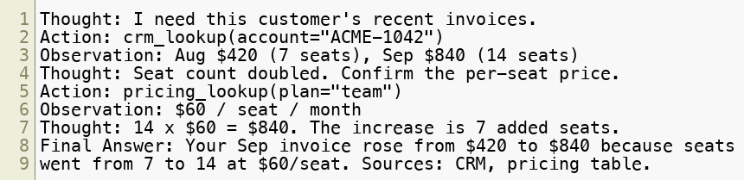
Motivating Example — A Support / Research Assistant
Goal: "A customer asks why their invoice doubled this month. Explain it."
Same loop, real tools, cited sources — a demo the business actually recognizes.
Copyright © 2026 by Elephant Scale, All Rights Reserved

Slide 17
Safety From Line One
Max-steps cap in the loop — always
Human-in-the-loop for anything that sends, buys, deletes, or changes records
Least privilege — minimal tools and scopes
Log everything — plan, tool call + args, result, final output (JSONL)
Treat tool/retrieved text as untrusted — data, not instructions
A demo that works once is not a pilot. We build the guardrails in from the first lab, not after.
Copyright © 2026 by Elephant Scale, All Rights Reserved

Slide 18
Putting It Together
An agent = model + tools + a capped loop pointed at a goal
Use one only when the task is complex, messy, and language-driven
ReAct makes the loop visible: Thought / Action / Observation / Final Answer
Real tasks are multi-step — they need a scratchpad and a step cap
Safety and logging are part of the design, not an afterthought
You now have the mental model. Next you build it — by hand, no framework.
Copyright © 2026 by Elephant Scale, All Rights Reserved

Slide 19
Lab 1 — Environment Setup & Your First Agent Loop (ReAct)
Stop here and run Lab 1.
You will:
Verify your Python env and labs/.env keys ( ./labs/verify-setup.sh ).
Register two tools: a calculator and a local lookup .
Build a ReAct loop against the OpenAI API — Thought / Action / Observation / Final Answer.
Parse each step, dispatch the action, and paste back the observation.
Enforce a max-steps cap and print the full trace.
Deliverable: a runnable agent_loop.py that solves a multi-step question and prints a ReAct trace ending in a Final Answer.
Time: 45 minutes
Copyright © 2026 by Elephant Scale, All Rights Reserved

Slide 20
Lab 2 — Research Assistant with Multi-Step Reasoning & Logging
Stop here and run Lab 2.
You will:
Fill the Agent Design Canvas before writing code.
Add a planning step, then loop a search tool multiple times (Tavily or local fallback).
Enforce a max-steps cap and treat every result as untrusted data.
Write a structured JSONL audit log ( run_start , plan , tool_call , tool_result , run_end ).
Synthesize a final answer with sources .
Deliverable: a runnable research_agent.py plus a run-log.jsonl from one complete run.
Time: 60 minutes
Copyright © 2026 by Elephant Scale, All Rights Reserved

