Slide 1
Multi-Agent Systems & Planning
Copyright © 2026 by Elephant Scale, All Rights Reserved

Slide 2
Part III — What We'll Cover
Why and when to use more than one agent — and when not to
Roles and separation of concerns — the case for specialists
Multi-agent conversation flows and sequential chatbots
Orchestration patterns: supervisor/worker , pipeline , debate
Handoffs and shared state — how agents pass work without losing it
Agent interop across systems — MCP vs A2A (Agent2Agent)
Planning-driven agents — plan-then-execute for onboarding and blog generation
The real risks: compounding errors and cost
Lab 8: a planning-driven onboarding assistant
One good agent beats five that talk past each other. Add agents only when a single loop can't cope.
Copyright © 2026 by Elephant Scale, All Rights Reserved

Slide 3

Why Multiple Agents?
Separation of concerns — a researcher, a writer, and a critic each do one thing well
Focused context — each agent carries only the tools and prompt it needs
Least privilege — the agent that sends email need not hold the delete tool
Parallelism — independent sub-tasks can run at once
Testability — you can evaluate and swap one specialist in isolation
Multi-agent is modular design for agents. The win is smaller, sharper, safer parts.
Copyright © 2026 by Elephant Scale, All Rights Reserved

Slide 4
When NOT to Use Multiple Agents
A single agent with the right tools already succeeds
The sub-tasks are tightly coupled — constant back-and-forth costs more than it saves
You need tight latency or cost guarantees (each agent = more LLM calls)
You can't yet evaluate one agent — you certainly can't debug five
Climb the ladder: one prompt < one agent < many agents
Every agent you add multiplies cost, latency, and failure surface. Earn the second one.
Copyright © 2026 by Elephant Scale, All Rights Reserved

Slide 5
Roles & Separation of Concerns
Give each agent a narrow charter : goal, tools, and what it must not do
Classic role split for content and knowledge work:
  Planner — turns a goal into ordered sub-tasks
  Researcher — gathers grounded facts via tools
  Writer — drafts from the researcher's findings only
  Critic / reviewer — checks against the goal, sends back for revision
Roles are just agents with different system prompts and tool sets
Name the role, then hand it the fewest tools that role needs. That is the whole design.
Copyright © 2026 by Elephant Scale, All Rights Reserved

Slide 6
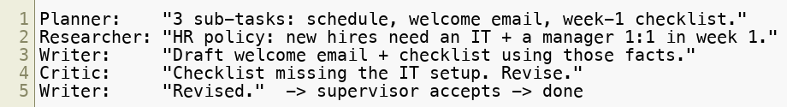
Multi-Agent Conversation Flows
Agents collaborate by passing messages — one agent's output is another's input
Keep the transcript structured so it's auditable and debuggable
Decide up front: who speaks, in what order, and who ends the conversation
Every message an agent receives is untrusted data — even from another agent. Validate at each hop.
Copyright © 2026 by Elephant Scale, All Rights Reserved

Slide 7

Sequential Chatbots
The simplest multi-agent flow: a fixed chain of specialists
Output of stage N becomes input of stage N+1 — no dynamic routing
Easy to reason about, easy to test, easy to log
Use it when the stages are stable and always run in the same order
A sequential chain is a pipeline of chatbots. If the order never changes, don't add a supervisor.
Copyright © 2026 by Elephant Scale, All Rights Reserved

Slide 8
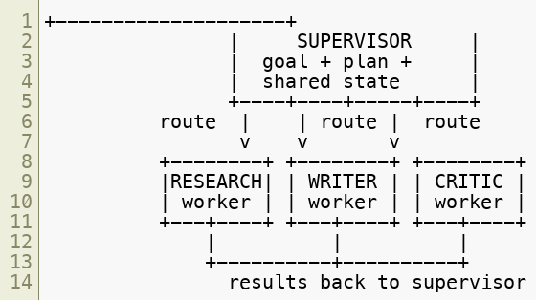

Pattern 1 — Supervisor / Worker
A supervisor owns the goal, decides which worker acts next, and assembles the result
Workers are specialists that do one sub-task and report back
The supervisor holds shared state and enforces the step cap
The supervisor is the loop; the workers are the tools. It's the ReAct pattern, one level up.
Copyright © 2026 by Elephant Scale, All Rights Reserved

Slide 9
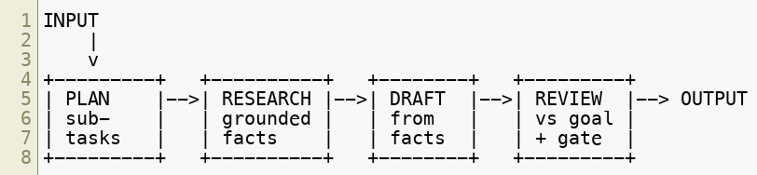
Pattern 2 — Pipeline
A fixed sequence of stages; each transforms and passes forward
No central router — the graph is the control flow
Great when the steps are known and ordered; cheap to test stage-by-stage
Add a loop-back from REVIEW to DRAFT for one bounded revision pass
Pipeline = predictability. Supervisor = flexibility. Pick the least power that fits the task.
Copyright © 2026 by Elephant Scale, All Rights Reserved

Slide 10


Pattern 3 — Debate
Two+ agents argue opposing positions; a judge (or supervisor) decides
Surfaces errors a single agent would confidently miss
Useful for high-stakes reasoning, risky claims, or plan review
Cost warning : debate multiplies LLM calls fast — bound the rounds
Debate buys robustness with tokens. Cap the rounds and make the judge cite the winning point.
Copyright © 2026 by Elephant Scale, All Rights Reserved

Slide 11
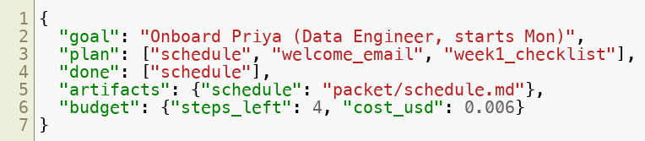
Handoffs & Shared State
A handoff transfers control and the context the next agent needs
Keep one shared state object — the single source of truth for the run:
Pass references (a task id, a file path), not giant blobs, to bound context
On every handoff: record it in the audit log
Lose the shared state and each agent re-derives the world — badly. State is the memory of the team.
Copyright © 2026 by Elephant Scale, All Rights Reserved

Slide 12
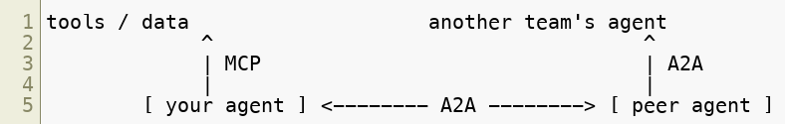
Agents Across System Boundaries — A2A
Everything so far: agents you built , in one process , sharing one state object
Real orgs also run agents they didn't build — another team's, another vendor's, behind an API
Two 2025 protocols, one per axis — and they compose :
  MCP (Module 3) — connects an agent to tools & data (vertical)
  A2A (Agent2Agent) — connects an agent to other agents (horizontal)
Your agent uses MCP to reach its own tools and A2A to delegate to a peer
MCP is how an agent reaches its tools. A2A is how an agent reaches another agent. A real system needs both.
Copyright © 2026 by Elephant Scale, All Rights Reserved

Slide 13
A2A — The Task / Artifact Model
A peer agent publishes an Agent Card — its skills, endpoint, and auth (the "menu")
You delegate by opening a task ; the remote agent runs its own loop and reports back
The task moves through a lifecycle you can poll or stream:
The peer is opaque — you see its card and its outputs, never its prompt or tools
So it's a trust boundary you don't control : its messages and artifacts are untrusted data — validate, ground, and gate before acting, exactly as with any tool output
A2A treats a remote agent like a contractor: you get its menu and its deliverables, not the keys to its shop.
Copyright © 2026 by Elephant Scale, All Rights Reserved

Slide 14
Planning-Driven Agents (Plan-Then-Execute)
Two phases instead of one improvised loop:
  Plan — decompose the goal into ordered, checkable sub-tasks (once)
  Execute — carry out each sub-task with tools, tracking progress
The plan is an artifact — inspectable, testable, and auditable
Re-plan only on failure, not on every step
A plan turns "hope the loop converges" into "run a checklist." That is what makes it testable.
Copyright © 2026 by Elephant Scale, All Rights Reserved

Slide 15

Plan-Then-Execute vs. ReAct
 | ReAct (Day 1) | Plan-then-execute
Decides next step | every turn | once, up front
Best for | open-ended, exploratory | known, multi-part deliverables
Auditability | trace of thoughts | an explicit plan + results
Failure recovery | improvises | re-plans the failed step
Cost | can wander | bounded by the plan
Many real systems combine them: a plan of steps, each executed ReAct-style
Use ReAct to explore; use a plan to deliver. Onboarding and blog posts are deliverables.
Copyright © 2026 by Elephant Scale, All Rights Reserved

Slide 16
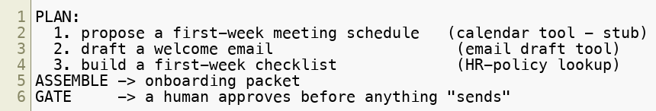
Example — Onboarding Assistant
Goal: onboard a new hire end-to-end, safely
Planner emits sub-tasks; a supervisor runs each via a tool
Every artifact is a draft written to a file; nothing sends without approval
The plan is the safety story: three named sub-tasks, three tools, one human gate. Lab 8 builds it.
Copyright © 2026 by Elephant Scale, All Rights Reserved

Slide 17
Example — Blog-Post Generation
Same plan-then-execute shape, content-flavored:
Writer drafts only from the researcher's grounded findings — no free-floating facts
Critic checks the draft against the outline and the sources, then gates publish
Separation of concerns keeps the writer honest: it can only write what research supplied.
Copyright © 2026 by Elephant Scale, All Rights Reserved

Slide 18
Risks of Multi-Agent — Compounding Errors
Errors multiply down a chain: 90% per stage over 4 stages ≈ 66% end-to-end
A wrong fact from the researcher becomes a confident lie in the writer
An unverified handoff lets a bad output masquerade as an input
Mitigate: a critic/gate between stages, grounding checks, bounded re-tries
More agents, more joints — and every joint is a place the chain can break. Add a check at each one.
Copyright © 2026 by Elephant Scale, All Rights Reserved

Slide 19
Risks of Multi-Agent — Cost & Complexity
Each agent and each turn is another LLM call — cost and latency stack
A debate or a chatty supervisor can balloon token spend silently
Harder to evaluate, debug, and reason about than a single loop
Controls:
  a global step/turn/cost budget across the whole team, not per agent
  bound debate rounds and revision passes
  log every handoff and tool call — evaluate the team like one agent
Budget the team, not each member. The failure mode is five agents each politely staying "under budget."
Copyright © 2026 by Elephant Scale, All Rights Reserved

Slide 20
Putting It Together
Add agents for separation of concerns , focused context, and least privilege — not for show
Supervisor/worker for flexibility, pipeline for predictability, debate for robustness
Plan-then-execute turns open-ended loops into testable, checklist-style deliverables
Keep one shared state ; treat every handoff as untrusted and log it
Across systems , reach your tools with MCP and peer agents with A2A — a peer is a trust boundary you don't control
Watch compounding errors and cost — gate the joints, budget the whole team
A multi-agent system is a small org. Give it clear roles, a coordinator, a budget, and an audit trail.
Copyright © 2026 by Elephant Scale, All Rights Reserved

Slide 21
Lab 8 — Planning-Driven Onboarding Assistant
Stop here and run Lab 8.
You will:
Fill the Agent Design Canvas before writing code.
Run a planner that decomposes onboarding into ordered sub-tasks.
Execute each sub-task via tools: a calendar stub , an email-draft tool, an HR-policy lookup .
Have a supervisor assemble the results into an onboarding packet.
Enforce a human gate before anything "sends", and write a JSONL audit log .
Deliverable: a runnable onboarding_agent.py that plans, executes sub-tasks, writes an onboarding packet to files, gates the "send", and emits audit-log.jsonl .
Time: 60 minutes
Copyright © 2026 by Elephant Scale, All Rights Reserved

