Slide 1
RAG & Vector Databases
Copyright © 2026 by Elephant Scale, All Rights Reserved

Slide 2
Part II — What We'll Cover
Why RAG — give the agent facts it wasn't trained on, and ground what it says
Embeddings — turning text into vectors that carry meaning
Vector databases — storing those vectors and searching them by similarity
Chunking — how you split documents decides what retrieval can find
Grounding & citation — answer from the sources , cite them, or say "not found"
Retrieval as a tool — the agent decides when to go look things up
RAG is how an agent stops guessing from memory and starts answering from evidence.
Copyright © 2026 by Elephant Scale, All Rights Reserved

Slide 3
The Ideas (whiteboard)
Embedding space — "near" means "related in meaning," not "same words"
Cosine similarity — the one number behind every vector search
Chunk size vs. recall — too big dilutes, too small loses context
Top-k retrieval — how many passages to pull, and why more isn't better
The failure mode: retrieve the wrong chunk → confidently wrong answer
We'll draw the vector space and walk one query end to end before the lab.
Copyright © 2026 by Elephant Scale, All Rights Reserved

Slide 4
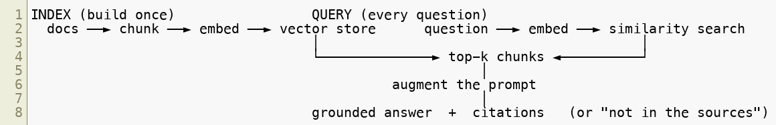

The RAG Pipeline (reference)
Same embedder on both sides. The store is just "find the nearest vectors, fast."
Copyright © 2026 by Elephant Scale, All Rights Reserved

Slide 5
Vector DBs in the Wild (reference)
Local / embedded: FAISS, Chroma, a plain NumPy matrix (what the lab uses offline)
Server / managed: pgvector, Pinecone, Weaviate, Milvus
They differ in scale, ops, and filters — the idea is identical : nearest-neighbor search
For a locked-down network, embedded + local embeddings runs with no cloud at all
Pick the DB for your ops reality; the retrieval concept doesn't change.
Copyright © 2026 by Elephant Scale, All Rights Reserved

Slide 6
Grounding: the Agentic Payoff
Retrieval returns passages with sources — not an answer
The agent answers only from those passages, and cites them
No supporting passage? Say so — don't fill the gap from memory
Wrap it as a tool — search_knowledge_base(query) — and the agent calls it when it needs facts
Grounding + citation + "I don't know" is what makes retrieval trustworthy in production.
Copyright © 2026 by Elephant Scale, All Rights Reserved

Slide 7
Lab 6 — RAG over a Local Vector Store
Stop here and run Lab 6.
You will:
Chunk a small document corpus and embed every chunk.
Build a vector store and run similarity search for a question.
Return the top-k passages with their sources .
Produce a grounded answer that cites the passages — or says the answer isn't in the corpus.
Expose retrieval as a search_knowledge_base tool the agent can call.
Runs fully offline (local embeddings + NumPy store); hosted embeddings are an optional switch.
Time: 60 minutes
Copyright © 2026 by Elephant Scale, All Rights Reserved

