Slide 1
DSPy & Databricks
Copyright © 2026 by Elephant Scale, All Rights Reserved

Slide 2
Part IV I–J — What We'll Cover
The DSPy idea — program your LLM, don't hand-tune prompt strings
Signatures — declare what (inputs -> outputs), not how
Modules — Predict , ChainOfThought , ReAct
Metrics + optimizers — BootstrapFewShot makes agents self-improve
When DSPy beats hand-prompting (and when it doesn't)
Databricks enterprise integration — Delta, MLflow, model serving
Lab 13: a self-improving DSPy agent + "Delta" analytics (local fallback)
Stop editing prompt strings by hand. Declare the behavior and let a compiler optimize it.
Copyright © 2026 by Elephant Scale, All Rights Reserved

Slide 3
The Problem DSPy Solves
Hand-prompting is brittle string surgery — tweak wording, re-test, repeat
Prompts don't transfer — new model, redo the fiddling
No metric in the loop — "seems better" is not measurable
Few-shot examples are hand-picked and go stale
DSPy: treat the prompt as compiled output , not source code you hand-write.
You wouldn't hand-tune assembly. DSPy is the compiler; your program is the source.
Copyright © 2026 by Elephant Scale, All Rights Reserved

Slide 4
The DSPy Idea — Programs Over Prompts
Write a program in Python; DSPy generates + optimizes the actual prompts
Three layers:
  Signature — the typed contract ( question -> answer )
  Module — the strategy ( Predict , ChainOfThought , ReAct )
  Optimizer — compiles the program against a metric + examples
Separate intent (signature) from strategy (module) from tuning (optimizer).
Copyright © 2026 by Elephant Scale, All Rights Reserved

Slide 5
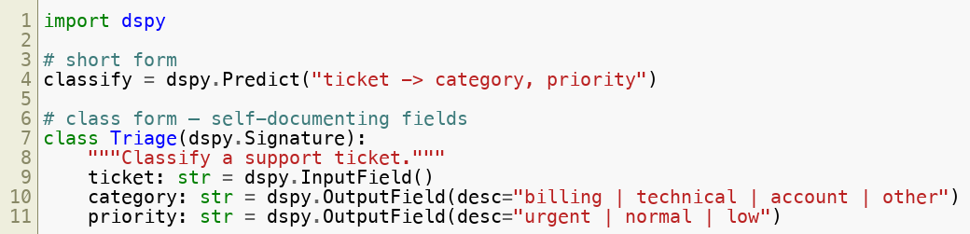

Signatures — Declare the Contract
A Signature names inputs and outputs with descriptions — not a prompt
Short form for quick work; class form when fields need docs
A signature is what you want. DSPy writes the prompt words for you.
Copyright © 2026 by Elephant Scale, All Rights Reserved

Slide 6
Modules — Choose the Strategy
Module | What it does | Use when
Predict | Direct input -> output | Simple classify / extract
ChainOfThought | Adds a reasoning step first | Reasoning, math, judgment
ReAct | Reason + call tools in a loop | Agents that use tools
ProgramOfThought | Generates + runs code | Precise calculation
Swap the module without touching the signature — same contract, new strategy.
Predict for facts, ChainOfThought for judgment, ReAct for tools. Start simple.
Copyright © 2026 by Elephant Scale, All Rights Reserved

Slide 7
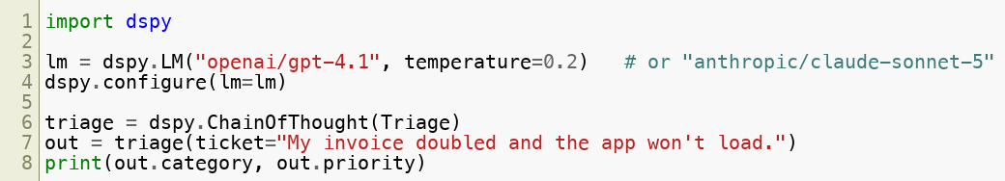

Configuring the LM
One global config points DSPy at any provider (OpenAI, Anthropic, Bedrock, local)
dspy.LM uses LiteLLM under the hood — same string names you already know
One line swaps the model. The program — signatures and modules — stays put.
Copyright © 2026 by Elephant Scale, All Rights Reserved

Slide 8

Metrics — Define "Better"
An optimizer needs a metric : a function scoring an example vs. the prediction
Return a bool or a float; this is the objective the compiler maximizes
This is the same discipline as your eval set (Day 3) — now in the training loop
Good metrics are cheap, deterministic, and aligned with what you actually want.
No metric, no optimization. "Looks good" cannot be compiled.
Copyright © 2026 by Elephant Scale, All Rights Reserved

Slide 9
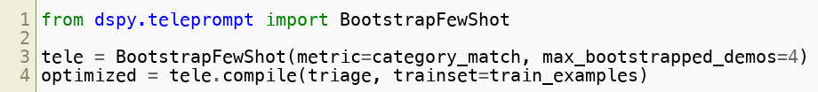
Optimizers — Self-Improvement from Examples
An optimizer (a "teleprompter") compiles your program to raise the metric
BootstrapFewShot — the model generates its own few-shot demos, keeps the ones that pass the metric, and bakes them into the prompt
Others: BootstrapFewShotWithRandomSearch , MIPROv2 (optimizes instructions too).
The agent teaches itself: try examples, keep what scores, embed the winners. That's the loop.
Copyright © 2026 by Elephant Scale, All Rights Reserved

Slide 10
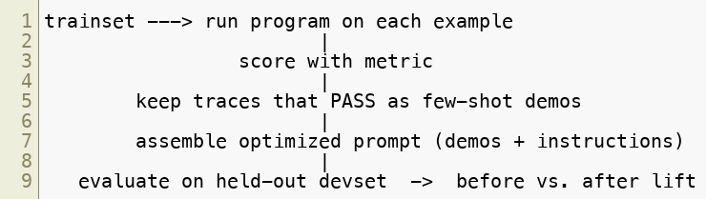
The Compile Loop, Visualized
You measure the lift : metric on devset before compile vs. after.
Lab 13 makes this number real — and writes it to an analytics table.
Self-improving is not magic. It's search over prompts, scored by your metric.
Copyright © 2026 by Elephant Scale, All Rights Reserved

Slide 11
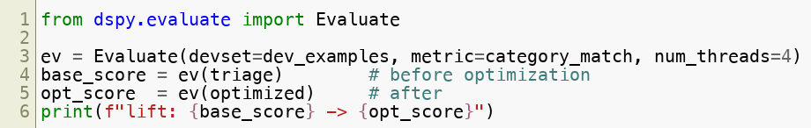
Evaluating a Program
dspy.Evaluate runs a program over a devset and reports the aggregate metric
Always evaluate on held-out data — never the trainset you compiled on
Report before and after on held-out data, or the "improvement" is just memorization.
Copyright © 2026 by Elephant Scale, All Rights Reserved

Slide 12

When DSPy Beats Hand-Prompting
Beats hand-prompting when:
  You have (or can label) examples + a metric
  The task is repeated at scale — worth optimizing once
  You need to swap models without redoing prompt work
  You're chaining multiple LLM steps (compounding prompt debt)
Skip it when:
  A one-off prompt already works
  You have no examples and no metric
  The team can't maintain the extra abstraction
DSPy pays off where prompts are assets you maintain — not for a throwaway one-liner.
Copyright © 2026 by Elephant Scale, All Rights Reserved

Slide 13
Databricks — Where This Goes to Production
Databricks is the enterprise platform DSPy programs often ship on:
  Delta tables — reliable, versioned tables (ACID) for training data & run metrics
  MLflow — track runs, params, metrics; register + version the compiled program
  Model Serving — deploy the program behind a REST endpoint, autoscaled
  Unity Catalog — governance, lineage, and access control (Day 5)
Foundation Model APIs serve LLMs inside the Databricks perimeter
DSPy compiles the agent; Databricks stores its data, tracks its runs, and serves it.
Copyright © 2026 by Elephant Scale, All Rights Reserved

Slide 14
Delta Tables (Conceptual)
A Delta table = Parquet files + a transaction log -> ACID, time travel, schema evolution
Perfect home for agent run metrics : append each run, query trends, audit history
Reads back into Spark or pandas — the analytics are just SQL/DataFrames
Lab 13 stand-in: write metrics to Parquet , read back with pandas/pyarrow .
The Databricks equivalent: df.write.format("delta").mode("append").saveAsTable(...) .
Same shape, smaller footprint: a Parquet file locally is a Delta table without the log.
Copyright © 2026 by Elephant Scale, All Rights Reserved

Slide 15
MLflow & Model Serving (Conceptual)
MLflow tracking — log the metric, the model id, the optimizer, the before/after lift
  every compile becomes a comparable, reproducible experiment
MLflow Models — package the compiled DSPy program as an artifact you can version
Model Serving — one click to a scalable REST endpoint; A/B new compiles safely
Track every compile like an experiment. "Which prompt is in prod?" should have an exact answer.
Copyright © 2026 by Elephant Scale, All Rights Reserved

Slide 16
Putting It Together
DSPy = Signatures (what) + Modules (how) + Optimizers (tune to a metric)
BootstrapFewShot makes an agent self-improve from examples + a metric
Always measure before vs. after on a held-out devset
Use DSPy where prompts are maintained assets ; skip it for one-offs
Databricks productionizes it: Delta (data), MLflow (tracking), Serving (deploy)
Locally, Parquet + pandas stands in for Delta — same shape, no cluster
Declare the behavior, define the metric, let the compiler do the prompt engineering.
Copyright © 2026 by Elephant Scale, All Rights Reserved

Slide 17
Lab 13 — Self-Improving Agent with DSPy + Delta Analytics
Stop here and run Lab 13.
You will:
Write a DSPy Signature + Module ( ChainOfThought ) for a classifier.
Define a metric and score a baseline on a held-out devset with dspy.Evaluate .
Run
BootstrapFewShot over a small trainset and re-score — measure the lift .
Write run metrics to a Parquet file and read them back with pandas (Delta stand-in).
Note the Databricks Delta equivalent for production.
Deliverable: a runnable self_improving.py that prints a before/after lift and writes runs.parquet .
Time: 60 minutes
Copyright © 2026 by Elephant Scale, All Rights Reserved

