Slide 1
LangGraph & Tavily
Copyright © 2026 by Elephant Scale, All Rights Reserved

Slide 2
Why This Module
We hand-built the loop in Lab 1
By hand, cycles + memory + resume get messy
LangGraph makes the loop a graph
Tavily gives the agent real search
We built the loop by hand so the framework is a convenience, not a mystery.
Copyright © 2026 by Elephant Scale, All Rights Reserved

Slide 3
The Hand Loop vs. A Graph Framework
Hand loop: while + if + parsing + your own memory
Fine for one agent, one path
Cracks appear when you need:
  branching that varies per run
  pause / resume across sessions
  streaming partial progress
  inspecting and replaying a run
A framework earns its keep when the control flow gets interesting.
Copyright © 2026 by Elephant Scale, All Rights Reserved

Slide 4
What LangGraph Is
A library for stateful, cyclic agent workflows
You declare a graph; the runtime drives it
Four ideas carry everything:
  State — the shared, typed data
  Nodes — functions that read and update State
  Edges — wiring between nodes
  Conditional edges — routing decided at runtime
Nodes do the work. Edges decide what happens next. State is the memory.
Copyright © 2026 by Elephant Scale, All Rights Reserved

Slide 5
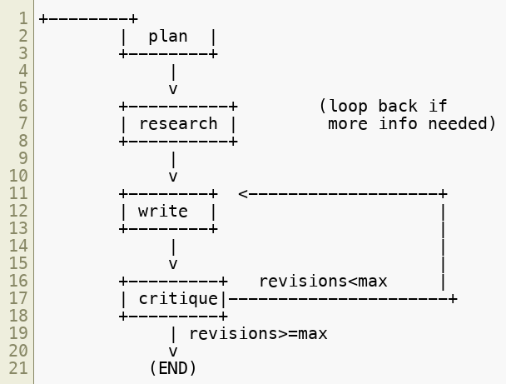
A State Graph, Drawn
The cycle write -> critique -> write is exactly what a hand loop hides in an if.
Copyright © 2026 by Elephant Scale, All Rights Reserved

Slide 6
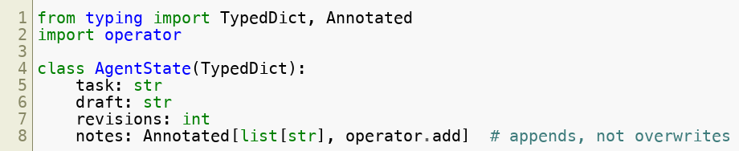
State: Typed, Shared, Reduced
State is a TypedDict (or Pydantic / dataclass)
Every node gets State, returns a partial update
Reducers say how updates merge
Without a reducer a field is replaced. With operator.add, lists accumulate.
Copyright © 2026 by Elephant Scale, All Rights Reserved

Slide 7
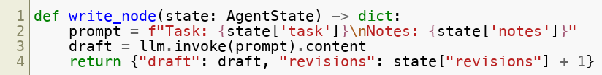

Nodes Are Just Functions
Input: the current State
Output: a partial State update (a dict)
No hidden globals — the graph passes State in
A node returns only what it changed. The runtime merges it into State.
Copyright © 2026 by Elephant Scale, All Rights Reserved

Slide 8
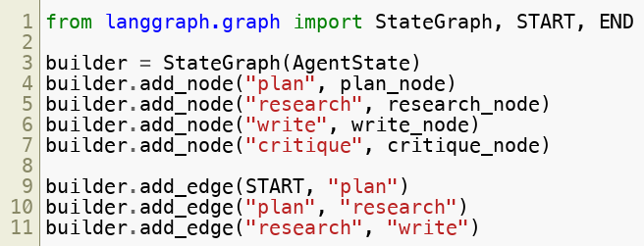
Building The Graph
Register nodes, then wire edges
START and END are the entry / exit sentinels
Static edges are the parts of the flow that never change.
Copyright © 2026 by Elephant Scale, All Rights Reserved

Slide 9
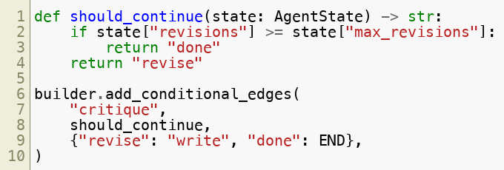
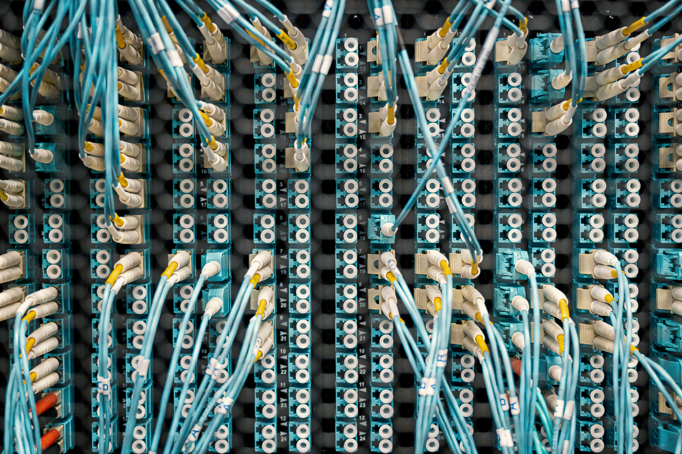
Conditional Edges = Routing
A router function reads State, returns the next node name
This is your if — but declared, inspectable, replayable
The router returns a label; the mapping turns the label into the next node.
Copyright © 2026 by Elephant Scale, All Rights Reserved

Slide 10
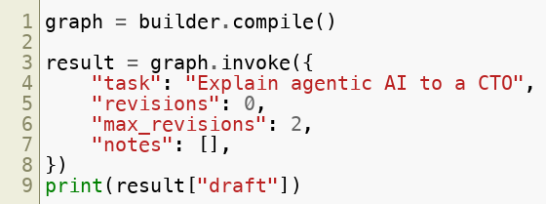
Compile And Run
compile() turns the builder into a runnable
invoke() runs to completion; input is the initial State
One object you can invoke, stream, checkpoint, and visualize.
Copyright © 2026 by Elephant Scale, All Rights Reserved

Slide 11
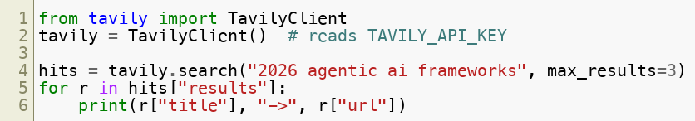
Agentic Search With Tavily
LLMs are frozen at training time — they need eyes on the web
Tavily is a search API built for agents:
  returns clean, ranked, LLM-ready snippets
  not ten blue links to scrape
Retrieval is a tool. Treat what it returns as untrusted data, not instructions.
Copyright © 2026 by Elephant Scale, All Rights Reserved

Slide 12
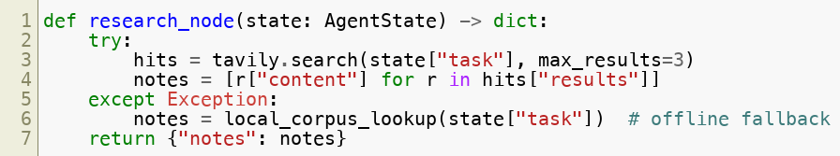
Research As A Node
Search lives inside a node, feeding State
Failures degrade gracefully — never crash the graph
Every external call needs a fallback. Lab 9 ships a local corpus for exactly this.
Copyright © 2026 by Elephant Scale, All Rights Reserved

Slide 13
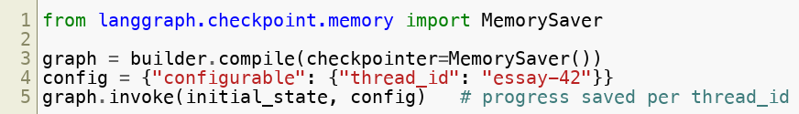
Persistence & Checkpointing
A checkpointer saves State after every node
Resume, time-travel, and human-in-the-loop all build on it
MemorySaver for dev; SQLite / Postgres for production
The thread_id is the conversation. Same id later = pick up where you left off.
Copyright © 2026 by Elephant Scale, All Rights Reserved

Slide 14


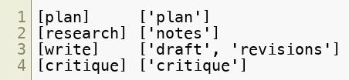
Streaming
Don't wait for the whole run — watch it happen
stream() yields after each node
Streaming is how a demo feels alive — and how you debug a stuck run.
Copyright © 2026 by Elephant Scale, All Rights Reserved

Slide 15
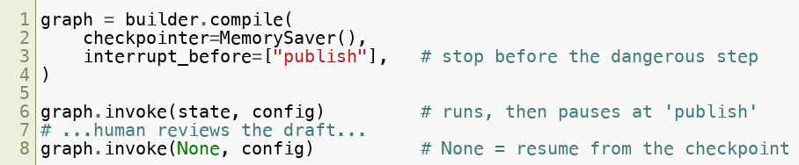
Human-In-The-Loop
Compile with an interrupt before a sensitive node
The graph pauses; a human inspects State; you resume
Interrupt + checkpoint = the approval gate from our safety checklist, built in.
Copyright © 2026 by Elephant Scale, All Rights Reserved

Slide 16
The Whole Pattern, In One Breath
State carries the work
Nodes transform it
Edges move between nodes
Conditional edges decide the path
Checkpointer remembers
Interrupt asks a human
Learn these six and every LangGraph agent reads the same way.
Copyright © 2026 by Elephant Scale, All Rights Reserved

Slide 17
When To Reach For LangGraph
Reach for it when you need:
  genuine cycles (reflect / revise loops)
  durable state across sessions
  human approval mid-run
  observability and replay
Skip it when a single straight-line call will do
Don't graph a one-shot prompt. Do graph an agent that loops and pauses.
Copyright © 2026 by Elephant Scale, All Rights Reserved

Slide 18
Lab 9 — Essay Writer Agent (LangGraph)
Stop here and run Lab 9.
You will:
Build a typed AgentState with a reducer.
Wire nodes: plan -> research (Tavily + local fallback) -> write -> critique.
Add a conditional edge that loops write <-> critique up to N times.
Compile with a MemorySaver checkpointer.
Stream the run and read State after each node.
Deliverable: a runnable LangGraph essay writer, a streamed transcript, and the final revised essay.
Time: 75 minutes
Copyright © 2026 by Elephant Scale, All Rights Reserved

