Slide 1
Vault Configuration
How does Vault encrypt data?
Static secrets
Dynamic secrets
Secret management
Copyright © 2025 by Elephant Scale, All Rights Reserved

Slide 2
How does Vault encrypt data?
How does Vault encrypt data?
Static secrets
Dynamic secrets
Secret management
Copyright © 2025 by Elephant Scale, All Rights Reserved

Slide 3

How does Vault encrypt data?
Vault encrypts data by leveraging a few key sources.
  The libraries that Vault uses, or the cryptography modules
  Golang's crypto and
  x/crypto libraries that are part of the golang language.
Copyright © 2025 by Elephant Scale, All Rights Reserved

Slide 4
Vault cryptography libraries
Kerckhoffs's principle
  A cryptosystem should be secure even if everything about the system, except the key, is public knowledge
  No security-by-obscurity
Shannon's maxim
  The enemy knows the system
HashiCorp principle
  the source code for how you encrypt and decrypt data should be open source
Copyright © 2025 by Elephant Scale, All Rights Reserved
Notes:
This is very important and it's part of our open-source story because we at HashiCorp abide by something called Kerckhoffs's principle. Kerckhoffs's principle is a principle that comes from a 19th-century military cryptologist who stated that basically there is no security in obscurity. If you have a very secure system that everything that talks about how that system protects itself should be visible.
We translate that into modern times to mean that the source code for how you encrypt and decrypt data should be open source, and that's why HashiCorp's Vault source code for how it—Vault—handles encryption is all composed in its open-source binary. You can go into GitHub and take a look at it now, for example.

Slide 5
Cryptography at HashiCorp
Leverage those Golang crypto and x/crypto libraries
  for heavy lifting associated with encrypting and decrypting data
Those libraries contain the methods and functions
  implementations of various algorithms like AES256
  for internally encrypting data and decrypting data
  allowing you to leverage cryptography without
Copyright © 2025 by Elephant Scale, All Rights Reserved
Notes:
So we leverage those Golang crypto and x/crypto libraries to handle the heavy lifting associated with encrypting and decrypting data. Those libraries contain the methods and functions that are the implementations of various algorithms like AES256 that are used within Vault, for either internally encrypting data and decrypting data or fo—as part of our transit backend—allowing you to leverage cryptography without having to deploy your own cryptographic infrastructure.

Slide 6
Vault key management
How does Vault manage keys that are associated with these cryptographic functions?
Vault handles this all through its own internal keyring
  open source
  not require a user to integrate into something like an HSM (Hardware security module) unless they want to.
Copyright © 2025 by Elephant Scale, All Rights Reserved
Notes:
There's also this element of key management, how does Vault manage keys that are associated with these cryptographic functions? Vault handles this all through its own internal keyring, which is again also in open source, and allows Vault to not have to require a user to integrate into something like an HSM (Hardware security module) unless they want to.

Slide 7
Entropy and Cybersecurity
Entropy is the foundation upon which all cryptographic functions operate.
  It is a measure of the randomness or diversity of a data-generating function.
  Data with full entropy is completely random and no meaningful patterns can be found.
  Low entropy data provides the ability or possibility to predict forthcoming generated values
Copyright © 2025 by Elephant Scale, All Rights Reserved
Notes:
Entropy is the foundation upon which all cryptographic functions operate. Entropy, in cyber security, is a measure of the randomness or diversity of a data-generating function. Data with full entropy is completely random and no meaningful patterns can be found. Low entropy data provides the ability or possibility to predict forthcoming generated values. One measure of the quality of cryptographic functions is to measure the entropy of their output. Highly entropic algorithms are needed for encryption and hash functions.

Slide 8
Vault cryptography integrations
Two key things that we need to focus on
  entropy
  links to other cryptographic standards or follows cryptographic standards
Copyright © 2025 by Elephant Scale, All Rights Reserved
Notes:
When we talk about encryption, there are two key things that we need to focus on. The first is entropy and the second is how that encryption algorithm links to other cryptographic standards or follows cryptographic standards.

Slide 9
Entropy in Vault
The entropy of Vault's encryption varies depending upon what system Vault is being run on
  Golang's crypto and x/crypto libraries use a randomized function that calls different entropy pools
    Entropy pool for Windows
    Entropy pool for Linux
Copyright © 2025 by Elephant Scale, All Rights Reserved
Notes:
We talk about entropy with Vault. The entropy of Vault's encryption varies depending upon what system Vault is being run on. So with Golang's crypto and x/crypto libraries, they use a randomized function that calls different entropy pools depending on which operating system you're deploying that on. For example, Windows uses a different type of entropy pool than the entropy pool used by Linux.

Slide 10
Is your entropy sufficient?
What is sufficient entropy for Vault?
  In many ways, those random number generators are sufficiently random
  For some Vault Enterprise customers
    Seal Wrap
Copyright © 2025 by Elephant Scale, All Rights Reserved
Notes:
One question that you need to really ask yourselves is, "What is sufficient entropy for Vault?" In many ways, those random number generators are sufficiently random. However, especially with Vault Enterprise customers, there are times where we run into questions about, "Is that entropy sufficiently random? Is the method that's used to randomly derive the numbers—used for either salts or otherwise numbers used only once or nonces to protect certain cryptographic components that are protected by Vault—sufficiently random for my threat model?" And if it's not, this is where a Vault Enterprise feature called Seal Wrap comes into play.

Slide 11
Seal Wrap
Seal Wrap allows to leverage external cryptographic modules
  Similar to HSM (Hardware Security Module)
  protect and wrap the cryptographic infrastructure of Vault
  operate within very rigorous cryptographic environments in a way that doesn't violate
    their story around entropy,
    their story around key rotation,
    key management, etc.
Copyright © 2025 by Elephant Scale, All Rights Reserved
Notes:
Seal Wrap allows us to leverage external cryptographic modules, such as those that are contained within your HSM, to protect and wrap the cryptographic infrastructure of Vault in such a way that we can allow Vault to operate within very rigorous cryptographic environments in a way that doesn't violate their story around entropy, their story around key rotation, key management, etc.

Slide 12
US standard of FIPS 140-2
FIPS 140-2 level one, two, and three environments
with Seal Wrap, Vault can
  Be wrapped with another layer of cryptography
  from a separate, very secure source such as an HSM
Copyright © 2025 by Elephant Scale, All Rights Reserved
Notes:
For example, the US standard of FIPS 140-2 has different levels that refer to how secure an implementation of cryptography is. Well, with Seal Wrap, Vault can allow its data that's being used and stored within cryptographic reservoirs within Vault—so its keyring, the methods that it uses to encrypt data, etc.—all that can be wrapped with another layer of cryptography that comes from a separate, very secure source such as an HSM. And in that kind of model, those HSMs can be configured to run at a very high level of a FIPS level. Thus allowing Vault to non-disruptively operate in FIPS 140-2 level one, two, and three environments.

Slide 13
Static secrets
How does Vault encrypt data?
Static secrets
Dynamic secrets
Secret management
Copyright © 2025 by Elephant Scale, All Rights Reserved

Slide 14
Key/Value Secrets Engine
Vault can be used to store any secret in a secure manner.
The secrets may be
  SSL certificates and keys for your organization's domain
  credentials to connect to a corporate database server, etc.
Storing such sensitive information in plaintext is not desirable.
Copyright © 2025 by Elephant Scale, All Rights Reserved

Slide 15
Static secret scenario
Personas
  devops with privileged permissions to write secrets
  apps reads the secrets from Vault
Challenge
  Developers use a single admin account to access a third-party app (e.g. Splunk)
  and anyone who knows the user ID and password can log in as an admin
  SSH keys to connect to remote machines are shared and stored as a plaintext
  An app integrates with LDAP, and its configuration information is in a plaintext
Copyright © 2025 by Elephant Scale, All Rights Reserved
Notes:
Organizations often seek an uniform workflow to securely store this sensitive information.

Slide 16
Solution
Use Vault
  centralized secret storage
  Secure any sensitive information
Vault encrypts these secrets using 256-bit AES in GCM mode
  with a randomly generated nonce prior to writing them to its persistent storage.
  The storage backend never sees the unencrypted value
  even if an attacker gained access to the raw storage, they wouldn't be able to read your secrets.
Copyright © 2025 by Elephant Scale, All Rights Reserved
Notes:
The Advanced Encryption Standard (AES), also known by its original name Rijndael (Dutch pronunciation: [ˈrɛindaːl]),[3] is a specification for the encryption of electronic data established by the U.S. National Institute of Standards and Technology (NIST) in 2001.[4]
AES is a subset of the Rijndael block cipher[3] developed by two Belgian cryptographers, Vincent Rijmen and Joan Daemen
In cryptography, Galois/Counter Mode (GCM) is a mode of operation for symmetric-key cryptographic block ciphers which is widely adopted for its performance. GCM throughput rates for state-of-the-art, high-speed communication channels can be achieved with inexpensive hardware resources
Considered secure but costly in hardware

Slide 17
Lab: Static Secret
Continue with lab21
NOTE: For the purpose of this lab, we will use the root token to work with Vault.
Best practice
  root tokens are only used for just enough initial setup or in emergencies.
  As a best practice, use tokens with appropriate set of policies based on your role in the organization.
https://github.com/elephantscale/vault-consul-labs-answers/tree/main/lab21
Copyright © 2025 by Elephant Scale, All Rights Reserved

Slide 18
Dynamic secrets
How does Vault encrypt data?
Static secrets
Dynamic secrets
Secret management
Copyright © 2025 by Elephant Scale, All Rights Reserved

Slide 19
Dynamic Secrets: Database Secrets Engine
Challenge
  Data protection is a top priority, and database credential rotation is a critical part of any data protection initiative. Each role has a different set of permissions granted to access the database. When a system is attacked by hackers, continuous credential rotation becomes necessary and needs to be automated.
Solution
  Applications ask Vault for database credentials rather than setting them as environment variables. The administrator specifies the TTL of the database credentials to enforce its validity so that they are automatically revoked when they are no longer used.
Copyright © 2025 by Elephant Scale, All Rights Reserved

Slide 20
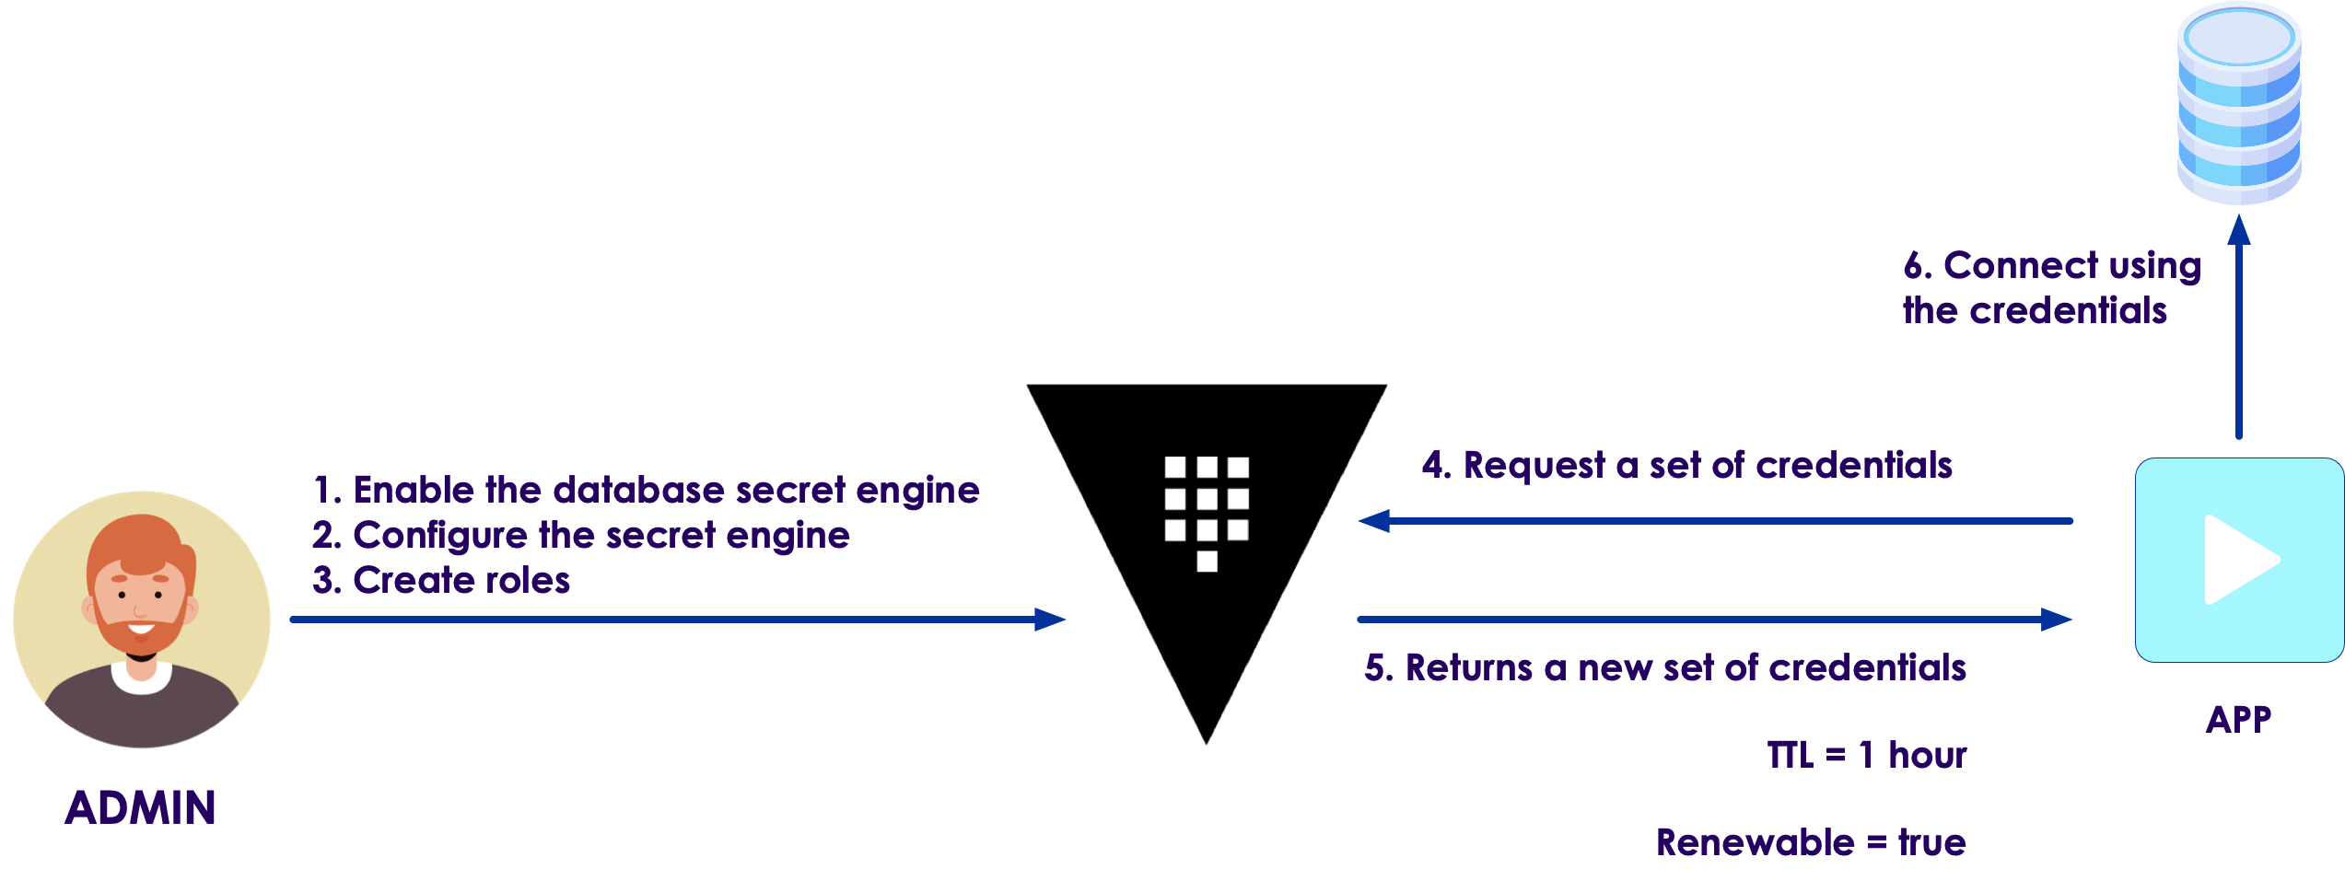
Dynamic secrets
Copyright © 2025 by Elephant Scale, All Rights Reserved
Notes:
Each app instance can get unique credentials that they don't have to share. By making those credentials short-lived, you reduce the chance that they might be compromised. If an app was compromised, the credentials used by the app can be revoked rather than changing more global sets of credentials.
Personas
The end-to-end scenario described in this lab involves two personas:
admin with privileged permissions to configure secrets engines
apps read the secrets from Vault

Slide 21

Start Postgres
The lab requires a Postgres database. Docker provides a Postgres server image that satisfies this requirement.
  NOTE : This lab works for an existing Postgres database given appropriate credentials and connection information.
  Pull a Postgres server image with docker .
Copyright © 2025 by Elephant Scale, All Rights Reserved

Slide 22
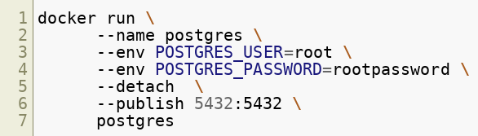
Create a user
Create a Postgres database with a root user named root with the password rootpassword.
Copyright © 2025 by Elephant Scale, All Rights Reserved
Notes:
The database is available.

Slide 23


Talk to DB
The credentials generated by the Vault role in the "create a role" step requires a role named ro that has been granted the ability to read all tables.
Connect to the Postgres database via the CLI within the postgres container.
Create a role named ro.
Grant the ability to read all tables to the role named ro
Copyright © 2025 by Elephant Scale, All Rights Reserved
Notes:
The role is created and assigned the appropriate permissions.
Disconnect from the Postgres database.

Slide 24
Start Vault
In another terminal, start a Vault dev server with root as the root token.
Copyright © 2025 by Elephant Scale, All Rights Reserved
Notes:
The Vault dev server defaults to running at 127.0.0.1:8200. The server is initialized and unsealed.
Insecure operation : Do not run a Vault dev server in production. This approach starts a Vault server with an in-memory database and runs in an insecure way.

Slide 25

Export environment variables
Export an environment variable for the vault CLI to authenticate with the Vault server.
Copyright © 2025 by Elephant Scale, All Rights Reserved
Notes:
NOTE : For these tasks, you can use Vault's root token. However, it is recommended that root tokens are only used for enough initial setup or in emergencies. As a best practice, use an authentication method or token that meets the policy requirements.
The Vault server is ready.

Slide 26
Scenario
In this lab, you are going to configure the PostgreSQL secrets engine, and create a read-only database role. The Vault-generated PostgreSQL credentials will only have read permission.
  Enable the database secrets engine
  Configure PostgreSQL secrets engine
  Create a role
  Request PostgreSQL credentials
  Manage leases
  Define a password policy
  Define a username template
Copyright © 2025 by Elephant Scale, All Rights Reserved

Slide 27

Enable the database secrets engine
Enable the database secrets engine at the database/ path.
Copyright © 2025 by Elephant Scale, All Rights Reserved

Slide 28
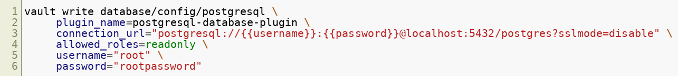
Configure PostgreSQL secrets engine
(Persona: admin)
The database secrets engine supports many databases through a plugin interface. To use a Postgres database with the secrets engine requires further configuration with the postgresql-database-plugin plugin and connection information.
Configure the database secrets engine with the connection credentials for the Postgres database.
Copyright © 2025 by Elephant Scale, All Rights Reserved

Slide 29
Create a role
(Persona: admin)
In configure Postgresql secrets engine step, you configured the PostgreSQL secrets engine with the allowed role named readonly. A role is a logical name within Vault that maps to database credentials. These credentials are expressed as SQL statements and assigned to the Vault role.
Define the SQL used to create credentials.
Copyright © 2025 by Elephant Scale, All Rights Reserved
Notes:
The SQL contains the templatized fields {{name}}, {{password}}, and {{expiration}}. These values are provided by Vault when the credentials are created. This creates a new role and then grants that role the permissions defined in the Postgres role named ro. This Postgres role was created when Postgres was started.

Slide 30
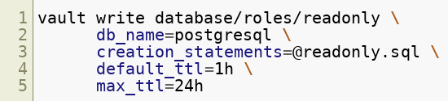
Create the role named readonly
Copyright © 2025 by Elephant Scale, All Rights Reserved
Notes:
The role generates database credentials with a default TTL of 1 hour and max TTL of 24 hours.

Slide 31
Request PostgreSQL credentials
(Persona: apps)
The applications that require the database credentials read them from the secret engine's readonly role.
Read credentials from the readonly database role.
Copyright © 2025 by Elephant Scale, All Rights Reserved

Slide 32
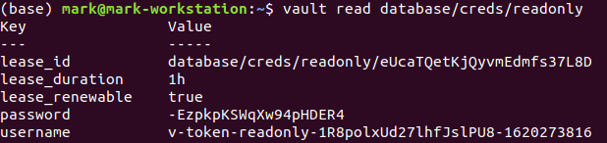
Result
You will get something like this
Copyright © 2025 by Elephant Scale, All Rights Reserved
Notes:
The Postgres credentials are displayed as username and password. The credentials are identified within Vault by the lease_id.

Slide 33
Validation
Connect to the Postgres database via the CLI within the postgres container.
Your system prompt is replaced with a new prompt root=#. Commands issued at this prompt are executed against the Postgres database running within the container.
List all the database users.
Copyright © 2025 by Elephant Scale, All Rights Reserved

Slide 34
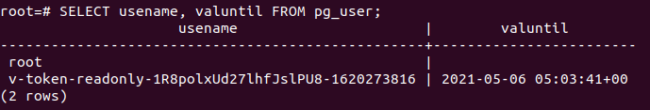
Users
You will see this kind of output
Copyright © 2025 by Elephant Scale, All Rights Reserved
Notes:
The output displays a table of all the database credentials generated. The credentials that were recently generated appear in this list.
Disconnect from the Postgres database.

Slide 35
Manage leases
(Persona: admin)
The credentials are managed by the lease ID and remain valid for the lease duration (TTL) or until revoked. Once revoked the credentials are no longer valid.
List the existing leases.
Copyright © 2025 by Elephant Scale, All Rights Reserved

Slide 36
Leases
All valid leases for database credentials are displayed.
Create a variable that stores the first lease ID.
Copyright © 2025 by Elephant Scale, All Rights Reserved

Slide 37

Lease renew
Renew the lease for the database credential by passing its lease ID.
Copyright © 2025 by Elephant Scale, All Rights Reserved
Notes:
Note that the TTL of the renewed lease is set to 1h.

Slide 38
Revoke
Revoke the lease without waiting for its expiration.
Observe success status
Copyright © 2025 by Elephant Scale, All Rights Reserved

Slide 39
List leases
List the existing leases.
The lease is no longer valid and is not displayed.
Copyright © 2025 by Elephant Scale, All Rights Reserved

Slide 40
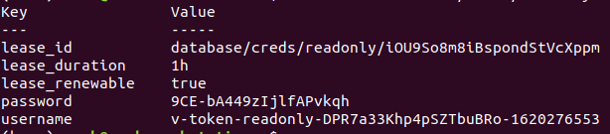
Read new creds
Read new credentials from the readonly database role.
All leases associated with a path may be removed.
Copyright © 2025 by Elephant Scale, All Rights Reserved

Slide 41
Revoke
Revoke all the leases with the prefix database/creds/readonly.
Copyright © 2025 by Elephant Scale, All Rights Reserved
Notes:
The prefix flag matches all valid leases with the path prefix of database/creds/readonly.
List the existing leases.
All the leases with this path as a prefix have been revoked.

Slide 42
Define a password policy
The database secret engines generate passwords that adhere to a default pattern that may be overridden with a new password policy. A policy defines the rules and requirements that the password must adhere to and can provide that password directly through a new endpoint or within secrets engines.
The passwords you want to generate adhere to these requirements.
  length of 20 characters
  at least 1 uppercase character
  at least 1 lowercase character
  at least 1 number
  at least 1 symbol
Copyright © 2025 by Elephant Scale, All Rights Reserved

Slide 43
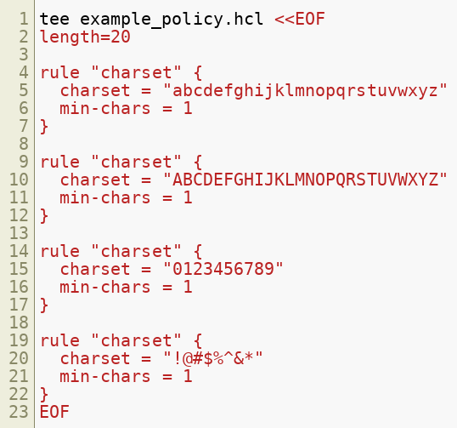
Password policy
Define this password policy in a file named example_policy.hcl.
Copyright © 2025 by Elephant Scale, All Rights Reserved
Notes:
The policy is written in HashiCorp Configuration Language (HCL). The length field sets the length of the password returned to 20 characters. Each rule stanza defines a character set and the minimum number of occurrences those characters need to appear in the generated password. These rules are cumulative so each one adds more requirements on the password generated.

Slide 44
Create policy
Create a Vault password policy named example with the password policy rules defined in example_policy.hcl.
Copyright © 2025 by Elephant Scale, All Rights Reserved
Notes:
This policy can now be accessed directly to generate a password or referenced by its name example when configuring supported secrets engines.

Slide 45

Generate
Generate a password from the example password policy.
Copyright © 2025 by Elephant Scale, All Rights Reserved
Notes:
The password generated adheres to the defined requirements.

Slide 46

Apply the password policy
Configure the database secrets engine with the example password policy.
Copyright © 2025 by Elephant Scale, All Rights Reserved
Notes:
The same connection information is used to establish the connection with the database server. The difference is that the password_policy has been set to the example policy.

Slide 47
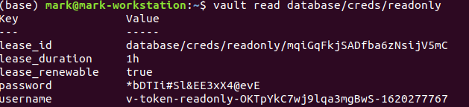
Read creds
Read credentials from the readonly database role.
You will get similar output
Copyright © 2025 by Elephant Scale, All Rights Reserved
Notes:
The credentials display the username and password generated. The password generated adheres to the example password policy defined in the secrets engine's configuration.

Slide 48
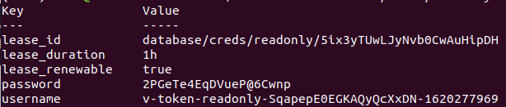
Define a username template
The database secret engines generate usernames that adhere to a default pattern. A customized username template may be provided to meet the needs of your organization.
  Ensure that custom username templates include enough randomness to prevent the same username being generated multiple times.
Read credentials from the readonly database role.
Copyright © 2025 by Elephant Scale, All Rights Reserved
Notes:
The generated username, v-token-readonly-SqapepE0EGKAQyQcXxDN-1620277969, uses the default pattern expressed as a Go template, {{ printf "v-%s-%s-%s-%s" (.DisplayName | truncate 8) (.RoleName | truncate 8) (random 20) (unix_time) | truncate 63 }}.

Slide 49
Configure
Configure the database secrets engine with the username template.
Copyright © 2025 by Elephant Scale, All Rights Reserved
Notes:
This username template is prefixed with myorg-, uses the name of role, readonly, the unix timestamp in seconds, and a random sequence of 8 characters.

Slide 50
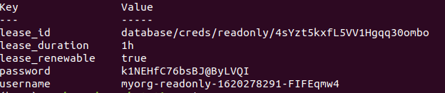
Read creds
Read credentials from the readonly database role.
Copyright © 2025 by Elephant Scale, All Rights Reserved
Notes:
The username generated adheres to the template provided to the configuration.

Slide 51
Secret management
How does Vault encrypt data?
Static secrets
Dynamic secrets
Secret management
Copyright © 2025 by Elephant Scale, All Rights Reserved

Slide 52
Secrets engines
Static Secrets: Key/Value Secrets Engine
Versioned Key/Value Secrets Engine
Cubbyhole Response Wrapping
Dynamic Secrets: Database Secrets Engine
Couchbase Secrets Engine
Database Secrets Engine with MongoDB
Copyright © 2025 by Elephant Scale, All Rights Reserved

Slide 53
Secrets engines cont'd
Database Root Credential Rotation
Database Static Roles and Credential Rotation
Active Directory Service Account Check-out
OpenLDAP Secrets Engine
Azure Secrets Engine
A dozen more secret engines
Copyright © 2025 by Elephant Scale, All Rights Reserved

Slide 54
Versioned Key/Value Secrets Engine
The Static Secrets lab introduced the basics of working with key-value secrets engine.
Vault 0.10 introduced K/V Secrets Engine v2 with Secret Versioning.
Let us look at the key-value secrets engine v2 features.
Copyright © 2025 by Elephant Scale, All Rights Reserved

Slide 55
Versioned Key/Value scenario
The KV secrets engine v1 does not provide a way to version or roll back secrets
This made it difficult to recover from
  unintentional data loss or
  overwrite when more than one user is writing at the same path.
Copyright © 2025 by Elephant Scale, All Rights Reserved

Slide 56
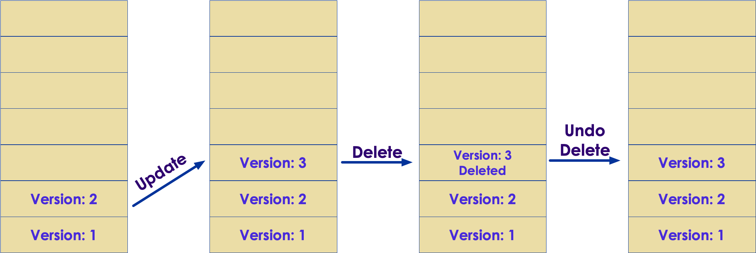
Versioned Key/Value solution
Copyright © 2025 by Elephant Scale, All Rights Reserved
Notes:
Run the version 2 of KV secrets engine which can retain a configurable number of secret versions. This enables older versions' data to be retrievable in case of unwanted deletion or updates of the data. In addition, its Check-and-Set operations can be used to protect the data from being overwritten unintentionally.

Slide 57
Versioned Key/Value solution
Run the version 2 of KV secrets engine
  it can retain a configurable number of secret versions.
  This enables older versions' data to be retrievable in case of unwanted deletion or updates of the data. In addition,
  its Check-and-Set operations can be used to protect the data from being overwritten unintentionally.
Copyright © 2025 by Elephant Scale, All Rights Reserved

Slide 58
Cubbyhole Secret Engine
The term
  cubbyhole comes from an Americanism where you get a "locker" or "safe place" to store your belongings or valuables.
  It is not possible to reach into another token's cubbyhole even as the root user
  By contrast, the secrets in the key/value secrets engine are accessible to any token
Copyright © 2025 by Elephant Scale, All Rights Reserved
Notes:
The term cubbyhole comes from an Americanism where you get a "locker" or "safe place" to store your belongings or valuables. In Vault, the cubbyhole is your "locker". All secrets are namespaced under your token. If that token expires or is revoked, all the secrets in its cubbyhole are revoked as well.
It is not possible to reach into another token's cubbyhole even as the root user. This is an important difference between the cubbyhole and the key/value secrets engine. The secrets in the key/value secrets engine are accessible to any token for as long as its policy allows it.

Slide 59
Cubbyhole Scenario
Personas
  The end-to-end scenario described in this tutorial involves two personas:
    admin with privileged permissions to create tokens
    apps trusted entity retrieving secrets from Vault
Challenge
  In order to tightly manage the secrets, you set the scope of who can do what using the Vault policy and attach that to tokens, roles, entities, etc.
  How can you securely distribute the initial token to the trusted entity?
Copyright © 2025 by Elephant Scale, All Rights Reserved
Notes:
Personas
The end-to-end scenario described in this tutorial involves two personas:
admin with privileged permissions to create tokens
apps trusted entity retrieving secrets from Vault
Challenge
In order to tightly manage the secrets, you set the scope of who can do what using the Vault policy and attach that to tokens, roles, entities, etc.
Think of a case where you have a trusted entity (Chef, Jenkins, etc.) which reads secrets from Vault. This trusted entity must obtain a token. If the trusted entity or its host machine was rebooted, it must re-authenticate with Vault using a valid token.
How can you securely distribute the initial token to the trusted entity?

Slide 60
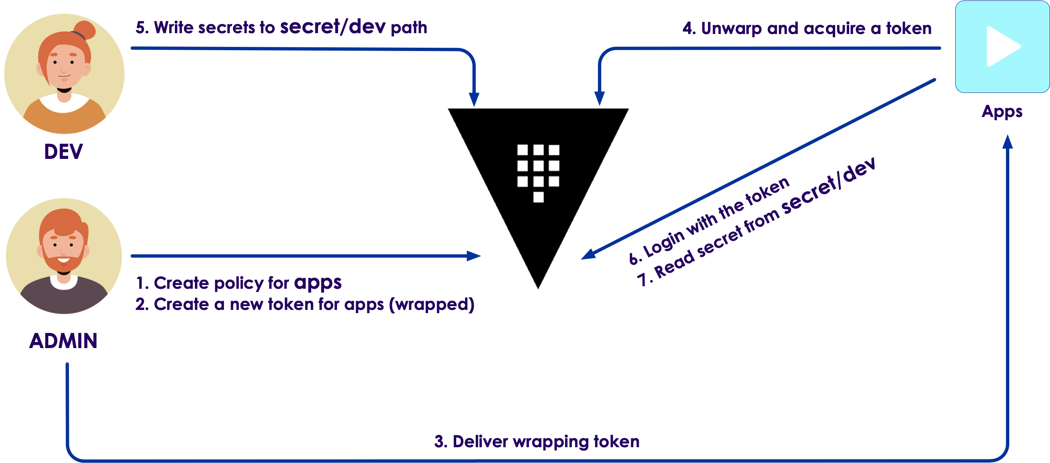
Cubbyhole solution
Copyright © 2025 by Elephant Scale, All Rights Reserved

Slide 61
Cubbyhole solution
the initial token is stored in the cubbyhole secrets engine.
The wrapped secret can be unwrapped using the single-use wrapping token.
Even the user or the system created the initial token won't see the original value.
The wrapping token is short-lived and can be revoked just like any other tokens so that the risk of unauthorized access can be minimized.
Copyright © 2025 by Elephant Scale, All Rights Reserved
Notes:
Use Vault's cubbyhole response wrapping where the initial token is stored in the cubbyhole secrets engine. The wrapped secret can be unwrapped using the single-use wrapping token. Even the user or the system created the initial token won't see the original value. The wrapping token is short-lived and can be revoked just like any other tokens so that the risk of unauthorized access can be minimized.
What is cubbyhole response wrapping?
When response wrapping is requested, Vault creates a temporary single-use token (wrapping token) and insert the response into the token's cubbyhole with a short TTL Only the expecting client who has the wrapping token can unwrap this secret Any Vault response can be distributed using the response wrapping Benefits of using the response wrapping:
It provides cover by ensuring that the value being transmitted across the wire is not the actual secret. It's a reference to the secret. It provides malfeasance detection by ensuring that only a single party can ever unwrap the token and see what's inside It limits the lifetime of the secret exposure The TTL of the response-wrapping token is separate from the wrapped secret's lease TTL

Slide 62
Couchbase Secrets Engine
Vault provides powerful dynamic credential lifecycle management for a wide range of database solutions.
Let's look at the use of the database secrets engine to dynamically generate credentials for Couchbase Server database users.
Copyright © 2025 by Elephant Scale, All Rights Reserved

Slide 63
Couchbase challenge
Credential management is critical for secrets hygiene, but managing the lifecycle of credentials across numerous heterogeneous platforms such as database solutions can be cumbersome and time-consuming.
An application requires credentials to access a specific database platform, but those credentials should never be hard coded into the application or allowed to persist past their useful lifetime.
Copyright © 2025 by Elephant Scale, All Rights Reserved

Slide 64
Couchbase solution
Vault provides a databases secrets engine with support for credential lifecycle management across a range of database solutions.
Administrators can define credential attributes, such as attached policies and time to live values, such that the credential provides least privileged access for only the allowed time-frame and is revoked when no longer needed.
Copyright © 2025 by Elephant Scale, All Rights Reserved
Notes:
Personas
The end-to-end scenario described in this tutorial involves 3 personas:
couchbase admin manages Couchbase Server and by Vault for managing Couchbase Server user credentials.
vault admin has privileged capabilities to configure Vault secrets engines.
user needs credentials from Vault that allow access to Couchbase Server documents.

Slide 65
Database Secrets Engine with MongoDB
Data protection is a top priority
  and database credential rotation is a critical part of any data protection initiative.
Vault's database secrets engine generates database credentials dynamically
Each app instance can get unique credentials
Copyright © 2025 by Elephant Scale, All Rights Reserved
Notes:
Data protection is a top priority, and database credential rotation is a critical part of any data protection initiative. When a system is attacked by hackers, continuous credential rotation becomes necessary and needs to be automated.
Vault's database secrets engine generates database credentials dynamically based on user-defined roles. The database administrator can pre-define the time-to-live (TTL) of the database credentials to enforce its validity so that they are automatically revoked when they are expired.
Each app instance can get unique credentials that they don't have to share. By making those credentials short-lived, you reduce the chance that they might be compromised. If an app was compromised, the credentials used by the app can be revoked rather than changing more global sets of credentials.

Slide 66
Database Root Credential Rotation
Vault's database secrets engine gives every service instance gets a unique set of database credentials
This reduces the manual tasks performed by the database administrator and makes the database access more efficient and secure.
Copyright © 2025 by Elephant Scale, All Rights Reserved
Notes:
Vault's database secrets engine provides a centralized workflow for managing credentials for various database systems. By leveraging this, every service instance gets a unique set of database credentials instead of sharing one. Having those credentials tied directly to each service instance and live only for the life of the service, any abnormal access pattern can be mapped to a specific service instance and its credential can be revoked immediately.
This reduces the manual tasks performed by the database administrator and makes the database access more efficient and secure.

Slide 67
Database Root Credential Rotation - challenge
Vault is managing the database credentials on behalf of the database administrator
  it must also be given a set of highly privileged credentials
Credentials are often long-lived and never change once configured on Vault
Copyright © 2025 by Elephant Scale, All Rights Reserved
Notes:
Because Vault is managing the database credentials on behalf of the database administrator, it must also be given a set of highly privileged credentials which can grant and revoke access to the database system. Therefore, it is very common to give Vault your root credentials.
However, these credentials are often long-lived and never change once configured on Vault. This may violate the Governance, Risk and Compliance (GRC) policies surrounding that data stored in the database.

Slide 68
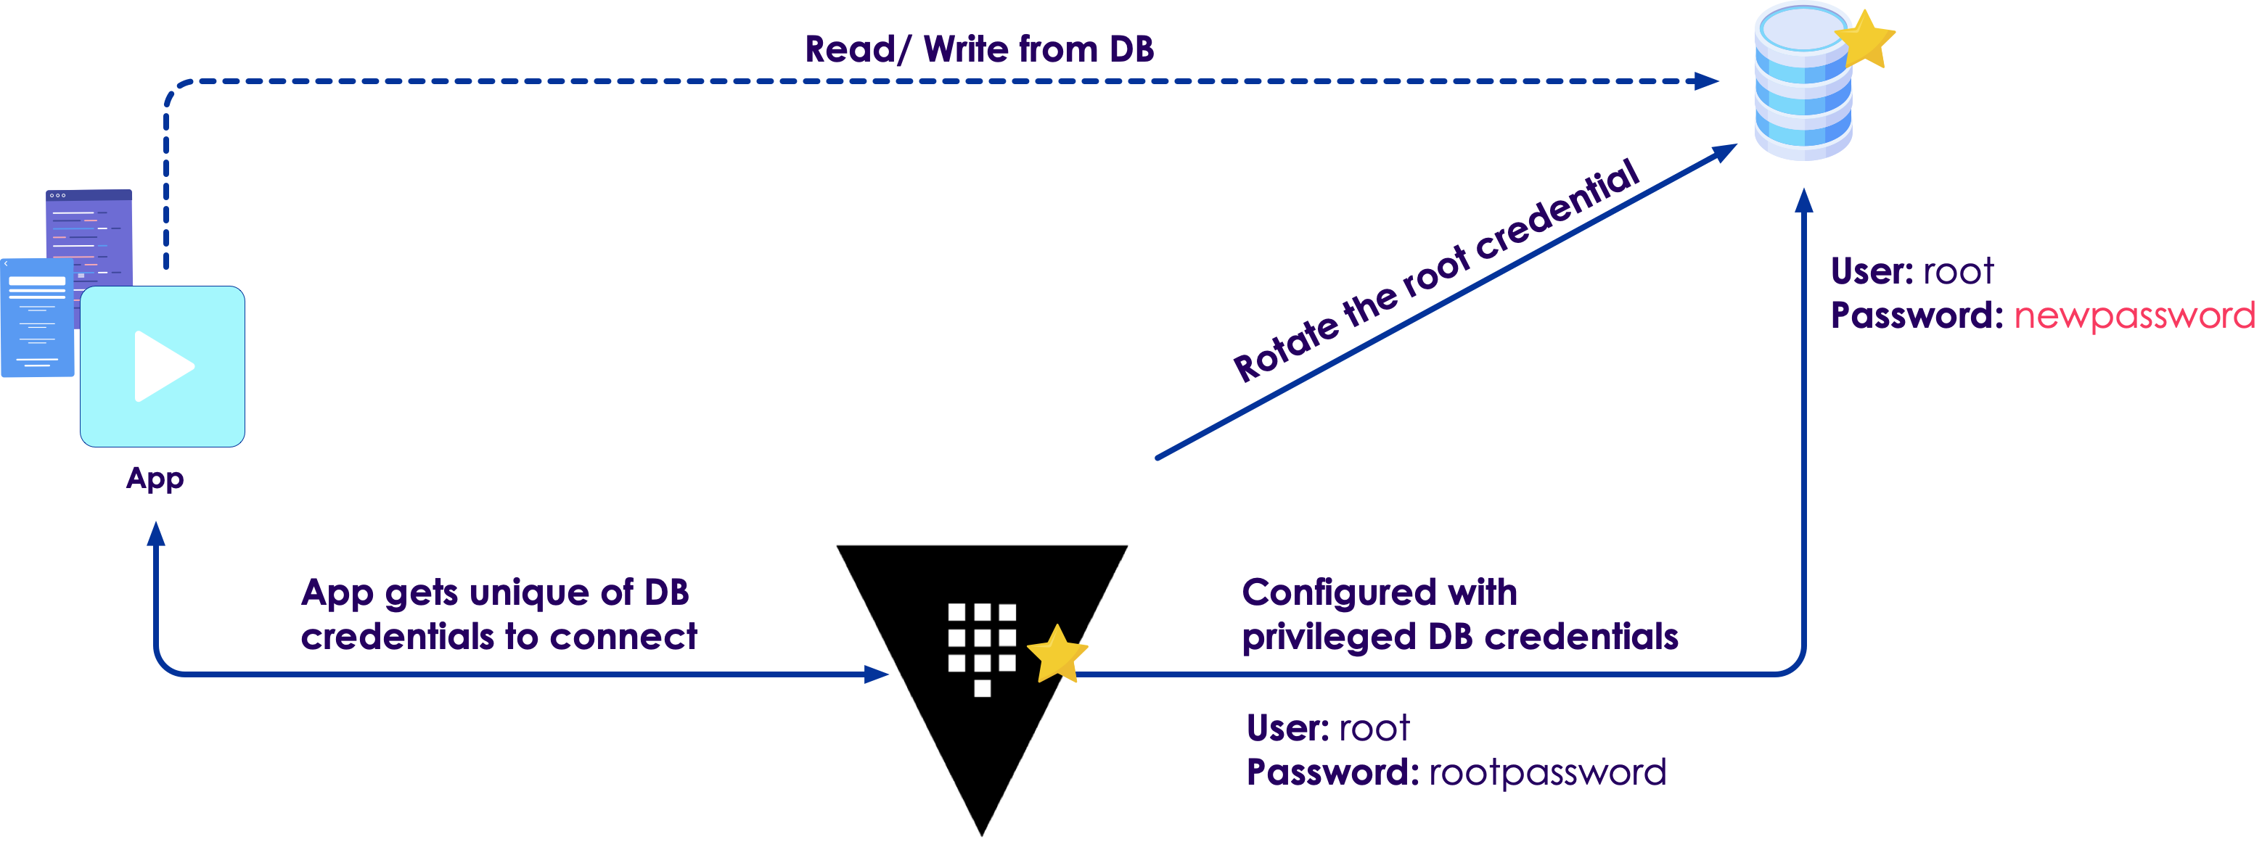
Database Root Credential Rotation - solution
Copyright © 2025 by Elephant Scale, All Rights Reserved

Slide 69
Database Root Credential Rotation - solution
Use the Vault's /database/rotate-root/:name API endpoint to rotate the root credentials stored for the database connection.
Best Practice : Use this feature to rotate the root credentials immediately after the initial configuration of each database.
Copyright © 2025 by Elephant Scale, All Rights Reserved

Slide 70
Database Static Roles and Credential Rotation
Vault creates a unique set of username and password with specified time-to-live (TTL) every time a client requests.
This allows each application to have its own database credentials.
Adopting the database secrets engine requires some code change in those applications.
Copyright © 2025 by Elephant Scale, All Rights Reserved

Slide 71
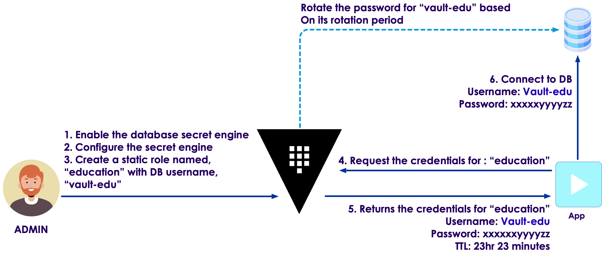
Database Static Roles and Credential Rotation - solution
Copyright © 2025 by Elephant Scale, All Rights Reserved
Notes:
Database secrets engine enables organizations to automatically rotate the password for existing database users. This makes it easy to integrate the existing applications with Vault and leverage the database secrets engine for better secret management.

Slide 72
Active Directory Service Account
Vault 0.10.2 introduced the Active Directory (AD) secrets engine which was designed to rotate the shared AD passwords dynamically.
This allowed companies to reduce the risk of damage from a password leak.
Challenge
  Service accounts are limited based on Client Access License (CAL)
  This makes credential rotation cumbersome
Copyright © 2025 by Elephant Scale, All Rights Reserved
Notes:
A service account is a user account that is created explicitly to provide a security context for services running on Windows Server operating systems. Often, an organization has a limited number of service accounts based on their Client Access License (CAL) which they share among the team. As a result, credential rotation is a cumbersome process and it's difficult to audit who took what actions with those shared credentials.

Slide 73
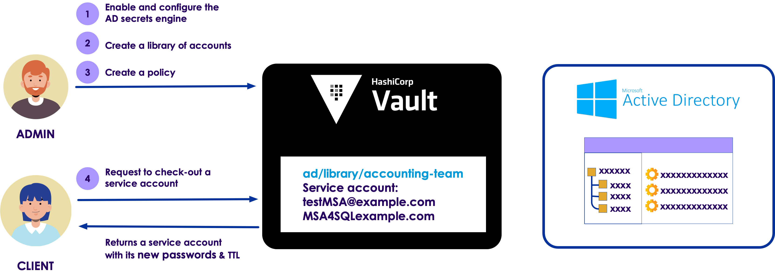
Active Directory Service Account - solution
The requester first checks out the account
When done, they check the service account back
Whenever a service account is checked back in, Vault rotates its password
Copyright © 2025 by Elephant Scale, All Rights Reserved
Notes:
Use the AD service account check-in/check-out feature of the AD secrets engine to allow a team to share a select set of service accounts. To use the shared service accounts, the requester first checks out the account. When done using the account, they simply check the service account back in for others to use. Whenever a service account is checked back in, Vault rotates its password.

