Slide 1
Consul
Consul overview
Microservices
Consul for Service Discovery
Terraform integration
Copyright © 2025 by Elephant Scale, All Rights Reserved

Slide 2
Consul overview
Consul overview
Microservices
Consul for Service Discovery
Terraform integration
Copyright © 2025 by Elephant Scale, All Rights Reserved

Slide 3

Monolith
Copyright © 2025 by Elephant Scale, All Rights Reserved
Notes:
A - login B - Show balance C - Wire transfers D - Foreign exchange
A bug causes a rebuild and redeploy

Slide 4

Microservices
Copyright © 2025 by Elephant Scale, All Rights Reserved

Slide 5
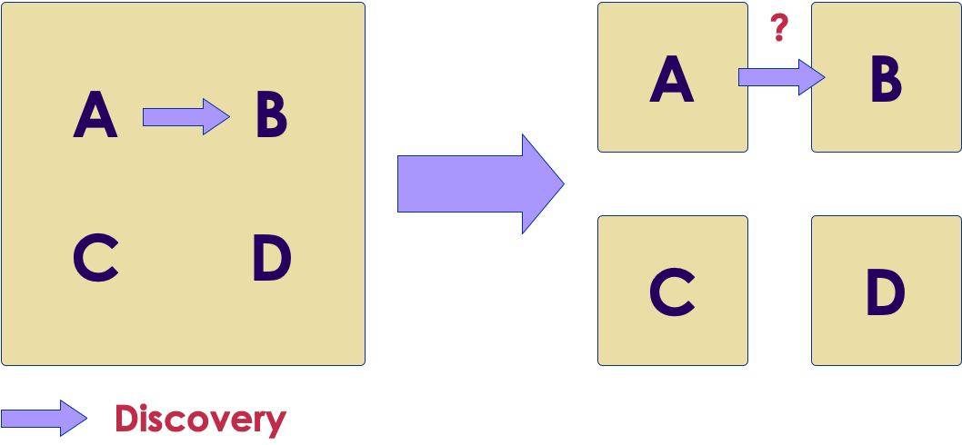
Discovery
Copyright © 2025 by Elephant Scale, All Rights Reserved
Notes:
A talks to B in nanoseconds Now where is B and milliseconds or seconds for latency

Slide 6
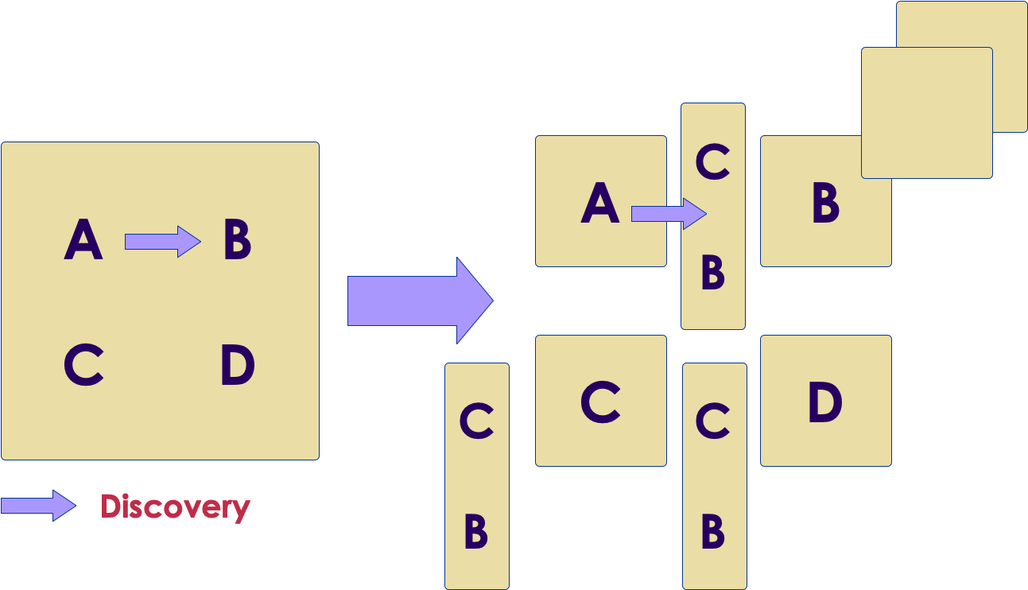
Load balancers?
Copyright © 2025 by Elephant Scale, All Rights Reserved
Notes:
Load balancers
Even scalability
Too many load balancers
Too many SPOFs
Double latency
Load balancing management

Slide 7
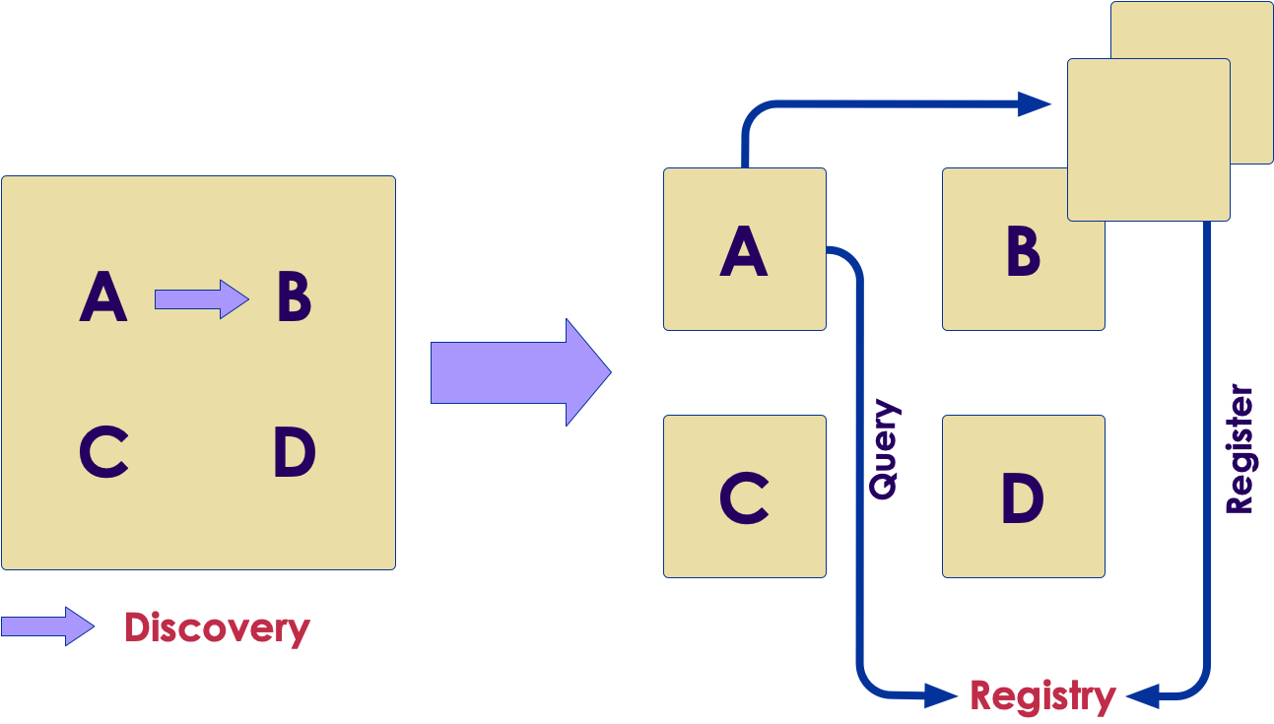
Registry
Copyright © 2025 by Elephant Scale, All Rights Reserved
Notes:
No load balancers
The instance registers

Slide 8
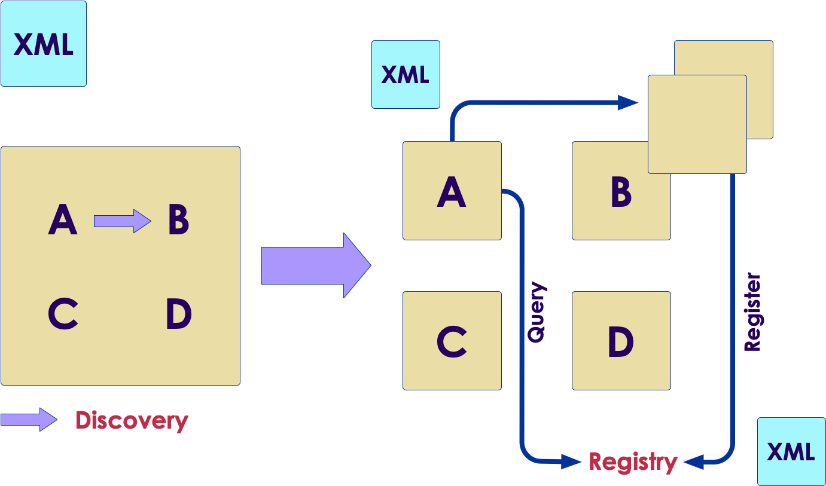
Configuration
Copyright © 2025 by Elephant Scale, All Rights Reserved
Notes:
Before, one configuration file XML, now - many
Such as, are we in maintenance mode

Slide 9
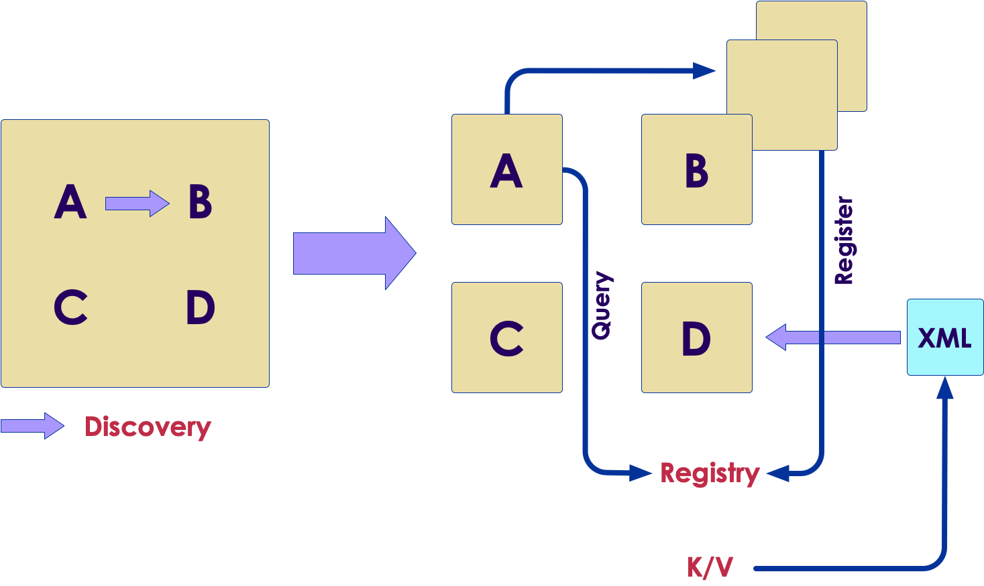
Configuration in Consul
Copyright © 2025 by Elephant Scale, All Rights Reserved
Notes:
Stored as K/V
Pushed to components in real time

Slide 10
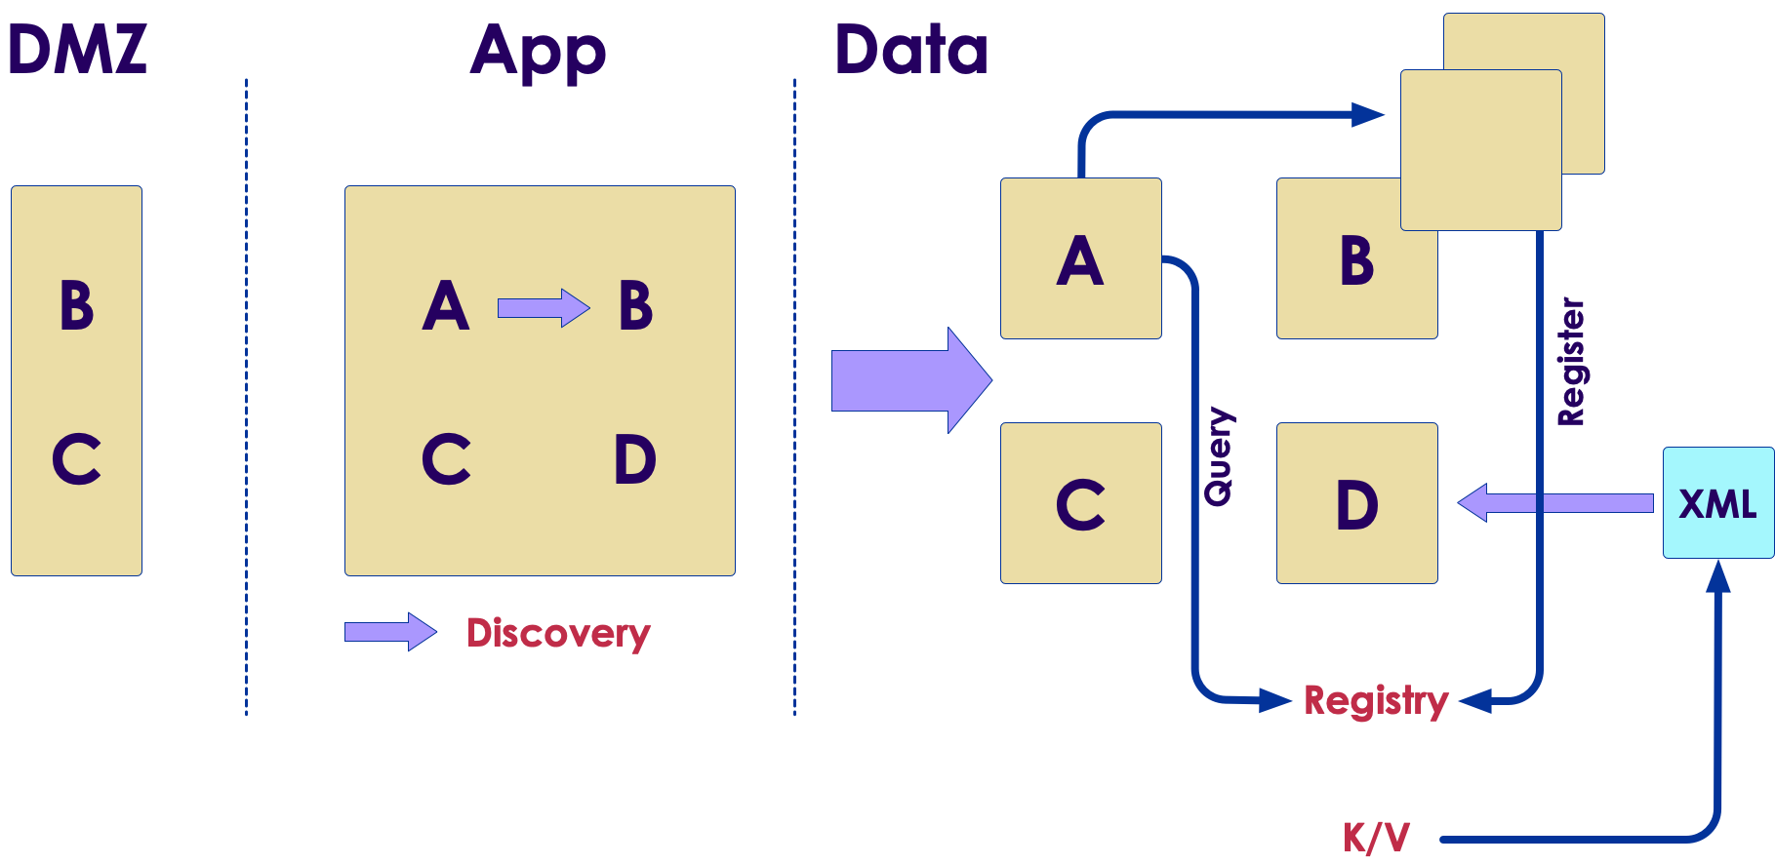
Zones
Copyright © 2025 by Elephant Scale, All Rights Reserved
Notes:
Zones were easy
Three tiers
Now we have multiple front doors and communications
How do we communicate

Slide 11
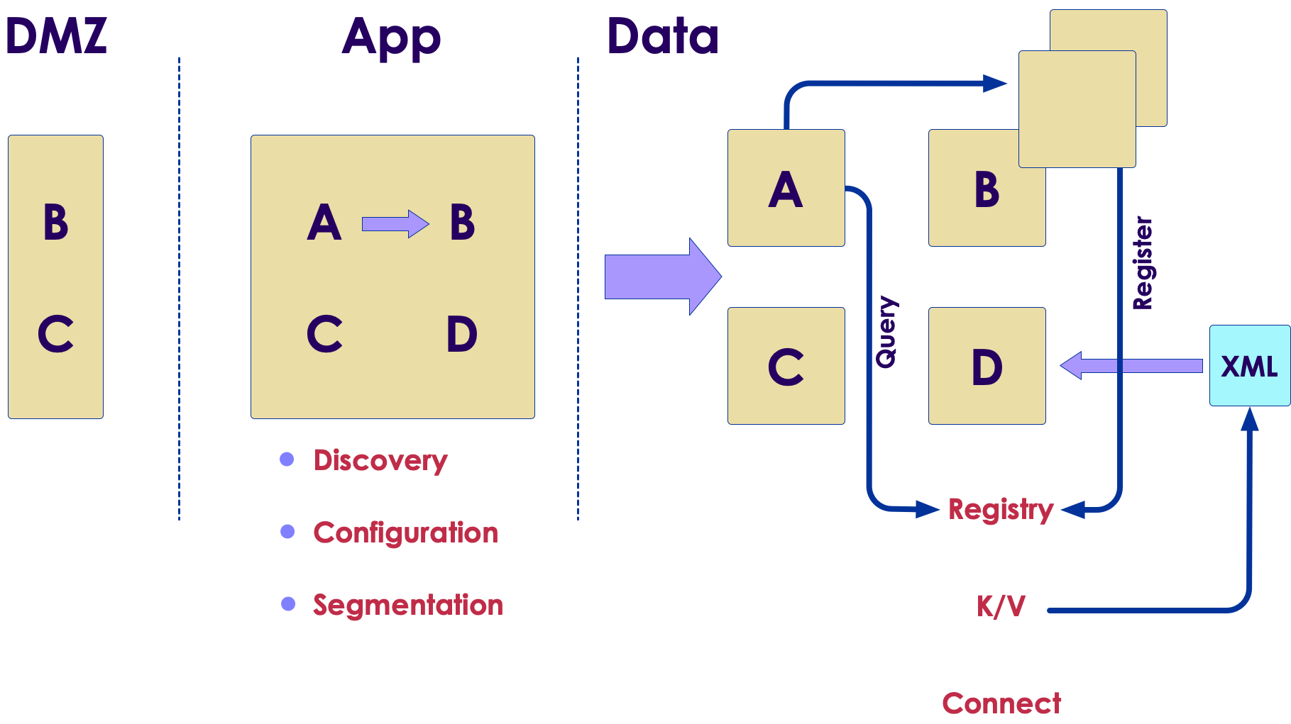
Segmentation
Copyright © 2025 by Elephant Scale, All Rights Reserved
Notes:
Segmentation is done with "Connect" in Consul

Slide 12
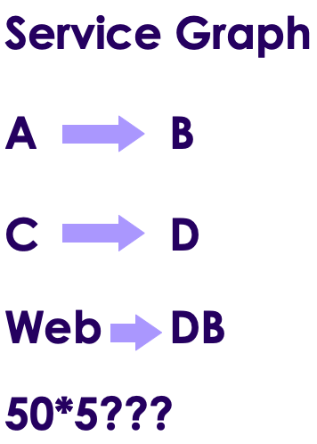
Service graph
Copyright © 2025 by Elephant Scale, All Rights Reserved
Notes:
We were not talking IP to IP
Now we are!
In firewall rules translation, the rules scale dependent on the number of servers

Slide 13
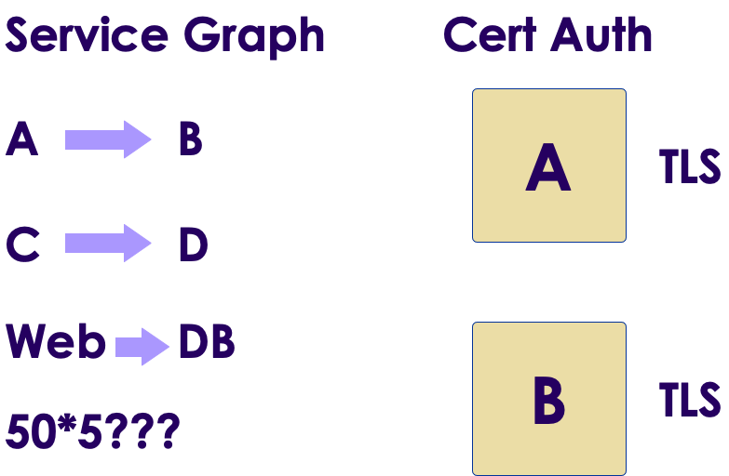
Identity
Copyright © 2025 by Elephant Scale, All Rights Reserved
Notes:
How do we assert identity?
How do we know A is A and B is B
Issue TLS certs to authenticate A and B
This is better than IP that gives now guarantees
But how do we enforce this?

Slide 14
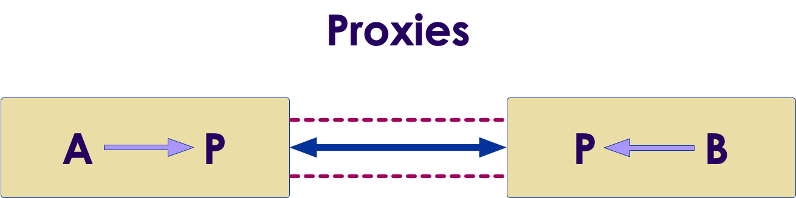
Proxies
Copyright © 2025 by Elephant Scale, All Rights Reserved
Notes:
This translates into a set of proxies
A talks to proxy transparently, unaware than anything has changes
The proxies are using certificate authority: A will verify that it is talking to B and B will verify that it is talking to A
Second advantage of using Mutual TLS is that now you have established an ecrypted channel between them
This is getting more important in light of such regulations ad GDPR
We cannot trust traffic within our own network. The data is now encrypted both at rest and in transit
A can talk to be and vice versa, but should A be talking tobe at all? This goes back to the service graph and asks if A is allowed to talk to B

Slide 15
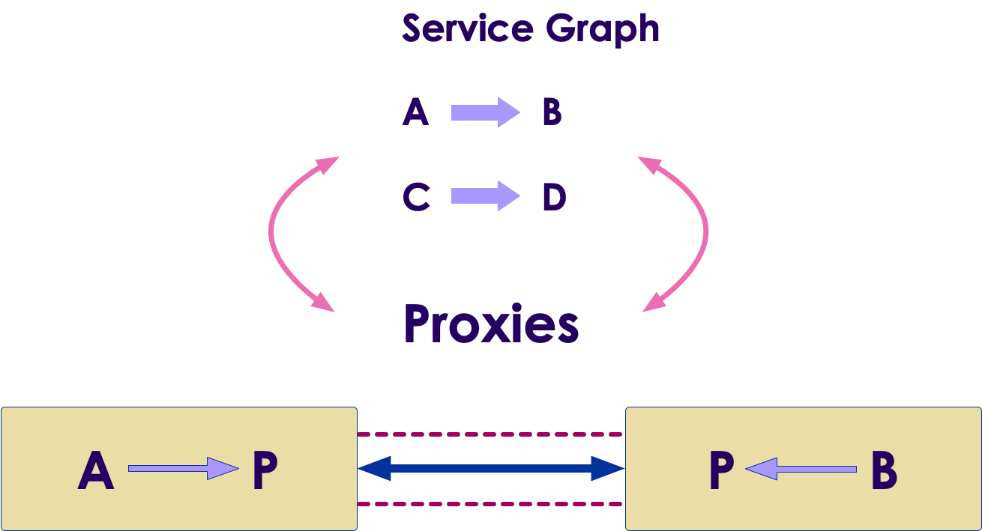
Proxies and Service Graph
Copyright © 2025 by Elephant Scale, All Rights Reserved
Notes:
A can talk to be and vice versa, but should A be talking tobe at all? This goes back to the service graph and asks if A is allowed to talk to B

Slide 16
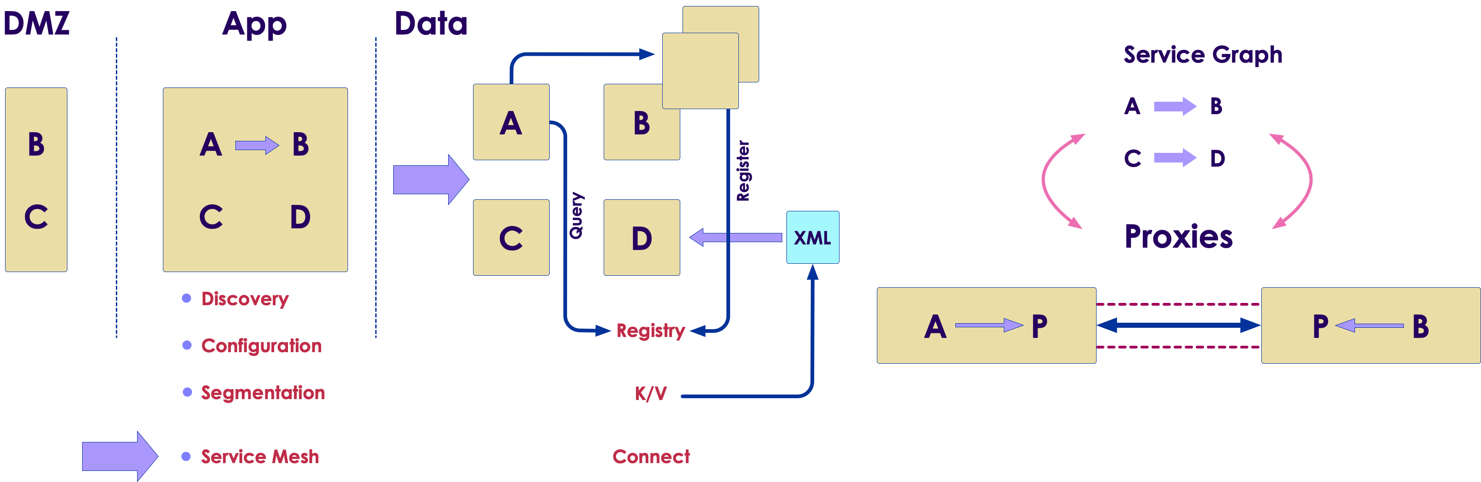
Service mesh
Copyright © 2025 by Elephant Scale, All Rights Reserved
Notes:
We improved the programmer's efficiency
But we got three operational problems
Together they are called Service Mesh - and that is was Consul is set up to address

Slide 17
Lab: Consul install
Please do lab 'lab31'
https://github.com/elephantscale/vault-consul-labs-answers/tree/main/lab31
Copyright © 2025 by Elephant Scale, All Rights Reserved

Slide 18
Microservices
Consul overview
Microservices
Consul for Service Discovery
Terraform integration
Copyright © 2025 by Elephant Scale, All Rights Reserved

Slide 19
Microservices - insert the microservices slides here
Copyright © 2025 by Elephant Scale, All Rights Reserved

Slide 20
Consul for Service Discovery
Consul overview
Microservices
Consul for Service Discovery
Terraform integration
Copyright © 2025 by Elephant Scale, All Rights Reserved

Slide 21
Why service discovery?
Applications are running on dynamic infrastructure
Need to determine services are running and how they can be accessed
HashiCorp provides a solution, and it is Consul
How?
  applications and services register with Consul
  service registry is populated
  connect to critical services throughout the organization
Copyright © 2025 by Elephant Scale, All Rights Reserved
Notes:
In a fast-moving business where applications are running on dynamic infrastructure, determining where services are running and how they can be accessed may become a challenge to manage. Fortunately, HashiCorp provides a solution to this dilemma with its Consul product. By instructing applications and services to register with Consul, a service registry can be populated, and applications can query the registry to discover and connect to critical services throughout the organization.

Slide 22
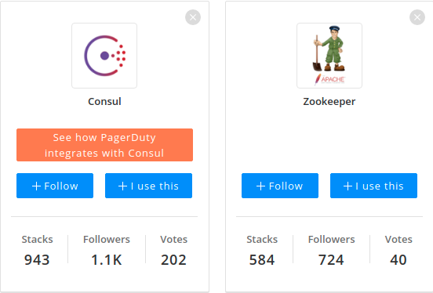
Consul vs Zookeeper
Copyright © 2025 by Elephant Scale, All Rights Reserved

Slide 23
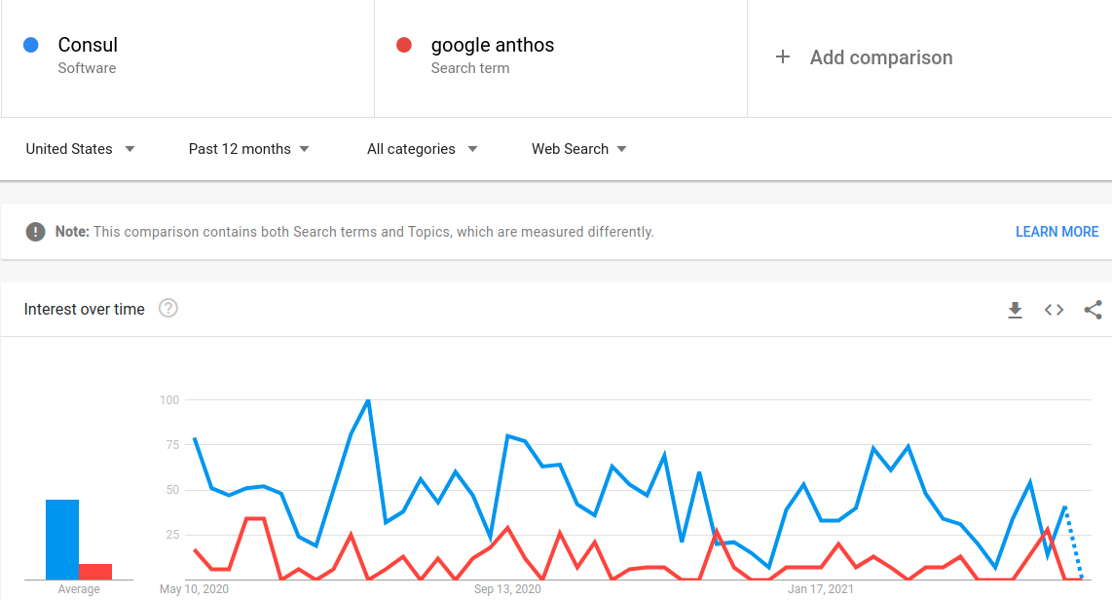
Consul vs Google Anthos
Copyright © 2025 by Elephant Scale, All Rights Reserved

Slide 24
Consul is from HashiCorp
Consul is a solution provided by HashiCorp
tight integration with Consul to simplifies access to Vault
Users and applications can query Consul using either DNS or the API
Consul responds to the query with the information needed to establish communication with the active Vault node
Faster and smarter than a load balancer
Copyright © 2025 by Elephant Scale, All Rights Reserved
Notes:
Since Consul is a solution provided by HashiCorp, it should come as no surprise that HashiCorp Vault includes tight integration with Consul to simplify access to Vault. Users and applications can query Consul using either DNS or the API when communication to Vault is required. Consul responds to the query with the information needed to establish communication with the active Vault node. If the Vault environment changes, Consul is immediately aware of those changes and begins directing subsequent requests to the now- active Vault environment. This strategy can help organizations reduce or eliminate the reliance on a front-end load balancer that may not reflect changes fast enough when using a health check configured with timeouts and thresholds.

Slide 25
Consul and Vault cluster
Consul can also simplify the connectivity to standby nodes within the cluster
Especially when running Vault Enterprise with performance standby nodes
Performance standby nodes can service Vault read operations and help Vault operators scale those read operations within a cluster
Copyright © 2025 by Elephant Scale, All Rights Reserved
Notes:
In addition to maintaining a connection to the active node, Consul can also simplify the connectivity to standby nodes within the cluster. This connectivity may be especially convenient when running Vault Enterprise with performance standby nodes. As previously discussed, these performance standby nodes can service Vault read operations and help Vault operators scale those read operations within a cluster. By using Consul to communicate with the performance standby nodes, clients a

Slide 26
Registering the Vault Service with Consul
When you deploy a Vault cluster with Consul backend -
  Vault service is automatically registered with the Consul service registry by default
Best practice
  If Consul service discovery is desired, a second Consul cluster should be deployed to manage this functionality
Copyright © 2025 by Elephant Scale, All Rights Reserved
Notes:
When a Vault cluster is deployed using a Consul storage backend, the Vault service is automatically registered with the Consul service registry by default. However, HashiCorp recommends that the Consul cluster deployed as the storage backend never be used for additional Consul functionality, such as service discovery. This recommendation ensures the Consul cluster can dedicate all available resources to servicing the storage backend rather than other Consul functions. If Consul service discovery is desired, a second Consul cluster should be deployed to manage this functionality.

Slide 27
How to register
The service_registration stanza is added to the Vault configuration
This configuration includes
  the address and port of the Consul cluster
  the Consul ACL token to permit Consul access (if Consul ACLs are enabled)
  other configurable parameters such as service_tags.
Copyright © 2025 by Elephant Scale, All Rights Reserved
Notes:
The service_registration stanza needs to be added to the Vault configuration file to register the Vault service with a Consul cluster.

Slide 28
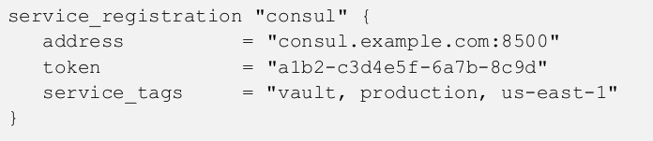
service_registration stanza example
Copyright © 2025 by Elephant Scale, All Rights Reserved
Notes:
This configuration includes the address and port of the Consul cluster, the Consul ACL token to permit Consul access (if Consul ACLs are enabled), and other configurable parameters such as service_tags. Keep in mind that the token is a Consul ACL token, not a Vault token. The ACL token needs to be associated with a Consul ACL policy with appropriate permissions, such as reading from the key/value path and creating the Consul service. Figure 6-6 provides an example of the stanza to be added to the Vault configuration file.

Slide 29

Connecting to Vault using Consul
In Consul, all Vault cluster nodes are registered as the Vault service
To use Consul to discover the active node in a cluster, a client can query Consul with the DNS name
Copyright © 2025 by Elephant Scale, All Rights Reserved
Notes:
To discover the current standby node(s) in a Vault cluster, the client can query Consul for the DNS name found in Figure 6-8. If there are multiple standby nodes, Consul responds to the query with all the standby nodes.

Slide 30
Performance standby node(s)
In Vault Enterprise
  To discover the performance standby node(s)
  client can query Consul for the DNS name
Copyright © 2025 by Elephant Scale, All Rights Reserved
Notes:
When running Vault Enterprise, a client or application may need to discover the performance standby node(s) in a Vault cluster for read operations. To do so, the client can query Consul for the DNS name found in Figure 6-9. If there are multiple performance standby nodes, Consul responds to the query with all the standby nodes.

Slide 31
Terraform integration
Consul overview
Microservices
Consul for Service Discovery
Terraform integration
Copyright © 2025 by Elephant Scale, All Rights Reserved

Slide 32
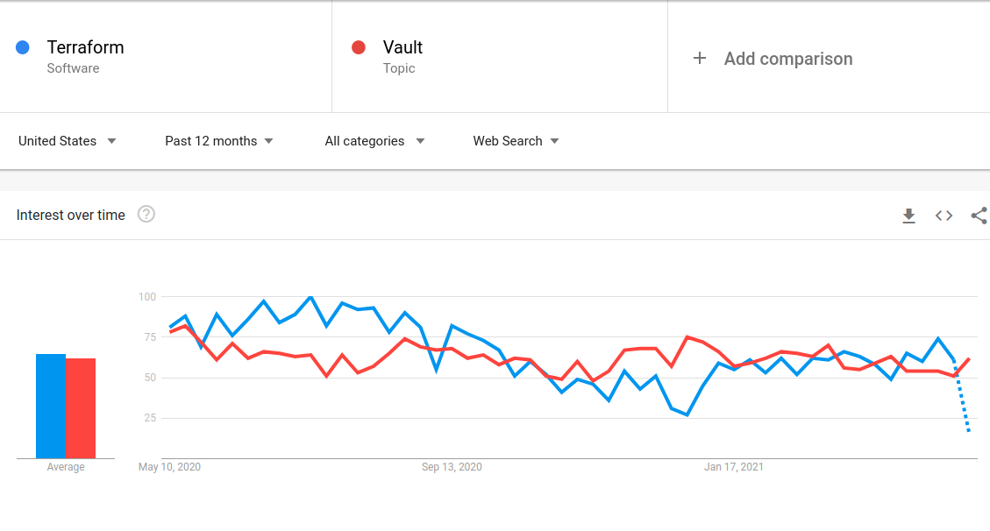
Terraform and Vault
Copyright © 2025 by Elephant Scale, All Rights Reserved
Notes:
Vault is one of HashiCorp's most popular products, but its adoption is dwarfed by the popularity of another HashiCorp product, Terraform. Terraform allows customers to define infrastructure components as code to create a predictable and repeatable process for standing up applications and supporting infrastructure. Terraform supports integration with Vault in several ways, including the ability to deploy Vault infrastructure, manage Vault infrastructure, configure Vault components, and retrieve Vault secrets.

Slide 33
Vault Infrastructure with Terraform
Terraform and Vault often go together
Your deployment may have custom Terraform modules
If so, it may make sense to store the modules in the Terraform pubic registry
Copyright © 2025 by Elephant Scale, All Rights Reserved
Notes:
Organizations deploying Vault to automate the security of applications and infrastructure are often Terraform adopters as well. If so, it is highly likely that these organizations maintain custom Terraform modules for their data center or their selected public cloud platform. Using these modules or modules from the Terraform public registry, customers can simplify a Vault cluster's deployment and ongoing management.

Slide 34
Vault Architecture
Components to go in the Terraform configuration files:
  Consul nodes
  Vault nodes
  load balancers
  security groups
  DNS records
  network connectivity
Copyright © 2025 by Elephant Scale, All Rights Reserved
Notes:
As discussed in the Designing the Vault Architecture section, many components must be considered when architecting a Vault solution. Since Terraform supports many private and public cloud resources, organizations can easily define these components in Terraform for deployment. Components such as the Consul and Vault nodes, load balancers, security groups, DNS records, and network connectivity can easily be declared in a Terraform configuration file. Any changes to the environment can be applied using Terraform for simplified management as well.

Slide 35
Repeatability
Repeatability if one the benefits of deploying Vault with Terraform
Other benefits
  performance or
  disaster recovery
  replicated clusters *high availability
Copyright © 2025 by Elephant Scale, All Rights Reserved
Notes:
One of the most significant benefits of deploying Vault with Terraform is repeatability. As Vault adoption increases, so does the need for performance or disaster recovery replicated clusters to ensure high availability and recovery of the service. By developing Terraform configurations for Vault, an organization can readily deploy additional clusters when needed. This strategy also ensures that each cluster is provisioned consistently regardless of where the new cluster is needed.

Slide 36
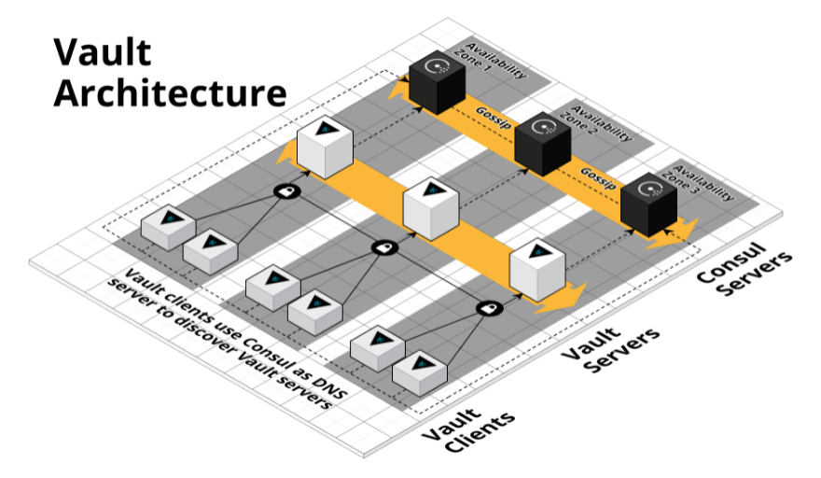
Terraform configurations for Vault
Amazon Web Services (https://github.com/hashicorp/terraform-aws-vault)
Microsoft Azure (https://github.com/hashicorp/terraform-azurerm-vault)
Google Cloud (https://github.com/terraform-google-modules/terraform-google-vault)
Copyright © 2025 by Elephant Scale, All Rights Reserved

Slide 37
Configure Vault Provider and Credentials
Similar to other Terraform providers:
  declared within the Terraform configuration file
  Sensitive information should be provided using environment variables
Example
  Terraform authenticates with Vault using a token
  Vault address and token should be provided as an environment variable
  VAULT_ADDR - the IP address or hostname of the targeted Vault cluster
  VAULT_TOKEN, which is used to authenticate to Vault
Copyright © 2025 by Elephant Scale, All Rights Reserved
Notes:
Getting started with the Terraform Vault provider is like using any other Terraform provider: the provider and related arguments should be declared within the Terraform configuration file. Any sensitive information should be provided using environment variables. This technique ensures that information is not stored in a cleartext Terraform file. For example, if Terraform authenticates with Vault using a token, the Vault address and token should be provided as an environment variable. In this scenario, two environment variables need to be set: VAULT_ADDR, which sets the IP address or hostname of the targeted Vault cluster, and VAULT_TOKEN, which is used to authenticate to Vault.

Slide 38
Consuming Secrets with Terraform
Rather than provide Terraform with static credentials
Terraform can integrate with Vault to retrieve or generate credentials before applying the configuration
For example,
  Terraform can retrieve temporary AWS credentials from Vault to deploy EC2 instances
  After the lease has expired, Vault automatically revokes the AWS credentials.
Copyright © 2025 by Elephant Scale, All Rights Reserved

Slide 39
Coding for Reliability
Additional automated processes
  automated processes can ensure applications can access the vault service
Example
  a team is responsible for managing a shared, multi-tenant Vault service for hundreds of internal teams
  Vault environment was a large, multi-cluster Vault deployment
  Each onboarded application was configured to attach to a single, local cluster.
Solution
  native disaster recovery options built into Vault, or
  a load balancer in front of the Vault clusters, or even better
  use the AppRole auth method since both RoleIDs and SecretIDs are replicated across all clusters
Copyright © 2025 by Elephant Scale, All Rights Reserved

Slide 40
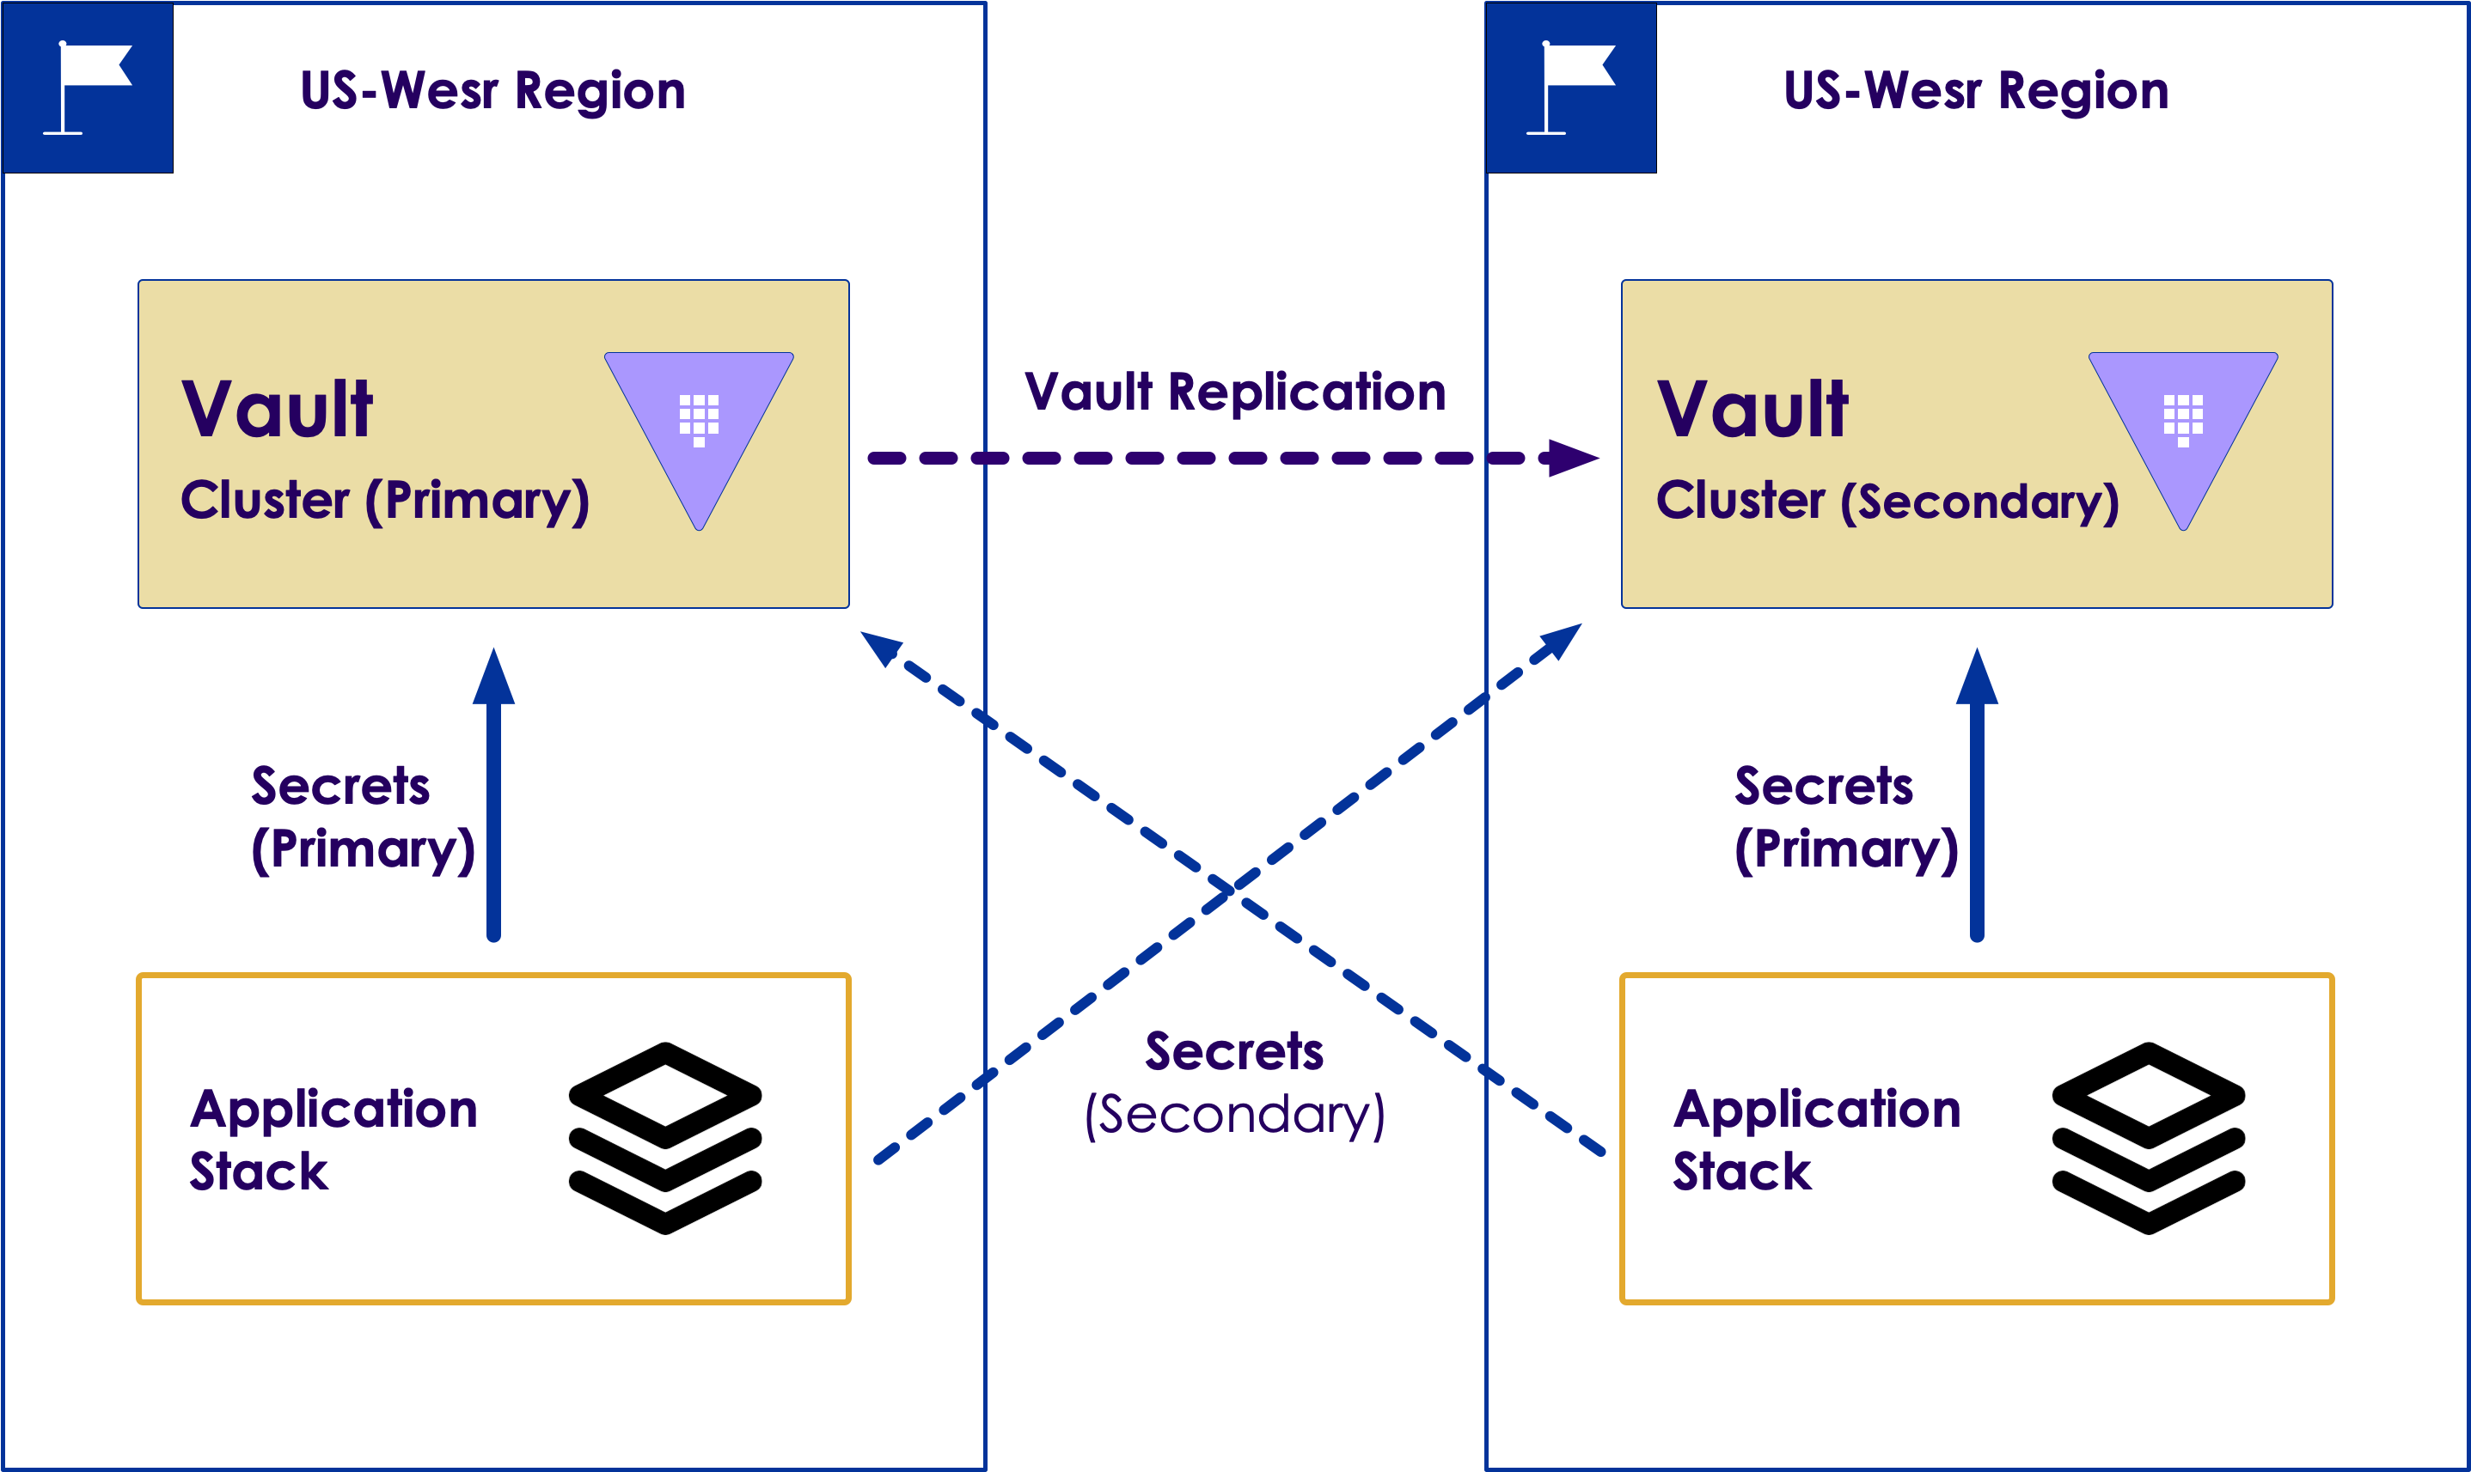
Reliability solution
Copyright © 2025 by Elephant Scale, All Rights Reserved
Notes:
Revisiting the above scenario, the application team needs to interact with Vault in the most efficient way while considering high availability across multiple clusters. Knowing that tokens are not replicated across clusters, the application team needs a solution to authenticate to any Vault cluster to retrieve secrets.
The operations team can start by using the AppRole auth method since both RoleIDs and SecretIDs are replicated across all clusters. Combining this authentication mechanism capability with automation or pre-defined script can ensure applications can always access the Vault service, regardless of the status of the Vault environment.

Slide 41
More with Consul
Now that we know the basics, what is next? Perfect your skills in the following areas:
  Consul Service Mesh
  Create a datacenter with Consul Docker containers as the agents
  Learn how to deploy Consul on Kubernetes
  Deploy HashiCorp Consul Service on Azure
  Secure Nomad jobs with Consul service mesh
Copyright © 2025 by Elephant Scale, All Rights Reserved

