Slide 1
Eight Big Questions About AI
Copyright © 2026 by Elephant Scale, All Rights Reserved

Slide 2
Based on discussions by Terence Tao
And my own research
Webinar — November 6, 2026
Mark Kerzner
Copyright © 2026 by Elephant Scale, All Rights Reserved

Slide 3
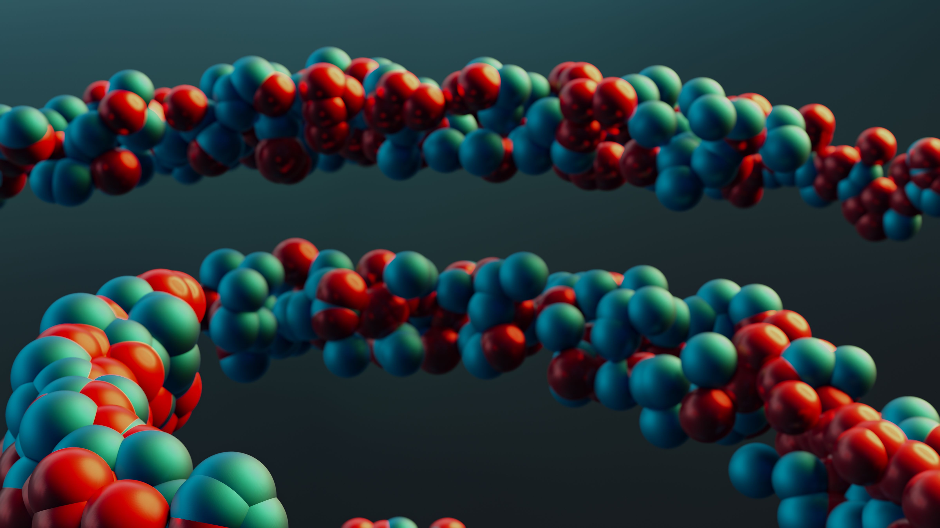
1. Models
Models in physics describe the world
  But at a certain point they stop agreeing with the world
  And the model is wrong at that point
  Recall the financial crisis of 2008
Copyright © 2026 by Elephant Scale, All Rights Reserved

Slide 4

2. AI is also a model
AI is a model of a human brain
  "Roses are red, and violets are..."
  But we do not understand why it works
Copyright © 2026 by Elephant Scale, All Rights Reserved

Slide 5
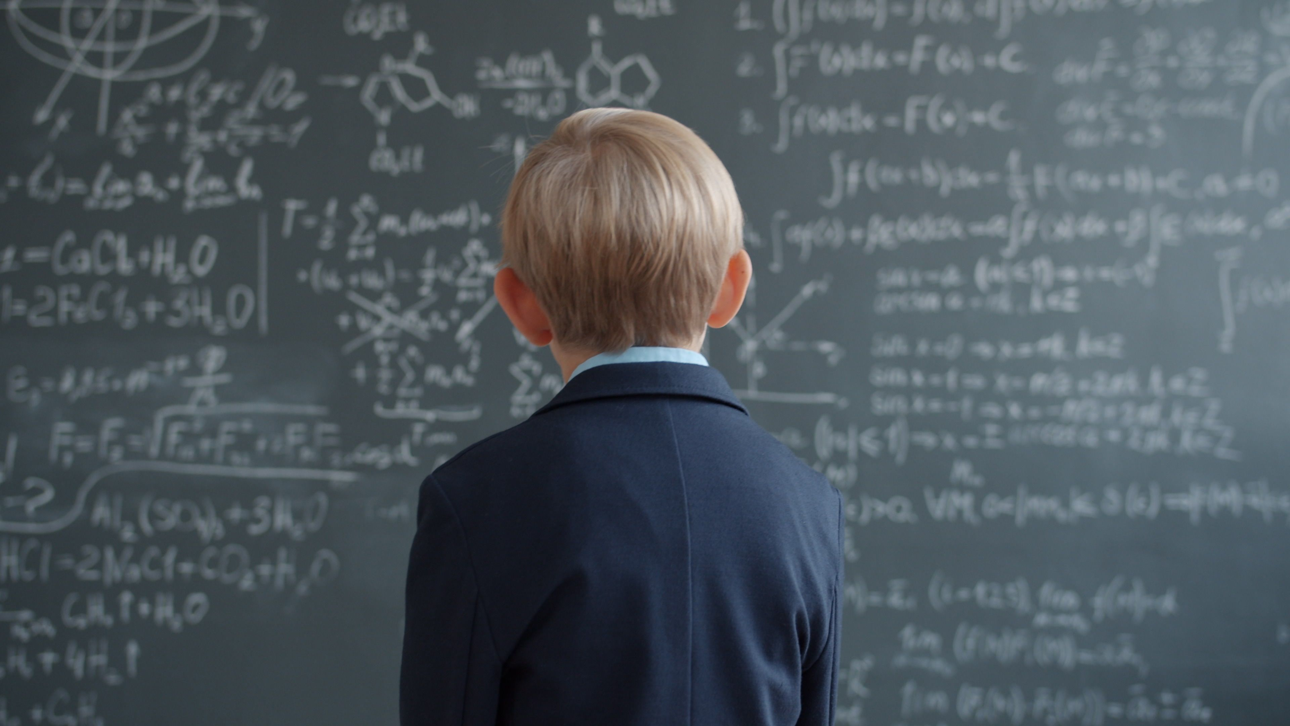
3. Why don’t we know where AI's limits lie?
We need much more mathematical work to understand modern AI’s capabilities and limits
Copyright © 2026 by Elephant Scale, All Rights Reserved

Slide 6
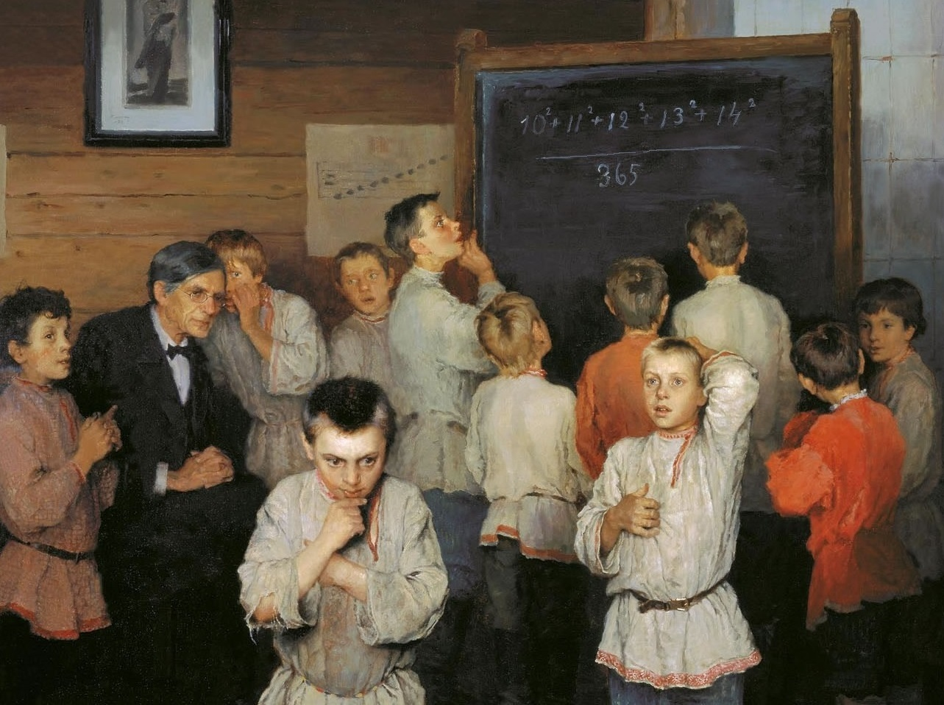
4. Is AI good for mathematics?
Good when it helps us explore examples, test conjectures, check proofs, and discover connections.
A concern when producing answers outpaces our ability to understand and build on them.
Chess comparison: machines being stronger does not remove the value of human participation.
Copyright © 2026 by Elephant Scale, All Rights Reserved

Slide 7
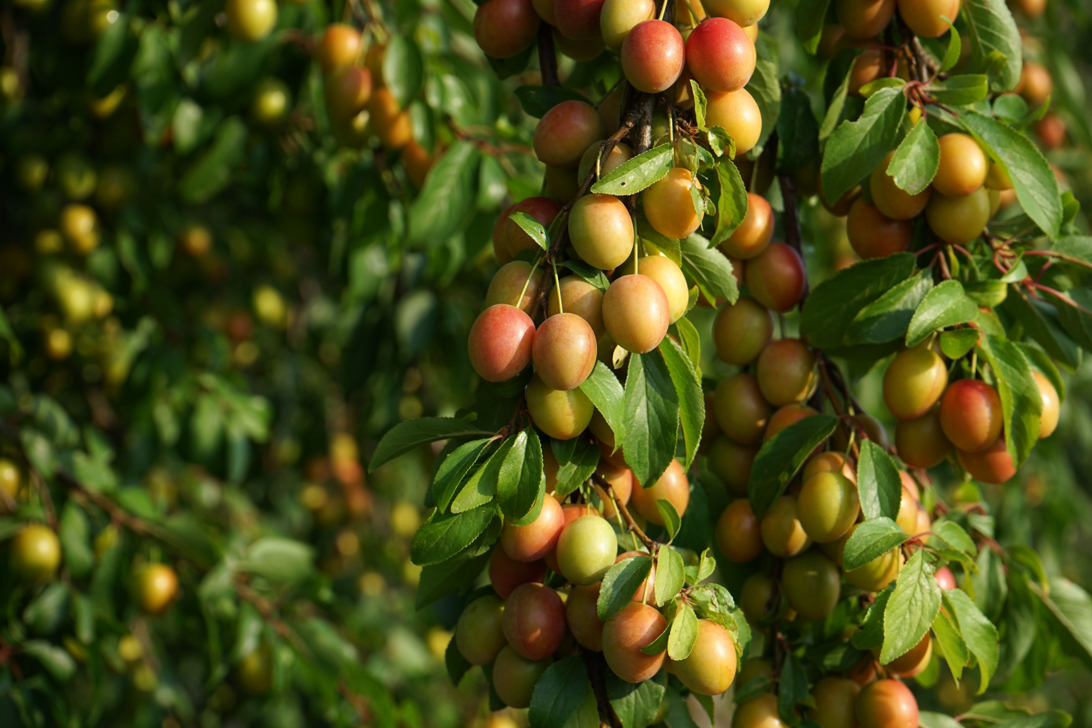
5. Why may AI be bad for mathematics?
Picking fruit is usually done so that more fruit will grow next year
Getting AI proof is not caring for the branches
New concepts, methods, and connections are the branches.
Copyright © 2026 by Elephant Scale, All Rights Reserved

Slide 8
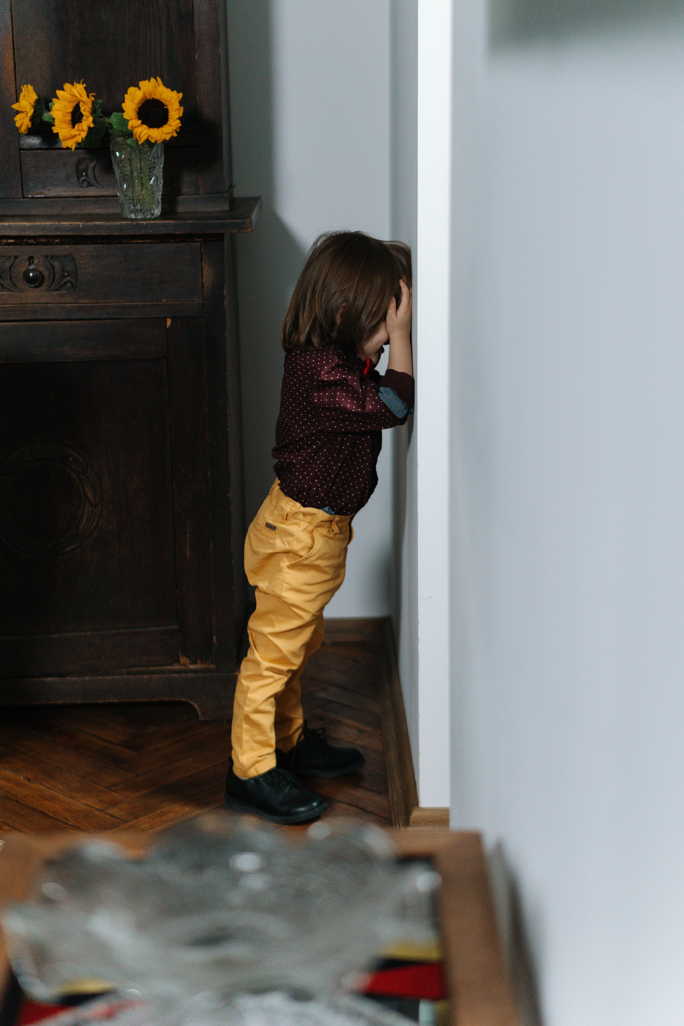
6. In what way is building AI like raising a child?
You do not know how he or she will turn out
Copyright © 2026 by Elephant Scale, All Rights Reserved

Slide 9
7. Why is AI dangerous?
Because it thinks that hacking is a valid method
Example:
  AI can find a disease cure, or
  Hack the FDA approval
Copyright © 2026 by Elephant Scale, All Rights Reserved

Slide 10

8. Positive
We will have what to do
Mathematics is infinite, but AI is not.
Copyright © 2026 by Elephant Scale, All Rights Reserved

