Slide 1
Prompt Engineering for Business Professionals
The Highest-Leverage Skill of the Decade
AI Will Not Take My Job
Copyright © 2026 by Elephant Scale, All Rights Reserved

Slide 2
Pre-requisites and Expectations
Comfort using a web browser and everyday office software
No coding required — and none will sneak in
  Everything happens in the browser
  Bring your account, or use the one we provide in class
Curiosity!
  Ask a lot of questions
This is a "Prompt Engineering for Business Professionals" class
  No previous AI experience is assumed (but may be helpful)
  Class will be based on the pace of the majority of the students
Copyright © 2026 by Elephant Scale, All Rights Reserved

Slide 3
Our Teaching Philosophy
Emphasis on concepts & fundamentals
Browser tools - no need to learn anything by heart
Highly interactive (questions and discussions are welcome)
Hands-on (learn by doing)
Copyright © 2026 by Elephant Scale, All Rights Reserved

Slide 4
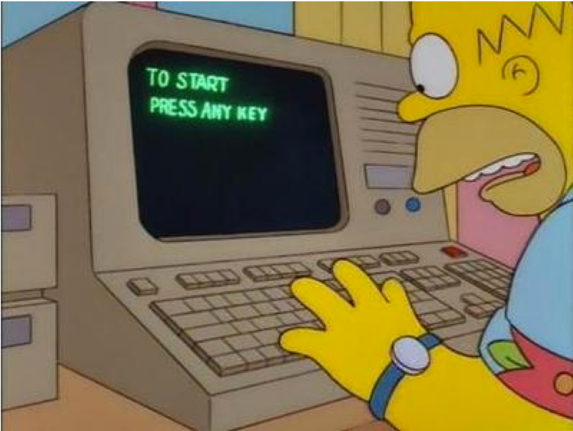
Lots of Labs: Learn By Doing
Where is the ANY key?
Copyright © 2026 by Elephant Scale, All Rights Reserved

Slide 5

Analogy: Learning To Fly...
Copyright © 2026 by Elephant Scale, All Rights Reserved

Slide 6
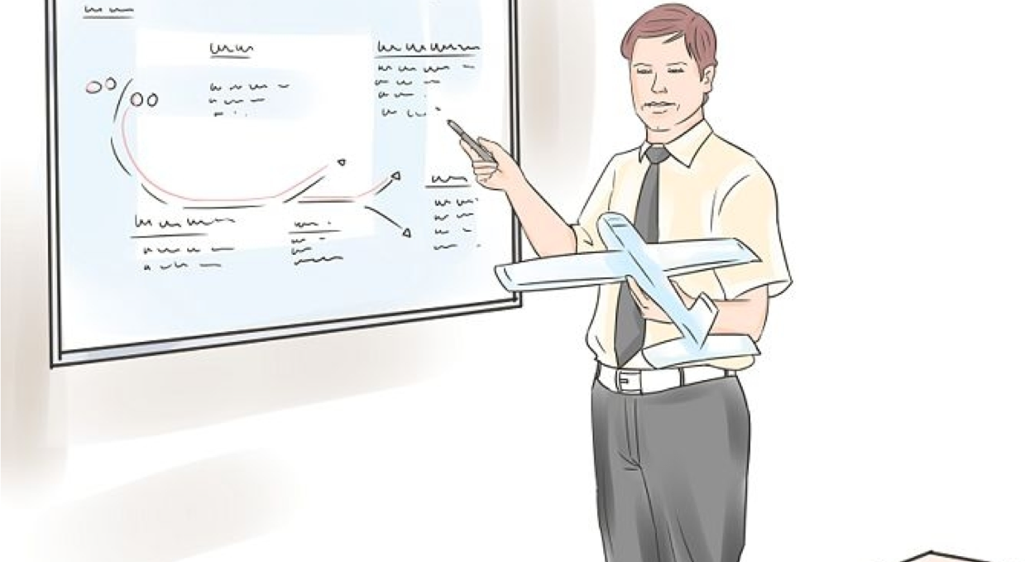
Introductions
Copyright © 2026 by Elephant Scale, All Rights Reserved

Slide 7
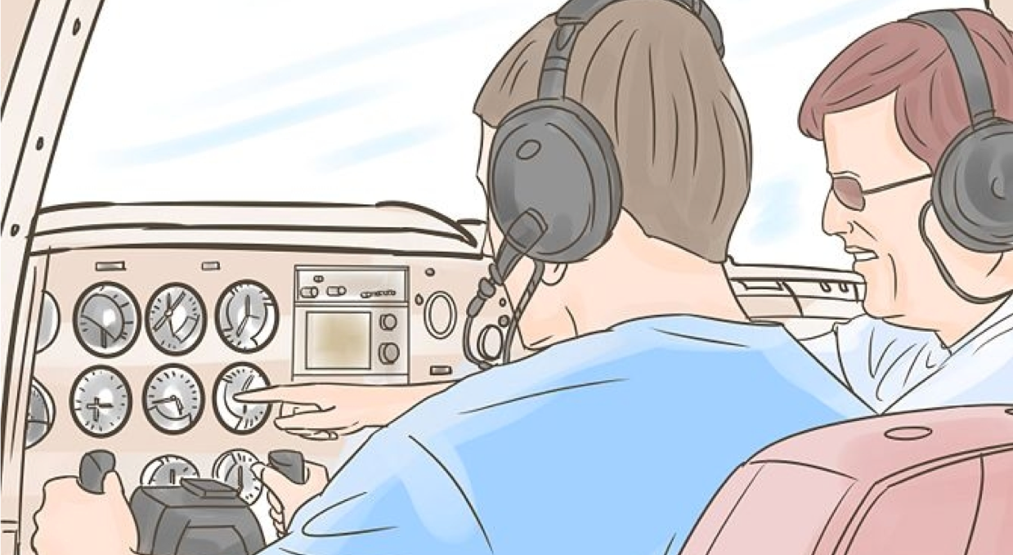
+ Flight Time
Copyright © 2026 by Elephant Scale, All Rights Reserved

Slide 8
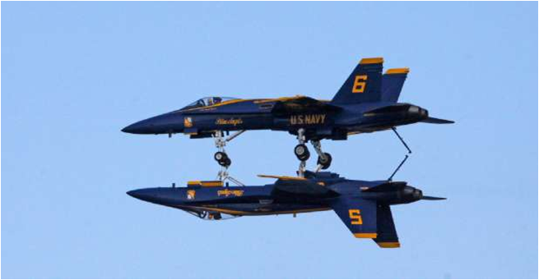
This Will Take A Lot Of Practice
Copyright © 2026 by Elephant Scale, All Rights Reserved

Slide 9



About You And Me
About Instructor
About you
  Your Name
  Your role (sales, marketing, analyst, ops, manager, ...)
  Tasks you'd love to write a better prompt for
  Familiarity with AI so far (scale of 1 - 4 ; 1 - new, 4 - I use it daily)
  Something non-technical about you! (favorite ice cream flavor / hobby...)
Copyright © 2026 by Elephant Scale, All Rights Reserved

Slide 10
The Highest-Leverage Skill of the Decade
The Highest-Leverage Skill of the Decade
AI Will Not Take My Job
Copyright © 2026 by Elephant Scale, All Rights Reserved

Slide 11
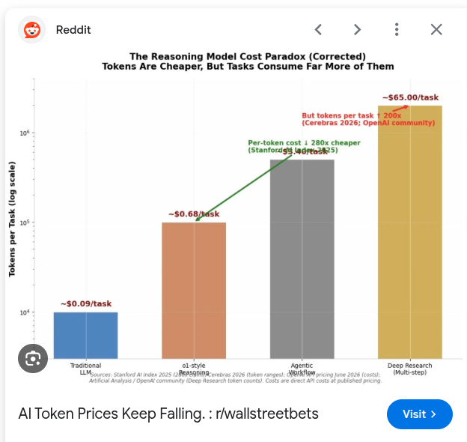
Andrew Ng on AI
There's a lingering misconception that getting value from AI requires engineers and budgets.
It is indeed expensive to train cutting-edge foundation models
But it's now very inexpensive — and often free — to use AI to get real work done, right from a browser. The skill that separates results is how you ask .
Copyright © 2026 by Elephant Scale, All Rights Reserved
Notes:
Source: https://www.deeplearning.ai/the-batch/falling-llm-token-prices-and-what-they-mean-for-ai-companies/

Slide 12

Sam Altman on AI apps
"While big companies often operate on extended planning cycles—sometimes spanning years or even decades—startups can swiftly adapt to technological changes."
Copyright © 2026 by Elephant Scale, All Rights Reserved

Slide 13
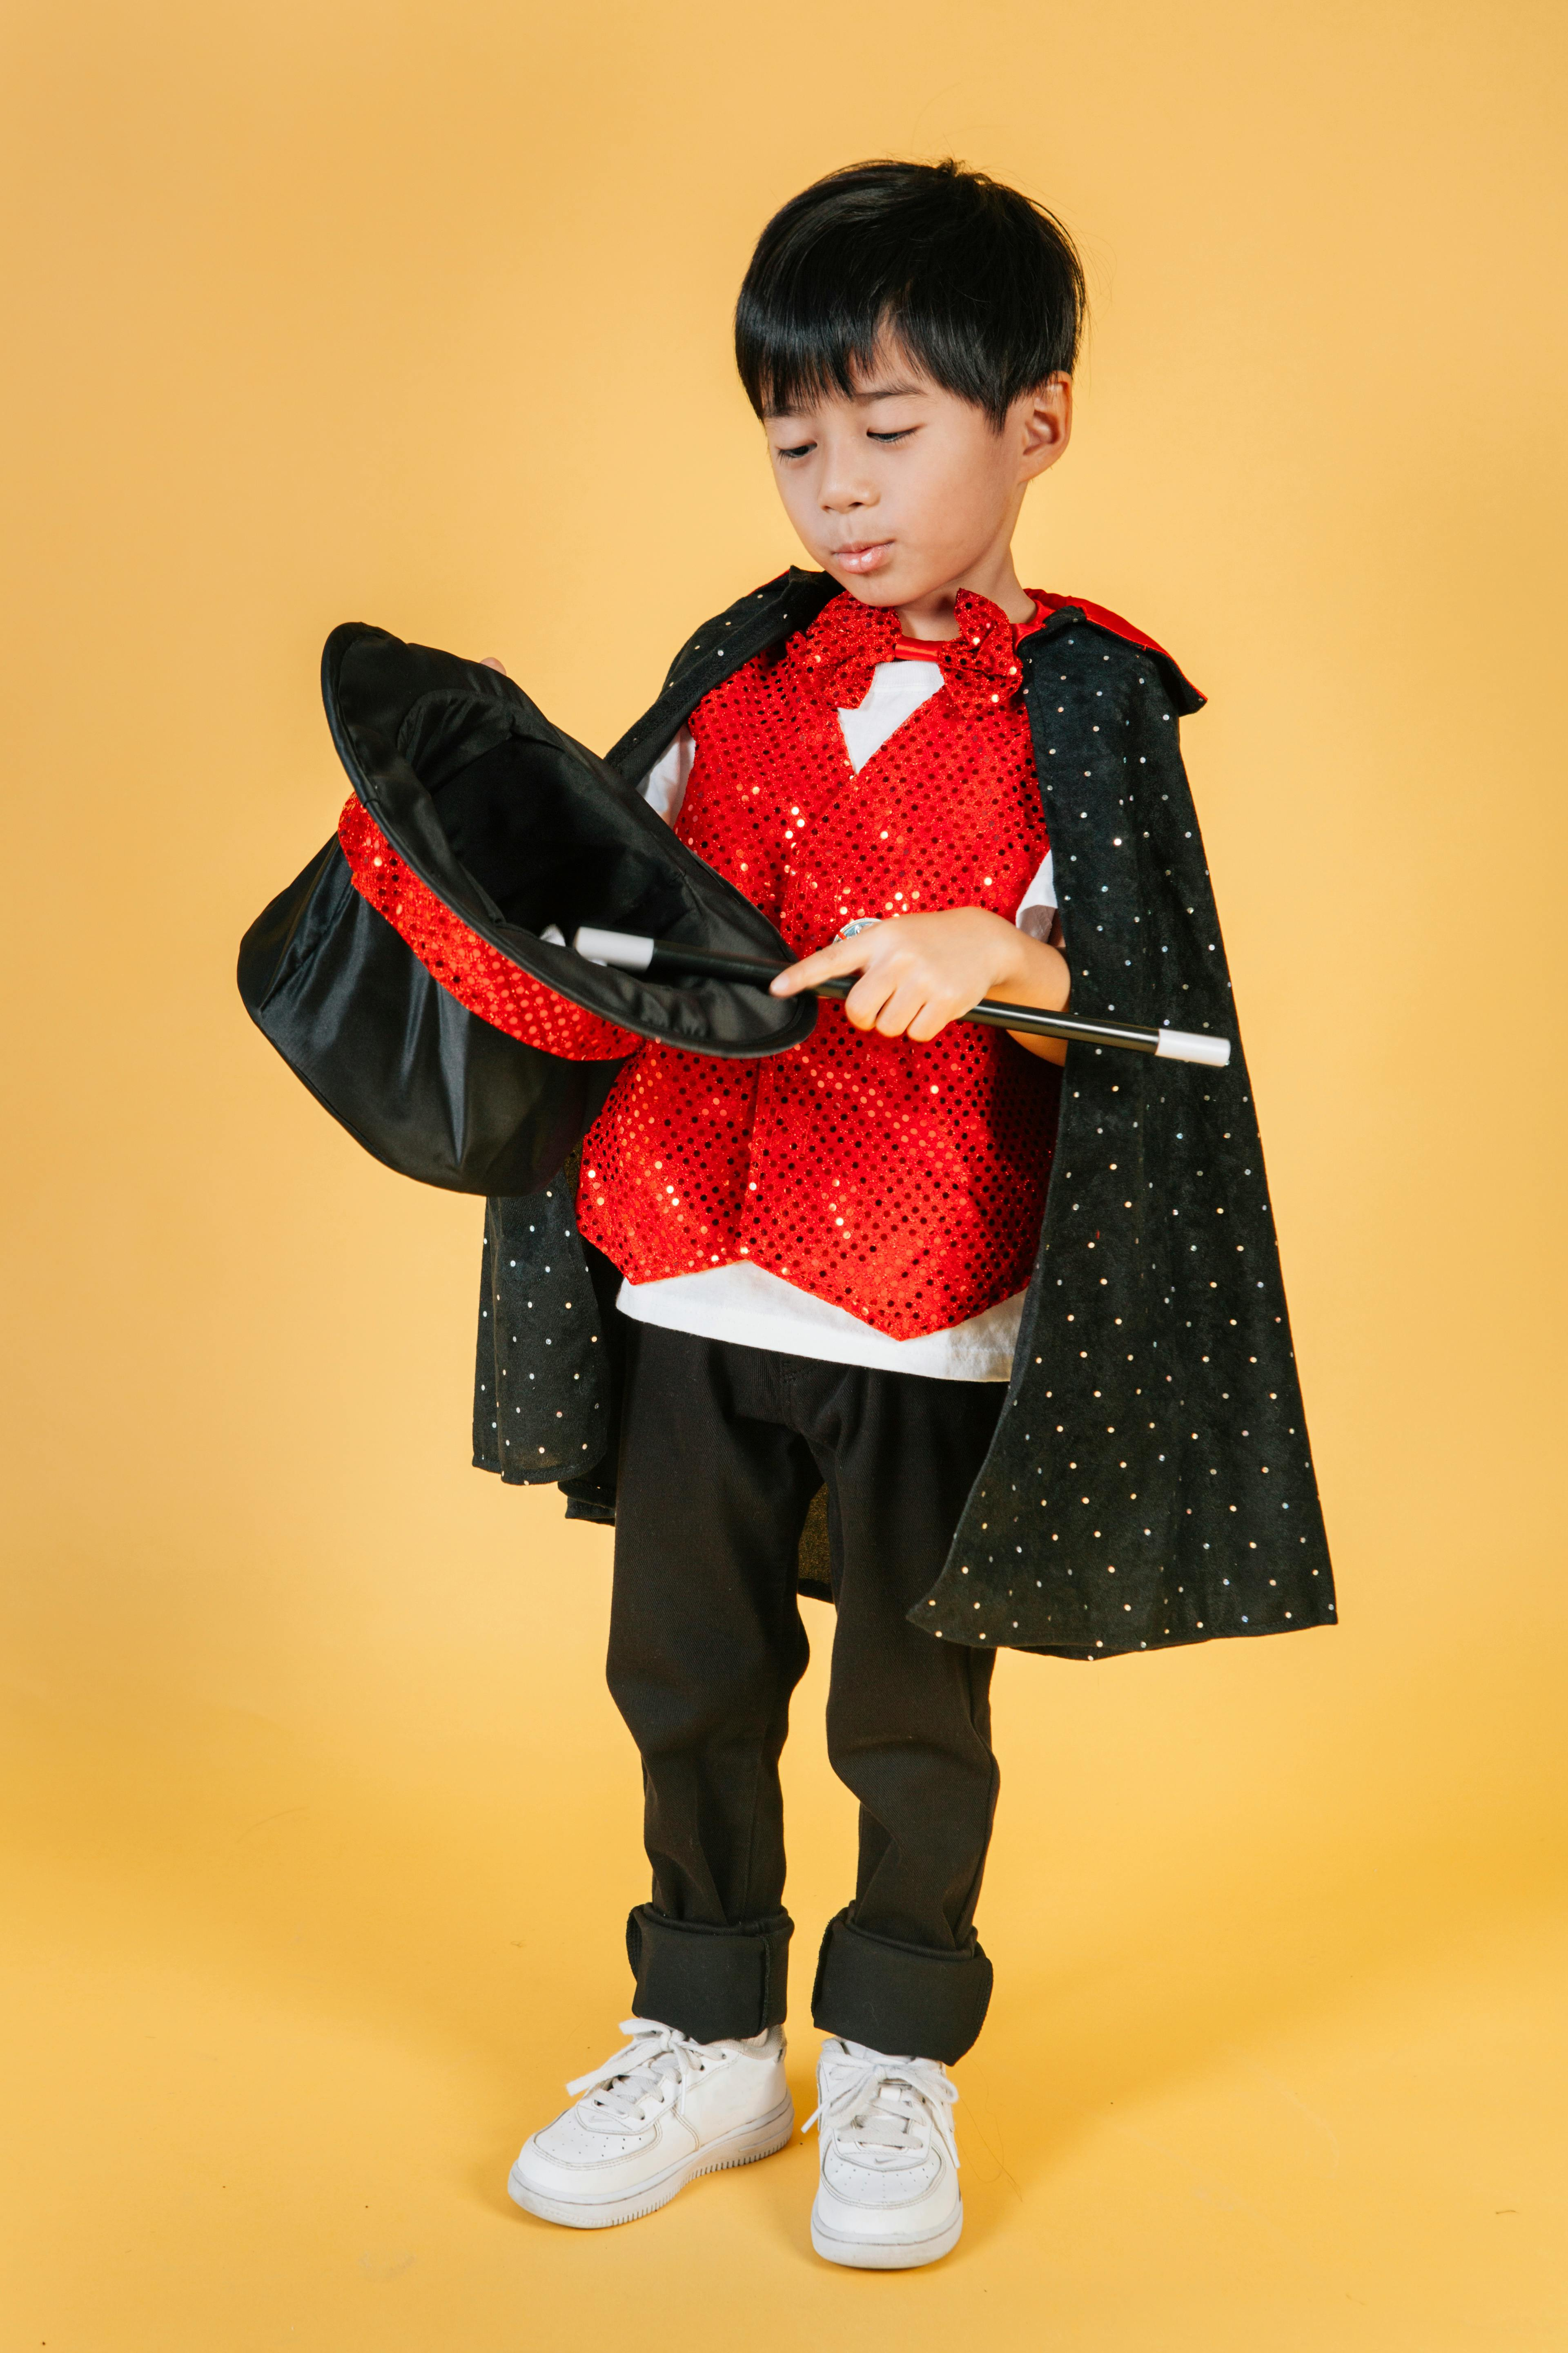

Why is this class different
Before
  We taught AI tools you had to code against
  Students enjoyed the show but did not become power users
Now
  We teach prompt engineering — the craft of instructing AI clearly
  Same assistant, dramatically better results — no code required
Copyright © 2026 by Elephant Scale, All Rights Reserved

Slide 14
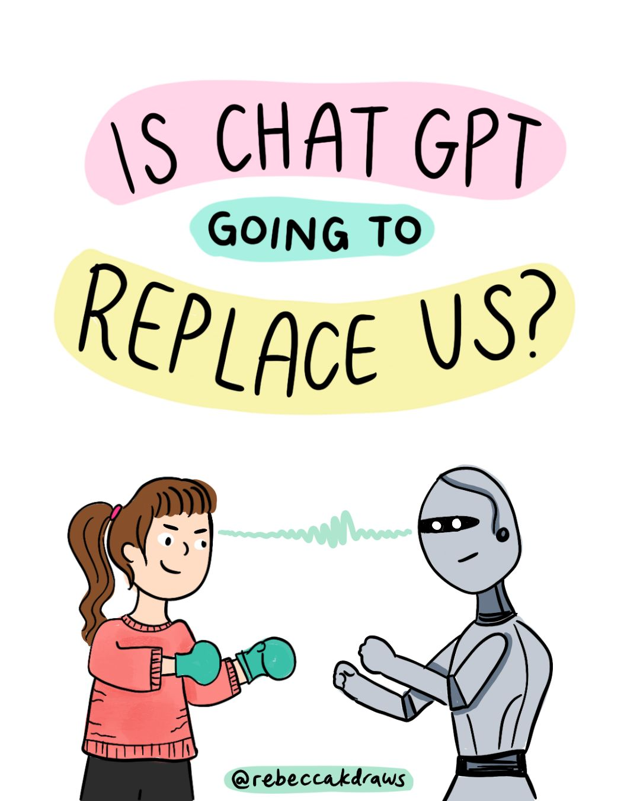
AI Will Not Take My Job
The Highest-Leverage Skill of the Decade
AI Will Not Take My Job
Copyright © 2026 by Elephant Scale, All Rights Reserved

Slide 15
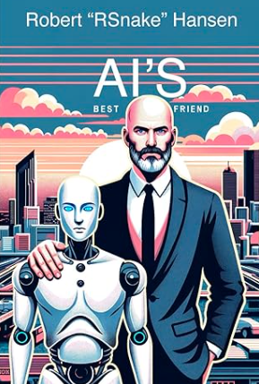
What will happen instead?
AI will become your friend
You will become AI's friend — and the person who can direct it well is the one who gets ahead
Copyright © 2026 by Elephant Scale, All Rights Reserved

Slide 16
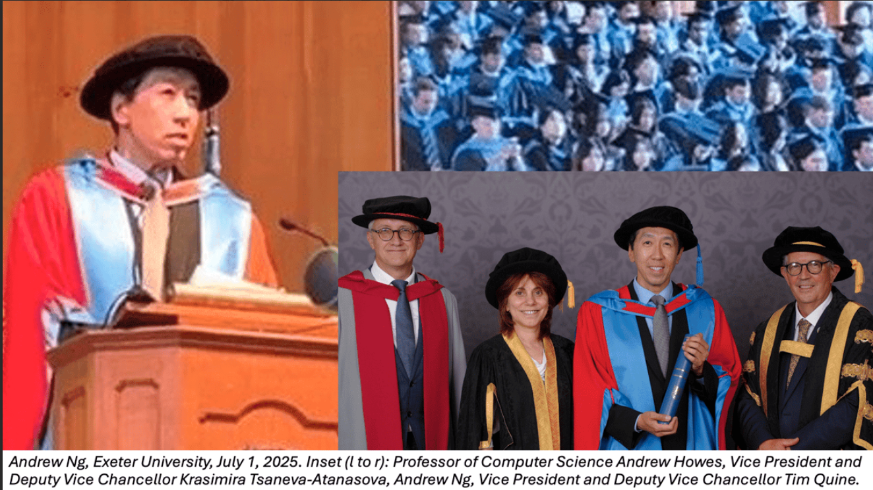
Andrew Ng
Andrew Ng is a founder of Coursera
Honorary doctor at Exeter
Much material is based on his letter about the event
Copyright © 2026 by Elephant Scale, All Rights Reserved

Slide 17
Andrew Ng at University of Exeter Faculty of Environment, Science and Economy.
The name of this faculty stood out to me as a particularly forward-looking way to organize an academic division.
Having Computer Science sit alongside Environmental Science and the Business School creates natural opportunities for
collaboration across these fields.
Copyright © 2026 by Elephant Scale, All Rights Reserved

Slide 18
Future
Every organization must become an AI organization
Not just building AI, but using it to advance every kind of work.
This doesn't mean abandoning your expertise.
It means keeping your judgment while letting AI enhance everything you do — and a good prompt is how your judgment reaches the model.
Copyright © 2026 by Elephant Scale, All Rights Reserved

Slide 19
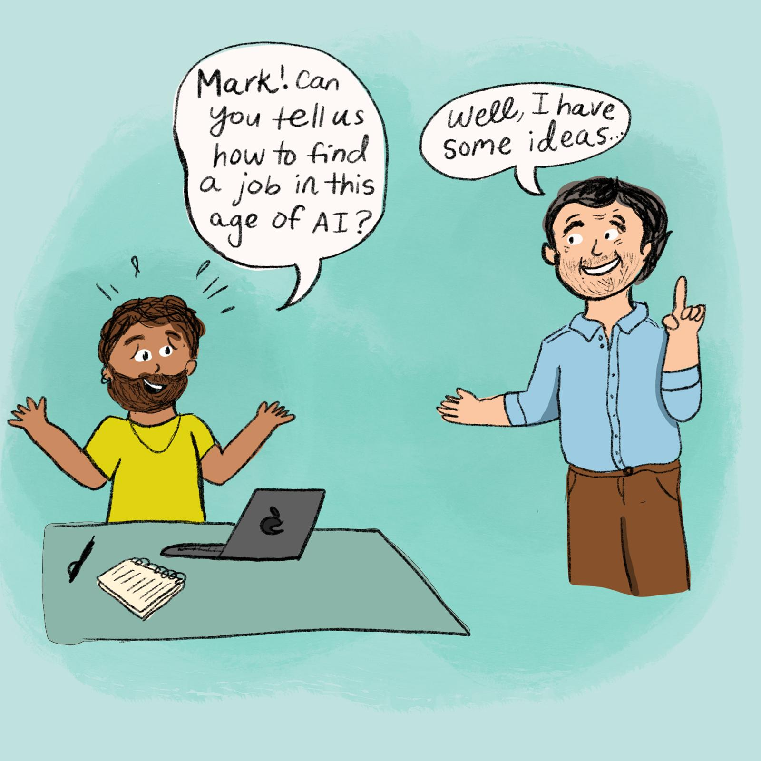
Yes, you will have to learn
The AI will be your helper on the way
DIY
  AI for Everyone
  Elephant Scale Webinar
For your company
  https://elephantscale.com/
  info@elephantscale.com
Copyright © 2026 by Elephant Scale, All Rights Reserved

Slide 20
The Two-Day Map
Day | Modules | You go from...
1 | 1 — How Modern AI Assistants Work | a mental model of how the model behaves
1 | 2 — The Anatomy of a Strong Prompt | building prompts from six blocks, not guesswork
1 | 3 — Prompting for Real Business Scenarios | on-brand marketing, sales, support & ops output
2 | 4 — Advanced Techniques | reasoning, prompt chains, grounding in your docs
2 | 5 — Refining, Testing & Evaluating | scoring prompt quality instead of guessing
2 | 6 — Building & Governing Prompt Systems | a reusable, versioned team prompt library
2 | 7 — Capstone | a working AI solution for your own work + a plan
In every module you build a real artifact you can take back to work.
Copyright © 2026 by Elephant Scale, All Rights Reserved

Slide 21
Ground Rules
Use classroom-approved accounts and data only.
Do not upload confidential information unless the environment is explicitly approved for it.
Verify important facts before you act on them — the model can be confidently wrong.
Keep a human approval step in any workflow that sends, publishes, deletes, or buys.
Copyright © 2026 by Elephant Scale, All Rights Reserved
Notes:
These four habits separate a useful AI habit from an expensive mistake. We make them second nature starting with Lab 01.

