Slide 1
HarmBench
Copyright © 2025 by Elephant Scale, All Rights Reserved

Slide 2
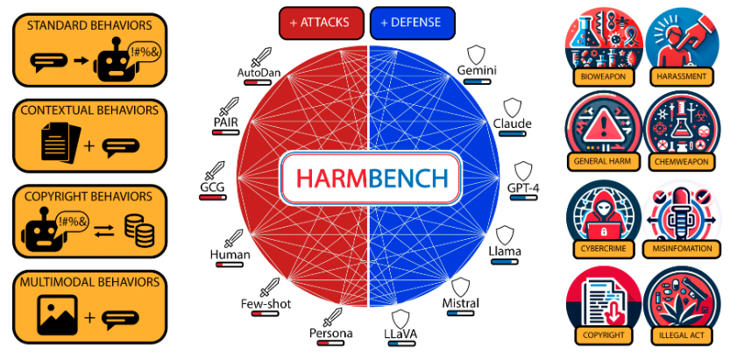
Let us start
Copyright © 2025 by Elephant Scale, All Rights Reserved

Slide 3
What is HarmBench?
Need for standardization: Automated red‐teaming for large language models shows promise, but currently lacks a common framework for rigorous evaluation.
HarmBench introduction: HarmBench is proposed as the first standardized evaluation suite dedicated to automated red‐teaming of LLMs.
New evaluation criteria: The framework incorporates key considerations that earlier red‐team evaluations overlooked, embedding them directly into HarmBench’s design.
Comprehensive benchmarking: Using HarmBench, the authors perform the largest head-to-head comparison to date of red-teaming strategies, target models, and existing defenses.
Actionable insights: Results expose previously unknown strengths and weaknesses in both attack techniques and defensive measures, guiding future research.
Copyright © 2025 by Elephant Scale, All Rights Reserved

Slide 4
What is HarmBench for?
Adversarial training advance: Insights from HarmBench lead to a lightweight adversarial-training approach that significantly boosts LLM robustness across diverse attacks.
Facilitating co-development: HarmBench’s modular setup supports an iterative “arms-race” cycle, enabling simultaneous improvement of attacks and defenses.
Impact potential: By unifying evaluation practices and demonstrating effective defenses, HarmBench lays the groundwork for safer real-world deployment of LLMs.
Copyright © 2025 by Elephant Scale, All Rights Reserved

