Slide 1
Protection Cookbook
Copyright © 2025 by Elephant Scale, All Rights Reserved

Slide 2
First pinch of advice
Prompt Guard for prompt injection detection
Redact for sensitive information detection and transformation
Secure Audit Log for sensitive information access tracking
Sanitize to protect against malicious links
Threat Intelligence to detect malicious entities
Copyright © 2025 by Elephant Scale, All Rights Reserved
Notes:
Source: Pangea

Slide 3
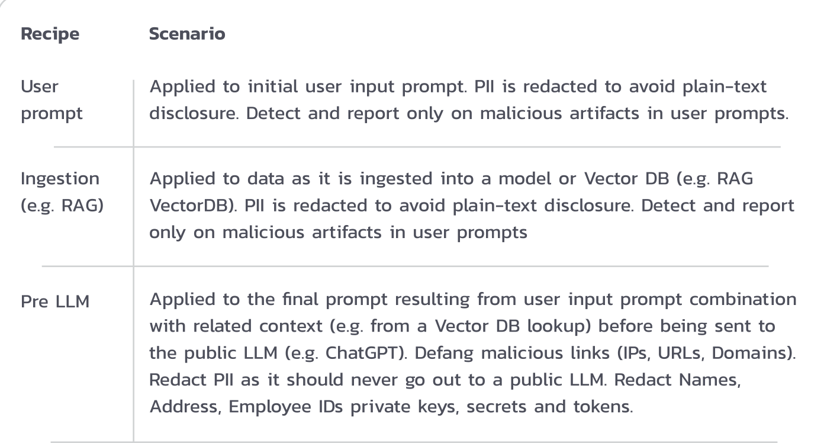
Recipe book 2
Copyright © 2025 by Elephant Scale, All Rights Reserved

Slide 4
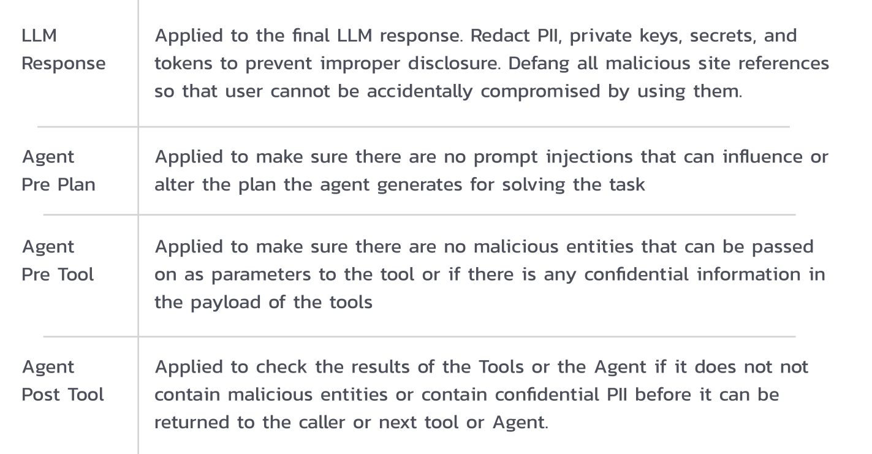
Recipe book 3
Copyright © 2025 by Elephant Scale, All Rights Reserved

Slide 5
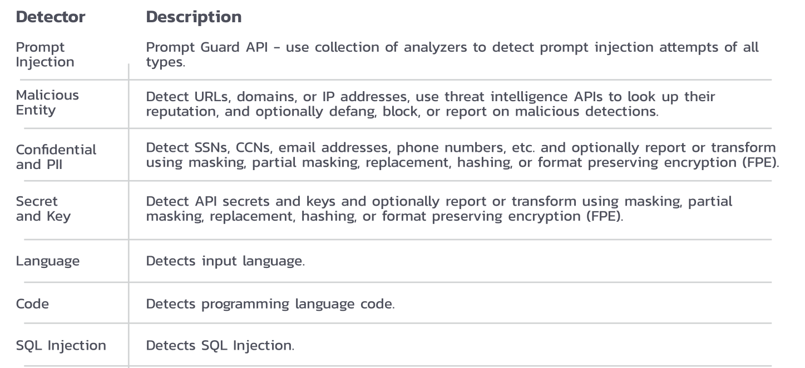
Protectors 1
Copyright © 2025 by Elephant Scale, All Rights Reserved

Slide 6
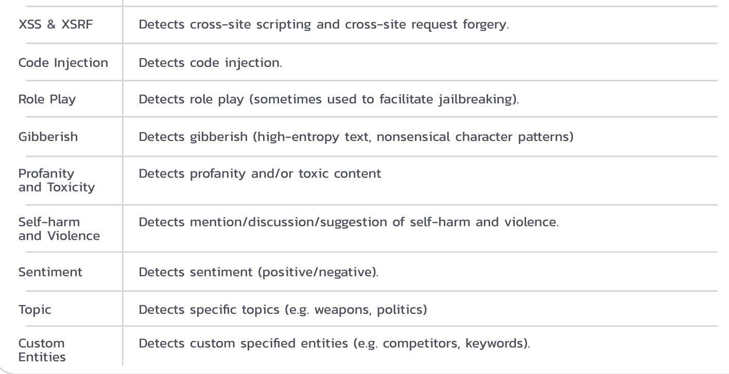
Protectors 2
Copyright © 2025 by Elephant Scale, All Rights Reserved

