Slide 1
OSI Security Model
The OSI Layers
Common Attacks by Layer
Defense in Depth
Copyright © 2025 by Elephant Scale, All Rights Reserved

Slide 2
The OSI Layers
The OSI Layers Common Attacks by Layer Defense in Depth
Copyright © 2025 by Elephant Scale, All Rights Reserved

Slide 3
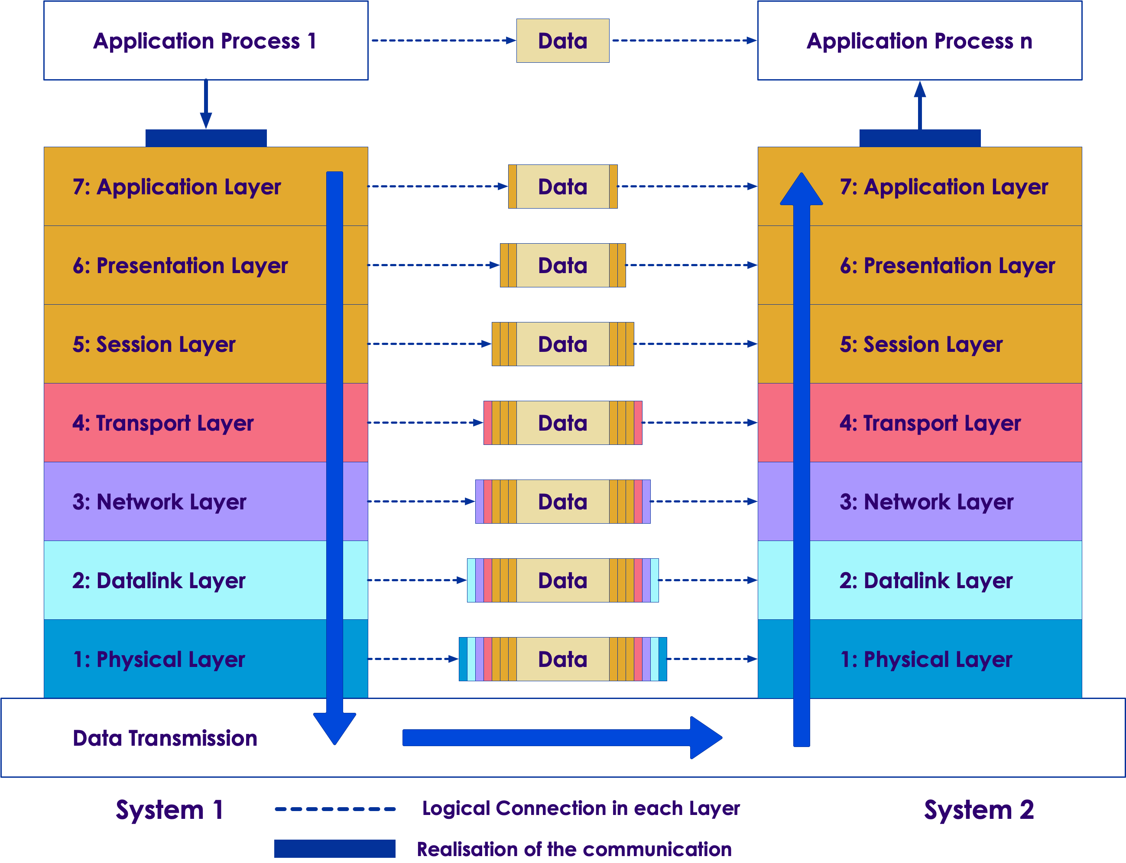
The OSI Layers
Open System Interconnection or OSI layers
Reference model for how information from software in one device moves to an application on another computer
Copyright © 2025 by Elephant Scale, All Rights Reserved
Notes:
Image credit: https://superuser.com/questions/874393/what-protocol-is-used-to-transfer-a-message-in-a-http-application Licensed for free use and sharing with attribution and without modification

Slide 4
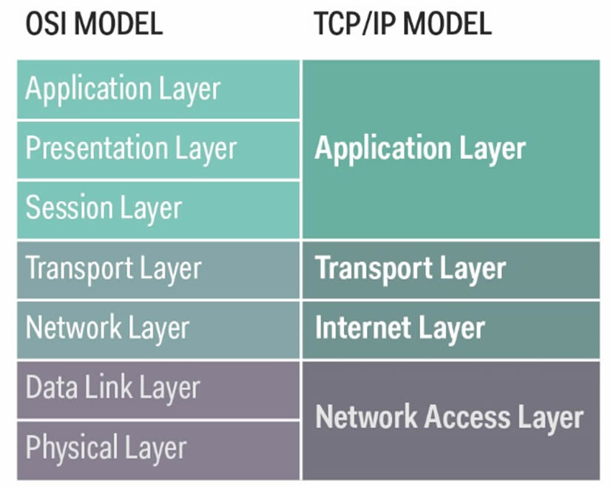
The OSI Layers
Maps to various implementations
TCP/IP architecture for example
Copyright © 2025 by Elephant Scale, All Rights Reserved
Notes:
Image Credit: https://nicolaswindpassinger.com/osi-reference-model

Slide 5
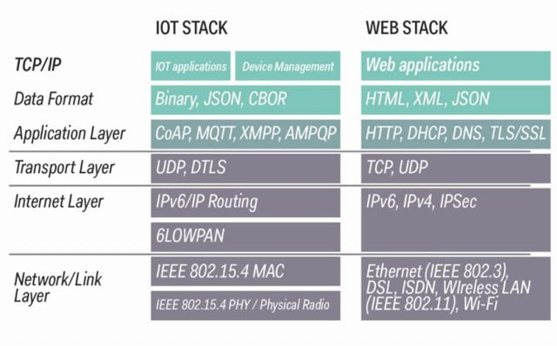
The OSI and IoT
OSI maps to different protocols and standards for web and IoT worlds
Copyright © 2025 by Elephant Scale, All Rights Reserved
Notes:
Image Credit: https://nicolaswindpassinger.com/osi-reference-model

Slide 6
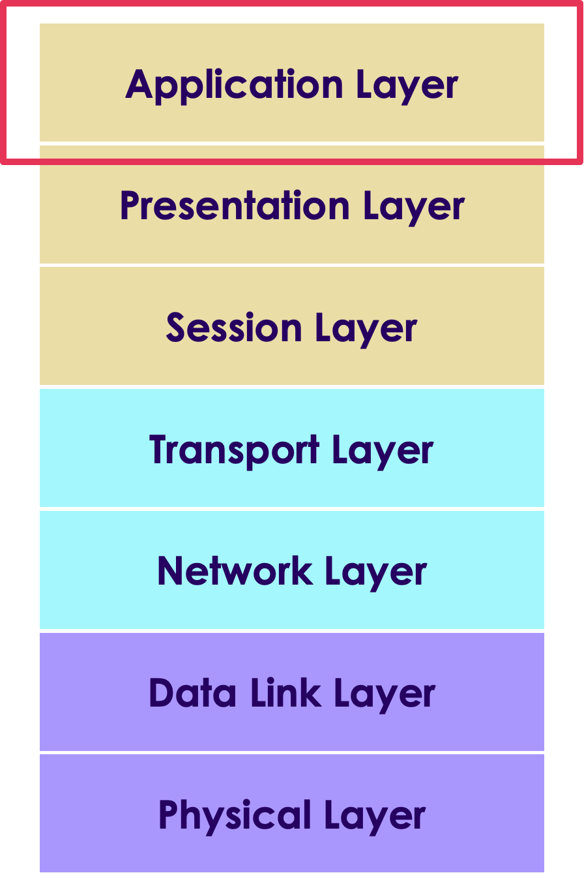
Application Layer
Represents processes on the level of applications and users, IoT and otherwise
Links the business application access to network services
Messaging protocols found at this layer CoAP, MQTT, XMPP, AMPQP and HTTP
Copyright © 2025 by Elephant Scale, All Rights Reserved
Notes:
Ref:

Slide 7
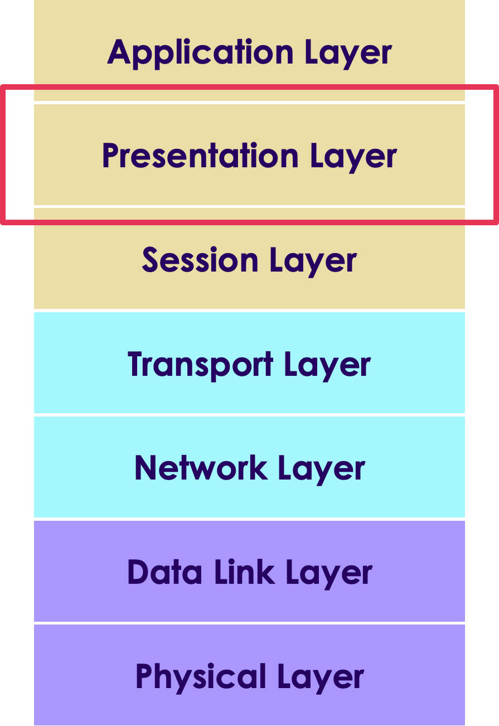
Presentation Layer
Formats and encrypts data for communication.
Resolves compatibility issues in the communication between the application and the network.
For example, TLS class of cryptographic protocols
Copyright © 2025 by Elephant Scale, All Rights Reserved
Notes:
Ref:

Slide 8
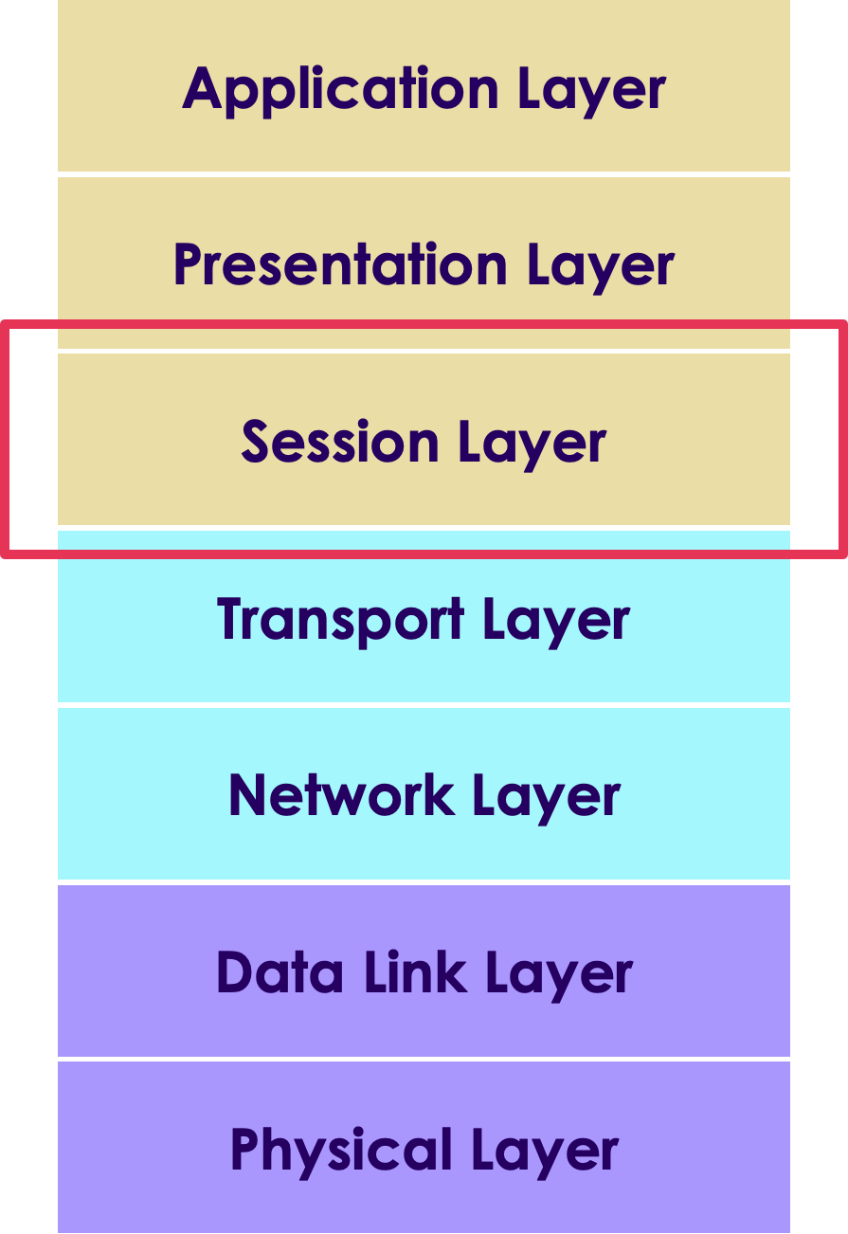
Session Layer
Connections between local and remote applications are initiated, managed and terminated here
Manages sessions over multiple devices on the same network
Copyright © 2025 by Elephant Scale, All Rights Reserved
Notes:
Ref:

Slide 9
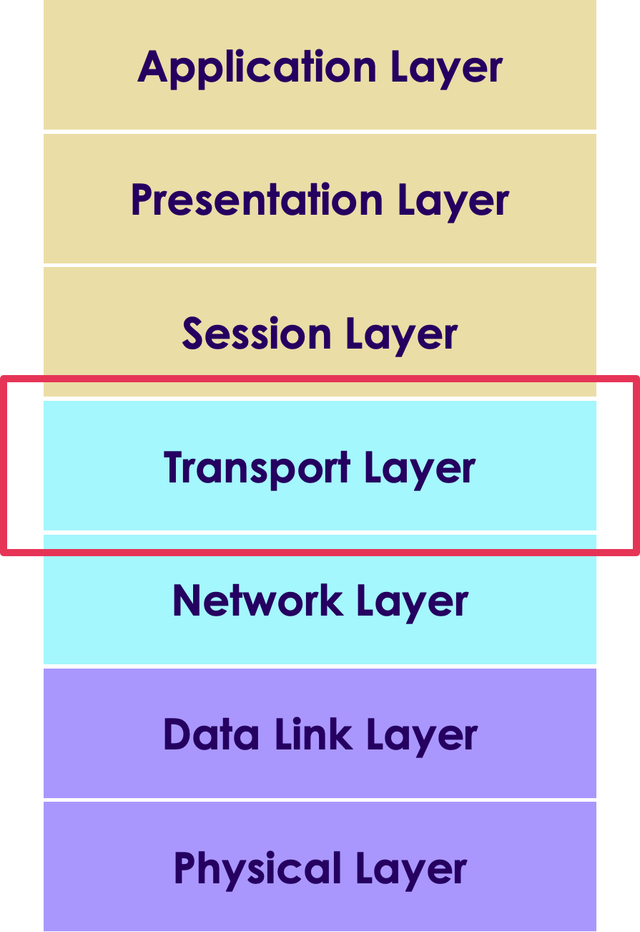
Transport Layer
Manages the host-to-host data transmission
Ensures that data transfers between hosts are completed.
Manages error recovery and retransmission of lost data.
TCP and UDP are two common protocols in this layer
Copyright © 2025 by Elephant Scale, All Rights Reserved
Notes:
Ref:

Slide 10
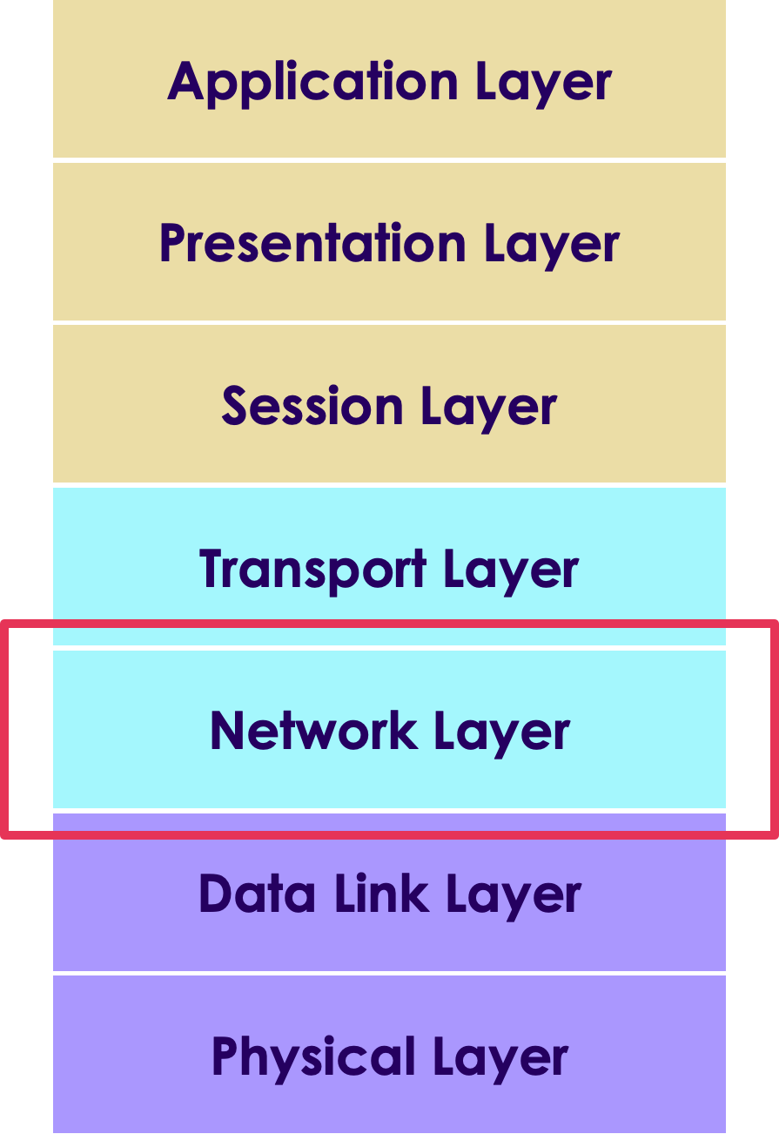
Network Layer
Responsible for routing and transferring data packets between different nodes across various networks
Includes the IP the Internet Protocol part of TCP/IP
Of concern to IoT is that it also includes IPv4 and IPv6
Copyright © 2025 by Elephant Scale, All Rights Reserved
Notes:
Ref:

Slide 11
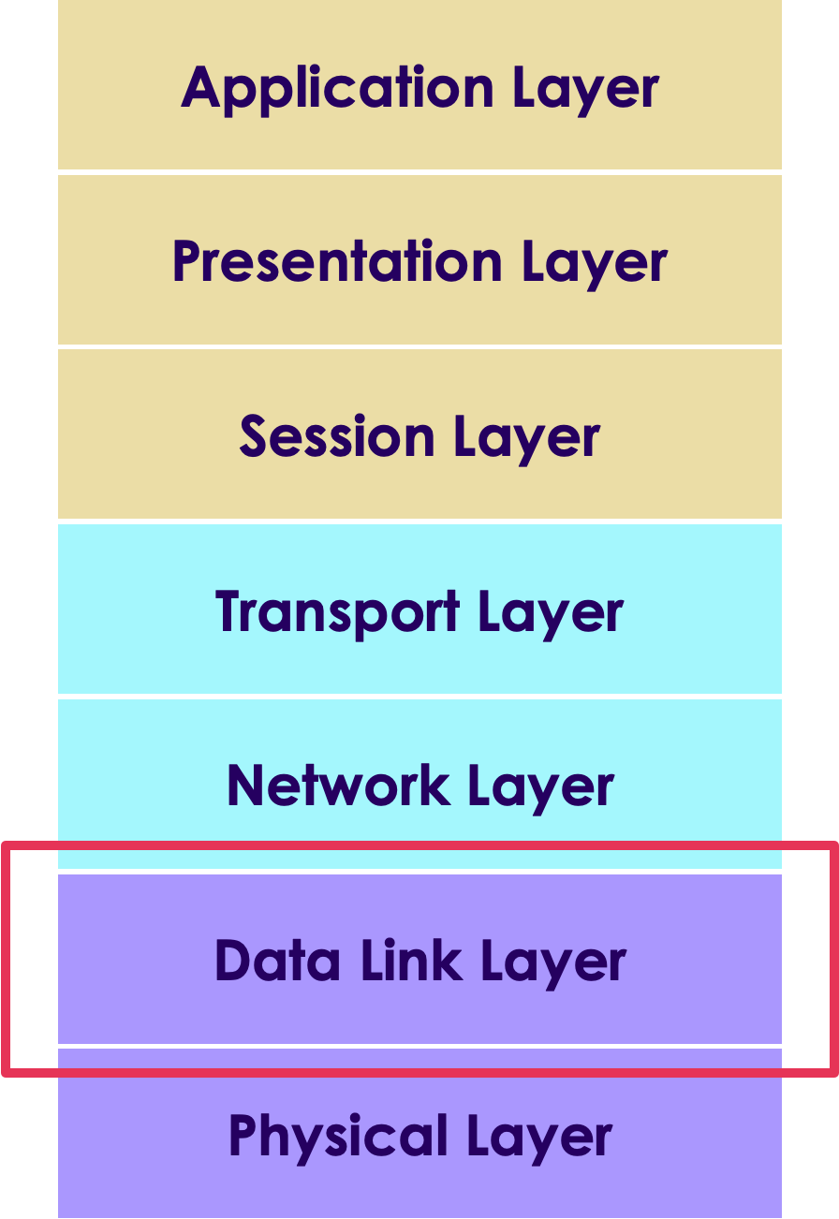
Data Link Layer
Later where data transfer between two directly connected nodes in a network takes place
Divided into two sub layers:
Medium access control layer (MAC layer)
Logical link control layer (LLC).
Various IEEE 802 standards apply to this layer
IEEE 802.15.4 or low rate Wireless PAN for example
Copyright © 2025 by Elephant Scale, All Rights Reserved
Notes:
Ref:

Slide 12
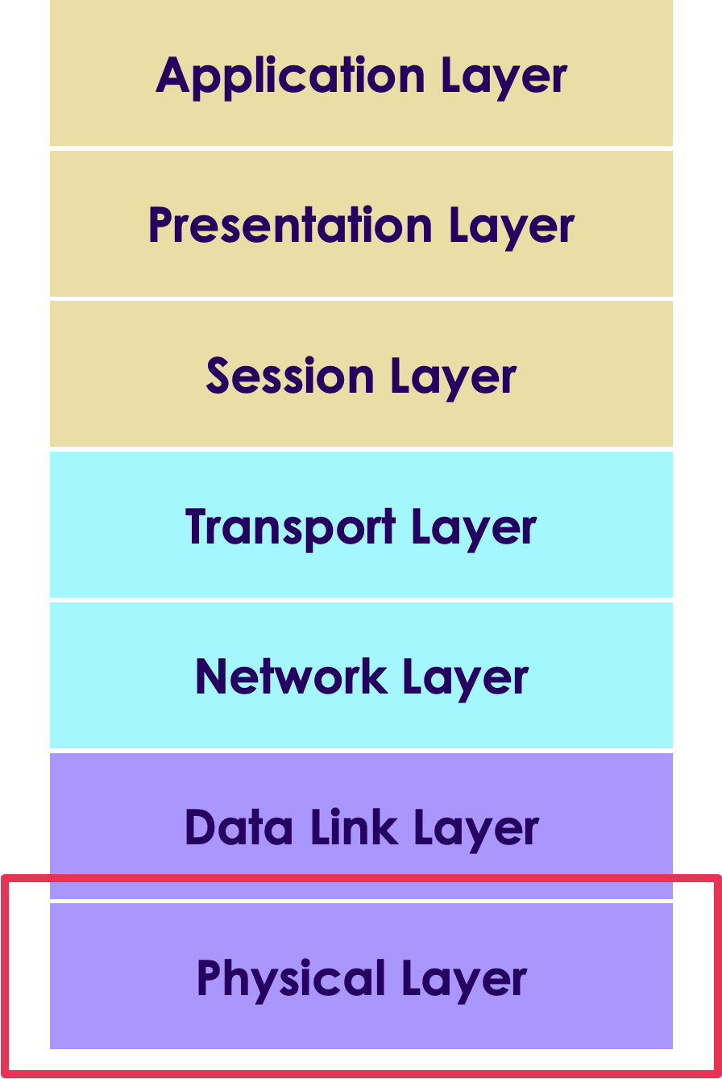
Physical Layer
Layer where networks are organized
Foundation of IoT and its connected
Includes the essential physical structure needed to make the IoT possible
E.g., cables and radio frequency links
Essential transmission specifications, communication protocols and hardware on a device and data level.=
Copyright © 2025 by Elephant Scale, All Rights Reserved
Notes:
Ref:

Slide 13
OST Intuitive Model
Using OSI to figure out why an application isn't working
Layer 1: Physical
Is the network cable plugged in?
Layer 2: Data Link
Do you have a link light?
Layer 3: Network
Are you getting an IP?
Layer 4: Transport
Can you connect to your default gateway?
Layer 5: Session
Do you have DNS server information?
Can you ping 4.2.2.2 but not google.com?
Layers 6&7: Presentation & Application
Can you browse to a site?
Copyright © 2025 by Elephant Scale, All Rights Reserved

Slide 14
Common Attacks by Layer
The OSI Layers Common Attacks by Layer Defense in Depth
Copyright © 2025 by Elephant Scale, All Rights Reserved

Slide 15
Examples of Attacks at Each Level
Layer | Description | Attack
7 | Application | Social Engineering, UserID/Password sniffing. Lack of role-based security for admin and support. Spoofing authentication credentials
6 | Presentation | Phishing, TLS/SSL sniffing Breaking weak or faulty encryption
5 | Session | Hacking – Telnet and FTP hacking Access to unsecured applications
4 | Transport | TCP Sessions sniffing Port sniffing
3 | Network | Man in the Middle Attacks Port sniffing
2 | Data Link | Spoofing MAC/ARP sniffing
1 | Physical | Sniffing, physical device compromise
Copyright © 2025 by Elephant Scale, All Rights Reserved

Slide 16
Application Level Security
Refers to the applications that support the end user functions
Applications at this layer include FTP, SMTP and other services
Supports user applications with that authentication and authorization
Main security challenge for IIoT is unauthorized access to control systems
Entry point to introduce additional vectors – e.g, creating backdoors for future attacks
Common attack vector using social engineering, phishing and other deceptive exploits
First line of defense is strong organizational procedures and policies on issuing, revoking and changing authentication credentials
Copyright © 2025 by Elephant Scale, All Rights Reserved

Slide 17
Application Level Security
UserID/Password is common authentication
Often implemented with weak account policy
Users suffer from password fatigue
Tend to use the same password across accounts
Tend to use short easy to guess passwords
Tend to not change their passwords
Copyright © 2025 by Elephant Scale, All Rights Reserved
Notes:
Several attacks have been documented where an individual used the same password for an administration account as they did for a social media account. The credentials were hacked from the social media account and then used to access the corporate network.

Slide 18
Application Level Security
Mitigations
Password policy requiring strong passwords and regular rotations
Use generated tokens instead of passwords
These have higher entropy and are harder to crack
Eliminates the problem of password reuse
MFA – multi-factor authentication
Requires authentication from two of three possible sources
What the user knows – password or token
Where the user is – specific IP address
Something the user has – mobile phone for a confirmation code
Copyright © 2025 by Elephant Scale, All Rights Reserved
Notes:
Several attacks have been documented where an individual used the same password for an administration account as they did for a social media account. The credentials were hacked from the social media account and then used to access the corporate network.

Slide 19
Presentation Level Security
Encryption is performed at this layer
Common attacks often involve weak or missing encryption
There must be both encryption for data in transit and encryption for data at rest
Copyright © 2025 by Elephant Scale, All Rights Reserved

Slide 20
Presentation Level Security
Exploitable weaknesses can occur when:
An encryption standard is used that is too weak, one that has known weaknesses for example
Flawed implementation of the encryption such as:
Keys are too short
Salts are not used in digests allowing the use of rainbow tables to reverse engineer passwords
Using an encryption library that has not been fully vetted
Using a home-grown encryption library that is not full tested
Flawed application of an encryption application
Failure to encrypt data when it should be
Not encrypting some data that is accessible
Copyright © 2025 by Elephant Scale, All Rights Reserved

Slide 21
Presentation Level Security
Presentation level security can be subverted at the application level
Called a Man in the Browser (MiTB) attack
Access is gained at the application level to steal or alter data before it become encrypted
Often the result of human engineering
Compromised user installs malware
Or malware is installed from a phishing or other attack
Can be mitigated to a degree by isolation
Applications used for systems control do not have access to other applications
No public access to the user control apps
Only the absolute minimum network access to private networks
Ideally, control systems only connect to the system they control
Copyright © 2025 by Elephant Scale, All Rights Reserved

Slide 22
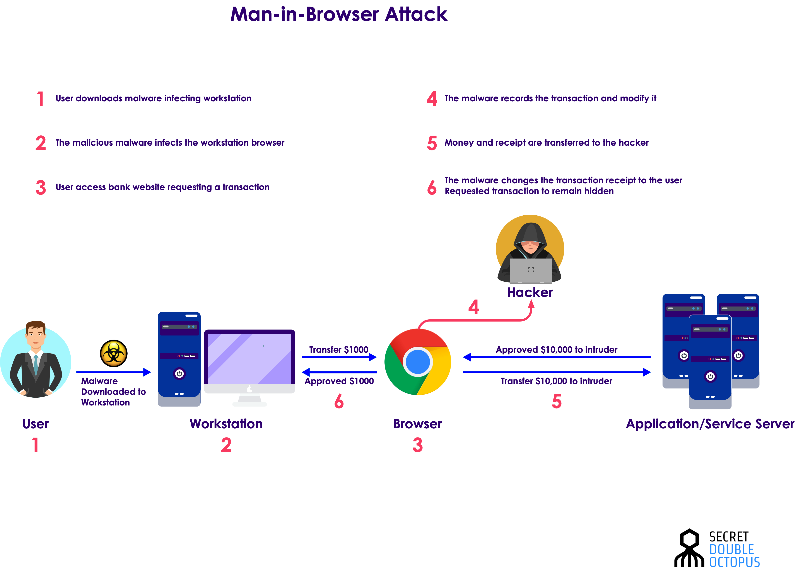
Man in the Browser
Copyright © 2025 by Elephant Scale, All Rights Reserved

Slide 23
Session Level Security
The main attacks at this level deal with interfering with sessions or some sort of session hijack
Man in the Middle (MiTD) attacks occur when an adversary can intercept communications between two parties in a session
A main risk is that an adversary could take over an automated system by hijacking a session between the system and an operator
Some potential exploits
Failure to use regular confirmation of identity of participant
Ignoring warning about expired TSL certificate for example
Failure to rotate credentials during a session
The longer a set of credentials is used, the more likely they are to be hacked
Failure to securely transmit session information
Often makes the session tokens or ids guessable by an adversary
Copyright © 2025 by Elephant Scale, All Rights Reserved

Slide 24
Transport Level Security
Internet based attacks probe for open ports
Can be used to inject malware
Malware often opens other ports as a backdoor
Mitigations involve
Regular port scans
Use of non-standard ports to confound probing for commonly used ports
Firewalls to block access to most ports except those explicitly allowed on a whitelist
Known or published IP addresses are potential targets
Mitigations involve
Use of an API gateway to map external IP addresses to internal addresses
Use of filtering and firewalling on the gateway
Establishment of a DNZ
Copyright © 2025 by Elephant Scale, All Rights Reserved

Slide 25
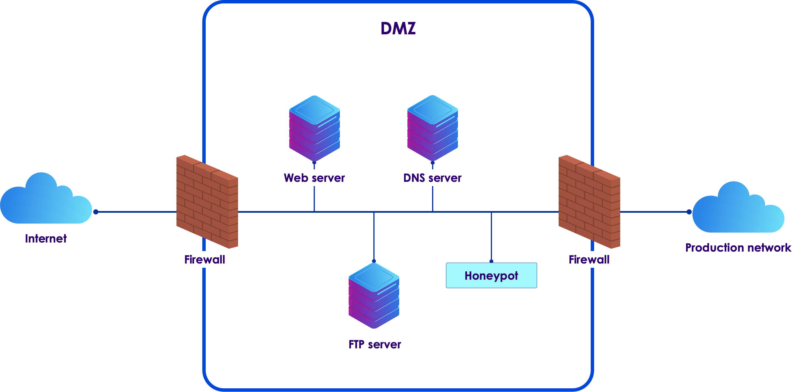
Demilitarized Zone and Honey Pots
DMZs connect internal networks to the outside world
Internal networks cannot be accessed directly
Must go through the DMZ
Including standard application-level attacks
Honeypots are fake networks
Designed to distract attackers
They wind up attacking the honeypot instead of the industrial system
Copyright © 2025 by Elephant Scale, All Rights Reserved

Slide 26
Network Layer Security
Level at which most network hardware operates
Switches, routers, firewalls, etc.
Attacker can reroute traffic via a compromised router
Many commercial routers have security flaws
Malware insertion into network devices is a common attack
Used by the NSA as part of their Tailored Access Operations (TAO)
Network devices are physically intercepted during shipment
Malware is installed to create backdoors
Security analyses often overlook off the shelf hardware
Copyright © 2025 by Elephant Scale, All Rights Reserved

Slide 27
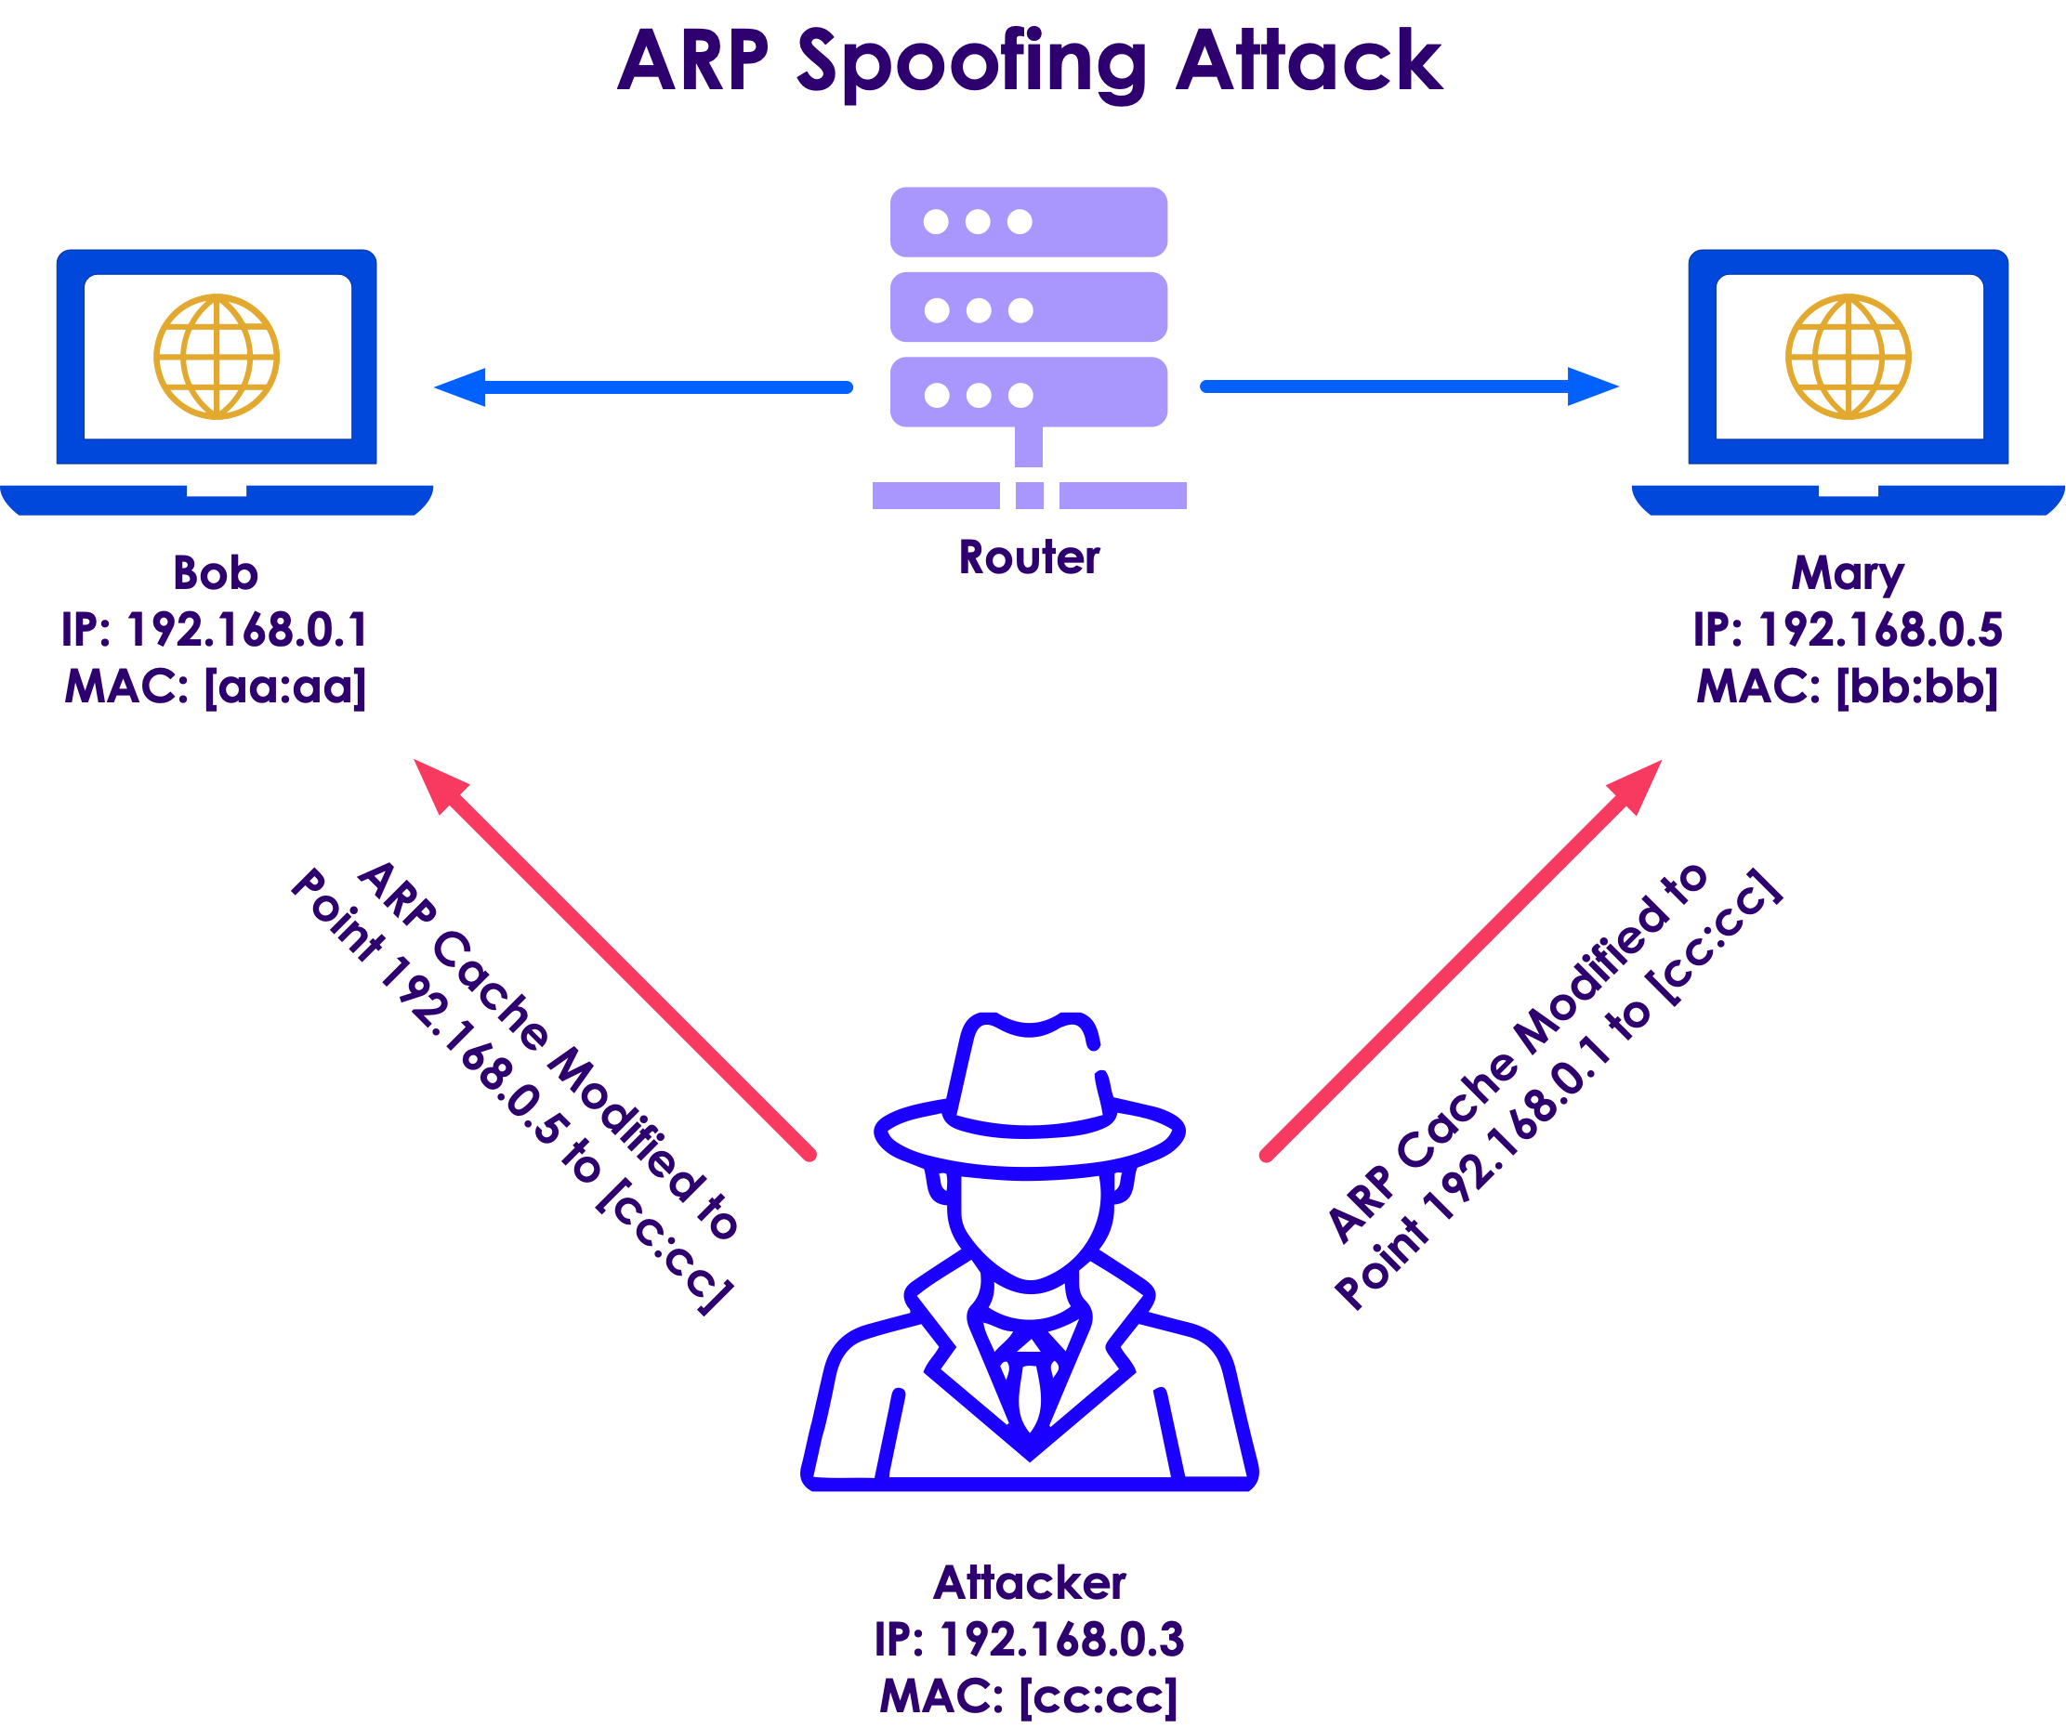
ARP Spoofing Attack
Copyright © 2025 by Elephant Scale, All Rights Reserved

Slide 28
Network Layer Security
Mitigations involve
Using NAT and other address translation strategies
Physically secure network equipment
Breeches at this layer commonly occur inside the organization
The use of VPNs where possible
However, this does add a layer of latency and complexity
Full security audits of all network equipment
Copyright © 2025 by Elephant Scale, All Rights Reserved

Slide 29
Data Link Layer Security
This layer works on the MAC address and packet layer
Common attack is to force a Network Interface Controller (NIC) into promiscuous mode
This allows it to absorb traffic intended for other machines
This is also the layer where attackers may spoof a MAC address
Mitigation
A common mitigation is to create separate virtual LANS (VLANs) on a single physical LAN
Access control lists can then be applied to the different VLANs
Disabling unused ports also helps at this layer too
Copyright © 2025 by Elephant Scale, All Rights Reserved

Slide 30
Physical Layer Security
Most common attack is compromised physical devices
Access to the devices creates opportunities for insertion of malware or physical taps or attacks
First line of defense
Physically isolate and lock up all the equipment
Allow access only to vetted people who need access
Use the lowest level of access needed
Social engineering attacks try to convince staff to allow access to bad actors
Mitigation is to have strongly enforced security measures
"We will not open the server room for anyone who claims to have lost their keycard."
Physical interception is done by accessing cables and other devices – data taps for example
Also done by monitoring EM signals from monitors and other devices
Copyright © 2025 by Elephant Scale, All Rights Reserved

Slide 31
Physical Layer Security
Common vector to disable physical devices
Power overloads
EM pulses or physical damage
Mitigations
Any device, cable or other "thing" connected to the network is vulnerable
Use proper shielding and physical isolation when necessary
Have a good disaster recover plan for loss of physical assets
Copyright © 2025 by Elephant Scale, All Rights Reserved

Slide 32
Defense in Depth
The OSI Layers Common Attacks by Layer Defense in Depth
Copyright © 2025 by Elephant Scale, All Rights Reserved

Slide 33
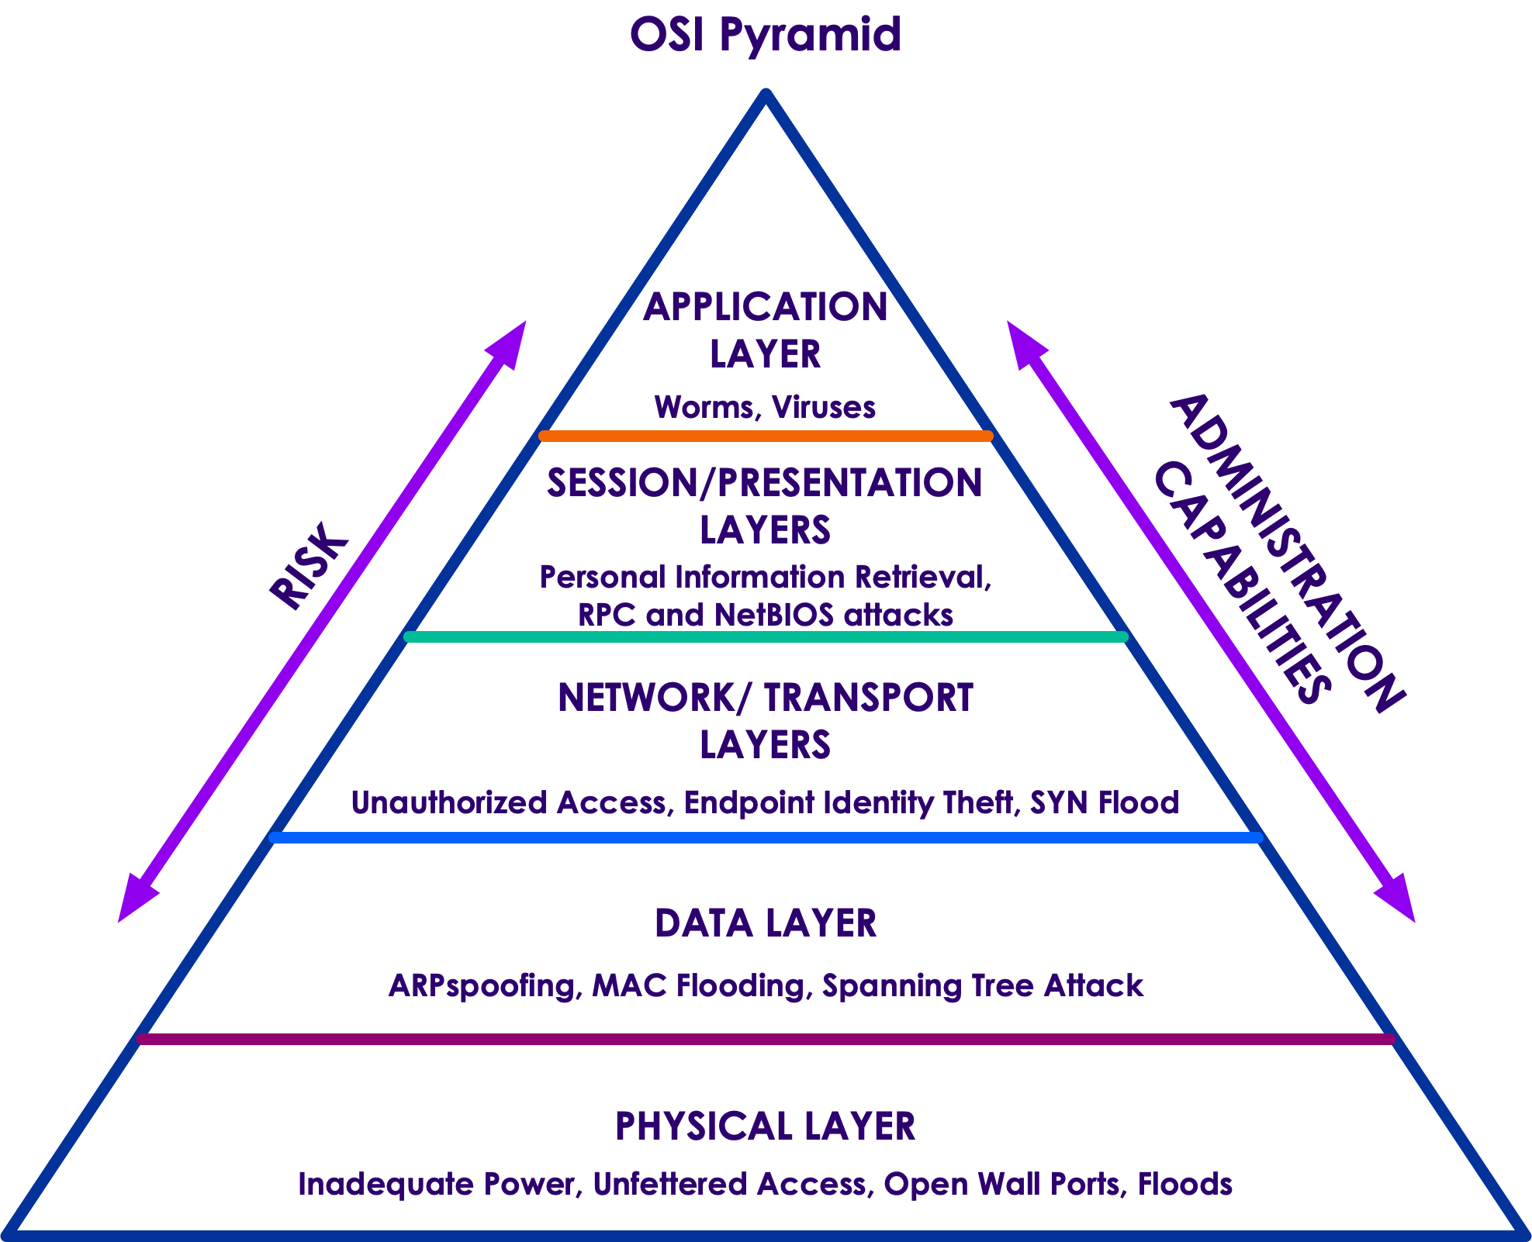
Defense in Depth
Any IoT security solution must include a security model and plan for each of the OSI levels or their equivalent
Any deployed system is as insecure as the security at its weakest level
Copyright © 2025 by Elephant Scale, All Rights Reserved

Slide 34
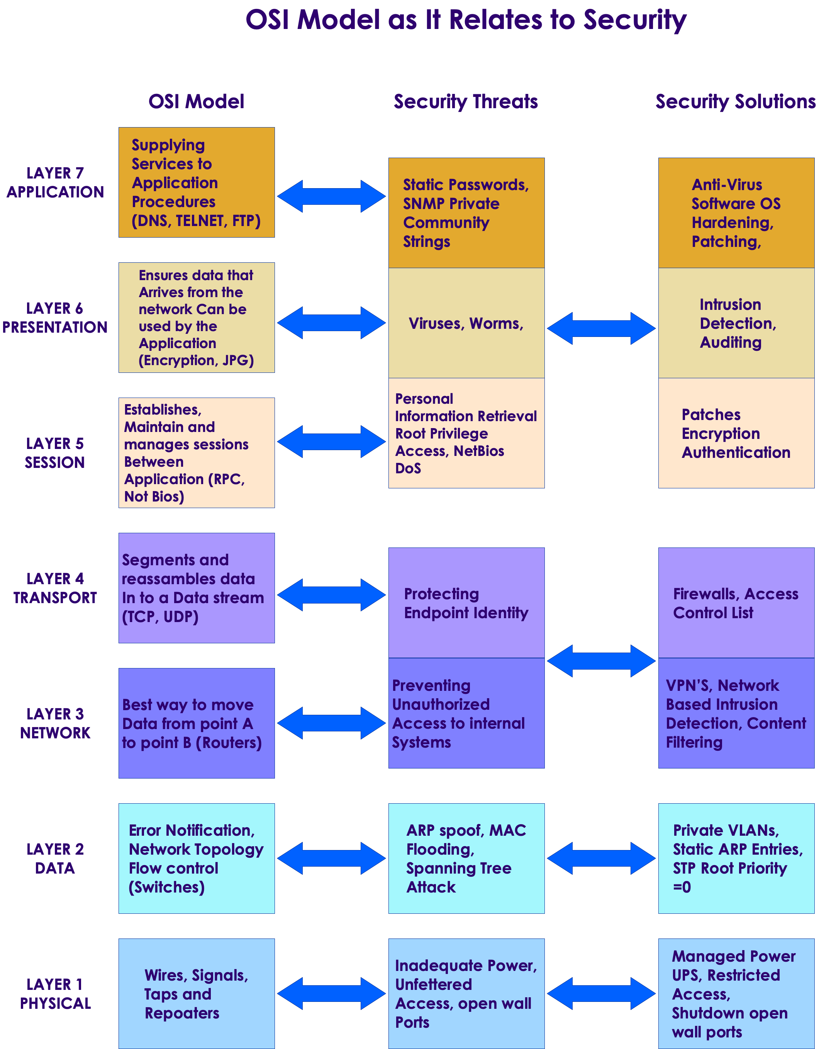
OSI mitigations
Copyright © 2025 by Elephant Scale, All Rights Reserved

Slide 35
Layer One Attacks
Traditional cybersecurity improvements push attackers toward alternative paths
The physical layer has become a fertile ground for attacks
Effectively, the soft underbelly of cybersecurity
Can take the form of a compromised employee planting a device on the network
Rogue and insecure hardware is often missed during security audits
Legitimate hardware can be altered to provide insecure access
Zero-trust network security causes attackers to look at physical access via hardware exploits
Even air-gapping is not an effective solution
For example, STUXNET
Copyright © 2025 by Elephant Scale, All Rights Reserved
Notes:
Taken from https://www.helpnetsecurity.com/2021/09/14/osi-layer-1/

Slide 36
Hardware Security Challenges
Firmware can be updated with compromised versions
Often overlooked in security testing
Recommended mitigation
automated security validation tools that can scan for configuration anomalies within their platform and evaluate security-sensitive bits within their firmware
Hardware uses multiple components from different manufacturers, each using a different supply chain
Security has to be enforced across the supply chain
Problem made more urgent by the increased use of systems on chips (SoCs)
SoCs consolidate multiple traditional components on a single chip
Bypasses the more traditional network security analysis
Copyright © 2025 by Elephant Scale, All Rights Reserved
Notes:
Taken from https://www.helpnetsecurity.com/2021/09/14/osi-layer-1/

