Slide 1
Vault introduction
Copyright © 2025 by Elephant Scale, All Rights Reserved

Slide 2

Please meet Vault
"Alice, please meet pudding"
"Pudding, please meet Alice"
From Alice in Wonderland
Copyright © 2025 by Elephant Scale, All Rights Reserved

Slide 3
HashiCorp history
Vagrant was first
Jump into development environment
Packer was next
Build machine images
Serf and Consul
Meet the network challenges of distributed applications
Terraform
Simple IaS
Nomad
Containers with binaries, JARs, VMs
Vault
Was not there
Copyright © 2025 by Elephant Scale, All Rights Reserved

Slide 4
The need for Vault
People need to store TLS certs, usernames, passwords, API keys, etc.
In particular, HashiCorp customers entrusted these to HashiCorp
Where do hackers go for big prizes?
Where the payout is great
So HashiCorp was nervous
But existing approaches did not work
Insecure
Hard to automate
Too complex
Copyright © 2025 by Elephant Scale, All Rights Reserved

Slide 5
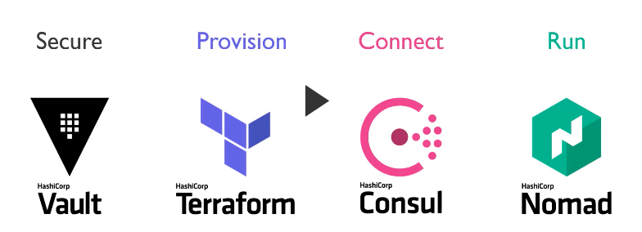
HashiCorp enterprise
Copyright © 2025 by Elephant Scale, All Rights Reserved

Slide 6
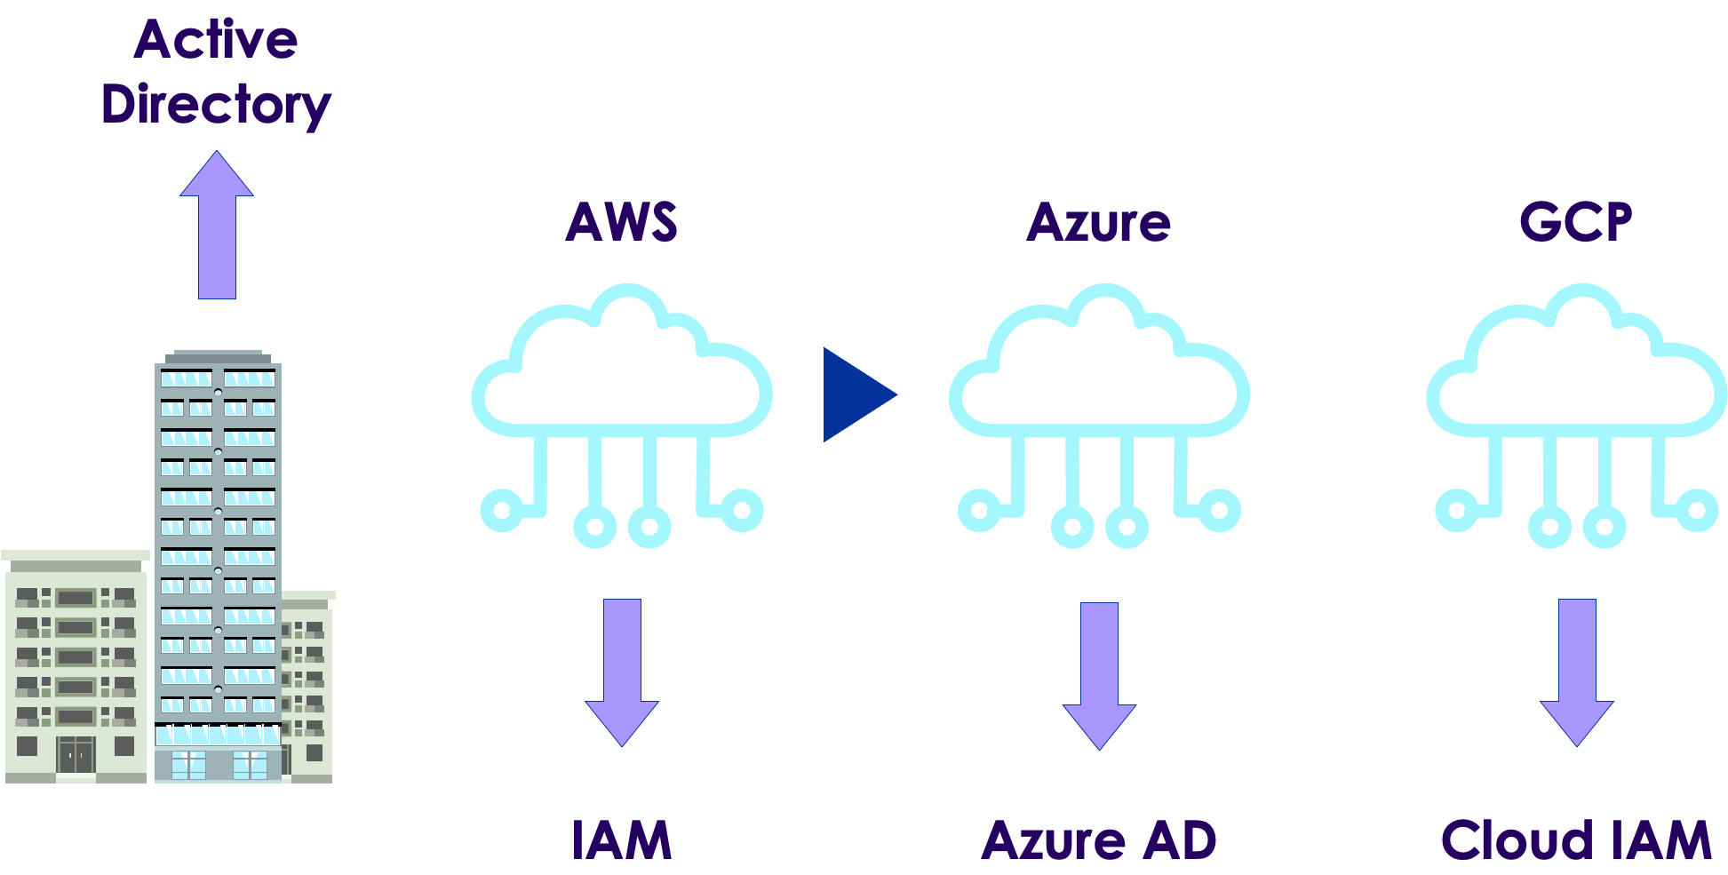
Identity management
Copyright © 2025 by Elephant Scale, All Rights Reserved

Slide 7
So, why Vault?
Allow access to systems and services
Only to authorized users and services
And, it's not easy
For example
Humans don't authenticate the same way as computers
Either humans suffer to computer designs are unnatural
Copyright © 2025 by Elephant Scale, All Rights Reserved

Slide 8
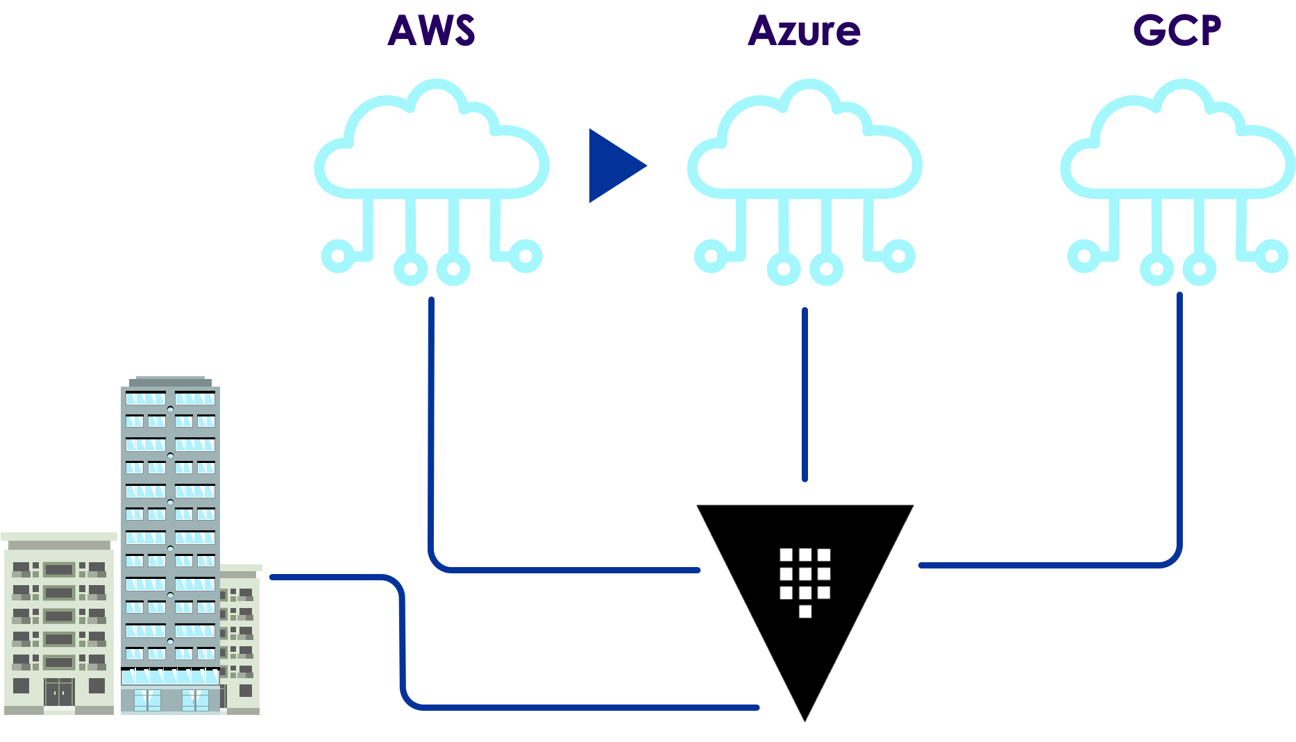
Vault place
Copyright © 2025 by Elephant Scale, All Rights Reserved

Slide 9
Vault idea
Let's look at Kerberos
It's good and popular
But complex and hard to integrate
Kerberos requires systems to integrate using GSS API
Let's invert it!
Instead of requiring every system to speak a common language
Create a plugin for each system
Allow Vault to speak to the system via plugin
Copyright © 2025 by Elephant Scale, All Rights Reserved

Slide 10
Vault plugins
Most RDMBS
NoSQL
Message queues
Public cloud providers
Active Directory
LDAP
More...
Copyright © 2025 by Elephant Scale, All Rights Reserved

Slide 11
Vault manages everyone
That has an API and credentials
Humans
Username/password
Single sign-on (SSO): Active Directory, Okta
Applications
Certificates
Bearer tokens
Cloud vendors
Kubernetes
Nomad
CloudFoundary
Copyright © 2025 by Elephant Scale, All Rights Reserved

Slide 12
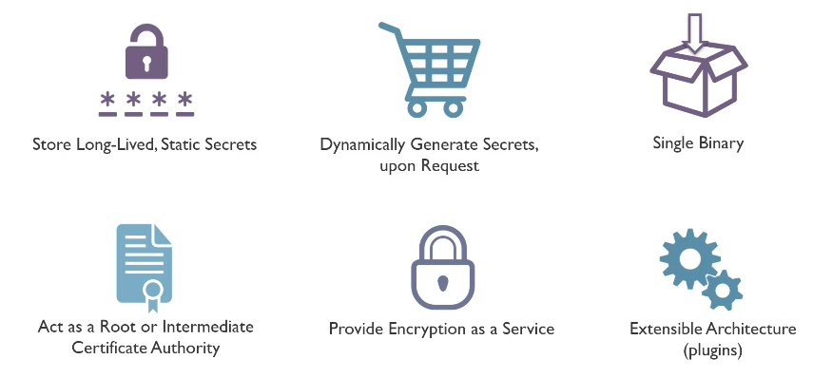
Benefits of Vault
Copyright © 2025 by Elephant Scale, All Rights Reserved

Slide 13
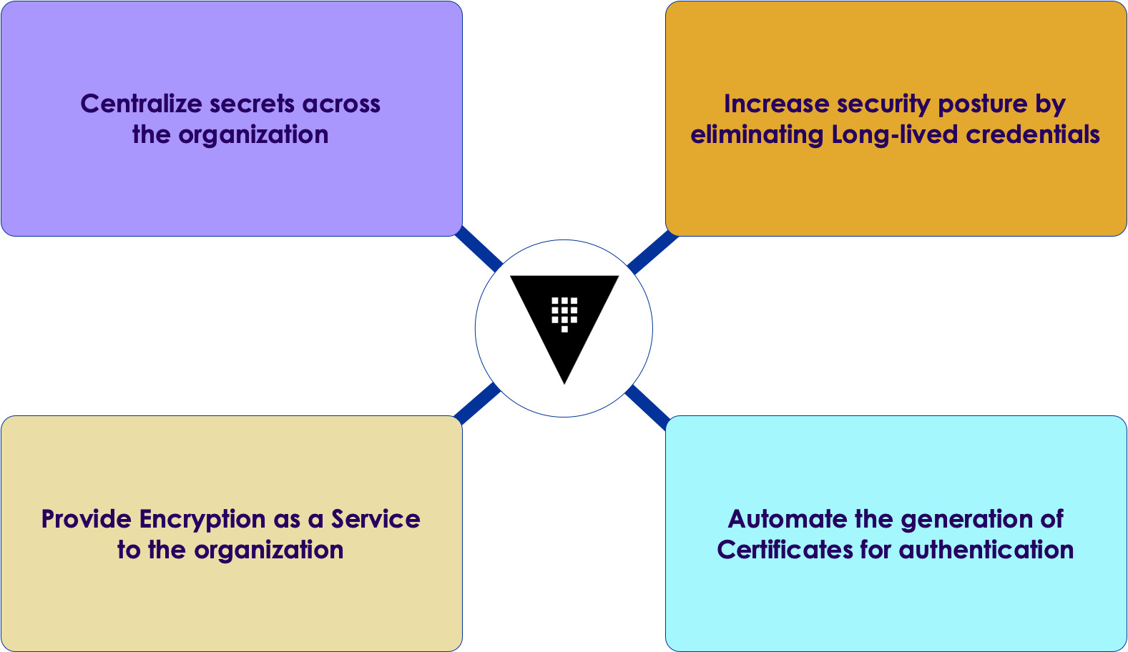
Problems Vault solves
Copyright © 2025 by Elephant Scale, All Rights Reserved

Slide 14
Authentication workflow
As a result of above, Vault was designed to provide
Consistent workflow for authentication of clients
Consistent way to define authorization
Consistent API for getting credentials and performing operations
As a result
Vault is easy to integrate
Plugins support a large ecosystem
Copyright © 2025 by Elephant Scale, All Rights Reserved

Slide 15
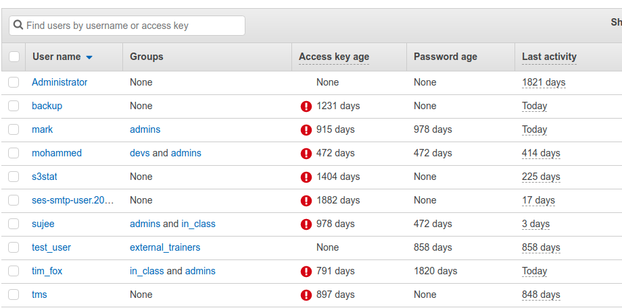
What is great about Kerberos?
Ephemeral access
Never granting long-term credentials
Instead, giving only short-term access
That can be renewed as needed or even revoked
Think of all announcement of breaches due to stolen credentials that are valid for months or years
Amazon keys is one such example (and it did happen to us!)
Copyright © 2025 by Elephant Scale, All Rights Reserved

Slide 16
But how?
Question:
How to bring this idea to Vault
Keep in mind, most systems to integrate with have not similar concept
Answer:
"Dynamic secret"
Secret engine
Creates an entirely dynamic username and password
Or, API token depending on the system
Copyright © 2025 by Elephant Scale, All Rights Reserved

Slide 17
Dynamic Secret
Credential that is only leased to the client
Day 1
Application or user needs certain privileged credentials
Day 2
Rotation of credentials
Revocation of access
Offboarding
With dynamic secret
The credential is automatically destroyed at the end of its time to live
If the client stores a copy of the credentials -
The target system will still reject it
Copyright © 2025 by Elephant Scale, All Rights Reserved

Slide 18
Leases are short-lived
Since leases are short-lived
Clients are forced to periodically come back to Vault
Renew a lease, or
Fetch a new dynamic secret
Advantages
Automate credential rotation
Elegant workflow for Day 2 challenge
Copyright © 2025 by Elephant Scale, All Rights Reserved

Slide 19
Building on Vault
Common challenges
Encrypting customer data
Key management
Answers
Secret engine (a.k.a. "transit" engine)
Holds encryption keys within Vault
Exposes API
Encryption
Decryption
Signing
Verifying transactions
More...
Leave key management and cryptography to Vault
Copyright © 2025 by Elephant Scale, All Rights Reserved

Slide 20
Vault today
Keeps initial capabilities and design
Supports a big number of authentication methods and secrets engines
Richer automation capabilities
Easier with CLI and web-based interface
Ecosystem integrations
Configuration management systems
Application platforms
Low-level data management
Encryption solutions
Key advantage: simplicity
(compared to the problem it attempts to solve)
Copyright © 2025 by Elephant Scale, All Rights Reserved

Slide 21
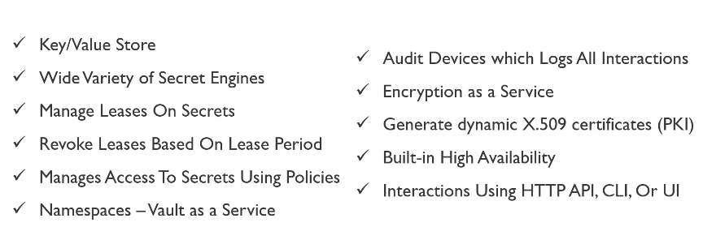
What Vault provides
Copyright © 2025 by Elephant Scale, All Rights Reserved

Slide 22
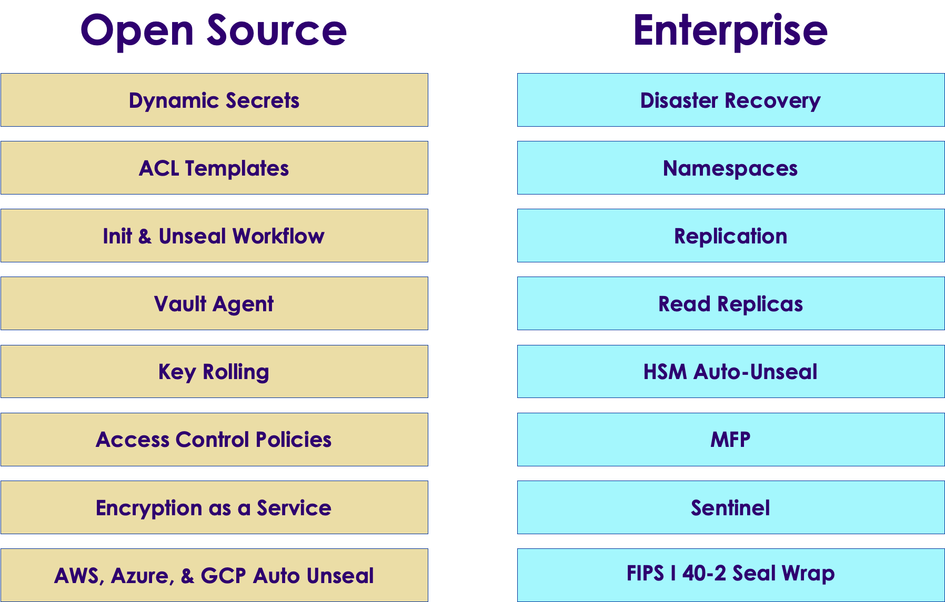
Vault open-source vs Enterprise
Copyright © 2025 by Elephant Scale, All Rights Reserved

Slide 23
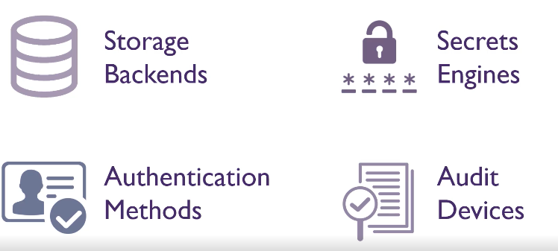
Vault components
Copyright © 2025 by Elephant Scale, All Rights Reserved

Slide 24
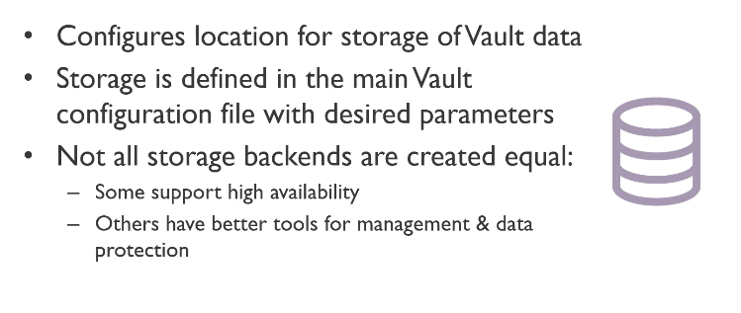
Vault storage backends
Copyright © 2025 by Elephant Scale, All Rights Reserved

Slide 25
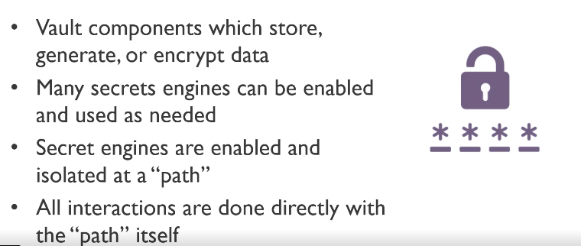
Vault secrets engines
Copyright © 2025 by Elephant Scale, All Rights Reserved

Slide 26
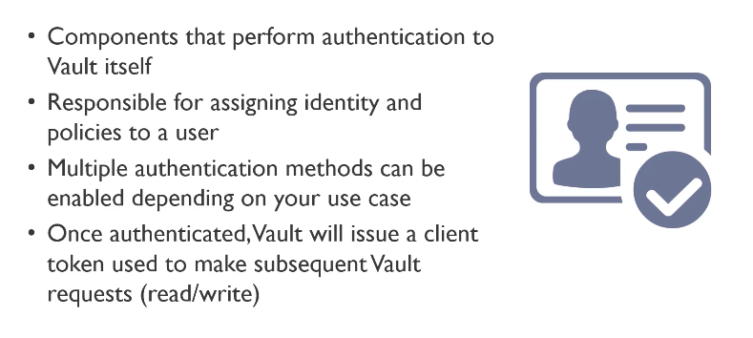
Vault auth methods
Copyright © 2025 by Elephant Scale, All Rights Reserved

Slide 27
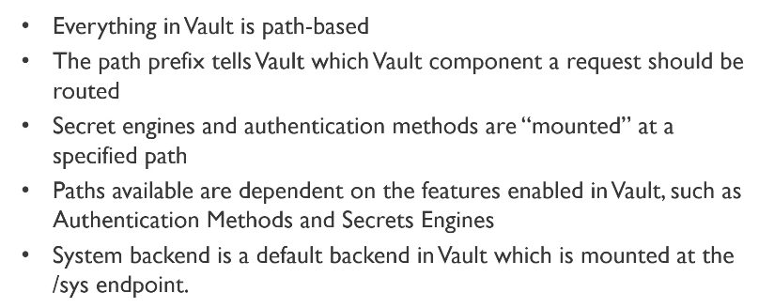
Vault paths
Copyright © 2025 by Elephant Scale, All Rights Reserved

Slide 28
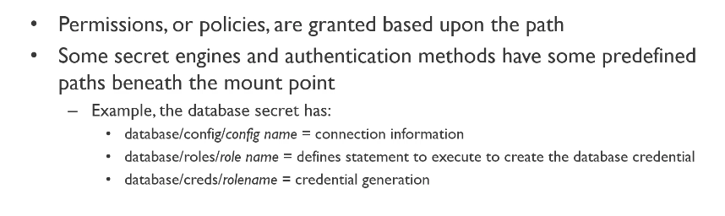
Vault paths cont'd
Copyright © 2025 by Elephant Scale, All Rights Reserved

Slide 29
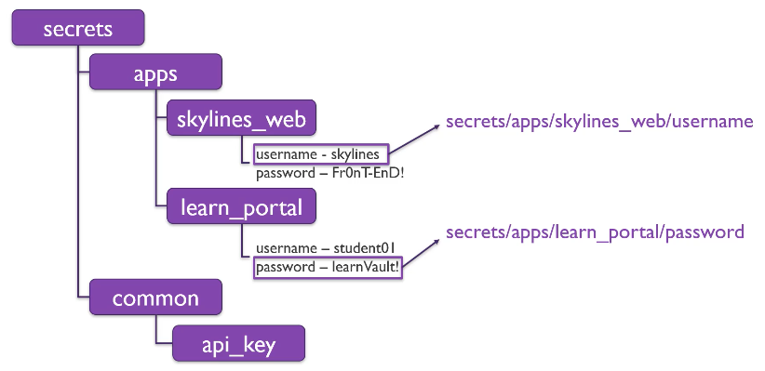
Vault path examples
Copyright © 2025 by Elephant Scale, All Rights Reserved

Slide 30
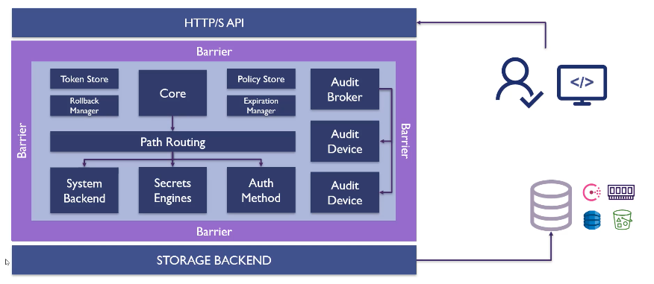
HashiCorp high-level
Copyright © 2025 by Elephant Scale, All Rights Reserved

Slide 31
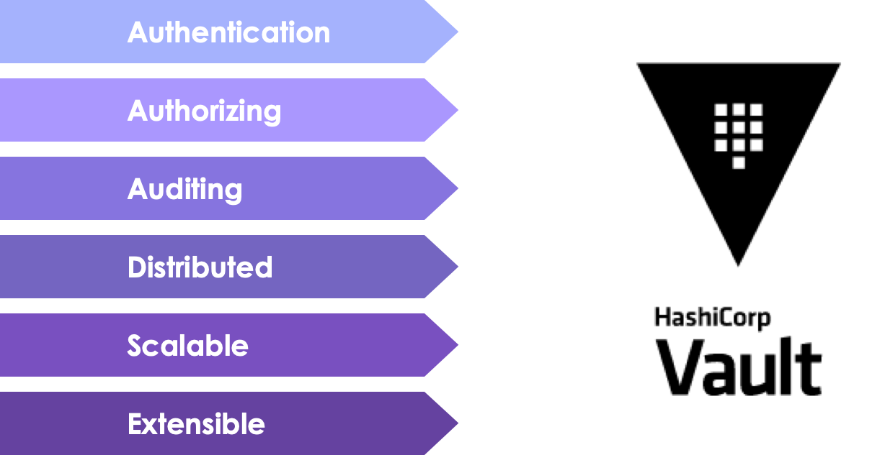
Vault summary
Copyright © 2025 by Elephant Scale, All Rights Reserved

Slide 32
Latest news: HCP Vault on AWS
APR 07 2021
HCP Vault is now generally available on AWS.
HCP Vault gives you the power and security of HashiCorp Vault
We still need to know how to use it :)
Copyright © 2025 by Elephant Scale, All Rights Reserved

Slide 33
What's involved
Create an account:
First create a HashiCorp Cloud Platform account.
Deploy a cluster
Next, select HCP Vault from the dashboard. We have a quickstart deployment guide that will walk you through the process of creating your HashiCorp Virtual Network (HVN) and a Vault cluster.
Peer with AWS
Once you have deployed their HVN and cluster, the next step is to peer that network with your existing AWS environments.
Copyright © 2025 by Elephant Scale, All Rights Reserved

Slide 34
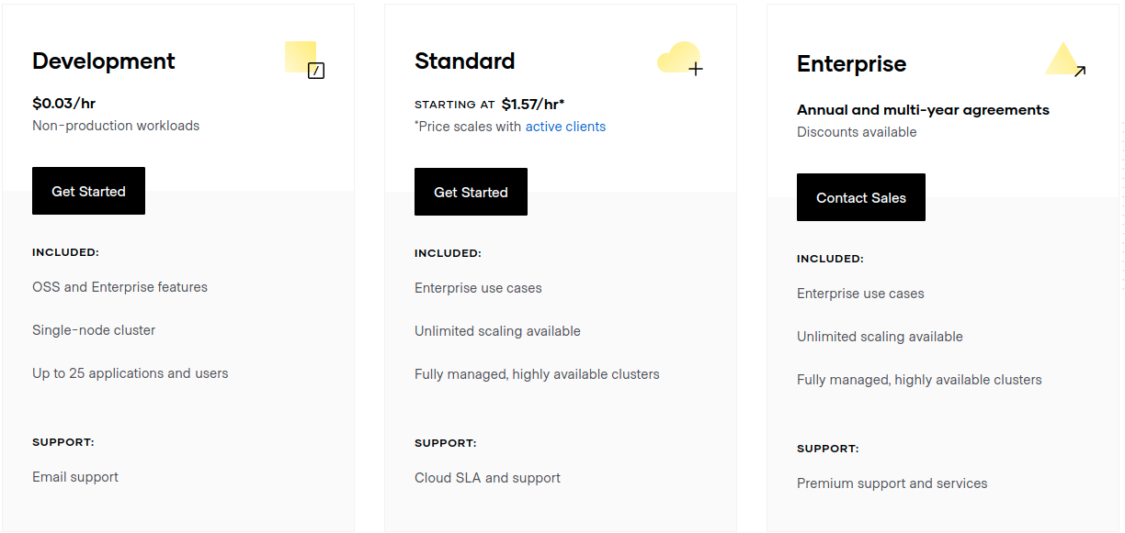
Vault on AWS pricing
Copyright © 2025 by Elephant Scale, All Rights Reserved

