Slide 1
AI Automation Essentials for Business Professionals
Copyright © 2026 by Elephant Scale, All Rights Reserved

Slide 2
Pre-requisites and Expectations
Comfort using a web browser and everyday office software
No coding required — and none will sneak in
Everything happens in the browser
Bring your accounts, or use the ones we provide in class
Curiosity!
Ask a lot of questions
This is an "AI Automation Essentials" class
No previous AI experience is assumed (but may be helpful)
Class will be based on the pace of the majority of the students
Copyright © 2026 by Elephant Scale, All Rights Reserved

Slide 3
Our Teaching Philosophy
Emphasis on concepts & fundamentals
Browser tools - no need to learn anything by heart
Highly interactive (questions and discussions are welcome)
Hands-on (learn by doing)
Copyright © 2026 by Elephant Scale, All Rights Reserved

Slide 4
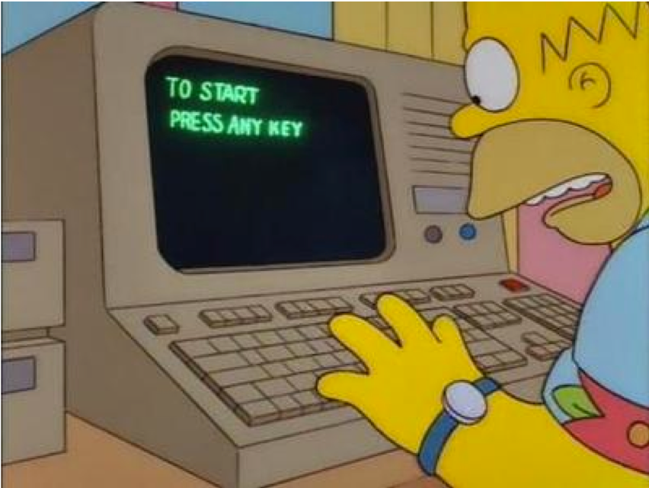
Lots of Labs: Learn By Doing
Where is the ANY key?
Copyright © 2026 by Elephant Scale, All Rights Reserved

Slide 5

Analogy: Learning To Fly...
Copyright © 2026 by Elephant Scale, All Rights Reserved

Slide 6
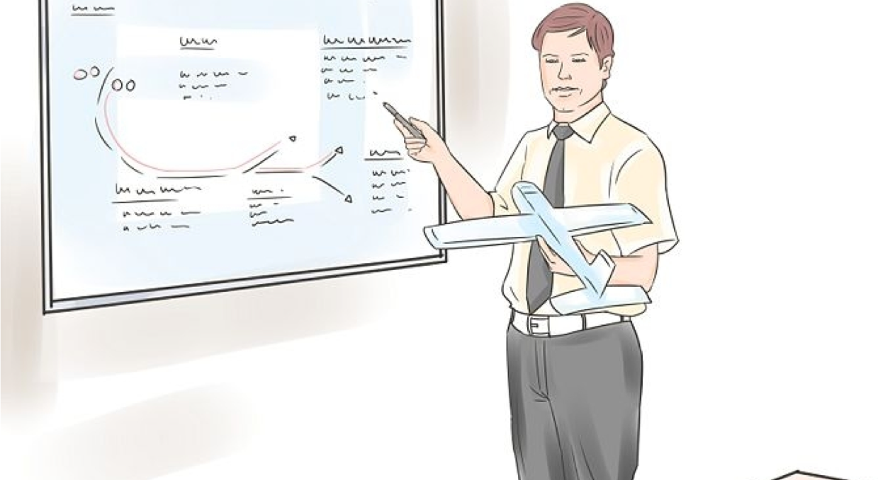
Introductions
Copyright © 2026 by Elephant Scale, All Rights Reserved

Slide 7
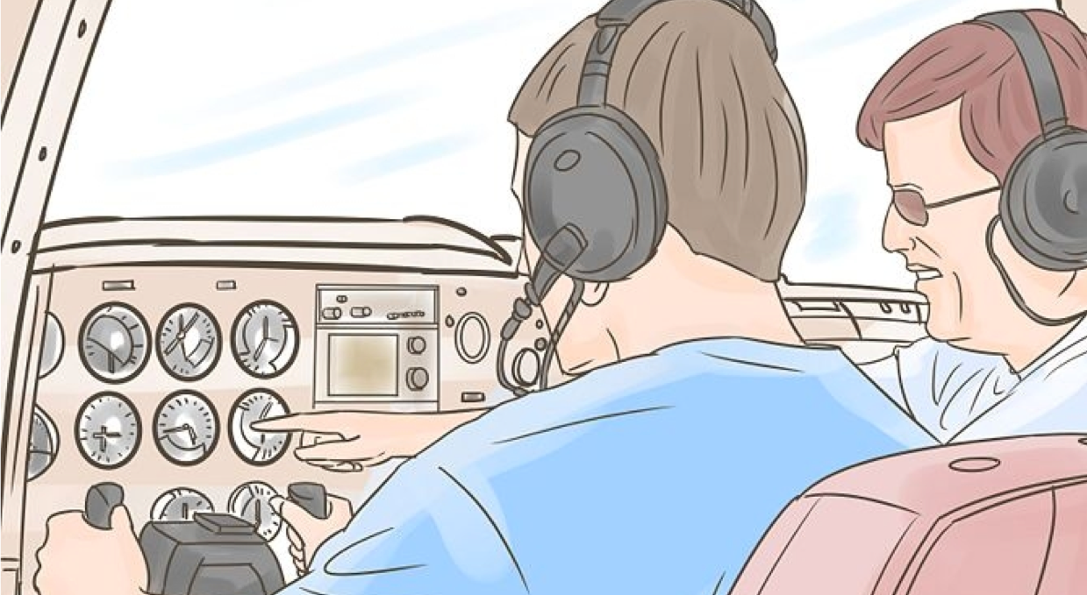
+ Flight Time
Copyright © 2026 by Elephant Scale, All Rights Reserved

Slide 8
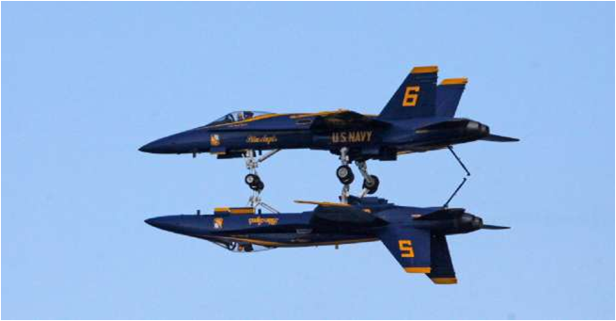
This Will Take A Lot Of Practice
Copyright © 2026 by Elephant Scale, All Rights Reserved

Slide 9



About You And Me
About Instructor
About you
Your Name
Your role (sales, marketing, analyst, ops, manager, ...)
Tools you use every day
Familiarity with AI so far (scale of 1 - 4 ; 1 - new, 4 - I use it daily)
Something non-technical about you! (favorite ice cream flavor / hobby...)
Copyright © 2026 by Elephant Scale, All Rights Reserved

Slide 10


Why is this class different
Before
We used to teach tools you had to code against
Students enjoyed the show but did not become magicians
Now
We teach AI automation — wiring AI into real workflows
You leave having built something, no code required
Copyright © 2026 by Elephant Scale, All Rights Reserved

Slide 11
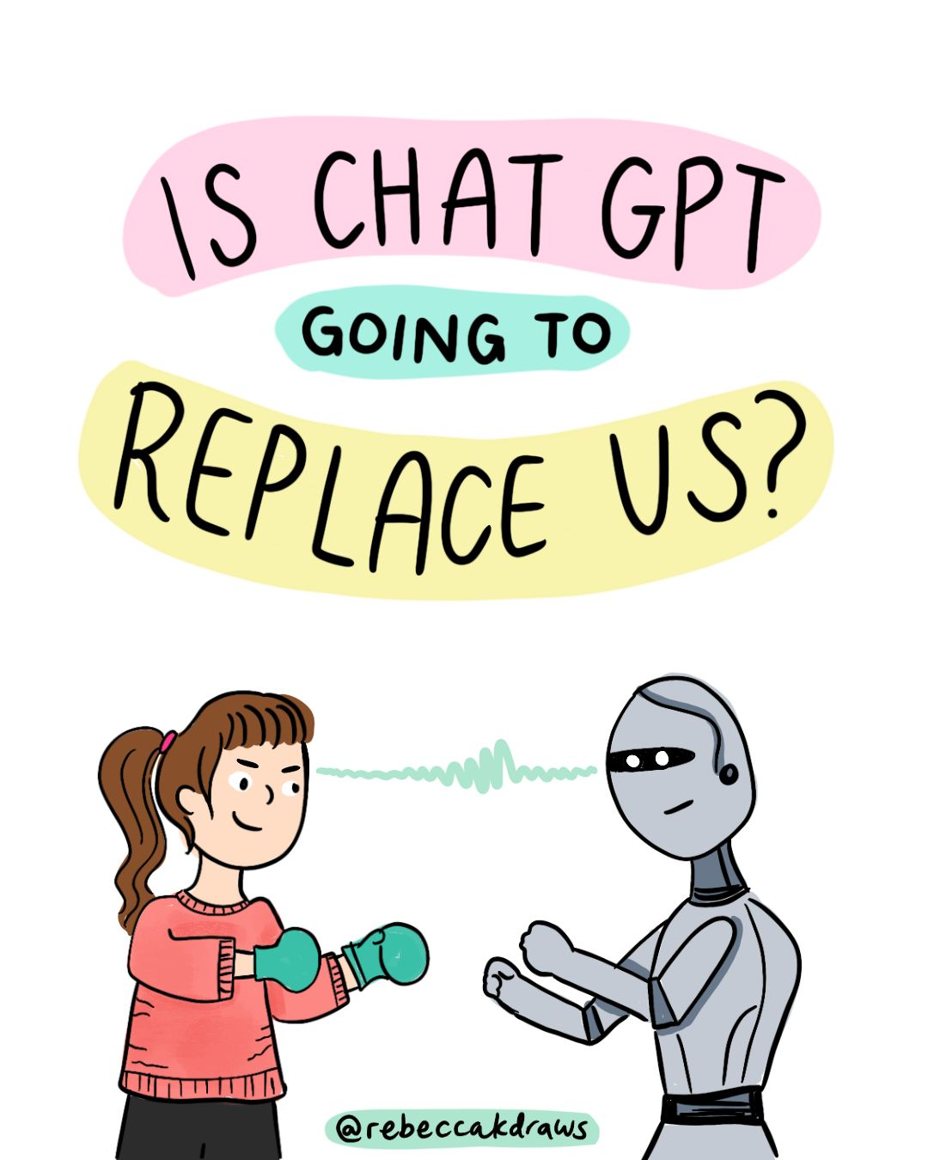
AI will NOT take my job
Copyright © 2026 by Elephant Scale, All Rights Reserved

Slide 12
The Two-Day Map
In every module you build a real artifact you can take back to work.
Day | Module | You go from...
1 | 1 — Foundations of Generative AI | mental model + AI vs. rules-based
1 | 2 — Prompt Engineering for Automation | prompts that feed downstream tools
1 | 3 — Evaluating & Troubleshooting | judge and fix AI output
2 | 4 — No-Code Automation & AI Agents | wire AI into a real workflow
2 | 5 — AI for Decisions & Insights | summarize, analyze, decide
2 | 6 — Responsible AI & Governance | ethics, privacy, EU AI Act / NIST
2 | 7 — ROI, Adoption & Capstone | build it, prove the ROI, present it
Copyright © 2026 by Elephant Scale, All Rights Reserved

Slide 13
Ground Rules
Use classroom-approved accounts and data only.
Do not upload confidential information unless the environment is explicitly approved for it.
Verify important facts before you act on them — the model can be confidently wrong.
Keep a human approval step in any workflow that sends, publishes, deletes, or buys.
Copyright © 2026 by Elephant Scale, All Rights Reserved
Notes:
These four habits separate a useful AI habit from an expensive mistake. We make them second nature starting with Lab 01.

