Slide 1
Prompt Engineering for Automation
Copyright © 2026 by Elephant Scale, All Rights Reserved

Slide 2
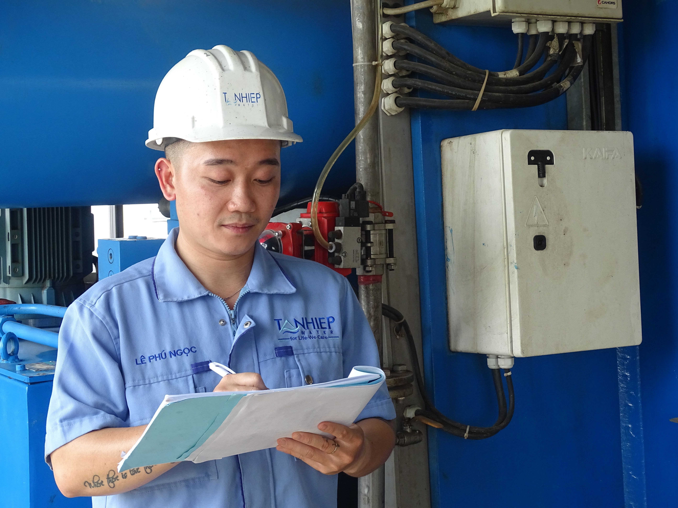
Why This Module
Prompts for people
Prompts for automation
Output shape matters
The next reader may be a machine
The prompt is the specification.
Copyright © 2026 by Elephant Scale, All Rights Reserved

Slide 3
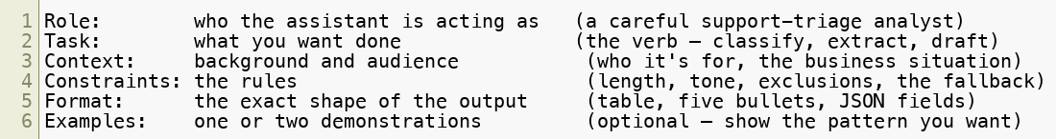
Anatomy of a Strong Prompt — Six Parts
Role
Task
Context
Constraints
Format
Examples
When output disappoints: which part did you leave to chance?
Copyright © 2026 by Elephant Scale, All Rights Reserved

Slide 4
The Six Parts, One at a Time
Role: lens
Task: verb
Context: situation
Constraints: rules
Format: output shape
Examples: pattern
For automation, format and constraints do the heavy lifting.
Copyright © 2026 by Elephant Scale, All Rights Reserved

Slide 5

Worked Example — Bad → Better → Best
Same task, three prompts
Bad — everything left to chance:
Better — audience, output, length budget:
Best — add a source boundary and a fallback:
Copyright © 2026 by Elephant Scale, All Rights Reserved

Slide 6
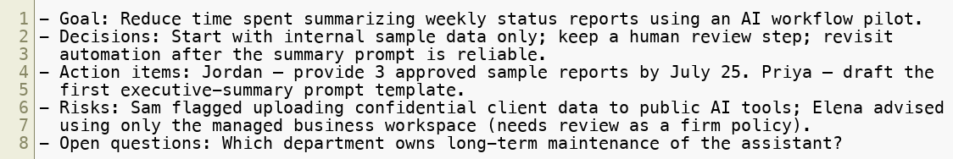
What "Best" Actually Returns
Fixed shape
Source-bound
Fallbacks visible
Copyright © 2026 by Elephant Scale, All Rights Reserved

Slide 7
Prompt Parameters — The Dials Inside the Instruction
Role
Audience
Format
Length
Tone
Evidence
Fallback
Each dial removes a guess.
Copyright © 2026 by Elephant Scale, All Rights Reserved

Slide 8
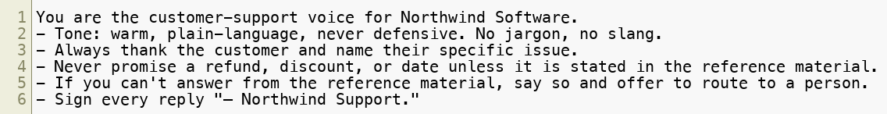
Role-Based Prompts for Consistent, On-Brand Output
Role
Voice
Boundaries
Fallback
Signature
Copyright © 2026 by Elephant Scale, All Rights Reserved

Slide 9
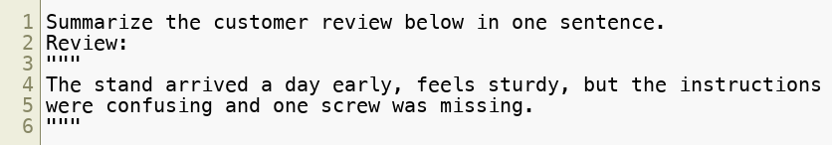
Separate Your Instructions From Your Data
Instructions
Data
Delimiters
Copyright © 2026 by Elephant Scale, All Rights Reserved

Slide 10
Ask for Structured Output — The Heart of Automation
Lists
Tables
JSON-like fields
Copyright © 2026 by Elephant Scale, All Rights Reserved

Slide 11
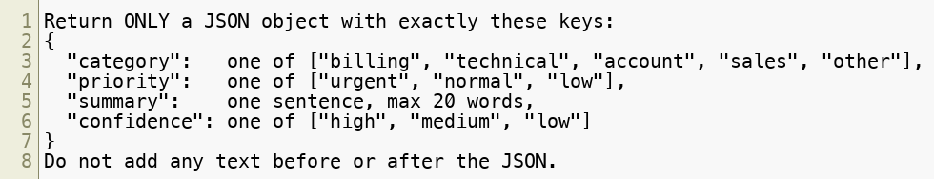
Structured Output — Make It Machine-Readable
Name every field
Pin values to a closed list
Return only the structure
Copyright © 2026 by Elephant Scale, All Rights Reserved

Slide 12
Say What to Do When the Assumption Fails
Missing data
Multiple asks
Low confidence
Human review
Copyright © 2026 by Elephant Scale, All Rights Reserved

Slide 13
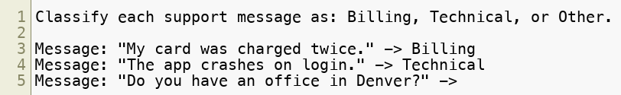
Show It an Example or Two (Few-Shot)
Show the pattern
Lock in tone
Lock in format
Cover edge cases
Copyright © 2026 by Elephant Scale, All Rights Reserved

Slide 14
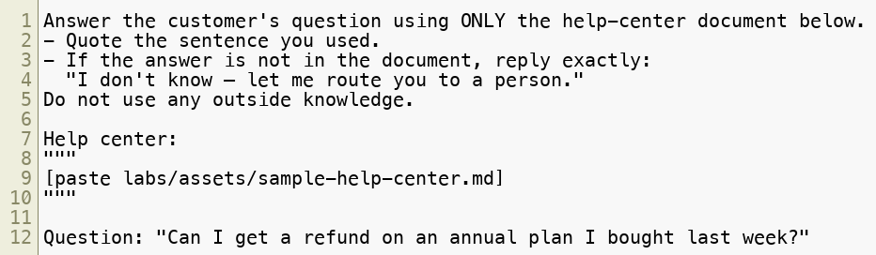
Grounding — Answers From the Source, Not the Guess
Use only this source
Quote the evidence
Say when it is missing
Copyright © 2026 by Elephant Scale, All Rights Reserved

Slide 15
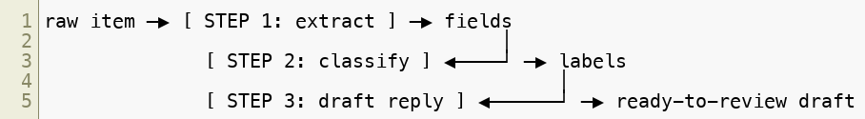
Advanced Prompting — Chains and Multi-Step Tasks
One job per step
Structured hand-offs
Easier testing
Easier repair
Copyright © 2026 by Elephant Scale, All Rights Reserved

Slide 16
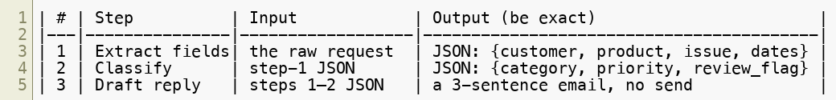
Designing the Hand-Offs
Output contracts
Fallback values
Human gate
Map before prompting
Copyright © 2026 by Elephant Scale, All Rights Reserved

Slide 17
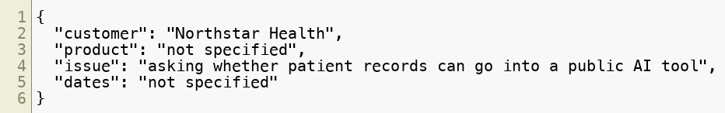
Worked Chain — Support Request → Structured Draft
Input
Step 1: extract
Input
Step 1 — Extract
Copyright © 2026 by Elephant Scale, All Rights Reserved

Slide 18
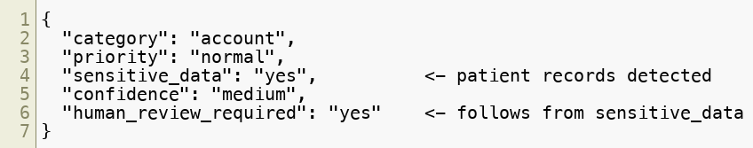
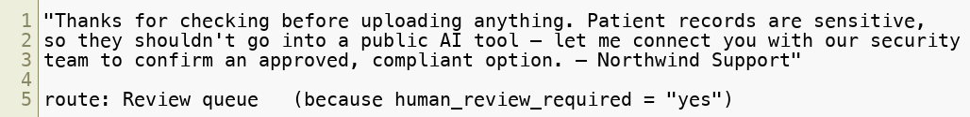
Worked Chain — Steps 2 and 3
Step 2: classify
Step 3: draft
Step 2 — Classify
Step 3 — Draft
Copyright © 2026 by Elephant Scale, All Rights Reserved

Slide 19
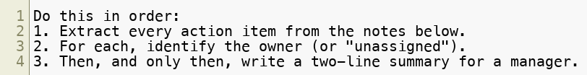
Give the Model Time to Think — Spell Out the Steps
Extract first
Identify owners
Then summarize
Copyright © 2026 by Elephant Scale, All Rights Reserved

Slide 20
Let It Solve Before It Judges
Solve independently
Then compare
Then flag differences
Copyright © 2026 by Elephant Scale, All Rights Reserved

Slide 21
Five Jobs Prompts Do Every Day
Summarize
Extract
Infer
Transform
Expand
Extract and infer drive automation.
Copyright © 2026 by Elephant Scale, All Rights Reserved

Slide 22
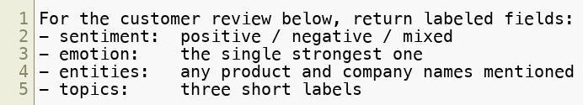
Infer — Structured Meaning in One Call
Sentiment
Emotion
Entities
Topics
Copyright © 2026 by Elephant Scale, All Rights Reserved

Slide 23
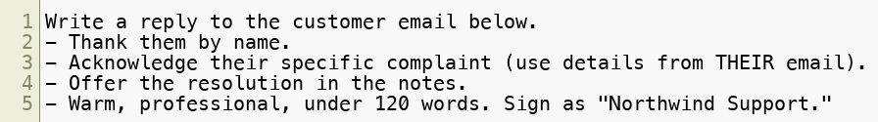
Expand — Keep the Human in the Loop
Draft the message
Use the source details
Human approves
Copyright © 2026 by Elephant Scale, All Rights Reserved

Slide 24
Set the Role Once — the "System" Instruction
Standing role
Standing constraints
Project instructions
Copyright © 2026 by Elephant Scale, All Rights Reserved

Slide 25
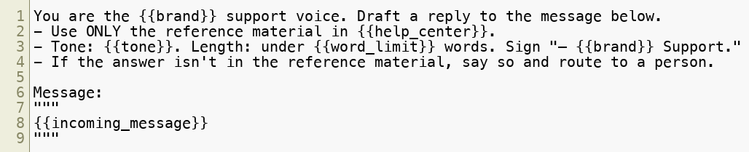
Turn a Recurring Task Into a Reusable, Parameterized Prompt
Named slots
Reusable template
Team asset
Copyright © 2026 by Elephant Scale, All Rights Reserved

Slide 26
Prompt-for-Automation — Cheat Sheet
Six parts
Delimit data
Structure output
Pin values
Name fallbacks
Chain steps
Ground in sources
Parameterize repeats
These are the building blocks for the lab.
Copyright © 2026 by Elephant Scale, All Rights Reserved

Slide 27
Live Prompt Writing and Feedback
Find the missing part
Add one fix
Re-run
Name what changed
Ask what the next step needs
Diagnose, fix one thing, re-run.
Copyright © 2026 by Elephant Scale, All Rights Reserved

Slide 28
Lab 02 - Build a Multi-Step Prompt Chain
Stop here and run Lab 02.
You will:
Design a three-step chain: extract → classify → draft.
Make each step return structured output.
Add fallbacks and a human review gate.
Run the sample requests.
Save the reusable prompt chain.
Deliverable: chain design, three prompts, sample outputs, and the review flag.
Copyright © 2026 by Elephant Scale, All Rights Reserved

