Slide 1
Foundations of Generative AI in Business
Copyright © 2026 by Elephant Scale, All Rights Reserved

Slide 2
Why This Module
Grounded opinion
From chat to workflows
Mental model for the rest of the course
Where AI fits in automation
Product names change. The mental model is the durable part.
Copyright © 2026 by Elephant Scale, All Rights Reserved

Slide 3
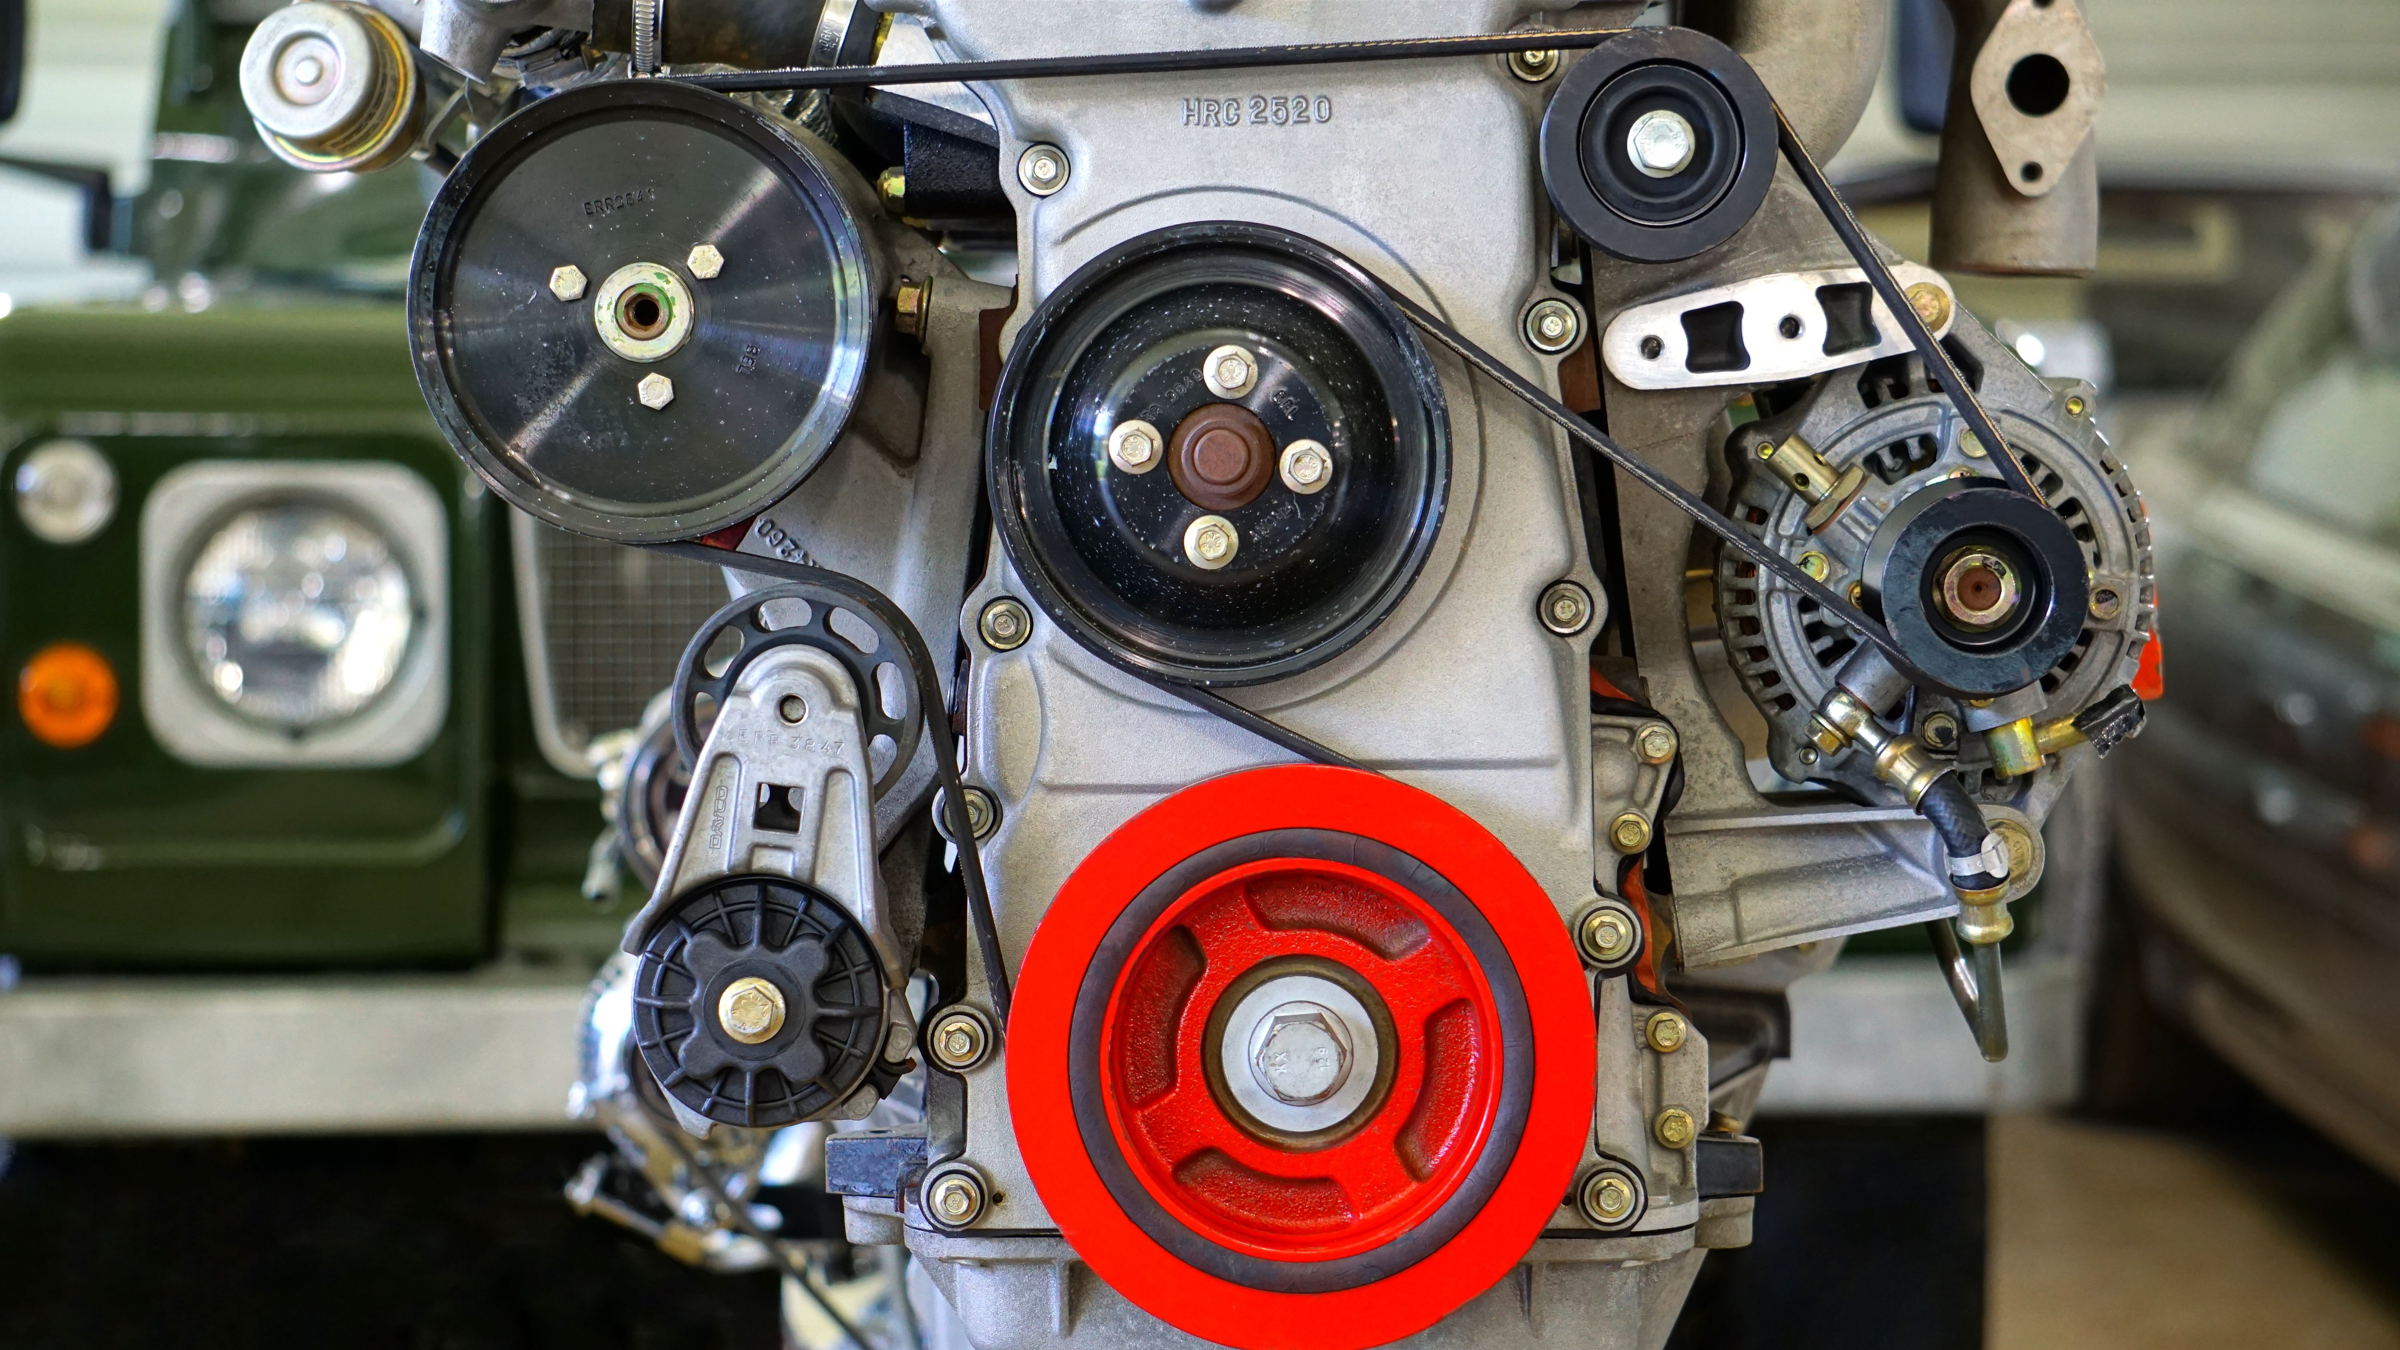
What Generative AI Is
Creates new content from instructions
Works in plain language
Drafts, summarizes, extracts, classifies
One tool, many roles
A flexible drafting and analysis assistant - powerful, but not automatically correct.
Copyright © 2026 by Elephant Scale, All Rights Reserved

Slide 4
What Generative AI Is NOT
Not a fact database
Not a calculator
Not company-aware by default
Not automatically current
Not the decision-maker
Most AI disappointments come from expecting one of these.
Copyright © 2026 by Elephant Scale, All Rights Reserved

Slide 5
How a Language Model Works, in Plain Language
Predicts the next piece of text
Pattern completion, not lookup
Fluent output
Confident errors
Context matters
Specific instructions matter
It sounds informed before it is grounded.
Copyright © 2026 by Elephant Scale, All Rights Reserved

Slide 6
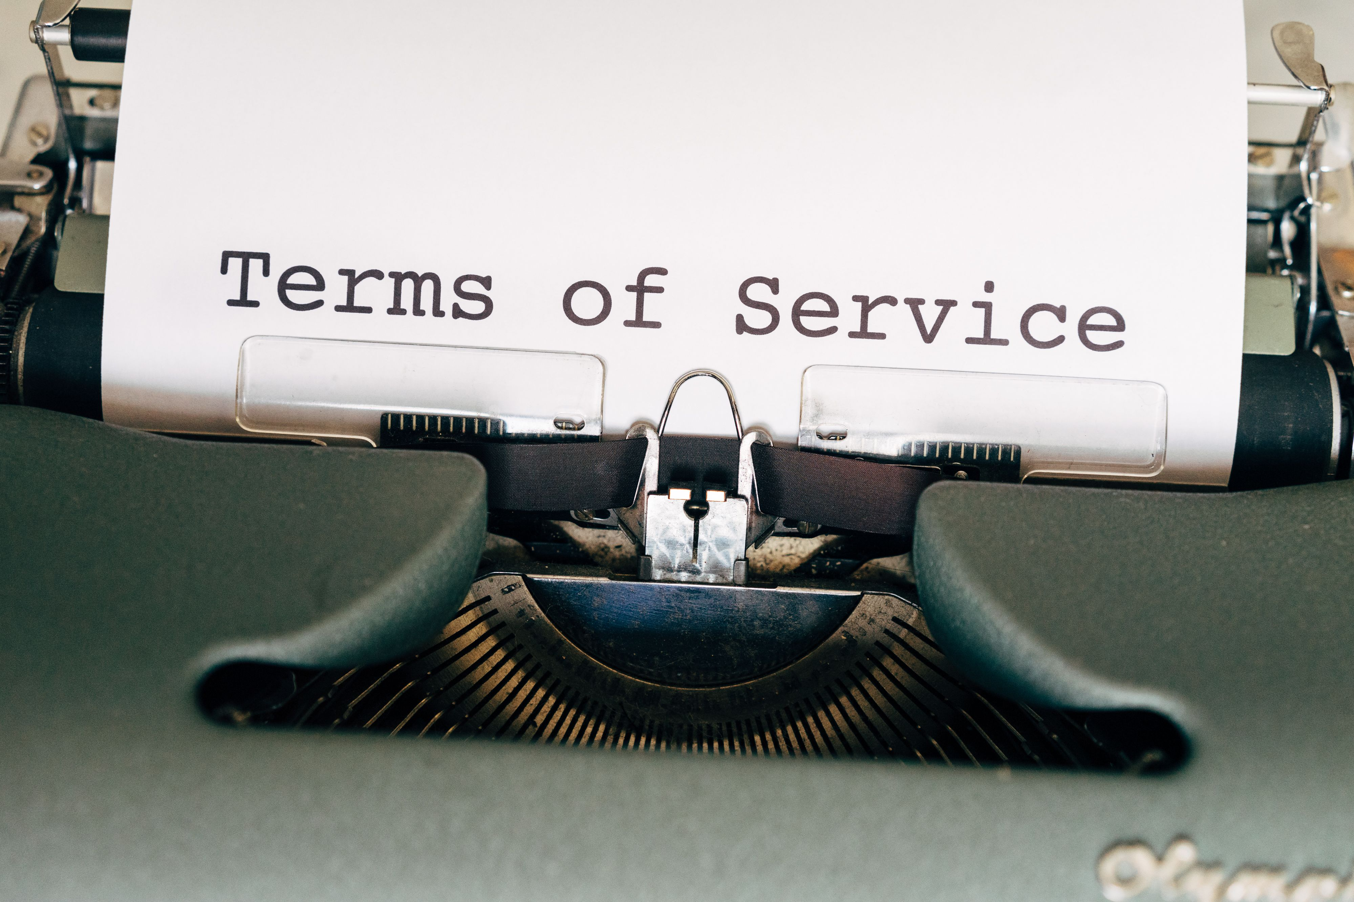
Key Terms — Without the Jargon (1 of 2)
Model
Prompt
Context
Tokens
Context is what the model can see.
Copyright © 2026 by Elephant Scale, All Rights Reserved

Slide 7
Key Terms — Without the Jargon (2 of 2)
Hallucination
Bias
Tool use
Agent
These terms explain the rest of the course.
Copyright © 2026 by Elephant Scale, All Rights Reserved

Slide 8
Multimodal AI — Beyond Text
Documents and PDFs
Spreadsheets and CSVs
Screenshots and photos
Charts and diagrams
Audio and video
The file can be the prompt.
Copyright © 2026 by Elephant Scale, All Rights Reserved

Slide 9

The Other Half — Rules-Based Automation
If-this-then-that logic
Email filters
Spreadsheet formulas
Workflow tools
Approval chains
Rules are not obsolete. They are part of the automation stack.
Copyright © 2026 by Elephant Scale, All Rights Reserved

Slide 10
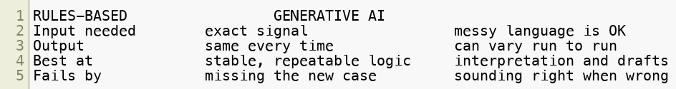
Generative AI vs. Rules-Based Automation
Core difference: rules follow a script; AI interprets messy language.
They fail in opposite directions — so they pair well.
Use rules for stable signals. Use AI for messy language. Review the exceptions.
Copyright © 2026 by Elephant Scale, All Rights Reserved

Slide 11
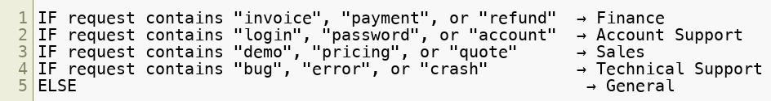
Worked Example — The Same Task, Two Ways
Task: route support requests
Sample data: lab01-routing-requests.csv
Approach A: rules
Approach B: AI interpretation
Same task. Different automation behavior.
Copyright © 2026 by Elephant Scale, All Rights Reserved

Slide 12
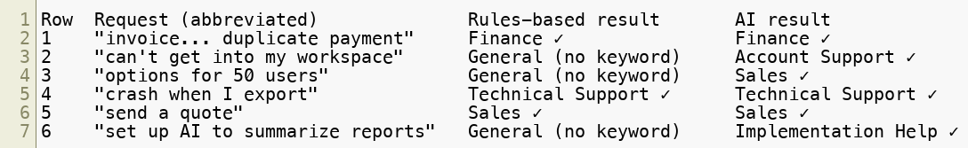
What Happens on the Real Rows
Expected keywords
Missing keywords
Clear intent
Rules handle stable signals. AI handles messy language.
Copyright © 2026 by Elephant Scale, All Rights Reserved

Slide 13
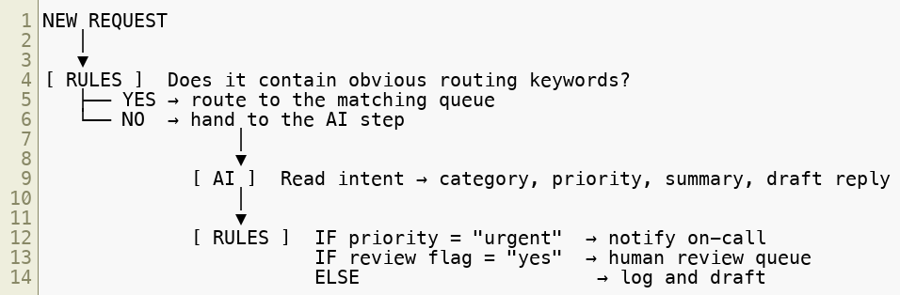
Why You Combine Them
Rules first
AI for interpretation
Rules and humans for control
You will build this shape again in Module 4.
Copyright © 2026 by Elephant Scale, All Rights Reserved

Slide 14
The 2026 Landscape — Assistants As Workbenches
Reasoning modes
File upload
Data analysis
Image understanding
Project context
Connectors and apps
This class uses ChatGPT Enterprise in the VM.
Copyright © 2026 by Elephant Scale, All Rights Reserved

Slide 15
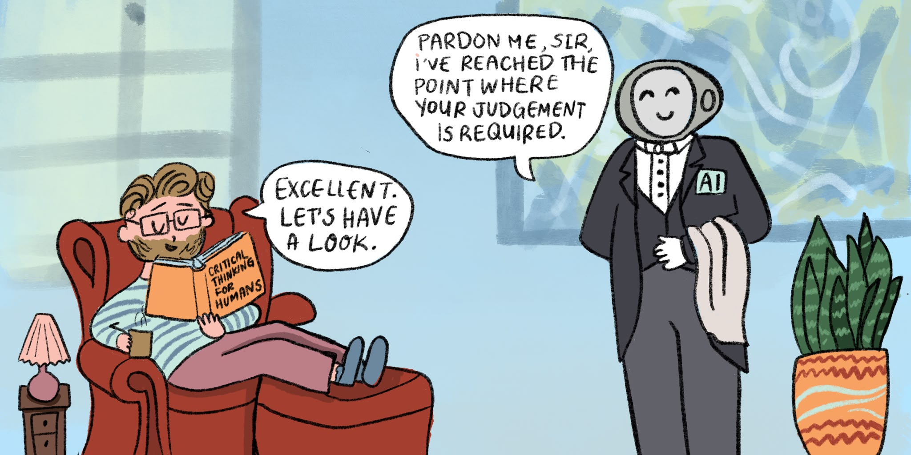
The Rise of AI Agents
Assistant
Tool use
Automation
Agent
From answering to acting.
Copyright © 2026 by Elephant Scale, All Rights Reserved

Slide 16
Common Myths — In Both Directions
Always right
Already knows your business
Replaces the whole team
Just hype
The realistic view is more useful than either myth.
Copyright © 2026 by Elephant Scale, All Rights Reserved

Slide 17
What AI Is Genuinely Good At
Drafting
Summarizing
Rewriting
Extracting structure
Classifying and routing
Explaining
Comparing options
Language-heavy work with fast review loops.
Copyright © 2026 by Elephant Scale, All Rights Reserved

Slide 18
What AI Is Weak At — and Needs Review
Fresh facts
Exact arithmetic
Citations and sources
Private facts not provided
Legal, medical, financial advice
Consequential actions
Higher consequence = stronger verification.
Copyright © 2026 by Elephant Scale, All Rights Reserved

Slide 19
Intro to AI Operations for Business Leaders
Where does it fit?
What data is allowed?
Who reviews the output?
How do we know it is working?
What are the guardrails?
AI at work is an operating model, not a demo.
Copyright © 2026 by Elephant Scale, All Rights Reserved

Slide 20

Safety Habits — Starting Today
Approved accounts and data
No confidential material in public tools
Ask for assumptions and uncertainties
Verify before reuse
Human in the loop
Good habits are cheap now and expensive later.
Copyright © 2026 by Elephant Scale, All Rights Reserved

Slide 21

Module Review — Your Turn
Task
Fit
Review point
Spot three workflows in your own department where AI could add real value.
Keep this list for the capstone.
Copyright © 2026 by Elephant Scale, All Rights Reserved

Slide 22
Foundations — Cheat Sheet
Generative AI
Core terms
Rules vs AI
Assistants and agents
Good fits and weak spots
Operating model
Fast drafting and analysis; human judgment still owns the outcome.
Copyright © 2026 by Elephant Scale, All Rights Reserved

Slide 23
Lab 01 - Rules Automation vs AI Interpretation
Stop here and run Lab 01.
You will:
Open labs/assets/lab01-routing-requests.csv .
Ask ChatGPT to simulate a rules engine using exact keyword rules.
Ask ChatGPT to route the same six requests as an AI assistant that reads meaning.
Compare the two tables and note where rules were sufficient vs where AI added value.
Write one sentence describing a hybrid workflow.
Deliverable: rules-engine table, AI routing table, comparison table, and one hybrid workflow sentence.
Time: ~35-45 min.
Instructor note: This is the first lab of the course. Run it as a guided, screen- shared walkthrough with the whole class — do it together, step by step, rather than turning students loose. Non-technical students calibrate best when the first lab is done as a group; it sets the pattern for every lab that follows.
Copyright © 2026 by Elephant Scale, All Rights Reserved

