Slide 1
File Analysis, Dashboard Reading & Executive Briefs
Copyright © 2026 by Elephant Scale, All Rights Reserved

Slide 2
Why This Module
Reports
Transcripts
Spreadsheets
Dashboards
Decisions
AI is your analyst, not your decision-maker.
Copyright © 2026 by Elephant Scale, All Rights Reserved

Slide 3
The Working Rule
Work from the source
Show the evidence
Flag uncertainty
Verify numbers
Keep the human decision
Every claim needs a receipt.
Copyright © 2026 by Elephant Scale, All Rights Reserved

Slide 4
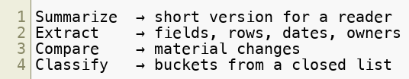
Four Document Jobs
Summarize
Extract
Compare
Classify
Different verbs need different prompts.
Copyright © 2026 by Elephant Scale, All Rights Reserved

Slide 5
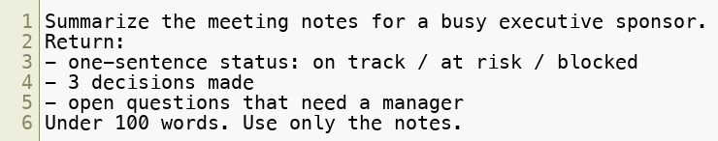
Summarize With a Purpose
Length
Audience
Focus
Exclusions
Source boundary
Same document, different reader, different summary.
Copyright © 2026 by Elephant Scale, All Rights Reserved

Slide 6
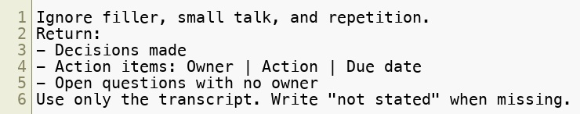
Transcripts Are Messy Documents
Filler
Crosstalk
Repetition
Half-finished thoughts
Missing owners
The value is cutting noise while keeping decisions.
Copyright © 2026 by Elephant Scale, All Rights Reserved

Slide 7
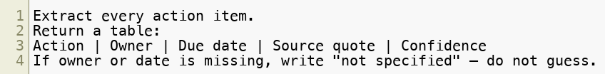
Extract, Don't Summarize
Action items
Dates
Owners
Amounts
Obligations
Source quote
Extraction turns text into rows.
Copyright © 2026 by Elephant Scale, All Rights Reserved

Slide 8
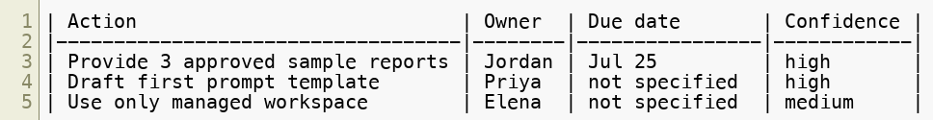
Worked Example — Meeting Notes
Source: labs/assets/sample-meeting-notes.md
Open question: maintenance owner
The missing owner may be the most important finding.
Copyright © 2026 by Elephant Scale, All Rights Reserved

Slide 9
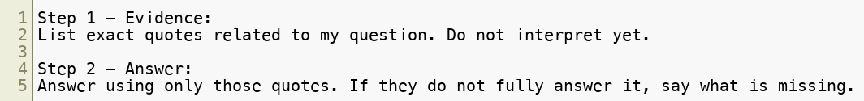
Extract Then Answer
Evidence first
Answer second
Missing data visible
Faster verification
Make the model show its work before it concludes.
Copyright © 2026 by Elephant Scale, All Rights Reserved

Slide 10
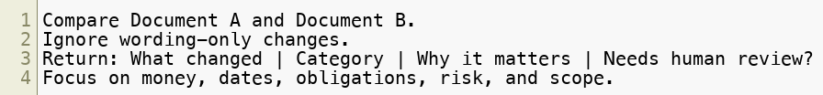
Comparing Documents
Ignore formatting
Focus on material changes
Sort by risk
Flag human review
Compare what matters, not every comma.
Copyright © 2026 by Elephant Scale, All Rights Reserved

Slide 11
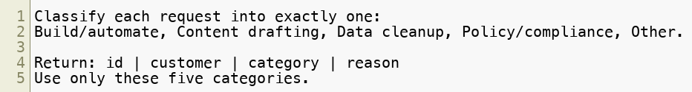
Classifying the Pile
Closed buckets
One primary category
Short reason
No invented labels
Closed lists make classification reusable.
Copyright © 2026 by Elephant Scale, All Rights Reserved

Slide 12
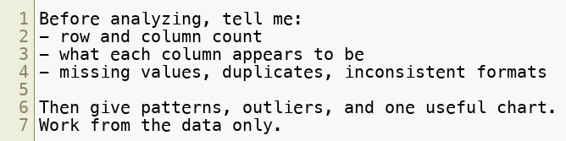
Analyzing Data, No Formulas
Sanity pass
Patterns
Outliers
Recommended chart
Caveats
A bad dataset makes bad insights sound polished.
Copyright © 2026 by Elephant Scale, All Rights Reserved

Slide 13
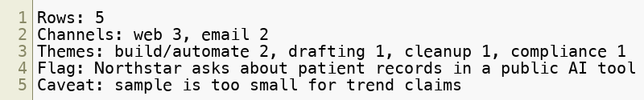
Worked Example — Support CSV
Source: labs/assets/sample-support-requests.csv
Count first. Interpret second.
Copyright © 2026 by Elephant Scale, All Rights Reserved

Slide 14
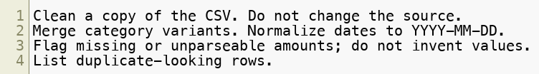
Clean a Messy CSV
Standardize categories
Normalize dates
Normalize amounts
Flag duplicates
Preserve source
Report assumptions
Cleaning is useful only when the gaps stay visible.
Copyright © 2026 by Elephant Scale, All Rights Reserved

Slide 15
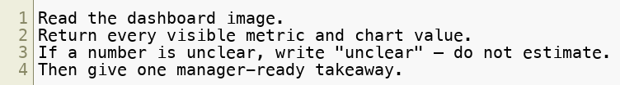
Read a Dashboard Image
Headline metrics
Chart values
Visible numbers only
Unclear when unclear
Cross-check source data
Image reading is convenient and fallible.
Copyright © 2026 by Elephant Scale, All Rights Reserved

Slide 16
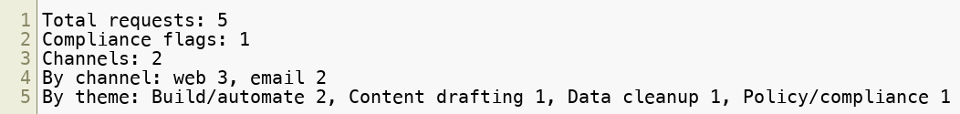
Dashboard Cross-Check
Source: labs/assets/sample-dashboard.png
Any number that goes in a deck gets checked against the source.
Copyright © 2026 by Elephant Scale, All Rights Reserved

Slide 17
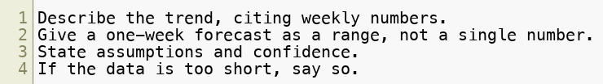
Trend & Forecast Assistance
Describe first
Forecast second
Use a range
State assumptions
State confidence
Small data needs humility.
Copyright © 2026 by Elephant Scale, All Rights Reserved

Slide 18
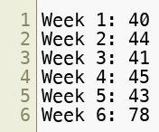
Worked Trend Example
Weeks 1-5 are flat
Week 6 is a spike
Forecast: 45-80, low confidence
Check what happened in Week 6
One spike is an event, not a trend.
Copyright © 2026 by Elephant Scale, All Rights Reserved

Slide 19
How AI Invents Trends
Finds patterns in noise
Smooths over outliers
Overstates confidence
Creates fake precision
The smoother the forecast on tiny data, the more suspicious you should be.
Copyright © 2026 by Elephant Scale, All Rights Reserved

Slide 20

Validate the Trend
Count the points
Find the driver
Re-add the numbers
Demand a range
Check confidence
Generating an insight is easy. Validating it is the professional skill.
Copyright © 2026 by Elephant Scale, All Rights Reserved

Slide 21
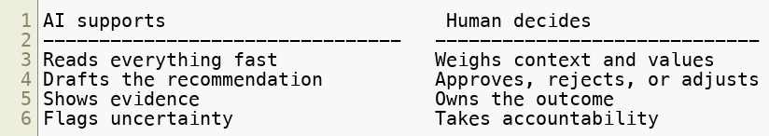
Decision Support vs. Decision-Making
Keep AI on the support side for consequential decisions.
Copyright © 2026 by Elephant Scale, All Rights Reserved

Slide 22
Where the Human Stays in Charge
Spend approval
Hiring or firing
Pricing
Legal claims
Medical advice
Customer-facing commitments
Irreversible actions
The higher the consequence, the clearer the human checkpoint.
Copyright © 2026 by Elephant Scale, All Rights Reserved

Slide 23
Executive Briefs
Sources used
Key findings
Evidence
Risks and caveats
Recommended next actions
Human decision needed
A good brief is shorter and more accountable.
Copyright © 2026 by Elephant Scale, All Rights Reserved

Slide 24
File Analysis — Cheat Sheet
Name the reader
Extract fields when you need rows
Ask for source quotes
Sanity-check data first
Cross-check image numbers
Validate trends
Keep the decision human
Work from the source. Show the receipts.
Copyright © 2026 by Elephant Scale, All Rights Reserved

Slide 25
Optional Lab 05A — Real Work Automation
ChatGPT Work
Scheduled Task
Pasted data snapshot
Recurring executive brief
Human review gate
Lab 5 teaches the analysis. Lab 5A shows it can run on a schedule.
Copyright © 2026 by Elephant Scale, All Rights Reserved

Slide 26
Lab 05 - File Analysis, Dashboard Reading & Executive Briefs
Stop here and run Lab 05.
You will:
Extract from sample meeting notes with source quotes.
Analyze sample-support-requests.csv .
Clean sample-vendor-invoices.csv .
Read sample-dashboard.png and cross-check the numbers.
Generate and validate a trend insight.
Produce a source-backed executive brief.
Deliverable: extraction table, support analysis, vendor cleanup, dashboard cross-check, trend validation, executive brief, and one sentence naming what AI supported versus what a human still decides.
Time: ~45-60 min.
Copyright © 2026 by Elephant Scale, All Rights Reserved

