Slide 1
ROI, Adoption & Enterprise Capstone
Copyright © 2026 by Elephant Scale, All Rights Reserved

Slide 2
Why This Module
Cost
Impact
Adoption
Capstone
30-day plan
A useful AI workflow needs a number and a rollout plan.
Copyright © 2026 by Elephant Scale, All Rights Reserved

Slide 3
The Arc
Cost
Impact
Adoption
Capstone build
Presentation
"What does it cost?" and "will the team use it?" are business questions.
Copyright © 2026 by Elephant Scale, All Rights Reserved

Slide 4
What AI Actually Costs
Tool cost
Build time
Review time
Maintenance
Future connector cost
The invoice is not the whole cost.
Copyright © 2026 by Elephant Scale, All Rights Reserved

Slide 5

Three Pricing Shapes
Subscription
Per-seat
Usage-based
Most real deployments mix pricing shapes.
Copyright © 2026 by Elephant Scale, All Rights Reserved

Slide 6

Estimate Usage Cost
Find the unit
Estimate volume
Multiply
Add retry padding
Set a cap
A cap turns "unbounded" into "at most this much."
Copyright © 2026 by Elephant Scale, All Rights Reserved

Slide 7
Hidden Costs
Build time
Review time
Maintenance
Prompt updates
Data updates
Ownership
Leave out human time and the ROI is fake.
Copyright © 2026 by Elephant Scale, All Rights Reserved

Slide 8
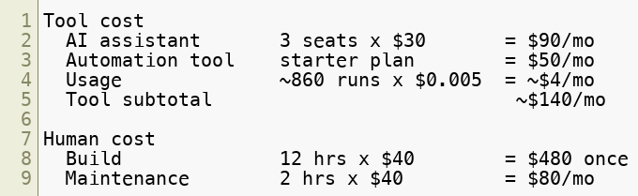
Worked Cost — Support Triage
Count each cost once.
Copyright © 2026 by Elephant Scale, All Rights Reserved

Slide 9
Measuring Impact
Time saved
Error reduction
Rework reduction
Cycle-time improvement
ROI
Payback
Pick the metric your manager already cares about.
Copyright © 2026 by Elephant Scale, All Rights Reserved

Slide 10

Baseline First
Measure the old way
Measure the new way
Include review time
Count rework
Use real volume
Without a baseline, "saves time" is only an anecdote.
Copyright © 2026 by Elephant Scale, All Rights Reserved

Slide 11
ROI Worksheet
Use case
Time saved
Error reduction
Costs
Bottom line
Honest risk
Worksheet: course-materials/roi-worksheet.md
Conservative numbers are more useful than impressive ones.
Copyright © 2026 by Elephant Scale, All Rights Reserved

Slide 12
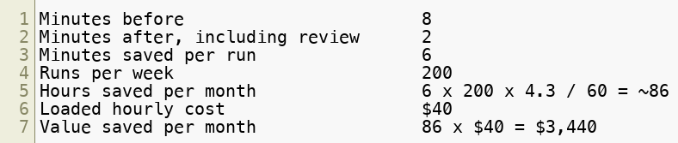
Worked ROI — Time Saved
Frequent and boring is where the money is.
Copyright © 2026 by Elephant Scale, All Rights Reserved

Slide 13
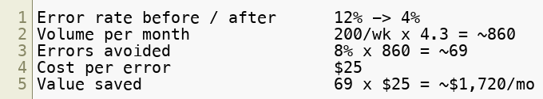
Worked ROI — Error Reduction
Only claim error savings you can defend.
Copyright © 2026 by Elephant Scale, All Rights Reserved

Slide 14
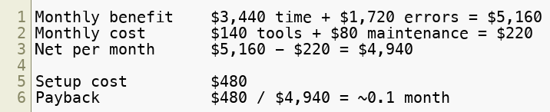
Worked ROI — Bottom Line
Payback is often the clearest number for a skeptic.
Copyright © 2026 by Elephant Scale, All Rights Reserved

Slide 15
Read the Number Honestly
State one weak assumption
Round savings down
Round costs up
Separate hard and soft benefits
Stress-test the result
A caveat makes the number more credible.
Copyright © 2026 by Elephant Scale, All Rights Reserved

Slide 16
Adoption Matters
Tools can be abandoned
Big launches can backfire
Teams need ownership
Workflows need support
ROI depends on use
A working automation nobody adopts saves zero hours.
Copyright © 2026 by Elephant Scale, All Rights Reserved

Slide 17
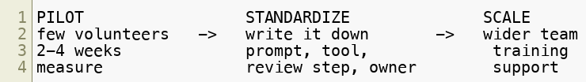
Pilot → Standardize → Scale
Pilot one workflow
Standardize what works
Scale only the proven version
Do not scale what you have not standardized.
Copyright © 2026 by Elephant Scale, All Rights Reserved

Slide 18
Change Management
Frame as leverage
Name the boring task removed
Find champions
Set honest expectations
Share prompts that work
Make help normal
People need control, context, and a visible win.
Copyright © 2026 by Elephant Scale, All Rights Reserved

Slide 19
Capstone Mission
One real workflow
Safe sample data
Human approval step
Connector-readiness note
Governance note
ROI estimate
30-day plan
Narrow and real beats broad and impressive.
Copyright © 2026 by Elephant Scale, All Rights Reserved

Slide 20
Capstone Building Blocks
Enterprise project or project-style chat
Structured prompt
Prompt chain
Document or data analysis
Simulated workflow
Review queue
Guardrails
Connector readiness
Use the pieces your workflow actually needs.
Copyright © 2026 by Elephant Scale, All Rights Reserved

Slide 21
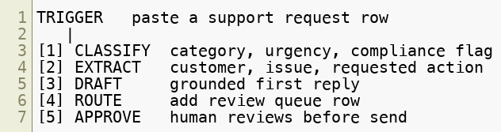
Worked Capstone — Support Triage
The AI routes and drafts. The human owns the send button.
Copyright © 2026 by Elephant Scale, All Rights Reserved

Slide 22
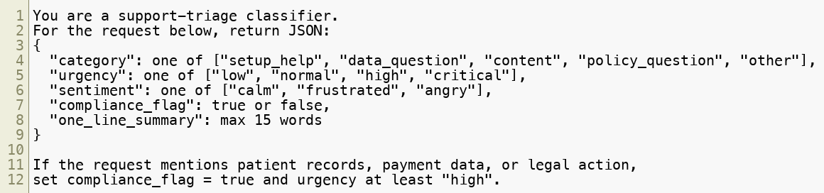
Worked Triage Prompt
Structured output lets the workflow route.
Copyright © 2026 by Elephant Scale, All Rights Reserved

Slide 23
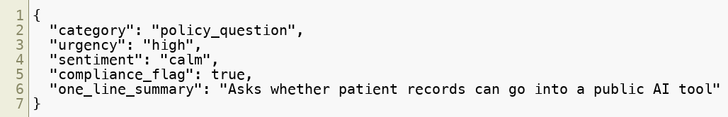
Worked Output
Input: Northstar asks about patient records in a public AI tool
The flag routes the case to a human.
Copyright © 2026 by Elephant Scale, All Rights Reserved

Slide 24
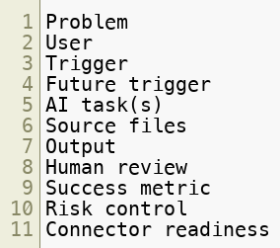
Capstone Design Canvas
Canvas: course-materials/automation-design-canvas.md
If you cannot name human review and risk control, the workflow is not ready.
Copyright © 2026 by Elephant Scale, All Rights Reserved

Slide 25
Capstone Rubric
Business fit
Prompt quality
Enterprise setup
Artifact quality
Safety controls
Connector readiness
Rollout plan
Rubric: course-materials/capstone-rubric.md
Most weak capstones fail on safety controls or rollout plan.
Copyright © 2026 by Elephant Scale, All Rights Reserved

Slide 26
Present It in Five Minutes
Problem
Workflow
Project and files
Demo
Controls
Connector recommendation
ROI
30-day plan
Lead with the problem, not the tool.
Copyright © 2026 by Elephant Scale, All Rights Reserved

Slide 27
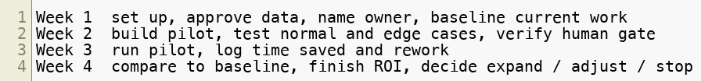
30-Day AI Action Plan
Week 1's baseline makes Week 4's ROI believable.
Copyright © 2026 by Elephant Scale, All Rights Reserved

Slide 28
Common Capstone Traps
Too broad
No human gate
No project setup
No baseline
Fake ROI
Sensitive data in demo
Connector overreach
Every trap is fixable if caught before the build.
Copyright © 2026 by Elephant Scale, All Rights Reserved

Slide 29
Module Review
Working workflow
Human gate
Tested edge case
ROI worksheet
Connector-readiness recommendation
30-day plan
Leave with an asset your team can run on Monday.
Copyright © 2026 by Elephant Scale, All Rights Reserved

Slide 30
Lab 07 - ROI, Adoption & Enterprise Capstone
Stop here and run Lab 07.
You will:
Choose one narrow workflow from your own work.
Fill the Capstone Design Canvas.
Build the ChatGPT Enterprise workflow artifacts.
Test a normal case and a tricky edge case.
Complete the connector-readiness checklist.
Fill the ROI worksheet.
Draft your 30-day plan and present in five minutes.
Deliverable: workflow, design canvas, review queue, test results, connector-readiness checklist, ROI worksheet, capstone rubric, and 30-day action plan.
Time: ~60-75 min.
Copyright © 2026 by Elephant Scale, All Rights Reserved

