Slide 1
Introduction to JavaScript Security
Cross-Site Scripting (XSS)
Cross-Site Request Forgery
Database Vulnerabilities
Session Hijacking
Distributed Denial of Service (DDoS)
Data Protection
Copyright © 2021 by Elephant Scale, All Rights Reserved

Slide 2
What We Will Cover
Cross-Site Scripting (XSS)
Cross-Site Request Forgery
Database Injection
Session Hijacking
DDoS
Data Protection
Copyright © 2021 by Elephant Scale, All Rights Reserved

Slide 3
Cross-Site Scripting (XSS)
Cross-Site Scripting (XSS) Cross-Site Request Forgery Database Vulnerabilities Session Hijacking Distributed Denial of Service (DDoS) Data Protection
Copyright © 2021 by Elephant Scale, All Rights Reserved

Slide 4
What Is It?
What is it?
Code injection attack
Enables attacker to execute malicious JavaScript in user's browser.
How?
By injecting a script into the page that the victim will download.
Consequences:
Cookie theft
Keylogging
Phishing
Copyright © 2021 by Elephant Scale, All Rights Reserved

Slide 5
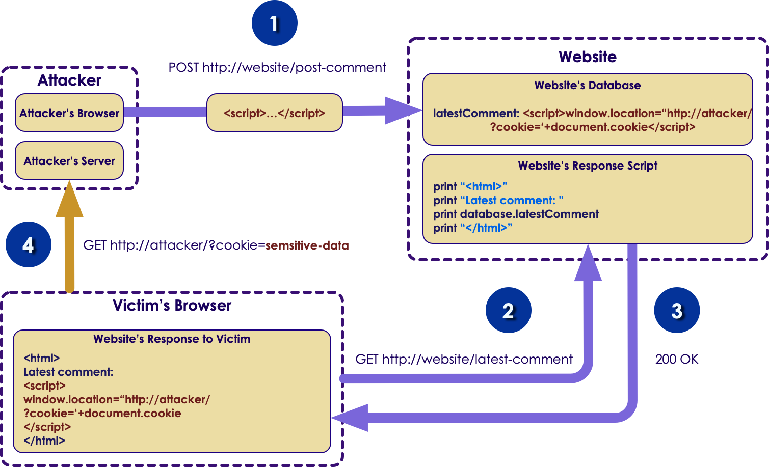
Mechanism
Copyright © 2021 by Elephant Scale, All Rights Reserved

Slide 6
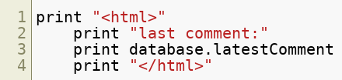
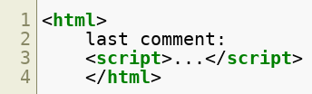
Example
Following server-side script is used to display the last comment:
Now attacker sends his script as comment "<script>...</script>"
Finally, user visits the page would get the response like this:
Copyright © 2021 by Elephant Scale, All Rights Reserved

Slide 7
How To Prevent
Web developers use two methods performing secure input handling
Encoding: browser considers the malicious script as data, not code.
Validation: filters the user input so that the browser just run the code without malicious commands.
Copyright © 2021 by Elephant Scale, All Rights Reserved

Slide 8
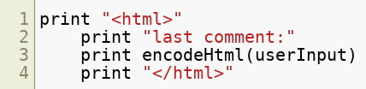

Encoding
Encoding user input on server-side: &lt; instead of < and &gt; instead of >
Resulting HTML would be like this:
Copyright © 2021 by Elephant Scale, All Rights Reserved

Slide 9
Validation
Allowing certain tags and elements
<em> <strong> allowed
<script> not allowed
How?
Classification strategy
Blacklisting: High complexity, Updating is a problem
Whitelisting: Simple, Easy updating so is much better
Validation outcome
Rejection: Simple implementation,
Sanitisation: More useful
Copyright © 2021 by Elephant Scale, All Rights Reserved

Slide 10
Which Method To Use?
First line of protection
Encoding and in some cases validation is a complementary
Second line of protection
Inbound validation
If you think of full protection of entire website
Content security policy (CSP)
XSS protection
Copyright © 2021 by Elephant Scale, All Rights Reserved

Slide 11
CSP
Makes browser download content from trusted sources
Validation
Even if injection happens, CSP can avoid downloading to user's computer
Inbound validation
If you think of full protection of entire website
Content security policy (CSP)
Copyright © 2021 by Elephant Scale, All Rights Reserved

Slide 12
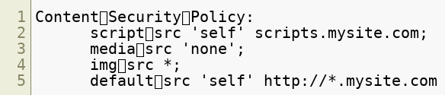
CSP Example
By default browsers don't use CSP
To enable CSP on your website add the following additional HTTP header "Content-Security-Policy"
Example Policy:
Copyright © 2021 by Elephant Scale, All Rights Reserved
Notes:
add header to every page you want to be secured

Slide 13
Lab
Cross Site Scripting:
Overview: We will run a script attack
Pre-requisites: Browser-Google Chrome
Approximate time: 20 minutes
Instructions: labs/javascript_security_labs/labs/Cross_site_Scripting.md
https://github.com/elephantscale/secure-coding-labs/blob/main/javascript_security_labs/labs/Cross_site_Scripting.md
Copyright © 2021 by Elephant Scale, All Rights Reserved

Slide 14
Cross-Site Request Forgery
Cross-Site Scripting (XSS) Cross-Site Request Forgery Database Vulnerabilities Session Hijacking Distributed Denial of Service (DDoS) Data Protection
Copyright © 2021 by Elephant Scale, All Rights Reserved

Slide 15
Synonyms
CSRF
XSRF
Sea Surf
Session Riding
Cross-Site Reference Forgery
Hostile Linking
Copyright © 2021 by Elephant Scale, All Rights Reserved

Slide 16
How?
Attacker sends a link to the user via for example email or social network
When clicks on the link, user performs the action on the web application they usually use
A state changes on the server
Copyright © 2021 by Elephant Scale, All Rights Reserved

Slide 17
Examples:
Transferring funds
Changing email address
Changing password
The attacker is not able to perform theft since there is no way to get the response
Copyright © 2021 by Elephant Scale, All Rights Reserved

Slide 18
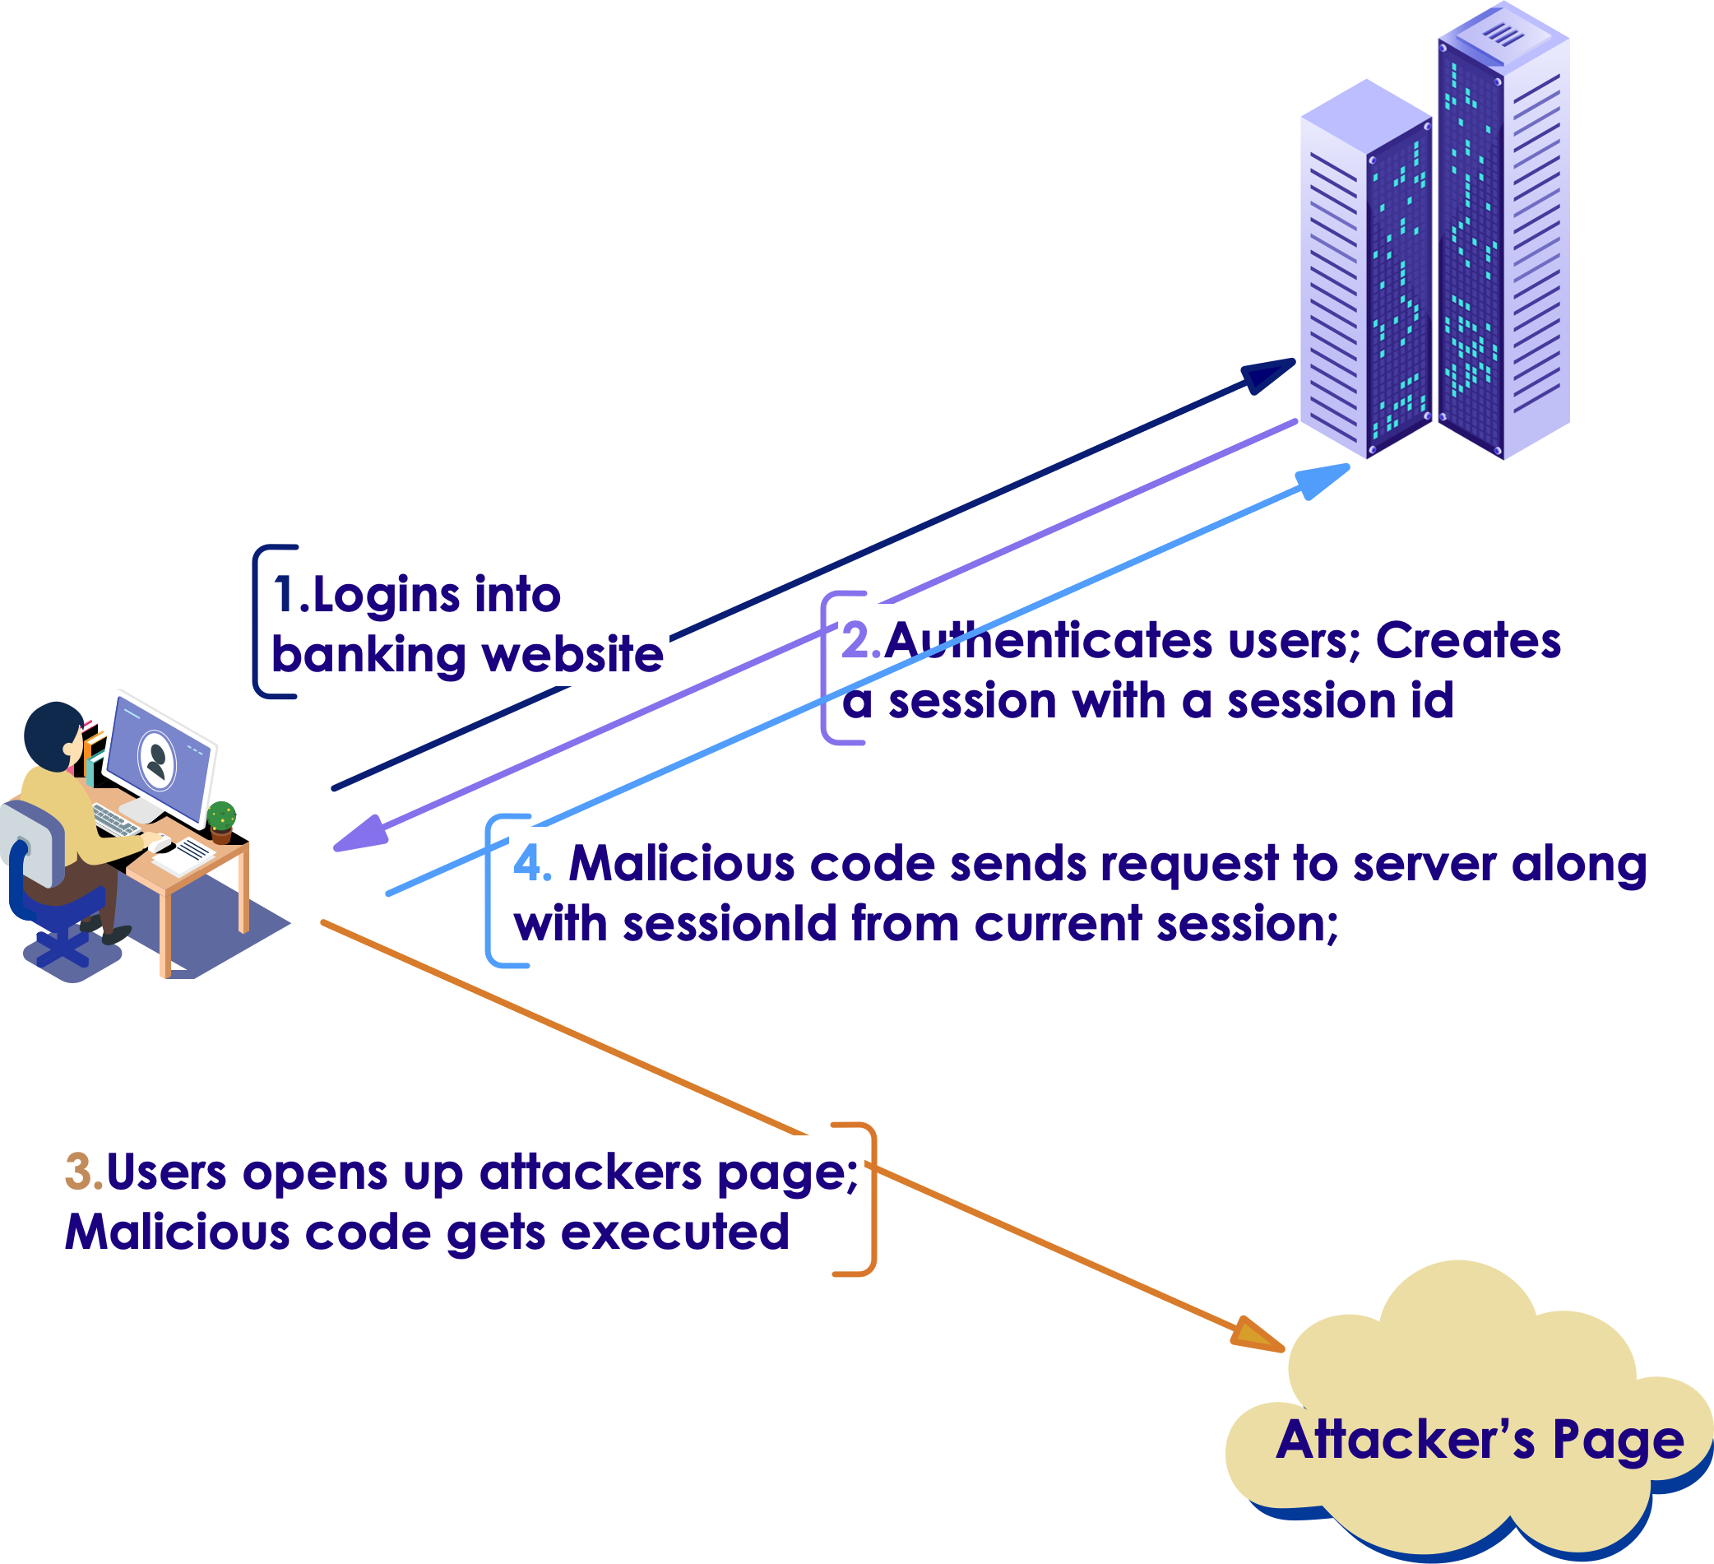
Mechanism
Copyright © 2021 by Elephant Scale, All Rights Reserved

Slide 19
Scenarios
GET
POST
And others like PUT and DELETE
Copyright © 2021 by Elephant Scale, All Rights Reserved

Slide 20
GET
Alice wants to transfer $100 to Bob via bank's website "bank.com"
Copyright © 2021 by Elephant Scale, All Rights Reserved

Slide 21
Get: cont'd
or
Copyright © 2021 by Elephant Scale, All Rights Reserved - Now via social engineering:

Slide 22
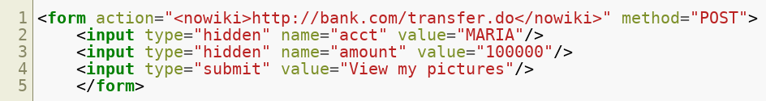
POST
Normal request: POST http://bank.com/transfer.do HTTP/1.1 acct=BOB&amount=100
Vulnerable request and wait for the victim to submit:
Copyright © 2021 by Elephant Scale, All Rights Reserved

Slide 23
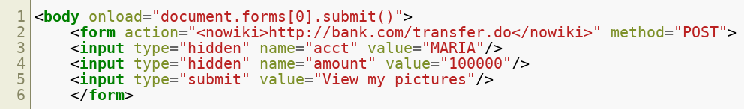
POST, cont'd
if you don't want to wait for the victim and send it automatically:
Copyright © 2021 by Elephant Scale, All Rights Reserved
Notes:
The only difference between GET and POST attacks is how the victim executes the attack.

Slide 24
Primary Defense Techniques
Token Based Mitigation
Synchronizer Token Pattern
A state changing operation needs a secure random token
Every session has a unique token
Encryption based Token Pattern
Instead of comparing tokens to validate an action uses cryptography
For applications that don't maintain states at the server side
Copyright © 2021 by Elephant Scale, All Rights Reserved

Slide 25
Defense In Depth Techniques
Verifying origin with standard headers
Double Submit Cookie
Samesite Cookie Attribute
Use of Custom Request Headers
User Interaction Based CSRF Defense (CAPTCHA)
Copyright © 2021 by Elephant Scale, All Rights Reserved
Notes:
These are beyond the scope of the lesson

Slide 26
What Methods Do Not Work?
Using a secret cookie
Only accepting POST requests
Multi-Step Transactions
URL Rewriting
HTTPS
Copyright © 2021 by Elephant Scale, All Rights Reserved

Slide 27
Database Vulnerabilities
Cross-Site Scripting (XSS) Cross-Site Request Forgery Database Vulnerabilities Session Hijacking Distributed Denial of Service (DDoS) Data Protection
Copyright © 2021 by Elephant Scale, All Rights Reserved

Slide 28
Common DBs
Most common databases:
SQL
NoSQL (MongoDB)
Copyright © 2021 by Elephant Scale, All Rights Reserved

Slide 29
SQL Injection
Executing malicious SQL instructions by exploiting query parameters
A non-secure query with concatenation:
query gets the id from user and gives the address.
Copyright © 2021 by Elephant Scale, All Rights Reserved

Slide 30

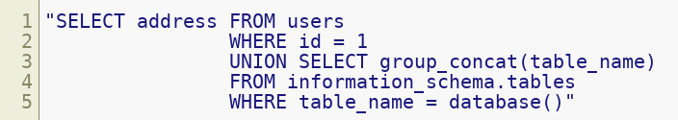
Retrieving All Database Tables
Normal user input: A number like 258
Resulting query: SELECT address FROM users WHERE id = 258
Malicious attacker input:
Resulting query:
Gets a list of all database tables
Copyright © 2021 by Elephant Scale, All Rights Reserved

Slide 31
Writing File To Disk
Attacker input:
1 UNION SELECT "<h1>some text</h1>" INTO OUTFILE "/home/website/public_html
Resulting query would be:
It works with the right permission
Copyright © 2021 by Elephant Scale, All Rights Reserved

Slide 32
Solution
If expected input is a number Input validation will work by not allowing strings as input
If not Prepared Statements or Parameterized Queries instead of concatenation
Copyright © 2021 by Elephant Scale, All Rights Reserved

Slide 33
NoSQL Injection
According to DB-Engines.com MongoDB is the most popular NoSQL database
JavaScript can access directly to MongoDB server by the following operations:
$Where
mapReduce
group
Copyright © 2021 by Elephant Scale, All Rights Reserved

Slide 34
Where
Is used where you need pass a string as query. example: $where: 'this.UserID = ' + req.query.id
Returns the document whose id is the input
Attacker types "0; return true" as input
The equivalent SQL query would be :
Copyright © 2021 by Elephant Scale, All Rights Reserved

Slide 35
Solution
Validation
Copyright © 2021 by Elephant Scale, All Rights Reserved
Notes:
Validation mitigates the problem more than half

Slide 36
Session Hijacking
Cross-Site Scripting (XSS) Cross-Site Request Forgery Database Vulnerabilities Session Hijacking Distributed Denial of Service (DDoS) Data Protection
Copyright © 2021 by Elephant Scale, All Rights Reserved

Slide 37
Session Establishment
The request is made by the client
Along with a response, the server transmits an identifier
The client reads and persists the identifier sent unchanged (is sent through cookies)
The client sends the identifier read and persisted on step 3 as a request
Copyright © 2021 by Elephant Scale, All Rights Reserved

Slide 38
Session Establishment, cont'd
The server reads and validates the identifier
Go to step 2
Identifier is a key part of the process
It must be created on a trusted system (server)
Copyright © 2021 by Elephant Scale, All Rights Reserved

Slide 39
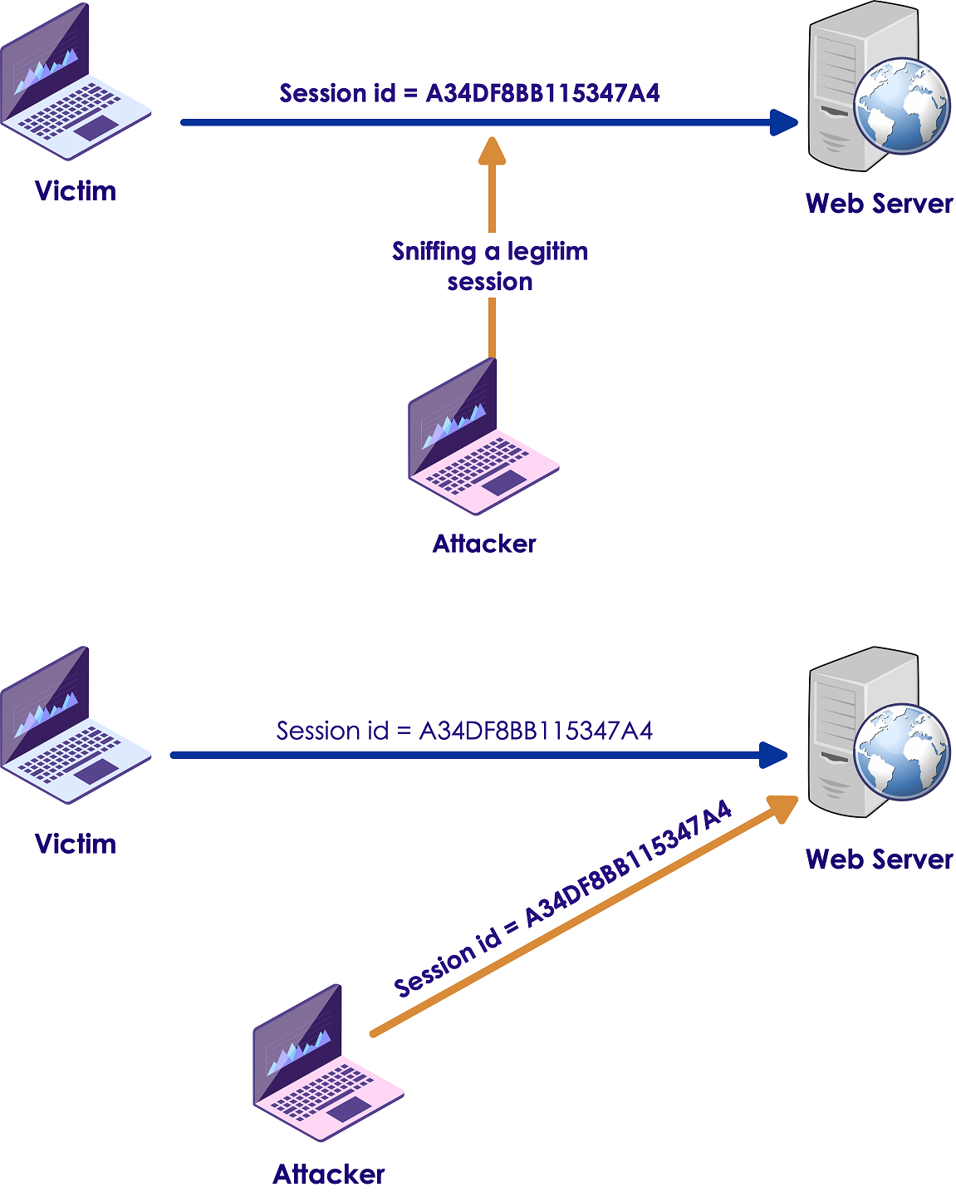
How?
Copyright © 2021 by Elephant Scale, All Rights Reserved

Slide 40
Protect Identifier
To protect identifier:
Always use HTTPS.
Try not to switch between HTTP and HTTPS.
If you have to switch, deactivate the previous identifier and generate new one
Per-request identifier is better than per-session identifier
From all protected pages logout must be available
Logout must terminate all sessions
Copyright © 2021 by Elephant Scale, All Rights Reserved

Slide 41
Distributed Denial of Service (DDoS)
Cross-Site Scripting (XSS) Cross-Site Request Forgery Database Vulnerabilities Session Hijacking Distributed Denial of Service (DDoS) Data Protection
Copyright © 2021 by Elephant Scale, All Rights Reserved

Slide 42
What Is It?
Common attack
Making many systems involved
If not protected JavaScript would be a DDoS weapon
Copyright © 2021 by Elephant Scale, All Rights Reserved

Slide 43
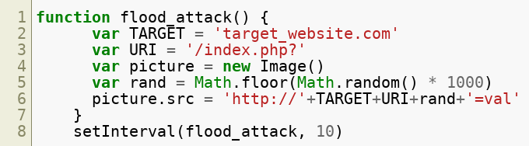
Sample Malicious Code
Copyright © 2021 by Elephant Scale, All Rights Reserved

Slide 44
Sample Malicious code, cont'd
Creates an image 100 times per second
Each visitor of the website containing this code would be a participant to attack to the target_website
Copyright © 2021 by Elephant Scale, All Rights Reserved

Slide 45
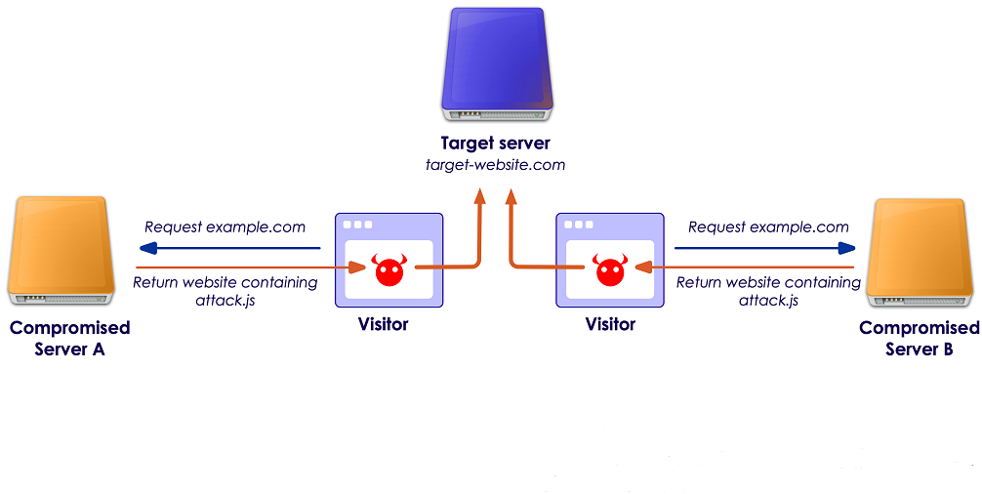
Mechanism
Copyright © 2021 by Elephant Scale, All Rights Reserved

Slide 46
Solution
Depends on how the attacker inserts the code into the page
Copyright © 2021 by Elephant Scale, All Rights Reserved

Slide 47
Data Protection
Cross-Site Scripting (XSS) Cross-Site Request Forgery Database Vulnerabilities Session Hijacking Distributed Denial of Service (DDoS) Data Protection
Copyright © 2021 by Elephant Scale, All Rights Reserved

Slide 48
Right Privileges
Let every user do what they really need not more
Example in an online store:
Salespersons should have read permission to view catalog
Market users should have permission to check statistics
Developers should have permission to modify pages and web application options
Copyright © 2021 by Elephant Scale, All Rights Reserved

Slide 49
Deleting Sensitive Info When Not Needed
Temp and cache files
If you need it encrypt or move it to a protected area
Copyright © 2021 by Elephant Scale, All Rights Reserved

Slide 50
Comments
Do not put comments like TODO list in source-code
Do not comment credentials:
Copyright © 2021 by Elephant Scale, All Rights Reserved

Slide 51
URL
Do not pass important information through HTTP GET because:
If not using HTTPS data can be intercepted by Man In The Middle Attack
User's information can be stored in browser's history including session IDs, pins and tokens
Copyright © 2021 by Elephant Scale, All Rights Reserved

Slide 52
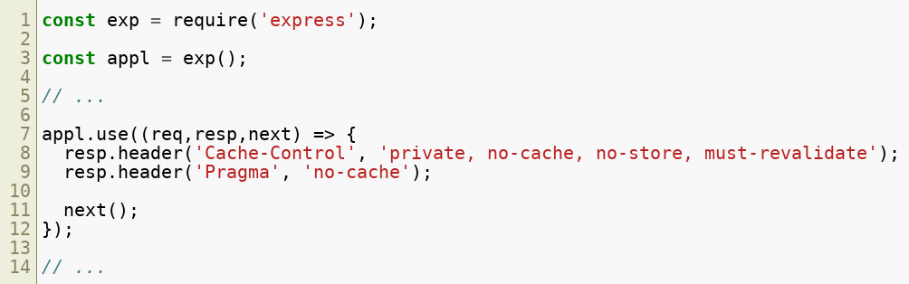
Cache
Disable cache control in pages containing sensitive intormation through setting header flags
Example: in an express app
Copyright © 2021 by Elephant Scale, All Rights Reserved

Slide 53
encryption and password hash
Encrypt every sensitive information
Example of aes-256-cbc in Node.js using crypto module:
Copyright © 2021 by Elephant Scale, All Rights Reserved

Slide 54
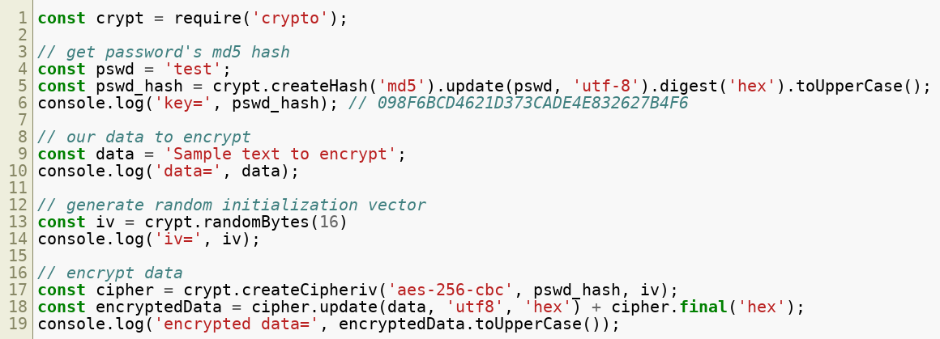
Example
Copyright © 2021 by Elephant Scale, All Rights Reserved

Slide 55
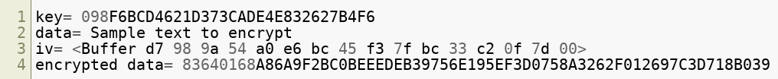
Output
Copyright © 2021 by Elephant Scale, All Rights Reserved

Slide 56
Disable Unnecessary Apps and Services
So simple: Check if there is any unnecessary app or service and disable it
Copyright © 2021 by Elephant Scale, All Rights Reserved

Slide 57
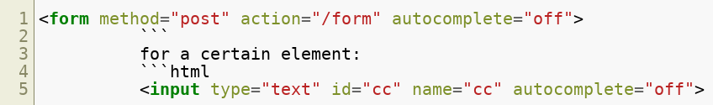
Disable Aautocomplete
for whole the form:
Copyright © 2021 by Elephant Scale, All Rights Reserved

Slide 58
Lab
JavaScript security:
Overview: We will run a URL attack
Pre-requisites: Browser-Google Chrome
Approximate time: 60 minutes
Instructions: labs/javascript_security_labs/README.md
https://github.com/elephantscale/secure-coding-labs/tree/main/javascript_security_labs
Copyright © 2021 by Elephant Scale, All Rights Reserved

