Slide 1
About Cyber-IACS
Copyright © 2021 by Elephant Scale, All Rights Reserved

Slide 2
Agenda - 2 days
Day | Theme | Detail
1 | IACS Cybersecurity | Industrial Automation and Control Systems (IACS) and security, * The role of managers, hackers, and developers
2 | Implementing IACS | Security design principals, * Cryptography * Software Development Lifecycle (SDLC), IEC62443 standards
Copyright © 2021 by Elephant Scale, All Rights Reserved

Slide 3
Pre-requisites and Expectations
Basic IT knowledge is assumed
Have a computer and a browser
Or on the cloud
Curiosity!
Ask a lot of questions
This is an IACS Cybersecurity class
No previous knowledge is assumed (but may be helpful)
Class will be based on the pace of majority of the students
Copyright © 2021 by Elephant Scale, All Rights Reserved

Slide 4
Our Teaching Philosophy
Emphasis on concepts & fundamentals
API - no need to learn anything by heart
Highly interactive (questions and discussions are welcome)
Hands-on (learn by doing)
Copyright © 2021 by Elephant Scale, All Rights Reserved

Slide 5
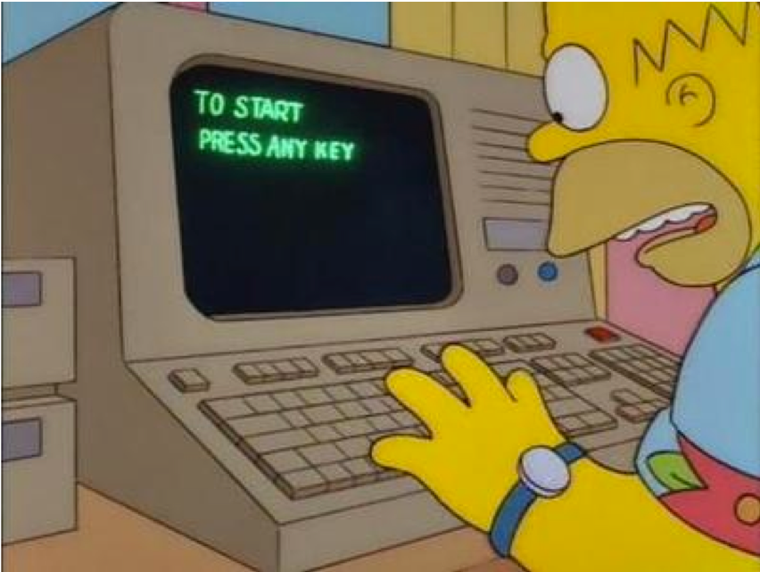
Lots of Labs: Learn By Doing
Where is the ANY key?
Copyright © 2021 by Elephant Scale, All Rights Reserved

Slide 6

Analogy: Learning To Fly…
Copyright © 2021 by Elephant Scale, All Rights Reserved

Slide 7
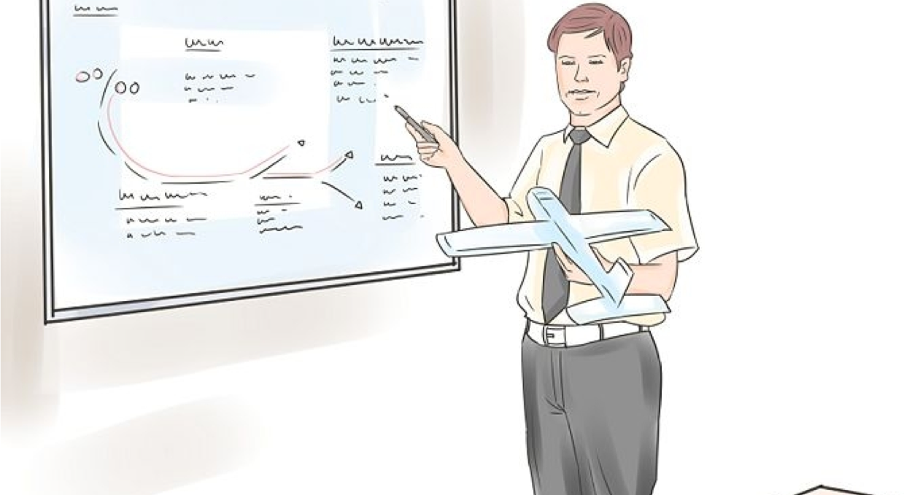
Instruction
Copyright © 2021 by Elephant Scale, All Rights Reserved
Notes:
http://aviation-schools.regionaldirectory.us/learn-to-fly-720.jpg

Slide 8
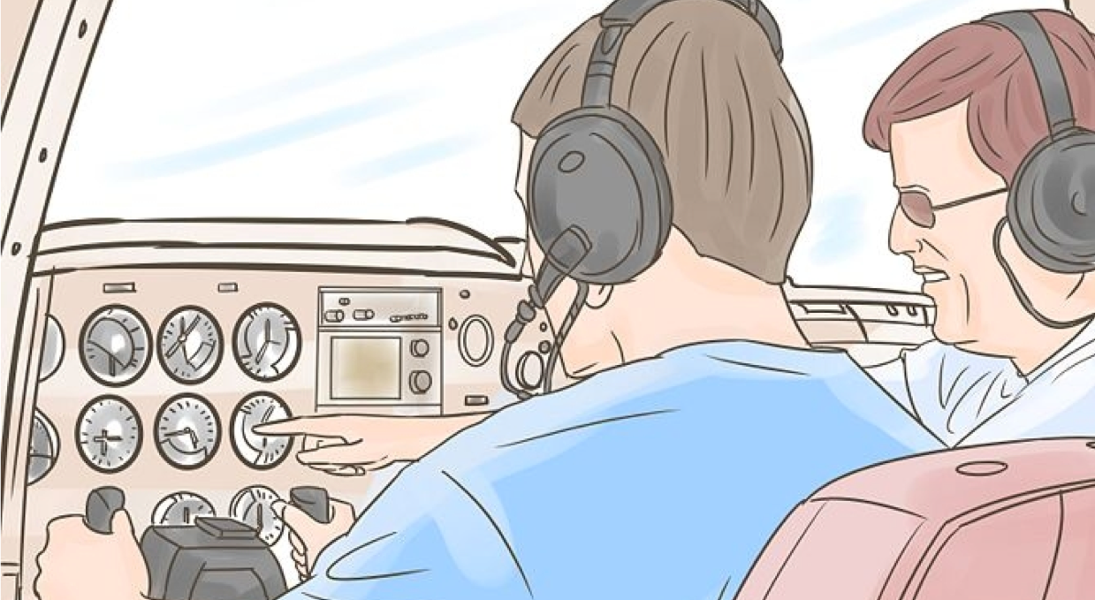
+ Flight Time
Copyright © 2021 by Elephant Scale, All Rights Reserved
Notes:
http://www.wikihow.com/Become-a-Certified-Flight-Instructor

Slide 9
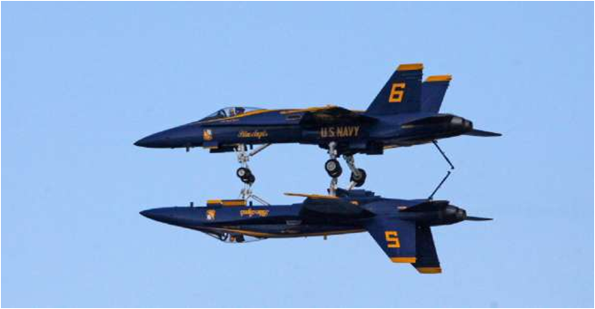
This Will Take A Lot Of Practice ☺
Copyright © 2021 by Elephant Scale, All Rights Reserved

Slide 10
Your class!
Yes, this is your class. What does this mean? You define the value.
What is the most important ingredient of class – your participation!
Your feedback and questions are always welcomed.
There is no protocol in class. Speak up anytime!
We value your comments during and after class. Just email mark@elephantscale.com .
Copyright © 2021 by Elephant Scale, All Rights Reserved

Slide 11
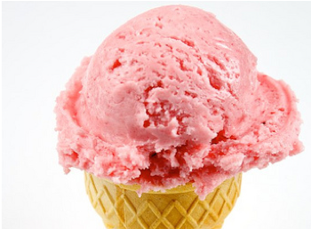

About You And Me
About Instructor
About you
Your Name
Your background (developer, admin, manager, ...)
Technologies you are familiar with
Familiarity with security? (scale of 1 – 4: 1 – new, 4 – expert)
Something non-technical about you!(favorite ice cream flavor or hobby…)
Copyright © 2021 by Elephant Scale, All Rights Reserved

