Slide 1
OT Cybersecurity Overview
Copyright © 2021 by Elephant Scale, All Rights Reserved

Slide 2
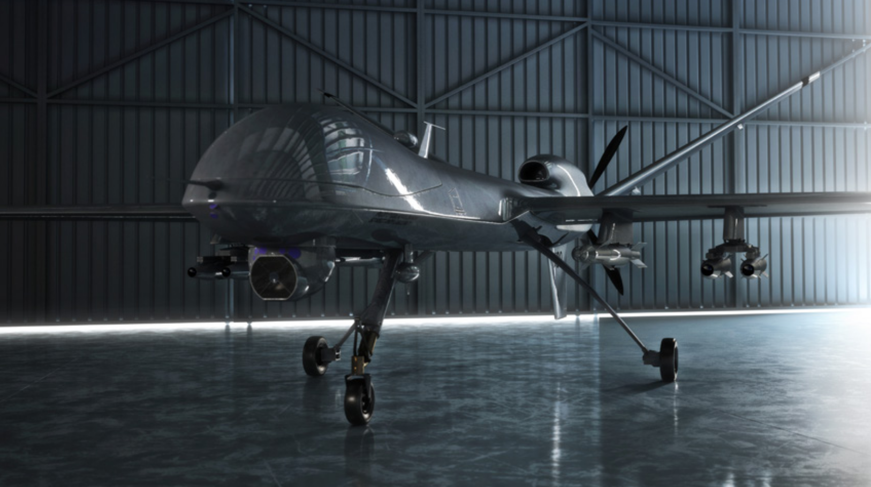
Trends and directions
Trends
As data collection and analysis become more important
IT and OT converge to enable “big data” initiatives
Directions
it has become necessary to reassess cybersecurity best practices
for protecting OT
Copyright © 2021 by Elephant Scale, All Rights Reserved
Notes:
The plan described in the following slides follows the direction suggested in the "Comprehensive Guide to Operational Technology Cybersecurity" eBook by MissionSecure company

