Slide 1
NiFi Overview
Motivation
Concepts
Benefits
Performance

Slide 2
Lesson Objectives
Understand NiFi motivation
Relate NiFi’s use cases to one’s own projects
Plan for NiFi implementation
Copyright © 2017 Elephant Scale. All rights reserved.
<number>

Slide 3
Motivation
➔ Motivation
Concepts
Benefits
Performance

Slide 4
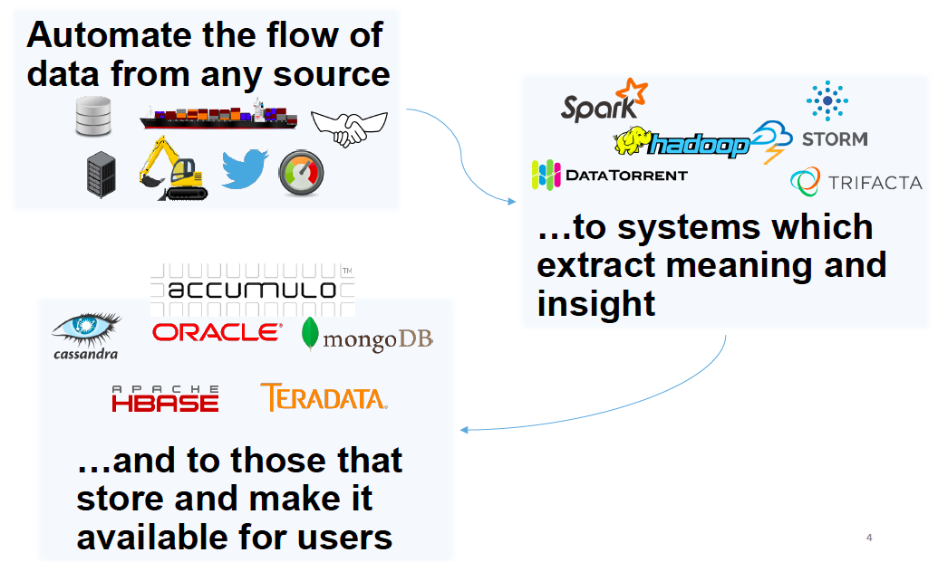
NiFi at a Glance
Copyright © 2017 Elephant Scale. All rights reserved.
<number>
Notes:
From presentation provided by Joe Witt and available here, https://www.slideshare.net/markkerzner/joe-witt-june2015bigdatahoustonmeetupapachenifioverview
Copyright © 2017 Elephant Scale. All rights reserved.
<number>

Slide 5

NiFi Trivia
Originally developed by the NSA
Donated to Apache in November 2014
Continued by Onyara
Now part of Hortonworks
NiFi = Niagara Files
Copyright © 2017 Elephant Scale. All rights reserved.
<number>
Notes:
One of the first presentation was at Houston Hadoop and Spark meetup, http://shmsoft.blogspot.ca/2015/06/joe-witt-of-onyara-presented-apache-nifi.html
Copyright © 2017 Elephant Scale. All rights reserved.
<number>

Slide 6
NiFi Use Cases
Remote sensor delivery
Inter-site / global distribution
Intra-site distribution
Big Data ingest
Data Processing (enrichment, filtering, sanitization)
Copyright © 2017 Elephant Scale. All rights reserved.
<number>

Slide 7
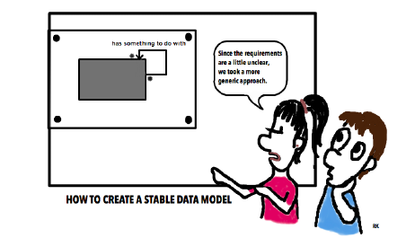
Challenges that NiFi Designers Faced
Transport / Messaging was not enough
Needed to understand the big picture
Needed the ability to make *immediate* changes
Must maintain chain of custody for data
Rigorous security and compliance requirements
Copyright © 2017 Elephant Scale. All rights reserved.
<number>

Slide 8
Why Transport and Messaging Insufficient
Data access exceeded resources to transport
Decoupling systems is about more than the connectivity
Message sizes ranged from B to GB
Not all data is created equal
Needed precise security controls
SSL and topic level authorization insufficient
Copyright © 2017 Elephant Scale. All rights reserved.
<number>

Slide 9
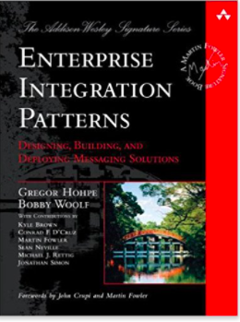
NiFi Foundations
Since enterprises started using software ☺
And had to exchange data between systems
There appeared a need for dataflow managing
NiFi automates the flow of data between systems
Many of NiFi ideas date back to this book (2003)
”Better Analytics Demands Better Workflow”
Joe Witt (original CTO of NiFi/Onyara)
Copyright © 2017 Elephant Scale. All rights reserved.
<number>
Notes:
Book link and image credit https://www.amazon.com/Enterprise-Integration-Patterns-Designing-Deploying/dp/0321200683/ref=sr_1_2
Copyright © 2017 Elephant Scale. All rights reserved.
<number>

Slide 10
Problems NiFi Solves
Failures
Networks fail
Hardware fails
Software fails
And people make mistakes
”Prepare for failure and then nothing fails” – Amazon mantra
Copyright © 2017 Elephant Scale. All rights reserved.
<number>

Slide 11
Other Problems that NiFi Solves
Data access exceeds capacity to consume
Boundary conditions are mere suggestions
Data is dirty
What is noise one day becomes signal the next
Priorities of an organization change
Systems evolve at different rates
Compliance and security
Copyright © 2017 Elephant Scale. All rights reserved.
<number>

Slide 12
Concepts
Motivation
➔ Concepts
Benefits
Performance

Slide 13

NiFi Concepts
The basic building blocks
Real-time Command and Control
The Power of Provenance
Copyright © 2017 Elephant Scale. All rights reserved.
<number>
Notes:
Original logo by Onyara
Copyright © 2017 Elephant Scale. All rights reserved.
<number>

Slide 14
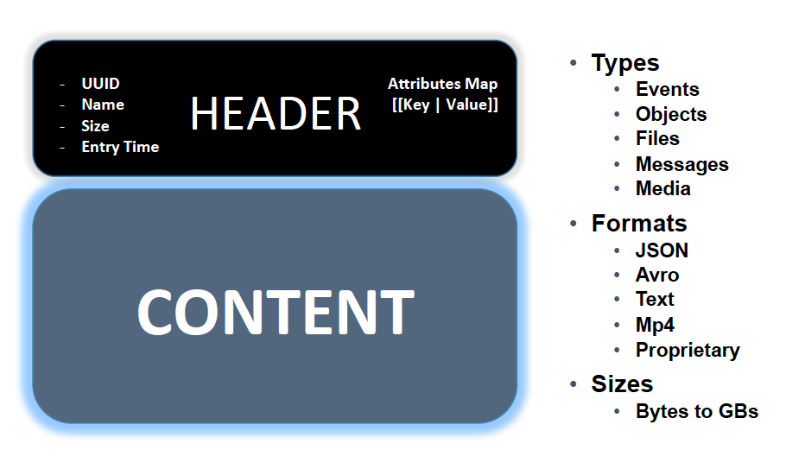
Flow File
Copyright © 2017 Elephant Scale. All rights reserved.
<number>
Notes:
Joe Witt slides
Copyright © 2017 Elephant Scale. All rights reserved.
<number>

Slide 15
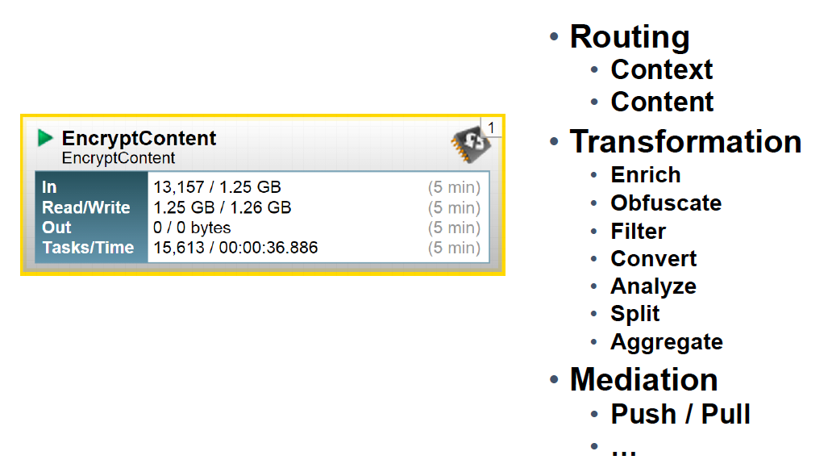
Flow File Processor
Copyright © 2017 Elephant Scale. All rights reserved.
<number>

Slide 16
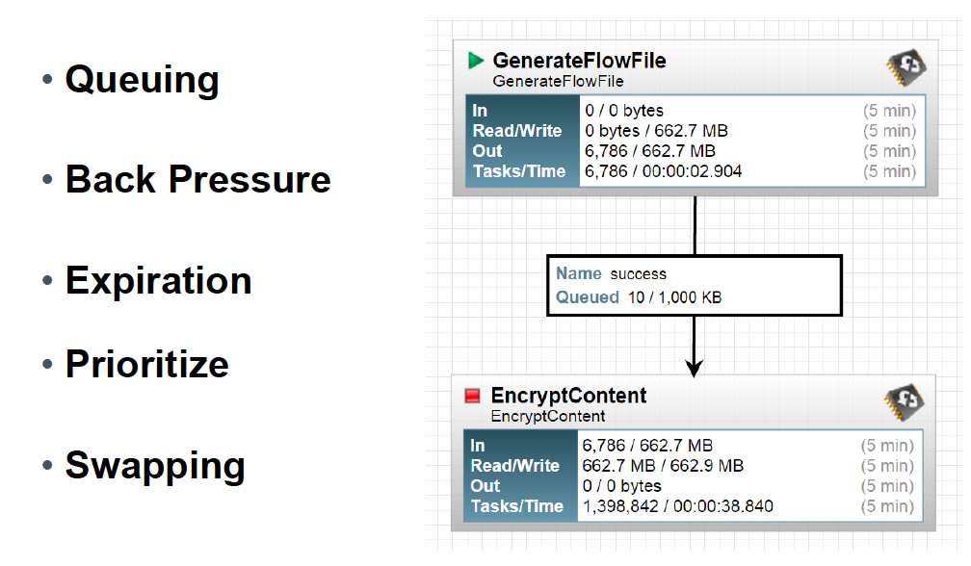
Connections
Copyright © 2017 Elephant Scale. All rights reserved.
<number>

Slide 17
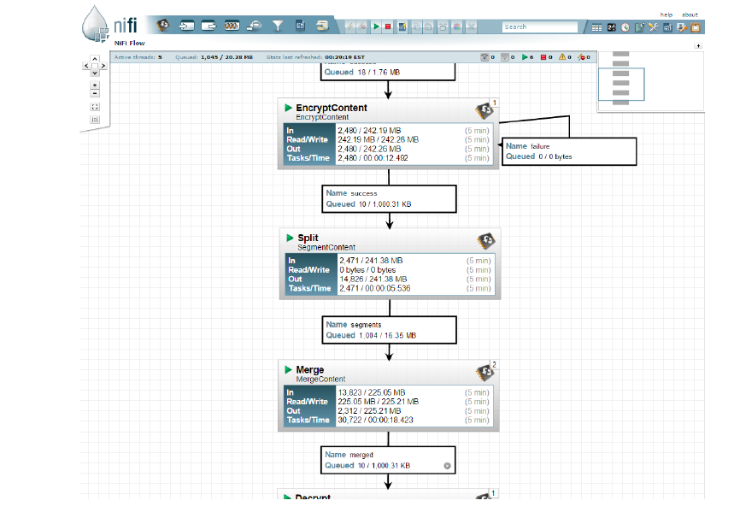
Flow Controller
Copyright © 2017 Elephant Scale. All rights reserved.
<number>

Slide 18
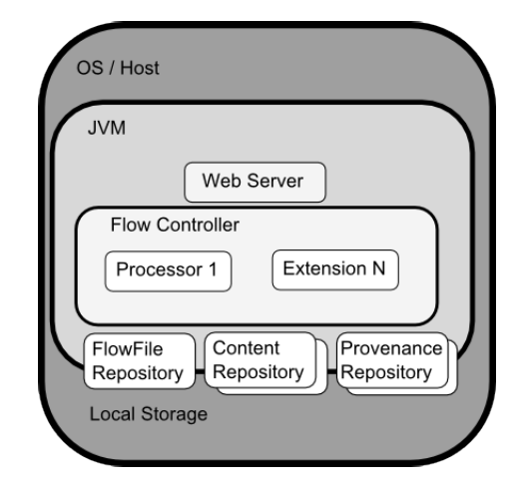
NiFi Architecture
Copyright © 2017 Elephant Scale. All rights reserved.
<number>
Notes:
Copyright © 2017 Elephant Scale. All rights reserved.
<number>

Slide 19
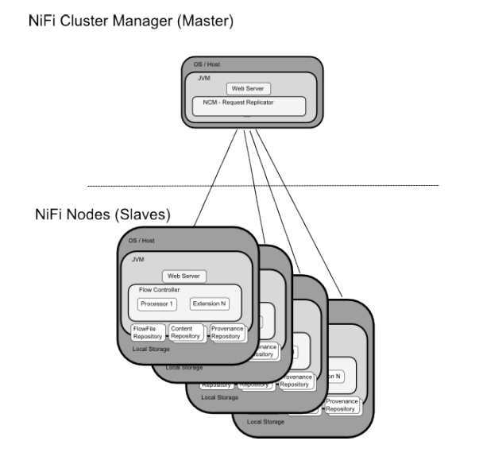
NiFi Clustering Model
Copyright © 2017 Elephant Scale. All rights reserved.
<number>

Slide 20
Benefits
Motivation
Concepts
➔ Benefits
Performance

Slide 21
Real Time Command and Control
Tighten the feedback loop
Changes have consequences (good or bad)
And you see them as they occur
Continuous Improvement
Compare real-time vs. historical statistics
View data provenance
View Content at any stage
Intuitive user experience
Visual programming
Logical flow graph
Copyright © 2017 Elephant Scale. All rights reserved.
<number>

Slide 22
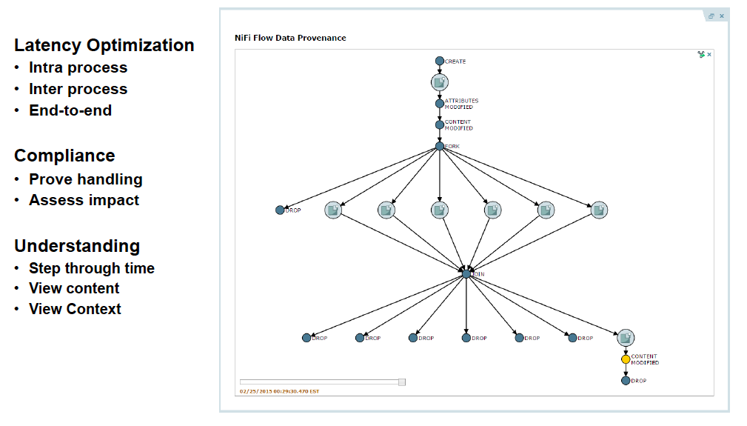
The Power of Provenance – Chain of custody
Copyright © 2017 Elephant Scale. All rights reserved.
<number>

Slide 23
Performance
Motivation
Concepts
Benefits
➔ Performance

Slide 24
Why is NiFi Fast?
Flow File Repo
Write Ahead Log
Content Repo
Add more partitions
Input/Output Streams
Copy on Write
Pass by Reference
Allow tradeoffs of latency vs throughput
Copyright © 2017 Elephant Scale. All rights reserved.
<number>

Slide 25
Review Questions
Copyright © 2017 Elephant Scale. All rights reserved.
<number>

