Slide 1
About Ansible Class
Copyright © 2025 by Elephant Scale, All Rights Reserved

Slide 2
Day 1
# | Hours | Subject
1 | 1 | Ansible Overview
2 | 2 | Deploying Ansible
3 | 2 | Playbooks
4 | 1 | Variables and Inclusions
Copyright © 2025 by Elephant Scale, All Rights Reserved

Slide 3
Day 2
# | Hours | Subject
1 | 01 | Task Control
2 | 01 | Block Control
3 | 01 | Variables
4 | 01 | Conditions
5 | 01 | Jinja2 Templates
6 | 01 | Ansible Vault
Copyright © 2025 by Elephant Scale, All Rights Reserved

Slide 4
Day 3
# | Hours | Subject
1 | 03 | Roles
2 | 01 | Optimizing Ansible
3 | 01 | Ansible Galaxy
Copyright © 2025 by Elephant Scale, All Rights Reserved

Slide 5
Pre-requisites for Ansible Class
No Ansible knowledge is assumed (but may be helpful)
Some software development experience (languages, databases, ...)
Have the Ansible development environment
We will set this up in class
Curiosity!
Ask a lot of questions
This is an intro-intermediate class.
Copyright © 2025 by Elephant Scale, All Rights Reserved

Slide 6
Our Teaching Philosophy
Emphasis on concepts & fundamentals
No need to memorize any API
Highly interactive (questions and discussions are welcome)
Hands-on (learn by doing)
Copyright © 2025 by Elephant Scale, All Rights Reserved

Slide 7
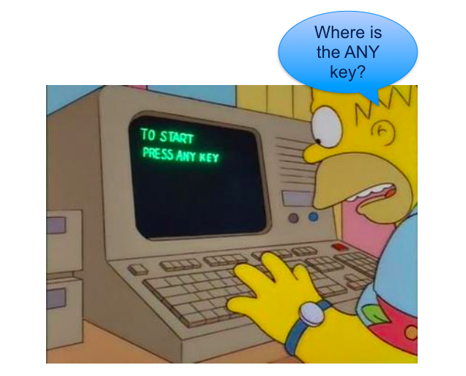
Lots of Labs: Learn By Doing
Where is the ANY key?
Copyright © 2025 by Elephant Scale, All Rights Reserved

Slide 8

Analogy: Learning To Fly...
Copyright © 2025 by Elephant Scale, All Rights Reserved

Slide 9
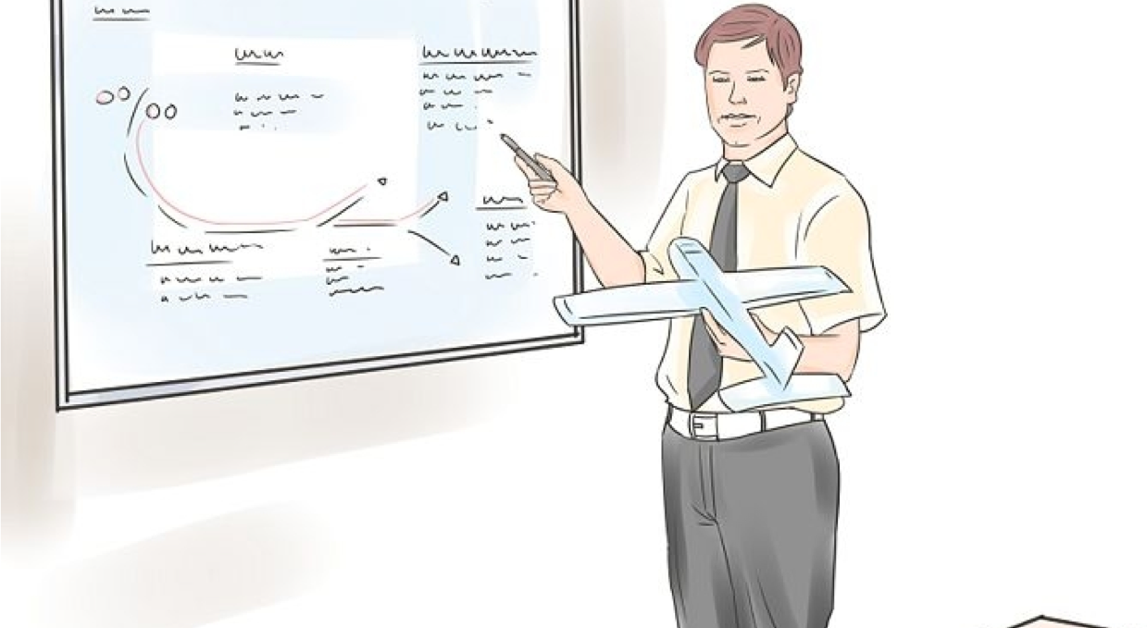
Instruction
Copyright © 2025 by Elephant Scale, All Rights Reserved
Notes:
http://aviation-schools.regionaldirectory.us/learn-to-fly-720.jpg

Slide 10
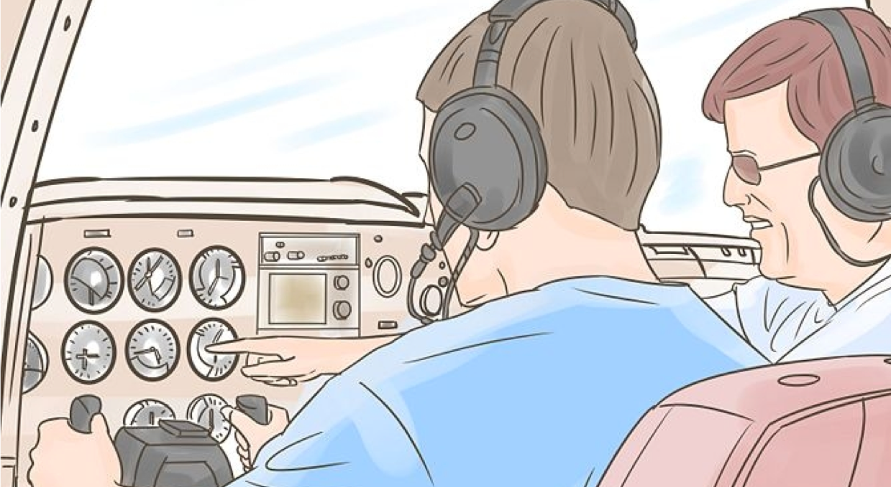
+ Flight Time
Copyright © 2025 by Elephant Scale, All Rights Reserved
Notes:
http://www.wikihow.com/Become-a-Certified-Flight-Instructor

Slide 11
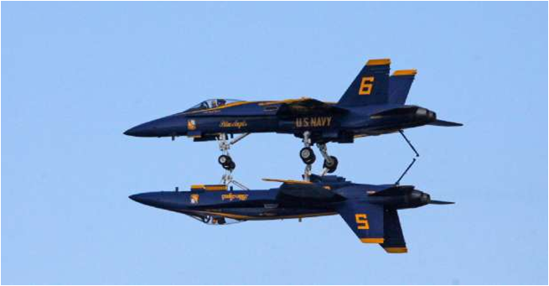
This Will Take A Lot Of Practice
Copyright © 2025 by Elephant Scale, All Rights Reserved

Slide 12


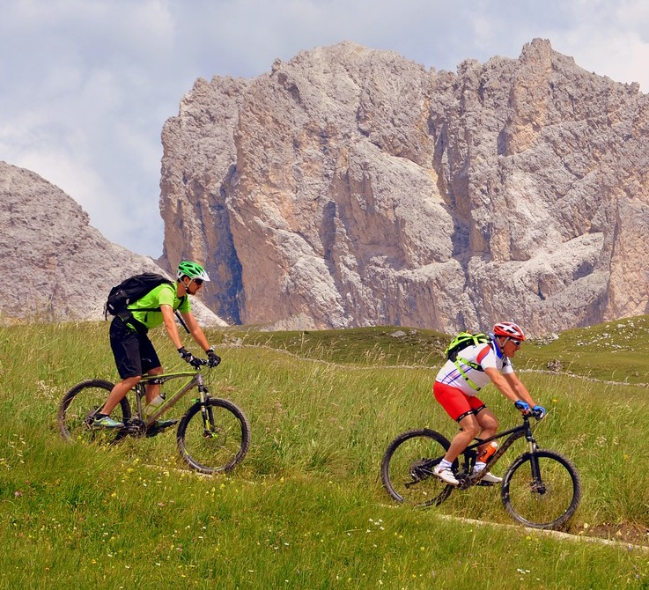
About You And Me
About Instructor
About you
Your Name
Your background (developer, admin, manager,...)
Technologies you are familiar with
Familiarity with Ansible (scale of 1 – 4 ; 1 – new, 4 – expert)
Something non-technical about you!(favorite ice cream flavor, hobby, etc.)
Copyright © 2025 by Elephant Scale, All Rights Reserved

