Slide 1
Why Ansible?
Why Agentless?
Inventory
Install Ansible
Copyright © 2025 by Elephant Scale, All Rights Reserved

Slide 2

Stating a Problem
Modern IT environments often require deploying and managing a large number of servers, applications, and services. When done manually, these tasks are error-prone, time-consuming, and difficult to scale. Configuration drift, inconsistent updates, and lack of centralized management can create unnecessary complexity and risk.
Copyright © 2025 by Elephant Scale, All Rights Reserved

Slide 3

Answer
Automation is the key to addressing these challenges. By using tools that enable streamlined, repeatable processes, organizations can ensure consistency, reduce human error, and achieve faster deployments.
Copyright © 2025 by Elephant Scale, All Rights Reserved

Slide 4
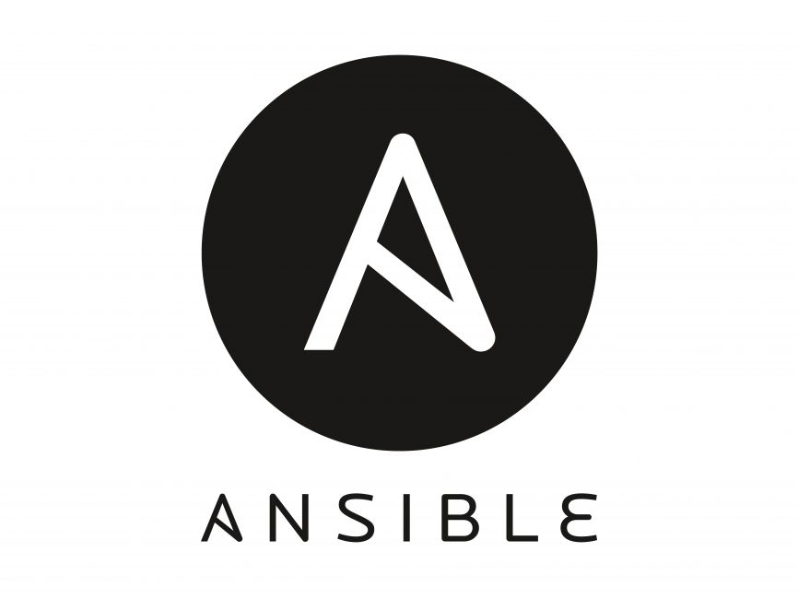
Automation
Automating the management and deployment of a large infrastructure is essential to maintain consistency and scalability.
Ansible is one such automation tool that makes it easy to define, manage, and orchestrate IT environments in a repeatable, secure, and predictable way.
Copyright © 2025 by Elephant Scale, All Rights Reserved

Slide 5

Ansible
Copyright © 2025 by Elephant Scale, All Rights Reserved

Slide 6
What is Ansible?
Simple IT Automation Tool Ansible is designed to simplify the deployment of applications and the maintenance of systems.
No Need for Custom Scripts You don’t have to write complex scripts or custom code to manage updates or roll out new features.
Human-Readable Language Ansible uses YAML, a syntax that closely resembles plain English, making configurations easy to write and review.
Agentless Architecture Because Ansible relies on SSH (or WinRM for Windows), there is no need to install any agents on the managed nodes. This makes setup and management far simpler.
Copyright © 2025 by Elephant Scale, All Rights Reserved

Slide 7
Where to Use Ansible
Configuration Management Maintain consistent system configurations across servers.
Application Deployment Automate the rollout of new application versions, ensuring consistent deployments.
Continuous Delivery Integrate with CI/CD pipelines to automate builds, tests, and releases.
Orchestration Coordinate complex, multi-step workflows and interdependent services.
Security Automation Streamline security patches, vulnerability scans, and compliance checks.
Multi-Tier Applications Manage configurations across multiple layers (web, application, database) seamlessly.
Cloud Provisioning Provision and manage resources on cloud providers (AWS, Azure, GCP, etc.).
Network Automation Configure and maintain network devices, such as switches and routers.
And More…
Copyright © 2025 by Elephant Scale, All Rights Reserved

Slide 8
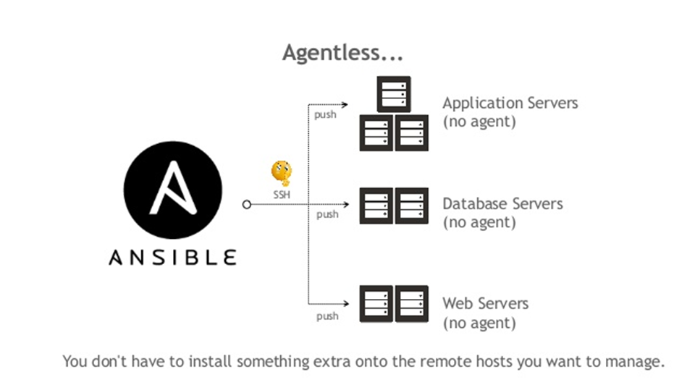
Agentless
Target systems do not require any pre-installed software or running services for Ansible to manage them. By default, Ansible communicates via SSH (on Unix-like systems) or WinRM (on Windows). Tasks execute on the remote host only when needed, leaving no persistent agents behind.
<span style="font-size:15px; color:red"> Important: Windows hosts require PowerShell and WinRM to be configured, but no separate agent or service is needed. </span>
Copyright © 2025 by Elephant Scale, All Rights Reserved

Slide 9
Why Agentless?
Why Agentless? Inventory Install Ansible
Copyright © 2025 by Elephant Scale, All Rights Reserved

Slide 10
Idempotent
Ansible ensures idempotency , meaning you can run the same task multiple times without altering the outcome after the first successful run.
This guarantees a consistent state on all managed systems, regardless of how many times the playbooks are executed.
Copyright © 2025 by Elephant Scale, All Rights Reserved

Slide 11

Continued
While Ansible is frequently used for configuration management, it is not a pure configuration management tool in the same sense as Puppet or Chef.
However , it can still manage configuration files effectively and is often used in that capacity.
Copyright © 2025 by Elephant Scale, All Rights Reserved

Slide 12
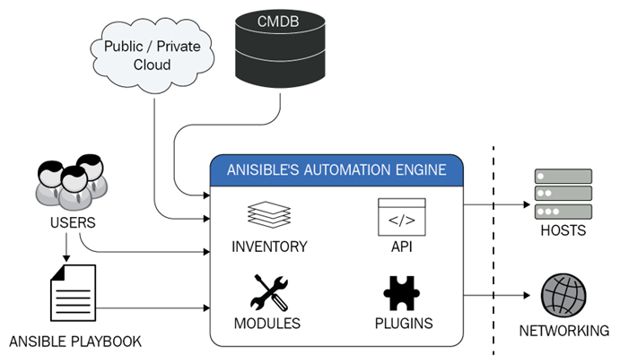
Ansible Architecture
Control Node : Where Ansible is installed and commands are run.
Managed Nodes : Systems you want to control, which require no special agents.
Inventory : A list of hosts or groups of hosts.
Modules : Units of code Ansible executes via SSH or WinRM.
Playbooks : YAML files that define a series of tasks.
Copyright © 2025 by Elephant Scale, All Rights Reserved

Slide 13

Run AGAINST
To “run against” a host or group means to execute a specific ad-hoc command, play, or playbook on those targeted systems.
The target hosts or groups are defined in the inventory.
Copyright © 2025 by Elephant Scale, All Rights Reserved

Slide 14
Ansible vs. Chef vs. Puppet vs. SaltStack
Below is a high-level comparison of popular automation/configuration management tools.
Feature | Ansible | Chef | Puppet | SaltStack
Configuration Language | YAML | Ruby DSL | Puppet DSL | YAML
Masterless Support | Yes | No | No | Yes
Agent-Based Support | Optional (`ansible-pull`) | Yes | Yes | Yes
Idempotent Execution | Yes | Yes | Yes | Yes
Real-Time Execution | Yes | No | No | Yes
Parallel Execution | Yes | Yes | Yes | Yes
Dependency Management | Yes | Yes | Yes | Yes
Dry-Run Testing | Yes | Yes | Yes | Yes
Declarative Configuration | Yes | Yes | Yes | Yes
Copyright © 2025 by Elephant Scale, All Rights Reserved

Slide 15
Inventory
Why Agentless? Inventory Install Ansible
Copyright © 2025 by Elephant Scale, All Rights Reserved

Slide 16
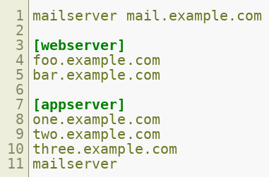
Inventory
Definition : An inventory is a list of hosts (systems) managed by Ansible.
Types : It can be static (a file) or dynamic (generated by a script).
Usage : Can be specified on the command line or within a default file (commonly /etc/ansible/hosts ).
Copyright © 2025 by Elephant Scale, All Rights Reserved

Slide 17
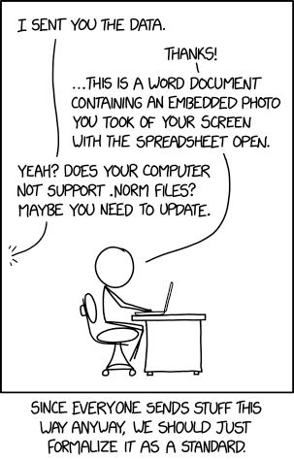
INI Format
Sections : Group hosts under bracketed sections (e.g., [webserver] ).
Hosts and Attributes : You can specify hosts and their connection parameters using key-value pairs (e.g., ansible_user=ubuntu ).
Optional Attributes : If no attributes are specified, Ansible uses defaults (like SSH key-based authentication).
Copyright © 2025 by Elephant Scale, All Rights Reserved

Slide 18
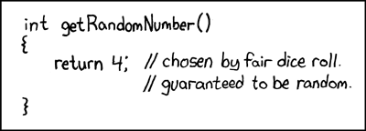
Static Inventory
Defined in a File : Commonly located in /etc/ansible/hosts .
INI Format : The most common format, but YAML and others are possible.
Easy to Maintain : Good for smaller environments or those that change infrequently.
Copyright © 2025 by Elephant Scale, All Rights Reserved

Slide 19
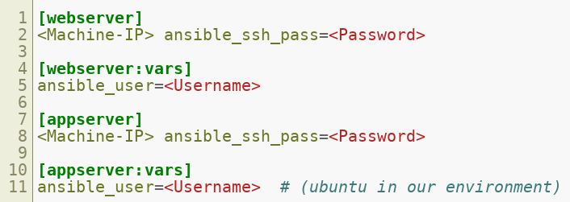
Example
Copyright © 2025 by Elephant Scale, All Rights Reserved

Slide 20
Dynamic Inventory
Script-Driven : Hosts are populated dynamically using external data sources, such as cloud provider APIs or CMDBs.
Format : The script outputs JSON describing groups, hosts, and associated variables.
Location : By default, Ansible will look in /etc/ansible/hosts or the directory specified with -i .
Copyright © 2025 by Elephant Scale, All Rights Reserved

Slide 21
Install Ansible
Why Agentless? Inventory Install Ansible
Copyright © 2025 by Elephant Scale, All Rights Reserved

Slide 22
Install Ansible
Language : Ansible is primarily written in Python, allowing it to run on many OSes including Debian, Red Hat-based distributions, and FreeBSD.
macOS : Can be installed via pip , Homebrew, or other package managers.
Windows : Native installation is supported via WSL2 (Windows Subsystem for Linux) or Python distributions. Windows Server 2025 requires Ansible Core 2.19+.
Copyright © 2025 by Elephant Scale, All Rights Reserved

Slide 23
Release Cycle
Frequency : Ansible releases occur approximately every four weeks for minor versions, with major releases twice a year.
Current Versions : As of 2025, Ansible 11.x is the latest stable release (based on ansible-core 2.18.x).
Changes : Each release includes bug fixes, new collections, and feature updates while maintaining backward compatibility.
Best Practice : Use official Ansible packages or repositories to stay up to date with the latest stable releases.
Copyright © 2025 by Elephant Scale, All Rights Reserved

Slide 24
LAB
Task : Install Ansible
Instructions : https://github.com/elephantscale/ansible-labs/blob/main/setup/Install-Ansible.md
Copyright © 2025 by Elephant Scale, All Rights Reserved

Slide 25
Ansible Ad-Hoc
Copyright © 2025 by Elephant Scale, All Rights Reserved

Slide 26
Ad-Hoc Commands
Definition : Quick, one-off Ansible commands run from the CLI using the ansible command.
Non-Reusable : Ideal for immediate tasks (e.g., checking connectivity, rebooting a server), but not for ongoing tasks.
Examples of Use :
Reboot Servers
Copy Files
Manage Packages and Users
Modules : You can invoke any Ansible module (e.g., ping , shell , yum ) with -m .
Arguments : Pass parameters using -a .
Inventory : Specify inventory location (or use default) with -i .
Copyright © 2025 by Elephant Scale, All Rights Reserved

Slide 27

Example
This command uses the ping module to check connectivity against all hosts defined in the hosts file.
Copyright © 2025 by Elephant Scale, All Rights Reserved

Slide 28
LAB
Objective : Practice running Ad-Hoc commands
Instructions : Ansible Labs - Adhoc
Copyright © 2025 by Elephant Scale, All Rights Reserved

