Slide 1
Ansible Playbook
Copyright © 2025 by Elephant Scale, All Rights Reserved

Slide 2

What is a Playbook?
Definition : A playbook is a YAML-formatted file that contains a list of “plays,” which in turn define tasks for configuration, deployment, and orchestration.
Purpose : Playbooks describe the desired state of your systems, allowing Ansible to maintain consistency across various environments.
Copyright © 2025 by Elephant Scale, All Rights Reserved

Slide 3

Key Components of a Playbook
Plays : Group tasks under a specific host or group of hosts.
Tasks : Individual instructions, often using Ansible modules, such as installing packages or creating files.
Variables : Key-value pairs that store data for dynamic or reusable settings.
Handlers : Special tasks triggered by “notify” statements to perform actions after changes (e.g., restarting a service).
Templates : Use Jinja2 to generate dynamic configuration files.
We will examine each component in more detail.
Copyright © 2025 by Elephant Scale, All Rights Reserved

Slide 4
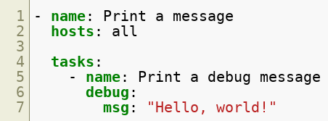
Playbook Example
Below is a simple playbook:
Let’s break down this example into its component parts.
Copyright © 2025 by Elephant Scale, All Rights Reserved

Slide 5

YAML Header
Purpose : This marker indicates the start of a YAML document.
No Specific Version : You’re simply declaring that the file is valid YAML.
Copyright © 2025 by Elephant Scale, All Rights Reserved

Slide 6

Play
Hosts : Defines which group(s) or host(s) the tasks should run against.
Become : Indicates that tasks in this play should run with elevated (sudo) privileges.
Copyright © 2025 by Elephant Scale, All Rights Reserved

Slide 7

What is a Play?
A play is a series of tasks that target a specific group of hosts:
In this example, servers refers to a host group defined in your inventory.
Copyright © 2025 by Elephant Scale, All Rights Reserved

Slide 8

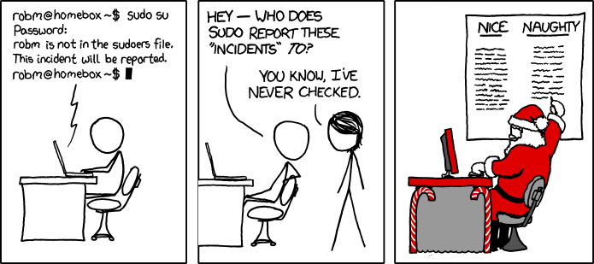
What is Become?
Definition : Tells Ansible to escalate privileges (e.g., sudo) for the tasks under this play.
Use Case : Ideal for tasks that require root or administrative privileges.
Copyright © 2025 by Elephant Scale, All Rights Reserved

Slide 9
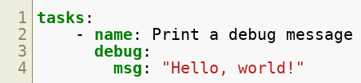
Task Structure
Name : A human-readable label for the task, aiding in clarity and logging.
Module : Specifies which Ansible module is used (e.g., debug , apt , yum , copy ).
Arguments : Key-value pairs passed to the module to configure its behavior.
Copyright © 2025 by Elephant Scale, All Rights Reserved

Slide 10

Task: Name
Purpose : Provides a descriptive identifier for the task.
Recommendation : Use clear, concise naming to quickly understand what the task does.
Copyright © 2025 by Elephant Scale, All Rights Reserved

Slide 11

Task: Module
Definition : The module to be executed by Ansible.
Examples : apt (Debian-based package manager), yum (Red Hat-based), copy , file , user , etc.
Custom Modules : You can write your own or use community-provided modules.
Copyright © 2025 by Elephant Scale, All Rights Reserved

Slide 12
Let’s Discuss Modules
Let’s Discuss Modules Returning to Our Playbook Conditionals Loops Handlers Blocks Templates Ansible Vault Plugins Roles Scaling Playbooks Run Strategy
Copyright © 2025 by Elephant Scale, All Rights Reserved

Slide 13

Task: Module Arguments
Key-Value Pairs : Customize module behavior, such as package names, file paths, or messages.
Example : When using the apt module, arguments might include name and state to indicate which package to install.
Copyright © 2025 by Elephant Scale, All Rights Reserved

Slide 14
Modules: Types
Core Modules
Maintained by the Ansible team.
Found in your Python site-packages directory (e.g., /usr/lib/python3.x/site-packages/ansible/modules ).
Extra Modules
Maintained by the community.
May be promoted to core or removed if unmaintained.
Installable via ansible-galaxy .
Copyright © 2025 by Elephant Scale, All Rights Reserved

Slide 15
Modules: Index
Local Documentation : /usr/share/doc/ansible/html/modules_by_category.html
Online Index (for current Ansible version): Ansible Modules by Category
Copyright © 2025 by Elephant Scale, All Rights Reserved

Slide 16
Modules: Documentation
Local Docs : /usr/share/doc/ansible/html/modules/<module_name>.html
Online Docs : https://docs.ansible.com/ansible/latest/collections/<collection_name>/<module_name>_module.html
Contents :
Description of the module
Required arguments (e.g., name , state )
Return values
Code examples
Copyright © 2025 by Elephant Scale, All Rights Reserved

Slide 17
Returning to Our Playbook
Let’s Discuss Modules Returning to Our Playbook Conditionals Loops Handlers Blocks Templates Ansible Vault Plugins Roles Scaling Playbooks Run Strategy
Copyright © 2025 by Elephant Scale, All Rights Reserved

Slide 18
Playbook: Summary
Single Play : Targets all hosts in the inventory.
Single Task : Uses the debug module to display “Hello, world!”
Execution : Run with ansible-playbook -i <inventory_file> playbook.yml .
Copyright © 2025 by Elephant Scale, All Rights Reserved

Slide 19
Running the Playbook
Execute the playbook with:
-v
: Increases verbosity, showing more detail on what Ansible is doing.
Default Behavior : Uses hosts: all if not overridden by the CLI.
Copyright © 2025 by Elephant Scale, All Rights Reserved

Slide 20
LAB
Practice your new knowledge by completing the hands-on exercises in the lab:
[Access the Lab Here] (Link to your specific lab resource)
Copyright © 2025 by Elephant Scale, All Rights Reserved

Slide 21
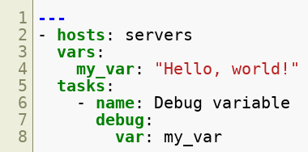
Variables and Facts
Consider the following example:
We’ll break this down to understand variables and facts more clearly.
Copyright © 2025 by Elephant Scale, All Rights Reserved

Slide 22

Variables
Definition : Store data for easy reuse or customization.
Location : Can be defined at the play level, in inventory, or in a separate file.
Scope : Variables can be scoped to a play, group, host, or globally.
Copyright © 2025 by Elephant Scale, All Rights Reserved

Slide 23

Task: Debug
Debug Module : Helps you print or inspect variables.
var
: Tells Ansible which variable to display.
Copyright © 2025 by Elephant Scale, All Rights Reserved

Slide 24
LAB
Hands-on practice:
[Access the Lab Here] (Link to your lab exercises)
Copyright © 2025 by Elephant Scale, All Rights Reserved

Slide 25
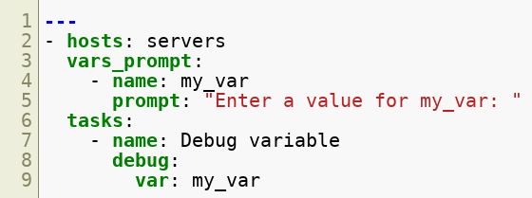
Prompt for Input
You can prompt the user for input dynamically:
Copyright © 2025 by Elephant Scale, All Rights Reserved

Slide 26
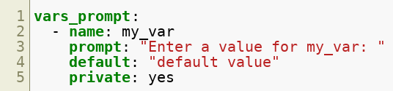
Variables: Prompt
default
: Used if the user presses Enter without typing a value.
private
: Masks user input (useful for passwords or sensitive data).
Copyright © 2025 by Elephant Scale, All Rights Reserved

Slide 27
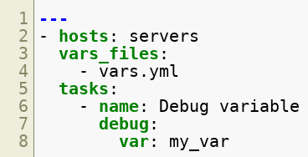
Variables: File
You can load variables from a separate file:
vars_files
: Lists one or more external YAML files containing variable definitions.
include_vars
: An alternative module that can also import variables from a file during a task.
Copyright © 2025 by Elephant Scale, All Rights Reserved

Slide 28

Variables: Register
register
: Captures the output of a task’s command for later use.
Usage : Refer to the registered variable in subsequent tasks.
Copyright © 2025 by Elephant Scale, All Rights Reserved

Slide 29
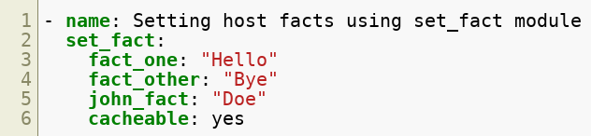
Variables: set_fact
set_fact
: Dynamically sets variables (known as “facts”) during a play’s execution.
cacheable
: Can cache these facts for future use if a fact cache (e.g., Redis) is configured.
Copyright © 2025 by Elephant Scale, All Rights Reserved

Slide 30
LAB
Explore further with a practice lab:
[Access the Lab Here]
Copyright © 2025 by Elephant Scale, All Rights Reserved

Slide 31
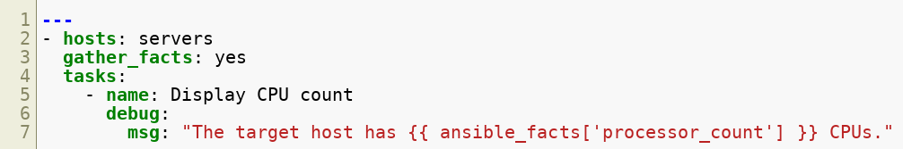
Ansible Facts
Facts are automatically collected information about each managed host (e.g., OS, network interfaces, CPU count).
Copyright © 2025 by Elephant Scale, All Rights Reserved

Slide 32

gather_facts
Purpose : Enables the automatic collection of system information from the target host.
Customization : You can choose which subsets of facts to gather or exclude.
Copyright © 2025 by Elephant Scale, All Rights Reserved

Slide 33
Task: Debug (Facts)
ansible_facts : A dictionary containing various system attributes.
Examples : ansible_facts['distribution'] , ansible_facts['interfaces'] , etc.
Copyright © 2025 by Elephant Scale, All Rights Reserved

Slide 34
LAB
Strengthen your fact-handling skills:
[Access the Lab Here]
Copyright © 2025 by Elephant Scale, All Rights Reserved

Slide 35
Conditionals
Let’s Discuss Modules Returning to Our Playbook Conditionals Loops Handlers Blocks Templates Ansible Vault Plugins Roles Scaling Playbooks Run Strategy
Copyright © 2025 by Elephant Scale, All Rights Reserved

Slide 36
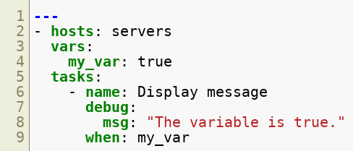
Conditionals
Conditionals allow tasks to run only if a specified expression evaluates to true .
Copyright © 2025 by Elephant Scale, All Rights Reserved

Slide 37

Variable Definition
my_var is set to true . The following task will only run under this condition.
Copyright © 2025 by Elephant Scale, All Rights Reserved

Slide 38
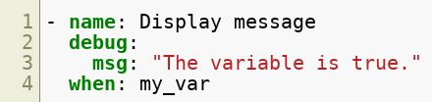
Task: Debug with Condition
when
: Determines whether the task executes.
Usage : Combine with logical operators ( and , or , not ), comparison operators ( == , != , > , < ), or fact variables.
Copyright © 2025 by Elephant Scale, All Rights Reserved

Slide 39
Conditions: Operators
Logical : and , or , not
Comparison : == , != , > , >= , < , <=
Boolean : true , false , none
Copyright © 2025 by Elephant Scale, All Rights Reserved

Slide 40
LAB
Test your knowledge of conditionals in a lab setting:
[Access the Lab Here]
Copyright © 2025 by Elephant Scale, All Rights Reserved

Slide 41
Loops
Let’s Discuss Modules Returning to Our Playbook Conditionals Loops Handlers Blocks Templates Ansible Vault Plugins Roles Scaling Playbooks Run Strategy
Copyright © 2025 by Elephant Scale, All Rights Reserved

Slide 42
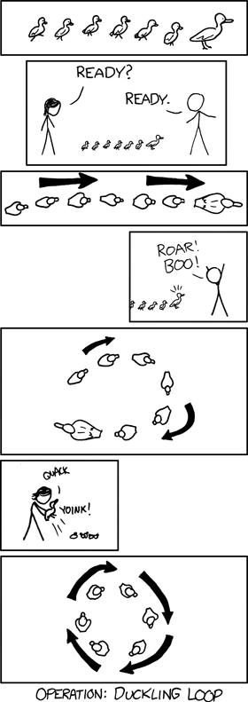
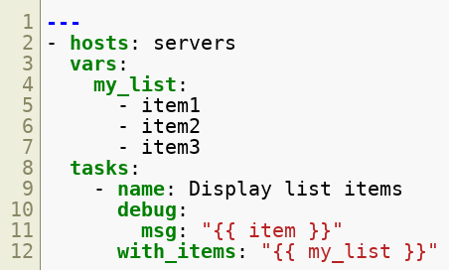
Loops
Ansible offers simple looping constructs to iterate over sets of data.
Copyright © 2025 by Elephant Scale, All Rights Reserved

Slide 43
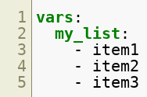
Defining the Variable
my_list : A list of items to iterate over in the tasks.
Copyright © 2025 by Elephant Scale, All Rights Reserved

Slide 44
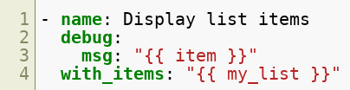
Task: Debug with Loops
with_items
: Iterates over my_list , rendering {{ item }} each time.
Copyright © 2025 by Elephant Scale, All Rights Reserved

Slide 45
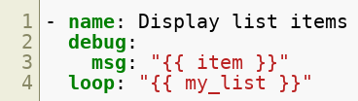
Loop Keyword
An alternative to with_items is the loop directive:
loop
: Modern syntax that offers additional functionality and flexibility.
Both approaches work : Choose based on your team's preference and existing codebase.
Copyright © 2025 by Elephant Scale, All Rights Reserved

Slide 46
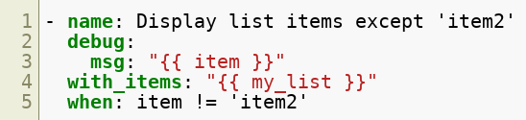
Loops with Conditionals
Combining loops with when allows you to filter or skip certain items.
Copyright © 2025 by Elephant Scale, All Rights Reserved

Slide 47
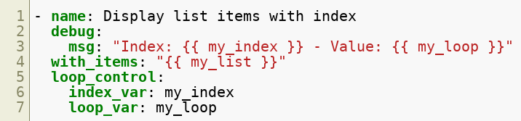
loop_control Keyword
index_var
: Stores the current iteration index.
loop_var
: Renames the loop variable from item to something else.
Copyright © 2025 by Elephant Scale, All Rights Reserved

Slide 48
LAB
Practice using loops in Ansible:
[Access the Lab Here]
Copyright © 2025 by Elephant Scale, All Rights Reserved

Slide 49
Handlers
Let’s Discuss Modules Returning to Our Playbook Conditionals Loops Handlers Blocks Templates Ansible Vault Plugins Roles Scaling Playbooks Run Strategy
Copyright © 2025 by Elephant Scale, All Rights Reserved

Slide 50
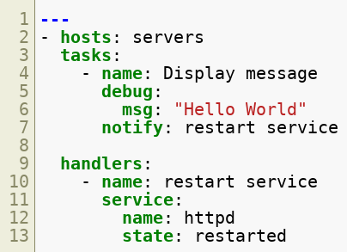
Handlers
Handlers are tasks that run in response to a “notify” event. For example:
Copyright © 2025 by Elephant Scale, All Rights Reserved

Slide 51
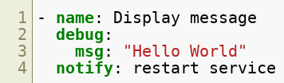
Task: Debug
Notification : If this task changes the system state, it triggers the handler named restart service .
Copyright © 2025 by Elephant Scale, All Rights Reserved

Slide 52
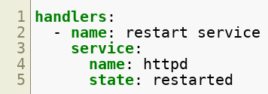
Handlers Section
Execution : Occurs only at the end of the play (or after all tasks are run).
Purpose : Typically used for service restarts, reloading configurations, etc.
Copyright © 2025 by Elephant Scale, All Rights Reserved

Slide 53
Best Practices
Idempotency : Handlers should focus on actions that make sense to trigger after a change has occurred (e.g., reloading a changed config).
Avoid Overuse : Don’t use handlers for normal tasks like package installs.
Copyright © 2025 by Elephant Scale, All Rights Reserved

Slide 54
LAB
Try out handlers in your lab environment:
[Access the Lab Here]
Copyright © 2025 by Elephant Scale, All Rights Reserved

Slide 55
Blocks
Let’s Discuss Modules Returning to Our Playbook Conditionals Loops Handlers Blocks Templates Ansible Vault Plugins Roles Scaling Playbooks Run Strategy
Copyright © 2025 by Elephant Scale, All Rights Reserved

Slide 56
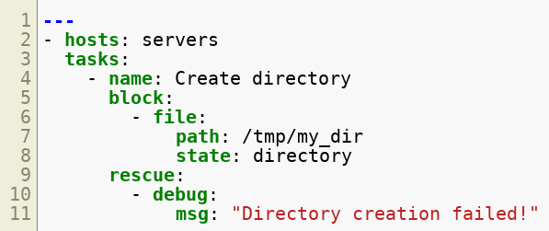
Blocks
Blocks let you group tasks and manage error handling within a single structure:
Copyright © 2025 by Elephant Scale, All Rights Reserved

Slide 57
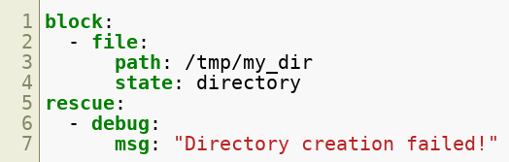
Task: Block
block
: Contains tasks that run sequentially.
rescue
: Runs only if any task in block fails.
always
: Runs regardless of success or failure (not shown in this example).
Copyright © 2025 by Elephant Scale, All Rights Reserved

Slide 58
Benefits
Readability : Groups related tasks, making your playbook more organized.
Error Handling : Simplifies recovery steps when a task fails.
Robustness : Allows for more structured exception handling in your automation.
Copyright © 2025 by Elephant Scale, All Rights Reserved

Slide 59
Templates
Let’s Discuss Modules Returning to Our Playbook Conditionals Loops Handlers Blocks Templates Ansible Vault Plugins Roles Scaling Playbooks Run Strategy
Copyright © 2025 by Elephant Scale, All Rights Reserved

Slide 60
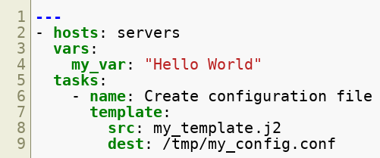

Templates
Jinja2 templates let you generate dynamic configuration files on target hosts:
Copyright © 2025 by Elephant Scale, All Rights Reserved

Slide 61

Variable: Define
Usage : Insert dynamic values into templates.
Location : Defined inline or loaded from external files.
Copyright © 2025 by Elephant Scale, All Rights Reserved

Slide 62
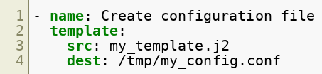
Task: Template
template
: Copies a Jinja2 file from the control node to the target, rendering variables.
src
: Path to your .j2 file.
dest
: Destination path on the managed node.
Copyright © 2025 by Elephant Scale, All Rights Reserved

Slide 63
Jinja2 Template
Syntax : Uses double curly braces ( {{ }} ) for variable references.
Advanced : Supports conditionals, loops, and filters in Jinja2.
Copyright © 2025 by Elephant Scale, All Rights Reserved

Slide 64
Benefits
Maintainability : Easy to modify a single template rather than multiple config files.
Consistency : Ensures consistent settings across multiple servers.
Modularity : Keeps playbooks clean by separating logic from configuration data.
Copyright © 2025 by Elephant Scale, All Rights Reserved

Slide 65
LAB
Try using templates with a hands-on lab:
[Access the Lab Here]
Copyright © 2025 by Elephant Scale, All Rights Reserved

Slide 66
Ansible Vault
Let’s Discuss Modules Returning to Our Playbook Conditionals Loops Handlers Blocks Templates Ansible Vault Plugins Roles Scaling Playbooks Run Strategy
Copyright © 2025 by Elephant Scale, All Rights Reserved

Slide 67
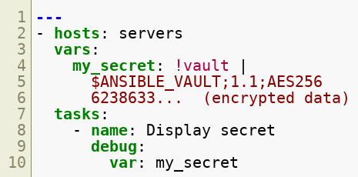
Ansible Vault
Purpose : Encrypt sensitive data (passwords, tokens, SSL certificates) within playbooks or variable files.
Built-In : Ships with Ansible, accessed via the ansible-vault command.
Copyright © 2025 by Elephant Scale, All Rights Reserved

Slide 68
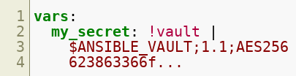
Encrypting Variables
!vault
: Indicates that the variable is encrypted.
Use Cases : Storing encrypted strings, entire files, or entire playbooks.
Copyright © 2025 by Elephant Scale, All Rights Reserved

Slide 69
Basic Vault Commands
Create : ansible-vault create vault.yml
Edit : ansible-vault edit vault.yml
View : ansible-vault view vault.yml
Encrypt : ansible-vault encrypt vault.yml
Decrypt : ansible-vault decrypt vault.yml
Rekey : ansible-vault rekey vault.yml
Copyright © 2025 by Elephant Scale, All Rights Reserved

Slide 70
Running Playbooks with Vault
Prompt for Password :
Password File :
Copyright © 2025 by Elephant Scale, All Rights Reserved

Slide 71
LAB
Practice protecting secrets with Ansible Vault:
[Access the Lab Here]
Copyright © 2025 by Elephant Scale, All Rights Reserved

Slide 72
Plugins
Let’s Discuss Modules Returning to Our Playbook Conditionals Loops Handlers Blocks Templates Ansible Vault Plugins Roles Scaling Playbooks Run Strategy
Copyright © 2025 by Elephant Scale, All Rights Reserved

Slide 73
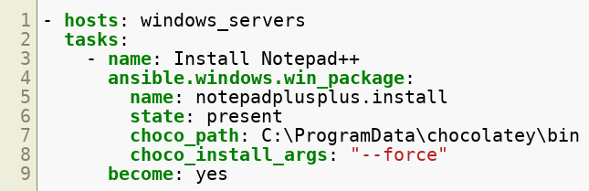
Plugins
Plugins extend Ansible’s functionality and run on the control node before or during play execution.
Copyright © 2025 by Elephant Scale, All Rights Reserved

Slide 74
Task: Module and Plugin
Module : ansible.windows.win_package manages Windows software packages.
Plugin : win_chocolatey used to interface with Chocolatey for Windows package management.
Parameters :
choco_path
: Path to Chocolatey binaries.
choco_install_args
: Additional installation flags.
Copyright © 2025 by Elephant Scale, All Rights Reserved

Slide 75
Plugin Types
Action Plugins : Extend or override how modules run.
Callback Plugins : Customize Ansible’s output formatting or logging.
Connection Plugins : Define how Ansible connects to hosts (e.g., SSH, WinRM).
Filter Plugins : Extend Jinja2 filters for templating.
Inventory Plugins : Dynamically generate inventory from external sources.
Lookup Plugins : Pull data from external systems or files.
Module Plugins : Extend modules’ underlying functionality.
Strategy Plugins : Control how tasks are executed (e.g., linear vs. free strategy).
Test Plugins : Add new Jinja2 test operators.
Terminal Plugins : Modify interactions with remote shells.
Var Plugins : Extend how variables are loaded.
Cache Plugins : Modify how facts and data are cached.
Copyright © 2025 by Elephant Scale, All Rights Reserved

Slide 76
Roles
Let’s Discuss Modules Returning to Our Playbook Conditionals Loops Handlers Blocks Templates Ansible Vault Plugins Roles Scaling Playbooks Run Strategy
Copyright © 2025 by Elephant Scale, All Rights Reserved

Slide 77
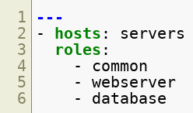
Roles
Purpose : Organize playbooks into reusable, maintainable collections of tasks, files, templates, and variables.
Syntax :
Copyright © 2025 by Elephant Scale, All Rights Reserved

Slide 78
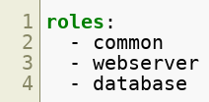
Role Definition
Structure : Each role includes directories for tasks, handlers, files, templates, and variables.
Example : webserver might include tasks to install Apache, handlers to restart Apache, templates for Apache config, etc.
Copyright © 2025 by Elephant Scale, All Rights Reserved

Slide 79
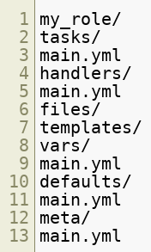
Role Directory Structure
tasks/ : Where you define the actions a role performs.
handlers/ : Where you define handlers (e.g., service restarts).
files/ : Where you store static files.
templates/ : Where you keep Jinja2 templates.
vars/ and defaults/ : Where role-specific variables are defined.
meta/ : Role metadata, dependencies, author info, etc.
Copyright © 2025 by Elephant Scale, All Rights Reserved

Slide 80
Benefits of Roles
Reusability : Roles can be shared or published to Ansible Galaxy.
Maintainability : Isolates functionality, making it easier to update and test.
Structure : Ensures a consistent framework across different roles and projects.
Copyright © 2025 by Elephant Scale, All Rights Reserved

Slide 81
LAB
Try creating and using roles in a lab:
[Access the Lab Here]
Copyright © 2025 by Elephant Scale, All Rights Reserved

Slide 82
Delegation and Local Actions
delegate_to
Execute a task on a different host than the one you’re managing.
Commonly used for tasks like load balancer updates or running a command from the control node itself.
local_action
Shortcut for delegating a task to localhost .
Why It Matters : Makes it easier to handle cross-service coordination (e.g., updating a load balancer after deploying web servers).
Copyright © 2025 by Elephant Scale, All Rights Reserved

Slide 83
Scaling Playbooks
Let’s Discuss Modules Returning to Our Playbook Conditionals Loops Handlers Blocks Templates Ansible Vault Plugins Roles Scaling Playbooks Run Strategy
Copyright © 2025 by Elephant Scale, All Rights Reserved

Slide 84
Why Scale?
Growing Infrastructure : As your server count and complexity increase, naive approaches can become slow or unmanageable.
Consistency Across Environments : Production, staging, and development environments may each have unique scaling needs.
Performance & Reliability : Efficient playbook execution ensures minimal downtime and faster deployments.
Copyright © 2025 by Elephant Scale, All Rights Reserved

Slide 85
Best Practices for Scaling
Use Roles & Collections
Break down playbooks into modular roles.
Leverage Ansible Galaxy Collections for third-party modules and roles.
Organize Inventory
Use dynamic inventory for cloud providers (AWS, Azure, GCP).
Group hosts logically to simplify targeting (e.g., [webserver] , [dbserver] ).
Limit Parallelism
Avoid overloading networks or remote hosts.
Use serial or batch_size to control how many hosts are updated at once.
Copyright © 2025 by Elephant Scale, All Rights Reserved

Slide 86
Best Practices for Scaling (Contd.)
Leverage Tags
Tag tasks or entire roles (e.g., tags: [“webserver_install”] ).
Makes partial or targeted execution easier ( --tags or --skip-tags ).
Use Caching
Enable fact caching to speed up repeated queries of host facts.
Employ Vault for Secrets
Keep sensitive credentials out of plain text while scaling to multiple teams or environments.
Copyright © 2025 by Elephant Scale, All Rights Reserved

Slide 87
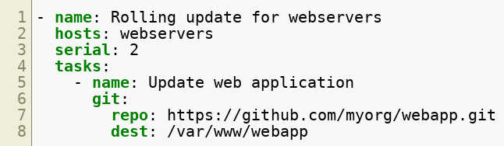
Rolling Updates
serial
: Updates 2 servers at a time, preventing all services from going offline simultaneously.
Benefit : Ideal for zero-downtime or minimal-downtime deployments.
Copyright © 2025 by Elephant Scale, All Rights Reserved

Slide 88
Run Strategy
Let’s Discuss Modules Returning to Our Playbook Conditionals Loops Handlers Blocks Templates Ansible Vault Plugins Roles Scaling Playbooks Run Strategy
Copyright © 2025 by Elephant Scale, All Rights Reserved

Slide 89
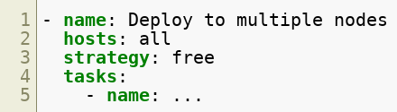
What is a Run Strategy?
Definition : A “strategy” in Ansible defines how tasks are executed across hosts.
Location : Specified at the play level, it tells Ansible whether to run tasks linearly, in parallel, or in a more customized manner.
Copyright © 2025 by Elephant Scale, All Rights Reserved

Slide 90
Default Strategy: Linear
Linear Execution :
Runs each task on all targeted hosts before moving on to the next task.
Ensures tasks complete in a well-ordered sequence.
Pros :
Simple and predictable.
Good for tasks that must finish on all hosts before the next task starts.
Cons :
Potentially slower if some hosts are significantly slower or busier than others.
Copyright © 2025 by Elephant Scale, All Rights Reserved

Slide 91
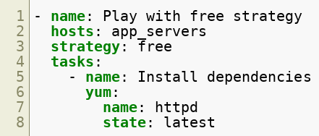
Free Strategy
Parallel Execution :
Allows each host to run through the tasks at its own pace.
Faster overall if some hosts are idle or have fewer changes.
Pros :
Speed: Freed from waiting on the slowest host for each task.
Efficiency: Busy hosts don’t delay others.
Cons :
Harder to predict exact timing of events on each host.
Might complicate debugging if issues arise at different times.
Copyright © 2025 by Elephant Scale, All Rights Reserved

Slide 92
Other Strategies & Customization
Debug Strategy
Prints more detailed information, mainly for troubleshooting.
Mitogen Strategy (Plugin)
A community strategy plugin that can significantly speed up Ansible by reducing SSH overhead.
Custom Strategy Plugins
Write your own to handle specialized execution models (e.g., partial concurrency, multi-phase rollouts).
Copyright © 2025 by Elephant Scale, All Rights Reserved

Slide 93
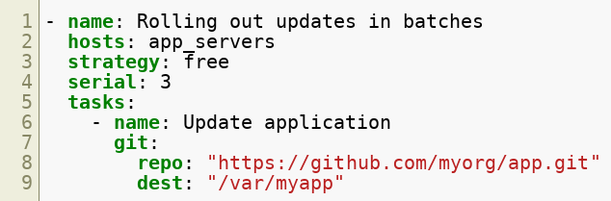
Strategy & Serial
You can combine strategies like free or linear with the serial keyword for partial concurrency:
Effect :
Processes 3 hosts at a time, each host can proceed through tasks independently of the others.
Copyright © 2025 by Elephant Scale, All Rights Reserved

Slide 94
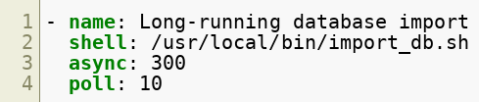
Asynchronous Tasks
async
Allow tasks to run in the background.
Lets you move on to other tasks without waiting for lengthy operations (e.g., large file downloads).
Example :
Why It Matters : Helps with performance and responsiveness when dealing with time-consuming tasks.
Copyright © 2025 by Elephant Scale, All Rights Reserved

Slide 95
Putting It All Together
Use Roles for modularity, especially in large environments.
Optimize Inventory to easily target specific groups and scale dynamically.
Employ Run Strategies ( linear , free , custom) based on your operational needs.
Leverage Rolling Updates & Serial to avoid downtime and reduce risk.
Test Thoroughly in staging or development environments before hitting production.
Copyright © 2025 by Elephant Scale, All Rights Reserved

Slide 96
LAB
Scaling & Strategy Practice
Implement a rolling update scenario with your existing roles.
Experiment with linear vs. free strategy.
Observe the impact on performance and reliability.
[Access the Lab Here] (Link to your scaling/strategy lab resource)
Copyright © 2025 by Elephant Scale, All Rights Reserved

Slide 97
Red Hat Automation Platform / AWX
What It Is : A web-based UI and enterprise solution for Ansible automation.
Use Cases : Role-based access control (RBAC), job scheduling, centralized logging, and reporting.
Distinction :
AWX is the open source community edition.
Red Hat Automation Platform is the Red Hat-supported commercial version with additional features and enterprise support.
Why Mention It : As teams and infrastructures grow, a web interface and enterprise features can greatly simplify user management, auditing, and visibility.
Copyright © 2025 by Elephant Scale, All Rights Reserved

Slide 98
Testing and Validation
Molecule
A popular framework to test Ansible roles locally or in CI/CD pipelines.
Supports multiple scenarios (Docker, Vagrant, etc.).
Ansible Lint
Checks playbooks and roles for potential issues or non-idiomatic Ansible usage.
Why It Matters : Promotes best practices, ensures playbooks remain maintainable, and helps catch errors before hitting production.
Copyright © 2025 by Elephant Scale, All Rights Reserved

Slide 99
CI/CD Integration
Continuous Integration
Run linting, static checks, and unit tests for roles (via Molecule or other frameworks).
Continuous Delivery
Integrate Ansible playbooks in your pipelines (e.g., Jenkins, GitLab CI, GitHub Actions) to automate deployments.
Why It Matters : Ensures reliability and repeatability, enabling automated testing and rollouts of code and infrastructure changes.
Copyright © 2025 by Elephant Scale, All Rights Reserved

Slide 100
Check Mode and Dry Runs
--check
Simulates running a playbook without making changes.
Ideal for validating tasks and seeing what would happen.
--diff
Shows you changes to files or templates that are about to be applied.
Why It Matters : Critical for safe operations in production; you can preview changes before actually applying them.
Copyright © 2025 by Elephant Scale, All Rights Reserved

Slide 101
Handling Command & Shell Modules Carefully
Idempotency Concerns
The command / shell modules can break idempotency if not managed carefully.
Use specialized modules ( file , copy , git , service ) whenever possible.
Why It Matters : Maintaining idempotency is the core advantage of Ansible, ensuring consistent states across multiple runs.
Copyright © 2025 by Elephant Scale, All Rights Reserved

Slide 102
Security & Compliance
Compliance as Code
Use Ansible to enforce security baselines (e.g., CIS Benchmarks, DISA STIGs).
Auditing
Combine with Red Hat Automation Platform/AWX for centralized logging of who ran what and when.
Why It Matters : Security is a major concern; Ansible’s agentless model and Vault encryption can simplify compliance tasks and auditing.
Copyright © 2025 by Elephant Scale, All Rights Reserved

