Slide 1
Terraform Walk-Through
Using Variables
Adding Scalability
Copyright © 2021 by Elephant Scale, All Rights Reserved

Slide 2
Our Plan
Getting started with Terraform
Setting up your AWS account
Installing Terraform
Deploying a single server
Deploying a single web server
More advanced configuration
Deploying a configurable web server
Deploying a cluster of web servers
Deploying a load balancer
Cleaning up
Copyright © 2021 by Elephant Scale, All Rights Reserved

Slide 3
We Will Use AWS
The largest market share
Although for you it may be different
Will try to provide examples for other clouds
All clouds give you a free tier
A trick to user after a year:
Use kind of address
If you already used up your free tier credits, the examples in the labs should still cost you no more than a few dollars.
Copyright © 2021 by Elephant Scale, All Rights Reserved

Slide 4
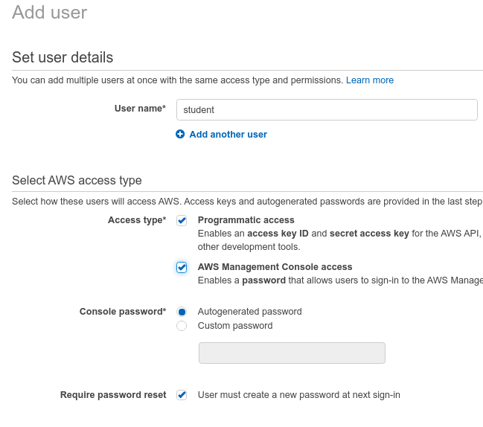
Setting Up Your AWS Account
If you don’t already have an AWS account , head over to https://aws.amazon.com and sign up
The only thing you should use the root user for is to create other user accounts with more-limited permissions, and then switch to one of those accounts immediately
If you are using an existing AWS account, it must have a Default VPC in it.
If the instructor provided a student account, you can use that
Copyright © 2021 by Elephant Scale, All Rights Reserved

Slide 5
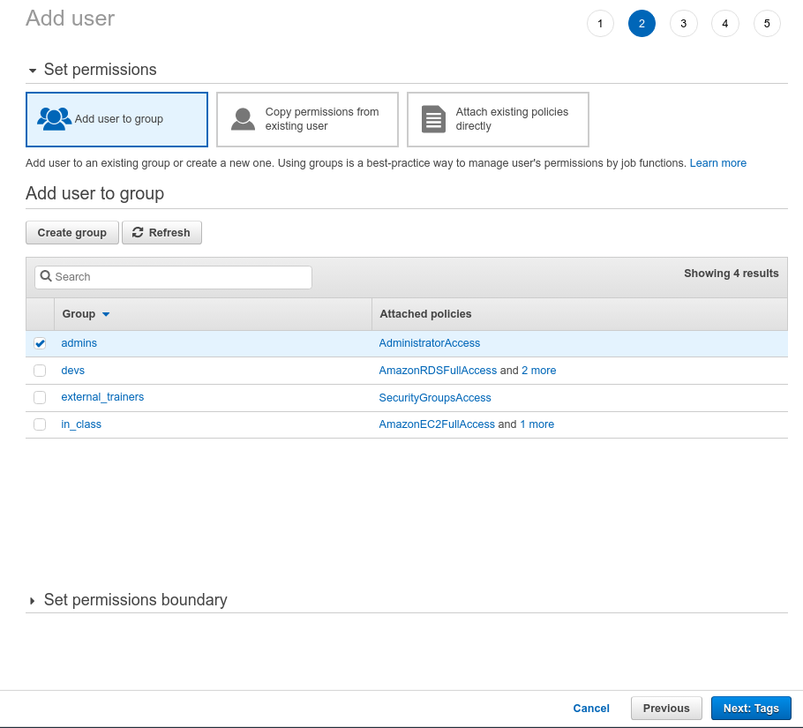
Giving AWS Permissions
Here are the permissions you will need (for some labs)
AmazonEC2FullAccess
AmazonS3FullAcces
AmazonDynamoDBFullAccess
AmazonRDSFullAccess
CloudWatchFullAccess
IAMFullAccess
For simplicity, you can give your user admin permissions
Copyright © 2021 by Elephant Scale, All Rights Reserved

Slide 6
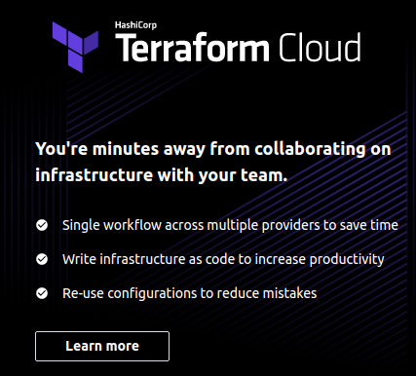
Install Terraform
Download the terraform executable from the Terraform home page
Depending on your OS, you may also install a native package
For Mac
brew install terraform
You may use a cloud server if provided by the instructor
You may use Terraform cloud account
Copyright © 2021 by Elephant Scale, All Rights Reserved

Slide 7

Verify
Ubuntu example
Your version of Terraform is out of date! The latest version is 0.14.8. You can update by downloading from https://www.terraform.io/downloads.html
OK... Update here
Copyright © 2021 by Elephant Scale, All Rights Reserved

Slide 8
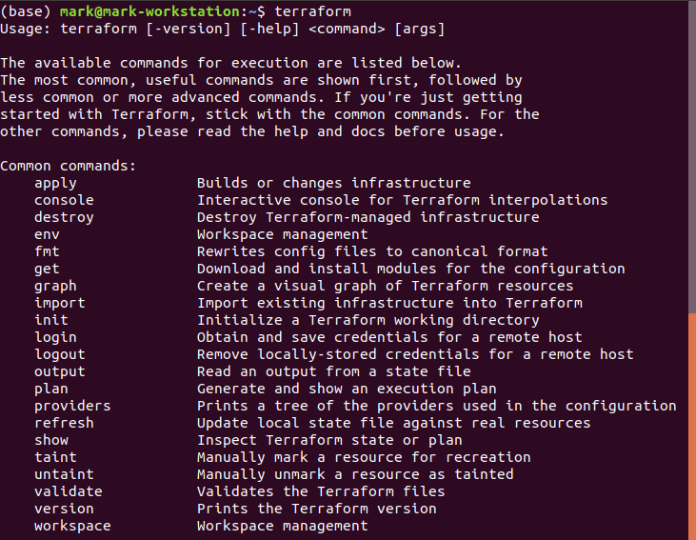
Now What?
Copyright © 2021 by Elephant Scale, All Rights Reserved

Slide 9
Connect to AWS - Way 1
Way 1: Set up AWS credentials
$export AWS_ACCESS_KEY_ID=(you access key id)
$export AWS_SECRET_ACCESS_KEY=(your secret access key)
This will only give you the setup for this shell
To make it work after reboot put it into .bashrc
vi ~/.bashrc
Copyright © 2021 by Elephant Scale, All Rights Reserved

Slide 10
Connect to AWS - Way 2
Way 2
Terraform supports the same authentication mechanisms as all AWS CLI and SDK tools
Therefore, it’ll also be able to use credentials in $HOME/.aws/credentials
These are automatically generated if you run the configure command on the AWS CLI, or IAM
Copyright © 2021 by Elephant Scale, All Rights Reserved

Slide 11

Let Us Prepare to Deploy a Server
Create an empty folder, lab01
Put in a file called main.tf
Put in there the following provider "aws" { region = "us-east-2" }
Now you will be adding resources, like this:
Copyright © 2021 by Elephant Scale, All Rights Reserved

Slide 12
Server Resource
ami
The Amazon Machine Image (AMI) to run on the EC2 Instance.
You can find free and paid AMIs in the AWS Marketplace
or create your own using tools such as Packer
This ami parameter to the ID of an Ubuntu 18.04 AMI in us-east-2. This AMI is free to use
instance_type
The type of EC2 Instance to run
Each type of EC2 Instance provides a different amount of CPU, memory, disk space, and networking capacity. The EC2 Instance Types page lists all the available options
t2.micro, which has one virtual CPU, 1 GB of memory, and is part of the AWS free tier
Copyright © 2021 by Elephant Scale, All Rights Reserved resource "aws_instance" "example" { ami = "ami-0c55b159cbfafe1f0" instance_type = "t2.micro" }

Slide 13
Do Not Try to Remember by Heart
Terraform supports dozens of providers
Each of which supports dozens of resources
Each resource has dozens of arguments
We recommend using the documentation.
Here is an example for ami
Now run terraform init
Copyright © 2021 by Elephant Scale, All Rights Reserved

Slide 14
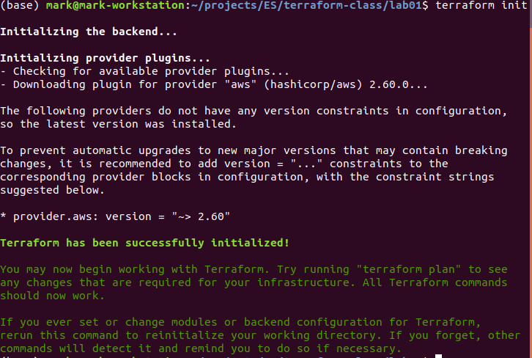
Result of
Copyright © 2021 by Elephant Scale, All Rights Reserved

Slide 15
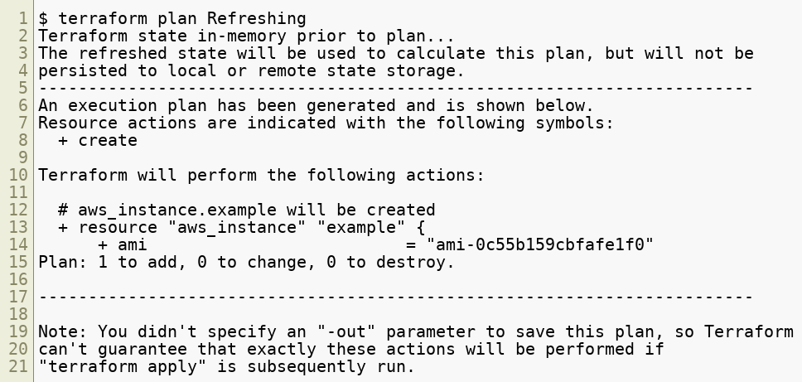
Result of "terraform plan"
Copyright © 2021 by Elephant Scale, All Rights Reserved

Slide 16
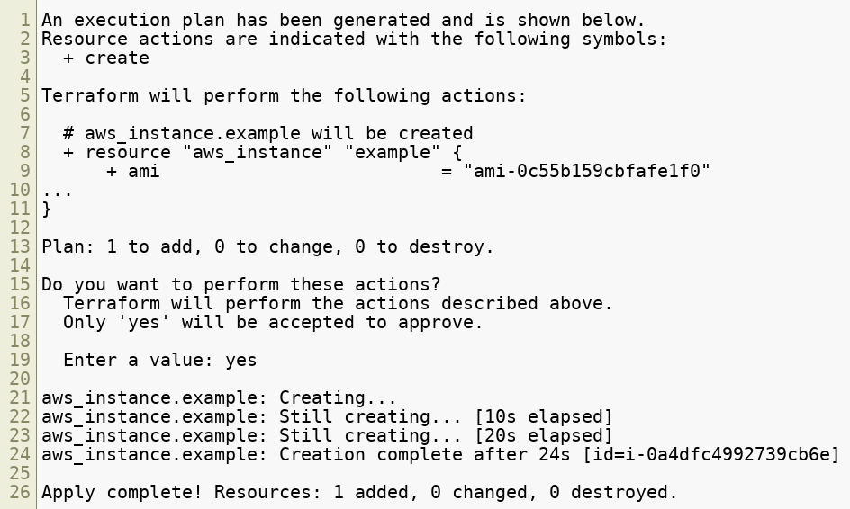
Result of "terraform apply"
Copyright © 2021 by Elephant Scale, All Rights Reserved

Slide 17
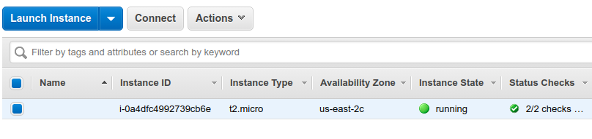
Verify the Deployment Result
Go to AWS dashboard
Verify that the server was indeed created
Copyright © 2021 by Elephant Scale, All Rights Reserved

Slide 18
Lab: Terraform Hello World
Please do this lab
terraform-up-and-running-code/labs/lab01-1.md
Here
Copyright © 2021 by Elephant Scale, All Rights Reserved

Slide 19
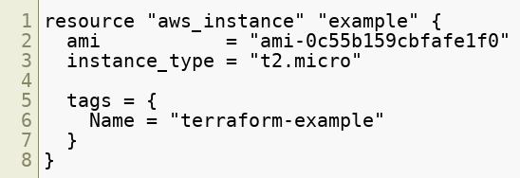
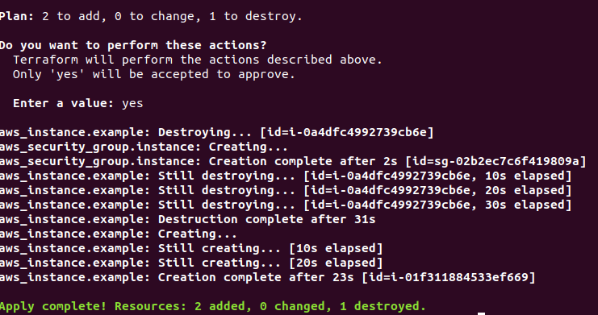
Next Step
Let's give our server a name tag
Add to your main.tf
(remove the previous server definition)
Run terraform apply
Verify that we gave our server a name
Copyright © 2021 by Elephant Scale, All Rights Reserved

Slide 20
Lab: Terraform Hello World - 2
Please do this lab
terraform-up-and-running-code/labs/lab01-2.md
Here
Copyright © 2021 by Elephant Scale, All Rights Reserved

Slide 21
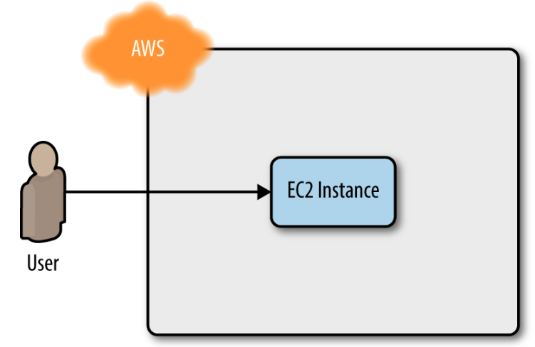
Deploy a Single Web Server
Copyright © 2021 by Elephant Scale, All Rights Reserved

Slide 22

Make a Web Server
In the real world, you would build a real web server such as Flask
We will, instead, do a one-command
However, how should we put it into our instance?
We will add it to the aws_instance, as User Data configuration
Copyright © 2021 by Elephant Scale, All Rights Reserved

Slide 23
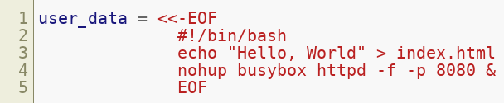
Adding a Script to the Instance
You pass a shell script to User Data by setting the user_data argument in your Terraform code as follows:
The <<-EOF and EOF are Terraform’s heredoc syntax, which allows you to create multiline strings without having to insert newline characters all over the place
Copyright © 2021 by Elephant Scale, All Rights Reserved

Slide 24
Lab: Make a web server
Please do this lab
terraform-up-and-running-code/labs/lab02-1.md
https://github.com/elephantscale/terraform-up-and-running-code/blob/master/labs/lab02-1.md
Copyright © 2021 by Elephant Scale, All Rights Reserved

Slide 25
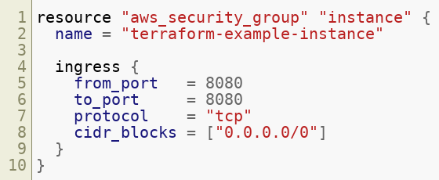
Wait! One More Thing!
By default, AWS does not allow any incoming or outgoing traffic from an EC2 Instance.
To allow the EC2 Instance to receive traffic on port 8080, you need to create a security group:
Creates a new resource called aws_security_group
Copyright © 2021 by Elephant Scale, All Rights Reserved

Slide 26
CIDR Blocks
The ingress in this group allows incoming TCP requests
on port 8080 from the CIDR block 0.0.0.0/0
CIDR blocks are a concise way to specify IP address ranges
For example
a CIDR block of 10.0.0.0/24
represents all IP addresses between 10.0.0.0 and 10.0.0.255
The CIDR block 0.0.0.0/0 is an IP address range that includes all possible IP addresses, so this security group allows incoming requests on port 8080 from any IP
Copyright © 2021 by Elephant Scale, All Rights Reserved

Slide 27
Passing the Security Group ID
You also need to tell the EC2 instance to actually use the security group by passing the group's ID
It goes into the vpc_security_group_ids argument of the aws_instance resource .
This is done with Terraform expressions
Copyright © 2021 by Elephant Scale, All Rights Reserved

Slide 28
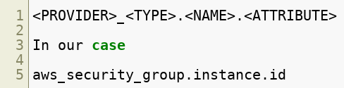
Terraform "expressions"
An expression in Terraform is anything that returns a value
The simplest type of expressions are literals
strings: "ami-0c55b159cbfafe1f0"
numbers: 7
Here we need an expression which is a reference
Copyright © 2021 by Elephant Scale, All Rights Reserved

Slide 29
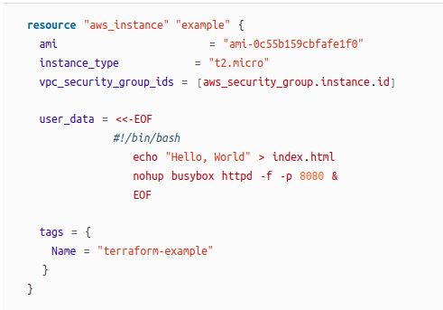
Altogether
Copyright © 2021 by Elephant Scale, All Rights Reserved

Slide 30
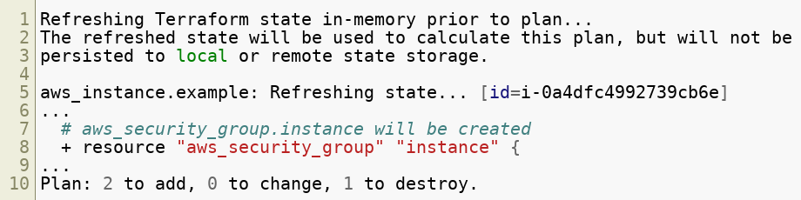
New Result of "terraform plan"
Copyright © 2021 by Elephant Scale, All Rights Reserved

Slide 31
New Result of "terraform apply"
Copyright © 2021 by Elephant Scale, All Rights Reserved

Slide 32
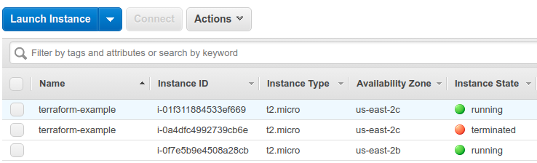
Et Voila!
Copyright © 2021 by Elephant Scale, All Rights Reserved

Slide 33


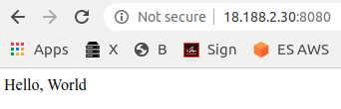
Test the Deployment
Copyright © 2021 by Elephant Scale, All Rights Reserved

Slide 34
Lab: Server Deployment
Please do this lab:
terraform-up-and-running-code/labs/lab02-2.md
https://github.com/elephantscale/terraform-up-and-running-code/blob/master/labs/lab02-2.md
Copyright © 2021 by Elephant Scale, All Rights Reserved

Slide 35
Quiz
Usernames and passwords referenced in the Terraform code, even as variables, will end up in plain text in the state file.
A. True
B. False
Copyright © 2021 by Elephant Scale, All Rights Reserved
Notes:
A.

Slide 36
Quiz
What happens when you apply Terraform configuration? Choose TWO correct answers.
A. terraform plan
B. terraform state
C. terraform apply
D. terraform validate
E. terraform output
Copyright © 2021 by Elephant Scale, All Rights Reserved
Notes:
A. C.

Slide 37

Terraform Dependencies
When you add a reference from one resource to another, you create an implicit dependency
Terraform
Parses these dependencies
builds a dependency graph from them
uses that to automatically determine in which order it should create resources
To see the dependencies, you use the command
Copyright © 2021 by Elephant Scale, All Rights Reserved

Slide 38
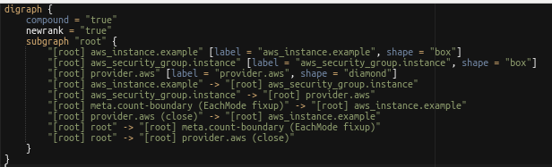
Terraform Graph Output
Copyright © 2021 by Elephant Scale, All Rights Reserved

Slide 39
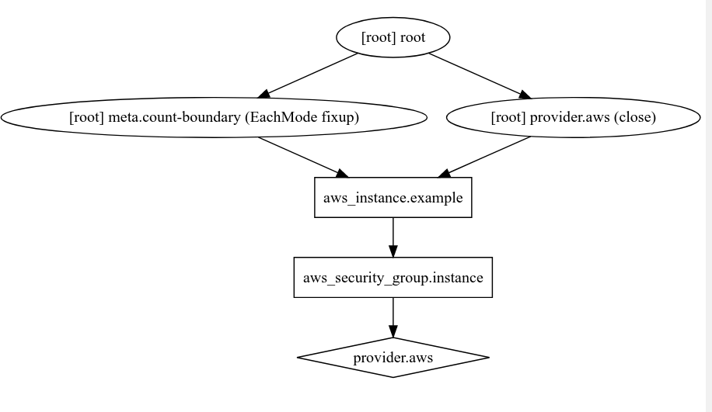
Terraform Graph Visual
Use a desktop app such as Graphviz or
webapp like GraphvizOnline
Copyright © 2021 by Elephant Scale, All Rights Reserved

Slide 40

NETWORK SECURITY
All our example deploy not only into your Default VPC (as mentioned earlier), but also the default subnets of that VPC
Running a server in a public subnet is fine for a quick experiment, but in real-world usage, it’s a security risk
For production systems, you should deploy all of your servers, and certainly all of your data stores, in private subnets
These have IP addresses that can be accessed only from within the VPC and not from the public internet
Copyright © 2021 by Elephant Scale, All Rights Reserved
Notes:
Source: https://www.pexels.com/

Slide 41
Using Variables
Using Variables Adding Scalability
Copyright © 2021 by Elephant Scale, All Rights Reserved

Slide 42

Deploy a Configurable Web Server
Don’t Repeat Yourself (DRY) principle
However, we violated it
the web server port 8080 is duplicated in both the security group and the User Data configuration
So, DRY:
every piece of knowledge must have a single, unambiguous, authoritative representation within a system
Copyright © 2021 by Elephant Scale, All Rights Reserved
Notes:
Source: https://www.pexels.com/

Slide 43

Terraform Input Variables
description
It’s always a good idea to use this parameter to document how a variable is used
default, or use these ways:
passing it in at the command line (using the -var option)
via a file (using the -var-file option)
via an environment variable
type
enforce type constraints on the variables a user passes in
type constraints: string, number, bool, list, map, set, object, tuple, and any
Copyright © 2021 by Elephant Scale, All Rights Reserved

Slide 44
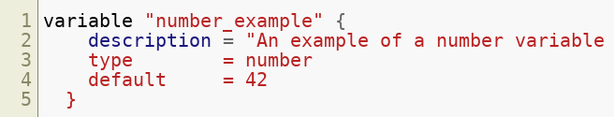
Examples of Terraform Input Variables
Input variable that checks that the value you pass in is a number:
Copyright © 2021 by Elephant Scale, All Rights Reserved

Slide 45
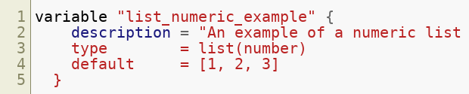
Examples of Terraform Input Variables
List input variable with all numbers
Copyright © 2021 by Elephant Scale, All Rights Reserved

Slide 46
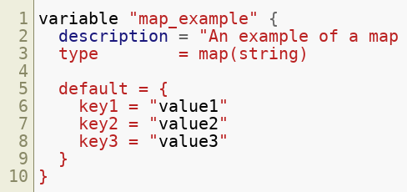
Examples of Terraform Input Variables
A map of strings
Copyright © 2021 by Elephant Scale, All Rights Reserved

Slide 47
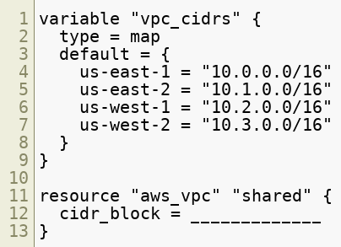
Quiz
Consider the following Terraform 0.12 configuration snippet. How would you define the cidr_block for us-east-1 in the aws_vpc resource using a variable?
A. var.vpc_cidrs[“us-east-1”]
B. var.vpc_cidrs.0
C. vpc_cidrs[“us-east-1”]
D.var.vpc_cidrs[0]
Copyright © 2021 by Elephant Scale, All Rights Reserved
Notes:
A.

Slide 48
Quiz
You have defined the values for your variables in the file terraform.tfvars, and saved it in the same directory as your Terraform configuration. Which of the following commands will use those values when creating an execution plan?
A. terraform plan
B. terraform plan -var-file=terraform.tfvars
C. All of the above
D. None of the above
Copyright © 2021 by Elephant Scale, All Rights Reserved
Notes:
C.

Slide 49
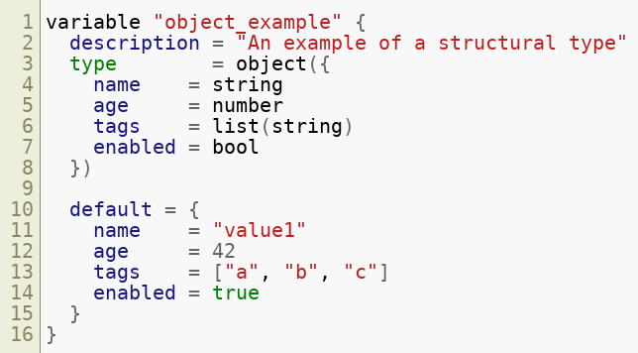
OO Coding with Terraform!
Copyright © 2021 by Elephant Scale, All Rights Reserved

Slide 50
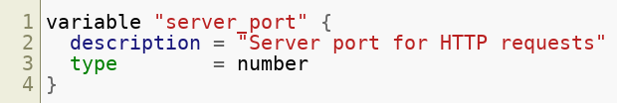
"server_port" Variable
Copyright © 2021 by Elephant Scale, All Rights Reserved

Slide 51

Using "server_port" Variable
If you run terraform apply , you will get this message:
Your choices now are:
Enter a value :)
terraform plan -var "server_port=8080"
export TF_VAR_server_port=8080
Supply a default
Copyright © 2021 by Elephant Scale, All Rights Reserved

Slide 52
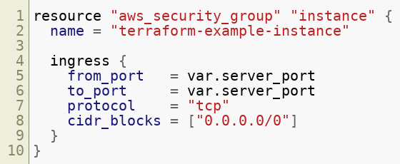
How to Use Your Variable
Simply, use var , like this: var.<VARIABLE_NAME>
For example
Copyright © 2021 by Elephant Scale, All Rights Reserved

Slide 53
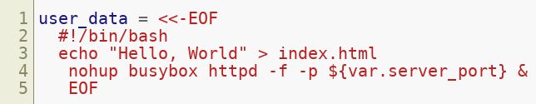
New Expression - Interpolation
"${...}"
Now, let us use the same server_port inside of User Data
Copyright © 2021 by Elephant Scale, All Rights Reserved

Slide 54
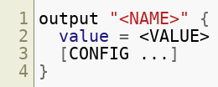
Setting an "output" variable
Additional variables
description
It is always a good idea to document
sensitive
true will instruct Terraform not to log this output at the end of terraform apply
For sensitive material or secrets such as passwords or private keys
Copyright © 2021 by Elephant Scale, All Rights Reserved

Slide 55
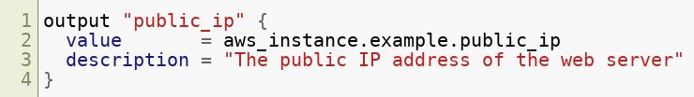
Output Variable For Our Script
Copyright © 2021 by Elephant Scale, All Rights Reserved

Slide 56
Lab: Experiment with variable
Go back to this lab:
terraform-up-and-running-code/labs/lab02-2.md
https://github.com/elephantscale/terraform-up-and-running-code/blob/master/labs/lab02-2.md
Experiment with providing the variables
default
var=
every other way
Copyright © 2021 by Elephant Scale, All Rights Reserved

Slide 57
Adding Scalability
Using Variables Adding Scalability
Copyright © 2021 by Elephant Scale, All Rights Reserved

Slide 58

Motivation for a Cluster
Running a single server is a good start, but in the real world, a single server is a single point of failure
If that server crashes, or if it becomes overloaded from too much traffic, users will be unable to access your site
The solution is to run a cluster of servers, routing around servers that go down, and adjusting the size of the cluster up or down based on traffic
We will need the following
Auto-scaling group (ASG)
VPC
Load balancer
Copyright © 2021 by Elephant Scale, All Rights Reserved

Slide 59
Discussion
When clusters makes sense and when it is not worth it?
Imagine a parallel research app for a cluster that would be rearchitected for Cloud
would have instances
a task dispatcher, etc.
would have to manage those instances, etc.
Alternatives
Very large instance with 100+ CPUs
Memory pool from Kove
Copyright © 2021 by Elephant Scale, All Rights Reserved

Slide 60
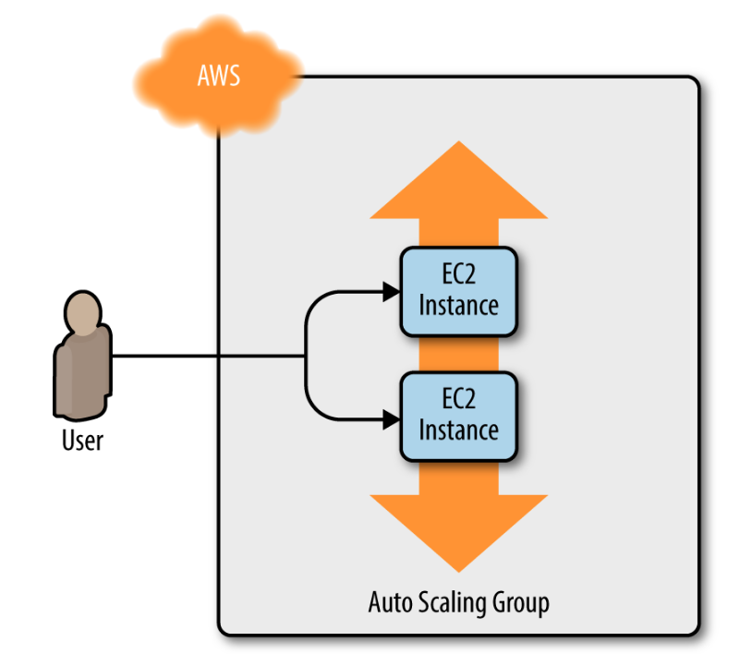
Auto-Scaling Group (ASG)
Copyright © 2021 by Elephant Scale, All Rights Reserved

Slide 61
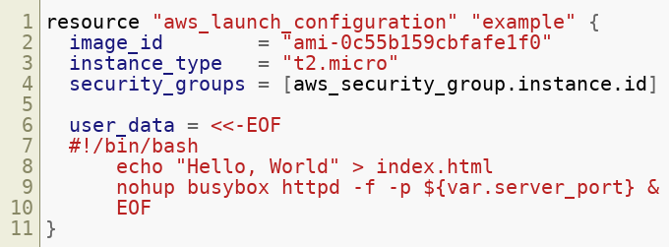
ASG Described in Terraform
To create an ASG, first describe the instance that goes into it
Create a launch configuration
The aws_launch_configuration resource
uses almost exactly the same parameters as the aws_instance resource
ami is now image_id
vpc_security_group_ids is now security_groups
put this instead of
Copyright © 2021 by Elephant Scale, All Rights Reserved

Slide 62
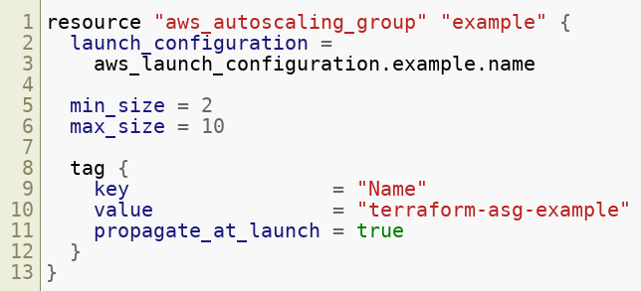
ASG with "aws_autoscaling_group"
ASG will run between 2 and 10 instances
each tagged with the name terraform-asg-example
ASG uses a reference to fill in the launch configuration name
Copyright © 2021 by Elephant Scale, All Rights Reserved
Notes:
The use of name leads to a problem: launch configurations are immutable, so if you change any parameter of your launch configuration, Terraform will try to replace it. Normally, when replacing a resource, Terraform deletes the old resource first and then creates its replacement, but because your ASG now has a reference to the old resource, Terraform won’t be able to delete it.
To solve this problem, you can use a lifecycle setting, see next slide.

Slide 63
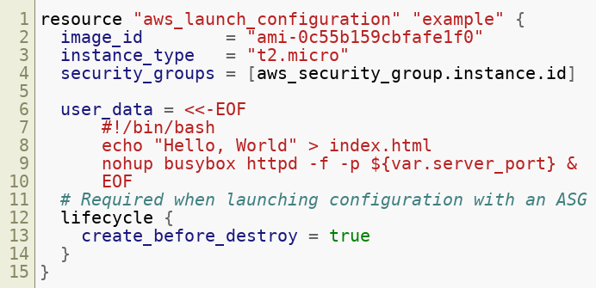
"Lifecycle" Setting
Use create_before_destroy
If you set create_before_destroy to true
Terraform will invert the order in which it replaces resources
create the replacement resource first
then deleting the old resource
Copyright © 2021 by Elephant Scale, All Rights Reserved

Slide 64
One More Parameter: "subnet_ids"
specifies to the ASG into which VPC subnets the EC2 Instances should be deployed
Each subnet lives in an isolated AWS AZ
By deploying your instances across multiple subnets
you make it fault-tolerant
Instead of hard-coding the list of subnet, we will get them data sources
Copyright © 2021 by Elephant Scale, All Rights Reserved

Slide 65
Data Sources
data source a piece of read-only information that is fetched from the provider (in this case, AWS) every time you run Terraform
data source in your configurations is a way to query the provider’s APIs for data
AWS data sources include
VPC data
subnet data
AMI IDs
IP address ranges
more
Copyright © 2021 by Elephant Scale, All Rights Reserved

Slide 66


Data Source Syntax
Example: Do I have the default VPC?
Copyright © 2021 by Elephant Scale, All Rights Reserved

Slide 67

Getting data for "data source"
Syntax
data.<PROVIDER>_<TYPE>.<NAME>.<ATTRIBUTE>
Example
data.aws_vpc.default.id
With this, you can find out the default subnet id
Copyright © 2021 by Elephant Scale, All Rights Reserved

Slide 68
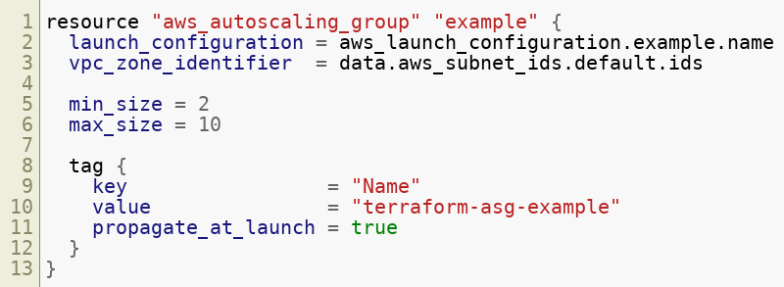
Use the Default Subnet id
Pull the subnet IDs out of the aws_subnet_ids data source
Tell your ASG to use those subnets via the vpc_zone_identifier argument
Copyright © 2021 by Elephant Scale, All Rights Reserved

Slide 69
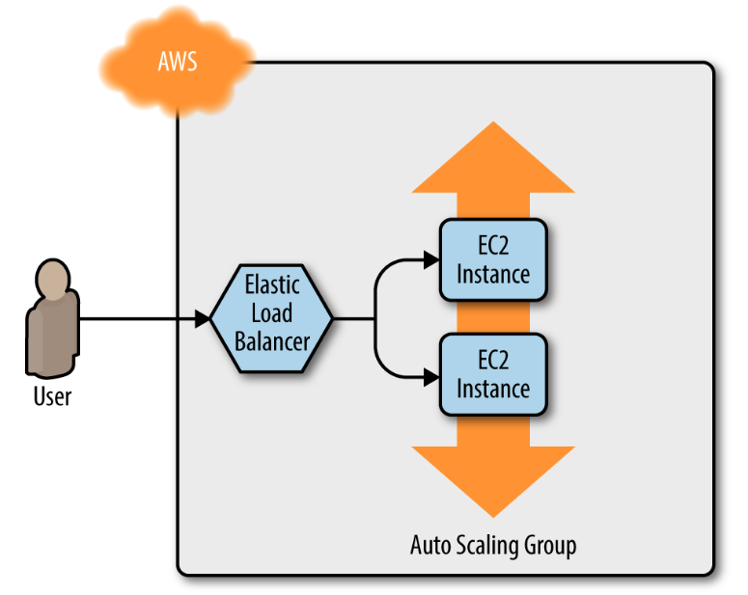
Load Balancer
Copyright © 2021 by Elephant Scale, All Rights Reserved

Slide 70

Using Load Balancer
Problem
you now have multiple servers, each with its own IP address
you want to give of your end users only a single IP to use
Solution
deploy a load balancer to distribute traffic across your servers
Advantage
highly available and scalable
ELB to the rescue
Amazon’s Elastic Load Balancer (ELB) service
Copyright © 2021 by Elephant Scale, All Rights Reserved

Slide 71
Lab: Creating a load balance
Please do the following lab
terraform-up-and-running-code/labs/lab02-3-prep.md
https://github.com/elephantscale/terraform-up-and-running-code/blob/master/labs/lab02-3-prep.md
Copyright © 2021 by Elephant Scale, All Rights Reserved

Slide 72
Load Balancer Types
Application Load Balancer (ALB)
Best suited for load balancing of HTTP and HTTPS traffic
Network Load Balancer (NLB)
Best suited for load balancing of TCP, UDP, and TLS traffic. Can scale up and down in response to load faster than the ALB (the NLB is designed to scale to tens of millions of requests per second). Operates at the transport layer (Layer 4) of the OSI model.
Classic Load Balancer (CLB)
This is the “legacy” load balancer that predates both the ALB and NLB. It can handle HTTP, HTTPS, TCP, and TLS traffic, but with far fewer features than either the ALB or NLB. Operates at both the application layer (L7) and transport layer (L4) of the OSI model.
Copyright © 2021 by Elephant Scale, All Rights Reserved

Slide 73
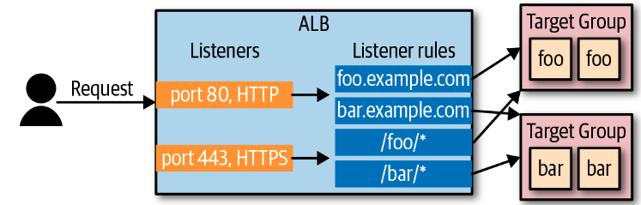
Application Load Balancer (ALB)
Copyright © 2021 by Elephant Scale, All Rights Reserved

Slide 74
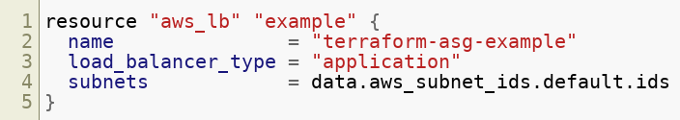
ALB Configuration
Copyright © 2021 by Elephant Scale, All Rights Reserved

Slide 75
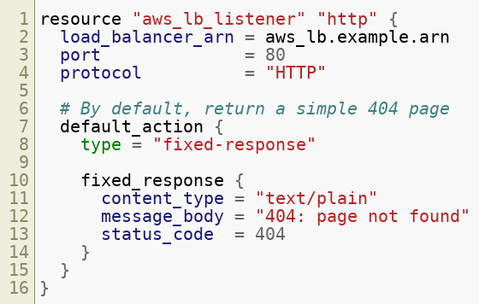
ALB Listener
Copyright © 2021 by Elephant Scale, All Rights Reserved

Slide 76
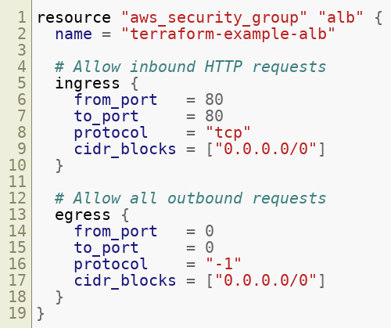
Security Group for ALB
Copyright © 2021 by Elephant Scale, All Rights Reserved

Slide 77
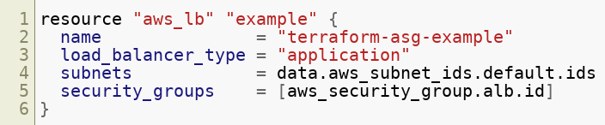
"aws_lb resource" to Use Our Security Group
Copyright © 2021 by Elephant Scale, All Rights Reserved

Slide 78
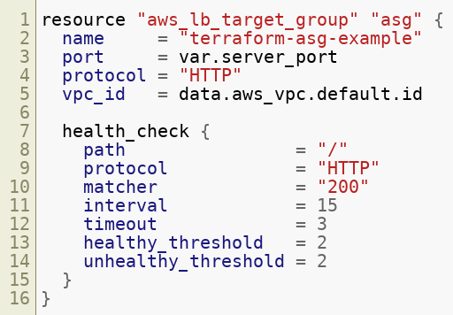
Limits for Your ASG
Copyright © 2021 by Elephant Scale, All Rights Reserved

Slide 79
What the Target Group Do?
health check your Instances by periodically sending an HTTP request to each Instance
will consider the Instance “healthy” only if the Instance returns a response that matches the configured matcher
we told the matcher to look for a 200 OK response the target group will automatically stop sending traffic to unhealthy instance
Copyright © 2021 by Elephant Scale, All Rights Reserved

Slide 80
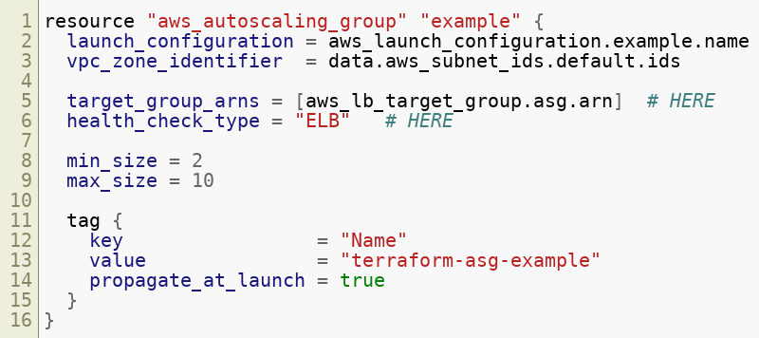
Target Group Knows Its EC2 Instances
Copyright © 2021 by Elephant Scale, All Rights Reserved

Slide 81
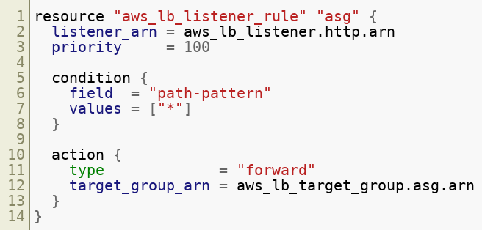
ALB Listener Rule
Copyright © 2021 by Elephant Scale, All Rights Reserved

Slide 82
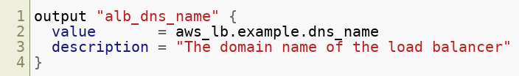
New Output - The DNS Name of the ALB
Copyright © 2021 by Elephant Scale, All Rights Reserved

Slide 83
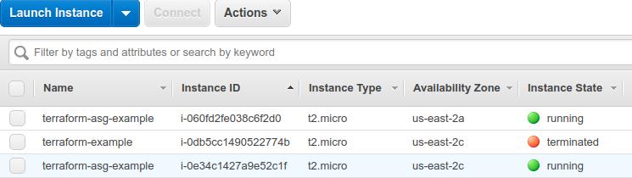
Results of Upcoming Lab - Instances
Copyright © 2021 by Elephant Scale, All Rights Reserved

Slide 84
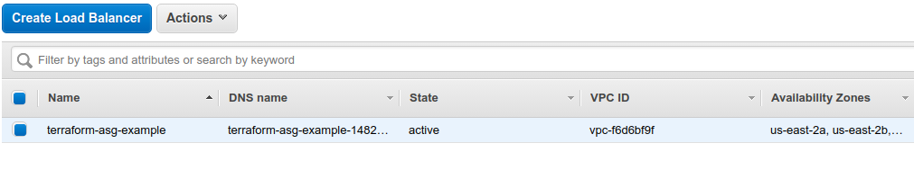
Results of Upcoming Lab - Load Balancer
Copyright © 2021 by Elephant Scale, All Rights Reserved

Slide 85
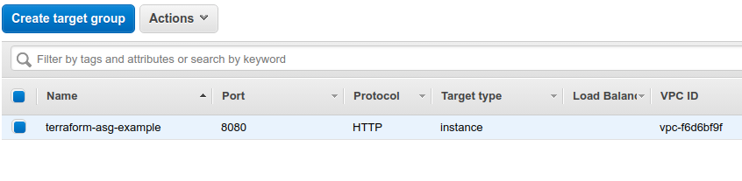
Results of Upcoming Lab - Target Group
Copyright © 2021 by Elephant Scale, All Rights Reserved

Slide 86
Lab: Deploy a Cluster with Load Balancer
Please do this labhttps://github.com/elephantscale/terraform-up-and-running-code/blob/master/labs/lab02-3.md
terraform-up-and-running-code/labs/lab02-3.md
https://github.com/elephantscale/terraform-up-and-running-code/blob/master/labs/lab02-3.md
Copyright © 2021 by Elephant Scale, All Rights Reserved

