Slide 1
Vault and Consul
Copyright © 2021 by Elephant Scale, All Rights Reserved

Slide 2
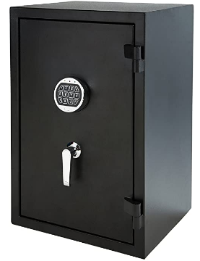

Vault and Consul Class Outline
Day | Agenda
1 | Vault: architecture, configuration, scalability
2 | Vault Identities: Entities and Groups, Namespaces, production, monitoring
3 | Microservices, microservices with Consul, Consul hands-on
Copyright © 2021 by Elephant Scale, All Rights Reserved

Slide 3
Prerequisites & Expectations
Familiarity with a programming or scripting language
Basic understanding of Linux development environment
Command line navigation
Editing files (e.g. using VI or nano)
This is an Infrastructure as Code (IaC) with Terraform class
You may be missing some pre-requisites, that’s OK
You should be willing to work hard, that is a must
Copyright © 2021 by Elephant Scale, All Rights Reserved

Slide 4
Our Teaching Philosophy
Emphasis on concepts & fundamentals
No need to learn APIs by heart
Highly interactive (questions, discussions, etc. are welcome)
Hands-on (learn by doing)
Build solid fundamentals of understanding and design
Copyright © 2021 by Elephant Scale, All Rights Reserved

Slide 5

Analogy: Learning to Fly...
Copyright © 2021 by Elephant Scale, All Rights Reserved

Slide 6
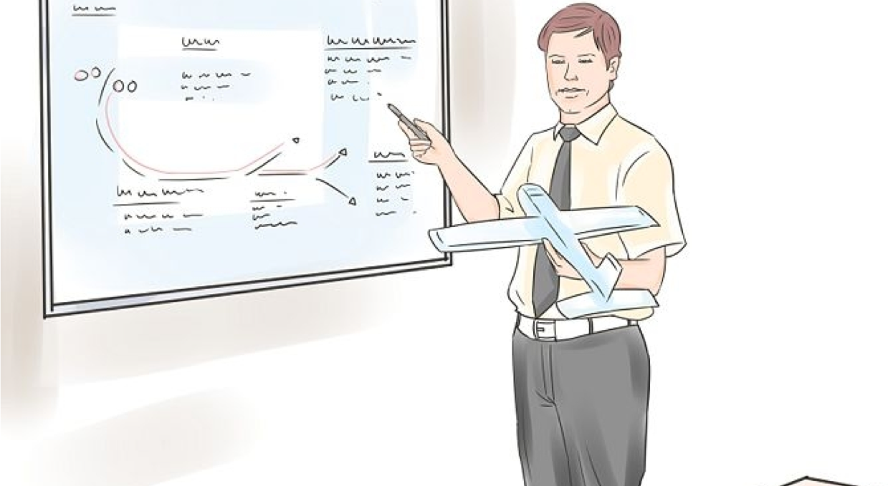
Instruction
Copyright © 2021 by Elephant Scale, All Rights Reserved

Slide 7

+ Flight Time
Copyright © 2021 by Elephant Scale, All Rights Reserved

Slide 8
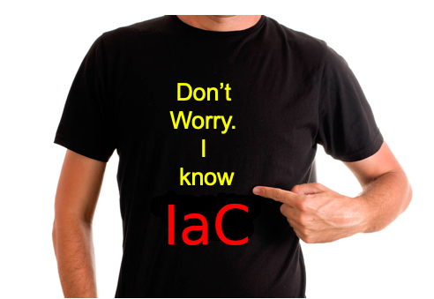
After the Class...
Copyright © 2021 by Elephant Scale, All Rights Reserved

Slide 9


About You and Me
About Instructor
About you
Your Name
Your background (developer, admin, manager, ...)
Technologies you are familiar with
Familiarity with Terraform or IaC (scale of 1 - 4 ; 1 - new, 4 - expert)
Something non-technical about you!(favorite ice cream flavor, hobby, etc.)
Copyright © 2021 by Elephant Scale, All Rights Reserved

Slide 10
Class Logistics
Instructor’s contact information
Slides
For each session, slides will be emailed out or delivered via virtual classroom
Server nodes
Provided in the cloud
Labs
Provided in the cloud
Will be delivered in a ZIP file for your future reference
Copyright © 2021 by Elephant Scale, All Rights Reserved

Slide 11
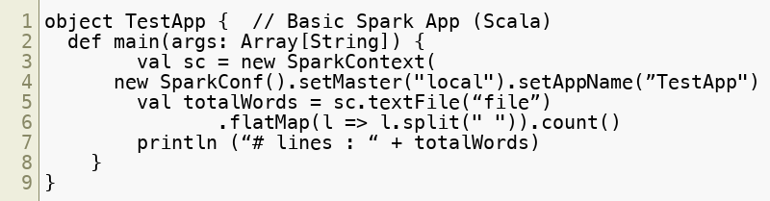
Typographic Conventions
Software code in the text uses a fixed-width code font:
catalog: Catalog = new CatalogImpl
Code fragments are the same, e.g., catalog.speakTruth
We use bold/color text for emphasis
Filenames are in italics, e.g., Catalog.scala
Longer code examples appear in a separate code box:
Copyright © 2021 by Elephant Scale, All Rights Reserved

Slide 12

Recommended books and credits
Bryan Krausen book on Amazon: Running HashiCorp Vault in Production
Bryan Krausen book on Gumroad in PDF format: Running HashiCorp Vault in Production
Udemy Profile for Bryan Krausen
Copyright © 2021 by Elephant Scale, All Rights Reserved

Slide 13
Questions?
Any questions?
Copyright © 2021 by Elephant Scale, All Rights Reserved

