Slide 1
Managing Terraform State
Copyright © 2021 by Elephant Scale, All Rights Reserved

Slide 2
The Plan
What is Terraform state?
Shared storage for state files
Limitations with Terraform’s backends
Isolating state files
Isolation via workspaces
Isolation via file layout
The terraform_remote_state data source
Copyright © 2021 by Elephant Scale, All Rights Reserved

Slide 3
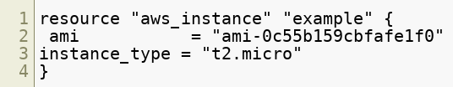
What Is Terraform State?
Every time you run Terraform, it records information about what infrastructure it created in a Terraform state file
By default, when you run Terraform in the folder /foo/bar, Terraform creates the file /foo/bar/terraform.tfstate.
Say, your Terraform configuration shows below
Copyright © 2021 by Elephant Scale, All Rights Reserved

Slide 4
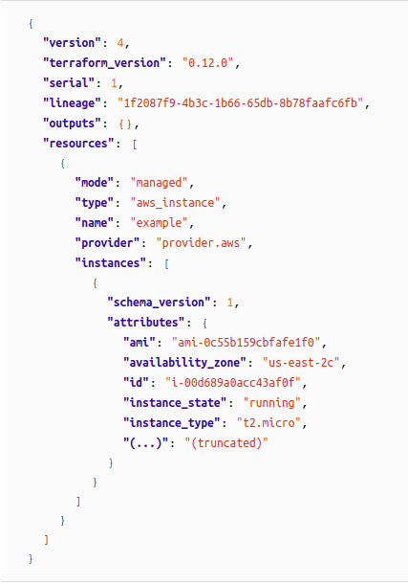
Example of "terraform.tfstate"
After you run terraform apply you will see the output in terraform.tfstate
Copyright © 2021 by Elephant Scale, All Rights Reserved

Slide 5
Meaning of "terraform.tfstate"
Resource with type aws_instance and name example corresponds to an EC2 Instance in your AWS account with ID i-00d689a0acc43af0f
Every time you run Terraform
it can fetch the latest status of this EC2 Instance from AWS
compare that to what’s in your Terraform configurations
determine what changes need to be applied
Thus, the output of the terraform plan command is a diff
between the code on your computer and
the infrastructure deployed in the real world, as discovered via IDs in the state file
Copyright © 2021 by Elephant Scale, All Rights Reserved
Notes:
THE STATE FILE IS A PRIVATE API
The state file format is a private API that changes with every release and is meant only for internal use within Terraform. You should never edit the Terraform state files by hand or write code that reads them directly.
If for some reason you need to manipulate the state file—which should be a relatively rare occurrence—use the terraform import or terraform state commands

Slide 6
Managing Terraform States
State file tracks managed resources created by Terraform
Other resources are ignored unless there is conflict
Existing resources can be added to a Terraform state
Resources can be removed from a Terraform state
Multiple state files can be used
Each state file manages a only its set of resources
Copyright © 2021 by Elephant Scale, All Rights Reserved

Slide 7
The "state" Command
The state command has multiple options (not all are listed)
terraform state list : lists the resources being managed
terraform state show <resource> : displays state data for a resource
terraform state rm <resource> : stops managing the AWS object linked to <resource>
terraform import <resource> <AWS ID> : links the Terraform resource with a terrafrom resource
Copyright © 2021 by Elephant Scale, All Rights Reserved

Slide 8
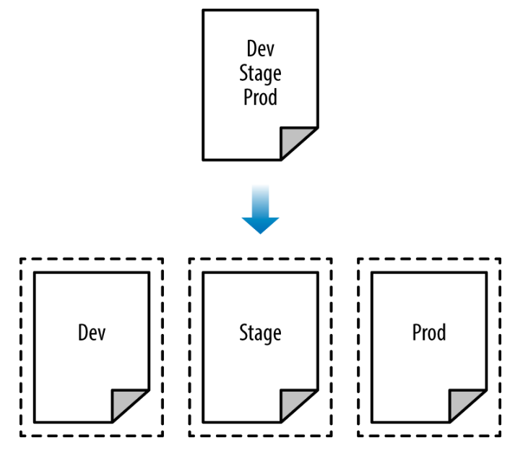
Separate Environments
We often need multiple copies of a deployment for different purposes
Common environments are: development, test, stage and production
Copyright © 2021 by Elephant Scale, All Rights Reserved

Slide 9
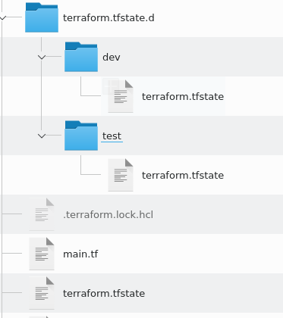
Terraform Workspaces
Terraform supports a separate configuration for each deployment
Each deployment is called a workspace
There is always a default workspace
We can create additional workspaces as we need them
For example, we could have defined dev and test workspaces
For local state files, each new workspace's state file is in its own folder
Copyright © 2021 by Elephant Scale, All Rights Reserved

Slide 10
The "workspace" Command
terraform workspace has several options:
list : lists all workspaces marking the current one with "*"
show : lists the currently active workspace
new <name> : creates and switches to the newly created workspace
select <name> : switches to the named workspace
delete <name> : deletes the named workspace
The "default" workspace can never be deleted
Deleting a workspace does not destroy the resources, it just leaves them unmanaged
Copyright © 2021 by Elephant Scale, All Rights Reserved

Slide 11
Remote Backends
Each Terraform configuration specifies where the state files are kept
This is called the "backend"
The default is to use files in the local directory
This is what we have been using so far
Terraform can also support "remote" backends
For example, we can keep state files in an S3 bucket on AWS
Not all providers can host remote back ends
Copyright © 2021 by Elephant Scale, All Rights Reserved

Slide 12
Problem with Local Backends
Shared storage for state files
Files need to be in common shared area so everyone on the team can access them
Without file locking, race conditions when concurrent updates to the state files take place
This can lead to conflicts, data loss, and state file corruption
Isolation
It's difficult to isolate the code used in different environments
Lack of isolation makes it easy to accidentally overwrite environments
Secrets
Confidential information is stored in the clear (i.e. AWS Keys)
Copyright © 2021 by Elephant Scale, All Rights Reserved

Slide 13
Remote AWS Backend
Using S3 as a backend resolves many of these issues
S3 manages the updating and access independently, and supports versions
S3 supports encryption
S3 supports locking for multiple access
S3 allows a common repository we can control access to
S3 is also managed so that we don't have to manage it
S3 has high levels of availability and durability
S3 also means we have reduced the risk of "loosing" configurations
Copyright © 2021 by Elephant Scale, All Rights Reserved

Slide 14
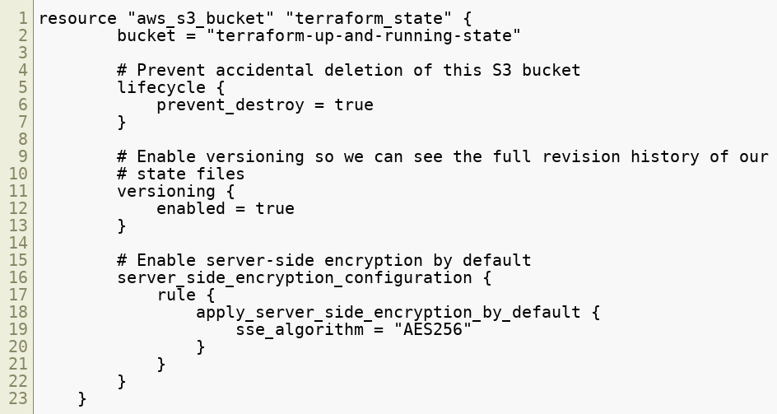
Setting up the S3 Bucket
Copyright © 2021 by Elephant Scale, All Rights Reserved

Slide 15
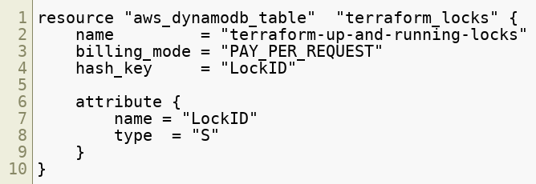
Setting up the Locking Table
Next, a DynamoDB table to use for locking
DynamoDB is Amazon’s distributed key–value store
It supports strongly consistent reads and conditional writes
Copyright © 2021 by Elephant Scale, All Rights Reserved

Slide 16
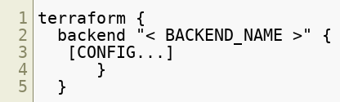
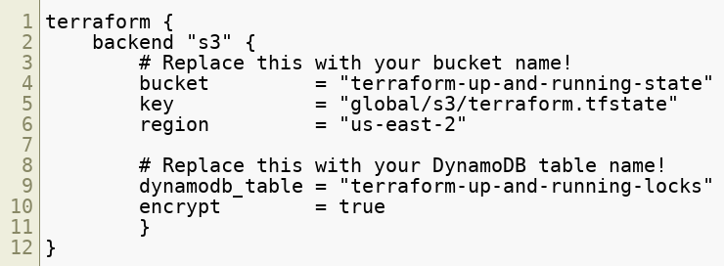
Setting Up the Backend
We have to tell Terraform the backend in now remote
We do this in the terraform directive
More specifically:
Copyright © 2021 by Elephant Scale, All Rights Reserved

Slide 17
Moving State File Locations
To move local state to a remote backend
Create the remote backend resources and define the backend configuration
Run terraform init and the local config is copied to the remote backend
To move from remote backend to a local backend
Remove the backend configuration
Run terraform init and the remote config is copied to the local backend
Copyright © 2021 by Elephant Scale, All Rights Reserved

Slide 18
Moving Backends Summary
To make this work, you need to use a two-step process:
Create the S3 bucket and DynamoDB table and deploy that code with a local backend
Add a remote backend configuration to it to use the S3 bucket and DynamoDB table
Run terraform init to copy your local state to S3
To revert to a local state backend
Remove the backend configuration
Rerun terraform init to copy the Terraform state to the local disk
Run terraform destroy to delete the S3 bucket and DynamoDB table
Copyright © 2021 by Elephant Scale, All Rights Reserved

Slide 19
Remote Backend Advantage
A single S3 bucket and DynamoDB table can be shared across all your Terraform code
You’ll probably only need to do it once per AWS account
After the S3 bucket exists, in the rest of your Terraform code, you can specify the backend configuration right from the start without any extra steps
Copyright © 2021 by Elephant Scale, All Rights Reserved

Slide 20
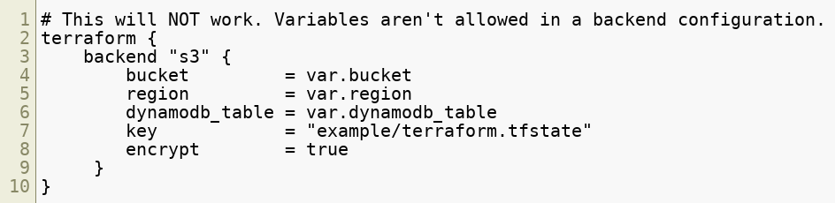
Backend Limitation
Variables and references cannot be used in the backend block
The following will not work
Copyright © 2021 by Elephant Scale, All Rights Reserved

Slide 21
File Isolation
Most secure approach is to have a folder for each configuration
Each deployment has its own backend, local or remote.
This allows for isolation of all files
Allows for different access and authentication mechanisms
Eg. Different S3 buckets used as backends can have different policies
Copyright © 2021 by Elephant Scale, All Rights Reserved

Slide 22
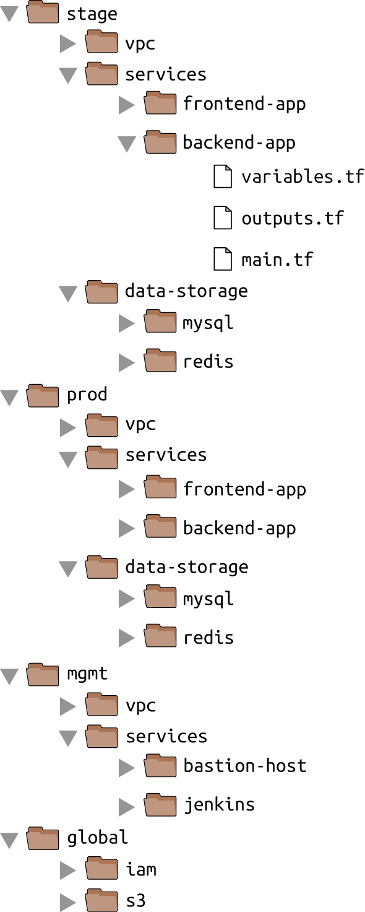
File Isolation Example
Copyright © 2021 by Elephant Scale, All Rights Reserved

Slide 23
Workspaces Use Case
If you already have a Terraform module deployed
you want to do some experiments with it
but you don’t want your experiments to affect the state of the already deployed infrastructure
Run terraform workspace new to deploy a new copy of the exact same infrastructure, but storing the state in a separate file
Copyright © 2021 by Elephant Scale, All Rights Reserved

Slide 24
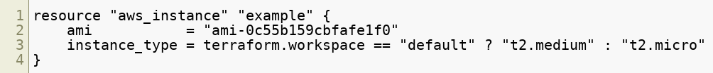
Workspace Specific Configurations
You can even change how that module behaves based on the workspace you’re in by reading the workspace name using the expression terraform.workspace
Workspaces allow a fast and easy way o quickly spin up and tear down different versions of your code
Copyright © 2021 by Elephant Scale, All Rights Reserved

Slide 25
Workspace Drawbacks
All workspace state fiels are stored in the same backend
They share same authentication and access controls which means they are not good for isolating
Workspaces are not visible in the code or on the terminal unless you run terraform workspace commands
A module in one workspace looks exactly the same as a module deployed in 10 workspaces
This makes maintenance more difficult, because you don’t have a good picture of your infrastructure
Workspaces can be fairly error prone
The lack of visibility makes it easy to forget what workspace you’re in and accidentally make changes in the wrong one
Copyright © 2021 by Elephant Scale, All Rights Reserved

Slide 26
Isolation via File Layout
To achieve full isolation between environments:
Put the Terraform configuration files for each environment into a separate folder
For example, all of the configurations for the staging environment can be in a folder called stage
All the configurations for the production environment can be in a folder called prod
Configure a different backend for each environment, using different authentication mechanisms and access controls
Each environment could live in a separate AWS account with a separate S3 bucket as a backend
Copyright © 2021 by Elephant Scale, All Rights Reserved

Slide 27
Typical Project File Layout
Copyright © 2021 by Elephant Scale, All Rights Reserved

Slide 28
Isolation via File Layout
At the top level, there are separate folders for each “environment
stage : An environment for preproduction workloads (testing)
prod : An environment for production workloads (user facing apps)
mgmt : An environment for DevOps tooling (Jenkins etc.)
global : Resources that are used across all environments (S3, IAM)
Within each environment, there are separate folders for each “component":
vpc : Network topology for this environment
services : Apps or microservices to run in this environment - each app could have its own folder to isolate it
data-storage : The data stores to run in this environment, such as MySQL or Redis
Copyright © 2021 by Elephant Scale, All Rights Reserved

Slide 29
Isolation via File Layout
Within each component are the actual Terraform configuration files with the following naming conventions:
variables.tf : Input variables
outputs.tf : Output variables
main.tf : The resources
Terraform looks for files in the current directory with the .tf extension
Using a consistent, predictable naming convention makes code easier to browse
Then you always know where to look to find a variable, output, or resource. If individual Terraform files are
Copyright © 2021 by Elephant Scale, All Rights Reserved

Slide 30
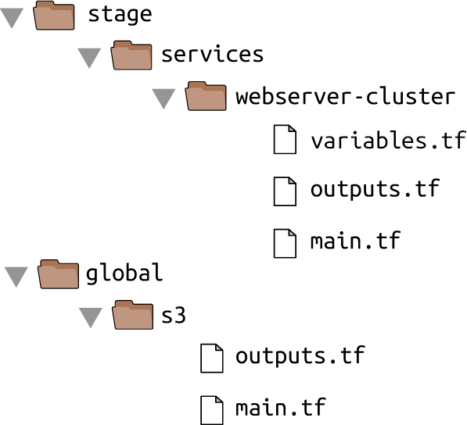
Rarranged Sample Code
Copyright © 2021 by Elephant Scale, All Rights Reserved

Slide 31
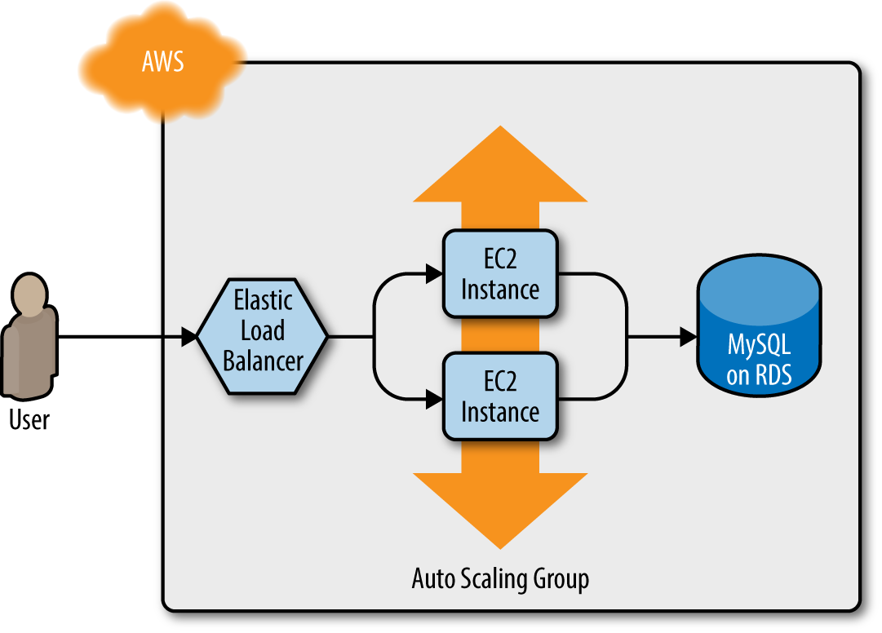
The "terraform_remote_state" Data Source
Assume that the web server cluster needs to communicate with a MySQL database
Copyright © 2021 by Elephant Scale, All Rights Reserved

Slide 32
Deployment Consideration
The MySQL database should probably be managed with a different set of configuration files as the web server cluster
Updates will probably be deployed to the web server cluster frequently
Wnat to avoid accidentally breaking the database when doing an update
Copyright © 2021 by Elephant Scale, All Rights Reserved

Slide 33
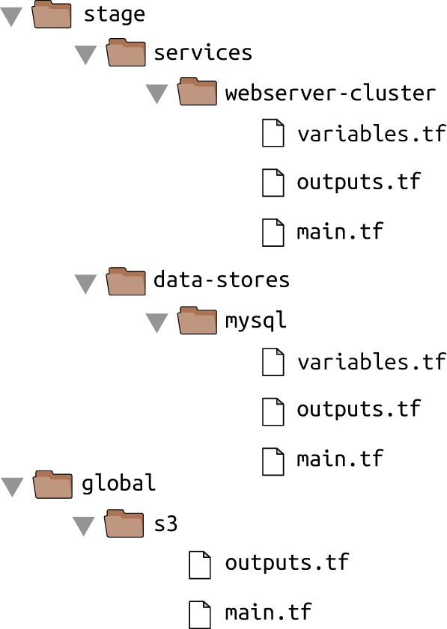
Deployment Consideration
Isolate the MySql configurations in a data-stores folder
Copyright © 2021 by Elephant Scale, All Rights Reserved

Slide 34
Keeping Secrets
One of the parameters that you must pass to the aws_db_instance resource is the master password to use for the database
This should not be in the code in plain text
There are two other options
Read the secret from a secret store - there are multiple secrets managers
AWS Secrets Manager and the aws_secretsmanager_secret_version data source (shown in the example code)
AWS Systems Manager Parameter Store and the aws_ssm_parameter data source
AWS Key Management Service (AWS KMS) and the aws_kms_secrets data source
Google Cloud KMS and the google_kms_secret data source
Azure Key Vault and the azurerm_key_vault_secret data source
HashiCorp Vault and the vault_generic_secret data source
Copyright © 2021 by Elephant Scale, All Rights Reserved

Slide 35
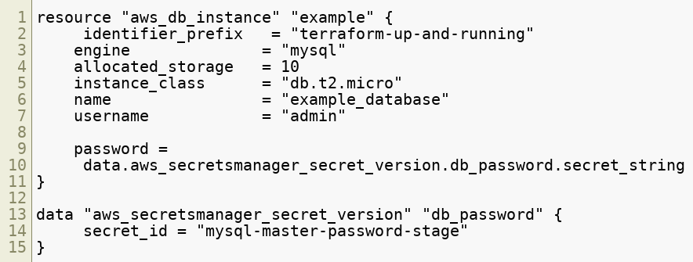
Using AWS Secrets Manager
Copyright © 2021 by Elephant Scale, All Rights Reserved

Slide 36
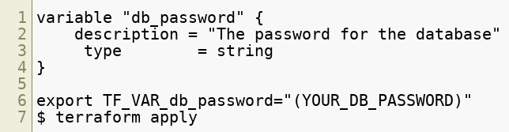
Keeping Secrets II
Other option is to manage them completely outside of Terraform
Then pass the secret into Terraform via an environment variable.
In the code below, there is no default since it's a secret
A known weakness of Terraform:
The secret will be stored in the Terraform state file in plain text
The only solution is to lock down and ecrypt the state files
Copyright © 2021 by Elephant Scale, All Rights Reserved

Slide 37
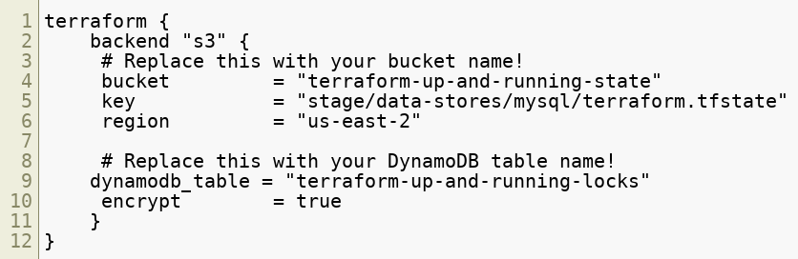
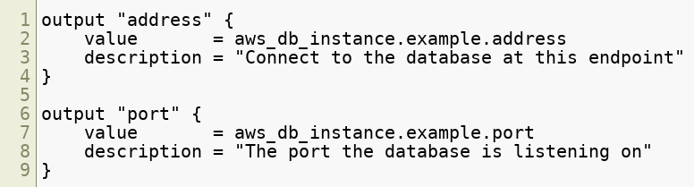
Creating the Database
Using the backend to create the state repository:
Run the Terraform init and apply commands to create the database
Provide the database ports to the webserver cluster
Copyright © 2021 by Elephant Scale, All Rights Reserved

Slide 38
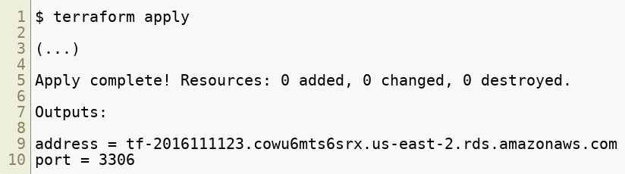
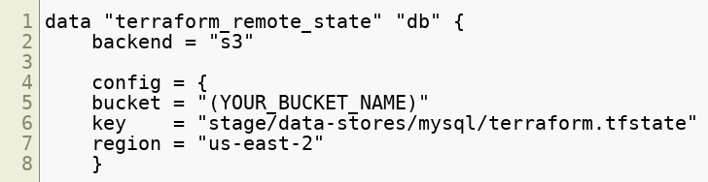
Integrating the Database
Running init again produces:
These outputs are now stored in the Terraform state for the database
The web server cluster code can read the data from this state file by adding the terraform_remote_state data source in stage/services/webserver-cluster/main.tf:
Copyright © 2021 by Elephant Scale, All Rights Reserved

Slide 39
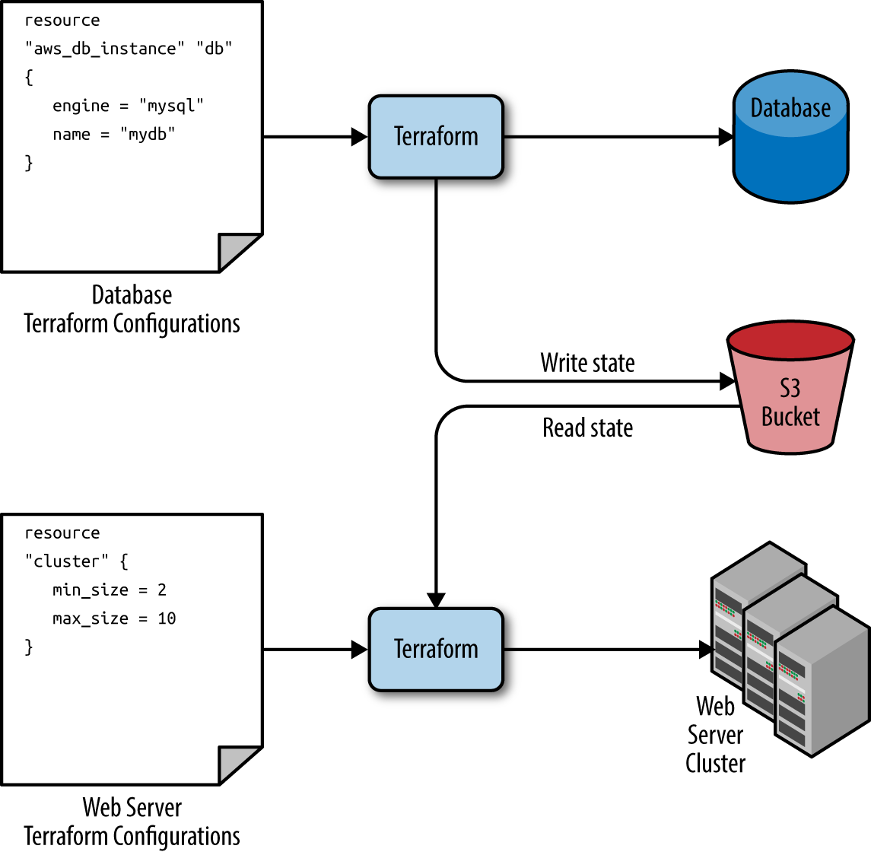
Reading the DB State
The webservice cluster reads the DB configuration from the state file in the S3 bucket
Copyright © 2021 by Elephant Scale, All Rights Reserved

Slide 40
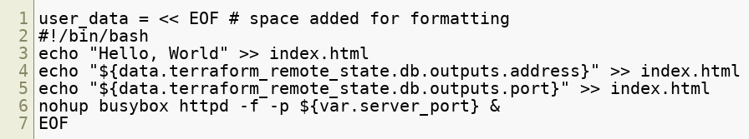
Reading the DB State
All Terraform data sources, like the data returned by terraform_remote_state, is read-only
Nothing in the webserver code can modify the state
The database’s state data can be read with no risk to the database
The output variables are stored in the state file can be read using an attribute reference of the form:
This code updates the User Data of the web server cluster Instances to pull the database address and port out of the terraform_remote_state data source:
Copyright © 2021 by Elephant Scale, All Rights Reserved

Slide 41
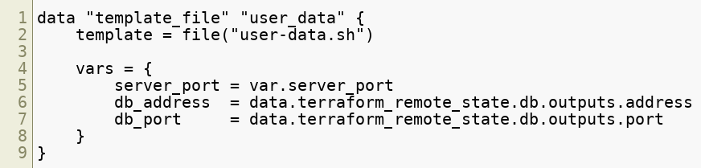
Template Files
Hard-coding the script in the previous slide is not effective
Instead we can read the contents from a file using the Terraform file() function which reads the contents of a file and returns it as a string
However, we have to dynamically insert Terraform data
To provide this facility, Terraform has a template_file data source that has two arguments: A template, which is a string to render and a map of variables to use while rendering as well as one output attribute called rendered, which is the result of rendering template
For example, this can be added to the webserver-cluster
Copyright © 2021 by Elephant Scale, All Rights Reserved

Slide 42
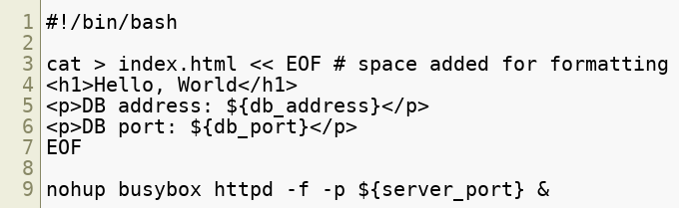
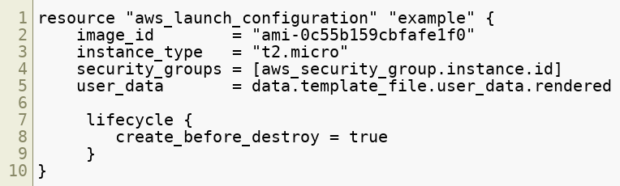
Template Files
We also have to provide the "slots" in the template code for insertion of the variables
We use standard Terraform string interpolation, and we don't need the var prefix
Copyright © 2021 by Elephant Scale, All Rights Reserved

Slide 43
Final Notes
Correct isolation, locking and state must be a priority
Bugs in a program only break a part of an app
Bugs in infrastructure can have catastrophic effects and result in whole systems crashing and becoming unworkable
Infrastructure has to be planned and incrementally tested
We never code infrastructure "on the fly"
We never experiment with infrastructure in a production environment
Always work in a sandbox
With IaaS, this is easily done
Copyright © 2021 by Elephant Scale, All Rights Reserved

