Slide 1
Git for Developers
Concepts
Hands-on exercises
Command-line
UI clients
© Elephant Scale, 2021

Slide 2
Agenda
What we will learn
Terminology
Basic operations
Changes, staging, commit
Merge and conflict resolution

Slide 3

Section - Terminology

Slide 4
What is Version Control?
Management of changes
Why is it important?
Revert code changes
Never loose code
Maintain multiple versions of a product
See the difference between two (or more) versions of your code
Prove that a particular change broke or fixed a piece of code
Review the history of some code
Submit a change to someone else's code
Share your code, or let other people work on your code
See how much work is being done, and where, when and by whom
Experiment with a new feature without interfering with working code
More?

Slide 5
Version control system examples
Server-based
CVS
PVCS
SourceSafe
Subversion
Distributed
Git
Mercurial

Slide 6
Aside: a little history
< 2005: Linux using BitKeeper
2005: BitKeeper unfriends Linux
Linus Torvalds and team design Git (uncouth person)
Speed
Simple design
Support for non-linear development
Distributed (you can work on the plane)
Handle large projects efficiently (speed and data size)

Slide 7
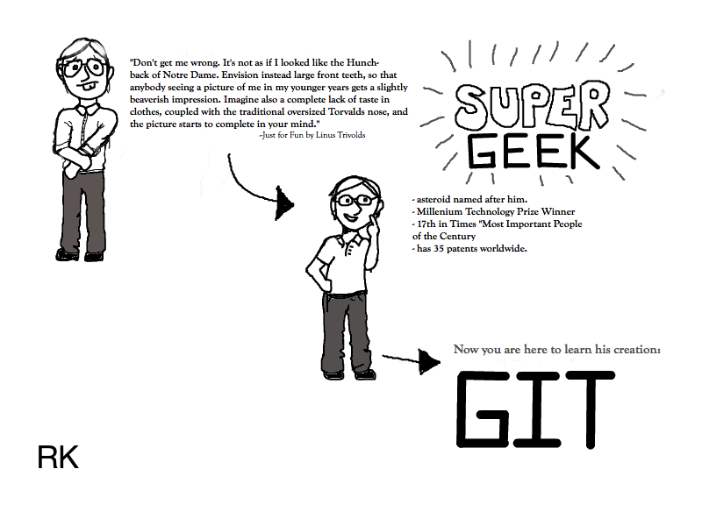
Cartoon – Linus Torvalds

Slide 8
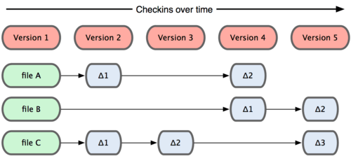
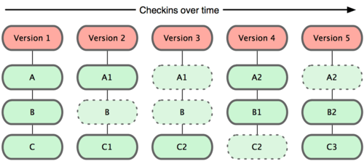
What’s the difference?
Other systems
Git
Source: Git book

Slide 9
Terminology
Key concepts
Repository
Working Copy
Index/Staging area
Blobs, Trees
Cloning
Remotes
Pulling + Pushing
Local history vs. Public history

Slide 10
How we will approach the terms
Define
Give examples
Hands-on

Slide 11
Repository
A set of files and directories
Historical record of changes in the repository
A set of commit objects
A set of references to commit objects, called heads
Let us give examples of what qualifies as a repository
A copy of a project directory?
CVS? Subversion?
Git is a complete repository, either local and remote

Slide 12

Working copy
A.k.a “working directory,” is a single checkout of one version of the project
Hands-on: analyze the git directory (.git)
Can you have multiple working copies?
Source: Git book

Slide 13
Index and Staging areas
Index and Staging area are the same
It is a simple file in the Git directory
Stores information about the next commit

Slide 14
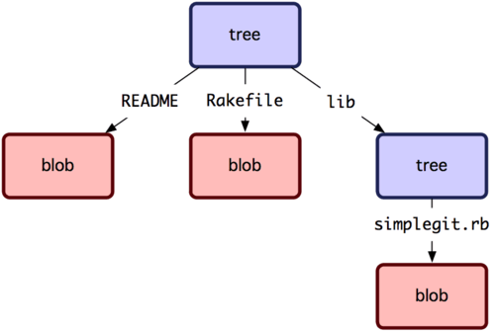
Blobs, Trees
Git is a key-value data store
You can store a value and get back a key
There are Git internals
All we need to know is “tree” and “blob”
Source: Git book

Slide 15
Lab 01 – Install git
Please do all steps in Lab 01:
https://github.com/elephantscale/git-labs/tree/main/lab01

Slide 16
Put and get values
Put value, observe the key you get in return
$ echo 'test content' | git hash-object -w –stdin
Find the file:
$ find .git/objects -type f
(SHA-1)
Get it back
git cat-file –p (SHA-1)

Slide 17
Lab 02
Please do all steps in lab 02:
https://github.com/elephantscale/git-labs/tree/main/lab02

Slide 18
Cloning
Getting a copy of the existing get repository (quick, what is repository?)
How? git clone <url>
Example:
$ git clone git://github.com/schacon/grit.git
Exercises
clone on the command line
clone in your preferred Git UI (i.e. Eclipse Git, SmartGit, etc.)
See the following lab

Slide 19
Lab 03
Please do all steps in lab 03:
https://github.com/elephantscale/git-labs/tree/main/lab03

Slide 20


Cloning vs ‘checkout’
In subversion, this would be checkout. Difference?
Git
Subversion

Slide 21
Remotes
Versions of your project that are hosted on the Internet or network – that’s how you collaborate
Remotes can be
Multiple
Read only or read-write
Try
git remote
origin – This is where you clone your project from

Slide 22

Pulling + Pushing
Pulling – from a branch on a remote
Fetching – all that you don’t have yet
Pushing – back to the branch on a remote
Source: Cutedocpix.com

Slide 23
Lab 04
Please do all steps in lab 04
https://github.com/elephantscale/git-labs/tree/main/lab04
Note, however, that the simples way to work is to always use
git commit –a
command

Slide 24
Local history vs. Public history
Local history is on your laptop
You can
Change commits
Change commit messages
Reorder
Squash
However
Be careful pushing this to the public history
Because other developers may end up having to merge

Slide 25
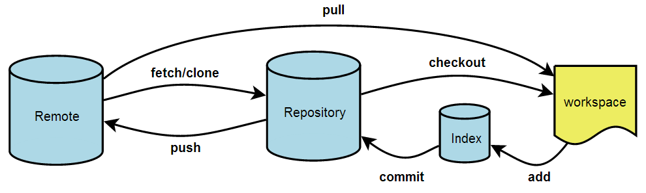
Section – Basic Git Operations
Source: Git book

Slide 26
Viewing a commit in UI
Execute the commands below
In Git Bash
gitk
Or
Tools-Git Shell
gitk
To view a specific commit
git show 5809 (first few letters of the SHA-1)

Slide 27
Switching branches
git checkout <branch-name>
Try switching between your branches
Try switching branches to your friend’s
Describe what happens when you switch a branch

Slide 28
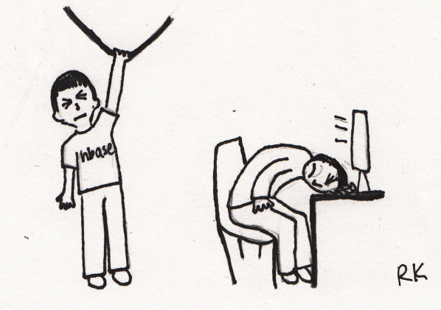
Switching branches – practical scenario
A day in the life of a web developer

Slide 29
Morning
Do work on a web site.
Create a branch for a new story you’re working on.
Do some work in that branch.
Let us try that.
Work on the text file of your choice
Create a branch for a new story your-name_new
Do some work in that branch.

Slide 30
Afternoon
Emergency fix is required in your branch your-name!
Switch back to your production branch.
Create a branch to add the fix.
Test, merge the hotfix branch into your-name, and push to production.
Switch back to your original story and continue working.
Let us do that (following lab)

Slide 31
Lab 05
Please do all steps in lab 05
https://github.com/elephantscale/git-labs/tree/main/lab05

Slide 32

Section: making changes, staging, and committing
Source: http://www.northeaststage.com

Slide 33
Making changes, staging and committing – in-depth look
Staging a commit
Making a commit
Pushing your change
Undoing latest local commit
Reverting a commit

Slide 34
Staging a commit
Review: what happens in staging?
Answer: your changes go to the staging area
Do commands
git status
git add <file>
git commit –a
Interactive
git add -i

Slide 35
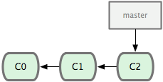
Making a commit
Commit is a record of your changes in a Git directory (repository)
Making a commit is moving the branch point (master in this case) to the next snapshot
Source: Git book

Slide 36

Commits
What are the differences and similarities between a commitment and a commit?

Slide 37
Commit features
Permanence
Commit leaves a record
Commit goes into the Git area
Commit can be further recorded in a remote
Impermanence
Commits can be taken back (undone locally or reverted)
Commits can be erased (rebase)

Slide 38
How does branching and merging work
Let’s go back to our morning-afternoon scenario. In brief…
Working on your issue
Get interrupted with the production fix
Fix the production, go back to your issue

Slide 39
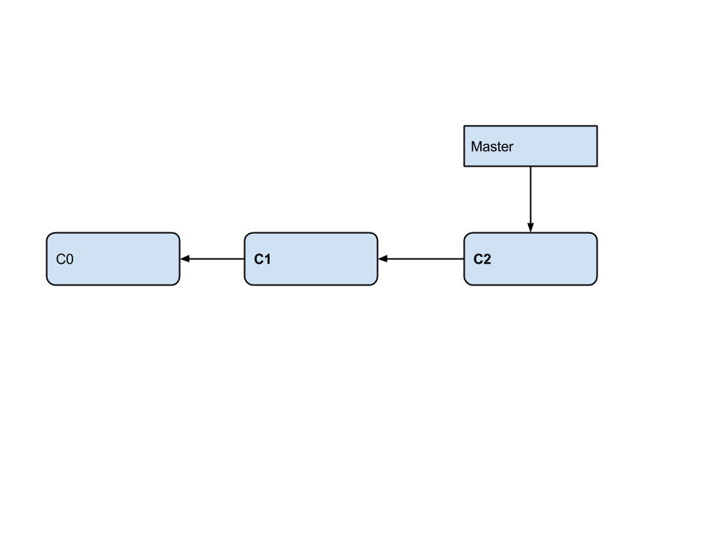
This is where you start

Slide 40
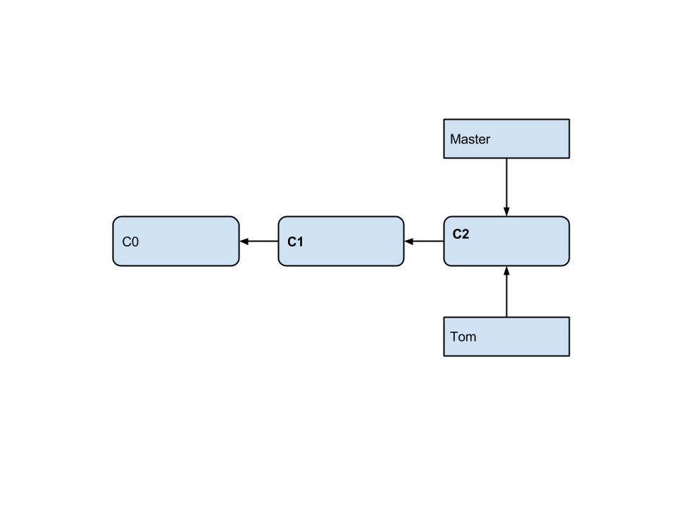
Prepare to work on your feature
git checkout tom -b

Slide 41
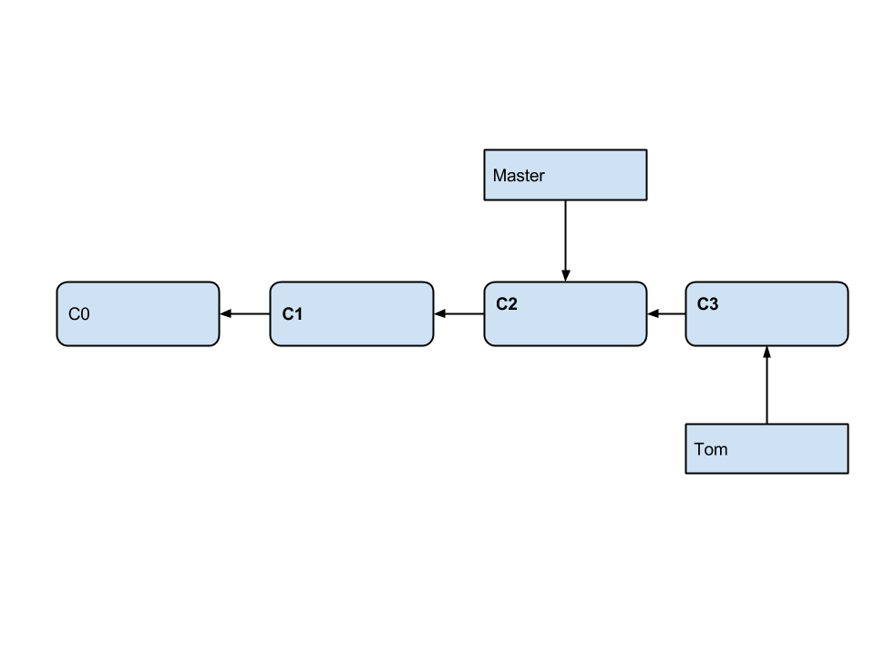
Commit your new changes
git commit -a

Slide 42
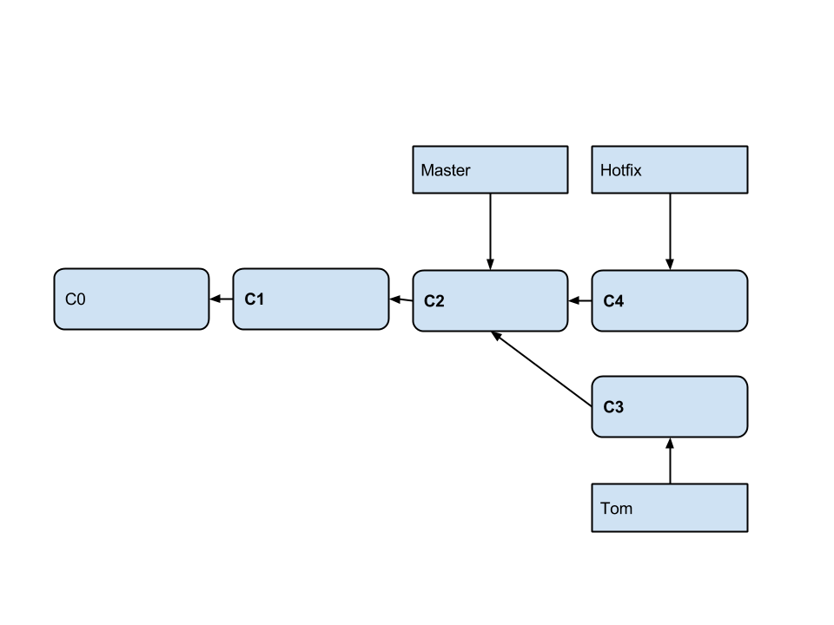
Work on hotfix
$ git checkout -b hotfix
Switched to a new branch 'hotfix'
$ do your work
$ git commit -a -m 'urgent fix'

Slide 43
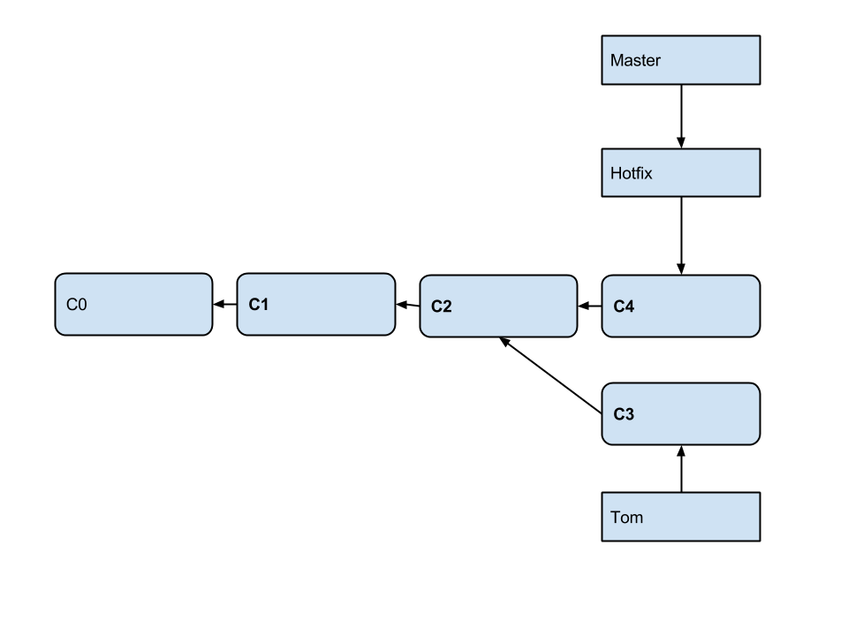
Merge hotfix
git checkout master
git merge hotfix

Slide 44
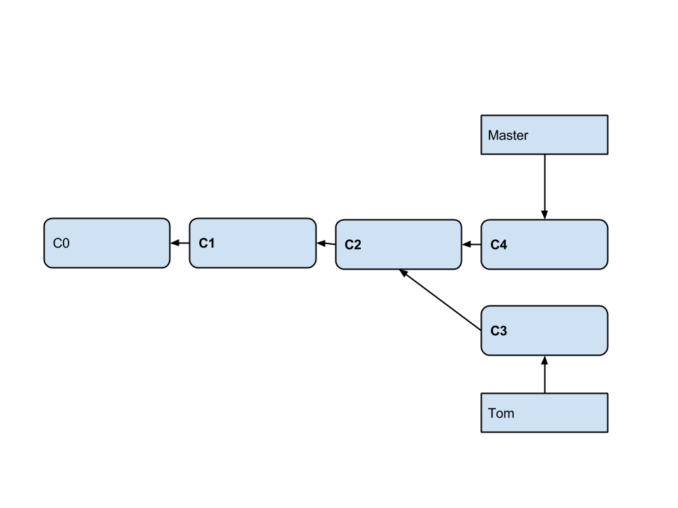
And now, clean up!
git branch -d hotfix

Slide 45
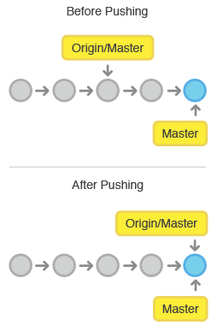
Pushing your change
git push <remote> <branch>
or simply
git push

Slide 46
Pushing – do not use force
As good practice, do not do this
git push <remote> --force
When can it happen?
Did not pull but want to push
Rebase (we will mention it later)

Slide 47
Undoing latest local commit
Can you do this?
git undo-commit
Yes, if prior you type
git config --global alias.undo-commit 'reset --soft HEAD^'
Another way:
git reset --soft HEAD~1

Slide 48
Undo staging
Say you did this and added too much
git add .
Here is how you can extricate yourself
git rm -r --cached .
In the future, you may do ‘add’ interactively
git add -n .
Try this: create a file, add it, then undo the staging

Slide 49
Revert commit
To go to a previous commit
git checkout 0d1d (start of your hash)
Careful! To go back and delete all subsequent commits
git reset --hard 0d1d (start of the commit hash)

Slide 50

Section: Merge and Conflict resolution

Slide 51
Merge and Conflict resolution
How merge conflicts happen
Preventing merge conflicts
How to resolve a merge conflict

Slide 52
How merge conflicts happen
Change a file in one branch
Chart the same file in another branch – same line!
Now merge one branch into the other
git checkout branch1 –b – now edit the file
git checkout branch2 –b – now edit the file
git merge branch1
Auto-merging <your-file>
CONFLICT (content): Merge conflict in <your file>
Automatic merge failed; fix conflicts and then commit

Slide 53
How to resolve a merge conflict
Git writes markers in the file
You edit that file
git add <file>

Slide 54
Conflict message example
git status
# # On branch branch1
# # You have unmerged paths.
# # (fix conflicts and run "git commit")
# #
# # Unmerged paths:
# # (use "git add ..." to mark resolution)
# #
# # both modified: <your file>
# #
# no changes added to commit (use "git add" and/or "git commit -a")

Slide 55
What you will see
Threshold events
<<<<<<< HEAD
two
=======
three
>>>>>>> branch-a

Slide 56
Lab 06
Please do all steps in lab 06
https://github.com/elephantscale/git-labs/tree/main/lab06

Slide 57
Preventing merge conflicts
Simple
Go with small iterations, in a branch, then merge and delete that branch
Do not forget to pull often
Advanced
git pull rebase. Git will:
Undo (unwind your commits)
Pull remote commits
Replay your local commits
You fix the conflicts if any
git rebase continue

Slide 58
Tagging
tags - symbolic names for a given revision. They always point to the same object (usually: to the same revision); they do not change.
branches - symbolic names for line of development. New commits are created on top of branch. The branch pointer naturally advances, pointing to newer and newer commits.

Slide 59
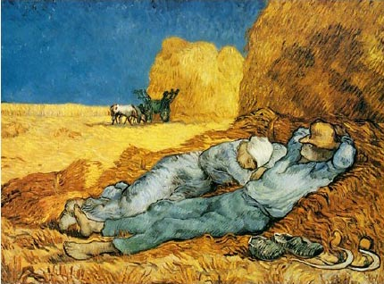
Vincent Van Gogh. Siesta

Slide 60


Detail
Painted late in life
Copied after Millet
Added his own artistic intensity

Slide 61
Pull requests
Git has no branch security
Anyone can work in his friend’s branch, then commit
How do you add not-trusted developers to the team?
New developers may be given read-only access
Then will fork the project but won’t be able to commit the changes
They then issues a git pull request

Slide 62
Lab 07
Please do all steps in lab 07
https://github.com/elephantscale/git-labs/tree/main/lab07

