Slide 1
Vault certificate preparation
Copyright © 2021 by Elephant Scale, All Rights Reserved

Slide 2
HashiCorp certifications
Terraform Associate
Vault Associate
Consul Associate
Copyright © 2021 by Elephant Scale, All Rights Reserved

Slide 3
HashiCorp Security Automation Certification
HashiCorp Certified: Vault Associate
HashiCorp Security Automation Certification
Prerequisites
Basic terminal skills
Basic understanding of on premise or cloud architecture
Basic level of security understanding
Copyright © 2021 by Elephant Scale, All Rights Reserved

Slide 4
Exam Objectives
Compare authentication methods
Create Vault policies
Assess Vault tokens
Manage Vault leases
Compare and configure Vault secrets engines
Utilize Vault CLI
Utilize Vault UI
Be aware of the Vault API
Explain Vault architecture
Explain encryption as a service
Copyright © 2021 by Elephant Scale, All Rights Reserved
Notes:
https://www.udemy.com/course/hashicorp-certified-vault-associate/

Slide 5
Quiz
When Vault is sealed, it can access the physical storage but cannot read the data because it does not know how to decrypt them.
A. True
B. False
Copyright © 2021 by Elephant Scale, All Rights Reserved
Notes:
A.

Slide 6
Quiz
Batch tokens can be renewed indefinitely.
A. True
B. False
Copyright © 2021 by Elephant Scale, All Rights Reserved
Notes:
B.

Slide 7
Quiz
To seal a Vault, the client token must have the sudo capability on the sys/seal path.
A. True
B. False
Copyright © 2021 by Elephant Scale, All Rights Reserved
Notes:
A.

Slide 8
Quiz
Which statement is true about an orphan token?
A. It does not expire when its parent does
B. It is not persisted
C. It does not have a max time-to-live (TTL)
D. It has a use limit
Copyright © 2021 by Elephant Scale, All Rights Reserved
Notes:
A.

Slide 9

Quiz
Which path will this policy allow?
A. kv/team_edu
B. kv/us-west/team
C. kv/us-west/team_edu
D. kv/us-west/ca/team_edu
Copyright © 2021 by Elephant Scale, All Rights Reserved
Notes:
C.

Slide 10
Quiz
What is true of Vault tokens? Choose TWO correct answers.
A. Vault tokens are generated by every authentication method login
B. Vault tokens are also known as unseal keys
C. Vault tokens are required for every Vault call
D. Vault token IDs always begin with "s." such as s.E7rOurS2n7m2Dt5409jWxR87
E. Vault tokens are the core method for authentication in Vault
Copyright © 2021 by Elephant Scale, All Rights Reserved
Notes:
A., E.

Slide 11
Quiz
Which statements correctly describe the command below? Choose TWO correct answers.
A. Returns an error due to missing encryption key name
B. Returns base64-encoded plaintext
C. Decrypts the ciphertext if the token permits
D. Returns the ciphertext
E. Requires sudo capability on the transit/decrypt/password path
Copyright © 2021 by Elephant Scale, All Rights Reserved
Notes:
B., C.

Slide 12
Quiz
An organization needs to protect sensitive application data currently stored in a database as plaintext. Which secrets engine provides a solution?
A. Key/Value v2 secrets engine
B. Cubbyhole secrets engine
C. Transit secrets engine
D. Database secrets engine
Copyright © 2021 by Elephant Scale, All Rights Reserved
Notes:
C.

Slide 13
Quiz
Which of the following statements explains the benefit of response wrapping? Choose TWO correct answers.
A. Limits the time of secret exposure by having a short-lived wrapping token
B. Allow versioning of the secrets
C. It protects Vault's master key
D. Only the reference to the secrets is transmitted over the public network
E. Limits the size of secrets to be transmitted over the network
Copyright © 2021 by Elephant Scale, All Rights Reserved
Notes:
A., D.

Slide 14
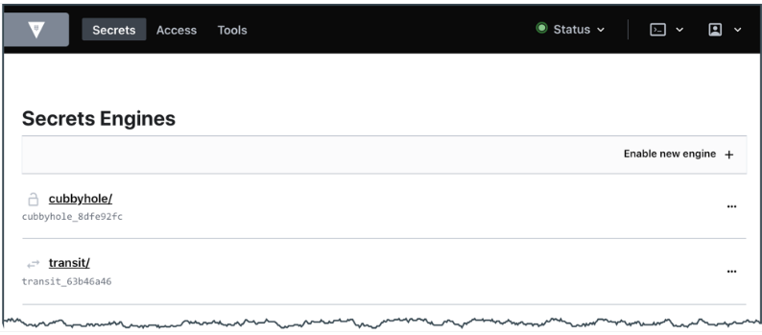
Quiz
You need to edit a policy, but the UI appears as shown. What is the problem?
A. This is an UI error. Contact support.
B. You don't have a permission to manage policies.
C. Vault UI does not support policy creation and management.
D. Use the command shell in UI to manage policies.
Copyright © 2021 by Elephant Scale, All Rights Reserved
Notes:
B.

Slide 15
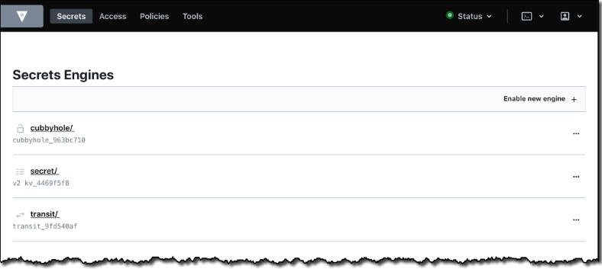
Quiz
Where on the page would you click to display the list of available Vault-created encryption keys?
A. Cubbyhole/
B. Secrets/
C. Transit/
Copyright © 2021 by Elephant Scale, All Rights Reserved
Notes:
C.

Slide 16
Quiz
Does Transit Secret Engine store the cipher-text data for future decryption requests?
A. True
B. False
Copyright © 2021 by Elephant Scale, All Rights Reserved
Notes:
B.

Slide 17
Quiz
The main idea of Shamir's Sharing Algorithm is to protect?
A. SSL/TLS key
B. Root tokens
C. Master key
D. Encryption keys
Copyright © 2021 by Elephant Scale, All Rights Reserved
Notes:
D.

Slide 18
Quiz
Matthew works as a security engineer in Medium Corp and is recently provided a project to set up the vault. Medium Corp extensively uses AWS and to protect the master key, they intend to make use of AWS KMS instead of shamir. How can this be achieved?
A. Shamir'a algorithm is the only choice available.
B. Add a new seal block in the configuration file, like KMS, and restart Vault with that
C. Use encryption at the server level
D. None of the above
Copyright © 2021 by Elephant Scale, All Rights Reserved
Notes:
B.

Slide 19
Quiz
By default, how many keys are needed for the unsealing process based on Shamir in Vault?
A. 1
B. 2
C. 3
D. 4
E. 5
Copyright © 2021 by Elephant Scale, All Rights Reserved
Notes:
C.

Slide 20
Quiz
Which of the following engine supports Dynamic secrets?
A. Key/Value version 1
B. Key/Value version 2
C. Cubbyhole
D. TOTP
E. Google cloud
Copyright © 2021 by Elephant Scale, All Rights Reserved
Notes:
E.
https://www.udemy.com/course/hashicorp-certified-vault-associate/learn/quiz/4903088#overview Q5

Slide 21
Quiz
Why does Transit Secret engine require Base64 encoded data instead of just plain-text?
A. Base64 consumes less network traffic
B. Base64 encoding provides additional security from hackers
C. Base64 can be used to encode various objects such as binary files, PDFs, and images for encryption
D. Base 64 acts as an additional authentication step
Copyright © 2021 by Elephant Scale, All Rights Reserved
Notes:
C.

Slide 22
Quiz
Enterprise Corp has started to make use of Vault in production environments. They intend to go with the replication feature to reduce the latency. They also want to be able to perform local reads on the replica that would be running in their secondary region. Which of the following approach can be used?
A. Disaster recovery replication
B. Replica replication
C. Performance replication
D. Performance replication with Disaster Recovery replication
Copyright © 2021 by Elephant Scale, All Rights Reserved
Notes:
C.

Slide 23
Quiz
Medium Corp is making use of the Transit Secret Engine for encryption and decryption requests. They have a TLS connection from application to Vault and authentication based on AppRole auth method. They are making use of one encryption key to perform all the cryptographic operations.
As a Vault Architect, what are the suggestions that you can provide to improve on this architecture?
A. Make use of SSL/TLS connection instead of just TLS
B. AppRole is not secure, make use of Token authentication
C. Key Rotation should be integrated, and all the data should not be encrypted with the single key
D. All of the above
Copyright © 2021 by Elephant Scale, All Rights Reserved
Notes:
C.

Slide 24
Quiz
Enterprise Corp is using Vault in its production. They want to make sure that a sufficient amount of replication is set up so that no data is lost. What is the best way to achieve this?
A. Performance replication
B. Disaster replication
C. Disaster recovery replication
D. High availability
Copyright © 2021 by Elephant Scale, All Rights Reserved
Notes:
C.

Slide 25
Quiz
Can we make use of both Performance and DR replication together as part of the same cluster?
A. True
B. False
Copyright © 2021 by Elephant Scale, All Rights Reserved
Notes:
A.

Slide 26
Quiz
What can be added as part of the Identity Groups?
A. Users
B. Tokens
C. Entities
D. Aliases
Copyright © 2021 by Elephant Scale, All Rights Reserved
Notes:
C.

Slide 27
Quiz
Does the default policy allow writing data to the secret/ path?
A. True
B. False
Copyright © 2021 by Elephant Scale, All Rights Reserved
Notes:
B.

Slide 28
Quiz
Where is the cached data in the Vault agent stored?
A. In Sink location
B. In memory
C. In a special hidden location on disk
D. Vault agent does not support cache
Copyright © 2021 by Elephant Scale, All Rights Reserved
Notes:
B.

Slide 29
Quiz
Medium Corp is designing an application, and they want it to be able to perform reads based on secret/ path in the vault. They do not want to configure any logic to store tokens and make requests with tokens. What is the way to achieve this?
A. Make use of Agent Auto-Auth method
B. Tokens are mandatory and any request that an application sends must include tokens. This cannot be done.
C. Make use of Vault agent caching
D. Use AppRole auth method
Copyright © 2021 by Elephant Scale, All Rights Reserved
Notes:
C.

Slide 30
Quiz
Does the default policy allow writing data to cubbyhole/ path?
A. True
B. False
Copyright © 2021 by Elephant Scale, All Rights Reserved
Notes:
A.

Slide 31
Quiz
Can response wrapped token be used multiple times?
A. True
B. False
Copyright © 2021 by Elephant Scale, All Rights Reserved
Notes:
B.

Slide 32
Quiz
In which of the following scenarios, using ROOT is mandatory?
A. Unsealing Vault
B. Initializing Vault
C. Configuring Audit devices
D. Starting Vault
Copyright © 2021 by Elephant Scale, All Rights Reserved
Notes:
C.

Slide 33
Quiz
Can we make use of Token Accessor to perform authentication?
A. True
B. False
Copyright © 2021 by Elephant Scale, All Rights Reserved
Notes:
B.

Slide 34
Quiz
Medium Corp is using the Key/Value engine of version 2. They plan to enable four K/V secret engines in Vault for different use-cases. Is this possible?
A. True
B. False
Copyright © 2021 by Elephant Scale, All Rights Reserved
Notes:
A.

Slide 35
Quiz
Large Corp intends to enable the AWS Secret Engine. For 4 different AWS accounts, they want to make use of four secret engines of AWS type. How to uniquely identify between them if all of them are running?
A. Make use of the right version when enabling them
B. Mount them on different paths
C. Name them accordingly
D. You cannot use four different AWS secrets engines running at the same time
Copyright © 2021 by Elephant Scale, All Rights Reserved
Notes:
B.

Slide 36
Quiz
AWS Secret Engine is mounted on the following path aws/
By mistake, James has run the following command:
vault lease revoke -prefix aws/
What is the impact of it?
A. Leases generated in the last 30 minutes will be revoked
B. All leases and configuration of AWS secrets engine will be removed
C. All leases in the AWS secrets engine will be revoked
D. None of the above
Copyright © 2021 by Elephant Scale, All Rights Reserved
Notes:
C.

Slide 37
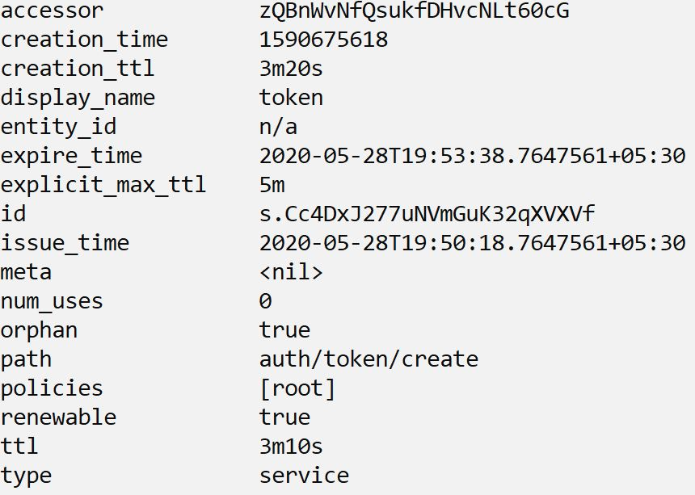
Quiz
What type of token is shown in the following screenshot?
A. Child token
B. Parent token
C. Sub token
D. User token
Copyright © 2021 by Elephant Scale, All Rights Reserved
Notes:
B.

Slide 38
Quiz
Matthew wants to see which policies are associated with a specific token. Which of the following command is the ideal way of achieving the lookup?
A. vault token lookup [ROOT TOKEN]
B. vault token lookup -accessor [CLIENT TOKEN]
Copyright © 2021 by Elephant Scale, All Rights Reserved
Notes:
B.

Slide 39
Quiz
The attacker was able to fetch the Accessor information associated with a token. Will he be able to reverse engineer a ROOT token from the accessor?
A. True
B. False
Copyright © 2021 by Elephant Scale, All Rights Reserved
Notes:
B.

Slide 40
Quiz
The secure application was receiving ciphertext data from the Transit Secret Engine. An attacker was able to intercept the data successfully. What should be the next steps that a Vault Administrator can perform according to best practice?
A. Nothing. Since it is ciphertext, the attacker will not be able to decrypt it
B. Rotate the encryption key and set the "minimum to decrypt" version to the latest version of the key
C. Delete and re-create a new transit secrets engine
D. None of the above
Copyright © 2021 by Elephant Scale, All Rights Reserved
Notes:
B.

Slide 41
Quiz
When Dynamic Secrets are created in Vault, what attribute is used to further renew or revoke these secret?
A. Secret name
B. Vault accessor
C. Nothing is needed
D. revocation_id
E. lease_id
Copyright © 2021 by Elephant Scale, All Rights Reserved
Notes:
E.

Slide 42
Quiz
When Dynamic Secrets are created in Vault, what attribute is used to further renew or revoke these secret?
A. vault user login
B. vault register
C. vault auth
D. vault login
Copyright © 2021 by Elephant Scale, All Rights Reserved
Notes:
D.

Slide 43
Quiz
Can the userpass auth method in Vault read the usernames from external database like Active Directory?
A. True
B. False
Copyright © 2021 by Elephant Scale, All Rights Reserved
Notes:
B.

Slide 44
Quiz
When Vault is first initialized, which one is among the default authentication methods available?
A. userpass
B. AppRole
C. GitHub
D. Tokens
Copyright © 2021 by Elephant Scale, All Rights Reserved
Notes:
D.

Slide 45
Quiz
Vault Policies are designed to be deny by default?
A. True
B. False
Copyright © 2021 by Elephant Scale, All Rights Reserved
Notes:
A.

Slide 46
Quiz
Alice needs to revoke all the secrets on a specific path. Which of the following commands can be used?
A. vault revoke -all <path>
B. vault secret revoke -all <path>
C. vault lease revoke -all <path>
D. vault lease revoke -prefix <path>
Copyright © 2021 by Elephant Scale, All Rights Reserved
Notes:
D.

Slide 47
Quiz
Does Vault trust the storage backend by default?
A. True
B. False
Copyright © 2021 by Elephant Scale, All Rights Reserved
Notes:
B.

Slide 48
Quiz
What is the maximum TTL of a token if no explict TTL is specified?
A. 10 days
B. 24 hours
C. 30 days
D. 32 days
E. Unlimited
Copyright © 2021 by Elephant Scale, All Rights Reserved
Notes:
D.

Slide 49
Quiz
Which command is used to renew a vault token?
A. vault renew token
B. vault token update
C. vault token renew
D. vault modify token
Copyright © 2021 by Elephant Scale, All Rights Reserved
Notes:
C.

Slide 50
Quiz
Unsealing Vault creates the encryption keys, which is used to unencrypt the data on the storage backend
A. True
B. False
Copyright © 2021 by Elephant Scale, All Rights Reserved
Notes:
B.

Slide 51
Quiz
Which of the following best describes a token accessor?
A. Describes the value associated with the token TTL
B. A value that acts as a reference to a token and can only be used to perform limited actions
C. A value that describes which clients have access to the attached token
D. A token used for Consul to access Vault auth methods
Copyright © 2021 by Elephant Scale, All Rights Reserved
Notes:
B.

Slide 52
Quiz
In order to extend Vault beyond a data center or cloud regional boundary, what feature should be used?
A. Vault plugins
B. Vault authentication
C. Vault replication
D. Vault extender
Copyright © 2021 by Elephant Scale, All Rights Reserved
Notes:
C.

Slide 53
Quiz
Which is the right command to enable the AWS Secret engine via CLI?
A. vault secrets aws enable
B. vault enable secrets aws
C. vault secrets enable aws
D. vault enable aws secrets engine
Copyright © 2021 by Elephant Scale, All Rights Reserved
Notes:
C.

Slide 54
Quiz
When the parent tokens are revoked, what happens to the child tokens?
A. Child tokens continue to exist till the lease expires
B. Child tokens will be converted to parent tokens
C. Child tokens will also be revoked
D. None of the above
Copyright © 2021 by Elephant Scale, All Rights Reserved
Notes:
C.

Slide 55
Quiz
Which among the authentication methods below is recommended when application running on a server needs to perform operations on Vault?
A. GitHub
B. SSH
C. Tokens
D. AppROle
E. SSO provider like Okta
Copyright © 2021 by Elephant Scale, All Rights Reserved
Notes:
D.

Slide 56
Quiz
Which feature in vault allows users to generate code for MFA similar to Google Authenticator?
A. Cubbyhole secrets engine
B. Random byte generator
C. TOTP secrets engine
D. Identity secrets engine
E. OTP feature
Copyright © 2021 by Elephant Scale, All Rights Reserved
Notes:
C.

Slide 57
Quiz
Which port does Vault use for API communication?
A. 7900
B. 8201
C. 8200
D. 8022
Copyright © 2021 by Elephant Scale, All Rights Reserved
Notes:
C.

Slide 58
Quiz
Which among the following token types do not have a TTL associated with them?
A. Service tokens
B. Batch tokens
C. Parent tokens
D. Child tokens
E. Root tokens
Copyright © 2021 by Elephant Scale, All Rights Reserved
Notes:
E.

Slide 59
Quiz
You have opened up the Vault UI however instead of asking the token, the vault is showing the following information that needs to be entered:
Key Shares
Key Threshold
What might be the cause?
A. The URL of Vault is incorrect
B. The storage backend of the Vault is not configured correctly
C. The Vault needs to be initialized and unsealed before it can be used
D. None of the above
Copyright © 2021 by Elephant Scale, All Rights Reserved
Notes:
C.

Slide 60
Quiz
A Vault client who has read access to the path secrets/apps/app1 is having trouble viewing the secret in the user interface (UI) but can access via the API. What can be done to resolve this issue?
A. Modify the policy to allow the create permission
B. Remove the deny policy blocking access to the secrets/apps/app1 path
C. Add list to the policy, so the user can browse the paths leading up to the key/value's path
D. Add read permission to the path secrets/apps
Copyright © 2021 by Elephant Scale, All Rights Reserved
Notes:
C.

