Slide 1
OT Cybersecurity Overview
Copyright © 2021 by Elephant Scale, All Rights Reserved

Slide 2
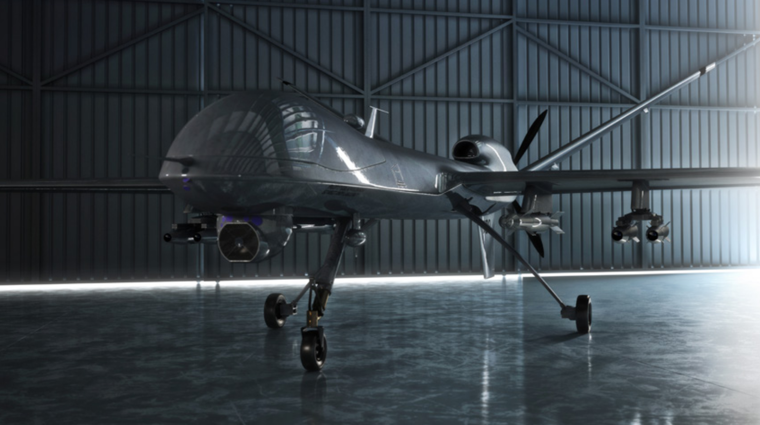
Trends and directions
Trends
As data collection and analysis become more important
IT and OT converge to enable “big data” initiatives
Directions
it has become necessary to reassess cybersecurity best practices
for protecting OT
Copyright © 2021 by Elephant Scale, All Rights Reserved
Notes:
The plan described in the following slides follows the direction suggested in the "Comprehensive Guide to Operational Technology Cybersecurity" eBook by MissionSecure company

Slide 3
OT security
What is Operational Technology (OT) Cybersecurity?
Operational technology (OT) cybersecurity references
software, hardware, practices, personnel, and services
deployed to protect operational technology infrastructure, people, and data.
IT and OT converge to enable “big data”
Copyright © 2021 by Elephant Scale, All Rights Reserved
Notes:
As data collection and analysis become more important, and as IT and OT converge to enable “big data” initiatives, it has become necessary to reassess cybersecurity best practices for protecting OT.

Slide 4

OT History
Third Industrial Revolution
We are in it, going to Fourth
Programmable logic controller (PLC)
Control Systems
Copyright © 2021 by Elephant Scale, All Rights Reserved
Notes:
The need for industrial controls arose with the first Industrial Revolution of the 1700s. Converting steam into usable energy was difficult and dangerous; it took decades to perfect a governor that could control the speed of steam engine output to truly tame this new power source. Each subsequent industrial revolution (we are currently into the fourth) has driven, or was driven by, further developments in controls on physical systems.
The Last Modern Era: Third Industrial Revolution
A major advance in industrial controls was the ability to automate multiple steps in a manufacturing process. To enable this type of operation, engineers developed electrically operated on/off switches, called relays, which could be combined to perform logical operations. This type of control logic appeared on manufacturing lines as early as 1900. Relays work great, but to modify the logic you had to rip out the hardware stack and re-wire it with a new relay configuration. Even if you only had to do this once a year, say when moving to a new product model on a production line, it was costly and time-consuming.
Programmable Logic Controllers The programmable logic controller (PLC), first designed in 1971, was created as a replacement for traditional relay stacks. PLCs applied electronics to production automation for the first time, thereby launching the third Industrial Revolution. The invention of the PLC made creating and modifying control logic much easier, and it quickly became the foundation for simple but powerful control loop systems, which consist of a sensor, controller (e.g., PLC), and actuator.
Control Systems From these simple process loops, very complex behavior can be modeled and controlled with nested and/or cascading architectures. Logic can be built to control continuous manufacturing processes, such as those found in a refinery or chemical plant, and batch manufacturing processes, such as is found on an assembly line. Control systems also found their way into distributed applications such as electrical power grids, railways, and pipelines.

Slide 5

SCADA
Supervisory Control and Data Acquisition (SCADA) Systems
Human-Machine Interface (HMI)
Distributed Control Systems (DCS)
Copyright © 2021 by Elephant Scale, All Rights Reserved
Notes:
Often in distribution system applications, data acquisition is as important as control. Historically, Supervisory Control and Data Acquisition (SCADA) systems have been used to integrate data acquisition systems (sensors) with data transmission systems and data presentation solutions that support Human- Machine Interface (HMI) software, creating centralized visibility into an entire system, such as an electric grid.
Distributed Control Systems (DCS) Distributed Control Systems (DCS) provide a similar set of functionalities as SCADA but on the scale of a factory, and typically with less complexity, or at least diversity, in networking and communications channels.

Slide 6
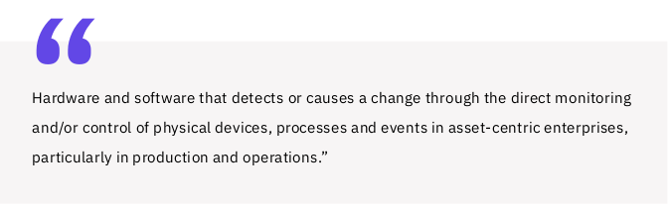
ICS and OT
Copyright © 2021 by Elephant Scale, All Rights Reserved
Notes:
All of the technologies we have discussed have historically been rolled up under the heading of industrial control systems (ICS). However, the use of the term operational technology (OT), in contradistinction to IT, has become popular in recent years. The analyst firm Gartner defines OT as...
This definition makes it clear that the distinction between OT and ICS is not so much in the core functionality of OT but more in the recognition of an evolving definition of “asset-centric” enterprises, with OT now finding application far beyond the traditional “industrial” industries where ICS has found a home for the last 50 years.

Slide 7

IoT and IIoT
Like OT, IoT utilizes devices such as actuators and sensors
IoT architectures are fairly streamlined compared with OT
When applied to industrial applications
Industrial Internet of Things (IIoT)
Copyright © 2021 by Elephant Scale, All Rights Reserved

Slide 8
Examples of IoT devices
Electricity/Gas/Water Smart Meters
Smart Home
Building Automation
Vehicle Head Unit
Security & Fire Alarms
Inventory Management
CCTV
Healthcare Monitoring
Assisted Living Monitoring
Copyright © 2021 by Elephant Scale, All Rights Reserved
Notes:
IoT leverages several new technologies that have significantly reduced the difficulty and cost of deploying monitoring and control systems, particularly in highly geographically distributed environments. These technologies include real-time analytics, commodity sensors, sophisticated embedded systems, cloud storage and computing, and 5G networks. The sophistication of analytics, the ubiquity of bandwidth—wired and wireless— and the low price of data storage and compact multi- purpose sensors have all converged to make it much cheaper and easier to collect, analyze and act, on massive amounts of data about the world around us.

