Slide 1
Vault Architecture
Copyright © 2021 by Elephant Scale, All Rights Reserved

Slide 2

Imagine going on vacation
The receptionist asks for your identity
After it is verified, you get the room key
With Vault, it is just as easy
Copyright © 2021 by Elephant Scale, All Rights Reserved
Notes:
Imagine that someone is taking a vacation to a beautiful and exotic location.
Their trip would begin with their arrival at the hotel to check in to their room.
At the front desk, the receptionist asks for the person to prove their identity by providing credentials.
The receptionist would then check their credentials against the hotel record on file and determine that they are whom they say they are.
After verifying the guest's identity, the receptionist would issue the guest a room key.
The specific level of access granted to the guest would depend on the guest's relationship with the hotel.
Where a first-time guest might only receive access to their room and the hotel gym, a returning guest may also receive access to the guest lounge for their loyalty.

Slide 3
Hotel entry
Hotel guest
Many entrances
Vault client
Variety of interfaces
API
CLI
UI
Copyright © 2021 by Elephant Scale, All Rights Reserved

Slide 4
Hotel protection
Hotel
Walls and dooar
Vault
cryptographic barrier
responsible for encrypting all information stored by Vault
Copyright © 2021 by Elephant Scale, All Rights Reserved

Slide 5
Hotel guests
Guest objective
Access their rooms
First, they check in
Vault client objective
Access data from a secrets engine
First, they authenticate
Vault validates the credentials of the user
through a configured auth method
to ensure those credentials are valid
Vault issues a token
Copyright © 2021 by Elephant Scale, All Rights Reserved

Slide 6
Vault's token
Token is issued to the client
Based on the policy for that user
Token permits access to different endpoints in Vault, called paths
Token has a time-to-live (TTL)
Copyright © 2021 by Elephant Scale, All Rights Reserved

Slide 7
Vault basic components
Paths
Secrets engines
Auth methods
Tokens
Policies
Copyright © 2021 by Elephant Scale, All Rights Reserved

Slide 8
Paths
the basic building blocks of Vault
every endpoint in Vault is accessible through a path
paths provide access to
secrets engines
policies
auth methods
static secret values
system health information.
Copyright © 2021 by Elephant Scale, All Rights Reserved
Notes:
Paths are the basic building blocks of Vault.
Like the hallways of a hotel, every endpoint in Vault is accessible through a path.
These paths provide access to everything within Vault, including secrets engines, policies, auth methods, static secret values, and system health information.
After a component is enabled in Vault, all interactions with that component are performed using the associated path.
Even Vault's administrative functions are configured using a path.

Slide 9

Secrets engines
Secrets Engines Secrets engines provide Vault's core functionality
Each secrets engine has its own specific function
static secret data
short-lived, dynamic credentials
encrypt plaintext data in transit
Copyright © 2021 by Elephant Scale, All Rights Reserved
Notes:
Secrets Engines Secrets engines provide Vault's core functionality, and without secrets engines, there is no point in deploying Vault.
The specific function of each secrets engine, however, can vary. Some secrets engines store static secret data, while other secrets engines can generate a set of short-lived, dynamic credentials. Some can even encrypt plaintext data in transit.
All other Vault components can be seen as supporting components to secrets engines.

Slide 10
Auth methods
Auth methods are responsible for
assessing identity
assigning a set of policies to a user or machine.
validate authentication requests
method examples
Active Directory
LDAP
GitHub
Kubernetes
Okta
Copyright © 2021 by Elephant Scale, All Rights Reserved
Notes:
Auth Methods Auth methods are responsible for assessing identity and assigning a set of policies to a user or machine.
Like the front desk at a hotel, auth methods validate authentication requests
through the configured identity provider
to ensure the credentials are valid before granting access to services.
Examples of auth methods include Active Directory, LDAP, GitHub, Kubernetes, Okta,
and identity management services on the major cloud providers.

Slide 11
Tokens
Tokens are the core method of authentication within Vault.
configured to use tokens directly as an authentication mechanism, or
an auth method can be used to generate dynamic tokens based on external identities
Copyright © 2021 by Elephant Scale, All Rights Reserved
Notes:
Tokens are the core method of authentication within Vault.
Vault can be configured to use tokens directly as an authentication mechanism,
or an auth method can be used to generate dynamic tokens based on external identities.
Regardless of how Vault clients authenticate to Vault, a token will be used for all subsequent requests.

Slide 12
Policies
Policies determine the level of access an entity has to a particular path
or the data contained therein once the entity has authenticated.
Permissions: "CRUD"
applied to a particular path and associated with specific Vault clients
or applied service-wide
Copyright © 2021 by Elephant Scale, All Rights Reserved
Notes:
Policies determine the level of access an entity has to a particular path or the data contained therein once the entity has authenticated.
Permissions defined inside of these policies follow the typical "CRUD" model of access: Create, Read, Update, Delete.
These permissions or "capabilities" are applied to a particular path and associated with specific Vault clients or applied service-wide.
Certain "parameters" can be associated with the policies to tighten security controls around specific actions further.
In summary, while auth methods handle authentication to Vault, policies control authorization to Vault components once a client has successfully authenticated.

Slide 13
Terminology
Storage Backend
Barrier
Secrets Engine
Audit Device
Auth Method
Client Token
Secret
Server
Copyright © 2021 by Elephant Scale, All Rights Reserved
Notes:
Storage Backend - A storage backend is responsible for durable storage of encrypted data. Backends are not trusted by Vault and are only expected to provide durability. The storage backend is configured when starting the Vault server.
Barrier - The barrier is cryptographic steel and concrete around the Vault. All data that flows between Vault and the storage backend passes through the barrier. The barrier ensures that only encrypted data is written out, and that data is verified and decrypted on the way in. Much like a bank vault, the barrier must be "unsealed" before anything inside can be accessed.
Secrets Engine - A secrets engine is responsible for managing secrets. Simple secrets engines like the "kv" secrets engine simply return the same secret when queried. Some secrets engines support using policies to dynamically generate a secret each time they are queried. This allows for unique secrets to be used which allows Vault to do fine-grained revocation and policy updates. As an example, a MySQL secrets engine could be configured with a "web" policy. When the "web" secret is read, a new MySQL user/password pair will be generated with a limited set of privileges for the web server.
Audit Device - An audit device is responsible for managing audit logs. Every request to Vault and response from Vault goes through the configured audit devices. This provides a simple way to integrate Vault with multiple audit logging destinations of different types.
Auth Method - An auth method is used to authenticate users or applications which are connecting to Vault. Once authenticated, the auth method returns the list of applicable policies which should be applied. Vault takes an authenticated user and returns a client token that can be used for future requests. As an example, the userpass auth method uses a username and password to authenticate the user. Alternatively, the github auth method allows users to authenticate via GitHub.
Client Token - A client token (aka "Vault Token") is conceptually similar to a session cookie on a web site. Once a user authenticates, Vault returns a client token which is used for future requests. The token is used by Vault to verify the identity of the client and to enforce the applicable ACL policies. This token is passed via HTTP headers.
Secret - A secret is the term for anything returned by Vault which contains confidential or cryptographic material. Not everything returned by Vault is a secret, for example system configuration, status information, or policies are not considered secrets. Secrets always have an associated lease. This means clients cannot assume that the secret contents can be used indefinitely. Vault will revoke a secret at the end of the lease, and an operator may intervene to revoke the secret before the lease is over. This contract between Vault and its clients is critical, as it allows for changes in keys and policies without manual intervention.
Server - Vault depends on a long-running instance which operates as a server. The Vault server provides an API which clients interact with and manages the interaction between all the secrets engines, ACL enforcement, and secret lease revocation. Having a server based architecture decouples clients from the security keys and policies, enables centralized audit logging and simplifies administration for operators.

Slide 14
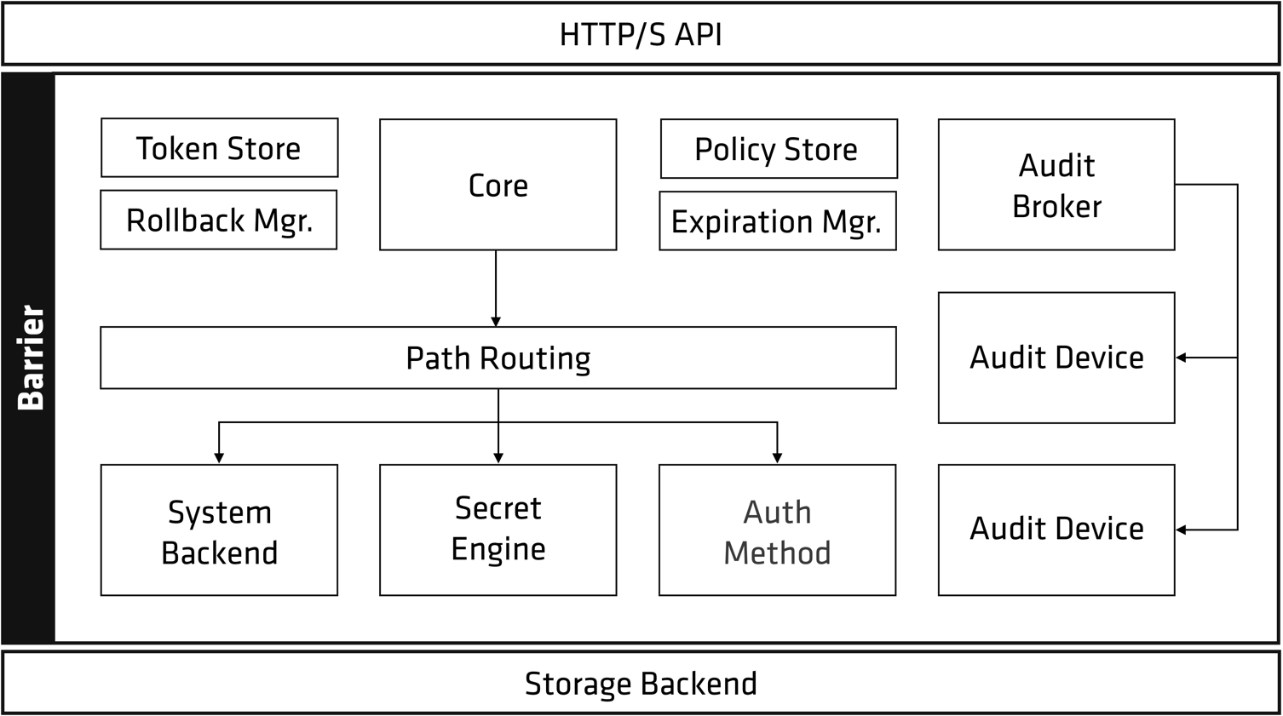
Vault architecture
Copyright © 2021 by Elephant Scale, All Rights Reserved
Notes:
Let's begin to break down this picture. There is a clear separation of components that are inside or outside of the security barrier. Only the storage backend and the HTTP API are outside, all other components are inside the barrier.
The storage backend is untrusted and is used to durably store encrypted data. When the Vault server is started, it must be provided with a storage backend so that data is available across restarts. The HTTP API similarly must be started by the Vault server on start so that clients can interact with it.

Slide 15
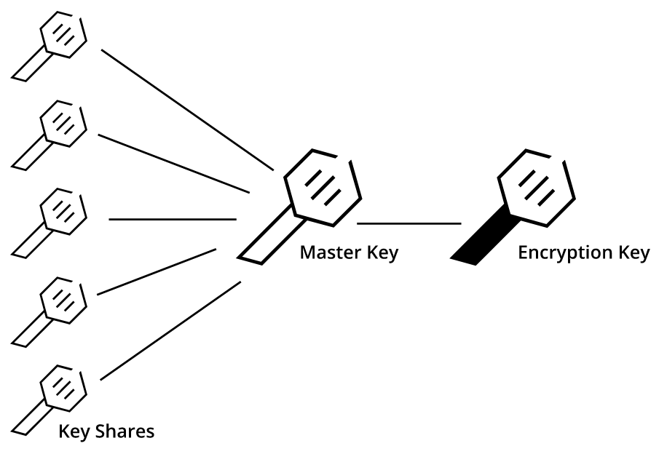
Vault starts sealed
Copyright © 2021 by Elephant Scale, All Rights Reserved
Notes:
Once started, the Vault is in a sealed state.
Before any operation can be performed on the Vault it must be unsealed. This is done by providing the unseal keys.
When the Vault is initialized it generates an encryption key which is used to protect all the data. That key is protected by a master key.
By default, Vault uses a technique known as Shamir's secret sharing algorithm to split the master key into 5 shares, any 3 of which are required to reconstruct the master key.

Slide 16

RSA inventors
Copyright © 2021 by Elephant Scale, All Rights Reserved
Notes:
The number of shares and the minimum threshold required can both be specified. Shamir's technique can be disabled, and the master key used directly for unsealing. Once Vault retrieves the encryption key, it is able to decrypt the data in the storage backend, and enters the unsealed state. Once unsealed, Vault loads all of the configured audit devices, auth methods, and secrets engines.
The configuration of those audit devices, auth methods, and secrets engines must be stored in Vault since they are security sensitive. Only users with the correct permissions should be able to modify them, meaning they cannot be specified outside of the barrier. By storing them in Vault, any changes to them are protected by the ACL system and tracked by audit logs.

Slide 17
Now Vault is unsealed
After the Vault is unsealed
requests can be processed from the HTTP API to the Core.
The core is used to
manage the flow of requests through the system,
enforce ACLs, and
ensure audit logging is done.
The client needs to authenticate.
Vault provides configurable auth methods
Provides flexibility in the authentication mechanism used
Copyright © 2021 by Elephant Scale, All Rights Reserved
Notes:
After the Vault is unsealed, requests can be processed from the HTTP API to the Core. The core is used to manage the flow of requests through the system, enforce ACLs, and ensure audit logging is done.
When a client first connects to Vault, it needs to authenticate. Vault provides configurable auth methods providing flexibility in the authentication mechanism used. Human friendly mechanisms such as username/password or GitHub might be used for operators, while applications may use public/private keys or tokens to authenticate. An authentication request flows through core and into an auth method, which determines if the request is valid and returns a list of associated policies.

Slide 18
Policies
Policies are just a named ACL rule
Example:
the "root" policy is built-in and permits access to all resources
Copyright © 2021 by Elephant Scale, All Rights Reserved
Notes:
Policies are just a named ACL rule. For example, the "root" policy is built-in and permits access to all resources. You can create any number of named policies with fine-grained control over paths. Vault operates exclusively in a whitelist mode, meaning that unless access is explicitly granted via a policy, the action is not allowed. Since a user may have multiple policies associated, an action is allowed if any policy permits it. Policies are stored and managed by an internal policy store. This internal store is manipulated through the system backend, which is always mounted at sys/.
Once authentication takes place and an auth method provides a set of applicable policies, a new client token is generated and managed by the token store. This client token is sent back to the client, and is used to make future requests. This is similar to a cookie sent by a website after a user logs in. The client token may have a lease associated with it depending on the auth method configuration. This means the client token may need to be periodically renewed to avoid invalidation.
Once authenticated, requests are made providing the client token. The token is used to verify the client is authorized and to load the relevant policies. The policies are used to authorize the client request. The request is then routed to the secrets engine, which is processed depending on its type. If the secrets engine returns a secret, the core registers it with the expiration manager and attaches a lease ID. The lease ID is used by clients to renew or revoke their secret. If a client allows the lease to expire, the expiration manager automatically revokes the secret.
The core handles logging of requests and responses to the audit broker, which fans the request out to all the configured audit devices. Outside of the request flow, the core performs certain background activity. Lease management is critical, as it allows expired client tokens or secrets to be revoked automatically. Additionally, Vault handles certain partial failure cases by using write ahead logging with a rollback manager. This is managed transparently within the core and is not user visible.

Slide 19

The Vault Service Process
Phase 1 - Preparation
Phase 2 - User Interaction
Phase 3 - Cleanup
Copyright © 2021 by Elephant Scale, All Rights Reserved
Notes:
There are many aspects to preparing Vault to handle client requests on a day-to-day basis.
Generally, there are three phases to prepare a production-ready Vault environment: the configuration, the client interaction, and post-client events.
Each phase is uniquely essential to building a working Vault environment.

Slide 20
Phase 1 - Preparation
The database secrets engine must be configured with an administrative credential
An auth method must be configured to permit access
A Vault policy that grants permission to the database secrets engine needs to be
Copyright © 2021 by Elephant Scale, All Rights Reserved
Notes:
The first phase involves the actions performed by an administrator to enable user interaction. Before a Vault client can retrieve a database credential from Vault, for example, there are configuration items that must be in place:
The database secrets engine must be configured with an administrative credential capable of creating dynamic user accounts with appropriate permissions on the target database.
An auth method must be configured to permit access to the entity requesting access to the database.
A Vault policy that grants permission to the database secrets engine needs to be created and attached to the entity.

Slide 21
Phase 2 - User Interaction
This phase is interaction from the user
When a client sends a request to Vault
the request is initiated using TLS
verify the identity of the Vault service and
establish secure communication with it
Copyright © 2021 by Elephant Scale, All Rights Reserved

Slide 22
The basic workflow of client interaction with Vault
The client sends an authentication request to Vault, specifying the auth method and credentials to be used.
Vault forwards those credentials to the appropriate authentication backend for verification.
Vault receives approval returns an access token
The Vault client uses the access token to issue a read
Vault validates the token
If permitted, Vault will use pre-configured database credentials to generate temporary database credentials
Copyright © 2021 by Elephant Scale, All Rights Reserved
Notes:
The client sends an authentication request to Vault, specifying the auth method and credentials to be used.
Vault forwards those credentials to the appropriate authentication backend for verification.
Vault receives approval from the appropriate authentication backend and returns an access token to the requestor based on the policies associated with the requestor.
The Vault client uses the access token to issue a read request to the associated path to generate database credentials.
Vault validates the token and the associated policy to determine whether access to a database credential should be granted.
If the token is permitted to access the requested path, Vault will use pre-configured database credentials to generate temporary database credentials based on the policy associated with the requestor. The database credentials are returned to the requestor.

Slide 23
Phase 3 - Cleanup
Once user interaction is complete,
Vault needs to clean up the token.
When a token or other credential is provisioned by Vault,
it is associated with a TTL or "lease."
This lease may be
time-based, such as 24 hours,
defined by a set number of uses.
After the lease expires,
the tokens are revoked, and
the associated credentials are removed automatically by Vault.
Copyright © 2021 by Elephant Scale, All Rights Reserved

Slide 24
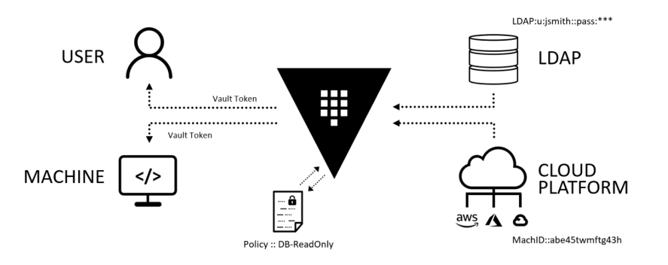
Database example
Copyright © 2021 by Elephant Scale, All Rights Reserved
Notes:
Figure 1-1 illustrates the database example, where a Vault client needs access to database credentials to read data inside the database.
Phase 1 of this example includes the configuration of the LDAP and Cloud auth method, the policy creation, and the database secrets engine configuration.
When a Vault client sends an authentication request using LDAP, for example, the workflow in Phase 2 is executed.
The client obtains a token and requests database credentials.
Once the client interaction is completed, the token will expire, and the database credentials will be revoked.

Slide 25
Philosophy of Vault
The intent and philosophy of Vault is to build security
into automated processes
that utilize temporary credentials
whether for a specific duration or one-time use.
The ultimate goal
migrate from static credentials and identities that require periodic manual rotation *.
Of course, this workflow can still be leveraged for static secrets as well.
Copyright © 2021 by Elephant Scale, All Rights Reserved

Slide 26
Interacting with Vault
It is critical for developers and Vault operators to understand
the details of the user interaction process
as they add integrations.
The previous section introduced this process at a high-level
Additional context on the day-to-day use of Vault
will significantly benefit the consumers of the Vault service.
Copyright © 2021 by Elephant Scale, All Rights Reserved

Slide 27
The Vault API
Secrets Engines
provide the core functionality of Vault
maintain static values
generate dynamic credentials
perform cryptographic functions.
Auth Methods
validating authentication requests from Vault clients
authorizing the user to perform actions in Vault
System Backend
Intended primarily for service administrators
configure the components and features within Vault
Copyright © 2021 by Elephant Scale, All Rights Reserved
Notes:
Every interaction with Vault happens through the API, regardless of the entry point. Even when clients interact with the CLI or web interface, the actions requested are performed using the API. While the CLI and web interface are friendlier to end users, they do not support all the actions that can be made by using the API directly. The API is divided into three main sections:
Secrets Engines
These provide the core functionality of Vault. Secrets engines can maintain static values, generate dynamic credentials, or perform cryptographic functions.
Auth Methods
These are responsible for validating authentication requests from Vault clients and authorizing the user to perform actions in Vault. HashiCorp Vault can use an external identity provider for authentication or provide internal identity management for granting access to secrets.
System Backend
This endpoint is intended primarily for service administrators to configure the components and features within Vault. The system backend can also be used by external services to monitor Vault, such as a third-party monitoring solution or a load balancer health check.

Slide 28
Vault Interfaces
Using the API
Programmatic interaction with Vault occurs when an application or service calls the Vault API
Using the CLI
Before configuring traditional application integration with the API, the CLI is often used to configure Vault
Using the Web UI
The Vault UI is accessible using modern web browsers *The UI can be accessed using the DNS name or hostname of the cluster and the configured port of the listener.
Copyright © 2021 by Elephant Scale, All Rights Reserved
Notes:
Using the API
Programmatic interaction with Vault occurs when an application or service calls the Vault API. This method should be the most common form of interaction with Vault. Interaction using the API is what Vault was designed for – a completely hands-off, automated secrets management experience. Automating complex tasks removes the human element, reduces organizational risk, and improves security.
Using the CLI
Before configuring traditional application integration with the API, the CLI is often used to configure Vault. The CLI simplifies the administration of the Vault service when performing initial Vault tasks, such as migrating secrets to Vault. Once the initial configuration has concluded, most of the day-to-day interactions can move to a programmatic function. Almost all the accessible API paths are available in the CLI, with few exceptions.
The CLI is the ideal method for Vault operators or users who might be more comfortable using a command line to perform manual interactions with Vault instead of clicking around in the web interface. Interaction through the CLI occurs through the same binary that is used to operate the Vault service. A user may issue CLI commands directly on a Vault node, or the binary may be downloaded on a local workstation to streamline access to Vault.
Using the Web UI
The Vault UI is accessible using modern web browsers. The UI can be accessed using the DNS name or hostname of the cluster and the configured port of the listener. For some users, the web interface is the most appropriate choice for accessing Vault. Although Vault was not initially designed with a user interface in mind, the web UI has quickly become a focus of development. Recent Vault releases have included significant improvements to the UI, adding new features and capabilities. The most common tasks a user or administrator might need to perform can be executed using the Vault web UI.

Slide 29
General Consumer Interaction
Basic human actions executed against the Vault service.
authenticate with Vault
receive an access token
use the token to manage Vault or read a secret.
Copyright © 2021 by Elephant Scale, All Rights Reserved
Notes:
General consumer interactions consist of the basic human actions executed against the Vault service. This type of interaction is often how users first approach Vault when the 20service is initially deployed. Under this category of interaction, a human user would authenticate with Vault, receive an access token, and use the token to manage Vault or read a secret.
Many of the standard authentication providers used today, such as directory services, OIDC solutions, or public cloud identity services, can be leveraged to validate human users.

Slide 30
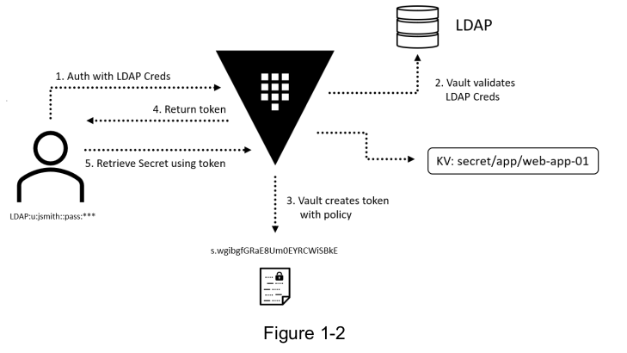
General Consumer Interaction
Copyright © 2021 by Elephant Scale, All Rights Reserved
Notes:
Example:
Jane Smith needs to retrieve the latest value of the root password for one of the Linux hosts she manages.
Jane uses the Vault CLI to log in to Vault using her LDAP username and password.
Once authenticated, Vault returns an access token to Jane. Jane then uses that access token to retrieve the value of the desired secret from a specific path in Vault.

Slide 31
Administrative Interaction
Human entity usually performs administrative interactions during both the deployment and initial management phases of the Vault service.
Tend to shift to programmatic interactions as the service matures
However, administrative interactions shift toward management of the Vault service rather than the management of secrets.
Copyright © 2021 by Elephant Scale, All Rights Reserved
Notes:
Like consumer interactions, a human entity usually performs administrative interactions during both the deployment and initial management phases of the Vault service. The administrative interactions also tend to shift to programmatic interactions as the service matures and grows.
However, administrative interactions shift toward management of the Vault service rather than the management of secrets.

Slide 32
More Administrative Interaction
It is common to use Endpoint Governing Policies (EGPs) to ensure the second factor of authentication is used for privileged users.
For example
all Vault users need to provide an LDAP username and password.
Vault administrators must also use a second factor of authentication, such as an Okta Verify push notification.
Increases the security of privileged user access.
configuring the Okta push to trigger at auth/ldap would initiate an Okta push for all users authenticating through LDAP
Copyright © 2021 by Elephant Scale, All Rights Reserved
Notes:
Vault administrators commonly use the same auth methods that are leveraged by other human users.
However, it is common to use Endpoint Governing Policies (EGPs) to ensure the second factor of authentication is used for privileged users. For instance, all Vault users need to provide an LDAP username and password. However, Vault administrators must also use a second factor of authentication, such as an Okta Verify push notification.
This strategy increases the security of privileged user access. When using an EGP to configure the second factor of authentication, the policy can be written to trigger the second factor based on the path requested.
For instance, configuring the Okta push to trigger at auth/ldap would initiate an Okta push for all users authenticating through LDAP. However, configuring the Okta to push to trigger at auth/ldap/users/jdoe would initiate an Okta push only for Jon Doe.
In this scenario, both the LDAP auth method and Okta MFA provider must be configured in Vault before the EGP can be used for triggering the second factor of authentication.

Slide 33
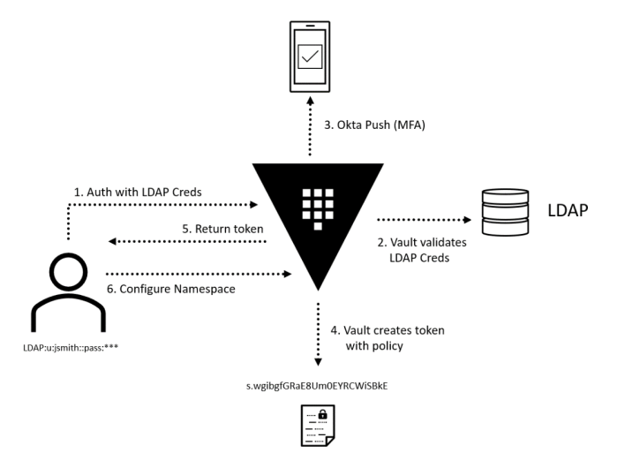
Admin interaction example
Copyright © 2021 by Elephant Scale, All Rights Reserved
Notes:
Jon Doe needs to create a namespace in Vault for a new team onboarding to Vault. Jon uses the Vault CLI to log in to Vault using his LDAP username and password. Jon receives an Okta Verify to verify his identity. Once authenticated, Jon receives an access token from Vault with administrative privileges. Jon uses his token to create and configure a new namespace in Vault.

Slide 34
Security and Compliance Interaction
Security and compliance personnel must ensure the Vault service is secure
security and compliance personnel have secrets that need to be stored and managed.
Also, need to ensure that the Vault service is being consumed in a secure and compliant manner
penetration testing
static code analysis.
Frequently use the Vault audit data to monitor operations using log aggregation and analytics tools
Splunk or an ELK stack
Copyright © 2021 by Elephant Scale, All Rights Reserved
Notes:
While Vault can increase the overall security of integrated applications, security and compliance personnel must ensure the Vault service is secure. The security and compliance team may interact with Vault in a variety of ways.
The first type of interaction is based on a need for secrets management and aligns with general consumer interactions. Typically, security and compliance personnel have secrets that need to be stored and managed.
The security and compliance teams also need to ensure that the Vault service is being consumed in a secure and compliant manner along validating the security of the Vault service.
This would include processes such as penetration testing or static code analysis. To ensure Vault is running and being consumed securely, the security and compliance teams will frequently use the Vault audit data to monitor operations using log aggregation and analytics tools, such as Splunk or an ELK stack.

Slide 35
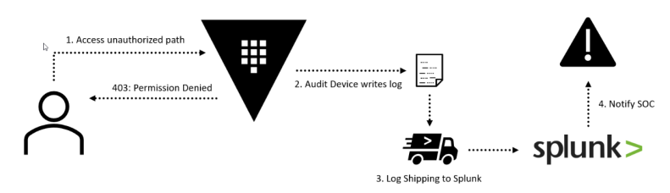
Security flow example
Copyright © 2021 by Elephant Scale, All Rights Reserved
Notes:
Example:
A Vault user authenticates with Vault and receives an access token. The access token is used in an attempt to retrieve a secret that the user does not have access to read.
The user's request is denied, and a log entry for the event is generated through an audit device and ingested into Splunk.
A notable security event is sent to the security operations center (SOC) for investigation

Slide 36
Vault Programmatic Interaction
Vault has robust API
For DevOps and public cloud migration
The
Have the majority of interactions take place through automation using the API directly
authenticate with Vault,
receive a token
use it to retrieve a secret.
AppRole auth method
RoleID (username) and a SecretID (password)
the client receives a token in response that can be used to retrieve a secret.
Copyright © 2021 by Elephant Scale, All Rights Reserved
Notes:
One of Vault’s most compelling features is its robust API, especially in organizations adopting a DevOps culture or migrating applications to the public cloud. The goal is to have the majority of interactions take place through automation using the API directly. This form of interaction requires the entity (usually an application or host) to authenticate with Vault, receive a token, and use it to retrieve a secret. One of the most common auth methods used for this machine-to-machine interaction is the AppRole auth method. This auth method uses a RoleID (username) and a SecretID (password) to authenticate a non-human entity with Vault. As a result of authentication, the client receives a token in response that can be used to retrieve a secret.

Slide 37
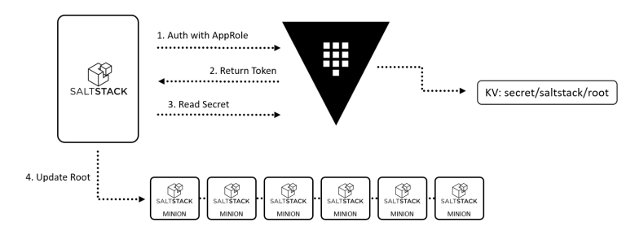
Programmatic Interaction
Copyright © 2021 by Elephant Scale, All Rights Reserved
Notes:
A root password on a group of Linux hosts needs to be rotated.
These hosts are using SaltStack for configuration management.
On the Salt master, a process is triggered to rotate the root password on all Salt minions.
The Salt master uses a RoleID and a SecretID, configured in environment variables, to authenticate with Vault and retrieve a short-lived access token.
The Salt master then uses this token to read a secret value at a specified
path in Vault and sends this value to all attached minions. Once received, each minion updates the local root password with the specified secret value.

