Slide 1
Consul
Consul overview
Microservices
Consul for Service Discovery
Terraform integration
Copyright © 2021 by Elephant Scale, All Rights Reserved

Slide 2
Consul overview
Consul overview Microservices Consul for Service Discovery Terraform integration
Copyright © 2021 by Elephant Scale, All Rights Reserved

Slide 3

Monolith
Copyright © 2021 by Elephant Scale, All Rights Reserved
Notes:
A - login B - Show balance C - Wire transfers D - Foreign exchange
A bug causes a rebuild and redeploy

Slide 4
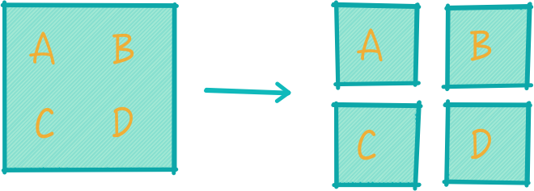
Microservices
Copyright © 2021 by Elephant Scale, All Rights Reserved

Slide 5
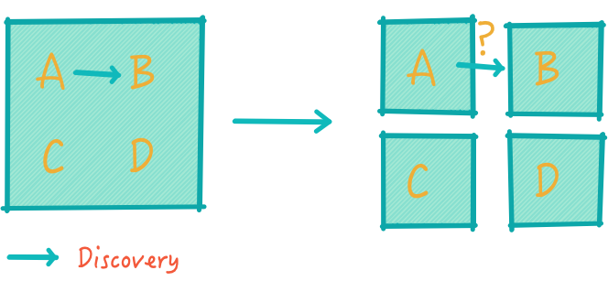
Discovery
Copyright © 2021 by Elephant Scale, All Rights Reserved
Notes:
A talks to B in nanoseconds Now where is B and milliseconds or seconds for latency

Slide 6
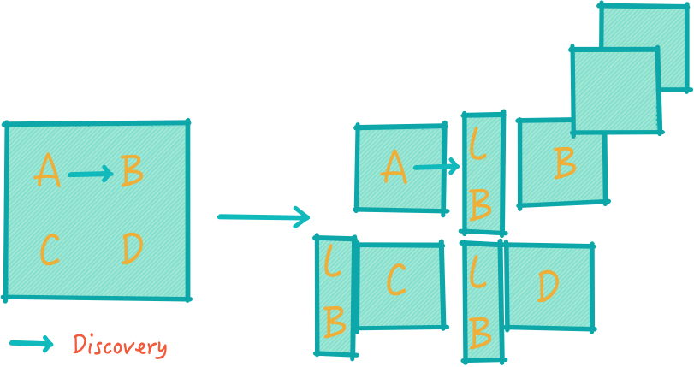
Load balancers?
Copyright © 2021 by Elephant Scale, All Rights Reserved
Notes:
Load balancers
Even scalability
Too many load balancers
Too many SPOFs
Double latency
Load balancing management

Slide 7
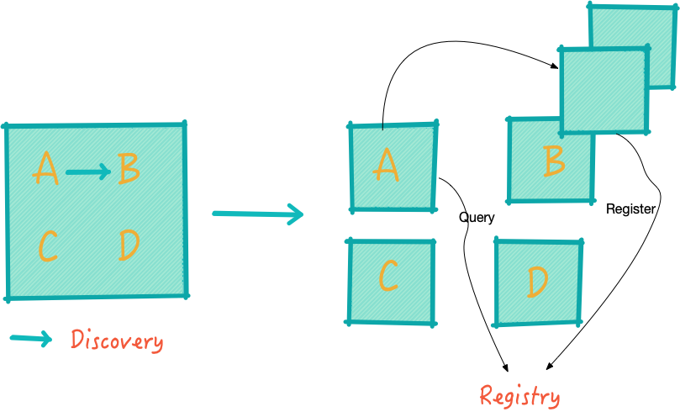
Registry
Copyright © 2021 by Elephant Scale, All Rights Reserved
Notes:
No load balancers
The instance registers

Slide 8
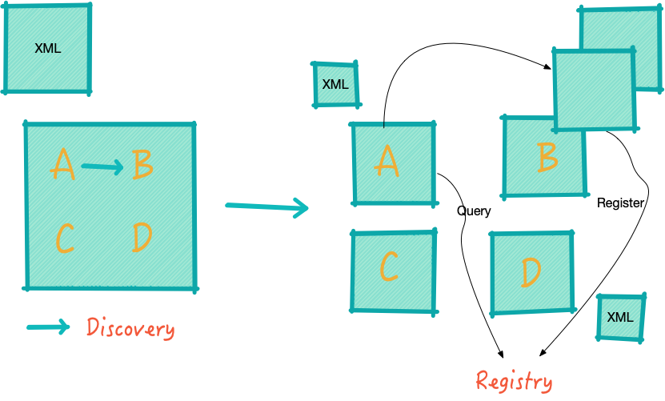
Configuration
Copyright © 2021 by Elephant Scale, All Rights Reserved
Notes:
Before, one configuration file XML, now - many
Such as, are we in maintenance mode

Slide 9
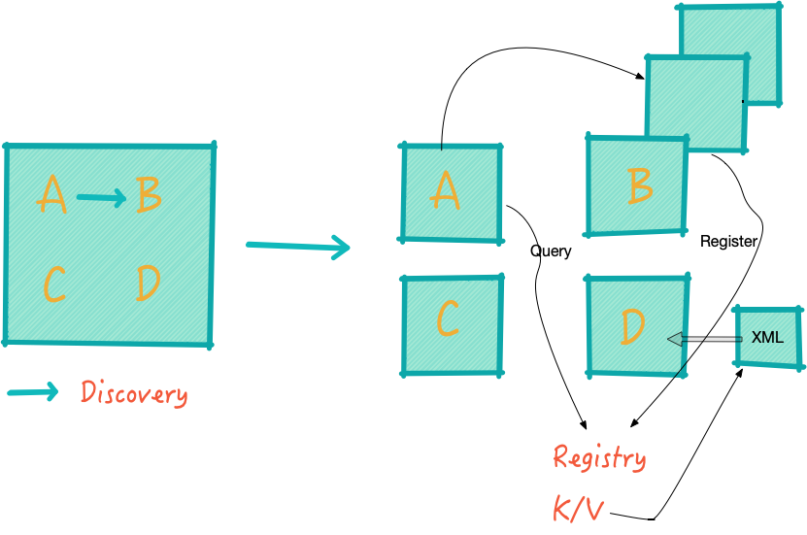
Configuration in Consul
Copyright © 2021 by Elephant Scale, All Rights Reserved
Notes:
Stored as K/V
Pushed to components in real time

Slide 10
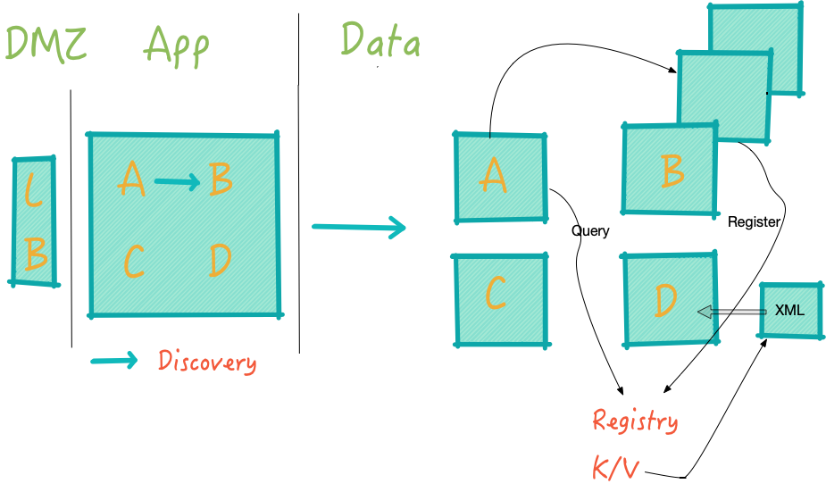
Zones
Copyright © 2021 by Elephant Scale, All Rights Reserved
Notes:
Zones were easy
Three tiers
Now we have multiple front doors and communications
How do we communicate

Slide 11
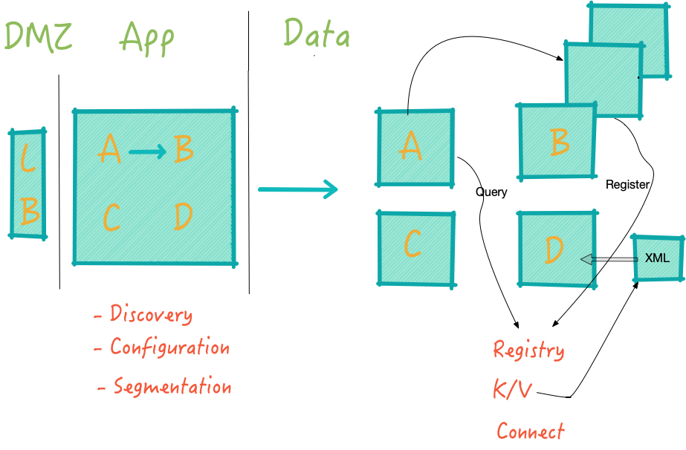
Segmentation
Copyright © 2021 by Elephant Scale, All Rights Reserved
Notes:
Segmentation is done with "Connect" in Consul

Slide 12
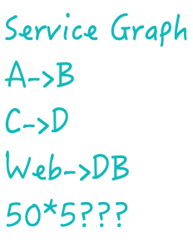
Service graph
Copyright © 2021 by Elephant Scale, All Rights Reserved
Notes:
We were not talking IP to IP
Now we are!
In firewall rules translation, the rules scale dependent on the number of servers

Slide 13
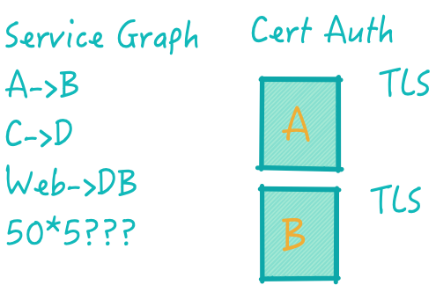
Identity
Copyright © 2021 by Elephant Scale, All Rights Reserved
Notes:
How do we assert identity?
How do we know A is A and B is B
Issue TLS certs to authenticate A and B
This is better than IP that gives now guarantees
But how do we enforce this?

Slide 14
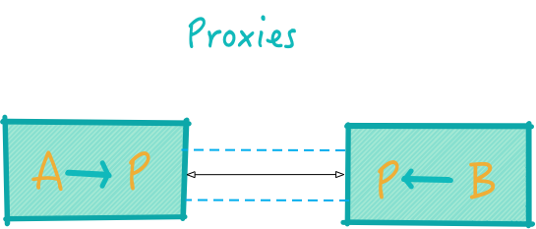
Proxies
Copyright © 2021 by Elephant Scale, All Rights Reserved
Notes:
This translates into a set of proxies
A talks to proxy transparently, unaware than anything has changes
The proxies are using certificate authority: A will verify that it is talking to B and B will verify that it is talking to A
Second advantage of using Mutual TLS is that now you have established an ecrypted channel between them
This is getting more important in light of such regulations ad GDPR
We cannot trust traffic withing our own network. The data is now encrypted both at rest and in transit
A can talk to be and vice versa, but should A be talking tobe at all? This goes back to the service graph and asks if A is allowed to talk to B

Slide 15
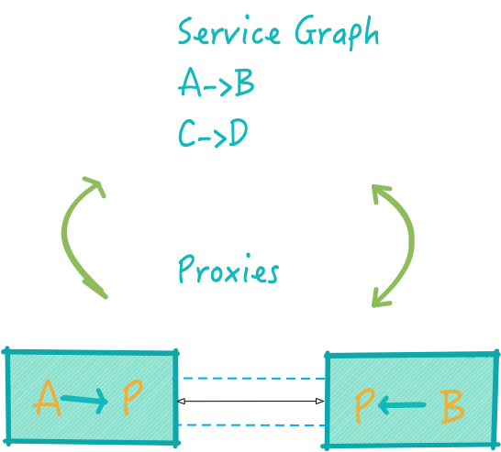
Proxies and Service Graph
Copyright © 2021 by Elephant Scale, All Rights Reserved
Notes:
A can talk to be and vice versa, but should A be talking tobe at all? This goes back to the service graph and asks if A is allowed to talk to B

Slide 16
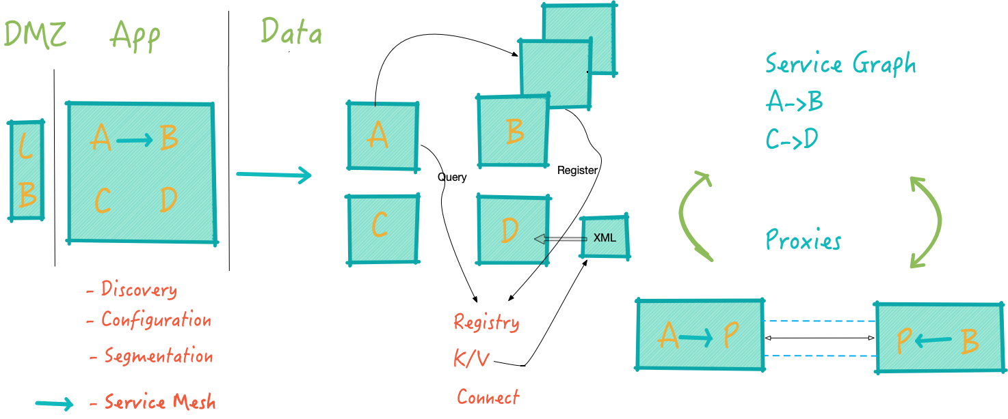
Service mesh
Copyright © 2021 by Elephant Scale, All Rights Reserved
Notes:
We improved the programmer's efficiency
But we got three operational problems
Together they are called Service Mesh - and that is was Consul is set up to address

Slide 17
Microservices
Consul overview Microservices Consul for Service Discovery Terraform integration
Copyright © 2021 by Elephant Scale, All Rights Reserved

Slide 18
Microservices
Copyright © 2021 by Elephant Scale, All Rights Reserved

Slide 19
Monolithic Services
Traditional Services are defined as monolithic
Monolithic Service Does all of the following:
Presentation
Business Logic
DB Access
Application Integration
Copyright © 2021 by Elephant Scale, All Rights Reserved
Notes:
Instructor Notes:
Participant Notes:
Monolithic services are what we're trying to move away from. Monolithic services are built from the "do everything" model.
REST services provide a more minimalistic, uncluttered interface, but the still can wrap the functionality of an application that is still trying to do anything and everything.

Slide 20
Disadvantages to Monolithic Services
Complexity to fully understand
Difficult to Scale
Reliability
Difficult to Test
Tight Coupling.
Violation of Single Concern
Difficult to Re-use components.
Copyright © 2021 by Elephant Scale, All Rights Reserved
Notes:
Instructor Notes:
Participant Notes:
Testability is one of the biggest liabilities of the monolithic service. Although we can write unit tests for each module within the service, there's no real easy way to design the entire service for testability, because the service itself is tightly coupled to so many other components.
Monolithic services tend to be difficult to repurpose, because designed as an integrated system, they are of little use outside of the area for which they were originally designed.

Slide 21
Conway's Law
Melvin Conway (1967) stated Conway's Law:
"Organizations which design systems -- are constrained to produce designs which are copies of the communication structures of those organizations"
What does this mean?
it means that are architecture will naturally match our own business structure
3 business units means likely three components
What's wrong with that? - Should we match our *own* business structure? - What about the business structure of our users??
Copyright © 2021 by Elephant Scale, All Rights Reserved

Slide 22
Eric Raymond's Hacker Dictionary
Eric Raymond re-states Conway's Law.
"If you have four groups working on a compiler; you will get a four-stage compiler"
The organization of the product is congruent with the organization of the organization
Copyright © 2021 by Elephant Scale, All Rights Reserved

Slide 23
Conways Laws:
Law 1: Communication dictates design
The mode of organizational communication is expressed through system design
Law 2: There is never enough time to do something right, but there is always enough time to do it over
A task can never be done perfectly, even with unlimited time, but there is always time to complete a task
Law 3: There is a homomorphism from the linear graph of a system to the linear graph of its design organization
Homomorphism exists between linear systems and linear organizational structures
Law 4: The structures of large systems tend to disintegrate during development, qualitatively more so than small systems
A large system organization is easier to decompose than a smaller one
Copyright © 2021 by Elephant Scale, All Rights Reserved

Slide 24
Conway's First Law
"Human beings are complex social animals."
For a complex system, design topics always involve communication between human beings.
"The Mythical Man-Month".
“Adding manpower to a late software project makes it later” — Fred Brooks, (1975)
Why?
Communication cost increases exponentially with the number of people in a project:
Communication Cost: n(n-1)/2 , or O(n²)
5 members team: 5*(5–1)/2 = 10 channels
15 member team: 15*(15–1)/2 = 105 channels
50 member team: 50*(50–1)/2 = 1,225 channels
Dunbar Number: (Robin Dunbar)
Human brains seem wired to have about 150 friends (5 of whom are intimate friends)
Copyright © 2021 by Elephant Scale, All Rights Reserved

Slide 25
Conway's Second Law
"Rome was not built in a day. Address the issues that can be addressed first."
“Problem too complicated? Ignore details. Not enough resources? Give up features.” – Erik Hollnagel (2009)
Solution:
Reslient
Fault-Tolerant
Copyright © 2021 by Elephant Scale, All Rights Reserved
Notes:
The system’s complexity, the number of functions, market competition, and investor expectations are increasing, but human intelligence remains constant. No organization is certain whether it can find sufficient talents, regardless of the capabilities and funds. For an extremely complex system, there will always be something ignored by the operators. Erik believes that the best solution to this issue is to just “let it be.” We often encounter such issues during daily development tasks. Are the requirements raised by product managers too complex? If so, ignore some minor requirements and focus on the major ones first. Do the product managers have too many requirements? If yes, give up some functions.

Slide 26
Conway’s Third Law
"Create independent subsystems to reduce the communication cost."
Business Boundaries create small systems
"Inter-operate, don't integrate"
Interoperate: Define System Boundareis and interface
Full stack to entire team
Complete Autonomy
Copyright © 2021 by Elephant Scale, All Rights Reserved

Slide 27
What are Microservices?
"Do One Thing and Do It Well"
Each microservice does minimal level of useful functionality
Application Composed of interconnecting services
Services communicate via RPC or Messaging
Services do their own persistence
Services are Testable
Services have their own testing strategy
Functionally
Copyright © 2021 by Elephant Scale, All Rights Reserved
Notes:
Instructor Notes:
Participant Notes:

Slide 28
UNIX Philosophy
Small is beautiful.
Make each program do one thing well.
Build a prototype as soon as possible.
Choose portability over efficiency.
Store data in flat text files.
Use software leverage to your advantage.
Use shell scripts to increase leverage and portability.
Avoid captive user interfaces.
Make every program a filter.
Copyright © 2021 by Elephant Scale, All Rights Reserved
Notes:
Instructor Notes:
Mike Gancarz cam up with the UNIX philosophy https://en.wikipedia.org/wiki/Unix_philosophy#Mike_Gancarz:_The_UNIX_Philosophy
Participant Notes:
Why does the UNIX Philosophy matter? It is because this philosophy.
Not to diminish the importance of Windows, but today, the vast majority of systems today are built on top of UNIX (the desktop PC being the primary exception). Linux, Mac OS X, Android, iOS, and most embedded devices all use a UNIX-like OS. There is a reason for its popularity in building modular systems.
Unix's pipe and filter architecture means that out of a few dozen reusable components, one can design complex systems. Shell scripts are then able to take that

Slide 29
Distributed Systems
Microservices are the "UNIX Philosophy"
in distributed systems
in services
Does this mean that I can only do this on Linux?
NO!
"UNIX Philosophy" can be used on Windows too!
It's just an idea
Copyright © 2021 by Elephant Scale, All Rights Reserved
Notes:
Instructor Notes:
It's important to make clear to participants that the UNIX philosophy is not one that has to be used only on Linux, although it certainly is a natural fit for the environment.
In this case, we are extending the idea to distributed systems. Unix was invented long before there was such a thing as distributed systems, so we are more looking at the design pattern as it relates to a new area: distributed systems
Participant Notes:
Operating Systems are a mature technology, but design patterns in distributed systems are wide open .

Slide 30
Microservice Advantages
Scalability
Functionality already distributed
Easy to Break it up as deployment
Testability
Each portion is minimal so easy to test
TDD
Re-usability
Components have to focus on doing one task well.
We avoid cluttering components with application specific code.
Copyright © 2021 by Elephant Scale, All Rights Reserved
Notes:
Instructor Notes:
Participant Notes:

Slide 31
Microservice Architecture Principles
Elastic
Resilient
Composable
Minimal
Complete
Copyright © 2021 by Elephant Scale, All Rights Reserved
Notes:
Instructor Notes:
Participant Notes:
This guide defines what we mean by Microservices. This comes from the original article describing the idea behind microservices.

Slide 32
Principle 1: Elastic
Must be able to scale up or down
Multiple Stateless Instances of Service
Routing and Load Balancing
Registration, Naming, and Discovery
Copyright © 2021 by Elephant Scale, All Rights Reserved
Notes:
Instructor Notes:
Participant Notes:
Elasticity means that the application can be freely distributed

Slide 33
Principle 2: Resilient
Service will have multiple Instances
High Availability
Redundancy
Fault Tolerance
No Single Point of Failure
No one service is indispensable
Load/Risk Distribution
Service Instance Dynamic
Copyright © 2021 by Elephant Scale, All Rights Reserved
Notes:
Instructor Notes:
Participant Notes:

Slide 34
Principle 3: Composable
Common, Uniform Interface
REST Principles
Composition Patterns:
aggregation
linking
caching
proxies
gateways
Copyright © 2021 by Elephant Scale, All Rights Reserved
Notes:
Instructor Notes:
Participant Notes:

Slide 35
Principle 4: Minimal
The "Micro" in Microservices!
Entities should be cohesive
SRP (Single Responsibility Principle
One business function
Not necessarily small in size
(See next slide)
But as as small as possible.
Copyright © 2021 by Elephant Scale, All Rights Reserved
Notes:
Instructor Notes:
Participant Notes:

Slide 36
Principle 5: Complete
Minimize coupling With Other Services
Tight Coupling limits re-usability.
Should fully accomplish business function
Don't "split" services for the sake of it
Each module is as big as it needs to be
"Micro" doesn't always mean small
Copyright © 2021 by Elephant Scale, All Rights Reserved
Notes:
Instructor Notes:
Participant Notes:
A rookie mistake is to split up a service into two just for the purpose of being small. If we have two services that only call each other, then there's no point in doing such a split.

Slide 37
Microservices and Containers
Container frameworks facilitate microservices.
Kubernetes Pods
Allows groups of containers to run together.
facilitates microservices.
Copyright © 2021 by Elephant Scale, All Rights Reserved
Notes:
Instructor Notes:
Participant Notes:

Slide 38
Consul for Service Discovery
Consul overview Microservices Consul for Service Discovery Terraform integration
Copyright © 2021 by Elephant Scale, All Rights Reserved

Slide 39
Why service discovery?
Applications are running on dynamic infrastructure
Need to determine services are running and how they can be accessed
HashiCorp provides a solution, and it is Consul
How?
applications and services register with Consul
service registry is populated
connect to critical services throughout the organization
Copyright © 2021 by Elephant Scale, All Rights Reserved
Notes:
In a fast-moving business where applications are running on dynamic infrastructure, determining where services are running and how they can be accessed may become a challenge to manage. Fortunately, HashiCorp provides a solution to this dilemma with its Consul product. By instructing applications and services to register with Consul, a service registry can be populated, and applications can query the registry to discover and connect to critical services throughout the organization.

Slide 40
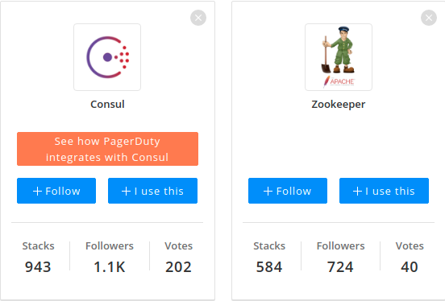
Consul vs Zookeeper
Copyright © 2021 by Elephant Scale, All Rights Reserved

Slide 41
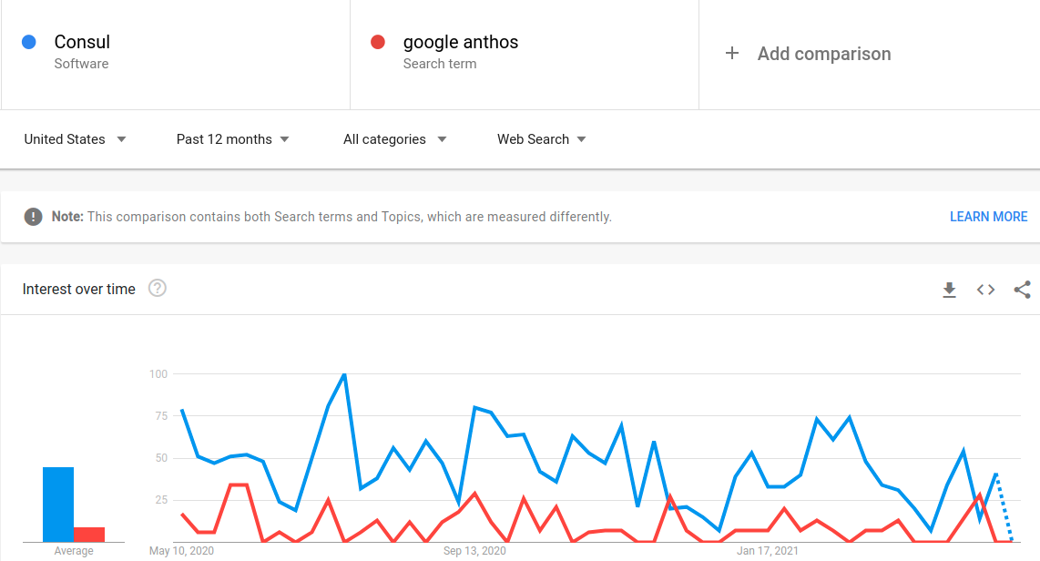
Consul vs Google Anthos
Copyright © 2021 by Elephant Scale, All Rights Reserved

Slide 42
Consul is from HashiCorp
Consul is a solution provided by HashiCorp
tight integration with Consul to simplifies access to Vault
Users and applications can query Consul using either DNS or the API
Consul responds to the query with the information needed to establish communication with the active Vault node
Faster and smarter than a load balancer
Copyright © 2021 by Elephant Scale, All Rights Reserved
Notes:
Since Consul is a solution provided by HashiCorp, it should come as no surprise that HashiCorp Vault includes tight integration with Consul to simplify access to Vault. Users and applications can query Consul using either DNS or the API when communication to Vault is required. Consul responds to the query with the information needed to establish communication with the active Vault node. If the Vault environment changes, Consul is immediately aware of those changes and begins directing subsequent requests to the now- active Vault environment. This strategy can help organizations reduce or eliminate the reliance on a front-end load balancer that may not reflect changes fast enough when using a health check configured with timeouts and thresholds.

Slide 43
Consul and Vault cluster
Consul can also simplify the connectivity to standby nodes within the cluster
Especially when running Vault Enterprise with performance standby nodes
Performance standby nodes can service Vault read operations and help Vault operators scale those read operations within a cluster
Copyright © 2021 by Elephant Scale, All Rights Reserved
Notes:
In addition to maintaining a connection to the active node, Consul can also simplify the connectivity to standby nodes within the cluster. This connectivity may be especially convenient when running Vault Enterprise with performance standby nodes. As previously discussed, these performance standby nodes can service Vault read operations and help Vault operators scale those read operations within a cluster. By using Consul to communicate with the performance standby nodes, clients a

Slide 44
Registering the Vault Service with Consul
When you deploy a Vault cluster with Consul backend -
Vault service is automatically registered with the Consul service registry by default
Best practice
If Consul service discovery is desired, a second Consul cluster should be deployed to manage this functionality
Copyright © 2021 by Elephant Scale, All Rights Reserved
Notes:
When a Vault cluster is deployed using a Consul storage backend, the Vault service is automatically registered with the Consul service registry by default. However, HashiCorp recommends that the Consul cluster deployed as the storage backend never be used for additional Consul functionality, such as service discovery. This recommendation ensures the Consul cluster can dedicate all available resources to servicing the storage backend rather than other Consul functions. If Consul service discovery is desired, a second Consul cluster should be deployed to manage this functionality.

Slide 45
How to register
The service_registration stanza is added to the Vault configuration
This configuration includes
the address and port of the Consul cluster
the Consul ACL token to permit Consul access (if Consul ACLs are enabled)
other configurable parameters such as service_tags.
Copyright © 2021 by Elephant Scale, All Rights Reserved
Notes:
The service_registration stanza needs to be added to the Vault configuration file to register the Vault service with a Consul cluster.

Slide 46
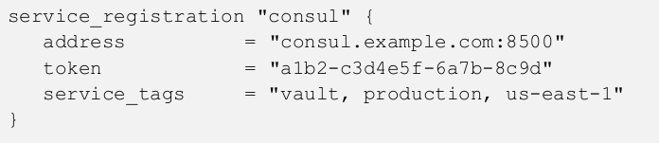
service_registration stanza example
Copyright © 2021 by Elephant Scale, All Rights Reserved
Notes:
This configuration includes the address and port of the Consul cluster, the Consul ACL token to permit Consul access (if Consul ACLs are enabled), and other configurable parameters such as service_tags. Keep in mind that the token is a Consul ACL token, not a Vault token. The ACL token needs to be associated with a Consul ACL policy with appropriate permissions, such as reading from the key/value path and creating the Consul service. Figure 6-6 provides an example of the stanza to be added to the Vault configuration file.

Slide 47

Connecting to Vault using Consul
In Consul, all Vault cluster nodes are registered as the Vault service
To use Consul to discover the active node in a cluster, a client can query Consul with the DNS name
Copyright © 2021 by Elephant Scale, All Rights Reserved
Notes:
To discover the current standby node(s) in a Vault cluster, the client can query Consul for the DNS name found in Figure 6-8. If there are multiple standby nodes, Consul responds to the query with all the standby nodes.

Slide 48
Performance standby node(s)
In Vault Enterprise
To discover the performance standby node(s)
client can query Consul for the DNS name
Copyright © 2021 by Elephant Scale, All Rights Reserved
Notes:
When running Vault Enterprise, a client or application may need to discover the performance standby node(s) in a Vault cluster for read operations. To do so, the client can query Consul for the DNS name found in Figure 6-9. If there are multiple performance standby nodes, Consul responds to the query with all the standby nodes.

Slide 49
Terraform integration
Consul overview Microservices Consul for Service Discovery Terraform integration
Copyright © 2021 by Elephant Scale, All Rights Reserved

Slide 50
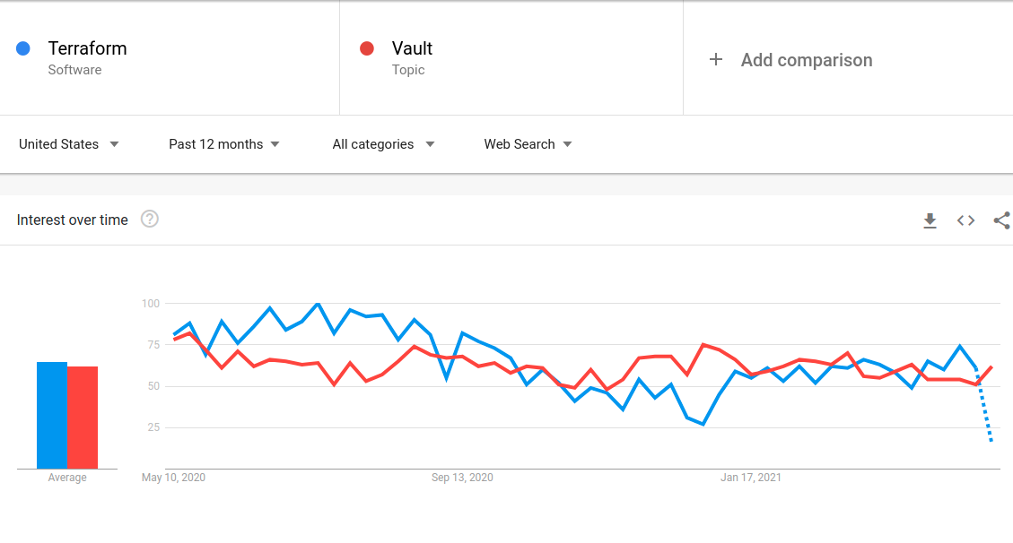
Terraform and Vault
Copyright © 2021 by Elephant Scale, All Rights Reserved
Notes:
Vault is one of HashiCorp's most popular products, but its adoption is dwarfed by the popularity of another HashiCorp product, Terraform. Terraform allows customers to define infrastructure components as code to create a predictable and repeatable process for standing up applications and supporting infrastructure. Terraform supports integration with Vault in several ways, including the ability to deploy Vault infrastructure, manage Vault infrastructure, configure Vault components, and retrieve Vault secrets.

Slide 51
Vault Infrastructure with Terraform
Terraform and Vault often go together
Your deployment may have custom Terraform modules
If so, it may make sense to store the modules in the Terraform pubic registry
Copyright © 2021 by Elephant Scale, All Rights Reserved
Notes:
Organizations deploying Vault to automate the security of applications and infrastructure are often Terraform adopters as well. If so, it is highly likely that these organizations maintain custom Terraform modules for their data center or their selected public cloud platform. Using these modules or modules from the Terraform public registry, customers can simplify a Vault cluster's deployment and ongoing management.

Slide 52
Vault Architecture
Components to go in the Terraform configuration files:
Consul nodes
Vault nodes
load balancers
security groups
DNS records
network connectivity
Copyright © 2021 by Elephant Scale, All Rights Reserved
Notes:
As discussed in the Designing the Vault Architecture section, many components must be considered when architecting a Vault solution. Since Terraform supports many private and public cloud resources, organizations can easily define these components in Terraform for deployment. Components such as the Consul and Vault nodes, load balancers, security groups, DNS records, and network connectivity can easily be declared in a Terraform configuration file. Any changes to the environment can be applied using Terraform for simplified management as well.

Slide 53
Repeatability
Repeatability if one the benefits of deploying Vault with Terraform
Other benefits
performance or
disaster recovery
replicated clusters *high availability
Copyright © 2021 by Elephant Scale, All Rights Reserved
Notes:
One of the most significant benefits of deploying Vault with Terraform is repeatability. As Vault adoption increases, so does the need for performance or disaster recovery replicated clusters to ensure high availability and recovery of the service. By developing Terraform configurations for Vault, an organization can readily deploy additional clusters when needed. This strategy also ensures that each cluster is provisioned consistently regardless of where the new cluster is needed.

Slide 54
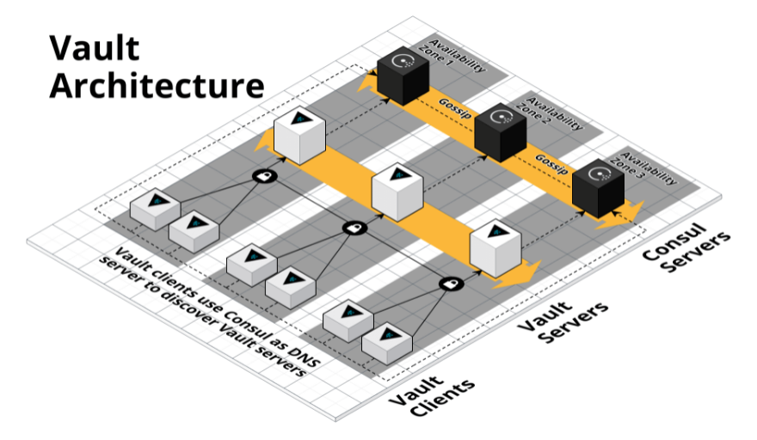
Terraform configurations for Vault
Amazon Web Services (https://github.com/hashicorp/terraform-aws-vault)
Microsoft Azure (https://github.com/hashicorp/terraform-azurerm-vault)
Google Cloud (https://github.com/terraform-google-modules/terraform-google-vault)
Copyright © 2021 by Elephant Scale, All Rights Reserved

Slide 55
Configure Vault Provider and Credentials
Similar to other Terraform providers:
declared within the Terraform configuration file
Sensitive information should be provided using environment variables
Example
Terraform authenticates with Vault using a token
Vault address and token should be provided as an environment variable
VAULT_ADDR - the IP address or hostname of the targeted Vault cluster
VAULT_TOKEN, which is used to authenticate to Vault
Copyright © 2021 by Elephant Scale, All Rights Reserved
Notes:
Getting started with the Terraform Vault provider is like using any other Terraform provider: the provider and related arguments should be declared within the Terraform configuration file. Any sensitive information should be provided using environment variables. This technique ensures that information is not stored in a cleartext Terraform file. For example, if Terraform authenticates with Vault using a token, the Vault address and token should be provided as an environment variable. In this scenario, two environment variables need to be set: VAULT_ADDR, which sets the IP address or hostname of the targeted Vault cluster, and VAULT_TOKEN, which is used to authenticate to Vault.

Slide 56
Consuming Secrets with Terraform
Rather than provide Terraform with static credentials
Terraform can integrate with Vault to retrieve or generate credentials before applying the configuration
For example,
Terraform can retrieve temporary AWS credentials from Vault to deploy EC2 instances
After the lease has expired, Vault automatically revokes the AWS credentials.
Copyright © 2021 by Elephant Scale, All Rights Reserved

Slide 57
Coding for Reliability
Additional automated processes
automated processes can ensure applications can access the vault service
Example
a team is responsible for managing a shared, multi-tenant Vault service for hundreds of internal teams
Vault environment was a large, multi-cluster Vault deployment
Each onboarded application was configured to attach to a single, local cluster.
Solution
native disaster recovery options built into Vault, or
a load balancer in front of the Vault clusters, or even better
use the AppRole auth method since both RoleIDs and SecretIDs are replicated across all clusters
Copyright © 2021 by Elephant Scale, All Rights Reserved

Slide 58
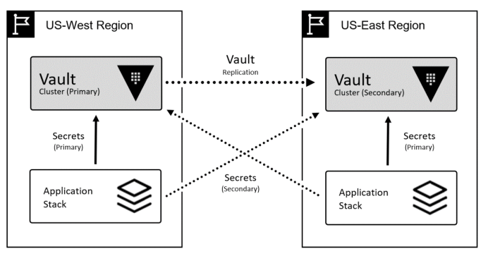
Reliability solution
Copyright © 2021 by Elephant Scale, All Rights Reserved
Notes:
Revisiting the above scenario, the application team needs to interact with Vault in the most efficient way while considering high availability across multiple clusters. Knowing that tokens are not replicated across clusters, the application team needs a solution to authenticate to any Vault cluster to retrieve secrets.
The operations team can start by using the AppRole auth method since both RoleIDs and SecretIDs are replicated across all clusters. Combining this authentication mechanism capability with automation or pre-defined script can ensure applications can always access the Vault service, regardless of the status of the Vault environment.

Slide 59
More with Consul
Now that we know the basics, what is next? Perfect your skills in the following areas:
Consul Service Mesh
Create a datacenter with Consul Docker containers as the agents
Learn how to deploy Consul on Kubernetes
Deploy HashiCorp Consul Service on Azure
Secure Nomad jobs with Consul service mesh
Copyright © 2021 by Elephant Scale, All Rights Reserved

