Slide 1
Secure Design
Copyright © 2021 by Elephant Scale, All Rights Reserved

Slide 2
Defining Secure by Design
Means software systems and products are designed from inception through retirement to be secure
Security is a fundamental part design and operations, not added on later
The design process must be secure - not susceptible to being subverted
Software development implementation of the core engineering practice secure by design
Built into the standard engineering lifecycle or product development workflow
Used in all forms of engineering, not just software engineering
Copyright © 2021 by Elephant Scale, All Rights Reserved

Slide 3
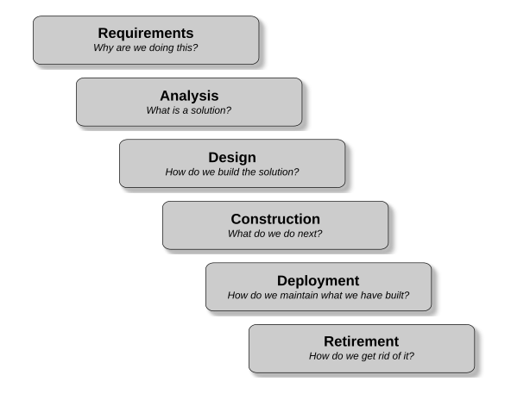
The Engineering Lifecycle
Copyright © 2021 by Elephant Scale, All Rights Reserved
Notes:
Image Credit: Rod Davison

Slide 4
Application Lifecycle Management (ALM)
Application of engineering product management to software
The lifecycle of a software product is defined to be:
“the entire time an organization spends money of the product from the initial idea to the end of the application’s life when it is no longer in use”
Three major milestones: idea, initial deployment, end-of-life
Three main areas of concern
Governance: Making business decisions like when a product should be retired
Development: Building and releasing software
Operations: Maintaining and supporting the software in production
We will focus primarily on development
Copyright © 2021 by Elephant Scale, All Rights Reserved

Slide 5
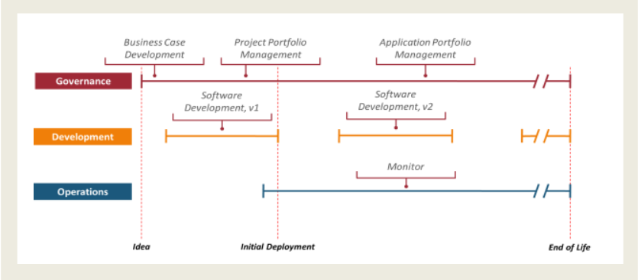
Application Lifecycle Management (ALM)
ALM accommodates all development SDLCs: waterfall, Agile, DevOps, etc
Copyright © 2021 by Elephant Scale, All Rights Reserved
Notes:
Image Credit: James Chappell

Slide 6
Iot Secure by Design
Secure lifecycle concepts applied to Internet of Things
Very similar to software secure by design lifecycle
Copyright © 2021 by Elephant Scale, All Rights Reserved
Notes:
Image Credit: www.epsprogramming.com/blog-posts/secure-by-design-for-the-internet-of-things

Slide 7
Secure Requirements
Security requirements must be part of the requirements for the project
Includes prioritized assessment of potential attackers during the product lifecycle
Inventory of attacks that should be expected
A robust and thorough threat analysis
Requirements from all security stakeholders
Government and industry standards and requirements
Eg. NSA Cyber Security Standards
https://www.nsa.gov/What-We-Do/Cybersecurity/Partnership/Standards/
Copyright © 2021 by Elephant Scale, All Rights Reserved

Slide 8
Nonfunctional Requirements
Nonfunctional requirements are the performance requirements of a system
For example, response time, load and stress capacity
Many attacks overstress system operations to destabilize it
Nonfunctional requirements must fully define the performance levels the system will experience in production
System design depends directly on the non-functional requirements
Systems that are patched up to meet performance requirements present a greater attack surface
Standardized nonfunctional requirements models provide "checklists" for completeness
Copyright © 2021 by Elephant Scale, All Rights Reserved

Slide 9
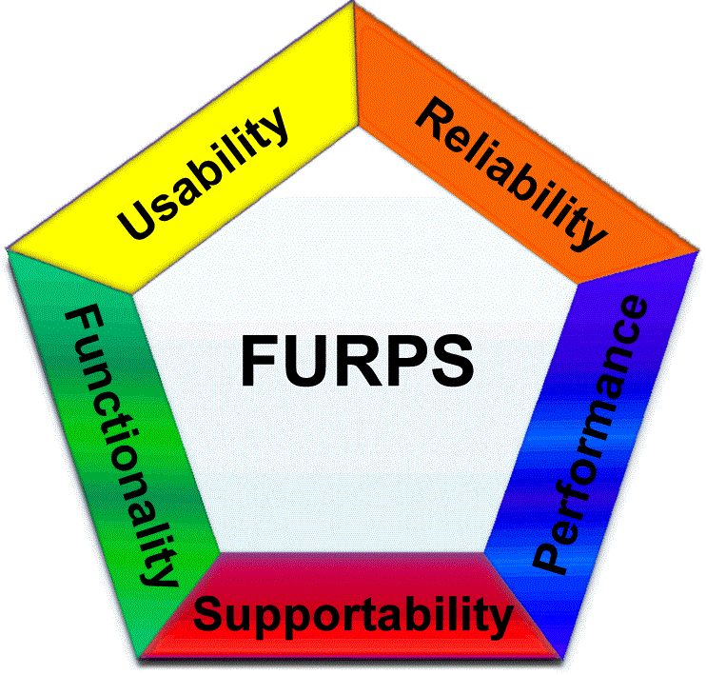
FURPS Requirements Model
Reliability
Mean time to failure
Failure severity
Failure frequency
Accuracy and Predictability
Allowable downtime and recovery time
Copyright © 2021 by Elephant Scale, All Rights Reserved
Notes:
Image Credit: Unknown

Slide 10
FURPS Requirements Model
Operational Performance
Speed
Response time
Throughput
Efficiency
Resource consumption
Load and stress
Copyright © 2021 by Elephant Scale, All Rights Reserved

Slide 11
FURPS Requirements Model
Supportability
Testability
Extensibility and adaptability
Maintainability
Compatibility
Configurability
Backup and recovery
Disaster management
Copyright © 2021 by Elephant Scale, All Rights Reserved

Slide 12
The Specification
A spec is a description of what is to be built, its capabilities and functionality
All engineering projects are built to a specification
Provides a baseline for testing and quality analysis
Not a design - only describes what the deliverable should be
Designs describe how to build something from a spec with the resources and technology available to the development team
One spec may give rise to multiple designs
Designs are the phase where solutions to nonfunctional requirements are crafted
Copyright © 2021 by Elephant Scale, All Rights Reserved

Slide 13
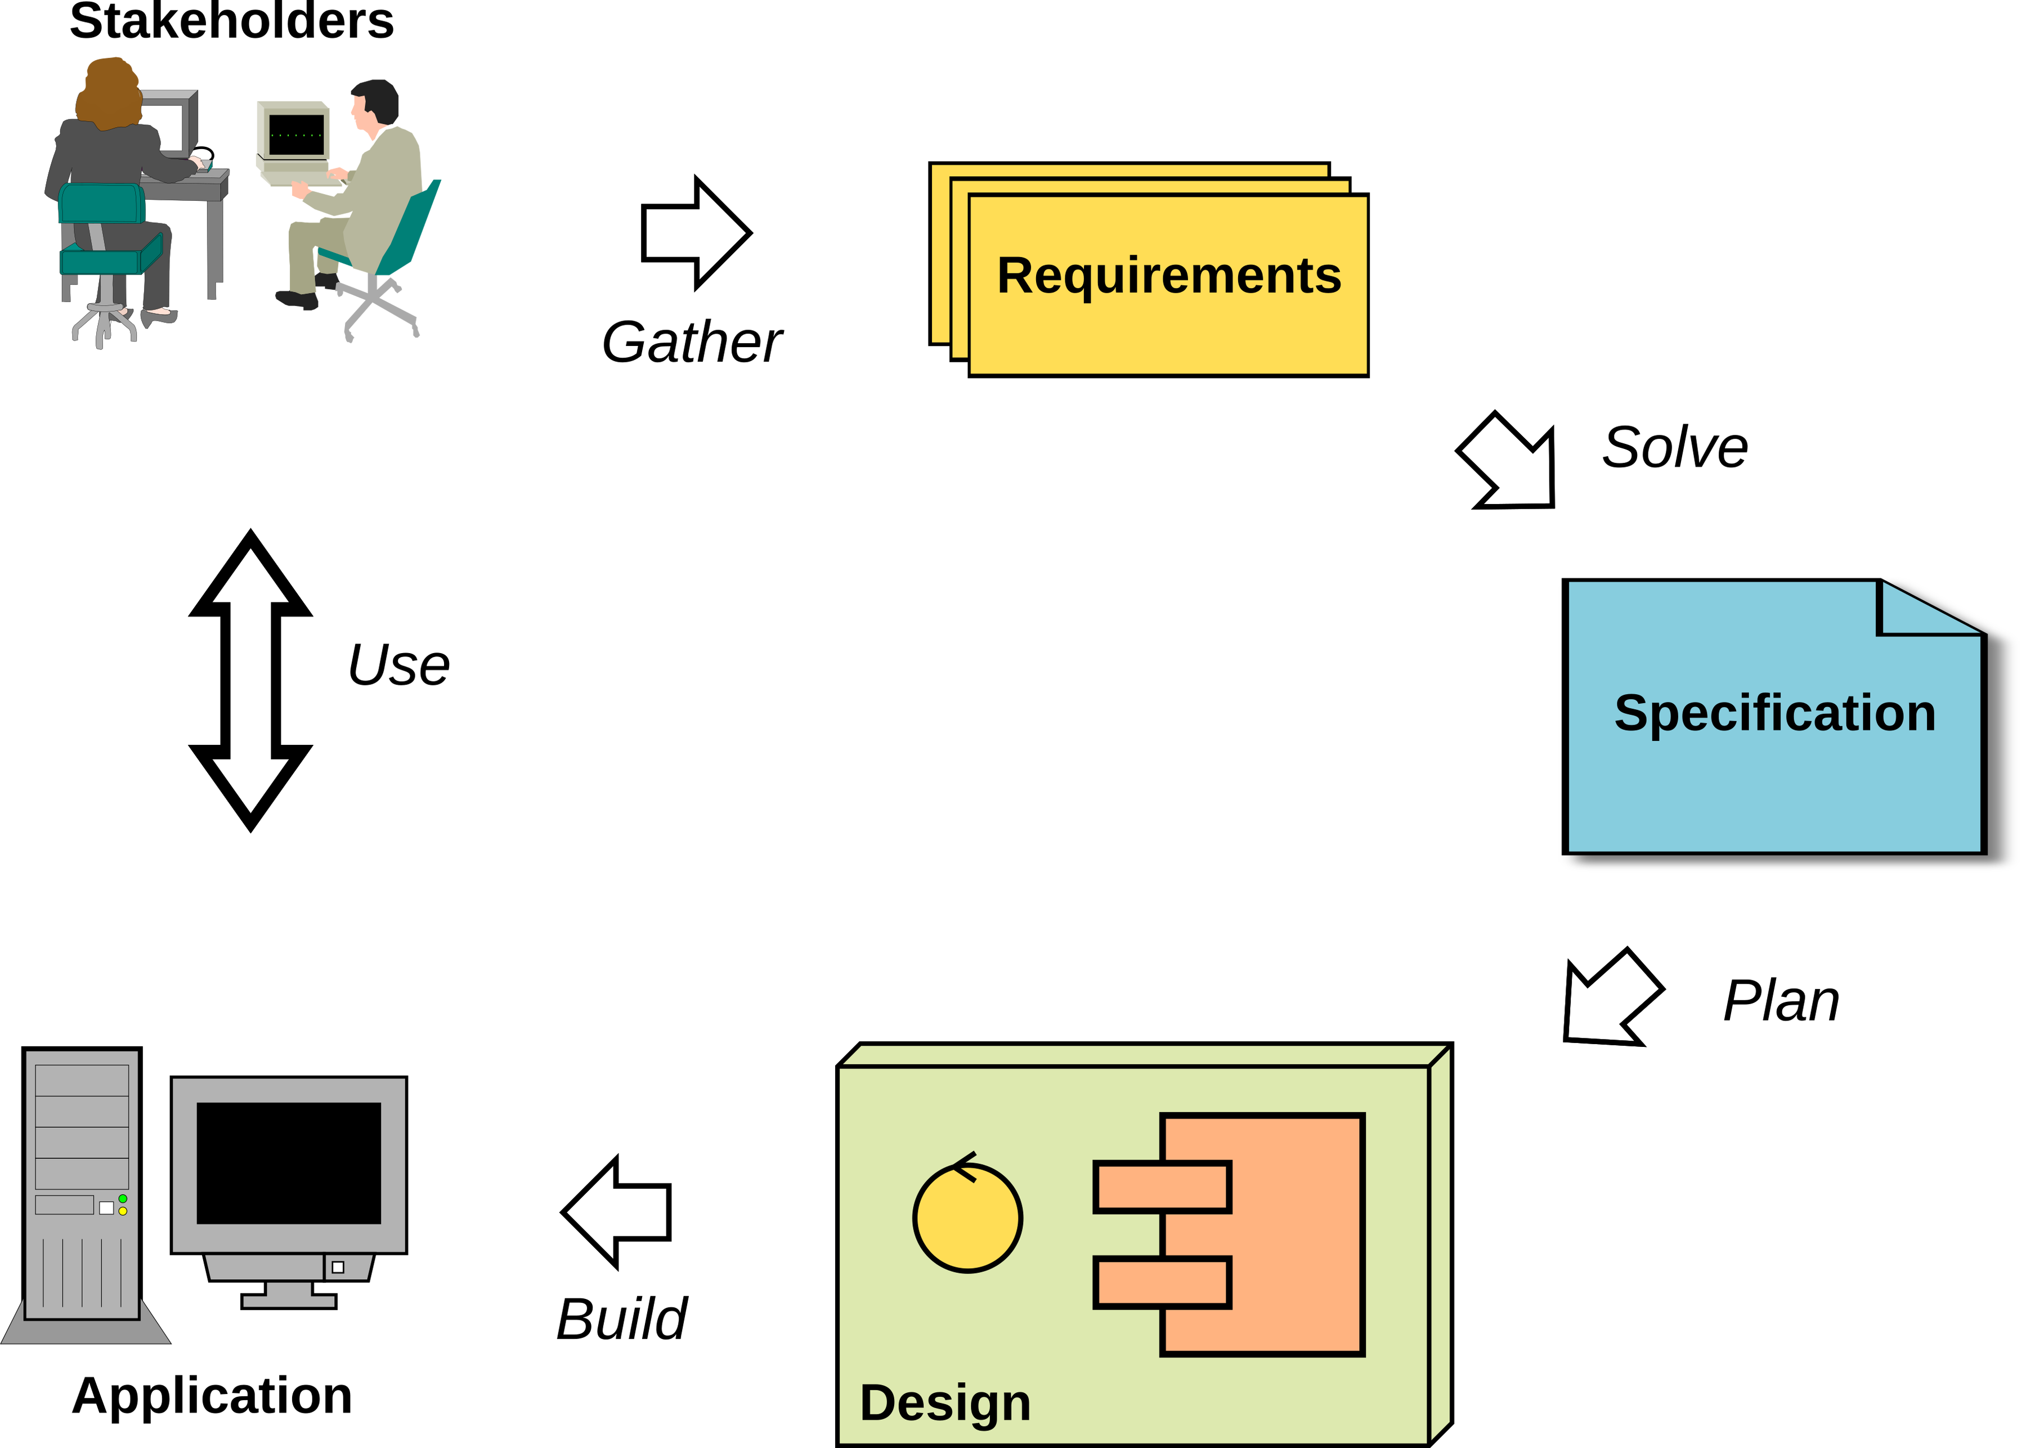
The Generic Software Development Process
Waterfall executes this once, Agile/DevOps execute this in multiple iterations
Copyright © 2021 by Elephant Scale, All Rights Reserved

Slide 14
Why a Specification?
Poorly designed software is inherently insecure
We can't have well-designed software unless we know:
Exactly what the software should do
What the software must not do
How the software should handle errors and exceptions
How the software should respond to attacks
"The most important single aspect of software development is to be clear about what you are trying to build." Edsger Dijkstra
"First solve the problem, THEN write the code." Donald Knuth
Copyright © 2021 by Elephant Scale, All Rights Reserved

Slide 15
IEEE Best Practices
The IEEE Best Practices for Software Requirements Specifications is the gold standard for software specs
It represents the minimum level of rigour for secure software
Developers should never have to speculate on what the software should do
When developers make assumptions about what code should do, it introduces vulnerabilities
Especially when their assumptions are wrong
The spec defines what the software does, the developer designs how the software will do what the spec describes
The IEEE Best Practices lists a set of properties that all software specs should have
Copyright © 2021 by Elephant Scale, All Rights Reserved

Slide 16
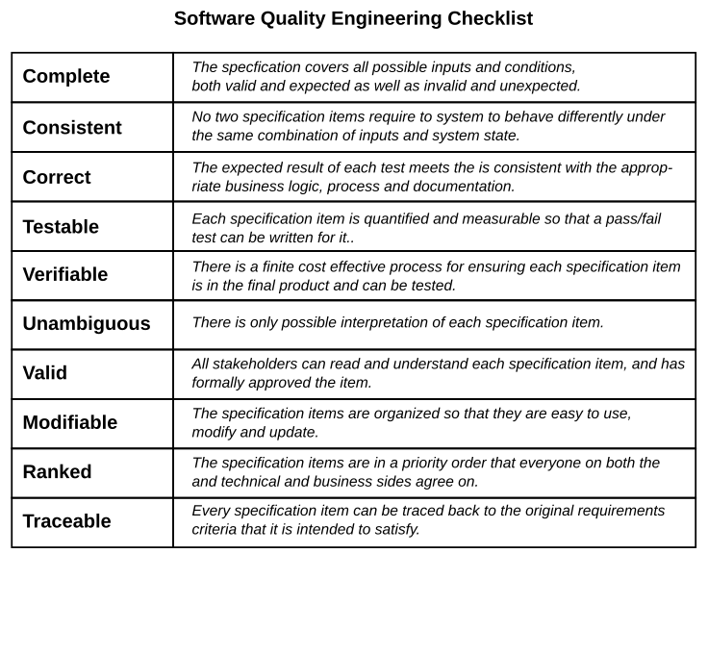
IEEE Spec Standards
Copyright © 2021 by Elephant Scale, All Rights Reserved
Notes:
Image Credit: Rod Davison

Slide 17
Specs and Testing
Since the spec describes exactly how the software will perform
Testers start developing tests based on the specification
Security testers also start developing penetration and exploit tests
As part of the specification, a full suite of acceptance tests will also be developed
If a tester cannot write a test to spec item, a developer cannot write code to it for the same reason
Eg. The spec does not cover what should happen with invalid input for a feature
The tester has no idea what the correct system response should be
The developer does not know what their code should produce
Copyright © 2021 by Elephant Scale, All Rights Reserved

Slide 18
Securing the Development Process
Design process security prevents the insertion of malicious code during development
Three examples of malicious code insertion
Backdoors: Programmers insert code that allows unauthorized access to the system
Logic Bombs: Code designed to compromise or damage the system when triggered by an attacker
Surprise Functionality: Functionality that is not in the spec that can be exploited by an attacker
Malicious code insertion is generally cannot be identified by standard testing
White box testing that exercises all the code must also be employed
Part of what testers do in exploratory testing is to look for surprise functionality
Copyright © 2021 by Elephant Scale, All Rights Reserved

Slide 19
Logic Bomb Examples
July 2019, contractor for Siemens set logic bombs to go off after a period fo time to force the company to hire him to fix the resulting damage
June 2008, systems administrator at UBS used a logic bomb to try and drive down the price of the company's stock
February 2002, a logic bomb was planted by a programmer at Deutsche Morgan Grenfell
It was discovered before it went off but took months to remove
2012, a contractor for the US Army placed a logic bomb into the payroll systems for the US Army Reserves
His employer had lost the contract to build the system which would affect his job
Copyright © 2021 by Elephant Scale, All Rights Reserved

Slide 20
Backdoor Examples
A systems administrator for the City of San Francisco created a hidden admin account and backdoor
When he was fired, he used the backdoor to lock everyone out of the system
Software and hardware manufactures often install backdoors for testing during development
These are undocumented, not secure and often not removed after development
Once these backdoors are known, they provide an easily breached attack surface
In 2014. SerComm, a company that assembled routers for LinkSys and Netgear was found to have installed backdoors in the routers
Borland's Interbase (versions 4 to 6) had a backdoor that allowed anyone to take full control of all the Interbase databases
Copyright © 2021 by Elephant Scale, All Rights Reserved

Slide 21
Surprise Functionality
Occurs when developers reuse source code or libraries from other projects or sources
The reused code is not vetted or inspected thoroughly
The resulting application now has undocumented and untested functionality
This unknown code now presents a potential exploit
This is not a deliberate attack, but rather just sloppy programming
Copyright © 2021 by Elephant Scale, All Rights Reserved

Slide 22
Securing the Codebase
Source code is an asset that needs to be secure
Best practice is to use a VCS like git with audit capabilities
Allows tracking of where all source code and subsequent changes originated
Once code has been finalized, it is "frozen" and cannot be changed
Only vetted code from the codebase is used in builds
Code management and access policies can enforced to establish a chain of possession for all code
Projects should use a standard code style so that everyone can read and understand the code
Copyright © 2021 by Elephant Scale, All Rights Reserved

Slide 23
Securing Writing the Code
Pair programming is used to improve security and code quality
One person codes while the other reviews the code as it is written
In addition to catching bugs, it makes malicious code insertion very difficult
As an extra layer of security and quality, the code is reviewed by a third developer on a random basis
To prevent collusion
The programmers paired together every day are chosen randomly
The third programmer who acts as reviewer is chosen randomly
Copyright © 2021 by Elephant Scale, All Rights Reserved

Slide 24
Code Reviews
All production code should subject to formal code reviews and walk-throughs
Participants should include people not involved in the project, ie. fresh eyes
Testers and security experts should be part of the review
No code is included in a build until it is passes a full review
Reviews and walk-throughs find errors and possible exploits as well as potential malicious code
Code reviews are done with reference to code standards, vulnerability lists and known potential problem areas
OWASP guide for conducting code reviews:
https://owasp.org/www-pdf-archive/OWASP_Code_Review_Guide-V1_1.pdf
Copyright © 2021 by Elephant Scale, All Rights Reserved

Slide 25
Coding Standards
There exist coding best practice standards for most languages
These are intended at starting points for organizations to develop their own coding standards
There are also secure coding standards
These focus on how to avoid code that introduced vulnerabilities
These are often the result of poor programming practices
Eg. A vulnerability is introduced in Java by failing to properly handle unchecked exceptions
Copyright © 2021 by Elephant Scale, All Rights Reserved

Slide 26
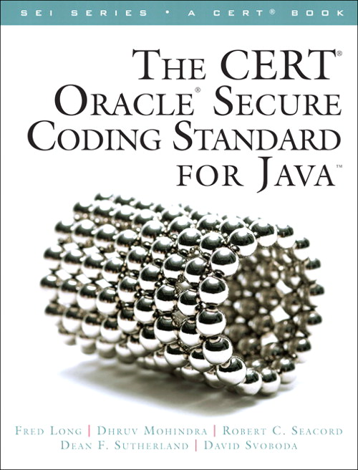
CERT Security Standards
Software Engineering Institute, NIST and CERT provide secure coding standards for Java, C, C++, Android and PERL
Newer languages like Rust are designed to reduce the ability of programmers to write insecure code
Copyright © 2021 by Elephant Scale, All Rights Reserved

Slide 27

Secure Architectural Design
Part of a larger approach referred to as In depth defence
This includes the design architecture for a system
The goal is to provide layers of protection for high value assets
High value assets include data and features control the system like admin accounts
There are a number of standards developed that can be used as a starting point
CERT, NIST, SEI and other organizations
Copyright © 2021 by Elephant Scale, All Rights Reserved

Slide 28
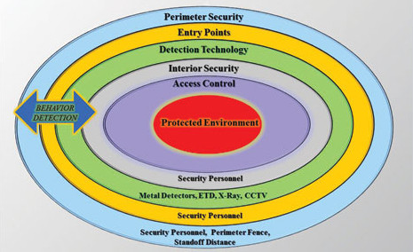
Layered Security Model
There are multiple variations on the basic concept of layered security
They all are implementations of security in depth
Assets are only reachable by going through multiple layers of security
Each layer provides a set of defences against the various types of attacks
Copyright © 2021 by Elephant Scale, All Rights Reserved
Notes:
Image Credit: www.securitymagazine.com/articles/83537-us-security-shifting-to-preventative-methods

Slide 29
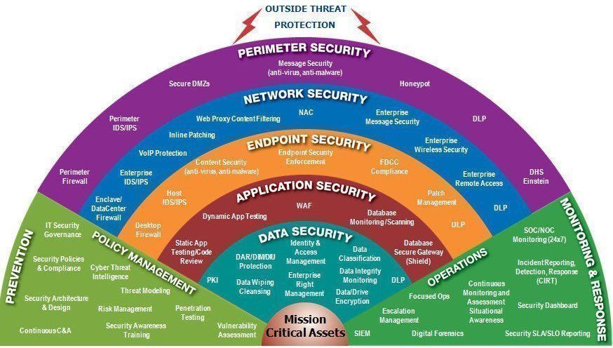
Layered Security Model
Another variation of the model is the "fan" model
The same basic layer approach but just different levels of detail
Copyright © 2021 by Elephant Scale, All Rights Reserved
Notes:
Image Credit: twitter.com/fisher85m/status/1030976170181976064

Slide 30
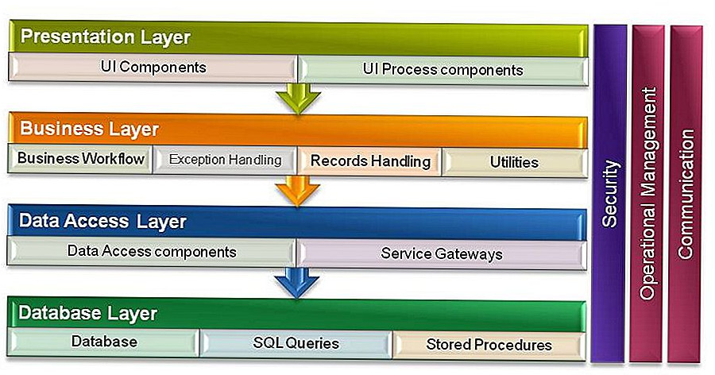
Design Layers
At the design level, this is partly implemented as a n-tier model
The basic form is the 3-tier model
Copyright © 2021 by Elephant Scale, All Rights Reserved
Notes:
Image Credit: tr.waldorf-am-see.org/589338-what-is-n-tier-architecture-OYJTJO

Slide 31
The Layers
The data access layer is responsible for accessing the actual databases
It can only be accessed from the business logic layer
It is often behind a firewall that will only accept connections from applications running in the Business Logic Layer
There is no other access to the data
The business layer provides the application functionality
It contains a series of checks to ensure that only well-formed requests are processed
Implements various access controls and authorization mechanisms
Rejects requests that do not pass security measures
The presentation Layer interacts with the user
It validates input and presents only the functionality allowed for a specific user
Role based authorization often means different types of users see different interfaces
Copyright © 2021 by Elephant Scale, All Rights Reserved

Slide 32
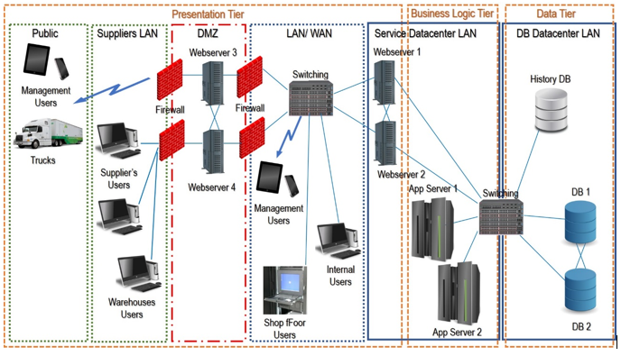
Physical Layer Implementation
The tiers in the layered model are often implemented in different physical architectural zones
Usually implemented by different networks and host environments
Enables the control of low level physical access between tiers
Copyright © 2021 by Elephant Scale, All Rights Reserved
Notes:
Image Credit: www.bmc.com/blogs/n-tier-architecture-tier-2-tier-3-and-multi-tier-explained/

Slide 33
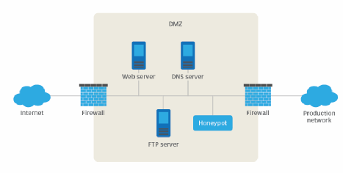
Using a DMZ (Demilitarized Zone)
It is an area of the system that is accessible to the outside world
Hosts services available to the public - web sites, etc.
Has no direct access to the internal networks
Often contains a honeynet as a security trap
Image Credit: searchsecurity.techtarget.com/definition/honey-pot
Copyright © 2021 by Elephant Scale, All Rights Reserved

Slide 34
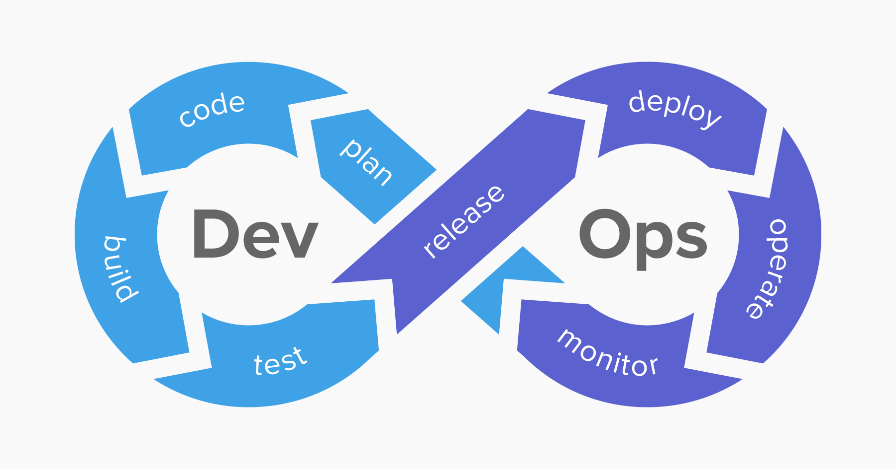
DevOps and Security
DevOps is a production model for software which emphasizes the integration of both development and prodcution
DevOps stresses continuous development, testing, integration and deployment
It relies heavily on automation
Copyright © 2021 by Elephant Scale, All Rights Reserved
Notes:
Image Credit: www.netsparker.com/blog/web-security/what-is-devsecops/

Slide 35
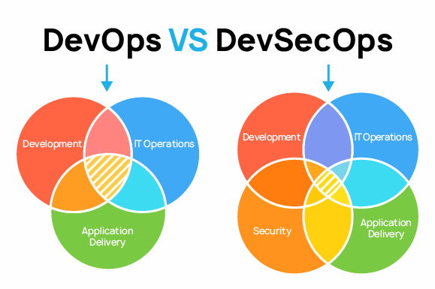
DevSecOps
DevSecOps implements the idea presented early in this module
Security is built into the whole development and production process
Copyright © 2021 by Elephant Scale, All Rights Reserved
Notes:
Image Credit: pvs-studio.com/en/blog/posts/0710/

Slide 36
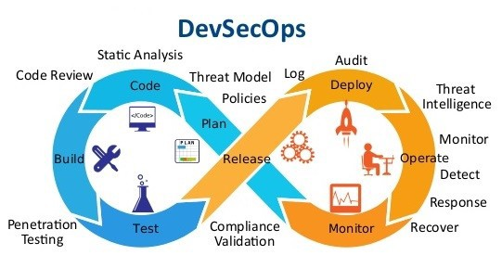
DevSecOps
Integration of the security into the DevOps model
Copyright © 2021 by Elephant Scale, All Rights Reserved
Notes:
Image Credit: levelup.gitconnected.com/top-15-devsecops-tools-for-an-enterprise-ci-cd-pipeline-bd865b47ed5f

