Slide 1
Security future
Copyright © 2021 by Elephant Scale, All Rights Reserved

Slide 2
API
Auto scaling groups API Hybrid clouds
Copyright © 2021 by Elephant Scale, All Rights Reserved

Slide 3
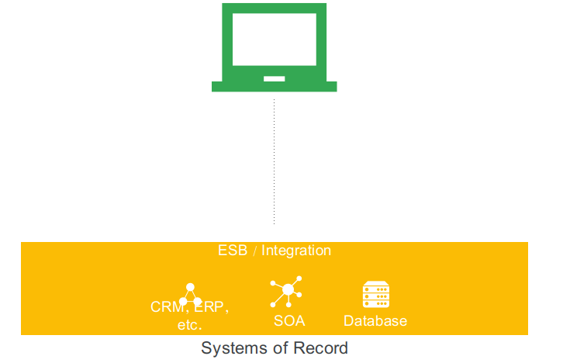
Early "API"
This is how you exposed your resources back then
Copyright © 2021 by Elephant Scale, All Rights Reserved
Notes:
Before we discuss the role of APIs and API Management in today's enterprise landscape, it is important for you to understand where we are, and how we got here.
Not too long ago, having a digital presence just meant you had a website. At the time, success was expressed in simple terms, such as the number of visits to the site or the number of users registered over months or years.
The relatively slow pace of change of the web channel allowed an IT organization to plan and execute changes to backend systems. The pace allowed them to keep up with demand.

Slide 4
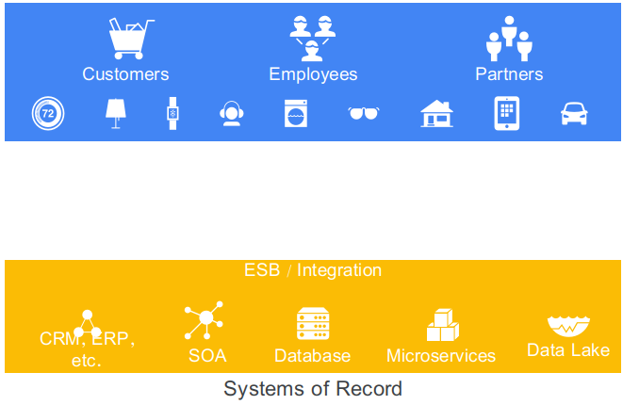
The gap
How do you bridge the gap?
Modern best practice is to decouple, or "bridge"
Copyright © 2021 by Elephant Scale, All Rights Reserved
Notes:
What about today?
The number of customer-facing applications has dramatically increased and diversified, opening the door to a new era of connected digital experiences.
Today, most companies embrace multiple methods of interaction as part of their digital strategy.
In addition to traditional web and mobile applications, companies are finding new channels for users to interact with data and services, powered by smart connected devices.

Slide 5
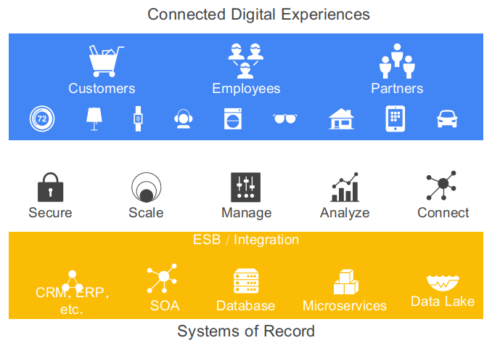
New architecture
This is a complete layer
You may not need all of it, but it is a good list
Copyright © 2021 by Elephant Scale, All Rights Reserved
Notes:
With all of these new apps and channels come new challenges, including:
securing communication and access for new channels and devices;
increasing scale to handle higher traffic and usage;
managing new channels, customers, partners, and apps;
improving visibility of business and technical metrics to allow data-driven business decisions;
and, leveraging ecosystems and platforms to increase reach.
All of these challenges add to the complexity and diversity of requirements that backend systems need to handle, ...

Slide 6
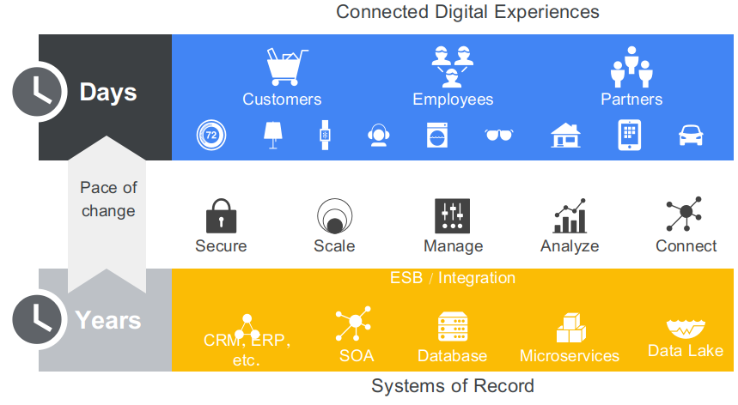
Pace
The speed of development is increasing
Copyright © 2021 by Elephant Scale, All Rights Reserved

Slide 7
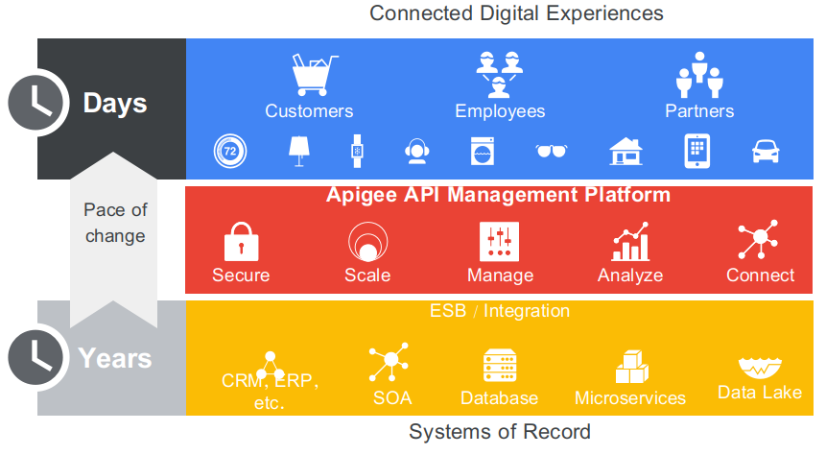
Apigee, the "all-out" solution
Copyright © 2021 by Elephant Scale, All Rights Reserved
Notes:
No free tier any longer

Slide 8
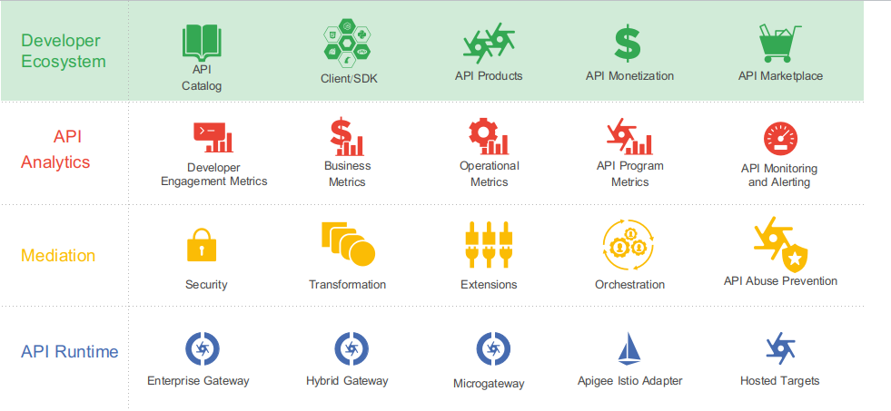
Apigee is on GCP
Copyright © 2021 by Elephant Scale, All Rights Reserved
Notes:
The developer ecosystem is an important factor in the success of your APIs.
APIs built and deployed on Apigee are bundled into API products, which can be deployed to a developer portal.
The developer portal facilitates the discovery and consumption of APIs and offers developers access to API documentation.

Slide 9
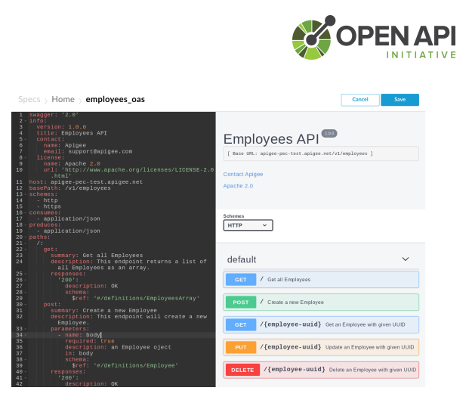
OpenAPI is the common language
You may or may not need to use API right now
But it is an upcoming architectural design pattern
So, it is good to know
Copyright © 2021 by Elephant Scale, All Rights Reserved

Slide 10
Quiz
Which versioning scheme follows Apigee's API design best practices?
A. GET /customers/{customend}/v1
B. GET /customers/v1/{customerid}
C. GET /v1/customers/{customerid}
D. GET /customers?customend={customerid}&version=v1
Copyright © 2021 by Elephant Scale, All Rights Reserved
Notes:
B.

Slide 11
Amazon API Gateway
API Types
RESTful APIs
Build RESTful APIs optimized for serverless workloads and HTTP backends using HTTP APIs.
WEBSOCKET APIs
Build real-time two-way communication applications, such as chat apps and streaming dashboards
Copyright © 2021 by Elephant Scale, All Rights Reserved

Slide 12
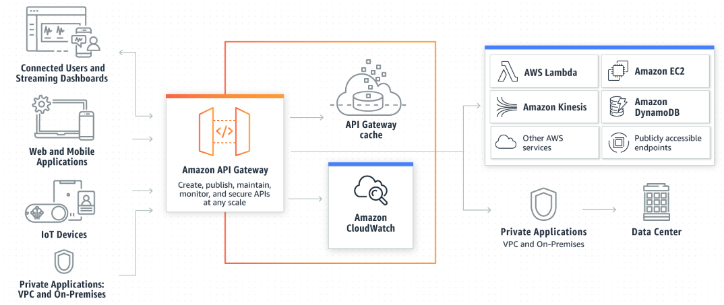
How AWS API Gateway Works
Copyright © 2021 by Elephant Scale, All Rights Reserved

Slide 13
Azure API gateway
Azure API management service is between your APIs and the Internet
An Azure API gateway is an instance of the Azure API management service
Azure portal controls how particular APIs are exposed to consumers
Copyright © 2021 by Elephant Scale, All Rights Reserved

Slide 14
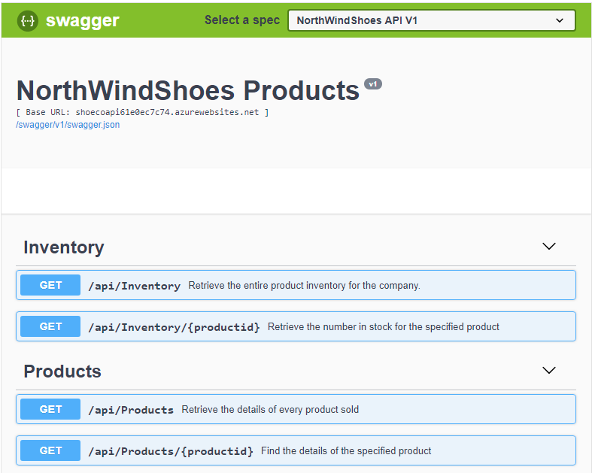
Building API on Azure
Copyright © 2021 by Elephant Scale, All Rights Reserved

Slide 15
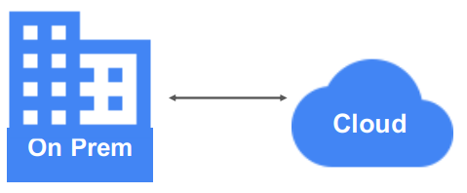
Hybrid Clouds
This, and more...
Copyright © 2021 by Elephant Scale, All Rights Reserved

Slide 16
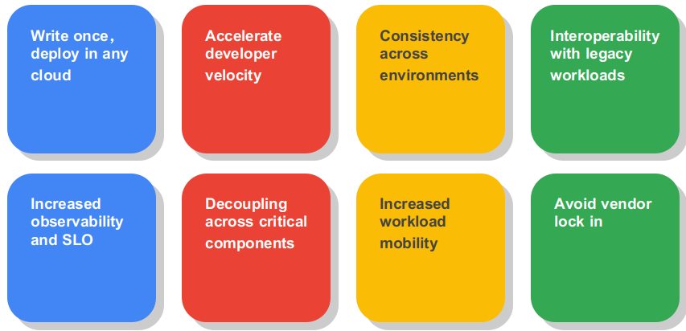
Hybrid environment wishlist
This may or may not be your goal though
Copyright © 2021 by Elephant Scale, All Rights Reserved

Slide 17
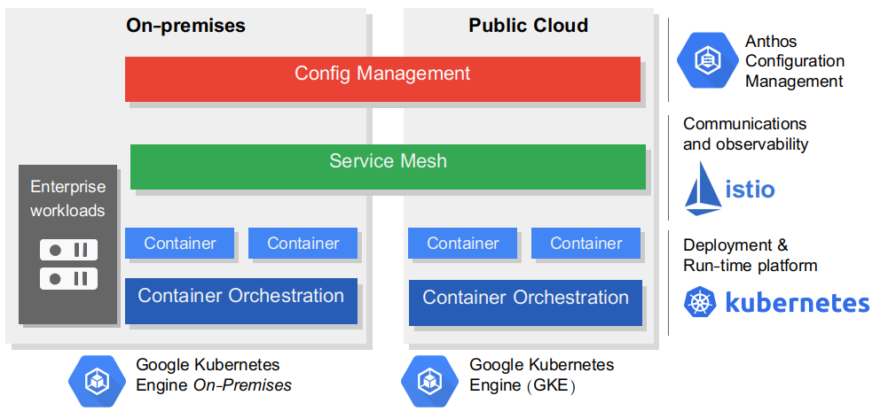
Anthos
Copyright © 2021 by Elephant Scale, All Rights Reserved

Slide 18
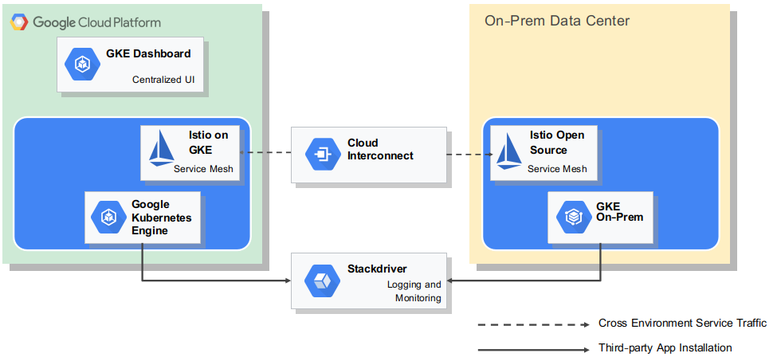
Anthos more details
Copyright © 2021 by Elephant Scale, All Rights Reserved

Slide 19
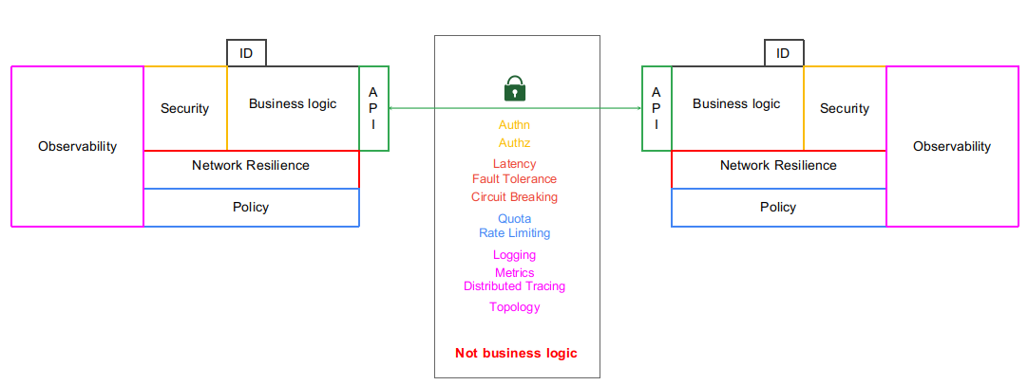
Enabler
Service mesh (ISTIO)
Copyright © 2021 by Elephant Scale, All Rights Reserved

Slide 20
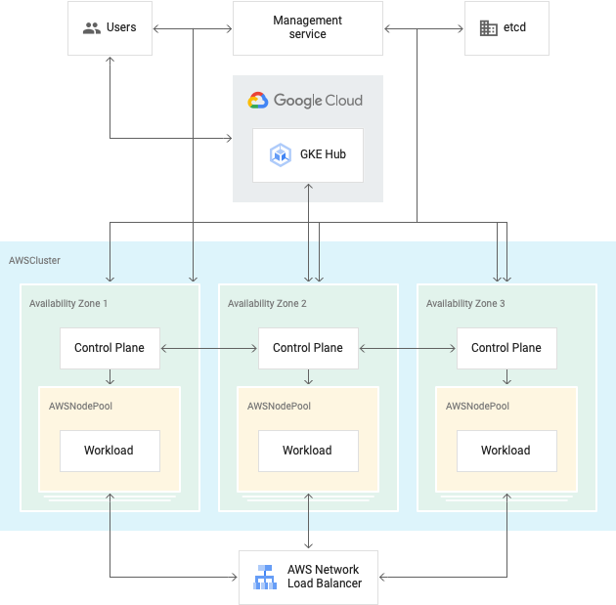
Anthos on AWS
Copyright © 2021 by Elephant Scale, All Rights Reserved

Slide 21

Congrats on completion
Copyright © 2021 by Elephant Scale, All Rights Reserved

