Slide 1
Serverless LLM with Bedrock
Starting with Amazon Bedrock
Summarizing an Audio File
Enable Logging in Bedrock
Deploying an AWS Lambda Function
Copyright © 2024 by Elephant Scale, All Rights Reserved

Slide 2
Starting with Amazon Bedrock
Starting with Amazon Bedrock Summarizing an Audio File Enable Logging in Bedrock Deploying an AWS Lambda Function
Copyright © 2024 by Elephant Scale, All Rights Reserved

Slide 3
Introduction
Amazon Bedrock provides a scalable way to use foundation models for generative AI.
Key Objectives :
Understand Bedrock’s role in simplifying access to pre-trained models.
Generate text for a variety of use cases using Amazon Bedrock.
Learn the basics of setting up and invoking Bedrock models.
Why use Bedrock?
Eliminates the need to train models from scratch.
Provides API access to multiple pre-trained models in a secure AWS environment.
Copyright © 2024 by Elephant Scale, All Rights Reserved

Slide 4
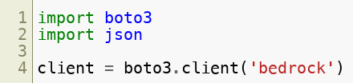
Setup
Import required libraries:
Why this is critical :
Ensures you have the right tools for invoking Bedrock’s API efficiently.
Copyright © 2024 by Elephant Scale, All Rights Reserved

Slide 5
Understanding Foundation Models
Foundation models are pre-trained on vast datasets and can perform multiple tasks.
Examples of Foundation Models in Bedrock :
Amazon Titan: Suitable for text generation and summarization.
Anthropic Claude: Optimized for conversational AI.
Copyright © 2024 by Elephant Scale, All Rights Reserved

Slide 6
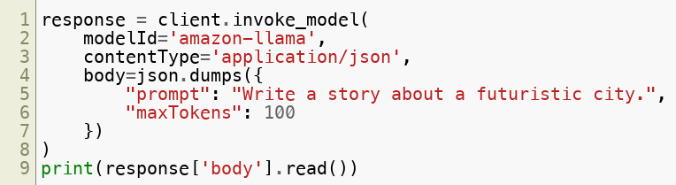
Generating Text
Example of generating text:
Copyright © 2024 by Elephant Scale, All Rights Reserved

Slide 7
Applications
Use Cases :
Automating content creation for blogs, marketing, and reports.
Summarizing long documents into concise insights.
Benefits of Bedrock :
No infrastructure management.
Scalable model access with robust security.
Copyright © 2024 by Elephant Scale, All Rights Reserved

Slide 8
Challenges and Solutions
Challenges :
Ensuring relevant and high-quality text generation.
Cost management with high-volume requests.
Solutions :
Fine-tune prompts to guide model outputs.
Monitor API usage with AWS CloudWatch.
Copyright © 2024 by Elephant Scale, All Rights Reserved

Slide 9
Next Steps
Experiment with different prompts and models to see their capabilities.
Explore integration with other AWS services like S3 for seamless workflows.
Copyright © 2024 by Elephant Scale, All Rights Reserved

Slide 10
Summarizing an Audio File
Starting with Amazon Bedrock Summarizing an Audio File Enable Logging in Bedrock Deploying an AWS Lambda Function
Copyright © 2024 by Elephant Scale, All Rights Reserved

Slide 11
Introduction
Combine Amazon Transcribe and Bedrock to process and summarize audio files.
Key Objectives :
Convert speech to text using Transcribe.
Use Bedrock for text summarization.
Why audio summarization matters :
Enables efficient processing of meetings, podcasts, and videos.
Copyright © 2024 by Elephant Scale, All Rights Reserved

Slide 12
Workflow Overview
Steps :
Upload an audio file to S3.
Transcribe the audio into text using Amazon Transcribe.
Summarize the text with Bedrock’s generative capabilities.
Copyright © 2024 by Elephant Scale, All Rights Reserved

Slide 13
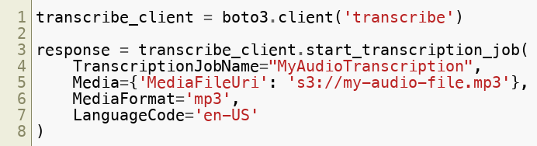
Transcribing Audio
Use Amazon Transcribe for speech-to-text conversion:
Key Insight :
Transcribe can handle multiple languages and audio formats, making it versatile for global applications.
Copyright © 2024 by Elephant Scale, All Rights Reserved

Slide 14
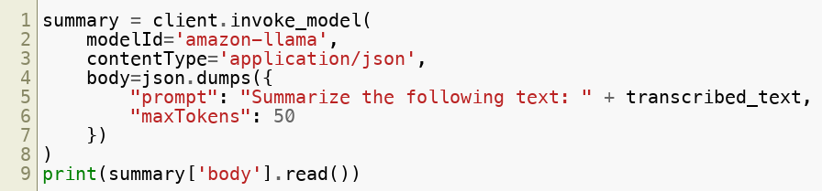
Summarizing Text
Use Bedrock to summarize the transcribed text:
Copyright © 2024 by Elephant Scale, All Rights Reserved

Slide 15
Real-World Applications
Use Cases :
Summarizing long business meetings into actionable insights.
Providing quick takeaways for podcasts or webinars.
Why it matters :
Reduces the time needed to extract key information from audio content.
Copyright © 2024 by Elephant Scale, All Rights Reserved

Slide 16
Challenges
Common Issues :
Handling poor-quality audio files.
Summarizing long or complex audio transcriptions.
Solutions :
Use noise reduction tools to improve audio quality before transcription.
Segment audio into smaller chunks for better summarization results.
Copyright © 2024 by Elephant Scale, All Rights Reserved

Slide 17
Enable Logging in Bedrock
Starting with Amazon Bedrock Summarizing an Audio File Enable Logging in Bedrock Deploying an AWS Lambda Function
Copyright © 2024 by Elephant Scale, All Rights Reserved

Slide 18
Introduction
Logging is essential for monitoring and debugging workflows.
Key Objectives :
Set up CloudWatch logging for Bedrock workflows.
Log and analyze API requests and responses.
Copyright © 2024 by Elephant Scale, All Rights Reserved

Slide 19
Importance of Logging
Why log your Bedrock workflows?
Detect and debug errors in real-time.
Monitor usage patterns and optimize costs.
AWS Services for Logging :
Amazon CloudWatch.
AWS X-Ray for distributed tracing.
Copyright © 2024 by Elephant Scale, All Rights Reserved

Slide 20
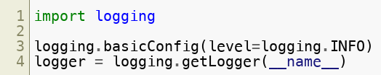
Setting Up Logging
Example:
Copyright © 2024 by Elephant Scale, All Rights Reserved

Slide 21
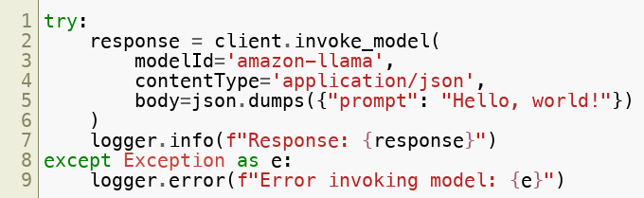
Logging Bedrock API Calls
Example:
Copyright © 2024 by Elephant Scale, All Rights Reserved

Slide 22

Advanced Logging
Use CloudWatch Insights to analyze logs:
Why use Insights?
Provides advanced querying capabilities to extract meaningful patterns from logs.
Copyright © 2024 by Elephant Scale, All Rights Reserved

Slide 23
Applications
Monitor Bedrock API performance in production environments.
Detect anomalies or errors in AI workflows.
Copyright © 2024 by Elephant Scale, All Rights Reserved

Slide 24
Deploying an AWS Lambda Function
Starting with Amazon Bedrock Summarizing an Audio File Enable Logging in Bedrock Deploying an AWS Lambda Function
Copyright © 2024 by Elephant Scale, All Rights Reserved

Slide 25
Introduction
Learn how to deploy serverless Lambda functions integrated with Bedrock.
Key Objectives :
Automate workflows with Lambda.
Process events in real time using Bedrock models.
Copyright © 2024 by Elephant Scale, All Rights Reserved

Slide 26
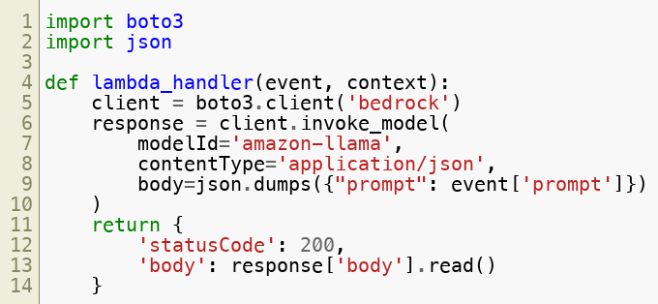
Setting Up a Lambda Function
Example:
Copyright © 2024 by Elephant Scale, All Rights Reserved

Slide 27
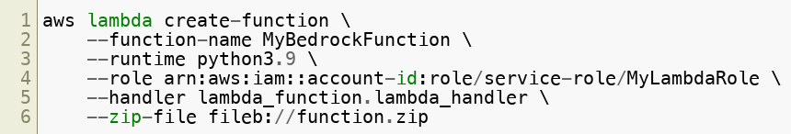
Deployment Steps
Use AWS CLI for deployment:
Copyright © 2024 by Elephant Scale, All Rights Reserved

Slide 28
Benefits of Serverless Architecture
Advantages :
Pay-as-you-go pricing.
Scales automatically with workload demand.
Real-world Scenarios :
Automating content generation workflows.
Integrating Bedrock into event-driven architectures.
Copyright © 2024 by Elephant Scale, All Rights Reserved

