Slide 1
DDDM Class
Copyright © 2021 by Elephant Scale, All Rights Reserved

Slide 2
About This Class
A practical, hands-on session
Goals
Developing Effective KPIs
Risk-Adjusted Benchmarking
Presentation of Benchmarking Data
Intro into anomaly detection (demo with visualization)
Copyright © 2021 by Elephant Scale, All Rights Reserved

Slide 3
Potential next session
Report Automation
Considerations
Excel, adhoc queries with SQL, Qlik
Scheduling, to relieve staff of the daily mundane tasks
Reusable Code
Building a report library
Tools/Techniques
Now using Teams and folders
Developing Self-Service Reporting
Enable people to run reports, putting the a, b, c topics together
Data Anomaly Detection/Correction
Detecting Statistical Outliers
Developing Error/Data Cleanup Processes
Copyright © 2021 by Elephant Scale, All Rights Reserved

Slide 4
Prerequisites & Expectations
Basic statistics and technical background
Basic knowledge of Excel
Copyright © 2021 by Elephant Scale, All Rights Reserved

Slide 5
Our Teaching Philosophy
Enable you to be an efficient data researcher
The essential knowledge of DDDM
Leaving you with enough knowledge to go deeper
Expose you to useful tools
Emphasis on concepts & fundamentals, not code
Highly interactive (questions, discussions, etc. are welcome)
Hands-on - lots of labs! (learn by doing)
Copyright © 2021 by Elephant Scale, All Rights Reserved

Slide 6
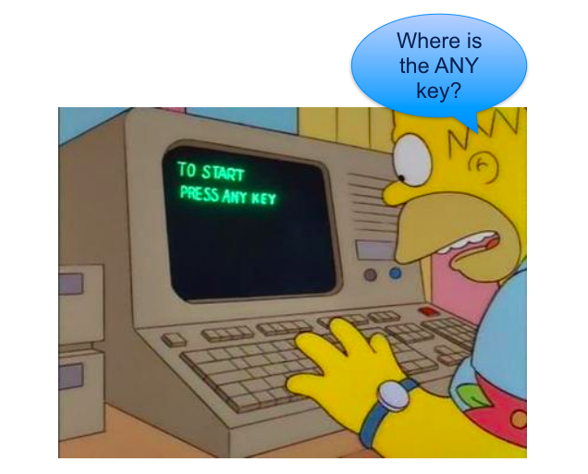
Lots of Labs: Learn By Doing
Copyright © 2021 by Elephant Scale, All Rights Reserved

Slide 7
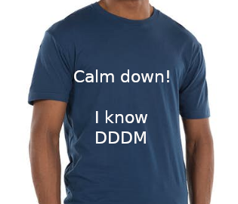
After The Class...
Copyright © 2021 by Elephant Scale, All Rights Reserved
Notes:
By the end of the class...

Slide 8
Class Logistics
Instructor's contact
Slides
For each session, slides will be emailed out or delivered via virtual classroom
Labs tasks
Lab files will be distributed
Labs playground
Provided in the cloud
Copyright © 2021 by Elephant Scale, All Rights Reserved

