Slide 1
Why Ansible?
Why Agentless?
Inventory
Install Ansible
Copyright © 2025 by Elephant Scale, All Rights Reserved

Slide 2

Stating a problem
Copyright © 2025 by Elephant Scale, All Rights Reserved

Slide 3

Answer
Copyright © 2025 by Elephant Scale, All Rights Reserved

Slide 4

Automation
Automating the management and deployment of a large infrastructure
Copyright © 2025 by Elephant Scale, All Rights Reserved

Slide 5

Ansible
Copyright © 2025 by Elephant Scale, All Rights Reserved

Slide 6
What is Ansible?
Ansible is a simple IT automation tool that makes your applications and systems easier to deploy.
Avoid writing scripts or custom code to deploy and update your applications
automate in a language that approaches plain English, using SSH, with no agents to install on remote systems.
Ansible is agentless, so you don’t have to install software on remote systems to manage them.
Copyright © 2025 by Elephant Scale, All Rights Reserved

Slide 7
Where to use Ansible
Configuration Management
Application Deployment
Continuous Delivery
Orchestration
Security Automation
Multi-Tier Applications
Cloud Provisioning
Network Automation
And more...
Copyright © 2025 by Elephant Scale, All Rights Reserved

Slide 8
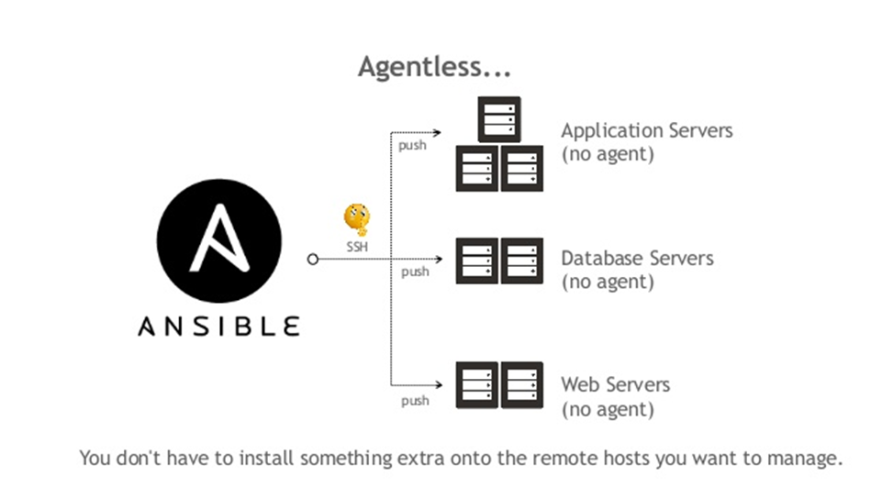
Agentless
Target systems do not need to have any software installed on them to be managed by Ansible.
Tasks are executed over SSH by default, but can also be executed locally.
<span style="font-size:15px; color:red"> except for Windows systems, which require a small Python executable to be installed. </span>
Copyright © 2025 by Elephant Scale, All Rights Reserved

Slide 9
Why Agentless?
Why Agentless? Inventory Install Ansible
Copyright © 2025 by Elephant Scale, All Rights Reserved

Slide 10
Idempotent
Ansible is idempotent, meaning that it can be run multiple times without changing the state of the system.
Copyright © 2025 by Elephant Scale, All Rights Reserved

Slide 11

Continued
Ansible is not a configuration management tool
BUT
it can be used to manage configuration files.
Copyright © 2025 by Elephant Scale, All Rights Reserved

Slide 12
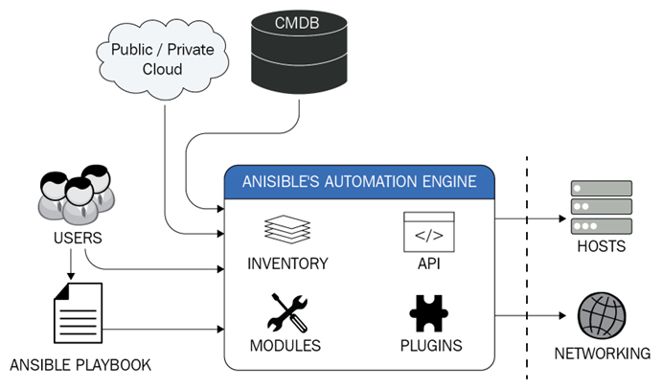
Ansible Architecture
Copyright © 2025 by Elephant Scale, All Rights Reserved

Slide 13

Run AGAINST
Means to run a specific adhoc, play or playbook on the specified host or group from the inventory
Copyright © 2025 by Elephant Scale, All Rights Reserved

Slide 14
Ansible Vs Chef Vs Puppet Vs SaltStack
Feature | Ansible | Chef | Puppet | SaltStack
Configuration language | YAML | Ruby DSL | Puppet DSL | YAML
Masterless support | Yes | No | No | Yes
Agent-based support | Optional (ansible-pull) | Yes | Yes | Yes
Idempotent execution | Yes | Yes | Yes | Yes
Real-time execution | Yes | No | No | Yes
Parallel execution | Yes | Yes | Yes | Yes
Dependency management | Yes | Yes | Yes | Yes
Dry-run testing | Yes | Yes | Yes | Yes
Declarative configuration | Yes | Yes | Yes | Yes
Copyright © 2025 by Elephant Scale, All Rights Reserved

Slide 15
Inventory
Why Agentless? Inventory Install Ansible
Copyright © 2025 by Elephant Scale, All Rights Reserved

Slide 16
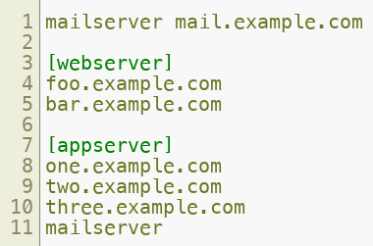
Inventory
A list of hosts that Ansible can manage
Can be static or dynamic
Can be defined in a file or in the command line
Copyright © 2025 by Elephant Scale, All Rights Reserved

Slide 17

INI Format
The INI format is a simple format that uses sections and key/value pairs
The sections are the groups of hosts
The key/value pairs are the hosts and their attributes
The attributes are optional
The attributes are used to define the connection parameters
The attributes are defined in the form of key=value pairs
The attributes are defined after the host name
Copyright © 2025 by Elephant Scale, All Rights Reserved

Slide 18
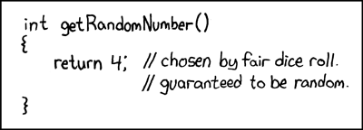
Static Inventory
A static inventory is a list of hosts defined in a file
The file is usually called hosts and is located in the /etc/ansible directory
The file can be in any format, but the most common one is the INI format
Copyright © 2025 by Elephant Scale, All Rights Reserved

Slide 19
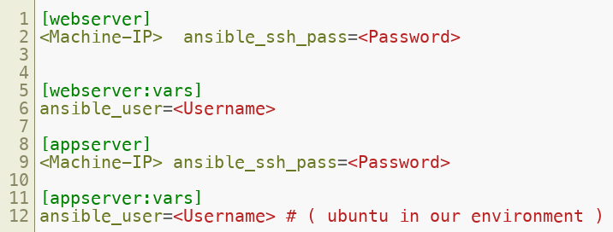
Example
Copyright © 2025 by Elephant Scale, All Rights Reserved

Slide 20
Dynamic Inventory
A dynamic inventory is a list of hosts that is generated by a script
The script can be written in any language
The script can be written to query a database, a cloud provider, or any other source
The script must return a JSON object with the list of hosts and their attributes
The script must be located in the /etc/ansible directory
Copyright © 2025 by Elephant Scale, All Rights Reserved

Slide 21
Install Ansible
Why Agentless? Inventory Install Ansible
Copyright © 2025 by Elephant Scale, All Rights Reserved

Slide 22
Install Ansible
Ansible is written in Python and, as such, can be installed on a wide range of systems
Debian
RedHat
FreeBSD
macOS
The one exception to this is Windows, though native Python distributions exist, there is yet no native Ansible build.
Copyright © 2025 by Elephant Scale, All Rights Reserved

Slide 23
Release Cycle
The release cycle for Ansible is usually about four months, and during this short release cycle, there are normally many changes, from minor bug fixes to major ones, to new features and even sometimes fundamental changes.
The simplest way to not only get up and running with Ansible but to keep yourself up to date is to use the native packages built for your operating system where they are available.
Copyright © 2025 by Elephant Scale, All Rights Reserved

Slide 24
LAB
Install Ansible
https://github.com/elephantscale/ansible-labs/blob/main/setup/Install-Ansible.md
Copyright © 2025 by Elephant Scale, All Rights Reserved

Slide 25
Ansible Ad-Hoc
Copyright © 2025 by Elephant Scale, All Rights Reserved

Slide 26
Ad-Hoc Commands
An Ansible ad hoc command uses the ansible command-line tool to automate a single task on one or more managed nodes.
ad hoc commands are quick and easy, but they are not reusable.
ad hoc tasks can be used to reboot servers, copy files, manage packages and users, and much more.* You can use any Ansible module in an ad hoc task.* ad hoc commands demonstrate the simplicity and power of Ansible
It will port over directly to the playbook language
For every ad hoc command you run, you will get a response in JSON format
You can use the -m option to specify the module to use
You can use the -a option to specify the arguments to pass to the module
You can use the -i option to specify the inventory file to use
Copyright © 2025 by Elephant Scale, All Rights Reserved

Slide 27

Example
Copyright © 2025 by Elephant Scale, All Rights Reserved

Slide 28
LAB
Adhoc Lab
https://github.com/elephantscale/ansible-labs/tree/main/adhoc
Copyright © 2025 by Elephant Scale, All Rights Reserved

