Slide 1
Vault certificate preparation
Copyright © 2021 by Elephant Scale, All Rights Reserved

Slide 2
HashiCorp certifications
Terraform Associate
Vault Associate
Consul Associate
Copyright © 2021 by Elephant Scale, All Rights Reserved

Slide 3
HashiCorp Security Automation Certification
HashiCorp Certified: Vault Associate
HashiCorp Security Automation Certification
Prerequisites
Basic terminal skills
Basic understanding of on premise or cloud architecture
Basic level of security understanding
Copyright © 2021 by Elephant Scale, All Rights Reserved

Slide 4
Exam Objectives
Compare authentication methods
Create Vault policies
Assess Vault tokens
Manage Vault leases
Compare and configure Vault secrets engines
Utilize Vault CLI
Utilize Vault UI
Be aware of the Vault API
Explain Vault architecture
Explain encryption as a service
Copyright © 2021 by Elephant Scale, All Rights Reserved
Notes:
https://www.udemy.com/course/hashicorp-certified-vault-associate/

Slide 5
Quiz
When Vault is sealed, it can access the physical storage but cannot read the data because it does not know how to decrypt them.
A. True
B. False
Copyright © 2021 by Elephant Scale, All Rights Reserved
Notes:
A.

Slide 6
Quiz
Batch tokens can be renewed indefinitely.
A. True
B. False
Copyright © 2021 by Elephant Scale, All Rights Reserved
Notes:
B.

Slide 7
Quiz
To seal a Vault, the client token must have the sudo capability on the sys/seal path.
A. True
B. False
Copyright © 2021 by Elephant Scale, All Rights Reserved
Notes:
A.

Slide 8
Quiz
Which statement is true about an orphan token?
A. It does not expire when its parent does
B. It is not persisted
C. It does not have a max time-to-live (TTL)
D. It has a use limit
Copyright © 2021 by Elephant Scale, All Rights Reserved
Notes:
A.

Slide 9

Quiz
Which path will this policy allow?
A. kv/team_edu
B. kv/us-west/team
C. kv/us-west/team_edu
D. kv/us-west/ca/team_edu
Copyright © 2021 by Elephant Scale, All Rights Reserved
Notes:
C.

Slide 10
Quiz
What is true of Vault tokens? Choose TWO correct answers.
A. Vault tokens are generated by every authentication method login
B. Vault tokens are also known as unseal keys
C. Vault tokens are required for every Vault call
D. Vault token IDs always begin with "s." such as s.E7rOurS2n7m2Dt5409jWxR87
E. Vault tokens are the core method for authentication in Vault
Copyright © 2021 by Elephant Scale, All Rights Reserved
Notes:
A., E.

Slide 11
Quiz
Which statements correctly describe the command below? Choose TWO correct answers.
A. Returns an error due to missing encryption key name
B. Returns base64-encoded plaintext
C. Decrypts the ciphertext if the token permits
D. Returns the ciphertext
E. Requires sudo capability on the transit/decrypt/password path
Copyright © 2021 by Elephant Scale, All Rights Reserved
Notes:
B., C.

Slide 12
Quiz
An organization needs to protect sensitive application data currently stored in a database as plaintext. Which secrets engine provides a solution?
A. Key/Value v2 secrets engine
B. Cubbyhole secrets engine
C. Transit secrets engine
D. Database secrets engine
Copyright © 2021 by Elephant Scale, All Rights Reserved
Notes:
C.

Slide 13
Quiz
Which of the following statements explains the benefit of response wrapping? Choose TWO correct answers.
A. Limits the time of secret exposure by having a short-lived wrapping token
B. Allow versioning of the secrets
C. It protects Vault's master key
D. Only the reference to the secrets is transmitted over the public network
E. Limits the size of secrets to be transmitted over the network
Copyright © 2021 by Elephant Scale, All Rights Reserved
Notes:
A., D.

Slide 14
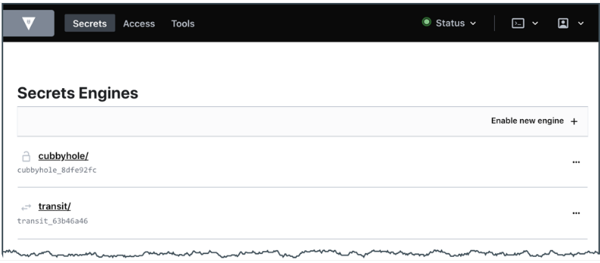
Quiz
You need to edit a policy, but the UI appears as shown. What is the problem?
A. This is an UI error. Contact support.
B. You don't have a permission to manage policies.
C. Vault UI does not support policy creation and management.
D. Use the command shell in UI to manage policies.
Copyright © 2021 by Elephant Scale, All Rights Reserved
Notes:
B.

Slide 15
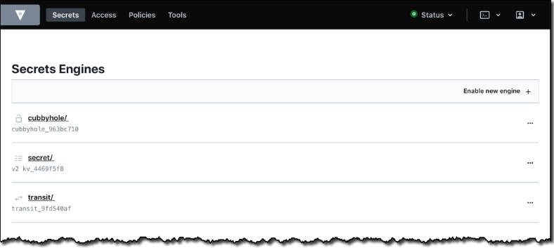
Quiz
Where on the page would you click to display the list of available Vault-created encryption keys?
A. Cubbyhole/
B. Secrets/
C. Transit/
Copyright © 2021 by Elephant Scale, All Rights Reserved
Notes:
C.

