Slide 1
Security Intro
Copyright © 2021 by Elephant Scale, All Rights Reserved

Slide 2

Personal Story
Hacker comes to town!
Jeremiah Grossman
Copyright © 2021 by Elephant Scale, All Rights Reserved

Slide 3
Grossman's Lessons
Make life (work) harder for hackers
And they will go elsewhere
Copyright © 2021 by Elephant Scale, All Rights Reserved

Slide 4
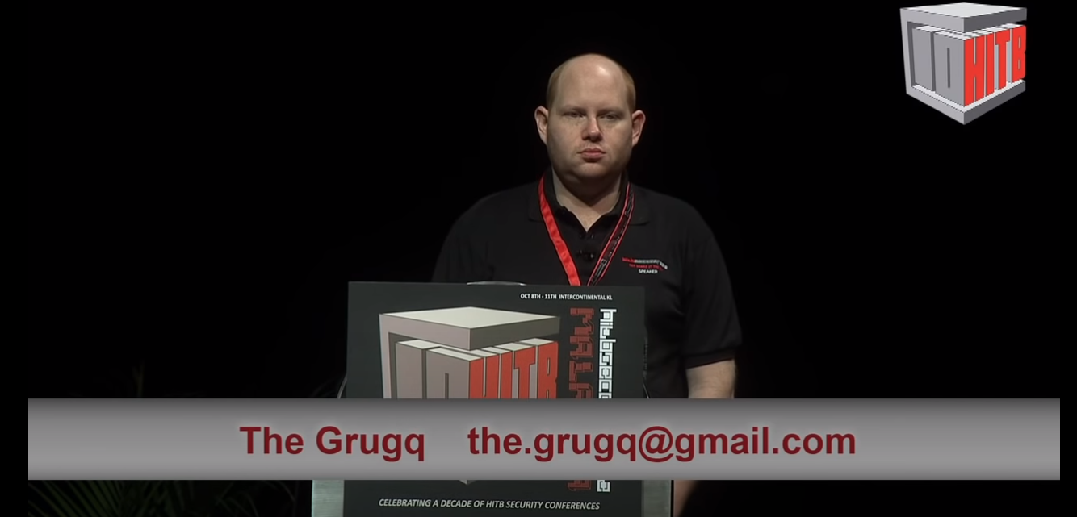
Told by GrugQ
Copyright © 2021 by Elephant Scale, All Rights Reserved

Slide 5
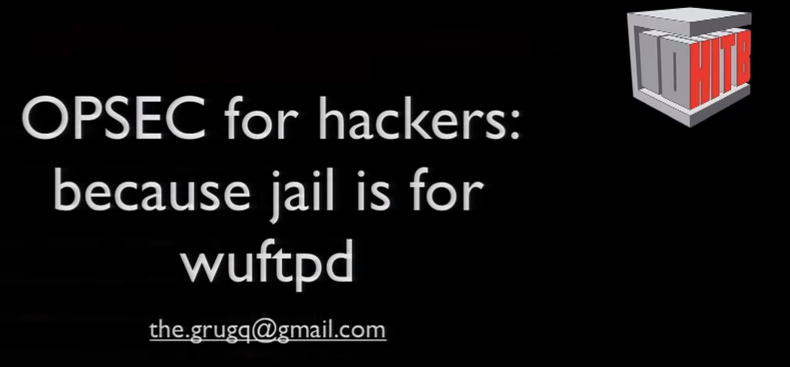
Hacking is a lifestyle
Copyright © 2021 by Elephant Scale, All Rights Reserved

Slide 6
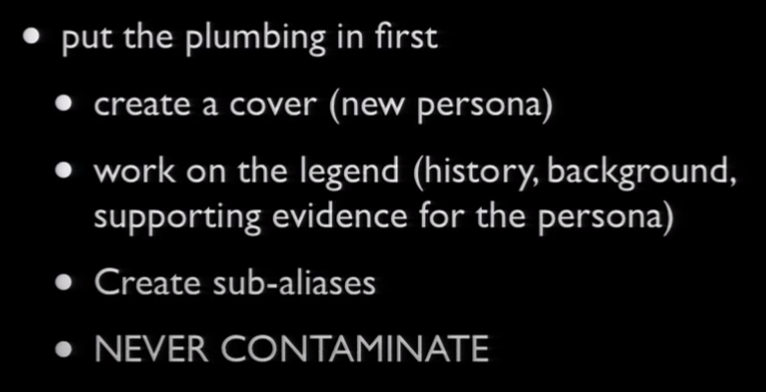
Summary of hacker advice
Copyright © 2021 by Elephant Scale, All Rights Reserved

Slide 7
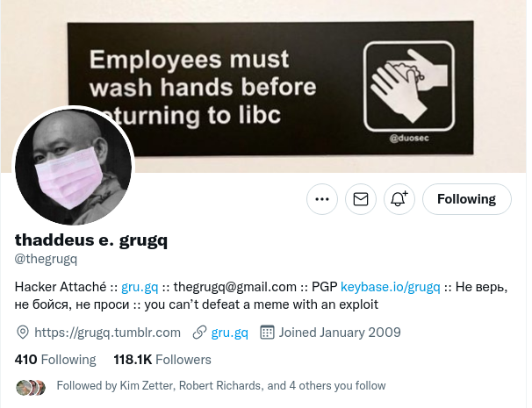
GrugQ Twitter
Copyright © 2021 by Elephant Scale, All Rights Reserved
Notes:
Followed by 118K
@thegrugq

Slide 8
Practically
You could do this:
Validate all inputs
Protect against all (?) attacks
Encrypt your data, in motion and in rest
And you will not be blamed
But this is dull
and brings no new functionality
Copyright © 2021 by Elephant Scale, All Rights Reserved

Slide 9
Suggestion
At times, let us play games
Red Team attacks
Blue Team defends
Tell your boss, you are doing security :)
Copyright © 2021 by Elephant Scale, All Rights Reserved

Slide 10
Criminal Economy
Criminal marketplaces
Escrow services
Bitcoin
Vouchers
Gift cards
Copyright © 2021 by Elephant Scale, All Rights Reserved

Slide 11
Is FBI involved?
Yes
Working with other agencies
Across borders
But they can only do so much
Copyright © 2021 by Elephant Scale, All Rights Reserved

Slide 12
Criminal Operations
Highly specialized
Productized
How can we imitate it?
By acquiring either a Red Team of Blue Team specialization
Copyright © 2021 by Elephant Scale, All Rights Reserved

