Slide 1
Common Attacks
Copyright © 2021 by Elephant Scale, All Rights Reserved

Slide 2
What this Module Covers
This module explores the following common attacks:
Cross site scripting (XSS)
Malicious file execution
Session hijacking
Encryption attacks
Unsecured direct object reference
Failure to authorize/hidden URLs
Cross site request forgery (CSRF)
There are other attacks not covered in this module
OWASP maintains a project identifying the current top ten attacks
[OWASP Top Ten] https://owasp.org/www-project-top-ten/
Copyright © 2021 by Elephant Scale, All Rights Reserved

Slide 3
Cross Site Scripting (XSS)
A form of injection attack
Malicious scripts are injected into an HTTP response from a trusted website
Because the script is from a trusted source, the user's browser executes it as trusted code
The browser cannot determine that the script originated from an untrusted source
The XSS script has the same level of trust as the website the HTTP response originated from
XSS is a common attack for stealing information stored in the user's browser
And for "drive-by" installation of malware on a computer
Copyright © 2021 by Elephant Scale, All Rights Reserved

Slide 4
Types of XSS Attacks
There are three types of XSS attacks
Stored XSS: Also referred to as persistent or Type I attacks
Reflected XSS: Also referred to as Type II attacks
DOM XSS: Also referred to as Type 0 attacks
XSS attacks rely on users clicking on a link to an infected URL
Social Engineering refers to the manipulative methods used to induce users to take some action to trigger the XSS attack
Email phishing is one of the most common
Potential victims are sent an email with the infected URL and a deceptive description
E.g. Limited time promotion: claim your $100 discount on your next Amazon purchase!!
The source of the email is usually spoofed or made to look like a legitimate sender the victim would trust
Copyright © 2021 by Elephant Scale, All Rights Reserved

Slide 5
Persistent XSS Attack
An attacker injects or inserts a malicious script payload into a trusted website
Vulnerable websites fail to check if the input is executable code
Typical injection targets are blog comments and other user generated content
A victim accessing the infected page will download the script payload in the HTTP response
The victim's browser executes the XSS payload code as it loads the HTTP response
Email phishing is usually used to trick users into visiting the infected URL
Copyright © 2021 by Elephant Scale, All Rights Reserved

Slide 6
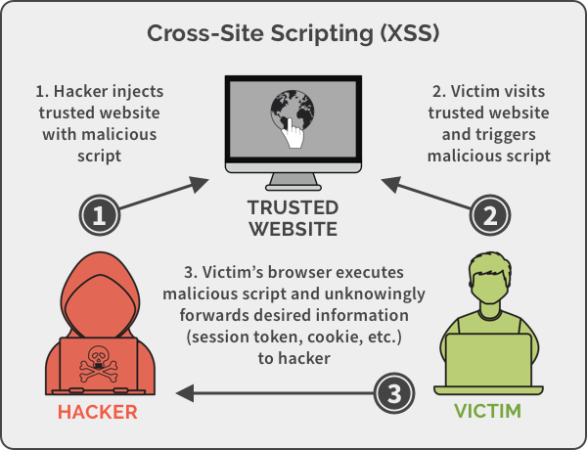
Persistent XSS Attack
Copyright © 2021 by Elephant Scale, All Rights Reserved
Notes:
Image credit: https://spanning.com/blog/cross-site-scripting-web-based-application-security-part-3/

Slide 7
Persistent XSS Attack Example
A blog saves comments on posts exactly as entered by users
An attacker posts the following comment which contains a malicious payload
When a victim loads the page containing the comment, the payload in the comment executes
The attack payload remains in persistent storage on the server
Multiple users may become victims of the attack
Phishing is used to deceptively direct victims to the URL containing the payload
OMG!!!, can you believe what this guy wrote!!! (link to payload comment)
Copyright © 2021 by Elephant Scale, All Rights Reserved

Slide 8
Sammy's Worm
Sammy's worm was an early (2005) worm that propagated through the MySpace user community by using an XSS attack
The worm displayed the message "Sammy is my hero," then sent a friend request to the author Sammy Kamkar
When an infected profile page was viewed, the payload would be replicated on the viewer's MySpace page
Within 20 hours, the worm was on one million MySpace pages - Sammy was arrested shortly after
A code fragment from the attack is shown below - notice where the XSS payload is located
Copyright © 2021 by Elephant Scale, All Rights Reserved

Slide 9
Reflected XSS Attack
A victim is induced to click on a malformed URL to a trusted website
The malformed URL is crafted to produce some sort of error HTTP response
The attack payload is part the malformed URL
Vulnerable websites will echo the attack payload as part of the HTTP response
When the response is opened in the victim's browser, the payload executes
This has the effect of "bouncing" the attack payload off of a trusted website
Copyright © 2021 by Elephant Scale, All Rights Reserved

Slide 10
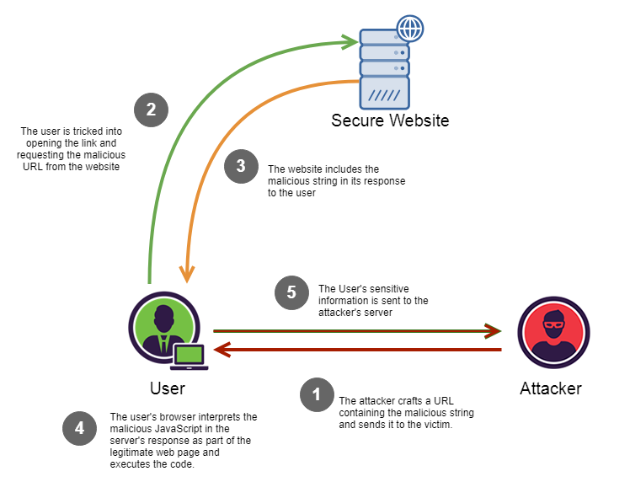
Reflected XSS Attack
Copyright © 2021 by Elephant Scale, All Rights Reserved
Notes:
Image Credit: https://medium.com/iocscan/reflected-cross-site-scripting-r-xss-b06c3e8d638a

Slide 11
Reflected XSS Attack Example
An attacker sends a link to a target in email which looks like:
Along with a deceptive description like Please review this suspicious transaction on your account
A vulnerable website will return the unfiltered content of the query in the error message
When the error page is loaded, the payload is executed in the victim's browser
Copyright © 2021 by Elephant Scale, All Rights Reserved

Slide 12
DOM XSS Attack
The attack payload is executed by modifying the DOM “environment” in the victim’s browser
The modification causes the original client side script to run in an “unexpected” manner
The HTTP responses is not affected, the HTML does not contain the attack payload
The payload is in the body of the page as part of the DOM tree
The client side code now executes differently because of the DOM modification
Generally executed by injecting malicious code as parameters or URI fragments
The malicious code is then incorporated into the existing page code
Copyright © 2021 by Elephant Scale, All Rights Reserved

Slide 13
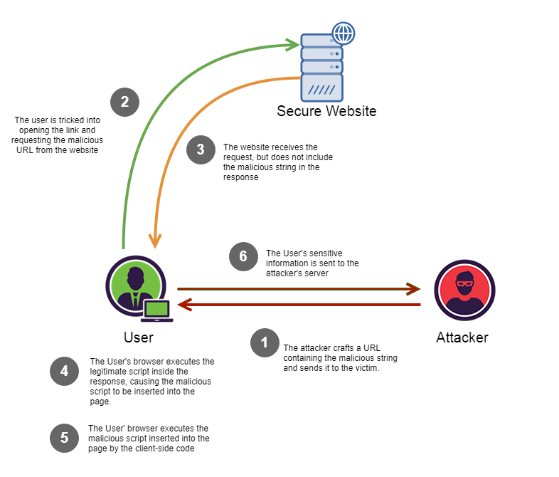
DOM XSS Attack
Copyright © 2021 by Elephant Scale, All Rights Reserved
Notes:
Image Credit: https://medium.com/iocscan/dom-based-cross-site-scripting-dom-xss-3396453364fd

Slide 14
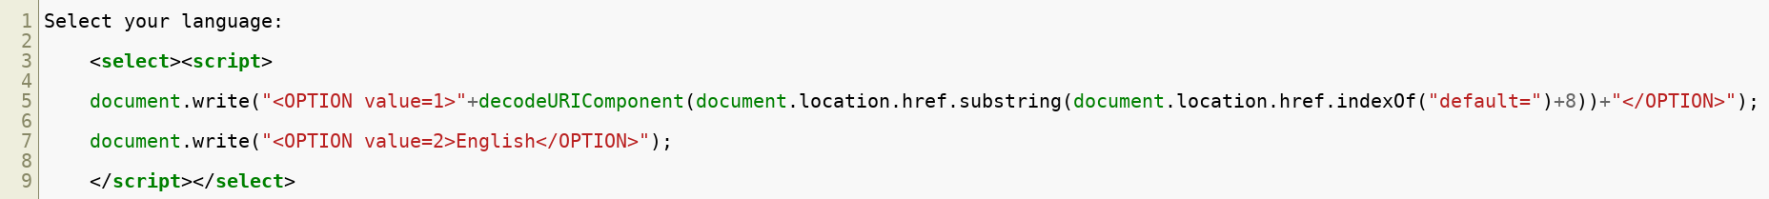
Example #1 - Parameter Insertion
A website allows users to select their language but uses English as the default:
This is processed by a script like this:
Note that the URI parameter "default=English" becomes part of the script
Copyright © 2021 by Elephant Scale, All Rights Reserved

Slide 15
Example #2 - Parameter Insertion
The attacker social engineers a victim to click on an altered link:
The original Javascript code in the page does not expect the default parameter to contain HTML markup
The markup is decoded and incorporated into the page's existing code
When browser renders the infected page, the incorporated attack payload is executed
The HTTP HTML response does not contain the payload
This payload is delivered in a modified client-side script
Copyright © 2021 by Elephant Scale, All Rights Reserved

Slide 16
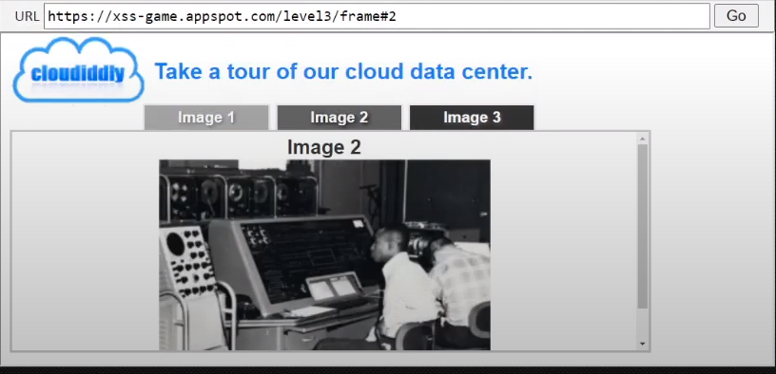
Example #2 - URI Fragment
The example above is a typical Single Page Application where the current user selection is indicated by a URI fragment
The user has selected image 2 so the URL is:
If the user selects image 1, then the URL is:
Copyright © 2021 by Elephant Scale, All Rights Reserved

Slide 17
Example #3 - URI Fragment
Determining the current page is done in the browser without accessing the server
A DOM XSS attack would be to cause the underlying code to throw an error and supply error handler that executes the attack payload
The onerror executes whatever JavaScript immediately follows it
When this link is visited by a victim, the exploit will execute
Copyright © 2021 by Elephant Scale, All Rights Reserved

Slide 18

The eBay XSS Attack
In 2014, hackers exploited an XSS vulnerability in the eBay website
Users were redirected to a fake login page used to harvest their login credentials -BBC Report: eBay redirect attack puts buyers' credentials at risk https://www.bbc.com/news/technology-29241563
Other companies suffering major XSS attacks are Minecraft, Wordpress, Adobe and others
Copyright © 2021 by Elephant Scale, All Rights Reserved

Slide 19
Defences Against XSS Attacks
XSS relies on social engineering like phishing attacks to get victims to click on the link provided by the attacker
First line of defence is to train users to not click on unvetted links in emails or posts
Email filtering can block links or to allow only whitelisted links
The primary website defence against XSS is to remove the website vulnerabilities that allow the injection of malicious code
For persistent XSS, this means not allowing code to inserted as if it were data
For reflected XSS, this means not allowing user supplied HTML in website responses
For DOM XSS, this means that all potential invalid or unexpected inputs are handled correctly
Copyright © 2021 by Elephant Scale, All Rights Reserved

Slide 20
Other XSS Preventive Measures
Implement Content Security Policy
A browser side directive to specify allowed sources of content
The directive below allows JavaScript to be loaded only from the page's site and from static.domain.tld
Hold all user generated or untrusted content for review before publishing
Copyright © 2021 by Elephant Scale, All Rights Reserved

Slide 21
Malicious File Execution
There are two basic types of malicious file execution
Client side attacks
Malicious code is inserted into the client machine to compromise its operations
Often targets communications between the browser and the browser security mechanisms
Server side attacks
Malicious code is inserted into the server environment to execute on the server or to interfere with the server operations
Often the result of poor security protocols on the server side
Copyright © 2021 by Elephant Scale, All Rights Reserved

Slide 22
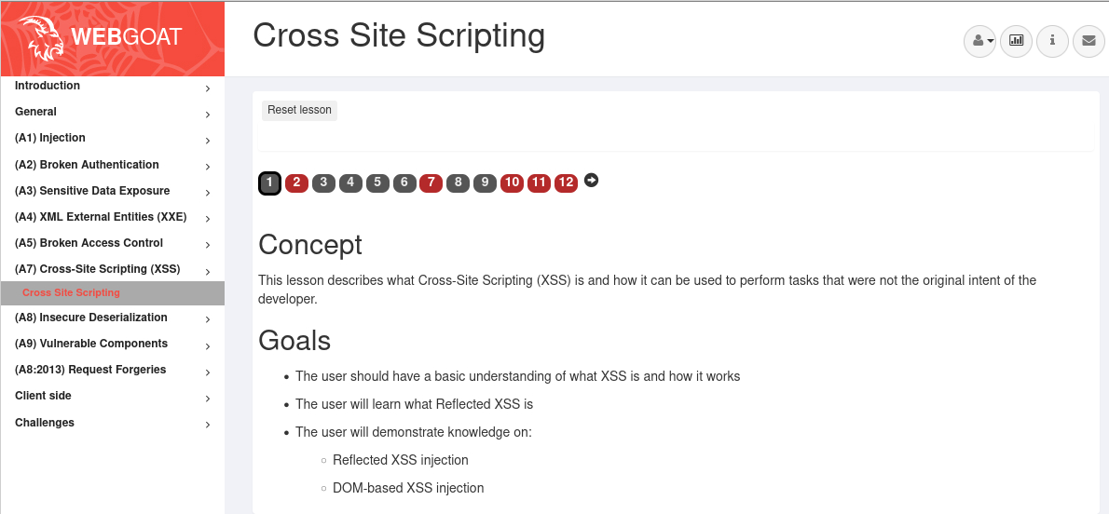
Labs
Goat labs for XSS
Copyright © 2021 by Elephant Scale, All Rights Reserved

Slide 23
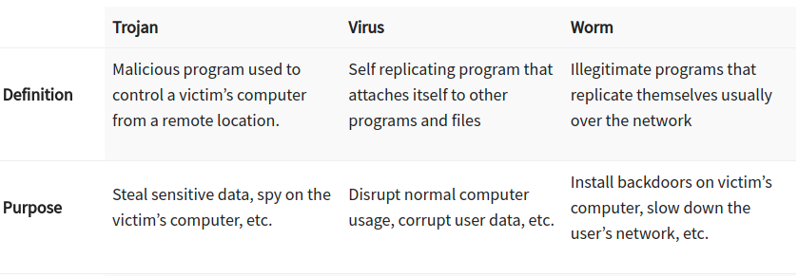
Client Side Attacks
The primary type of software used in a client side attack is a Trojan
Trojans are malicious code masquerading a trusted application
Trojans can also modify existing trusted applications
One of the most common client side attacks
Enables other attacks like session hijacking and manipulator in the middle
Other client side malware deliver vectors are worms and viruses
Worms and viruses are used to propagate malware across systems
The payload of a worm or virus is often a Trojan
Copyright © 2021 by Elephant Scale, All Rights Reserved
Notes:
Image Credit: www.guru99.com/learn-everything-about-trojans-viruses-and-worms.html

Slide 24
Common Types of Trojans - RATs
Remote Access Trojan (RAT): Allows attacker to take full control a computer
Often disguised as a utility or extension to an existing trusted program
Social Engineering often used to gain access to a machine for installation of the RAT
Eg. The Windows Support Scam is a social engineering attack for RAT installation
Users are served a phony webpage, shown on the next slide, often from some phishing attack
After calling the number, victims give scammers remote access to their computer
The scammers install a RAT disguised as an anti-virus or other utility
The scammers have free access to the infected machine to perform other attacks
Copyright © 2021 by Elephant Scale, All Rights Reserved

Slide 25
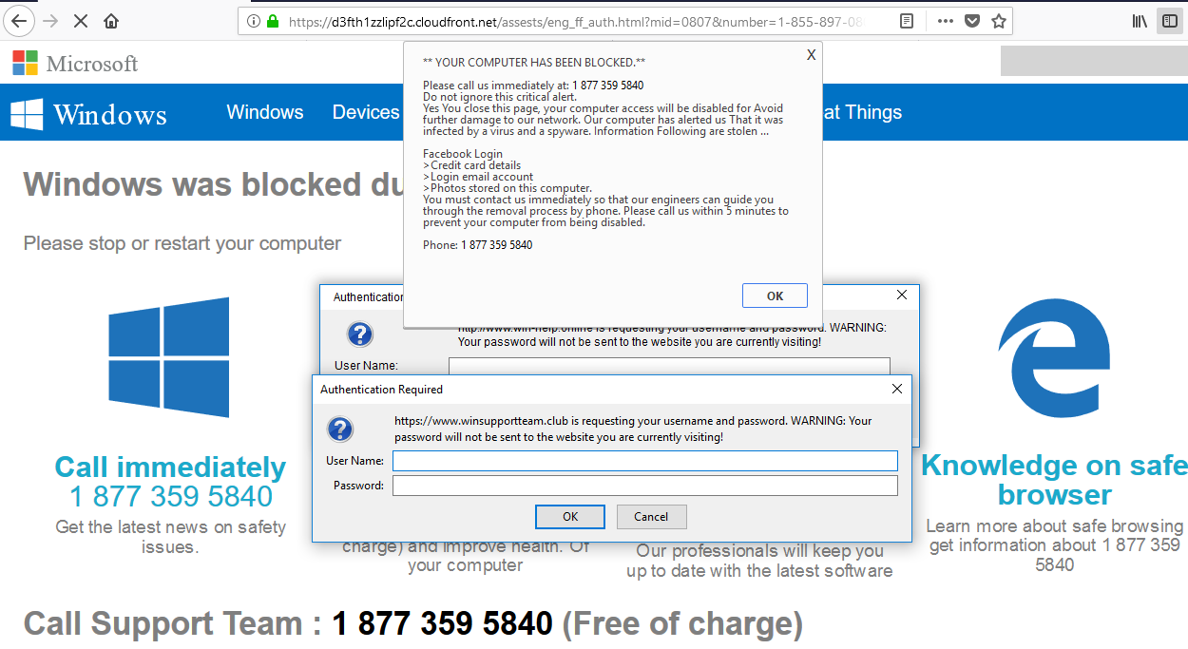
Windows Support Scam
Copyright © 2021 by Elephant Scale, All Rights Reserved
Notes:
Image Credit: wolfstreet.com/2018/08/19/scam-critical-alert-from-microsoft-iexplore-www-support-me-malware/

Slide 26
Common Types of Trojans - Loggers
Data Sending Trojan : Uses keylogger technology to capture sensitive data
Example passwords, credit card and banking information
Stolen data is sent to the attacker
Loggers are often part of malware with multiple functions or attacks
For example, collecting and sending all phone and computer data found on a computer
Often modifies the display of trusted web pages to request additional information to harvest
Login Trojans spoof legitimate login pages of well known sites to harvest user credentials
Copyright © 2021 by Elephant Scale, All Rights Reserved

Slide 27
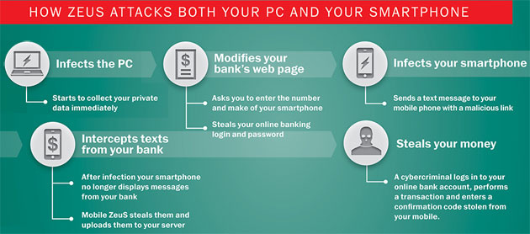
Zeus Trojan
The Zeus malware was a very widespread and highly damaging Trojan
The main attack vector was a phishing email containing a URL for an XSS attack
Opening the URL installed Zeus on the victim's computer
Zeus didn't masquerade as an application but rather modified existing applications
Currently not active, it is the basis for developing other trojans
Copyright © 2021 by Elephant Scale, All Rights Reserved
Notes:
Image Credit: https://techieandwhatever.blogspot.com/2017/06/what-is-zeus-malware-and-how-does-it.html

Slide 28
Other Trojan Types
Destructive Trojan: Designed to destroy data stored a computer
Eg. Ransomware since the encrypted data is often never recovered
Proxy Trojan: Uses the victim’s computer as a proxy server
Enables attackers to execute illicit acts from the infected computer
This is often used to creat BotNets or networks of controlled computers
FTP Trojan : Uses port 21 to enable FTP file uploads to the victim’s computer
Security software disabler Trojan: Disables security software like firewalls and antivirus software
Denial-of-Service attack Trojan: Designed to give the attacker ability to perform DOS attacks from victim’s computer.
Copyright © 2021 by Elephant Scale, All Rights Reserved

Slide 29
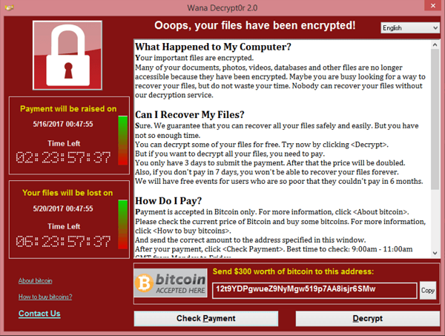
Ransomware - A Client Side Attack
Ransomware is the leading malware problems exemplified by 2021 cases like Colonial Pipeline, JBS Foods and the NBA
Typical attack vector is a phishing email using XSS attack to install the ransomware
Exploits vulnerabilities that allow running malicious code on the target computer (eg. unpatched security holes)
Ransomware can also be installed by a victim via compromised applications
Copyright © 2021 by Elephant Scale, All Rights Reserved
Notes:
Image Credit: en.wikipedia.org/wiki/WannaCry_ransomware_attack#/media/File:Wana_Decrypt0r_screenshot.png

Slide 30
Client Attack Defences
Since client attacks often start with an XSS attack, mitigating XSS attacks also helps prevent client side attacks
Trojans also spread via viruses and worms
Up to date anti-virus and malware scanning tools can block these vectors
Firewalls and other filtering tools can prevent access through open ports
Malware exploits unpatched security holes which can be mitigated by regular system updates
Users and programs should have only the level of access required
Eg. Administrative privileges for installing software are only granted for vetted applications
Copyright © 2021 by Elephant Scale, All Rights Reserved

Slide 31
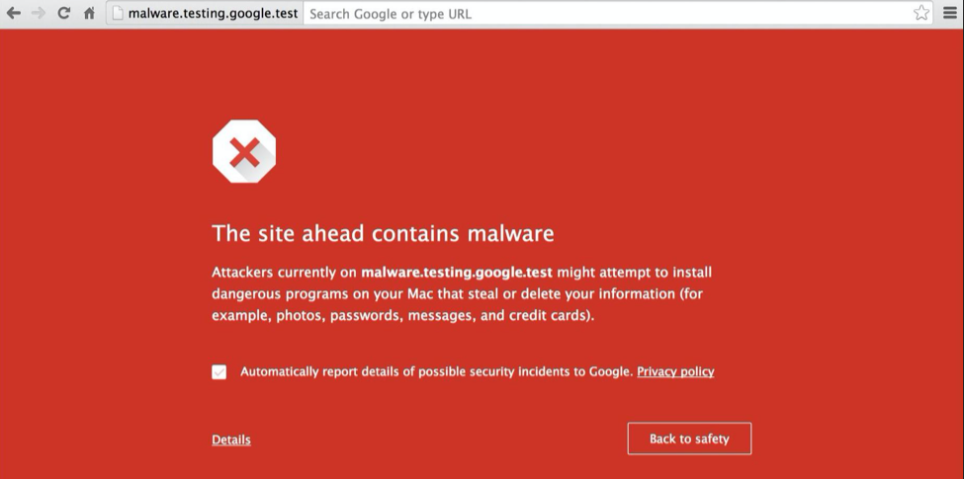
Client Attack Defences
Modern browsers have access to databases of know sources of malware
Following browser recommendations about unsafe sites mitigates XSS and other malware risks
Copyright © 2021 by Elephant Scale, All Rights Reserved

Slide 32
Server Side Attacks
Server side attacks have two primary modes
The first mode is to execute code on the server to control, damage or subvert the server
Installed malware can be used to harvest data, perform fraudulent actions or control the server
This often includes backdoors to allow attackers access to the system
Most of the scenarios and defences for client side attacks also apply
Some specific attacks are covered in session hijacking
The second mode is feed data to the server that is intended to cause existing programs on the server to be compromised
The goals of this attack mode is to render the server inoperable
Or to put the server into an unstable state to create vulnerabilities for further attacks
Copyright © 2021 by Elephant Scale, All Rights Reserved

Slide 33

OPM Hack and Data Breech
In 2015, the OPM disclosed that data on 21.5 million people had been stolen
Data stolen included millions of SF-86 forms
SF-86 forms contain the personal information used to process security clearances
Considered one of the most devastating cyberattacks of all time on the US Government
Copyright © 2021 by Elephant Scale, All Rights Reserved
Notes:
https://www.csoonline.com/article/3318238/the-opm-hack-explained-bad-security-practices-meet-chinas-captain-america.html https://www.opm.gov/cybersecurity/cybersecurity-incidents/

Slide 34
Office of Personal Management
How the hackers initially gained access has not been revealed
Likely through the direct installation of malware by a compromised individual
Once access was gained, hackers exfiltrated technical and administrative manuals for the system
Keyloggers on database adminstrators' terminals were installed
A backdoor into the system was also installed
Before being shut down, hackers also stole top secret manuals and documents about OPM procedures for conducting security clearances
Copyright © 2021 by Elephant Scale, All Rights Reserved

Slide 35
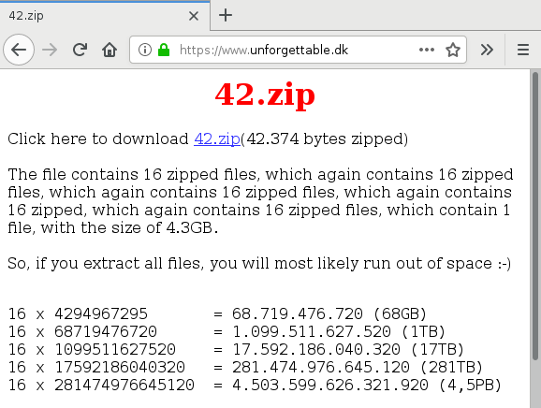
Decompression Bomb Attack
A decompression bomb is an archive file that is uploaded to a server
The file is designed so that unpacking the file overwhelms the system's resources
The 42.zip zip bomb file is 42 kilobytes in size but unpacks into 4.5 petabytes
Copyright © 2021 by Elephant Scale, All Rights Reserved
Notes:
Image Credit: www.bamsoftware.com/talks/woot19-zipbomb/

Slide 36
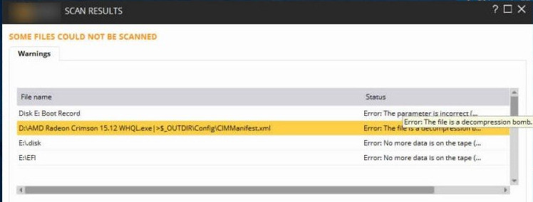
Decompression Bomb Attack
Decompression bomb attacks are designed to either crash the server or put it into a vulnerable state
Also used to disable anti-virus software
Older AV software will try to extract the contents of a zip bomb which results in the software crashing
Since the structure of zip bombs are well known, most up-to-date AV and threat scanning software can identify them
The threat is mitigated by banning archive files or performing scans for potential bombs
Copyright © 2021 by Elephant Scale, All Rights Reserved
Notes:
Image Credit: techbytesonline.com/what-actually-is-zip-bomb-zip-of-death/

Slide 37
Session Hijacking
HTTP is a stateless protocol but user interactions are usually stateful
For example, logging onto a web banking session
You have to be in an authenticated state before doing any banking
User session state is managed by some sort of session management token
This token identifies the client browser as the correct user for that session
Session hijack attacks involve stealing the token from a victim's session
The attacker can now take the place of the real user and perform actions the real user would be allowed to do in the session
For example, hijacking an on-line banking session and transferring funds to the attacker's account
Copyright © 2021 by Elephant Scale, All Rights Reserved

Slide 38
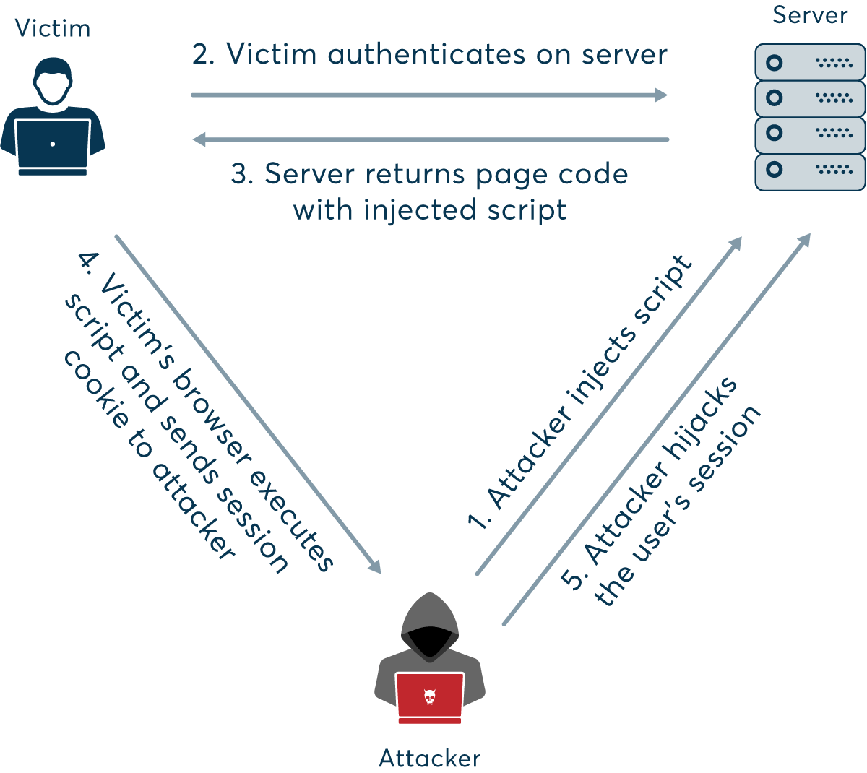
Session Hijacking
Copyright © 2021 by Elephant Scale, All Rights Reserved
Notes:
Image Credit: www.netsparker.com/blog/web-security/session-hijacking/

Slide 39
Session Hijacking
A session hijacking requires obtaining the session token
There are several ways this is done
Guessing predicable session tokens
Client side attacks, like XSS, to steal tokens
Trojans and malware on the client machine
Session sniffing
Two common forms of attacks that are enabled by session hijacking are:
Manipulator in the Middle Attack
Manipulator in the Browser Attack
Copyright © 2021 by Elephant Scale, All Rights Reserved

Slide 40
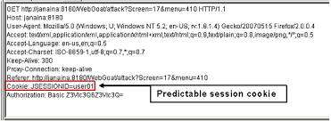
Predicable Session Tokens
Vulnerability is due to poor security design
Eg. using the user ID or other piece of data as the session token
Short tokens are easier to guess or to crack using brute force
Tokens that follow a predicable sequence can be predicted
To avoid this specific vulnerability
Use long and randomly generated session tokens
Change the token after each request or at random times
Copyright © 2021 by Elephant Scale, All Rights Reserved
Notes:
Image Credit: owasp.org/www-community/attacks/Session_Prediction

Slide 41
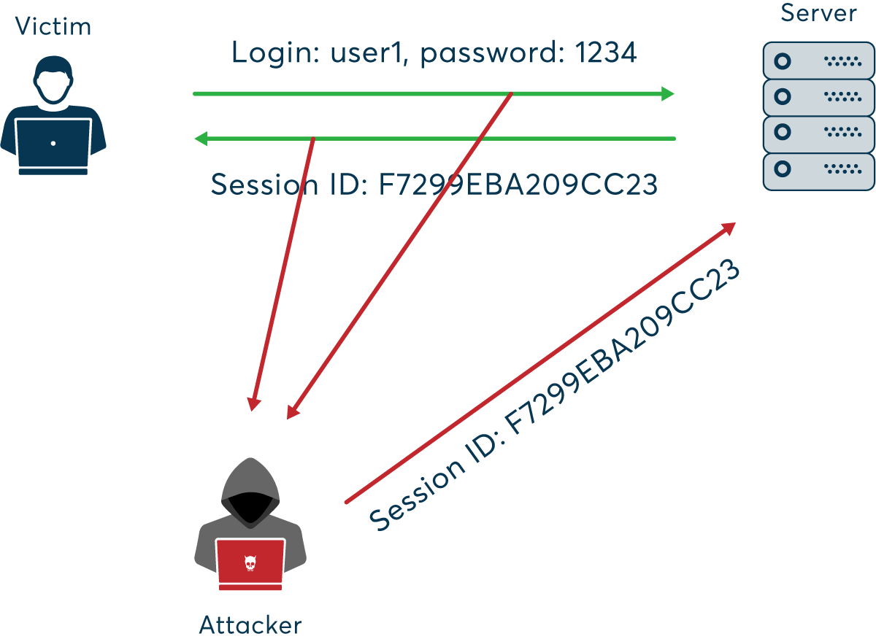
Sniffing Attacks
Copyright © 2021 by Elephant Scale, All Rights Reserved
Notes:
Image Credit: www.netsparker.com/blog/web-security/session-hijacking/

Slide 42
Sniffing Attacks
Attacker uses packet sniffing to monitor HTTP traffic and mine session tokens and credentials
To avoid this specific vulnerability:
Use HTTPS for all traffic - all of the session traffic will be encrypted including tokens
Use HTTPOnly to prevent access to stored cookies on the client machine
Constantly changing session keys to invalidate any captured tokens
Use a VPN - All traffic move through and "encrypted channel" that cannot be sniffed
Avoid unsecured WiFi networks since you don't know who is listening
Don't rely on just session keys to establish ID - use URLs, usage patterns or other identifying data as well
Copyright © 2021 by Elephant Scale, All Rights Reserved

Slide 43
Manipulator in the Middle Attack
Occurs when an attacker places themselves in a conversation between a victim and application
Often used to eavesdrop on communications
Allows the attacker to collect credentials and other information
Typical target are interactions between users and financial institutions
Or any application that requires authentication
Also used to "spoof" or impersonate one of the parties
Used to create a vulnerability to be exploited by a later attack
For example, spoofing wikipedia to install malware on the target's computer
NSA reportedly used a MitM attack to intercept traffic between targets and Google
Copyright © 2021 by Elephant Scale, All Rights Reserved
Notes:
Image Credit: www.imperva.com/learn/application-security/man-in-the-middle-attack-mitm/

Slide 44
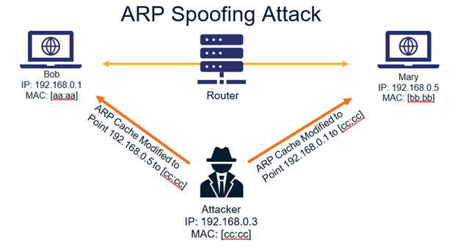
Spoofing Attacks
Man in the middle attacks can be initiated by a spoofing attack
IP Spoofing: Addresses in packet headers are altered so that traffic is routed to the attackers IP address
ARP Spoofing: Links attackers MAC address to a user's IP address on a network by using fake ARP messages
DNS Spoofing: Involves altering a DNS record so that users are sent to the attackers IP address
Neither party is aware that their traffic is passing through the attacker's spoof
Copyright © 2021 by Elephant Scale, All Rights Reserved
Notes:
Image Credit: thesslstore.com/blog/everything-you-need-to-know-about-arp-spoofing/

Slide 45
Mitigating MitM Attacks
Users should not use unsecured WiFi connections
Follow browser warnings about possible attempted MitM attack
Avoid using public networks - using VPNs is more secure
Servers should use robust communications protocols and encryption (TSL and HTTP) for every page
Timeouts to terminate idle applications to force new sessions
Copyright © 2021 by Elephant Scale, All Rights Reserved

Slide 46
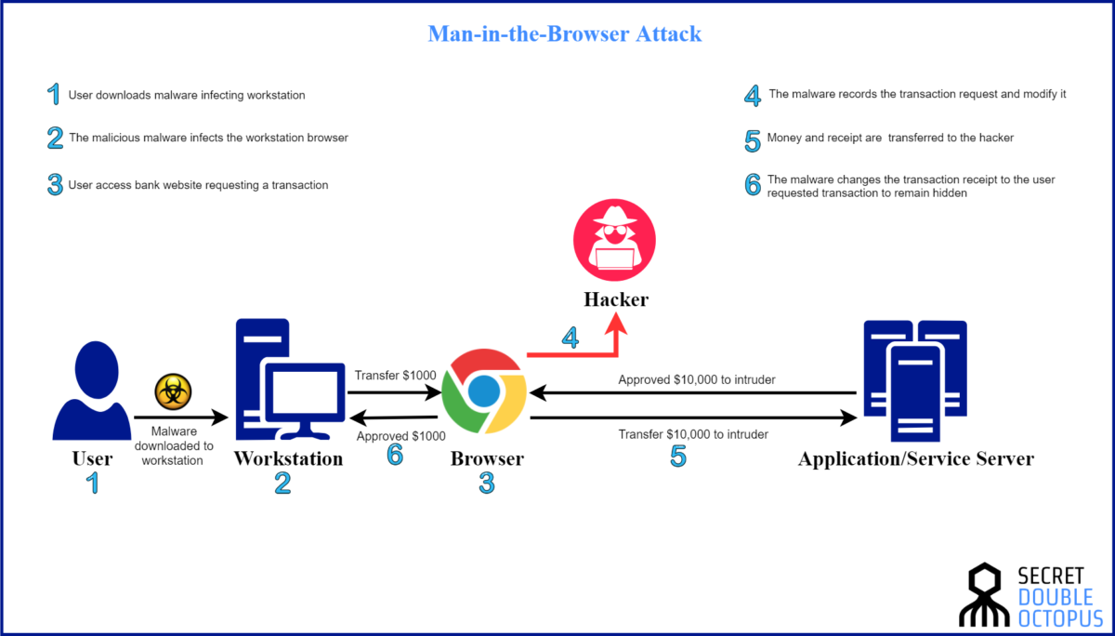
Manipulator in the Browser Attacks
MitB attacks manipulate traffic before it reaches the browser security layers
Enabled by trojans in infected libraries, browser extensions or helper applications
Mitigated by good malware defences and protocols
The Zeus trojan used MitB to add attacks to legitimate webpages
Copyright © 2021 by Elephant Scale, All Rights Reserved
Notes:
Image Credit: doubleoctopus.com/security-wiki/threats-and-tools/man-in-the-browser-attack/

Slide 47
Encryption Attack Vulnerabilities
Encryption attacks take a number of different forms
The most obvious is to find weaknesses where:
Encryption is not used - data or messages are clear text
Sensitive data is stored in accessible logs or caches
Weak or old cryptographic algorithms are in use
Weak or easily cracked cryptographic keys and passwords ("qwerty123") are in use
Other weakness occur when:
Encryption is done poorly or inconsistently
Authentication of SSL certificates is not done robustly
Copyright © 2021 by Elephant Scale, All Rights Reserved

Slide 48
Encryption Vulnerability Examples
Data is automatically decrypted when retrieved via an SQL query
SQL injection attack could to obtain information in clear text
Simple hashes are used to store data
Attacker can crack hashes by brute force computation
Rainbow tables are precomputed tables of output of hashing functions that allow for reverse engineering the hash
Poor key management
Attacker can gain access to the directories where keys are stored
Attacker can sniff keys included in messages or headers
Keys can be altered or destroyed to cause the system to fail
Mobile applications are especially susceptible
Copyright © 2021 by Elephant Scale, All Rights Reserved

Slide 49
Encryption Attack Mitigation
Keys are never hardcoded into applications
Logging and caching of keys or other cryptographic data is blocked
All sensitive data is encrypted at rest
All cryptographic algorithms and tools are up-to-date and support strong encryption
Avoid key leakage by using a secrets manager like Hashicorp Vault
Keep all unnecessary sensitive data (eg. old credit card info) in an inaccessible location
Encrypt all data in transit and enforce with protocols like HSTS - HTTP Strict Transport Security
Enforce strong and regularly changed passwords
Copyright © 2021 by Elephant Scale, All Rights Reserved

Slide 50
Advanced Cryptographic Attacks
HTTPS spoofing sends a fake certificate when the initial connection request to a secure site is made
Fake has a copy of the thumbprint associated with the compromised application
Can be used as part of a MitM attack
SSL BEAST exploits TLS version 1.0 vulnerability in SSL
The victim is infected with malicious JavaScript that captures encrypted cookies and enables the attacker cookies and authentication tokens
SSL hijacking is when an attacker passes forged authentication keys to both the user and application
Sets up what appears to be a secure connection when but it's actually a MitM attack
SSL stripping downgrades a HTTPS connection to HTTP by intercepting the TLS authentication
Copyright © 2021 by Elephant Scale, All Rights Reserved

Slide 51
Insecured Direct Access Attacks
This is a general category of several attacks
Direct Object Access: Attackers can access configuration files and other system resource
Insecure Direct Object Reference: Attackers can access files or resources they shouldn't by looking for access patterns
Directory Traversal: Attacker can drop into underlying file system and manipulate system files and directories
Web Shell: Attacker is able to gain access to the command shell on the host system
Copyright © 2021 by Elephant Scale, All Rights Reserved

Slide 52
Unsecured Direct Object Access Attack
Exploits a badly configured server environment
Happens when implementation objects are exposed
Eg. Configuration files, credentials, SQL queries
These objects can then be modified or destroyed
If implementation directories are accessible
Attackers can add new files to compromise the system
Creates an opportunity for malware installation
Copyright © 2021 by Elephant Scale, All Rights Reserved

Slide 53
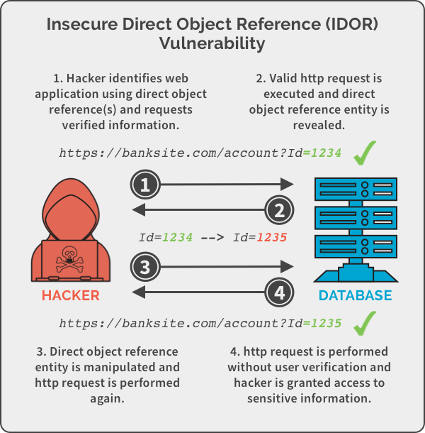
Insecure Direct Object Reference
Copyright © 2021 by Elephant Scale, All Rights Reserved
Notes:
Image Credit:panning.com/blog/insecure-direct-object-reference-web-based-application-security-part-6/

Slide 54
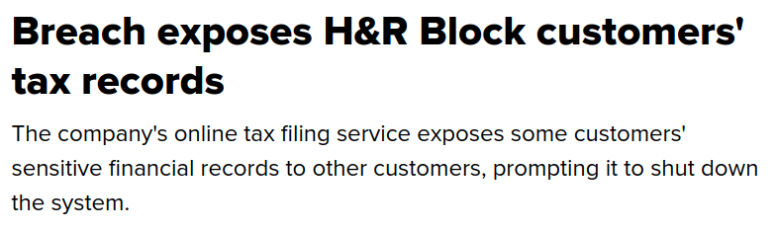
Insecure Direct Object Reference
Attacker is able to access implementation objects directly by guessing at their reference
Eg. guessing that the administrator account has account id "1" in the previous slide
Cause of a 2002 data breech at H&R Block where customer account numbers appeared in the URL
Changing the number in the URL allowed access to other customers' accounts
Copyright © 2021 by Elephant Scale, All Rights Reserved
Notes:
Image Credit: www.cnet.com/tech/services-and-software/breach-exposes-h-r-block-customers-tax-records/

Slide 55
Insecure Direct Object Reference Mitigations
These attacks are possible when there is a lack of role authorization
Users are able to access resources they should not be authorized for
Mitigate by ensuring that there is an authentication mechanism
Users can then only access the objects they are authorized for and are blocked from accessing other objects
Also mitigated by not exposing the reference to the object in a manner that can be recorded
Eg. URL references "MyAccount" instead of account number
Requires an addition step on the server to retrieve the object reference
Copyright © 2021 by Elephant Scale, All Rights Reserved

Slide 56
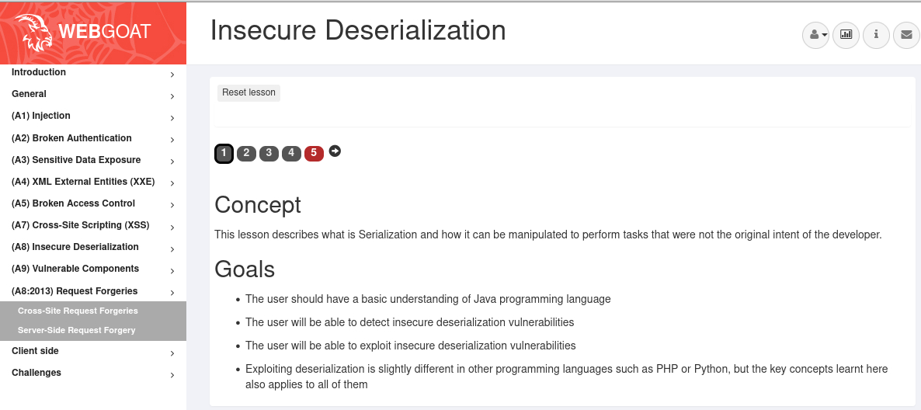
Labs
Goat labs
Insecure deserialization
Copyright © 2021 by Elephant Scale, All Rights Reserved

Slide 57
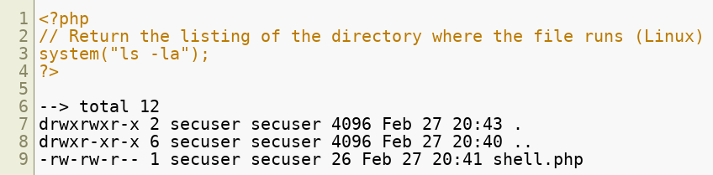
WebShell Attack
A webshell attack occurs when an attacker is able to run shell commands on a server
Intent is to gain escalation of privileges and persistent access to the machine
Exploits the ability of web programming languages to run shell commands
For example, accessing shell commands via php:
Can also exploit open ports and poorly configured ssh ports
Guessable root passwords create a vulnerability for ssh access
Copyright © 2021 by Elephant Scale, All Rights Reserved

Slide 58

Hidden URL Authorization Failure
Similar to the insecure direct object reference attack
Used to gain access to hidden resources or functionality
"Hidden" in this context means not made available to the user through the presentation layer
For example, an attacker notices that for user "bob," when the request to list accounts is made, the URL looks like
By altering the URL, the attacker might be able to access other accounts if proper authorization is not done
Copyright © 2021 by Elephant Scale, All Rights Reserved

Slide 59
Hidden URL Discovery
Various tools exist to search for hidden URLs
Fuzzing throws large amounts of random URls at the target
Surprisingly effecting
Also used in testing for this vulnerability
Dictionary attacks
Tries to find URLs with a list of possible names based on common user
Eg. config, web-config, users, admin, webadmin, etc
Copyright © 2021 by Elephant Scale, All Rights Reserved

Slide 60
Hidden URL Defences
Restrict access to authenticated users
Use role based permissions
Filter and block access to all unauthorized page types
Eg. XML files, *.conf files, etc
Ensure that every page request is vetted
If is not possible from the displayed page, it is rejected
Use fuzz testing and other testing tools to see if there are any accessible URLs that should not be accessed
Copyright © 2021 by Elephant Scale, All Rights Reserved

Slide 61
Cross Site Request Forgery
Forces victim to execute unwanted actions in a web application where they’re currently authenticated
Flow of the attack
Victim authenticates to a site, web banking for example
User clicks on an infected link that executes a banking request
The bogus request is approved because it appears to come from the authenticated user
If the banking request would normally be submitted by the authenticated user as:
Attacker engineers the victim to click load a page containing
Copyright © 2021 by Elephant Scale, All Rights Reserved

Slide 62
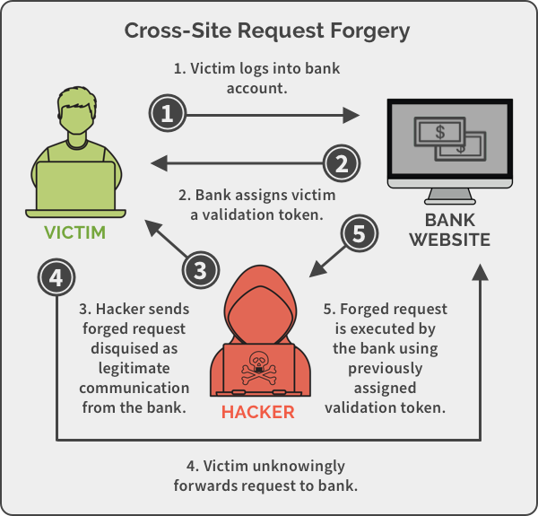
Cross Site Request Forgery
Example on the previous slide was contrived but captures the essence of the attack
While authenticated to a site, the attacker has the victim execute a malicious request to that site
The site assumes that it was the authenticated user that issued the request
For example, having user authenticated as an admin click on a link that adds the attacker as an admin user
Copyright © 2021 by Elephant Scale, All Rights Reserved
Notes:
Image Credit: spanning.com/blog/cross-site-forgery-web-based-application-security-part-2/cross-site-request-forgery-example/

Slide 63
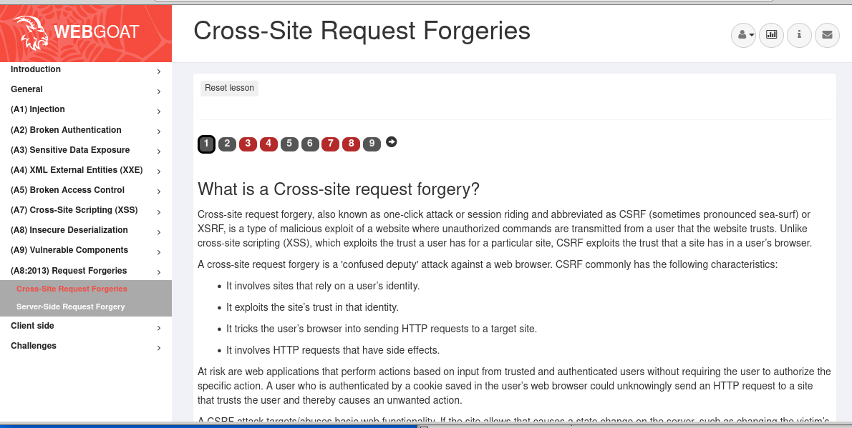
Labs
Goat labs (CSRF)
Copyright © 2021 by Elephant Scale, All Rights Reserved

