Slide 1
System Lifecycles and SDLCs
Copyright © 2021 by Elephant Scale, All Rights Reserved

Slide 2
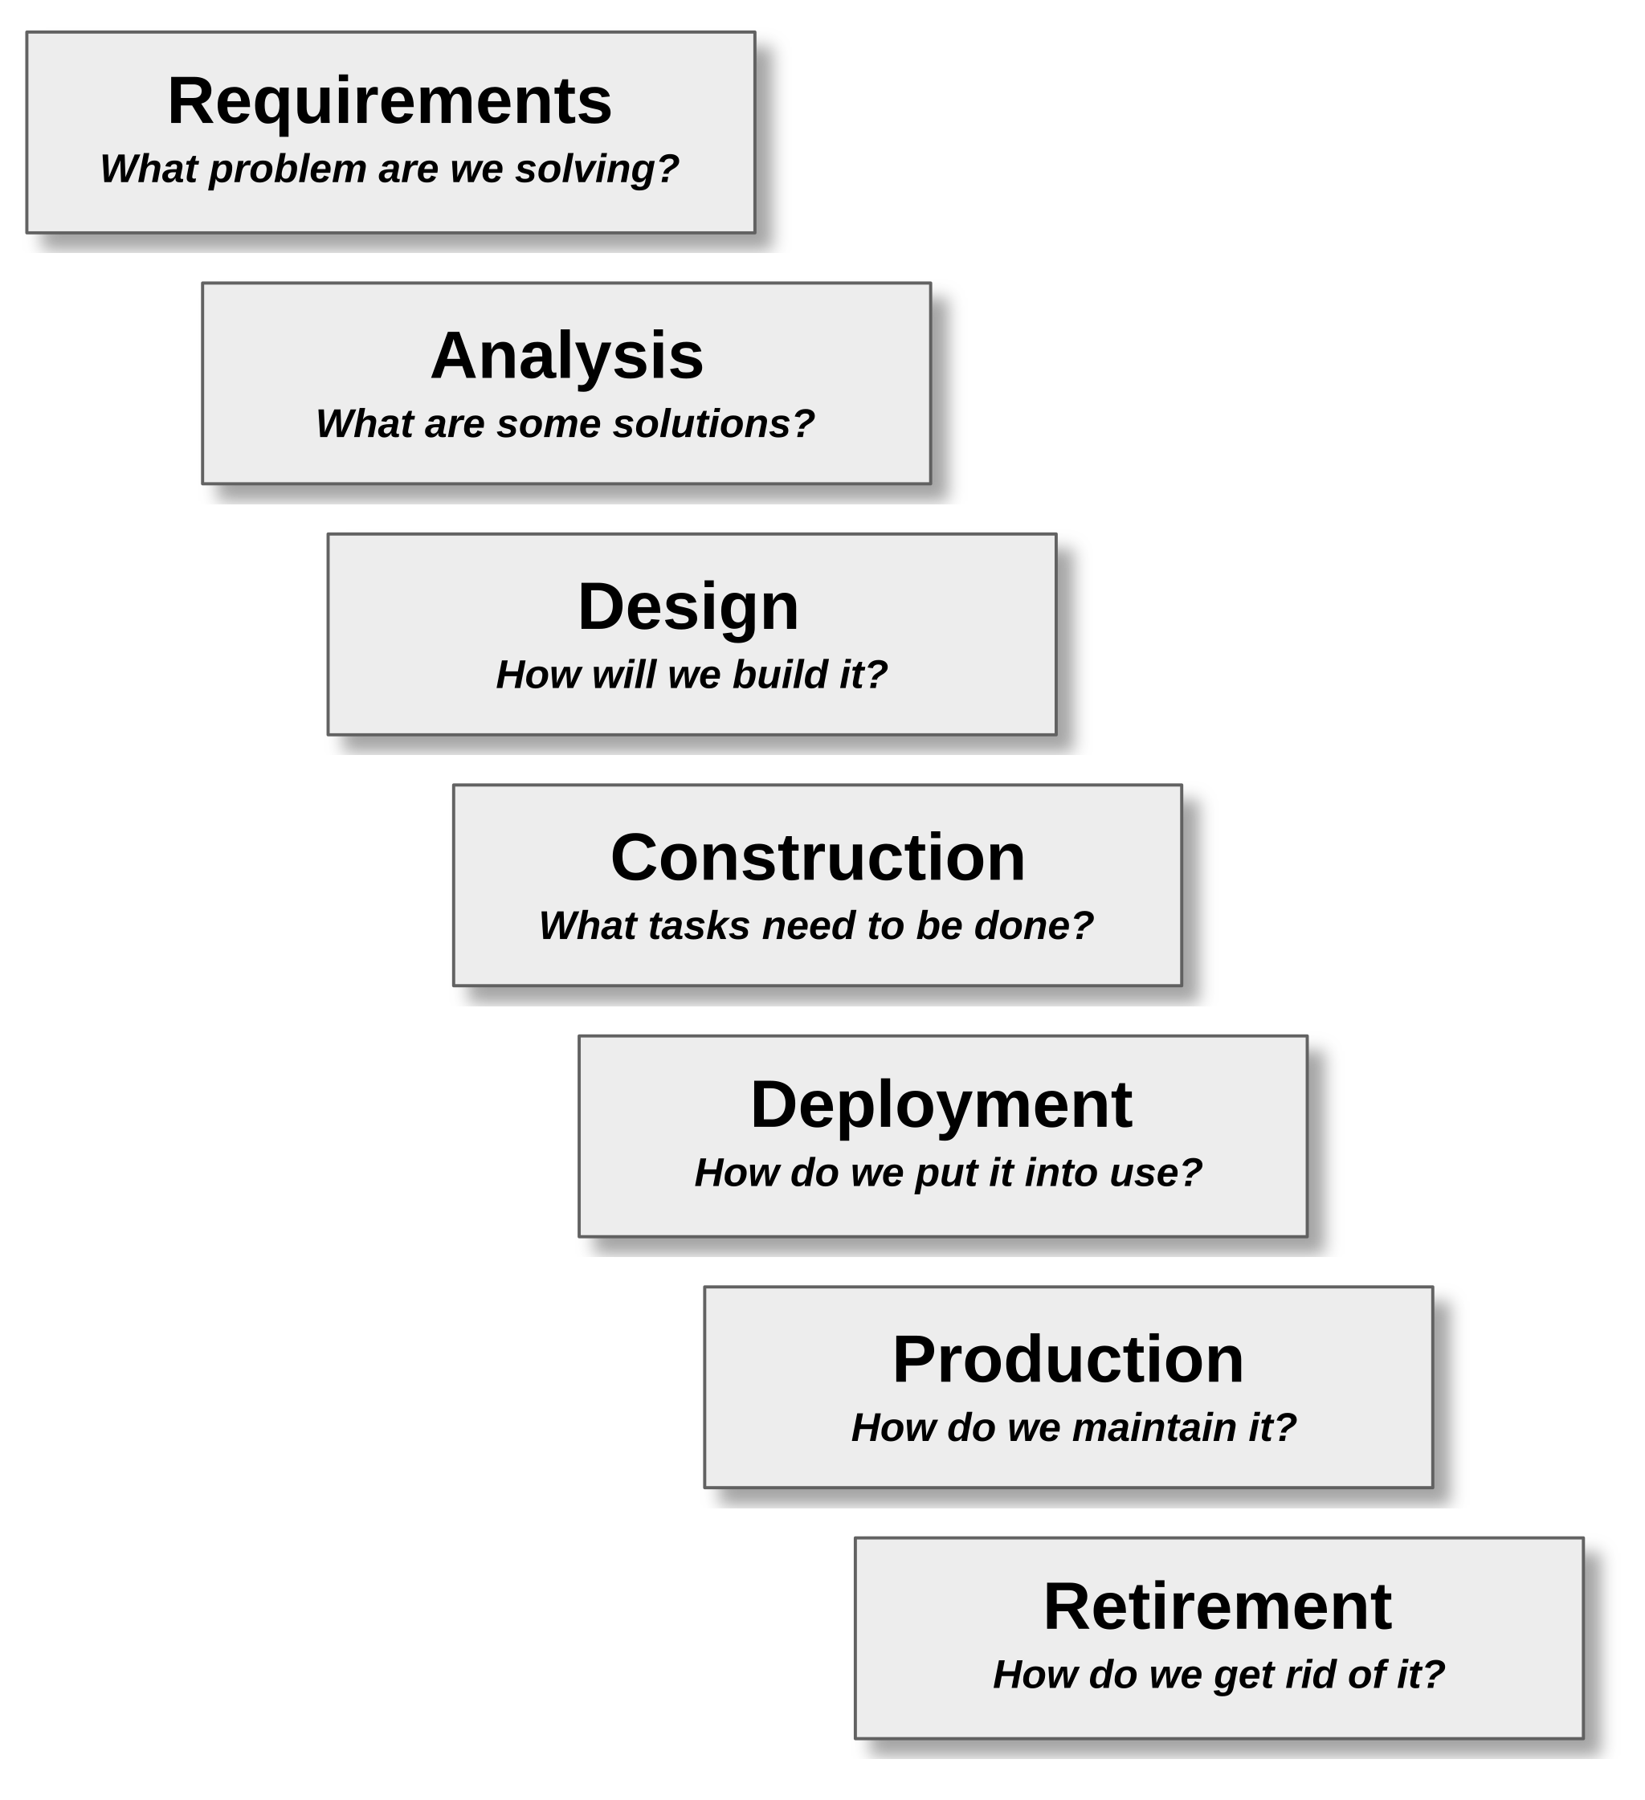
The Engineering Process
Used whenever a product or service is engineered
This includes software and IoT
Supported by
Classic software SDLCs
Including Agile and waterfall methodologies
SLC: System Lifecycle management
DevOps and DevSecOps
Copyright © 2021 by Elephant Scale, All Rights Reserved
Notes:
Image credit: https://superuser.com/questions/874393/what-protocol-is-used-to-transfer-a-message-in-a-http-application
Licensed for free use and sharing with attribution and without modification

Slide 3
Requirements
Identify the problem to be solved
What is needed by stakeholders
What factors constrain solutions
Acceptance criteria
How will we know the problem is solved?
Requirements types
Functional, non-functional (performance) and business
Security requirements are now considered separate from general non-functional requirements
Copyright © 2021 by Elephant Scale, All Rights Reserved
Notes:
Image credit: https://superuser.com/questions/874393/what-protocol-is-used-to-transfer-a-message-in-a-http-application
Licensed for free use and sharing with attribution and without modification

Slide 4
Analysis
Evaluate possible solutions
What would a solution look like?
How would it perform?
How would it be organized?
How would it be tested?
Evaluate possible architectural choices
High level design
Initial threat analysis
What sort of security and operational threats does the solution raise?
Copyright © 2021 by Elephant Scale, All Rights Reserved
Notes:
Image credit: https://superuser.com/questions/874393/what-protocol-is-used-to-transfer-a-message-in-a-http-application
Licensed for free use and sharing with attribution and without modification

Slide 5
Design
Only one solution can be built
What is possible with the available resources?
Define the concrete architecture
Design the components
Design how they interact
Choose technologies for construction of the components
Define the plan for construction phase
Identify the security vulnerabilities introduced by the choice of components
Copyright © 2021 by Elephant Scale, All Rights Reserved
Notes:
Image credit: https://superuser.com/questions/874393/what-protocol-is-used-to-transfer-a-message-in-a-http-application
Licensed for free use and sharing with attribution and without modification

Slide 6
Construction
Apply a development process
Roles and responsibilities
Testing, coding, etc.
Define the methodology
Agile/Scrum, etc.
Code, build, test
Identify new security issues as they arise during construction
Copyright © 2021 by Elephant Scale, All Rights Reserved
Notes:
Image credit: https://superuser.com/questions/874393/what-protocol-is-used-to-transfer-a-message-in-a-http-application
Licensed for free use and sharing with attribution and without modification

Slide 7
Deployment
Get the application into production
Roll out logistics
Continuous Deployment?
Beta test and acceptance test
Transition existing operations to the deployed app
Various deployment strategies can be used
Green/Blue
Canary, etc.
Goal is to ensure a successful transition to the application
Copyright © 2021 by Elephant Scale, All Rights Reserved
Notes:
Image credit: https://superuser.com/questions/874393/what-protocol-is-used-to-transfer-a-message-in-a-http-application
Licensed for free use and sharing with attribution and without modification

Slide 8
Production
Monitor performance
Manage changing requirements
Collect data for future development
Evaluate service level agreements
Look for “gotchas” in the real world
Identify new or emerging security threats
Exploits may be developed after deployment
Want to avoid 0-day exploits by getting patches and mitigations rolled out ASAP
Copyright © 2021 by Elephant Scale, All Rights Reserved
Notes:
Image credit: https://superuser.com/questions/874393/what-protocol-is-used-to-transfer-a-message-in-a-http-application
Licensed for free use and sharing with attribution and without modification

Slide 9
Retirement
How do we take the application out of production?
What are the implications for other systems that interact with our application?
How do we transition users to the application’s replacement?
Ensure that once the application is removed, there are no security holes left behind
Copyright © 2021 by Elephant Scale, All Rights Reserved
Notes:
Image credit: https://superuser.com/questions/874393/what-protocol-is-used-to-transfer-a-message-in-a-http-application
Licensed for free use and sharing with attribution and without modification

Slide 10
System Lifecycles and SDLCs
System Lifecycles

Slide 11
System Lifecycle Management
Also referred to as Application Lifecycle Management (ALM)
Most development processes only deal with activities up to the delivery of the finished product
SLC takes the larger view of treating any software-based product, or cyber-physical product, like any other product
The whole of the engineering process is managed
Does not replace a software development lifecycle (SDLC)
The application lifecycle is defined to be:
“the entire time an organization spends money of the product from the initial idea to the end of the application’s life when it is no longer in use.”
Also requires the evaluation of the product from three points of view:
The business perspective
The development perspective
The operations perspective

Slide 12
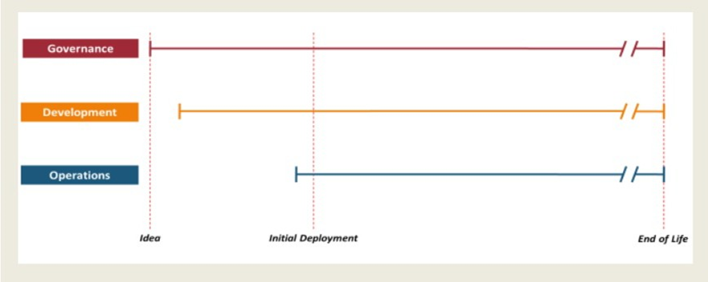
System Lifecycle Management
Three main milestones
Idea or Inception:
Before the start of the development process
Usually involves evaluating the business case, portfolio management issues and feasibility considerations
Provides a Go/NoGo decision before development starts

Slide 13
System Lifecycle Management
Deployment:
Occurs when the finished product is moved into production and made available to users
Retirement:
Ensures that at the end of life for the product, it can be taken out of production safely and without business or technical risk

Slide 14
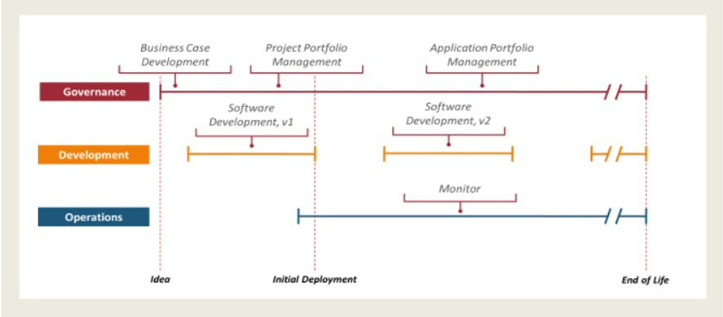
Governance
Begins with business case and feasibility studies
Portfolio management
Ensuring no overlap with other applications or any gaps that could create risk
Evaluation of risk, legal, social and other concerns
Makes mangement related decisions (like when to deploy)

Slide 15
Development
Only concerned about the choice of methodology
Integration with:
Records management, PM policies, security, etc.
Ensures that the development process is executed correctly
Requirements, Development, Test (RDT) is executed

Slide 16
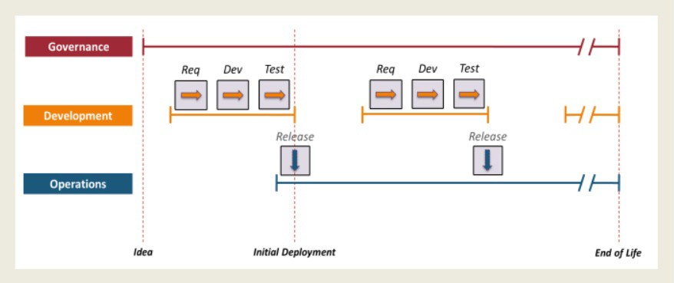
Development - Waterfall

Slide 17
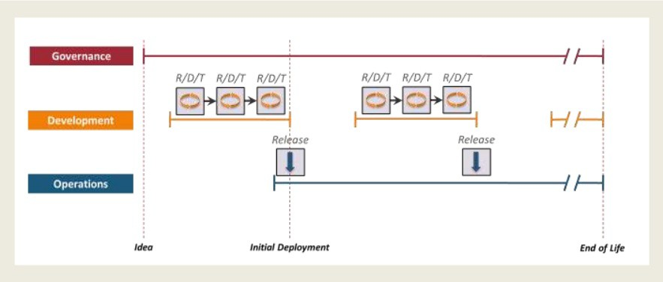
Development - Agile

Slide 18
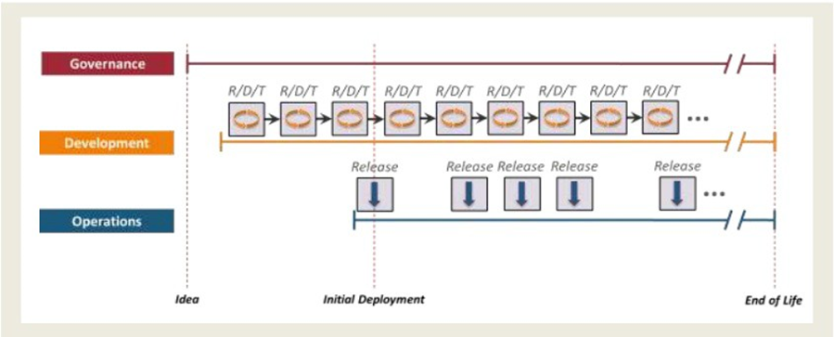
Development – Continuous Deliver

Slide 19
Operations
During deployment, governance makes decisions and development makes changes
Ops provides context for making dev and govern work together
Ops monitors usage, performance, service level targets, change requests and bug reports
Also monitors changes in the application’s technical environment that could impact the application

Slide 20
System Lifecycles and SDLCs
Software Development Lifecycles

