Slide 1
OpenAI Function Calling
Setup
LCEL
OpenAI Function with LangChain
Tagging and Extraction Using OpenAI
Tools and Routing
Conversational Agent
Copyright © 2024 by Elephant Scale, All Rights Reserved

Slide 2
Setup
Setup LCEL OpenAI Function with LangChain Tagging and Extraction Using OpenAI Tools and Routing Conversational Agent
Copyright © 2024 by Elephant Scale, All Rights Reserved

Slide 3
Introduction
Learn how to use OpenAI’s function calling feature.
Key steps covered:
Setting up your environment to interact with OpenAI APIs.
Defining and using custom functions to enhance AI interactions.
Understanding and handling function calls in AI workflows.
Why this is important:
Function calling enables structured and programmatic AI interactions, expanding the possibilities of automation and integration.
Copyright © 2024 by Elephant Scale, All Rights Reserved

Slide 4
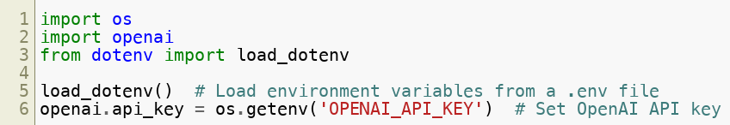
Setup
Import necessary libraries and configure API keys:
Key Insight:
Proper setup ensures secure and seamless access to OpenAI’s powerful APIs.
Copyright © 2024 by Elephant Scale, All Rights Reserved

Slide 5
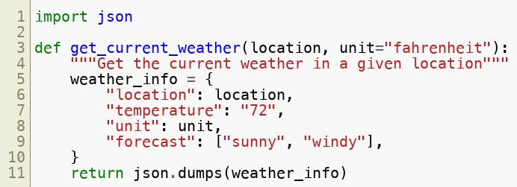
Defining a Custom Function
Create a function to simulate weather retrieval:
Why define custom functions:
Custom functions extend the capabilities of AI by integrating domain-specific logic.
Copyright © 2024 by Elephant Scale, All Rights Reserved

Slide 6
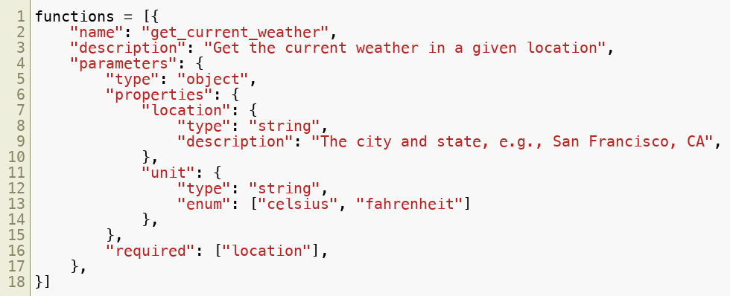
Registering the Function
Define the function’s schema for OpenAI:
Why this is important:
Function schemas define how the AI can interact with your functions, ensuring proper input and output handling.
Copyright © 2024 by Elephant Scale, All Rights Reserved

Slide 7
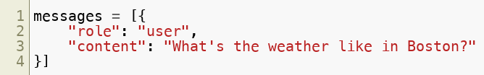
Sending a User Message
Example user message:
Copyright © 2024 by Elephant Scale, All Rights Reserved

Slide 8
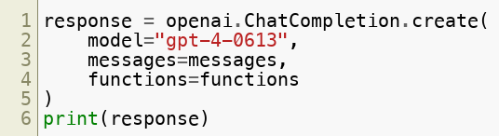
Invoking the Function
Send the message and function schema to OpenAI:
Why this matters:
Sending both user input and function schemas allows the AI to choose whether to call the function for additional information.
Copyright © 2024 by Elephant Scale, All Rights Reserved

Slide 9

Handling Function Output
Extract and execute the function call:
Key Insight:
Handling function calls programmatically enables seamless integration of AI-generated logic with external systems.
Copyright © 2024 by Elephant Scale, All Rights Reserved

Slide 10
Next Steps
Extend this workflow by:
Adding more complex functions and schemas.
Integrating with real-world APIs for dynamic data.
Why it’s important:
Leveraging OpenAI’s function calling enhances AI's ability to operate as an intelligent assistant in diverse applications.
Copyright © 2024 by Elephant Scale, All Rights Reserved

Slide 11
LCEL
Setup LCEL OpenAI Function with LangChain Tagging and Extraction Using OpenAI Tools and Routing Conversational Agent
Copyright © 2024 by Elephant Scale, All Rights Reserved

Slide 12
Introduction
This lesson focuses on understanding and implementing LCEL techniques.
Key objectives:
Exploring the fundamental concepts.
Hands-on coding to demonstrate LCEL principles.
Practical applications for real-world scenarios.
Copyright © 2024 by Elephant Scale, All Rights Reserved

Slide 13
LCEL
LCEL stands for LangChain Expression Language
a declarative framework within the LangChain ecosystem
designed to simplify the creation and management of complex chains involving Large Language Models (LLMs).
By allowing developers to describe desired operations rather than detailing procedural steps
LCEL enables more efficient and optimized execution of tasks such as
streaming
batch processing
and asynchronous operations
Copyright © 2024 by Elephant Scale, All Rights Reserved

Slide 14
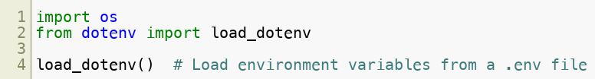
Setup
Import necessary libraries:
Ensure your environment is configured with all dependencies.
Copyright © 2024 by Elephant Scale, All Rights Reserved

Slide 15
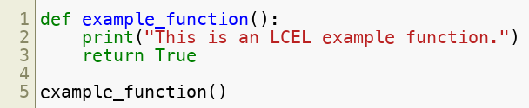
Code Example: Basic LCEL Implementation
Here’s an example of LCEL in action:
Copyright © 2024 by Elephant Scale, All Rights Reserved

Slide 16
Next Steps
Apply LCEL concepts to more complex scenarios.
Experiment with additional libraries and techniques.
Analyze results to refine your understanding of LCEL.
Copyright © 2024 by Elephant Scale, All Rights Reserved

Slide 17
OpenAI Function with LangChain
Setup LCEL OpenAI Function with LangChain Tagging and Extraction Using OpenAI Tools and Routing Conversational Agent
Copyright © 2024 by Elephant Scale, All Rights Reserved

Slide 18
Introduction
This lesson integrates OpenAI’s function calling capabilities with LangChain.
Key steps covered:
Setting up LangChain to work with OpenAI APIs.
Defining and invoking functions using LangChain workflows.
Demonstrating use cases for enhanced automation and efficiency.
Why this is important :
LangChain extends OpenAI’s function calling by providing a structured framework for building intelligent workflows, enabling scalability and customization.
Copyright © 2024 by Elephant Scale, All Rights Reserved

Slide 19
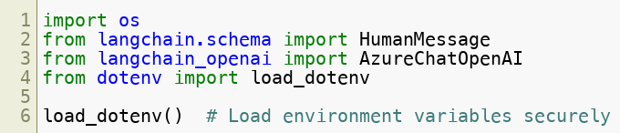
Setup
Import required libraries:
What this does :
Ensures secure configuration for OpenAI and LangChain integration by loading API keys and environment variables.
Copyright © 2024 by Elephant Scale, All Rights Reserved

Slide 20
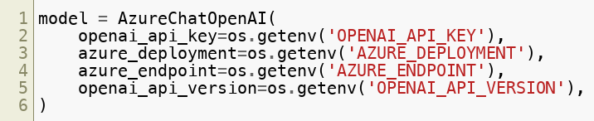
Connecting to OpenAI
Initialize the OpenAI model with LangChain:
Key insight :
Establishing this connection allows LangChain to leverage OpenAI’s capabilities for building conversational AI agents and automation workflows.
Copyright © 2024 by Elephant Scale, All Rights Reserved

Slide 21
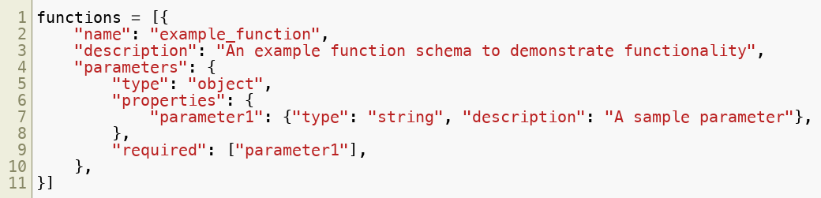
Defining a Custom Function
Define a function schema in LangChain for OpenAI:
Why this is important :
Defining function schemas ensures that OpenAI can correctly interpret and execute tasks according to your specifications.
Copyright © 2024 by Elephant Scale, All Rights Reserved

Slide 22
Preparing a User Query
Example of a user message:
What happens here :
The user’s input is structured into a message object that LangChain can process and pass to OpenAI for further action.
Copyright © 2024 by Elephant Scale, All Rights Reserved

Slide 23
Function Invocation and Response
Execute the function call and handle the response:
Understanding the response :
The output includes both the user’s original message and the response generated by the function, providing a complete interaction log.
Copyright © 2024 by Elephant Scale, All Rights Reserved

Slide 24
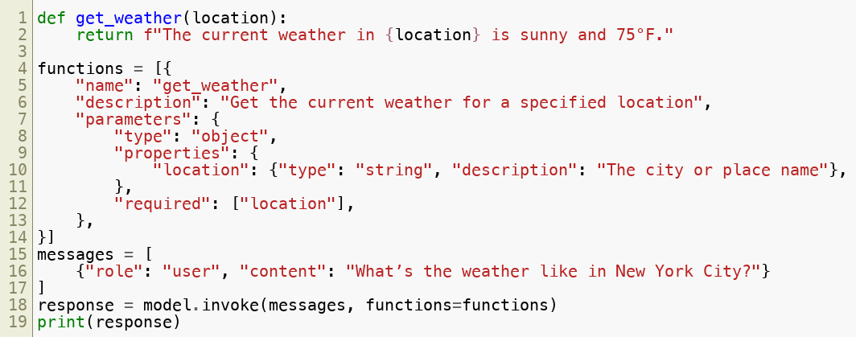
Advanced Example: Weather Function Integration
Example: Integrate a weather function using LangChain:
Key takeaway :
This example demonstrates how to integrate external logic (e.g., weather data) into LangChain workflows using OpenAI’s function calling.
Copyright © 2024 by Elephant Scale, All Rights Reserved

Slide 25
Debugging and Logging
Log function calls for debugging and transparency:
Why this matters :
Debugging ensures that your workflows are functioning as expected and helps identify any issues in function invocation.
Copyright © 2024 by Elephant Scale, All Rights Reserved

Slide 26
Next Steps
Experiment with:
Creating and testing more complex functions.
Integrating APIs for dynamic data retrieval and processing.
Build workflows for:
Conversational agents.
Task automation.
Data analysis pipelines.
Real-world impact :
Combining LangChain with OpenAI’s function calling unlocks powerful possibilities for building adaptive, intelligent systems.
Copyright © 2024 by Elephant Scale, All Rights Reserved

Slide 27
Tagging and Extraction Using OpenAI
Setup LCEL OpenAI Function with LangChain Tagging and Extraction Using OpenAI Tools and Routing Conversational Agent
Copyright © 2024 by Elephant Scale, All Rights Reserved

Slide 28
Introduction
This lesson explores how to use OpenAI functions for tagging and information extraction.
Key objectives:
Understand tagging and its applications in data categorization.
Implement information extraction using function calling.
Automate structured data generation from unstructured text.
Why this is important :
Automating tagging and data extraction saves time and reduces errors in information processing tasks.
Copyright © 2024 by Elephant Scale, All Rights Reserved

Slide 29
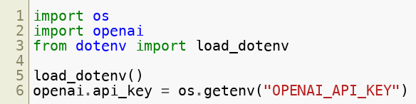
Setup
Import necessary libraries:
What this does :
Ensures secure and seamless configuration for accessing OpenAI’s API.
Copyright © 2024 by Elephant Scale, All Rights Reserved

Slide 30
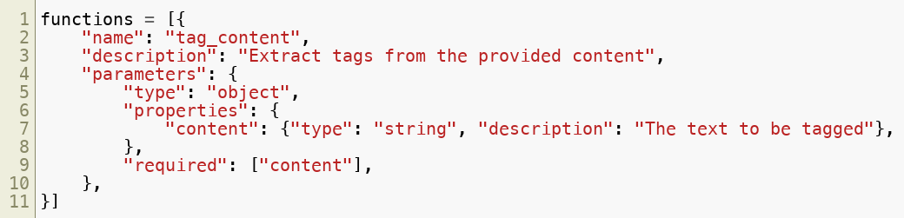
Defining a Function for Tagging
Example: Create a tagging function schema:
Copyright © 2024 by Elephant Scale, All Rights Reserved

Slide 31
Invoking the Function
Provide input for tagging:
Use OpenAI to call the tagging function:
Expected output :
Extracted tags such as ["AI", "automation"] .
Copyright © 2024 by Elephant Scale, All Rights Reserved

Slide 32
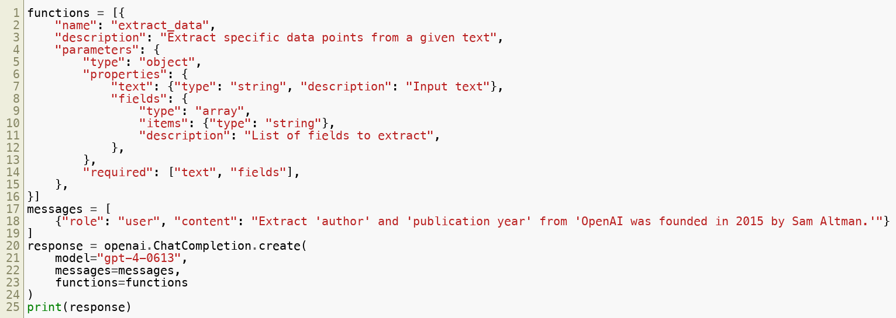
Extracting Specific Data
Example: Create a schema for extracting structured data:
Why this matters :
Enables precise and automated extraction of structured data from natural language inputs.
Copyright © 2024 by Elephant Scale, All Rights Reserved

Slide 33
Debugging and Validation
Log and validate function outputs for correctness:
Key insight :
Validation ensures that the extracted data meets the expected criteria, reducing errors in automated workflows.
Copyright © 2024 by Elephant Scale, All Rights Reserved

Slide 34
Tools and Routing
Setup LCEL OpenAI Function with LangChain Tagging and Extraction Using OpenAI Tools and Routing Conversational Agent
Copyright © 2024 by Elephant Scale, All Rights Reserved

Slide 35
Introduction
This lesson demonstrates how to use tools and routing in AI workflows.
Key objectives:
Understand the concept of tools in AI systems.
Implement routing logic to handle diverse workflows.
Leverage OpenAI’s capabilities for dynamic task management.
Copyright © 2024 by Elephant Scale, All Rights Reserved

Slide 36
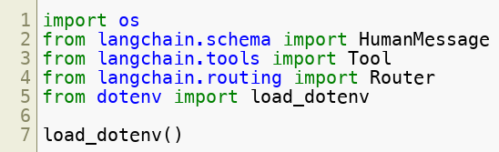
Setup
Import required libraries:
Copyright © 2024 by Elephant Scale, All Rights Reserved

Slide 37
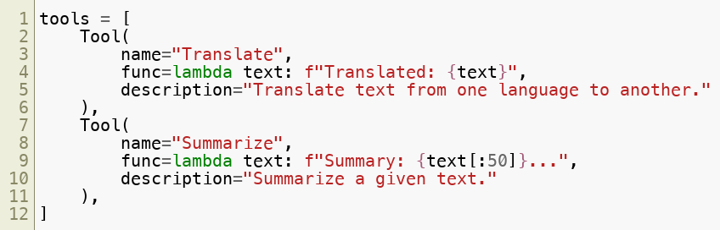
Tools in AI Workflows
Define tools for specific tasks:
Why tools matter :
Tools encapsulate functionality for specific tasks, making workflows modular and reusable.
Copyright © 2024 by Elephant Scale, All Rights Reserved

Slide 38
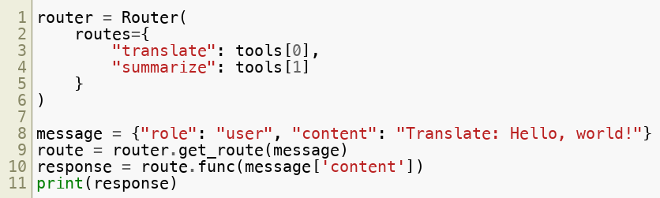
Routing Logic
Implement a router for task delegation:
Key insight :
Routing logic dynamically determines which tool to invoke based on user input, enabling flexible and adaptive workflows.
Copyright © 2024 by Elephant Scale, All Rights Reserved

Slide 39
Next Steps
Experiment with:
Creating additional tools for tasks like data analysis or image generation.
Building more complex routing logic for multi-step workflows.
Real-world applications :
Use tools and routing to design scalable AI systems for customer support, data processing, and more.
Copyright © 2024 by Elephant Scale, All Rights Reserved

Slide 40
Conversational Agent
Setup LCEL OpenAI Function with LangChain Tagging and Extraction Using OpenAI Tools and Routing Conversational Agent
Copyright © 2024 by Elephant Scale, All Rights Reserved

Slide 41
Introduction
This lesson focuses on building a conversational agent using OpenAI’s models.
Key objectives:
Understand the principles of conversational AI.
Implement a simple chatbot that interacts dynamically.
Explore advanced features like context handling and function calls.
Copyright © 2024 by Elephant Scale, All Rights Reserved

Slide 42
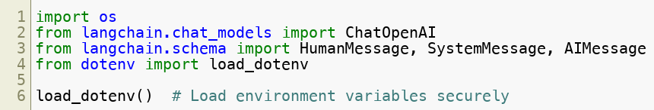
Setup
Import necessary libraries:
What this does :
Prepares your environment for creating and managing conversational agents.
Copyright © 2024 by Elephant Scale, All Rights Reserved

Slide 43
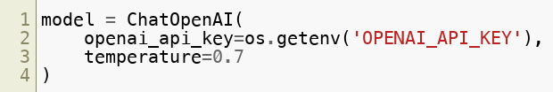
Initializing the Chat Model
Set up the conversational model:
Why this is important :
Configuring the model ensures appropriate behavior, such as creativity and relevance, during conversations.
Copyright © 2024 by Elephant Scale, All Rights Reserved

Slide 44
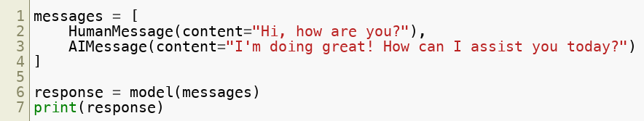
Basic Conversation
Example of a basic conversation flow:
What happens here :
The model processes user input and generates appropriate responses, simulating a conversational interaction.
Copyright © 2024 by Elephant Scale, All Rights Reserved

Slide 45
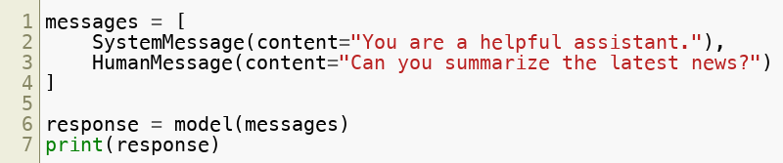
Context Handling
Add context to the conversation:
Why this matters :
Including system messages guides the AI’s behavior, ensuring responses align with the intended role or tone.
Copyright © 2024 by Elephant Scale, All Rights Reserved

Slide 46
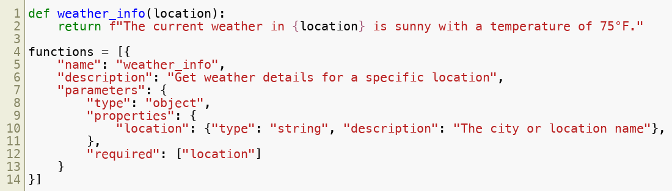
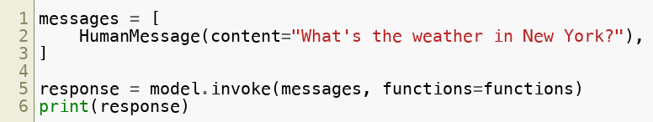
Advanced Features: Function Calling
Define a function for the conversational agent:
Call the function during a conversation:
Key Insight :
Function calling adds dynamic capabilities, enabling the conversational agent to perform tasks or fetch data beyond static responses.
Copyright © 2024 by Elephant Scale, All Rights Reserved

Slide 47
Next Steps
Experiment with:
Integrating APIs for real-time information retrieval.
Implementing multi-turn dialogues with context-aware responses.
Real-world applications :
Build intelligent assistants for customer support, education, and personal productivity.
Copyright © 2024 by Elephant Scale, All Rights Reserved

